Slide 1
What is Programming
Programming is
NAMING PARAMETRIC ABSTRACTIONS

Slide 2
Programming
NAMING
PARAMETRIC
ABSTRACTIONS

Slide 3
Programming
Natural language
NAMING
PARAMETRIC
ABSTRACTIONS
USING EXISTING
PARAMETRIC
ABSTRACTIONS

Slide 4
Programming
Natural language
NAMING
PARAMETRIC
ABSTRACTIONS
RECURSIVE PROCESS
USING EXISTING
PARAMETRIC
ABSTRACTIONS
TOP LEVEL PROCESS

Slide 5
Natural language: fixed abstraction
Noun: Cat
Verbs: Run
Adjective: fast

Slide 6
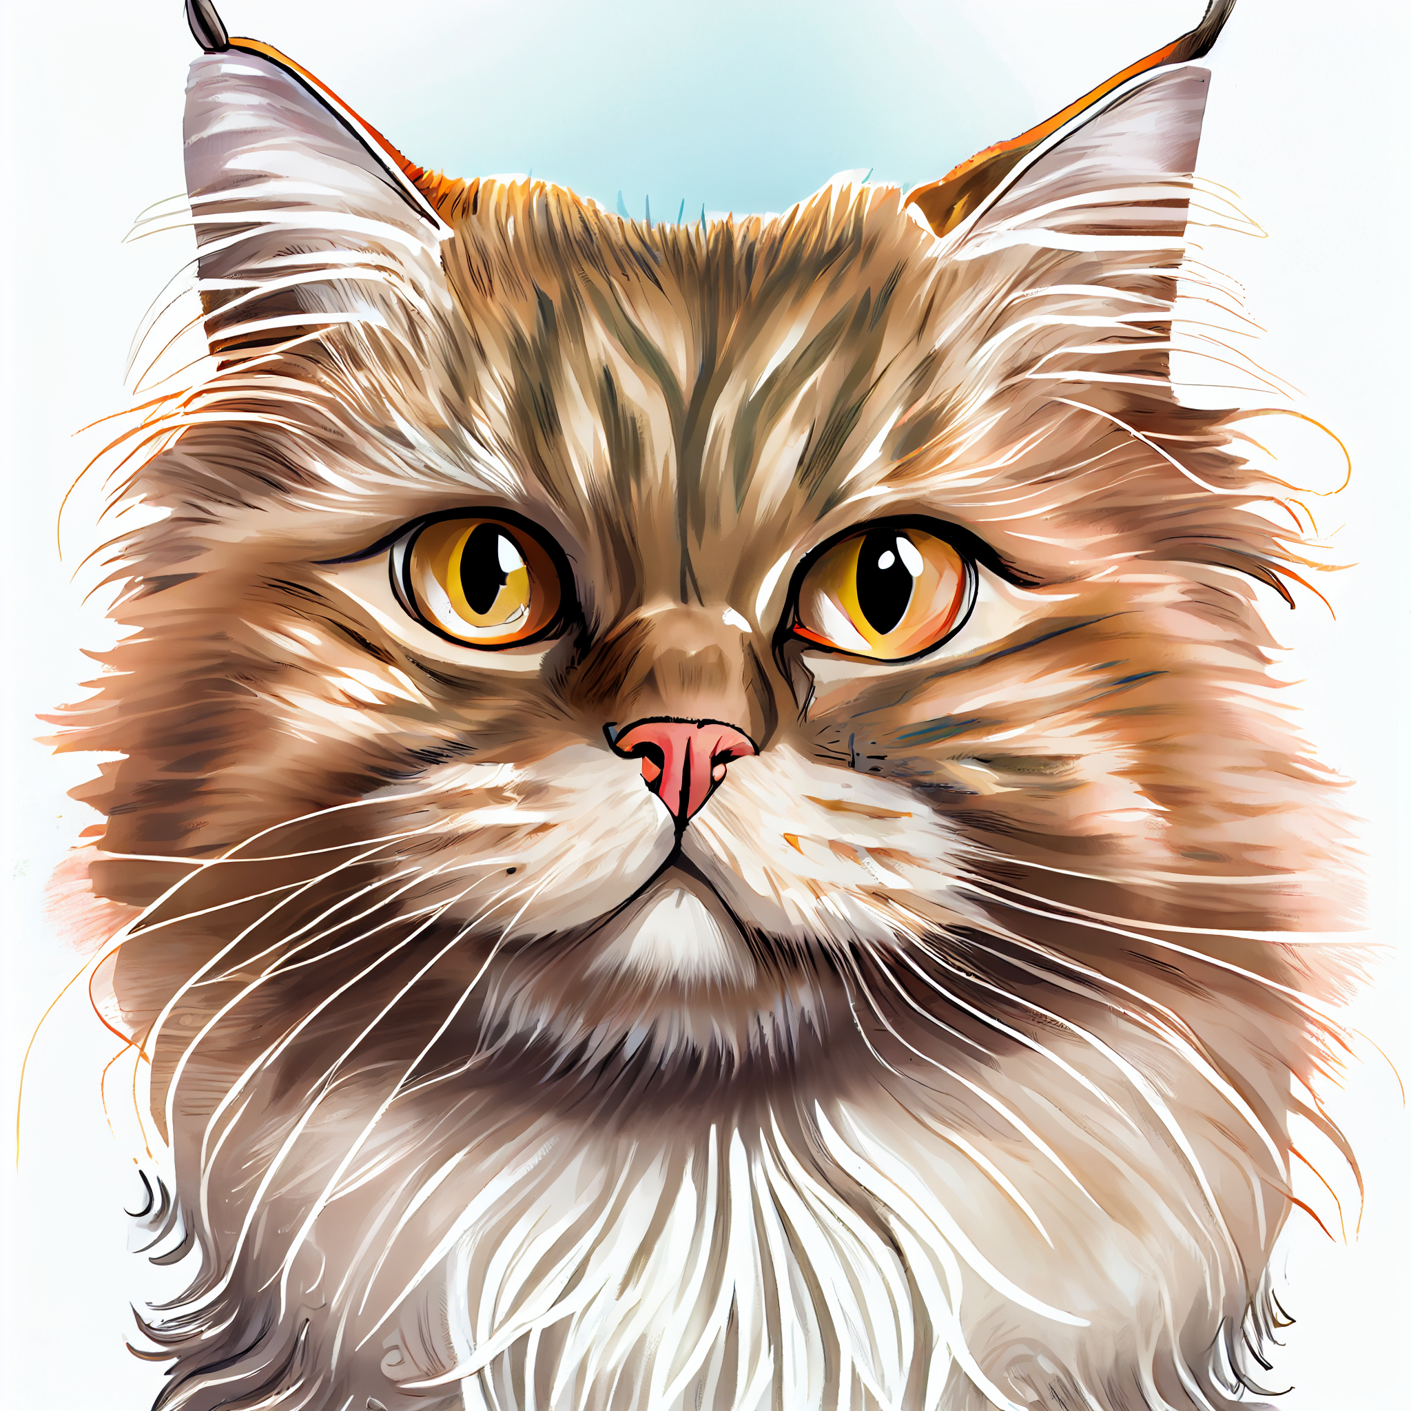
Natural language: fixed abstraction
Noun: Cat
Verbs: Run
Adjective: fast

Slide 7
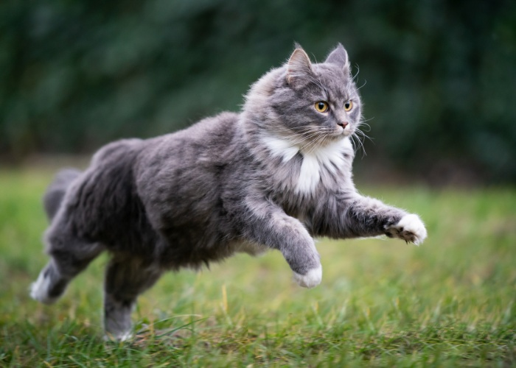
Natural language: fixed abstraction
Noun: Cat
Verbs: Run
Adjective: fast

Slide 8
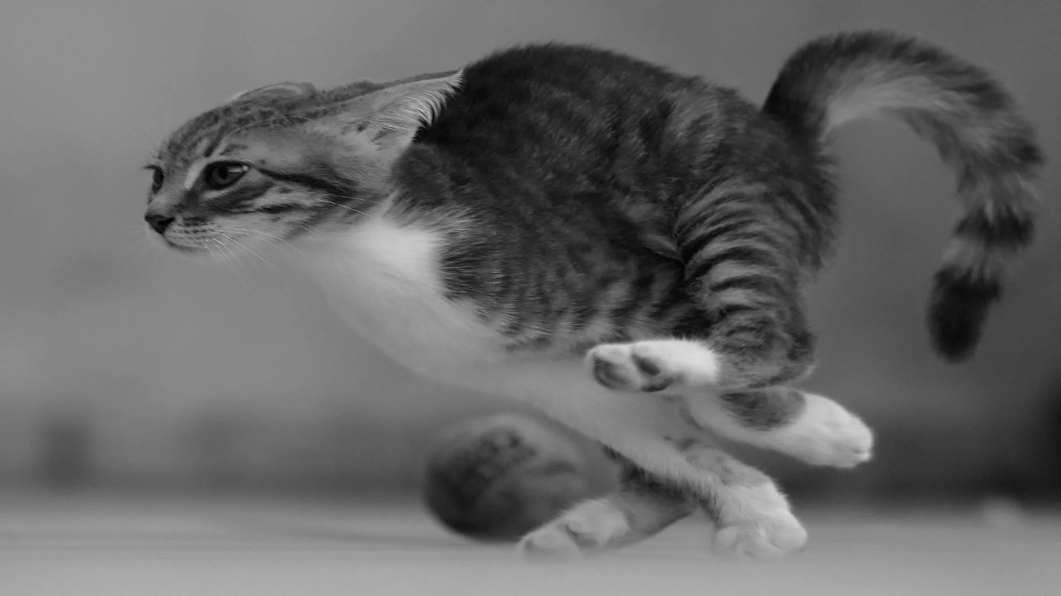
Natural language: fixed abstraction
Noun: Cat
Verbs: Run
Adjective: fast

Slide 9
The cat runs fast
We expect a reader of this sentence to know all of those words and their meaning before they can try to understand the sentence
As a writer, we are expected to mostly use existing words and to build on a shared cultural understanding

Slide 10
Programming: making up new words
NAMING PARAMETRIC ABSTRACTIONS
That is, we create new names! (naming)
Often parametric names, like running. (parametric)
New names are defined with other names. (abstractions)
Repeat the process until most of the used words
are words you created yourself.

Slide 11
The cat runs fast
We expect a reader of this sentence to know all of those words and their meaning before they can try to understand the sentence
As a writer, we are expected to mostly use existing words and to build on a shared cultural understanding

Slide 12
Cat{ escape(){ this.run(fast) } … }
We expect a reader of this sentence to have no clue what any word means. They are supposed to rely on the documentation of each word.
As a writer, we are expected to use short definitions, that can be documented independently from the specific words used in their formal definition.

Slide 13
Writing
Programming
Make a linear structure with chapters, sections and sentences.
Compose each sentence by putting words one after another.
Tweak some words and sentences until the result looks good.
The end result is a single unit of text, to be read from the start to the end.
Take a few words from the existing words set.
Make a new word using them
Put the new word in the words set.
Repeat until a single word encodes the whole desired program.
The end result is an unordered set of new words, their definitions can be read in any order

Slide 14
Writing
Programming
Make a linear structure with chapters, sections and sentences.
Compose each sentence by putting words one after another.
Tweak some words and sentences until the result looks good.
The end result is a single unit of text, to be read from the start to the end.
Take a few words from the existing words set.
Make a new word using them
Put the new word in the words set.
Repeat until a single word encodes the whole desired program.
The end result is an unordered set of new words, their definitions can be read in any order

Slide 15
Writing
Programming
Make a linear structure with chapters, sections and sentences.
Compose each sentence by putting words one after another.
Tweak some words and sentences until the result looks good.
The end result is a single unit of text, to be read from the start to the end.
Take a few words from the existing words set.
Make a new word using them
Put the new word in the words set.
Repeat until a single word encodes the whole desired program.
The end result is an unordered set of new words, their definitions can be read in any order

Slide 16
Programming
Reader:
  Do not read top to bottom, read inside out
  Do not assume the words “English meaning” to be the meaning intended in the code.
Writer:
  Avoid long sequences of words
  Keep definitions short and abstract

