Slide 1


Slide 2
Marco Servetto
Victoria University of Wellington
New Zealand
How To Get The Benefits
Of Lying Without Ever Lying

Slide 3
Qualche volta è più facile dire
qualcosa di tecnicamente falso,
come semplificazione di un
concetto tecnico complesso.
Questo può aiutare gli studenti.
Ma trovo che mentire sia antietico .
Tuttavia, considerate questa
immagine… Pensate sia la
Nuova Zelanda?
Io non ho mai detto che fosse
un luogo reale, infatti...

Slide 4
Ho semplicemente scritto a ChatGPT:
“Draw a beautiful new zealand
landscape as seen from POW sitting
on a wooden bench on top of a
mountain in a sunny day 16:9.
Make it look as a real photo”
Presentazione in due parti:
1) Come essere memorabili
senza mentire
2) Come mentire senza mentire
ed essere ancora piu’ chiari

Slide 5




Qui qualche risultato alternativo:

Slide 6
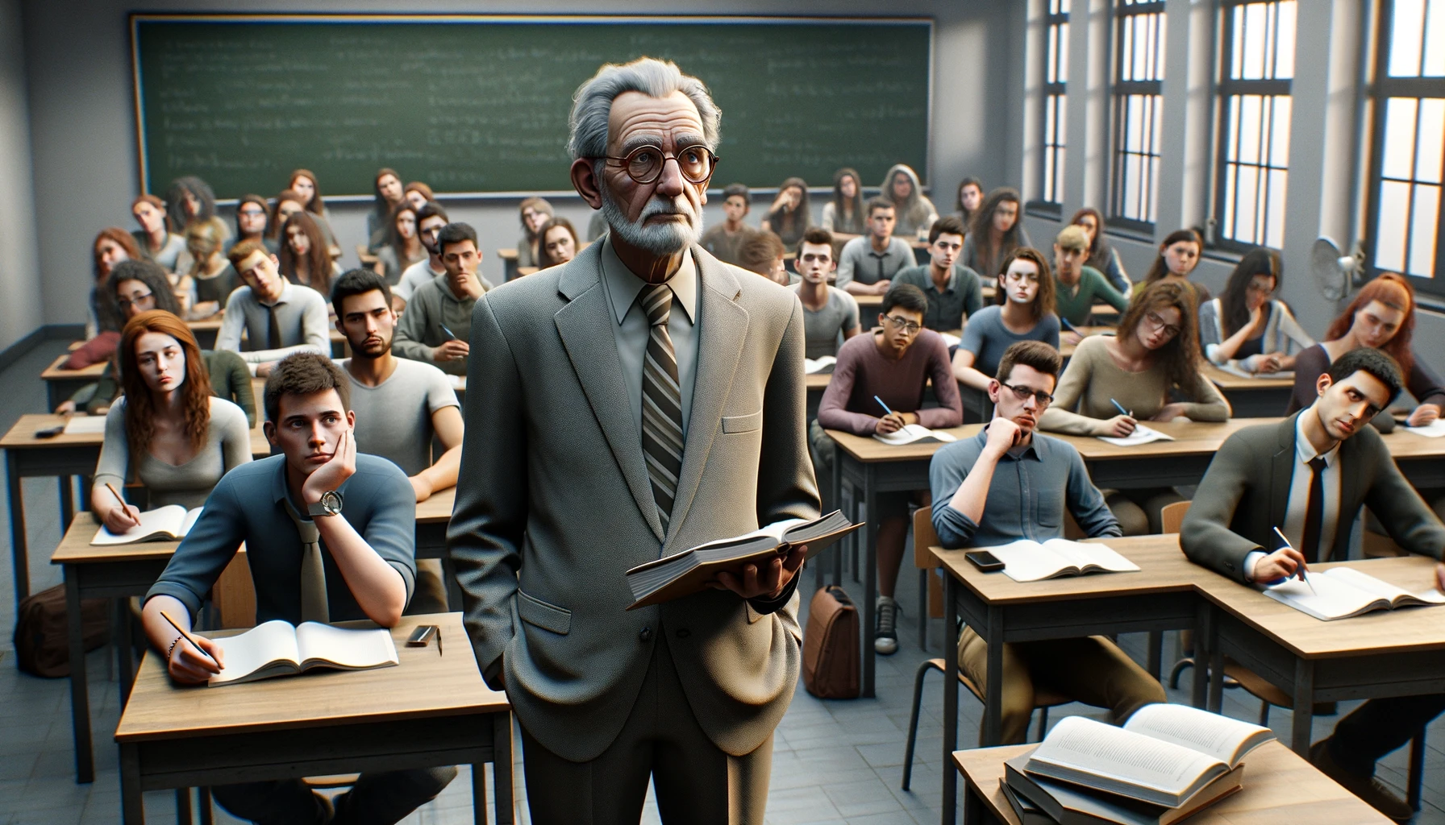
Quando ho cominciato ad insegnare
Le mie lezioni erano noiose e (quasi)
standard…
Poi ho imparato ad usare immagini
(Esempio nelle prossime slides)

Slide 7
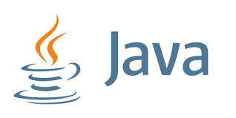

Slide 8
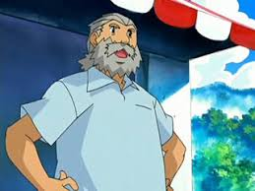
Java is now an old language(1996)

Slide 9
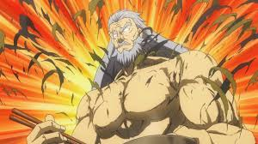
But, recently…..
(after training in secret for 20 years)

Slide 10
Java: now a modern language!
Now with
  Records,
  Interfaces with default methods
  Lambdas
We will use those features very intensively in this course!
We will use ‘class’ more rarely.

Slide 11
Hint!
When searching for Java examples, Java documentation or Java help
  Never search for “Java”
  you will get the old stuff.
  Search for “Java 20”, “Java 21”
  or “Java 2023” to get good stuff!

Slide 12
Hint!
When searching for Java examples, Java documentation or Java help
  Never search for “Java”
  you will get the old stuff.
  Search for “Java 20”, “Java 21”
  or “Java 2023” to get good stuff!
Cerco di usare immagini ‘memorabili’
E poi le riuso quando devo richiamare
il concetto.. ma ero limitato dalle
immagini che trovavo in rete. Adesso..

Slide 13
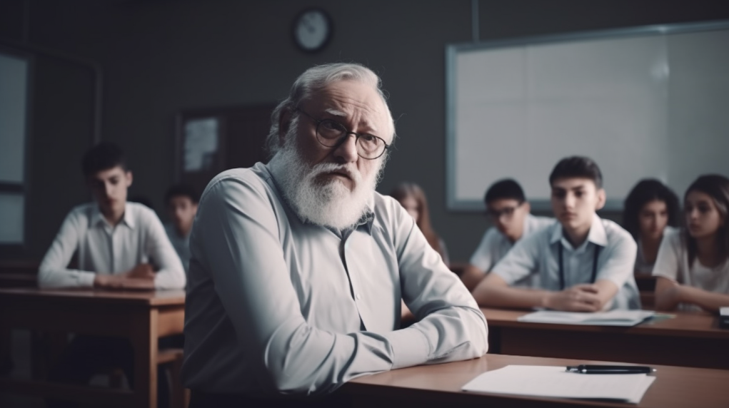
Questo ha reso le mie slides un po’ piu’
divertenti, ma comunque parlavo di
concetti tecnici in modo serio, completo
… ovvero difficile e noioso

Slide 14
Ho Cercato di usare immagini che
catturino l’attenzione
in modo comico ma accurato,
possibilmente appoggiandomi
a personaggi famosi e memorabili…
Purtroppo io sono un vecchio italiano
che insegna in nuova zelanda

Slide 15
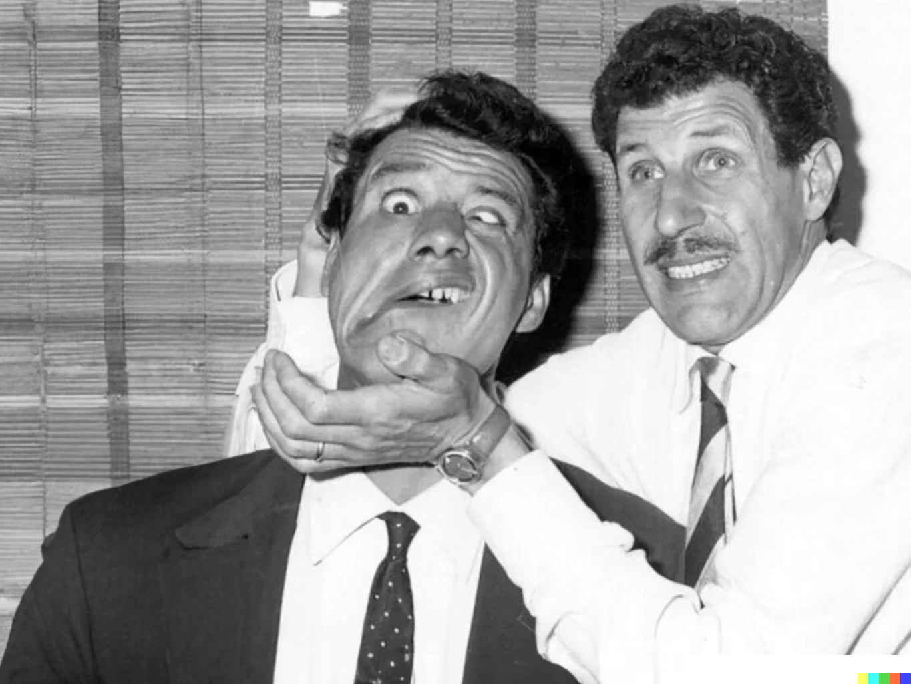
Overloading
Overriding
The two brothers

Slide 16
Overloading
Overriding
It is a good member of society.
Can do professional work.
People want to work with him.
It gets often confused with his brother.

Slide 17
Overloading
Very eager to act and take up some work.
Sadly the results are often unpredictable.
You have to convince him to desist in order to access the better brother.
Overriding
It is a good member of society.
Can do professional work.
People want to work with him.
It gets often confused with his brother.

Slide 18
Overloading
It is easy to accidentally assign work to the wrong brother
Very eager to act and take up some work.
Sadly the results are often unpredictable.
You have to convince him to desist in order to access the better brother.
Overriding
It is a good member of society.
Can do professional work.
People want to work with him.
It gets often confused with his brother.

Slide 19
Java exceptions and
Norse mythology
A volte ho grande successo

Slide 20
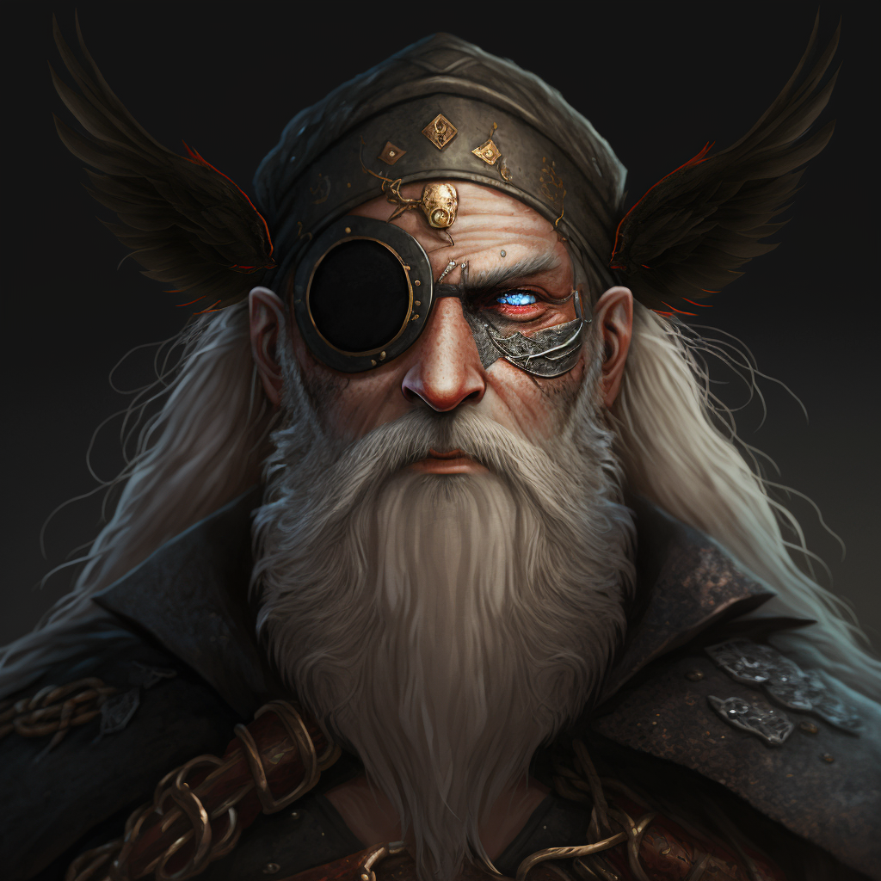
Java exceptions and
Norse mythology
Odin.
The father of all gods.
Throwable
The father of all kinds of exceptions.
It is very rare to do
new Throwable(..).
Sometime used as a type.
Quite rare to do catch(Throwable t){..}

Slide 21
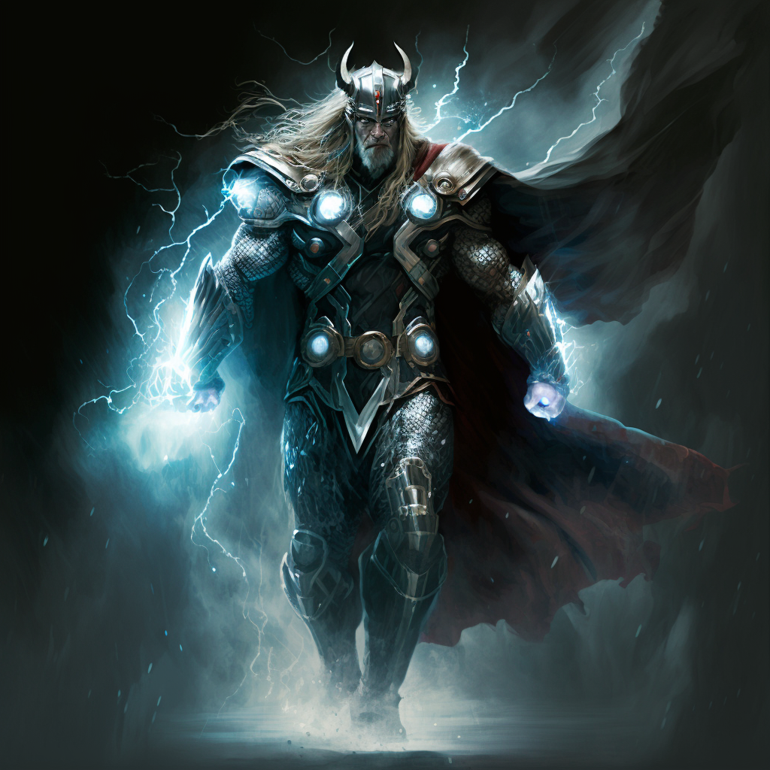
Java exceptions and
Norse mythology
Thor.
The most iconic.
Exception
The most iconic kind of Exception, the first that comes to mind.
Rare to do
new Exception(…)
catch(Exception e){..}
is often overkill

Slide 22
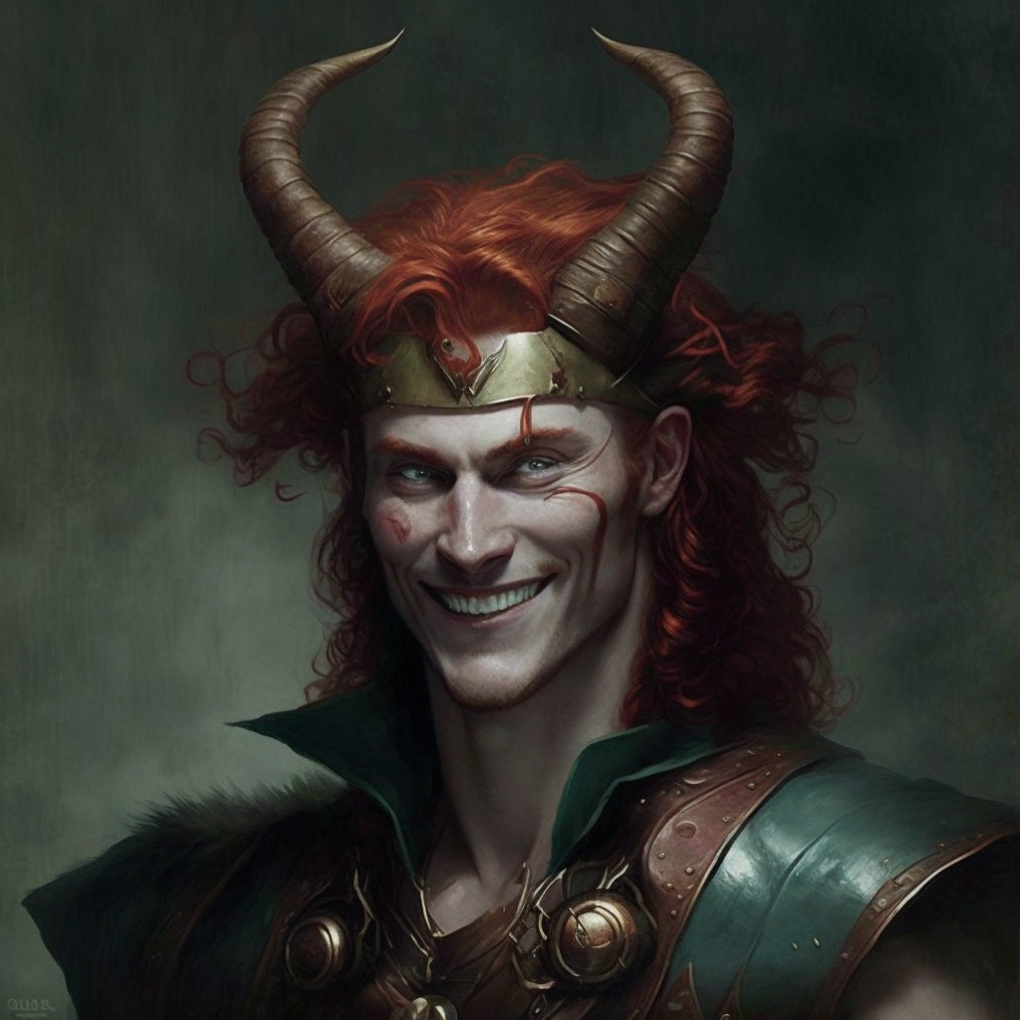
Java exceptions and
Norse mythology
Loki.
The sneaky guy
Error
The one whose name causes the most dread.
Common to do
new Error(e)
catch(Error e){..}
is common in library code

Slide 23

Java exceptions and
Norse mythology
Hoðr.
The good sneaky guy with a tragic past: tricked by Loki to kill Baldr, the god of light.
RuntimeException
Helps us to solve limitations of Java by tunneling errors around the type system.
Common to do
new RuntimeException(e)
catch(RuntimeException e){..}
is common in library code

Slide 24
Throwable
Exception
RuntimeException
Family relationships:
Throwable(Odin) is the father (supertype) of
  Error (Loki) and
  Exception (Thor). Exception is the father of
      RuntimeException (Hoðr)
They all spawn their minions
Error

Slide 25
Throwable
Exception
RuntimeException
Checked
Checked
Unchecked
Checked
Error
Unchecked
Unchecked
Unchecked

Slide 26
Throwable
Exception
RuntimeException
Error
An Error is a subclass of Throwable
that indicates serious problems that a reasonable application should not try to catch. Most such errors are abnormal conditions.
AssertionError, AWTError, CoderMalfunctionError, IOError,
LinkageError, ThreadDeath, VirtualMachineError, ...

Slide 27
Throwable
Exception
RuntimeException
The class Exception and its subclasses are a form of Throwable that indicates conditions that a reasonable application might want to catch.
The class Exception and any subclasses that are not also subclasses of RuntimeException are checked exceptions. Checked exceptions need to be declared in a method or constructor's throws clause if they can be thrown by the execution of the method or constructor and propagate outside the boundary.
Tons of kids:
ExecutionException, FontFormatException, GeneralSecurityException,
InterruptedException, IOException, MarshalException,
MidiUnavailableException, MimeTypeParseException, ParseException,
ReflectiveOperationException, SQLException, TimeoutException,
TooManyListenersException, XMLParseException, ...
Error

Slide 28
Throwable
Exception
RuntimeException
RuntimeException is the superclass of those exceptions that can be thrown during the normal operation of the Java Virtual Machine.
RuntimeException and its subclasses are unchecked exceptions. Unchecked exceptions do not need to be declared in a method or constructor's throws clause
Tons of kids. Those are actually useful/relevant
ArithmeticException, ArrayStoreException,ClassCastException,
CompletionException, ConcurrentModificationException,
EnumConstantNotPresentException,
IllegalArgumentException, IndexOutOfBoundsException,
NegativeArraySizeException, NoSuchElementException, NullPointerException,
SecurityException, UnmodifiableSetException, UnsupportedOperationException,
Error

Slide 29

More metaphors: catch something
If the hero is too weak, the monster will win and the hero will be defeated.
However, with the ‘finally’ block, the hero can say their last words!
No matter if they win or lose, they will say those words before the stack unwinds away from them, sending them back into oblivion.
Defend the
main loop!

Slide 30
Quindi, per rendere le mie lezioni
ancora piu’ coinvolgenti,…
ho cominciato a recitare
e ad aggiungere musica

Slide 31
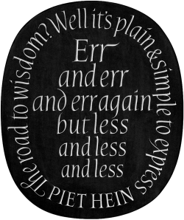
Automated testing -- Why is good
Don Knuth: this is the story of my life
[...]
Birds don't just fly
They fall down and get up
Nobody learns without getting it won
[...]
I wanna try everything
I wanna try even though I could fail
I'll keep on making those new mistakes
I'll keep on making them every day
Those new mistakes
Oh oh, try everything
Shakira - Try Everything
https://www.youtube.com/watch?v=c6rP-YP4c5I

Slide 32
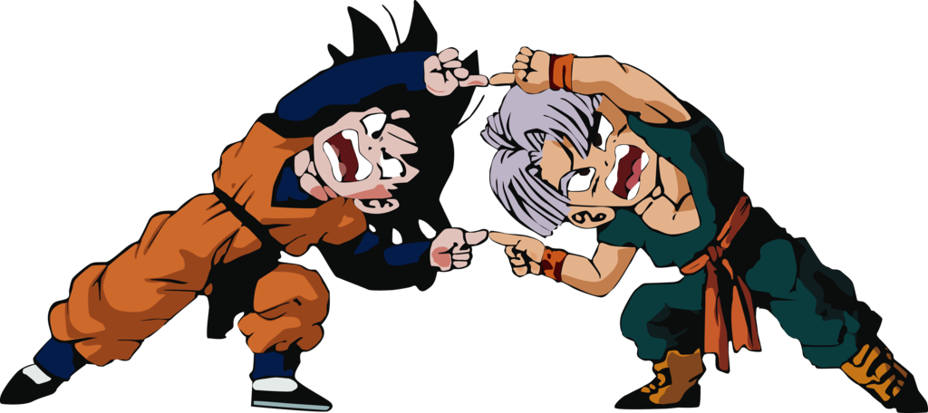
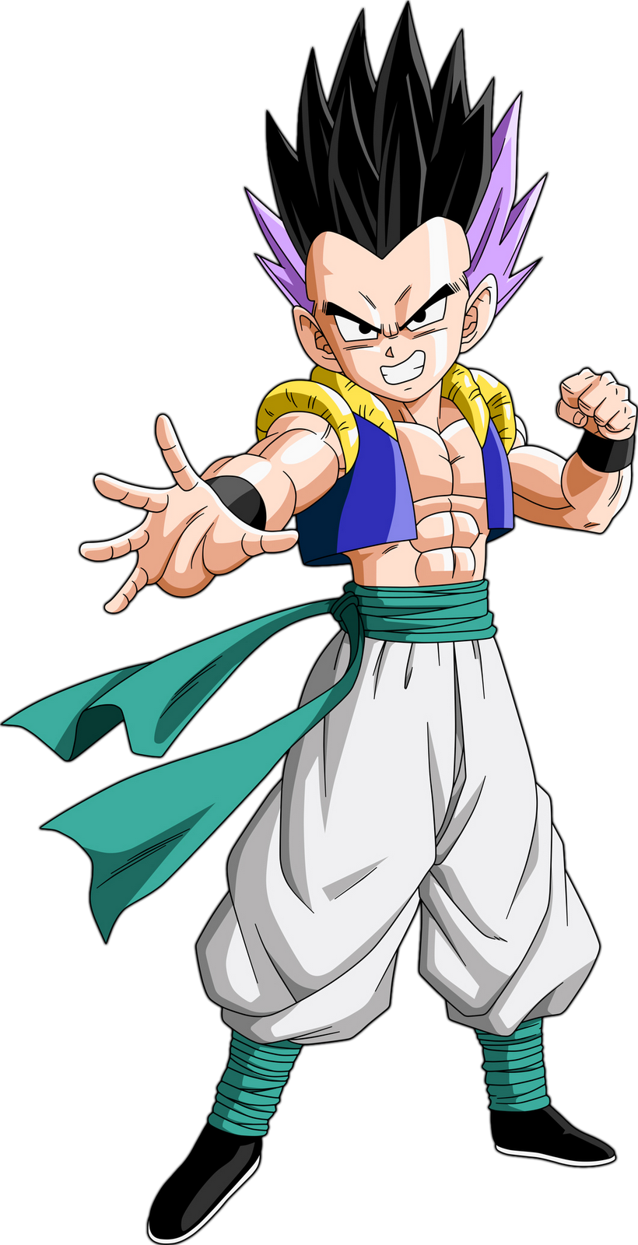
Multiple inheritance https://www.youtube.com/watch?v=8cpyejx506o
Gohan
Trunks
Goten
From Java8, this is now possible!
  A class cannot have more than one superclass
    Other languages (e.g. C++) support this
  But, a class can implement more than one interface
  Interfaces can now have reusable implementation!
class Goten extends Gohan, Trunks { … }
class Goten implements Gohan, Trunks { … }

Slide 33
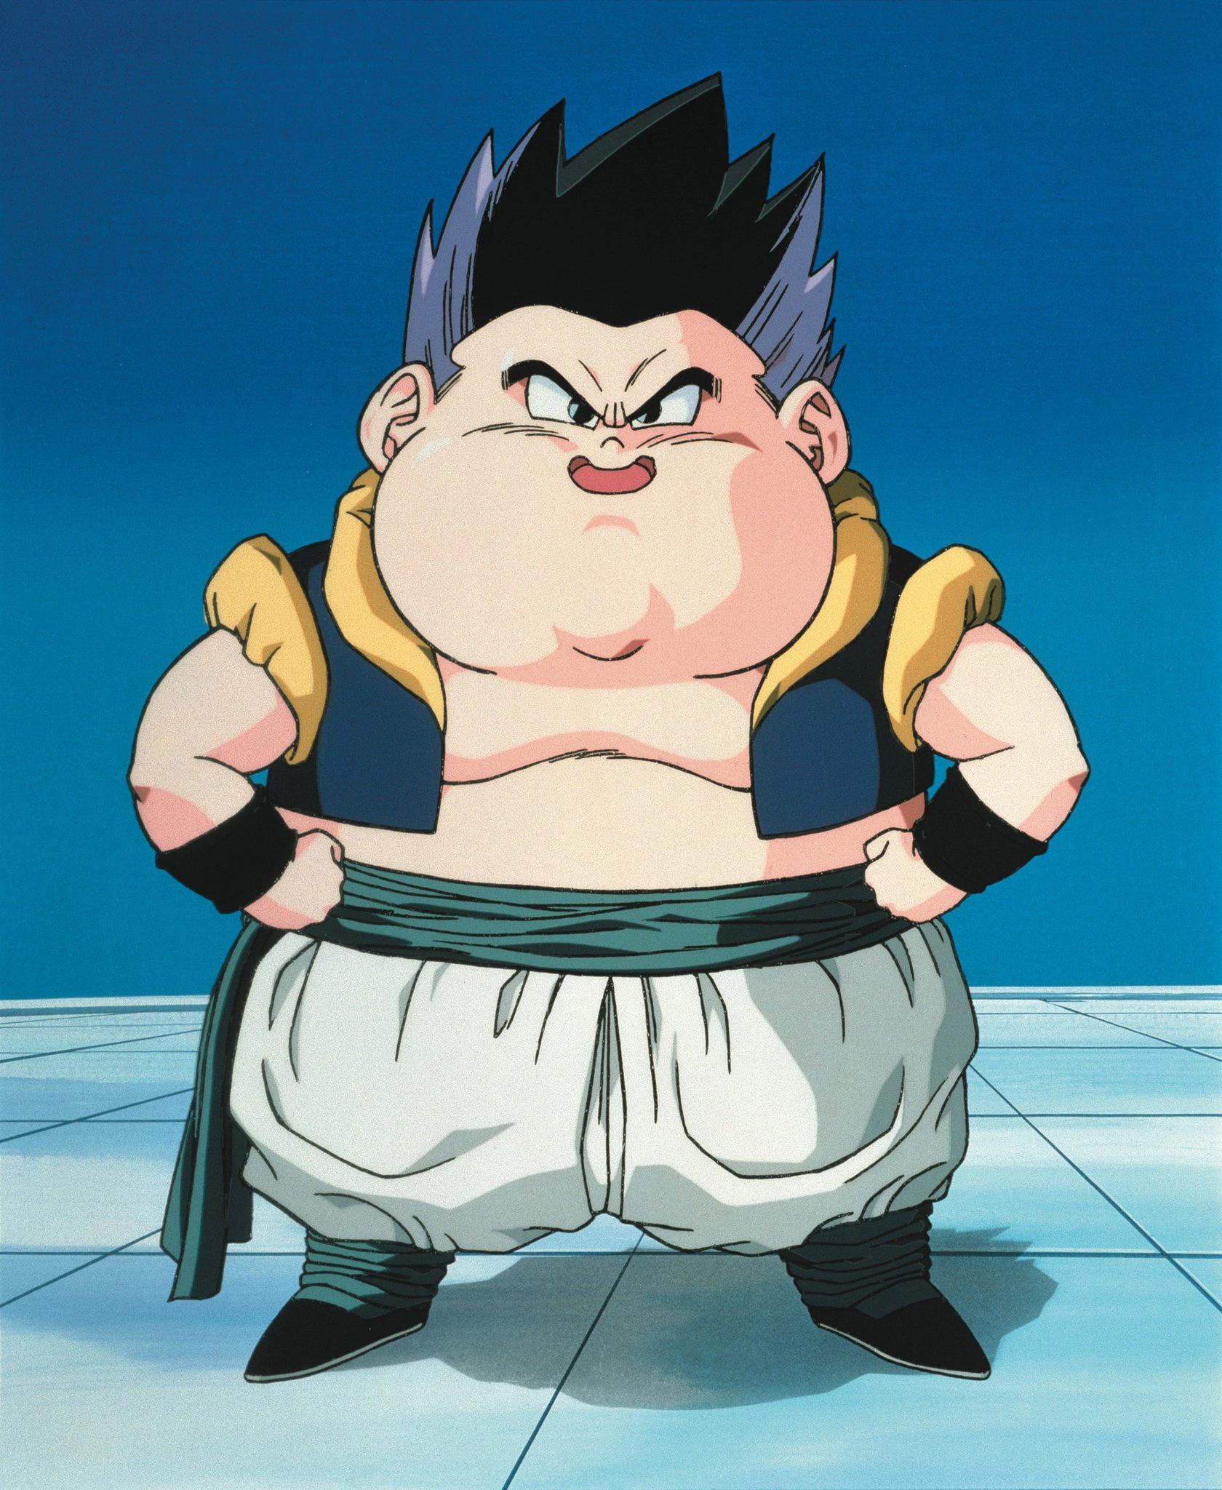
Risk of multiple inheritance: we may end up with too much stuff,
A class that is too fat.
(violating the single
responsibility principle)
To avoid this, we need to make the interfaces used to modularize our behaviour as slim as possible

Slide 34
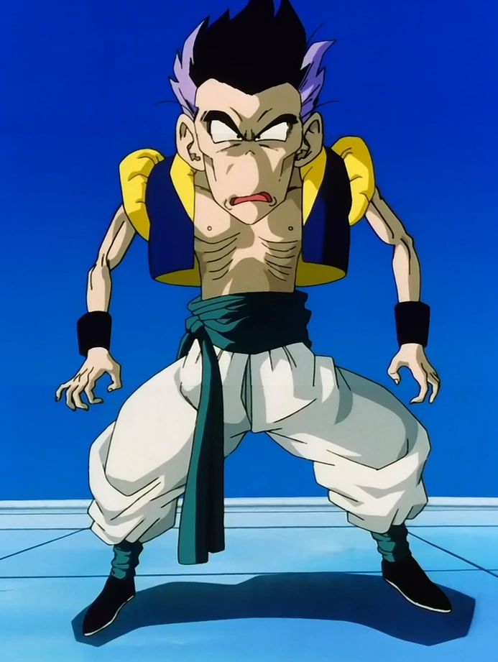
To avoid this, we need to make the interfaces used to modularize our behaviour as slim as possible
We can have many different interfaces, sometimes with just a single default method (and the private methods that it uses internally)
The other methods will be abstract and defined in other interfaces.

Slide 35
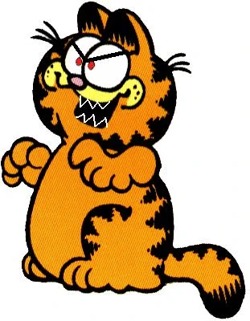
Property testing
A volte una sola immagine,
piccola e mai ripetuta e’
meglio e distrai meno
Instead of just testing that an operation on a specific input does exactly what we expect, we can generate some input and check for general properties, for example with minIndex we could generate random sequences of numbers and test that the number at the resulting input is indeed smaller than all the other ones.
Watch: https://www.youtube.com/watch?v=IYzDFHx6QPY
“The lazy programmer's guide to writing thousands of tests”
- Scott Wlaschin
This talk is also known as “The enterprise developer from hell”

Slide 36
A questo punto le mie lezioni non sono
piu’ noiose! Ma comunque parlo di
concetti tecnici in modo serio, completo
… ovvero difficile e spesso fuori dalla
portata dei miei studenti

Slide 37
Zone of Proximal Development (ZPD) and Constructivism
In Nuova Zelanda ci fanno seguire dei seminari di didattica.
L'apprendimento più efficace e’ spesso facilitato da coetanei più esperti, quelli appena ‘oltre il limite’. Gran parte del nostro apprendimento avviene attraverso l'interazione sociale, dove gli studenti costruiscono nuove comprensioni e conoscenze interagendo con coetanei impegnati nelle stesse o leggermente più avanzate fasi di apprendimento. Questi compagni di classe possono offrire intuizioni e spiegazioni uniche, particolarmente accessibili ad altri studenti.
Ascoltando queste teorie, e riconoscendole come veritiere sulla base della mia esperienza, mi sono sentito inutile come insegnante. Se gli studenti imparano meglio da altri studenti, quale e’ il mio ruolo?

Slide 38
Idea! Fingo di essere un altro studente quando insegno!
“Questi compagni di classe possono offrire intuizioni e spiegazioni uniche, particolarmente accessibili ad altri studenti.”
Perché piu’ accessibili? Perché sono FALSE!
Queste spiegazioni contengono abbastanza verità da permettere agli studenti di completare esercizi ed attività, ma non sono sempre perfettamente corrette. Sono semplificate, e spesso piene di incomprensioni che, nel lungo periodo, potrebbero rivelarsi controproducenti. Tuttavia, nel breve periodo, queste spiegazioni 'imperfette' funzionano.
Se uno è pronto a raffinare e correggere la propria conoscenza man mano che procede, allora imparare la realtà per approssimazioni successive potrebbe non essere una cattiva idea. Forse?

Slide 39

I just.. can not do it.
I can not lie.
I will not lie.
Even if I have to fail
all my students,
(and be fired for it)
I will not lie!

Slide 40
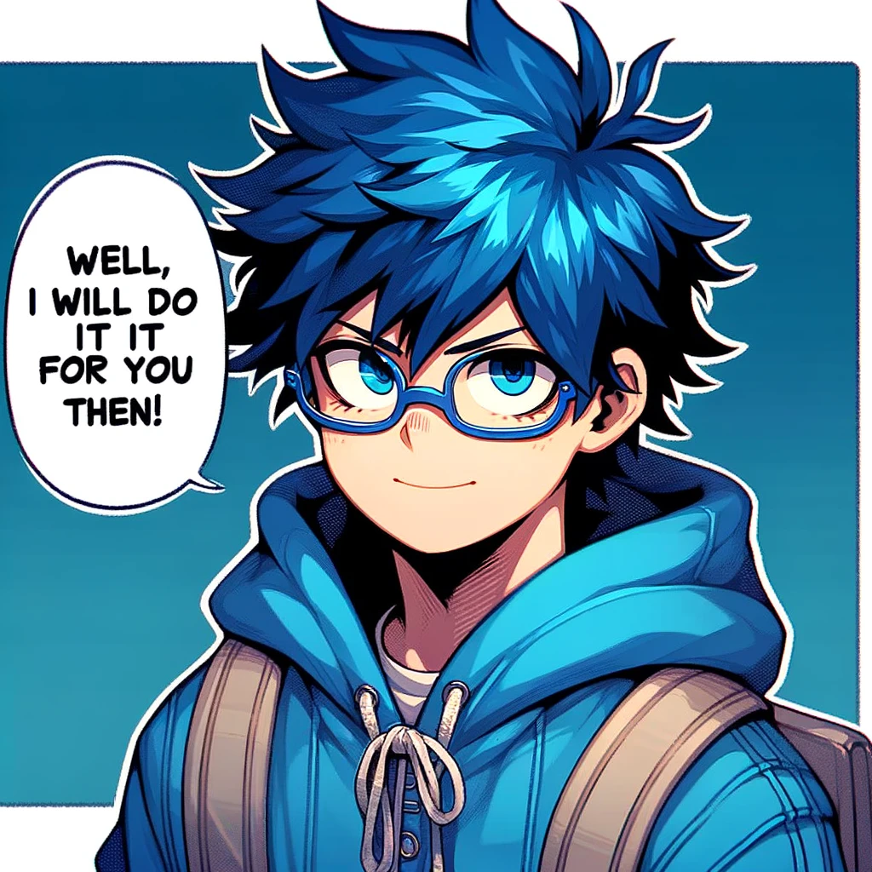

Ultimate Programming University

Slide 41
So, I stated writing a comicbook!
Quando una cosa e’ facile la spiego direttamente
Quando e’ difficile uso il fumetto.
La storia evolve cosi che il concetto sia rilevante.
I miei personaggi scoprono il concetto e non lo capiscono bene. Si aiutano tra di loro, discutono, fanno esercizi, esami etc.
Neanche I miei personaggi mentono, si limitano a dire cose ragionevoli e ‘in character’ a seconda del livello di competenza che hanno in quel momento nella storia.
Cosi posso usare spiegazioni imperfette senza mentire.

