Slide 1
12334567890qwertyuiopasdfghjklzxcvbnm1234567890
12334567890qwertyuiopasdfghjklzxcvbnm1234567890

Slide 2

In the world of programming, there exists an award
that surpasses all others in prestige and honor...

Slide 3
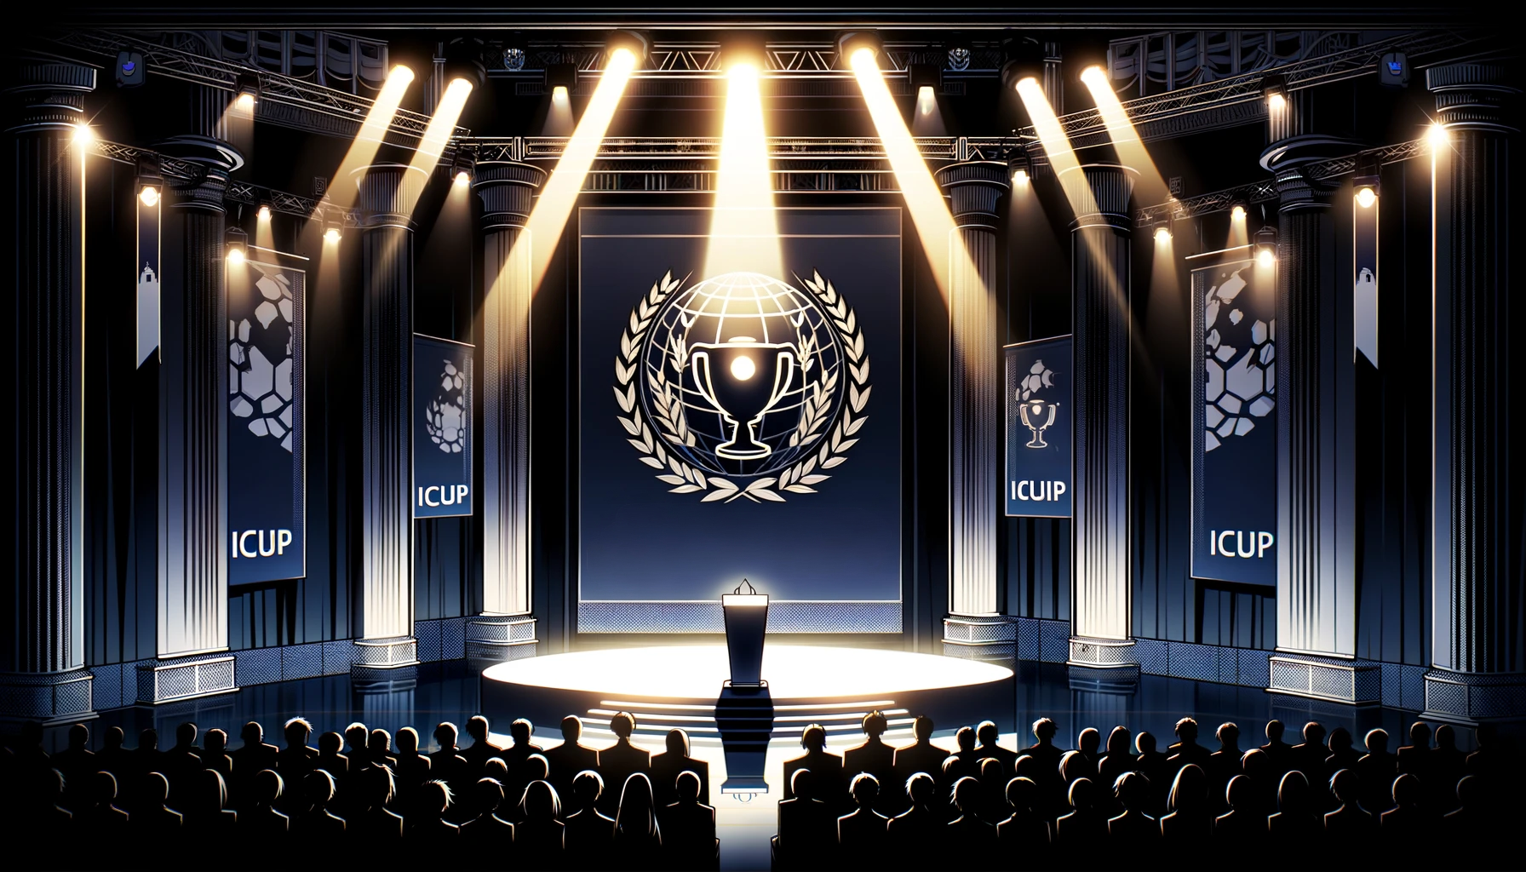
Presented by the International Conference of Ultimate Programming (ICUP),
the I-cup is a symbol of unparalleled innovation and mastery

Slide 4

This year, the I-cup is awared to Eugene Mortis, for his
groundbreaking work in monomorphic monadic monoization

Slide 5
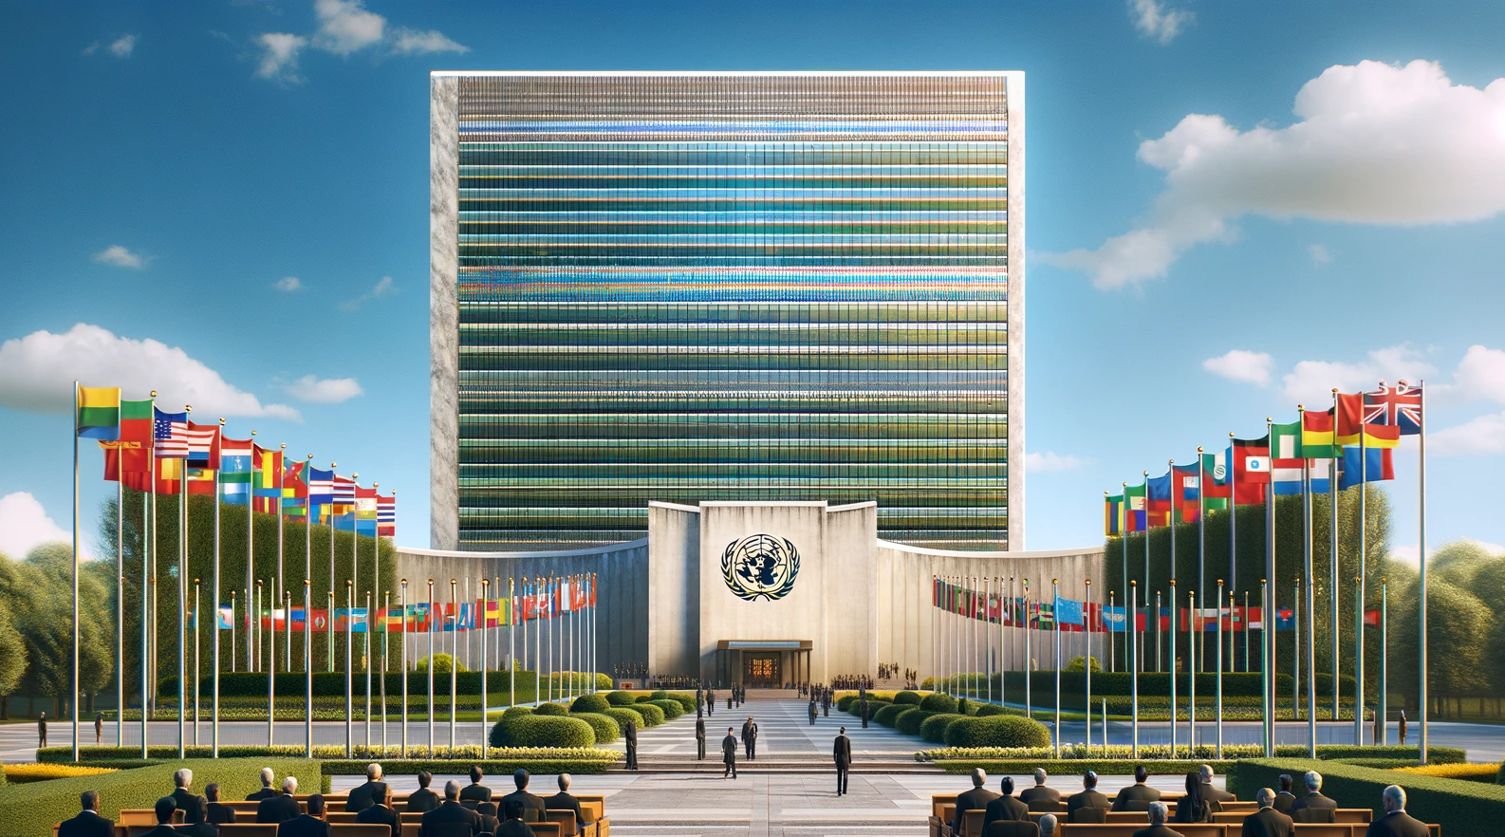
Following his remarkable achievement, Mortis is invited to a private audience
With the United Nations

Slide 6
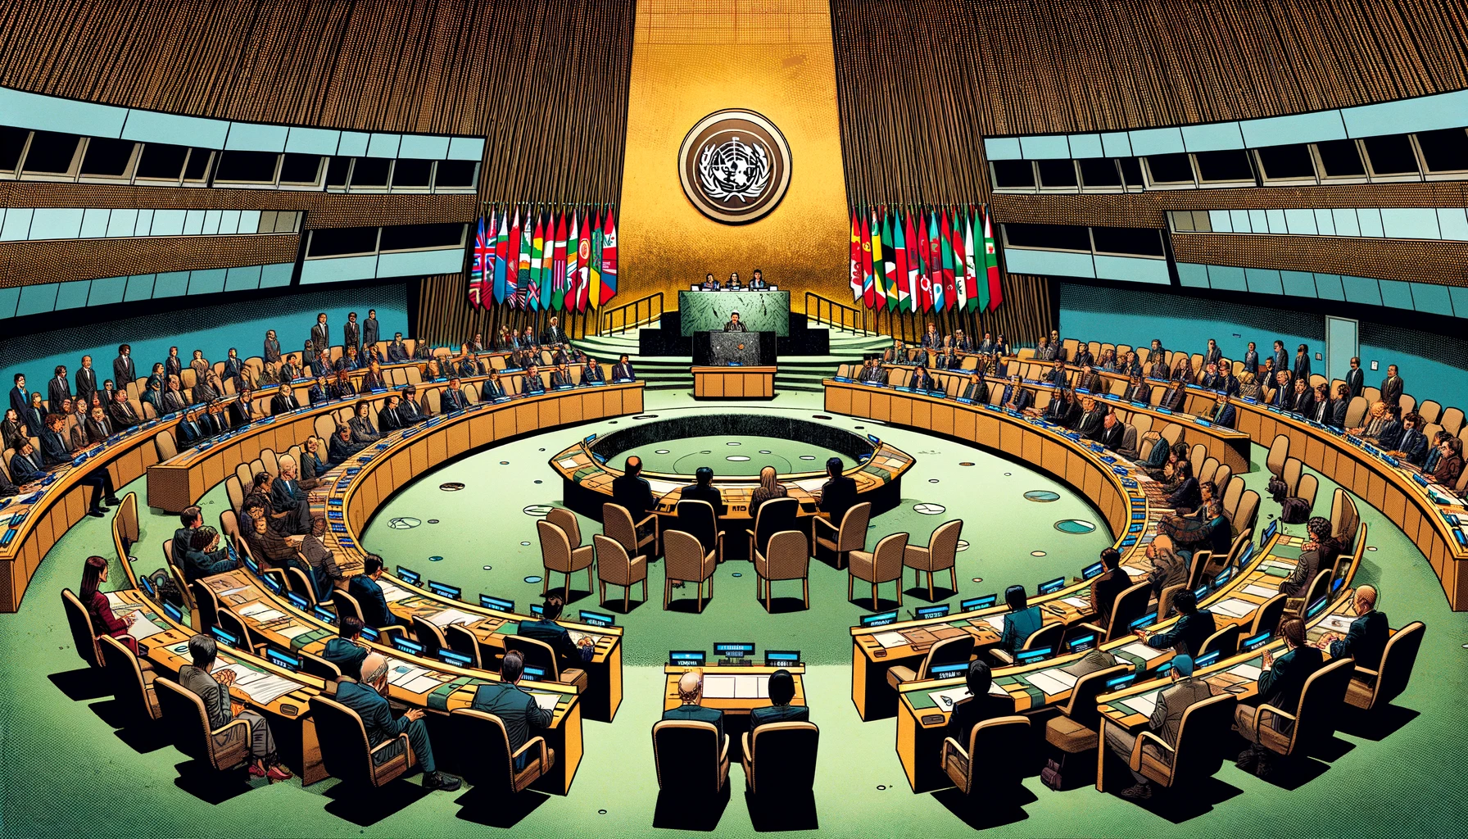

Slide 7
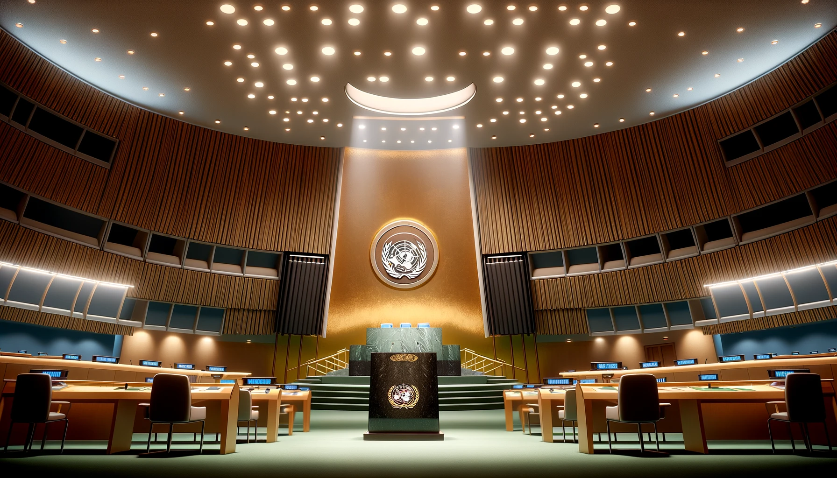
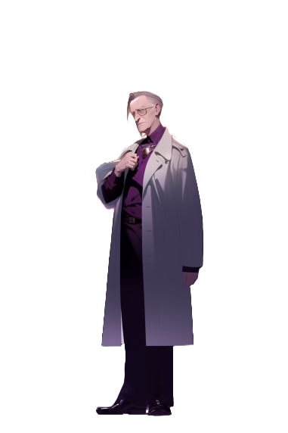
Esteemed delegates,
billions will perish due
to climate change
My zero-information
proof reveals a
geoengineering solution
CO2 trapping in ice
via strategically placed
magnetic towers
The proof,
by being zero information,
doesn't specify the locations
for these towers

Slide 8
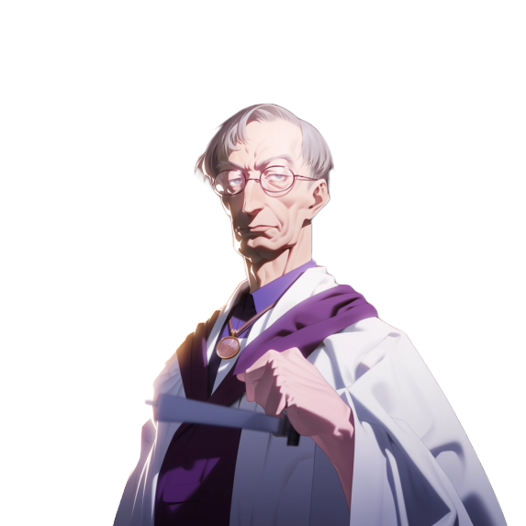
Surprisingly, the complexity
of this optimization problem is
beyond even my capabilities
Grant me permission
to establish my
own university
There I'll forge
a programming mind
surpassing
even my own
In this intense crucible,
students will be part of a
grand human experiment
a genius capable
of solving this
optimization problem

Slide 9
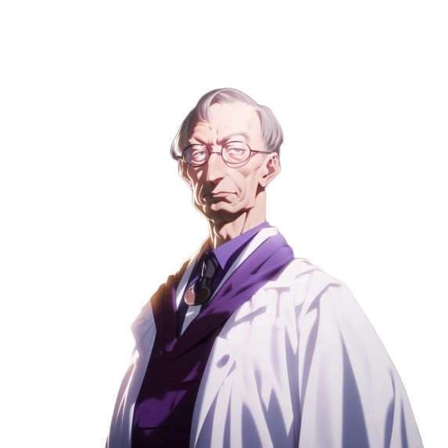
The university plan
you submitted…
It is a blatant violation
of human rights
Yes, It's practically a prison
for torturing students

Slide 10
The alternative is
billions of deaths
We have no choice
And so, with evident reluctance, the UN approved and established UPU,
Ultimate Programming University, granting it exceptional permissions.

Slide 11
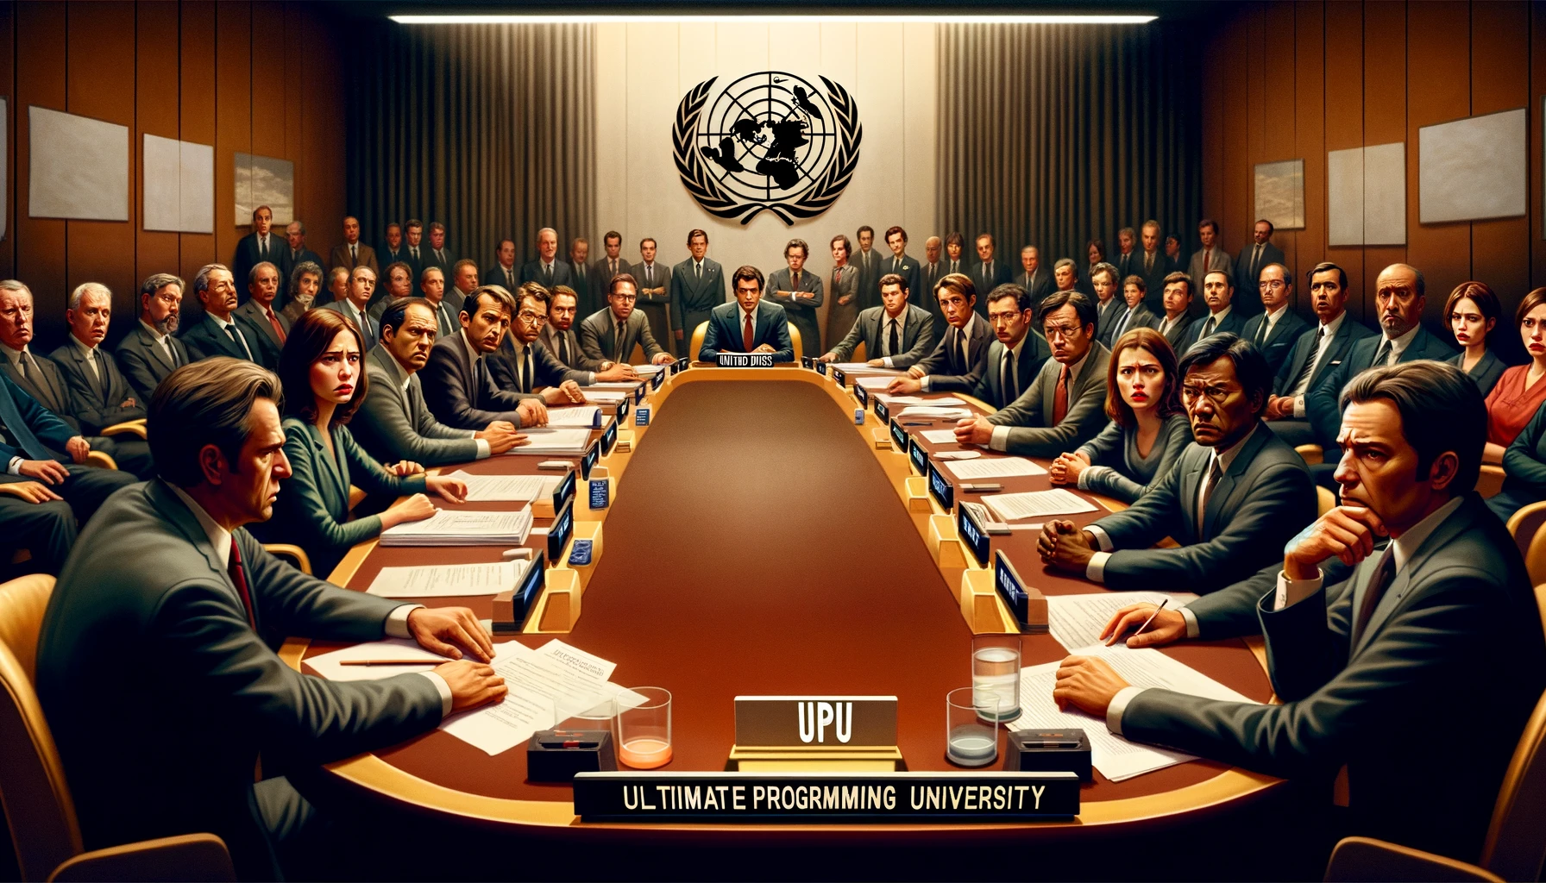

Slide 12

Ten years have passed, UPU is now a well established university,
but the details of his creation are kept secret
This is Sorrento Bay, UPU Freshman city. A new academic year is starting

Slide 13




Slide 14

Can you believe it, Ricky?
Today we are starting UPU!
Our dreams of making
video games are about
to get real.
Yeah, man. No more
high school drama
Just coding, games, and
that sweet sweet campus life

Slide 15


Dany, my man,
when have you ever
not aced a test?
Ricky, you ever think…
what if it's too much?
Programming, algorithms...
What if we can't keep up?
You worry about
everything!
Remember when you thought you'd
fail math, and you topped the class?

Slide 16

That was different.
University's a whole new level
And there's the social stuff,
the expectations!

Slide 17


Dude, we've got
each other's backs
Now, let's go show UPU
what we're made of!
Pizza,
we are mostly made of pizza!

Slide 19

This year, the I-cup is awared to Eugene Mortis, for his
groundbreaking work in monomorphic monadic monoization

Slide 20


This year, the I-cup is awared to Eugene Mortis, for his
groundbreaking work in monomorphic monadic monoization

Slide 21
The trophy itself is a marvel - a cup adorned with a hand in a thumbs-up gesture, resembling the letter 'i'.
The thumb, marked with Mortis's unique fingerprint, signifies both personal achievement
and the impact of one's work on the programming world

Slide 22

9
Presented by the International Conference of Ultimate Programming (ICUP),
the I-cup is a symbol of unparalleled innovation and mastery

Slide 23
9
Presented by the International Conference of Ultimate Programming (ICUP),
the I-cup is a symbol of unparalleled innovation and mastery

Slide 24

In the world of programming, there exists an award
that surpasses all others in prestige and honor...

