Slide 1
The alternative is
billions of deaths
… and it is with great difficulty that
I selected the student Charley
Dany, my man,
when have you ever
not aced a test?
Ricky, you ever think…
what if it's too much?
Programming, algorithms...
What if we can't keep up?
One for Harvard
and one for Oxford
You worry about
everything!
And so, with evident reluctance, the UN approved and established UPU,
Ultimate Programming University, granting it exceptional permissions.

Slide 2
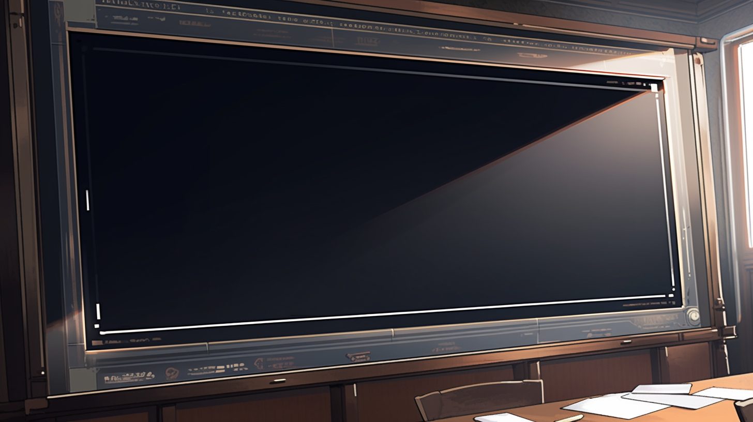
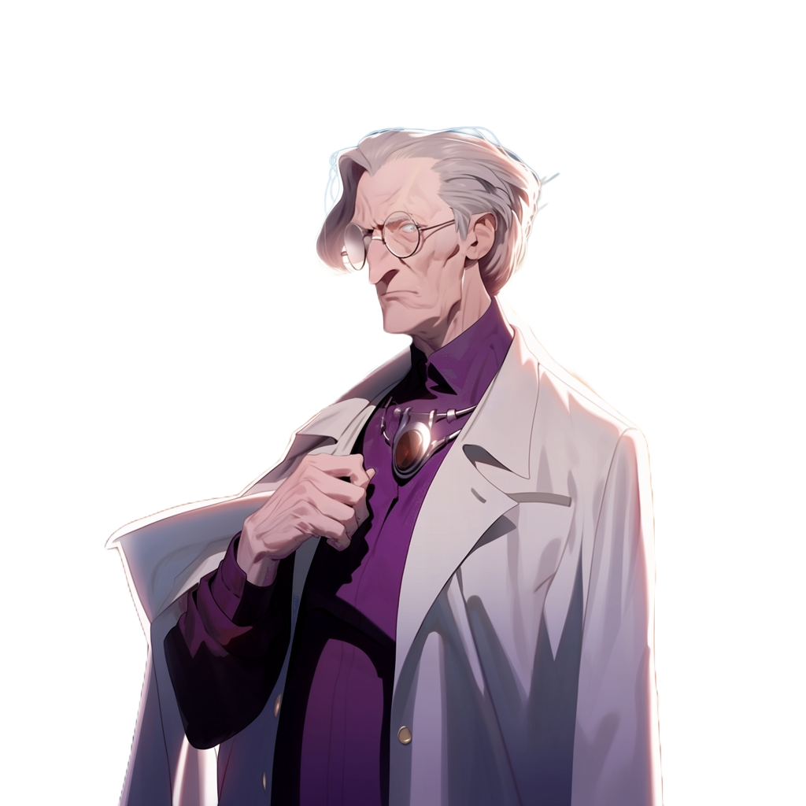
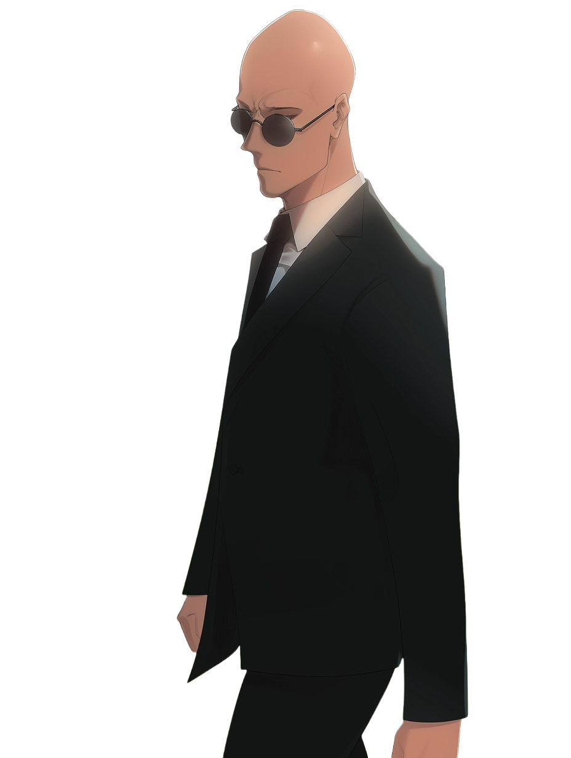
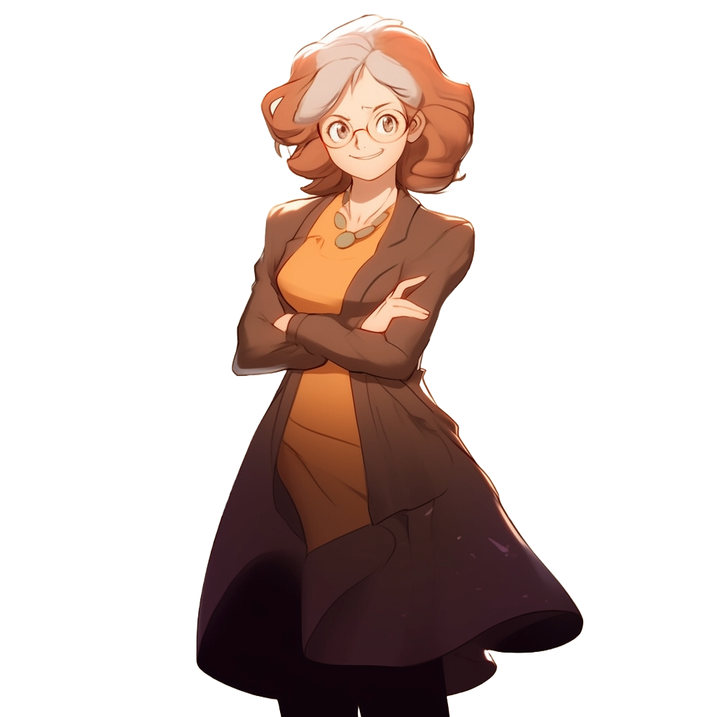
The course now continue with a single lecturer
I’m Elricho Pupon
Your Programming Professor
Computer Science
We divided the class in two,
to make it more manageable
You are the 100 students
assigned to me
The other 100 students are
assigned to Pumpkin

Slide 3
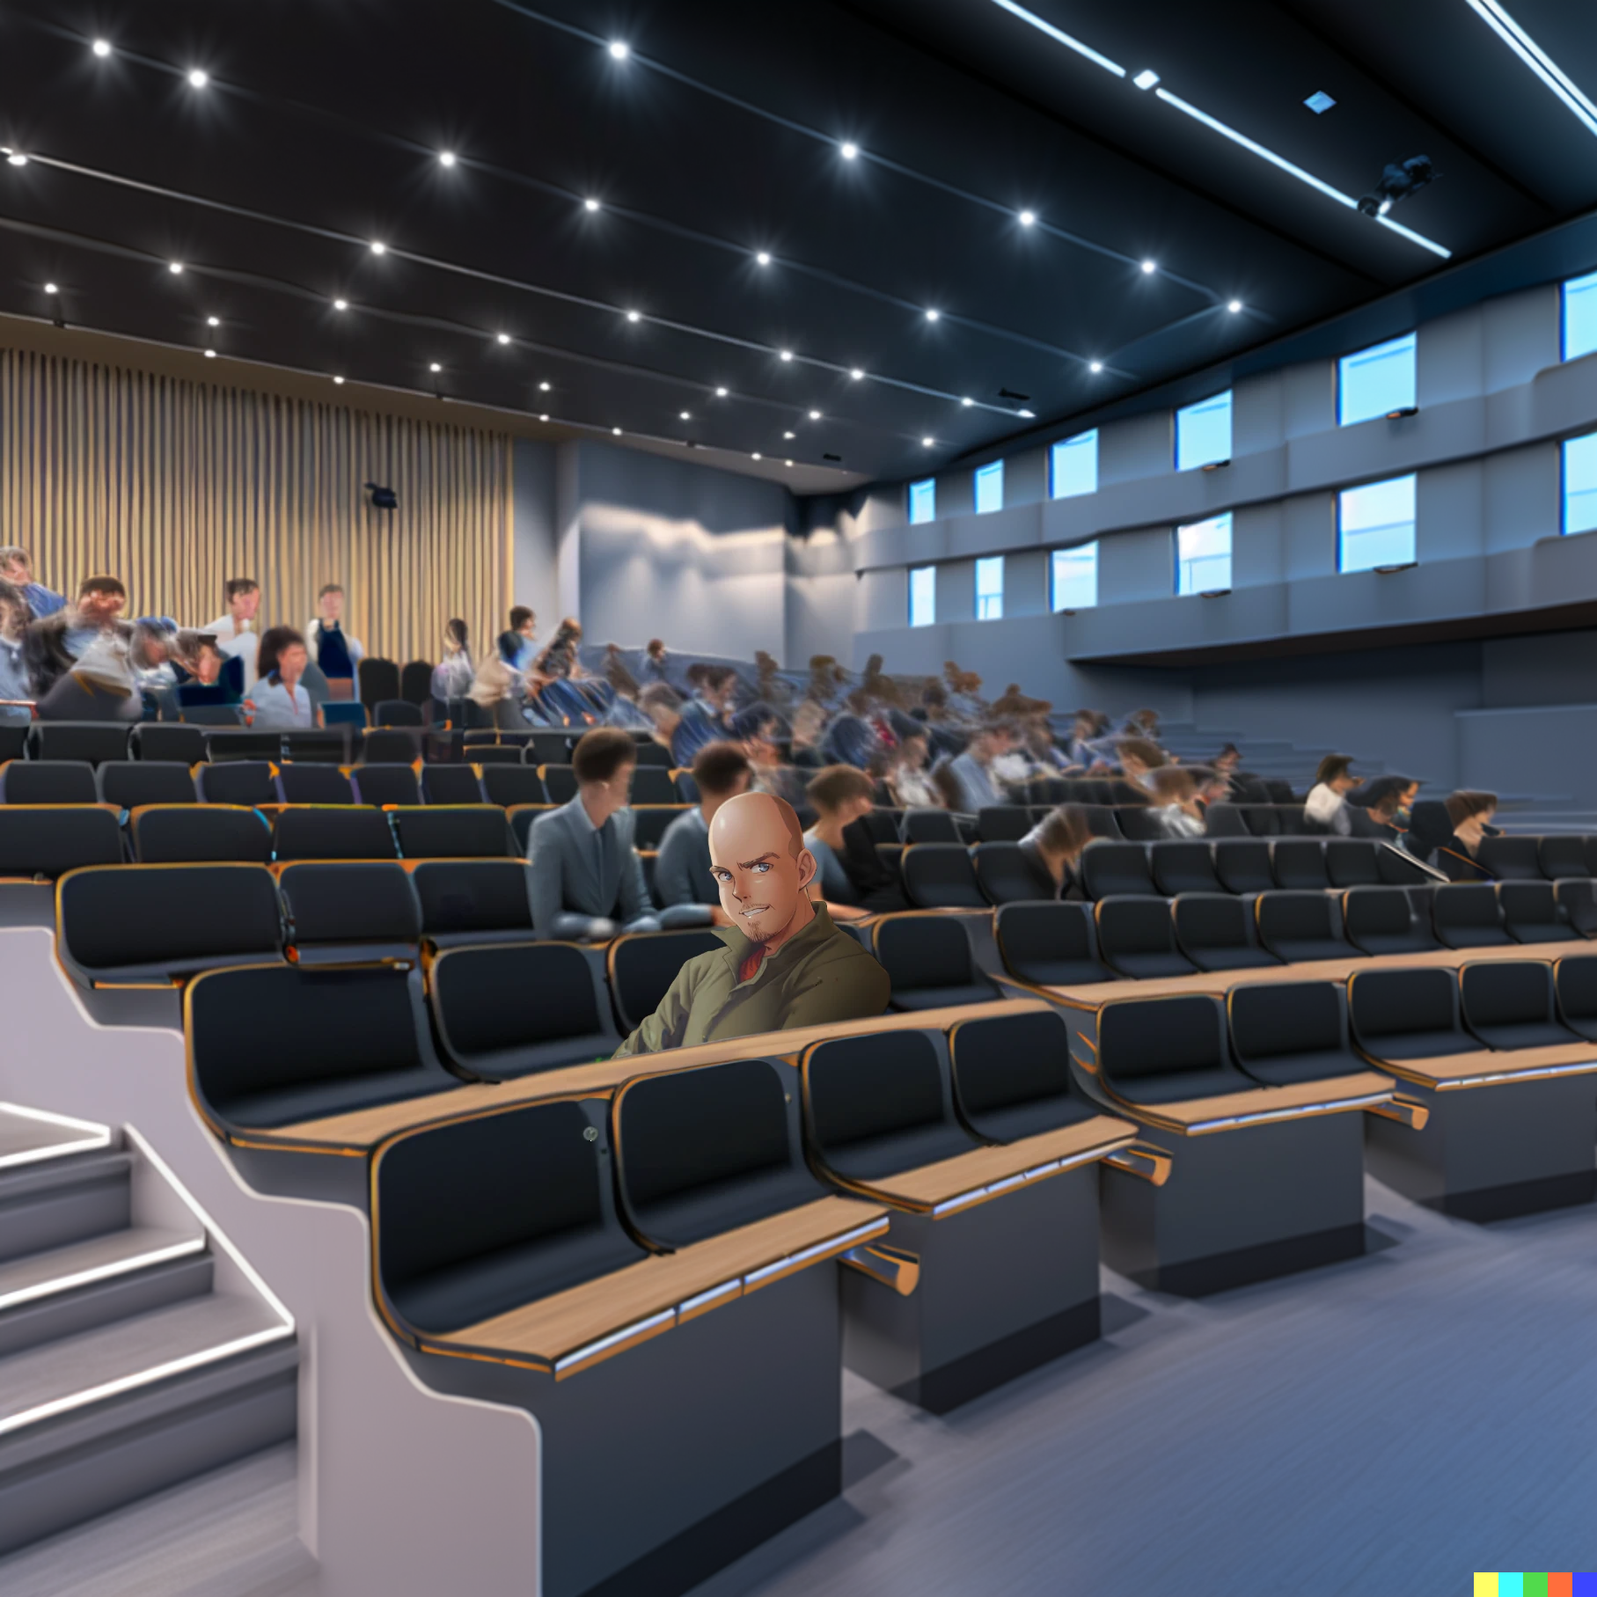
Please, stop this
and just solve
it symbolically

Slide 4

Such a good idea,
you must be very smart.

Slide 5
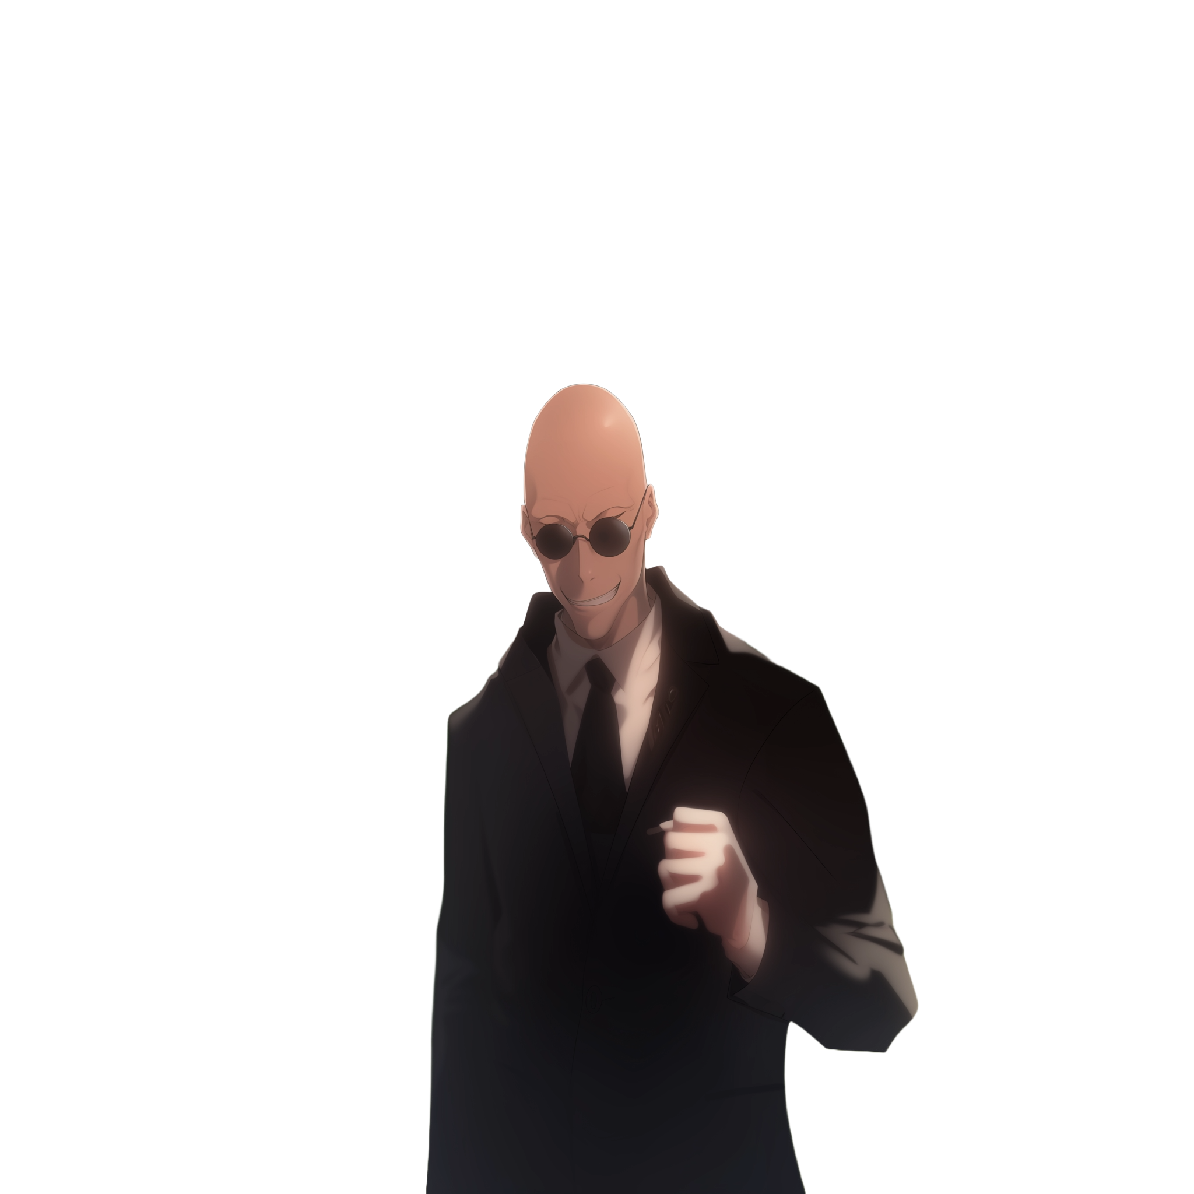
Such a good idea
You must be very smart

Slide 6

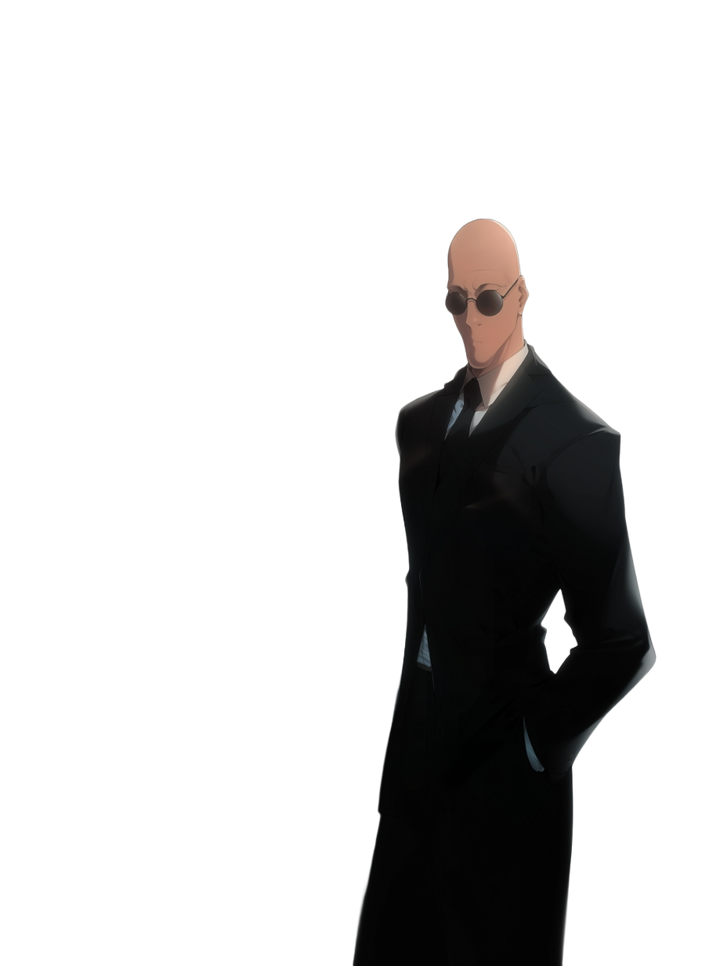
We can use use x and y for the
Original values of a and b
int a = x;
int b = y;
a = a+b;//a = x+y;
b = a-b;//b =
a = a-b;//a =

Slide 7

We can use use x and y for the
Original values of a and b
int a = x;
int b = y;
a = a+b;//a = x+y;
b = a-b;//b = (x+y)-y;//b = x
a = a-b;//a =
It can’t be!

Slide 8

int a = x;
int b = y;
a = a+b;//a = x+y;
b = a-b;//b = (x+y)-y;//b = x
a = a-b;//a = (x+y)-x;//a = y
Oh… but how...

Slide 9

int a = x;
int b = y;
a = a+b;//a = x+y;
b = a-b;//b = (x+y)-y;//b = x
a = a-b;//a = (x+y)-x;//a = y
It does not make sense,
there is even a repeated
’a’ minus ‘b’…
Ah?
So it is
working!
LOL, I’m
never forgetting
this

Slide 10
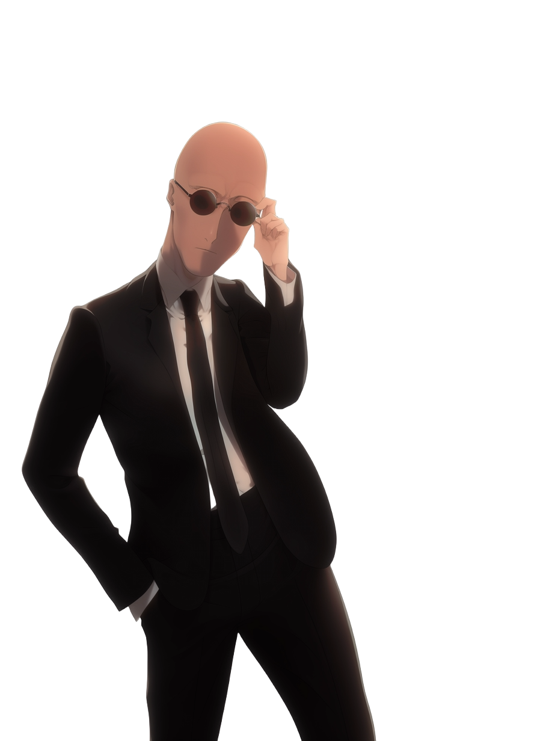
int a = x;
int b = y;
a = a+b;//a = x+y;
b = a-b;//b = (x+y)-y;//b = x
a = a-b;//a = (x+y)-x;//a = y
The repeated ‘a’ minus ‘b’…
How can the same expression
make two different results...

Slide 11
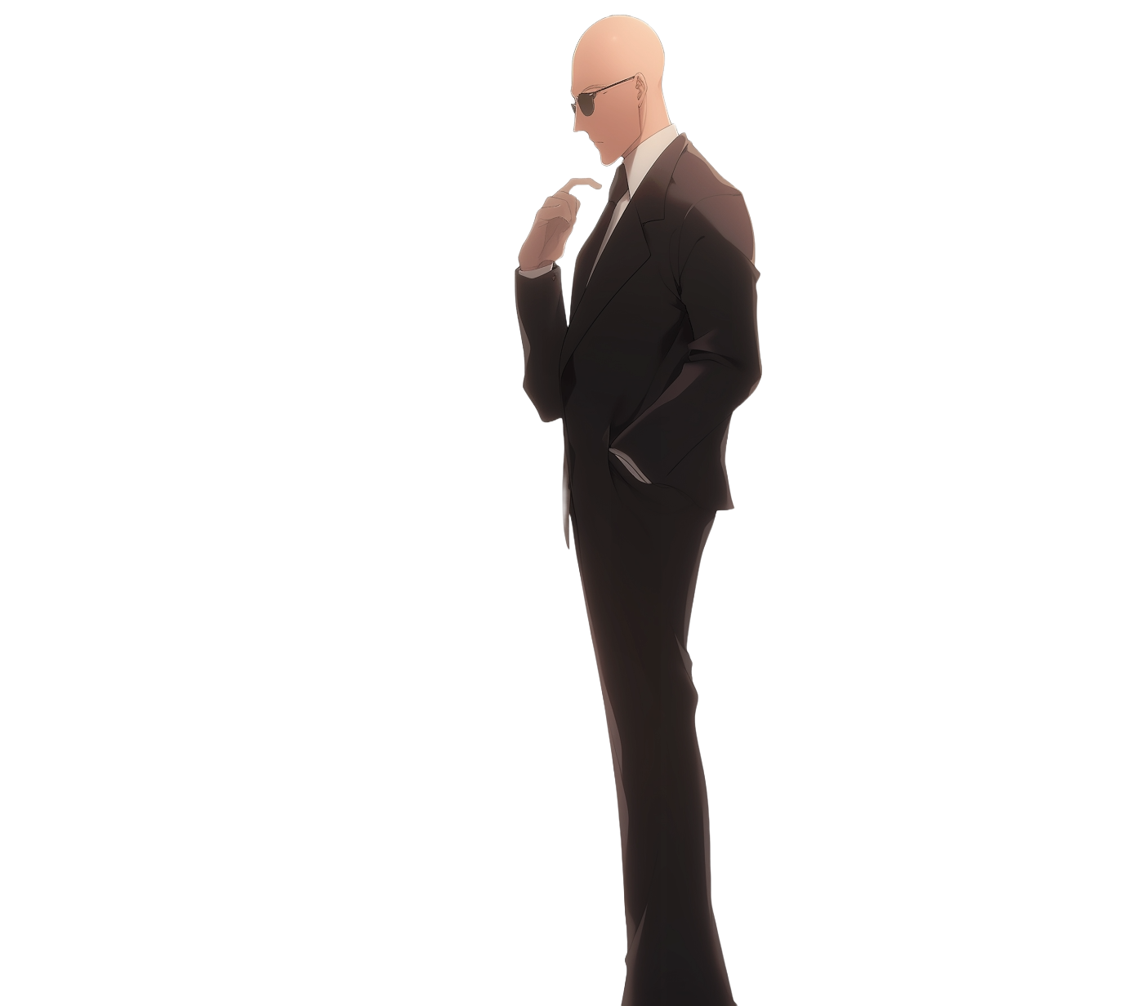
int a = x;
int b = y;
a = a+b;//a = x+y;
b = a-b;//b = (x+y)-y;//b = x
a = a-b;//a = (x+y)-x;//a = y
It is because ‘b’ has
changed its value

Slide 12
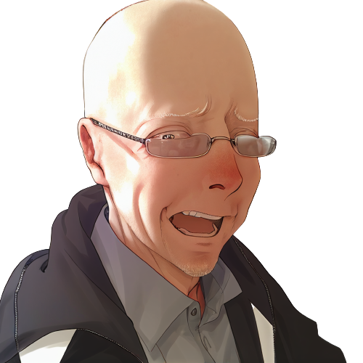
int a = x;
int b = y;
a = a+b;//a = x+y;
b = a-b;//b = (x+y)-y;//b = x
a = a-b;//a = (x+y)-x;//a = y
No, wait, there must be some other...

Slide 13
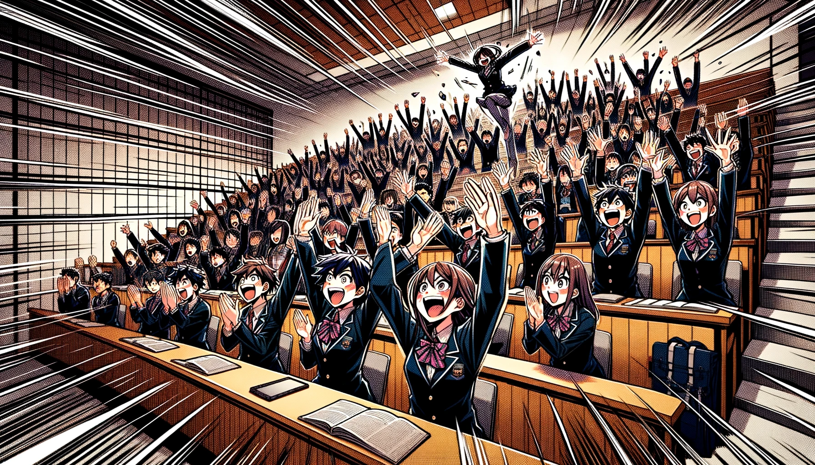
The whole class starts clapping and celebrating

Slide 14
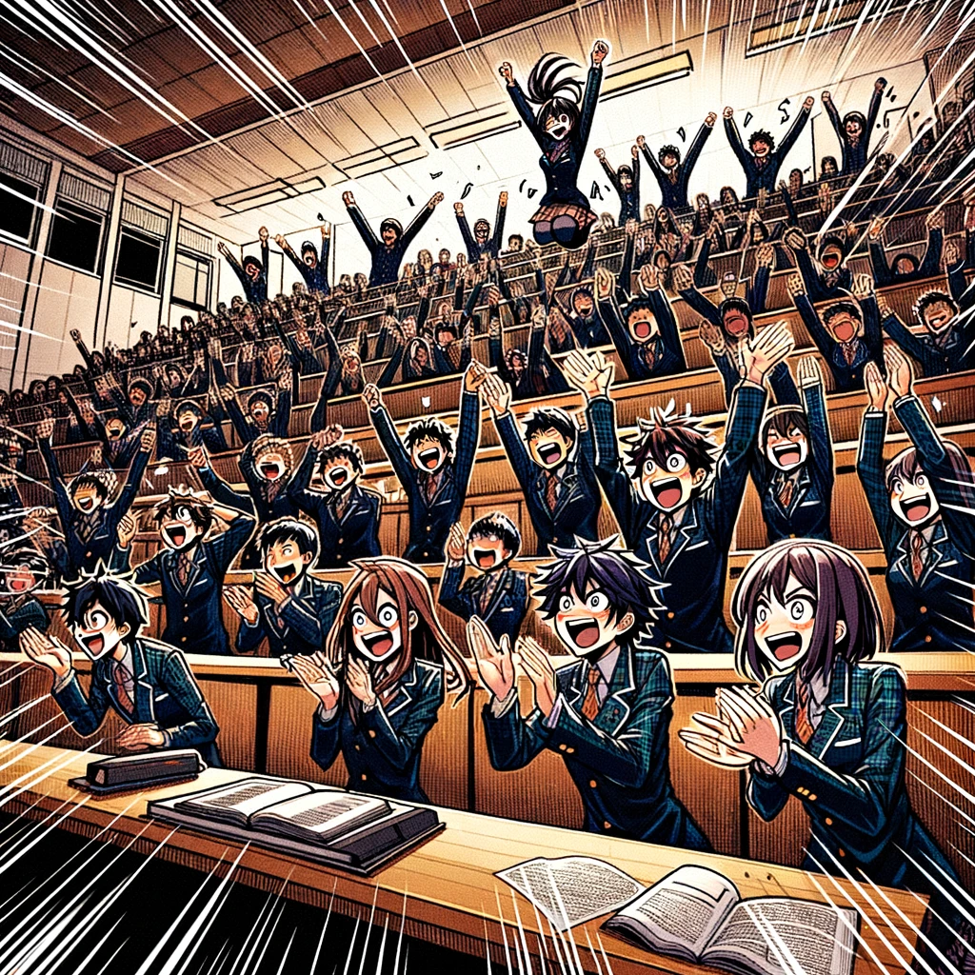
The professor’s bald head
shines under the bright lights,
flustered sweat marking
his embarrassment.
The room is a storm of
celebration until the
bell's chime signals the end,
leaving a lingering buzz of
excitement and a professor
in quiet contemplation.

Slide 16

No, NO!

Slide 17
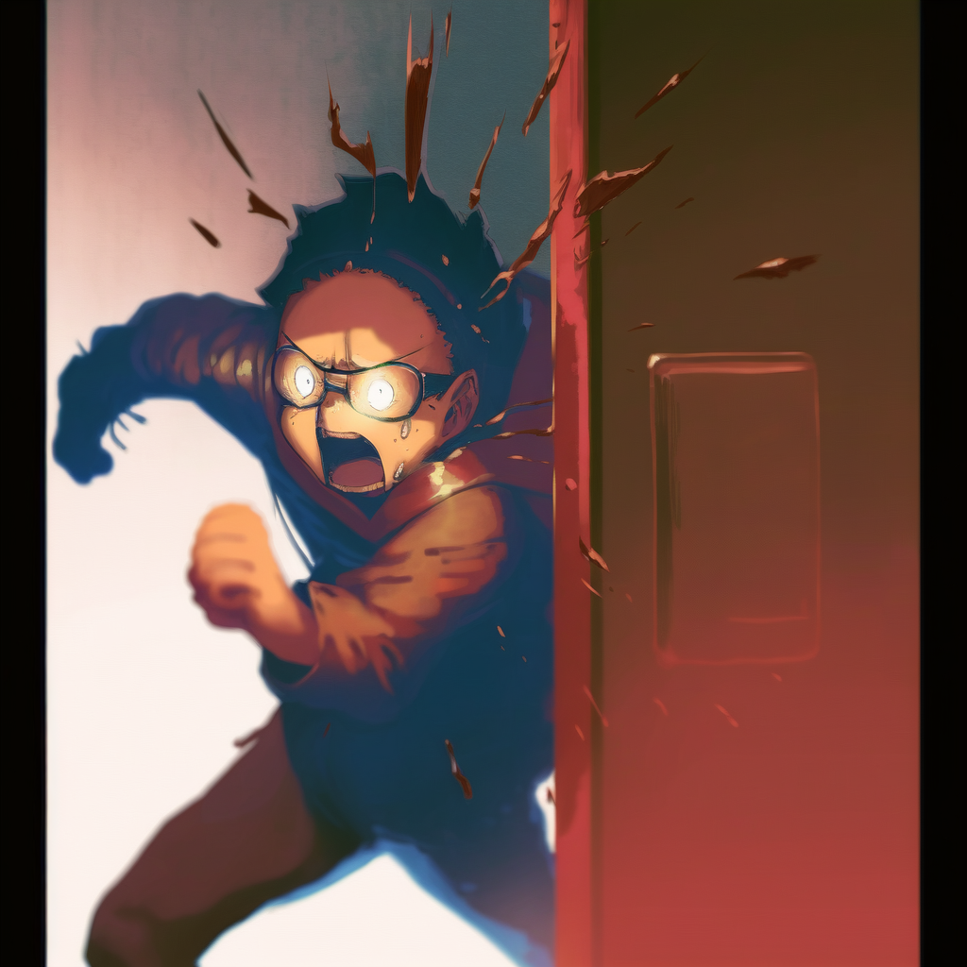
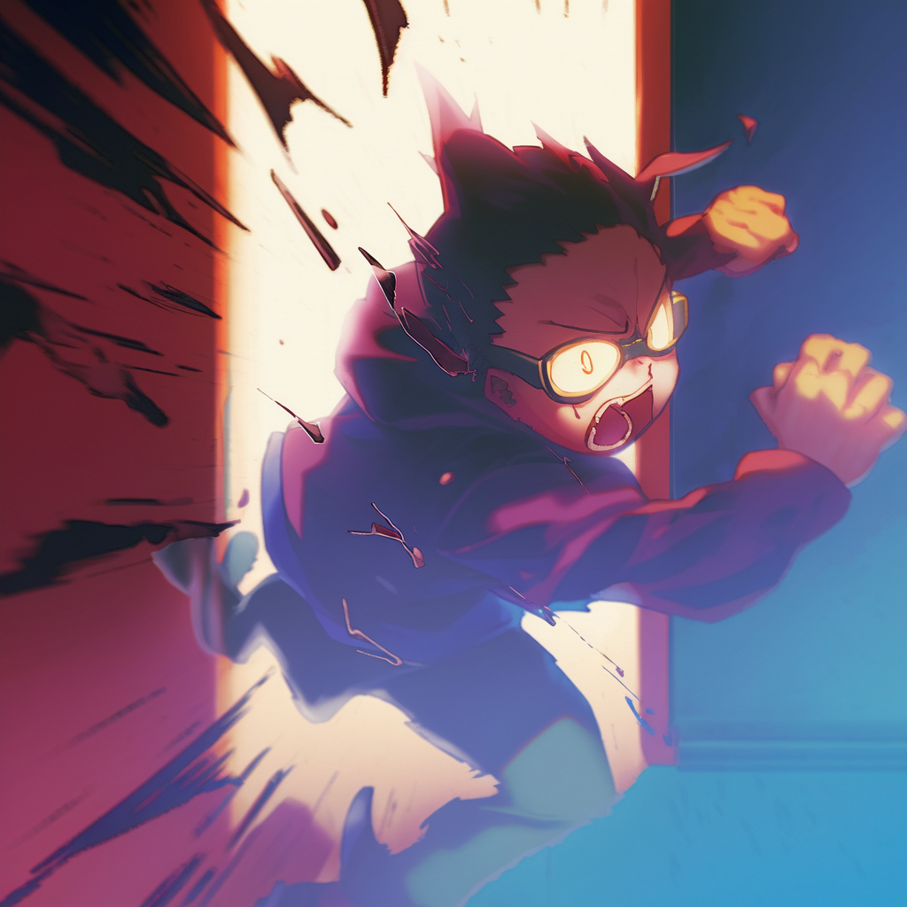
What have I done!

Slide 18

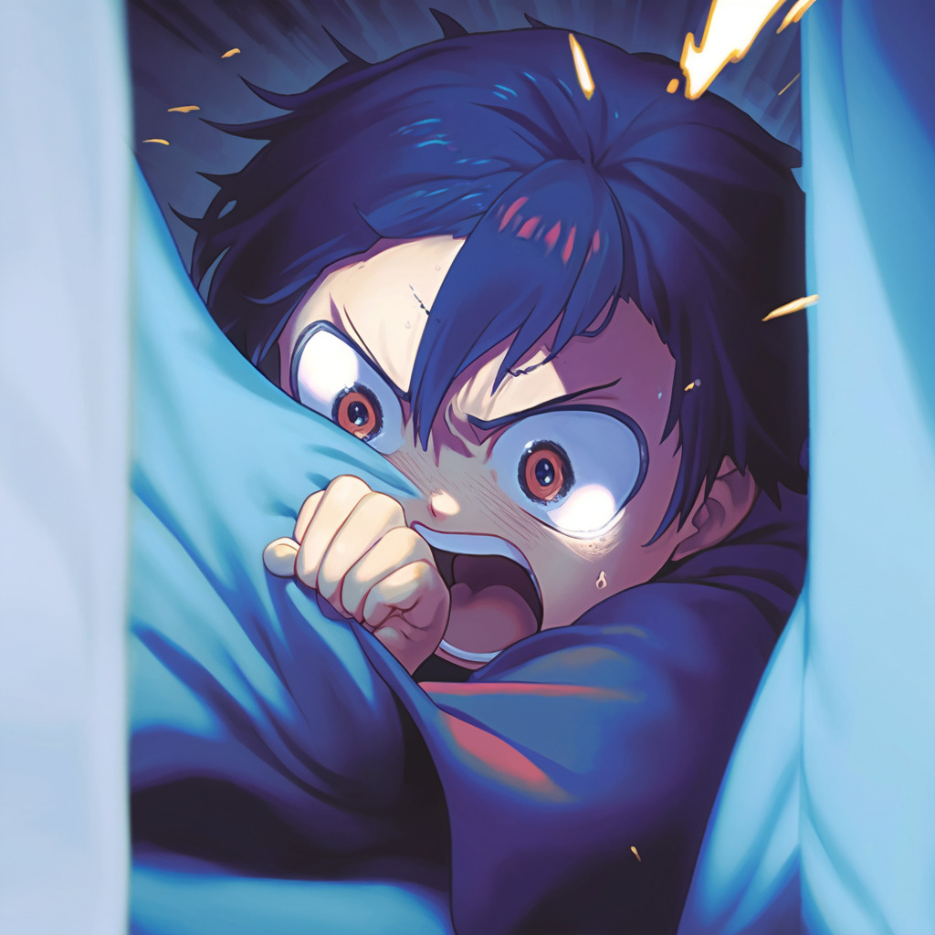
It is over!
All the class was
laughing at him,
he is going to hate me!
He is going to make
my life a nightmare!

Slide 19
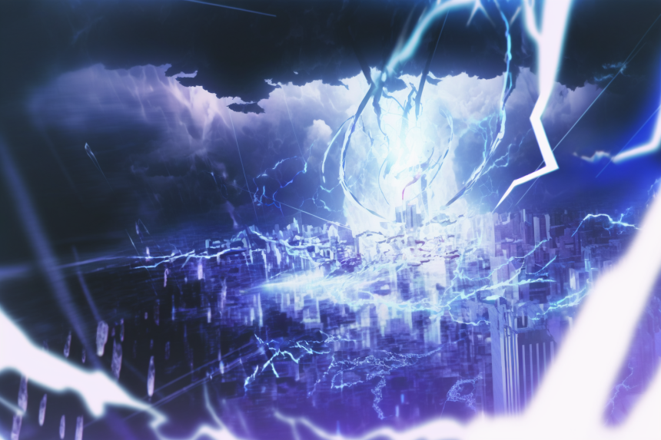
01: Invalid Metaphors

Slide 20
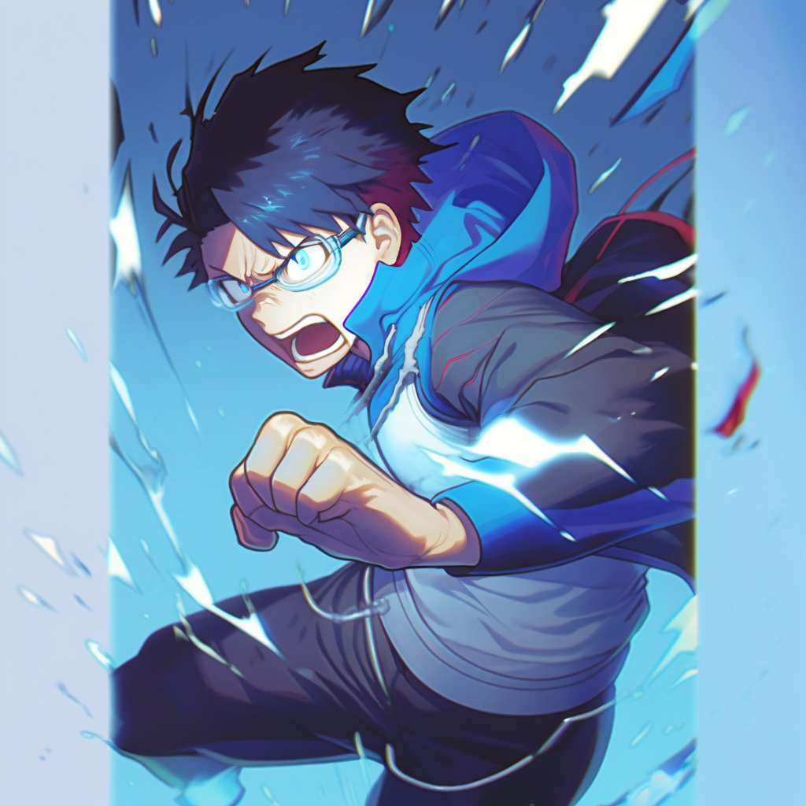
This is the end of
the first chapter.
What will the future hold
for our cowardly hero?

Slide 21

Credits
- Story: Marco
- Art: MidJourney, NijiJourney, Dall-E
- Composition: Marco
- Thanks to all my friends for
providing great feedback!

