Slide 1
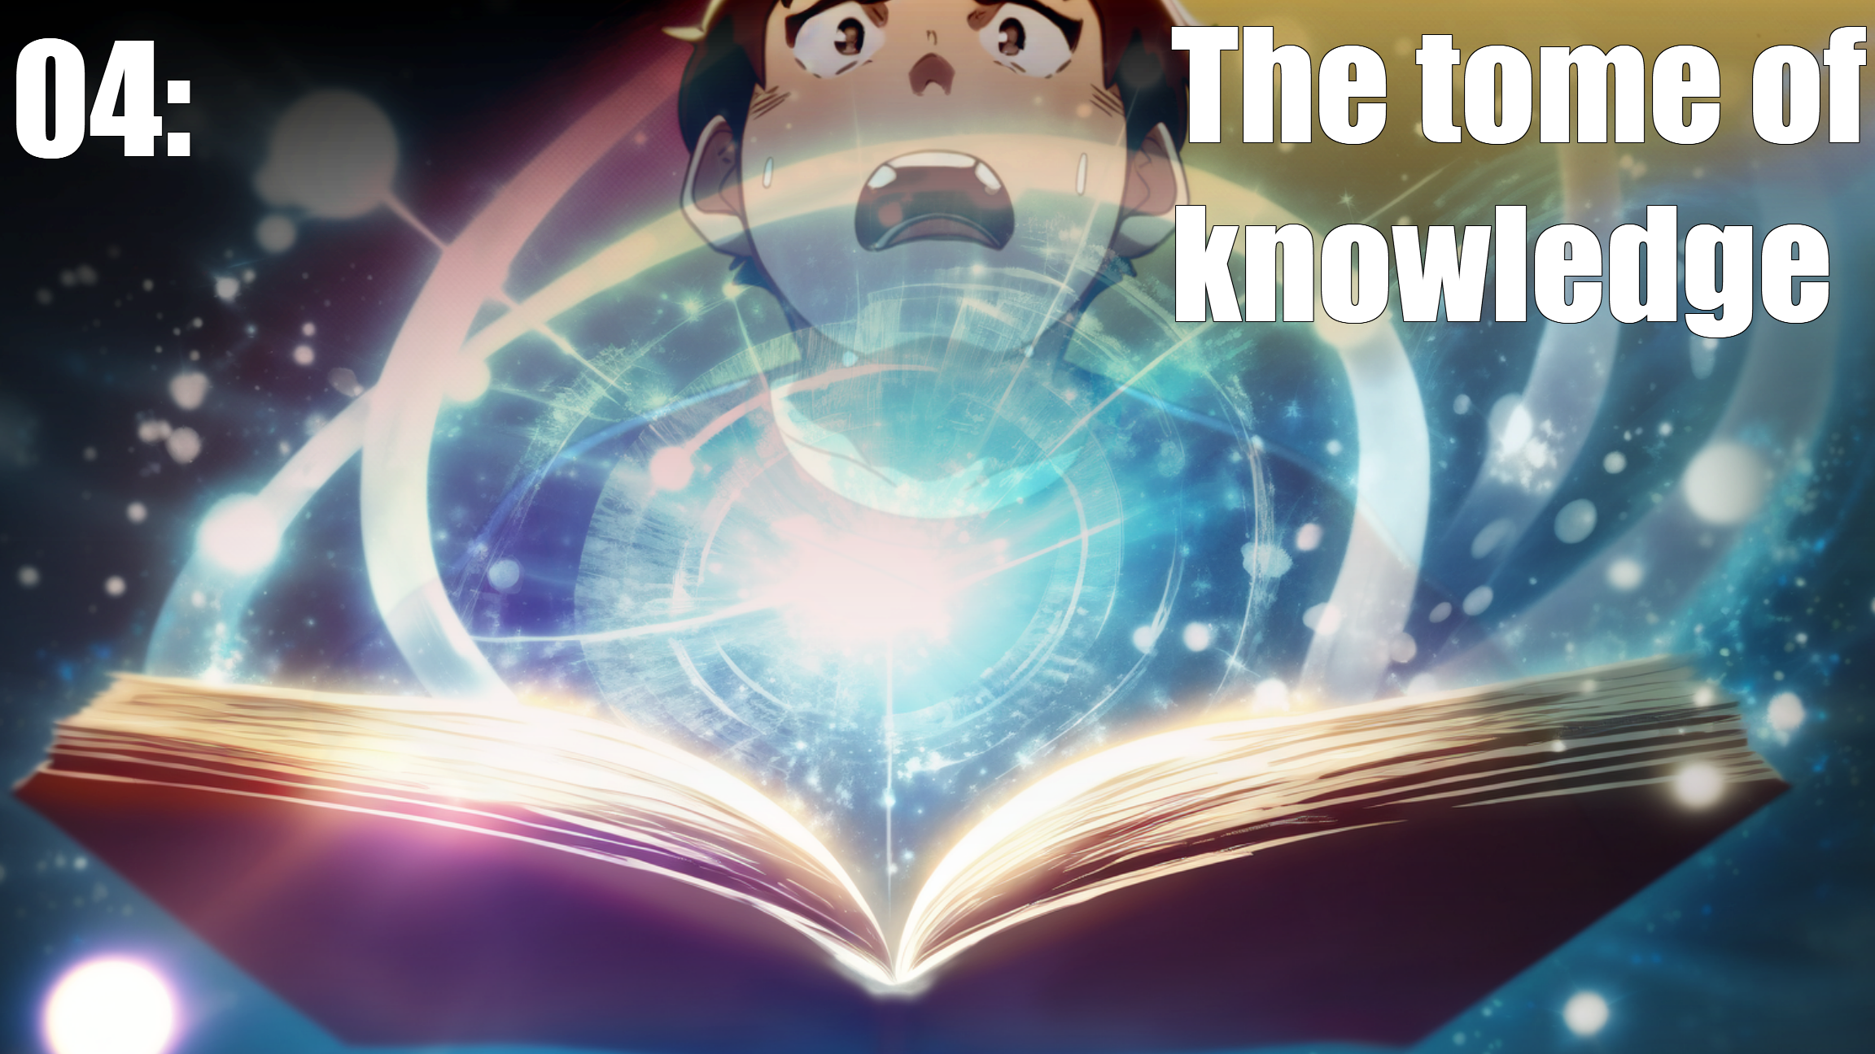

Slide 2
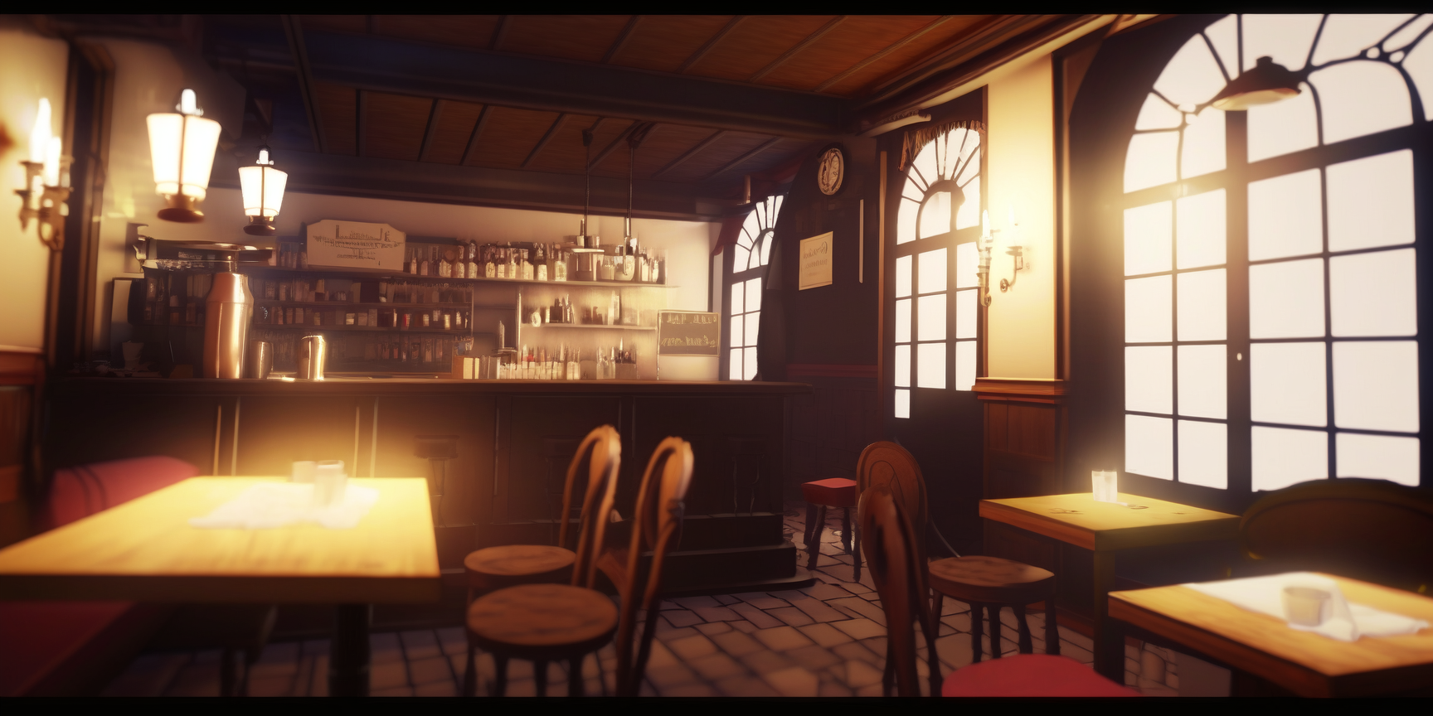
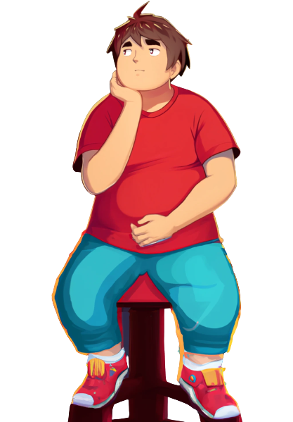
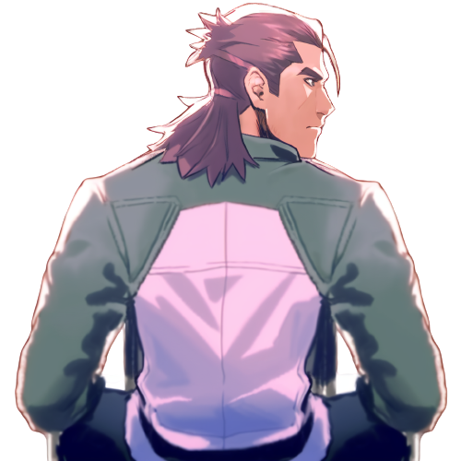
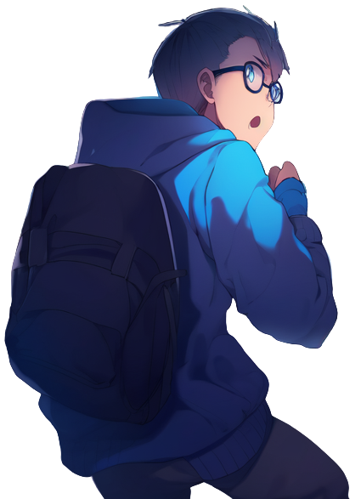
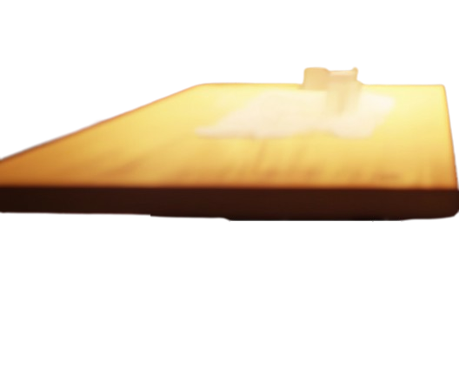
Dany, Ricky and Tommy are waiting for pizza together
Hey Dany, …
thanks for the
help last week!

Slide 3
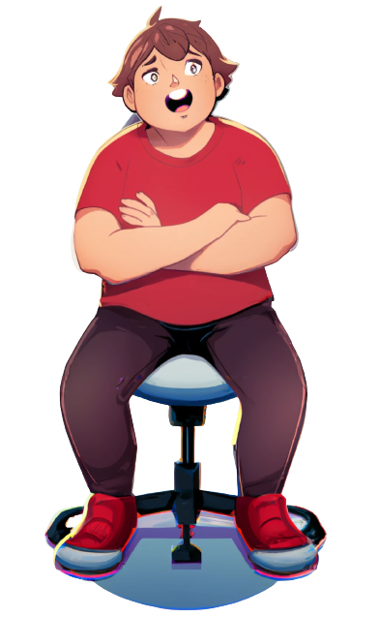
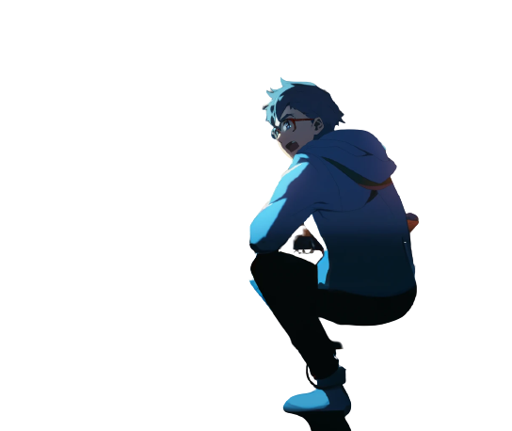
You really helped us
with the Lab work
Yea, we've clearly got
a better mark thanks to you

Slide 4
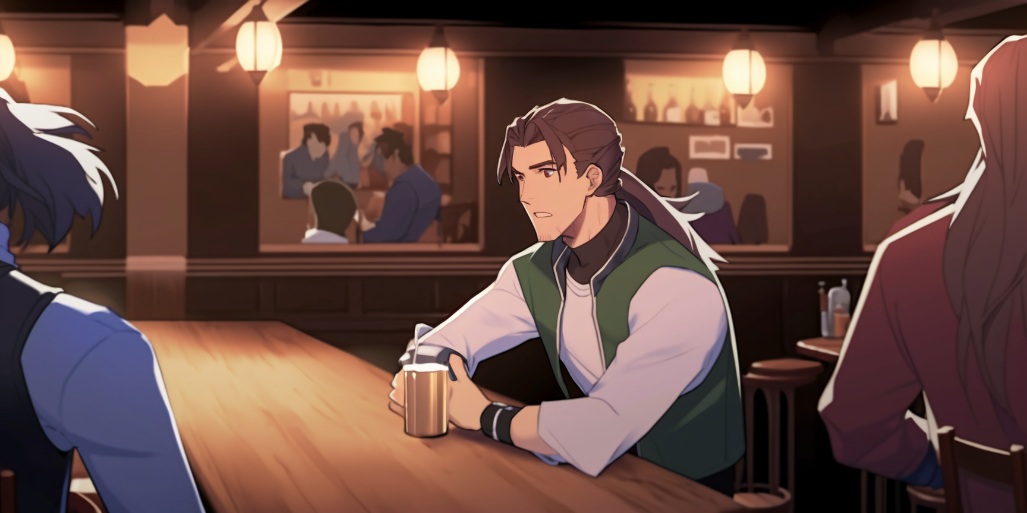
the mark of a single lab
is not that important
I've learned a
lot from Dany
You really helped us
with the Lab work
This makes my dream to fight
climate change more of a reality

Slide 5
From the last episode: the lecturer whose students
have the higest pass rate wins a terrible privilege:
Yeah, I feel like we can
take on anything now.

Slide 6
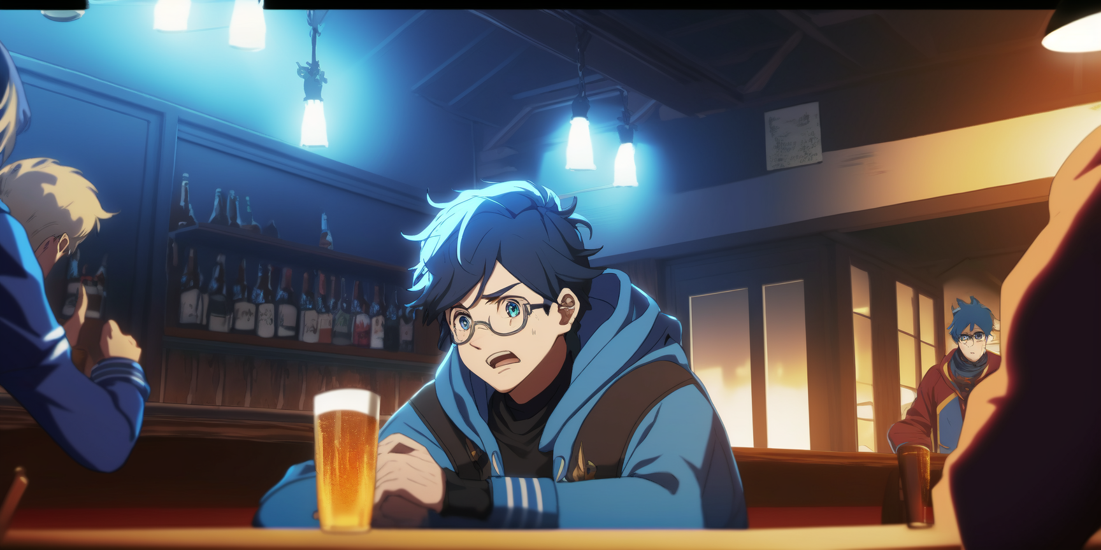
To fail any one student of their choice!
I want to help my friends pass the courses, but …
by helping them I'm making it easier
for Pupon to win
and then fail me.

Slide 7

What should I do?
Hehehe!

Slide 8
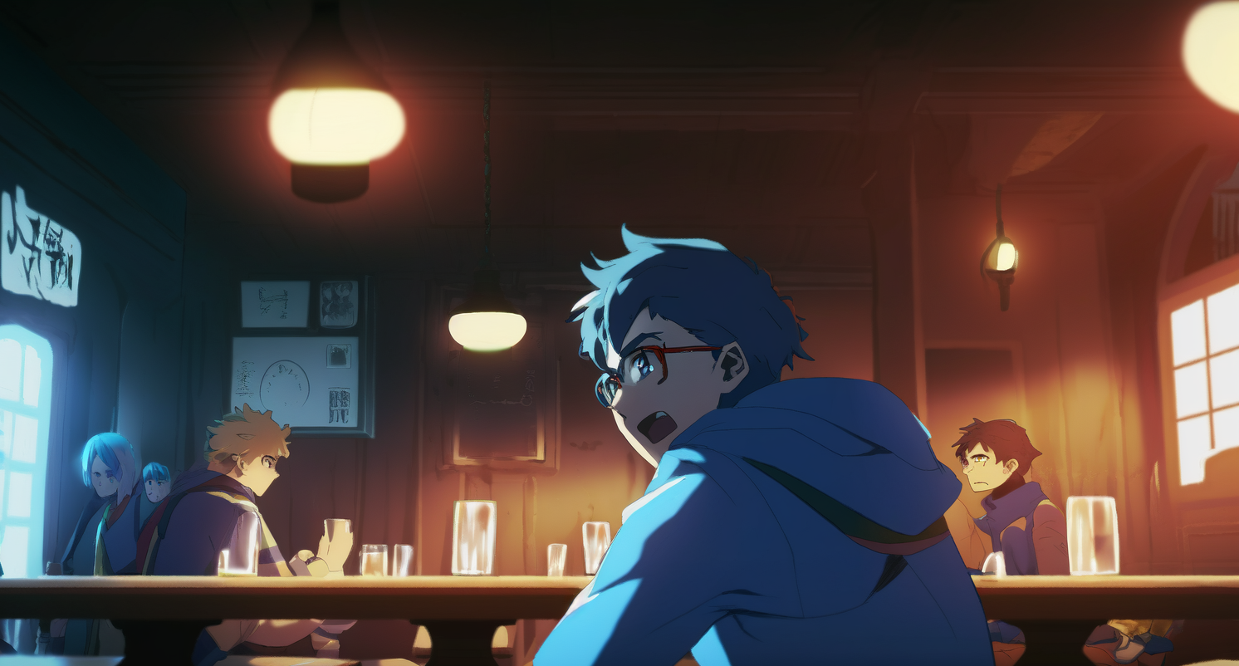
Should I stop helping my friends?
But then they might fail.
Should I continue?
But then I might fail.
I'll have to find a way to navigate this conflict of interests.

Slide 9
You know, I really
Wish we could get our
hands on Hanton's notes
Wait a minute, isn't that
Hanton over there?

Slide 10
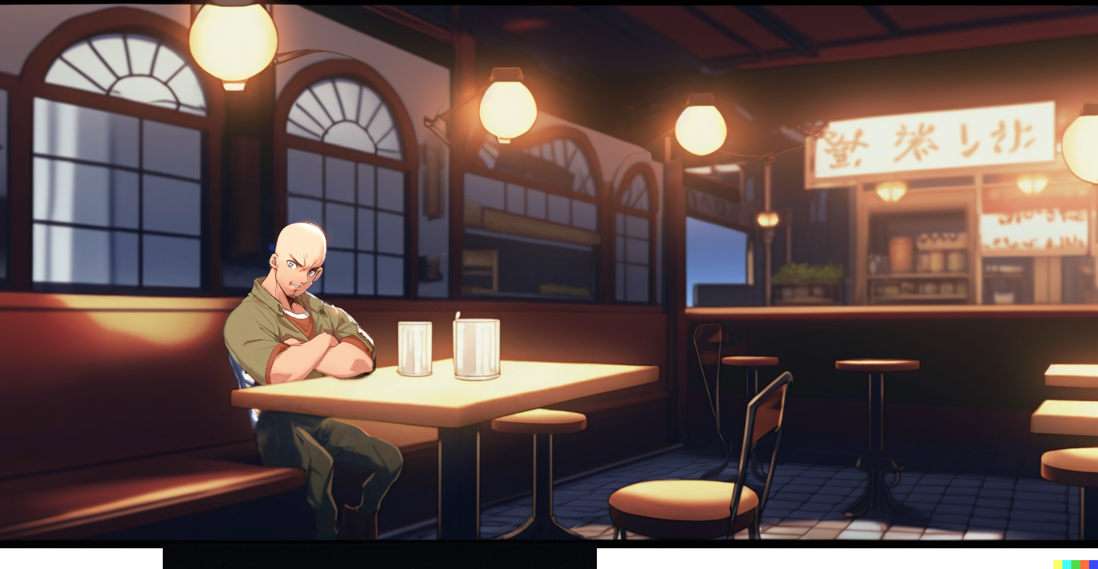
Indeed, Hanton was having dinner in the same place.

Slide 11
Let's go ask him for the notes
Easy!
I’m … I'm not sure if this is a good idea.

Slide 12
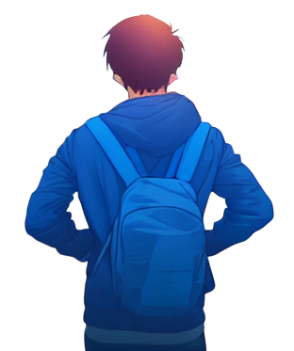
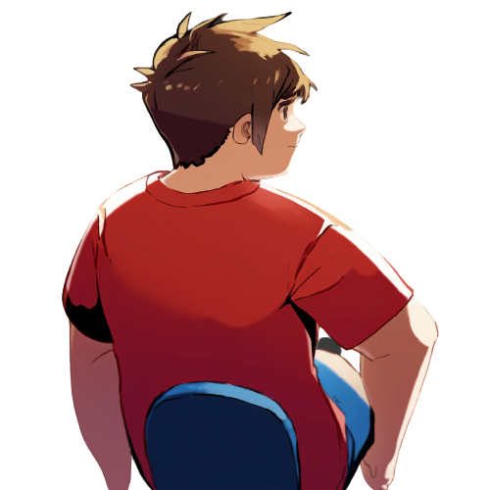
The trio approach Hanton's table
Hey Hanton,
we were wondering if we could
take a look at your notes

Slide 13

Hanton answers, looking arrogant and uninterested
My notes won't do you any good
They're just focused
on specific details
that won't help you learn,
… at least not at
your current level.

Slide 14
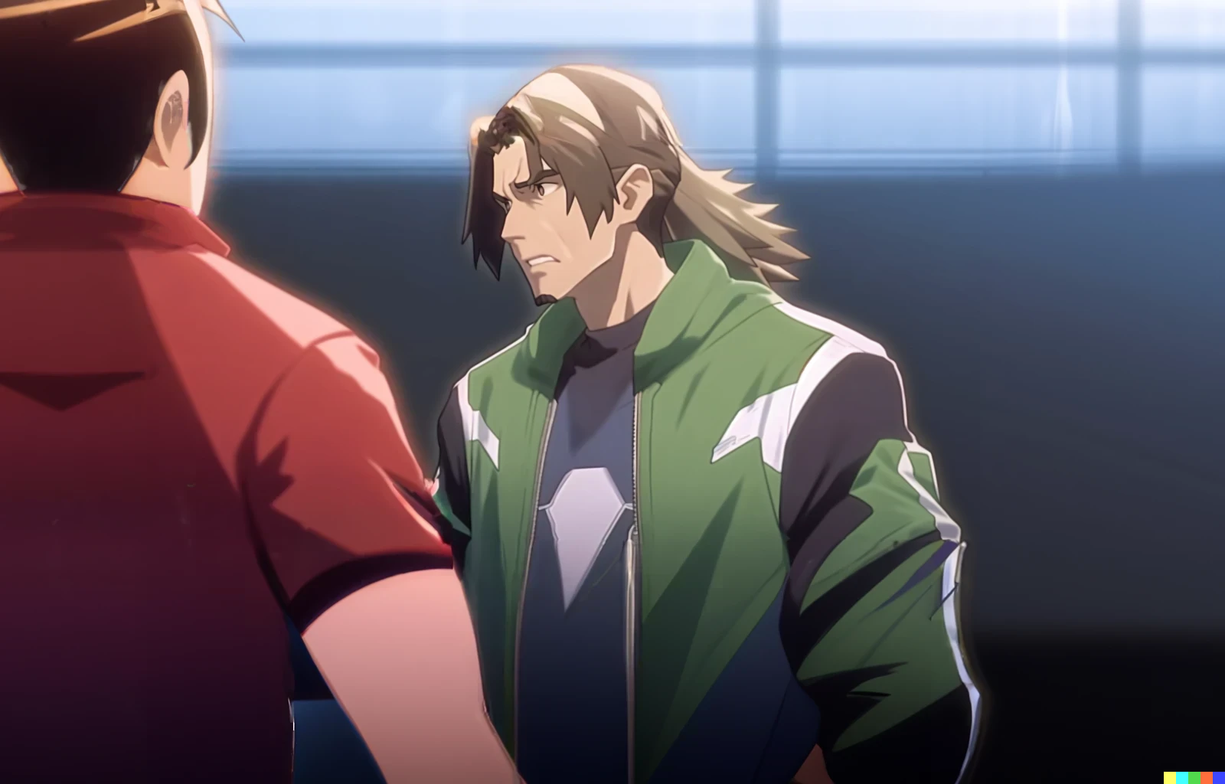
Riky is holding Tommy back
how dare you!
Relax, he is
not worth it

Slide 15
Is there something else
that I can do to help you?
Grrrr!
No thanks, you have done enough …

Slide 16
The trio return to their table, looking dejected
I don't know guys,
maybe we should just leave it
No way! We can still get those notes

Slide 17
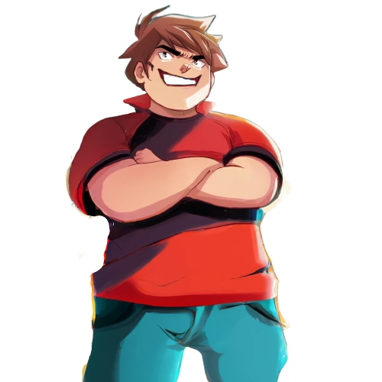
We should just act NOW then!

Slide 18
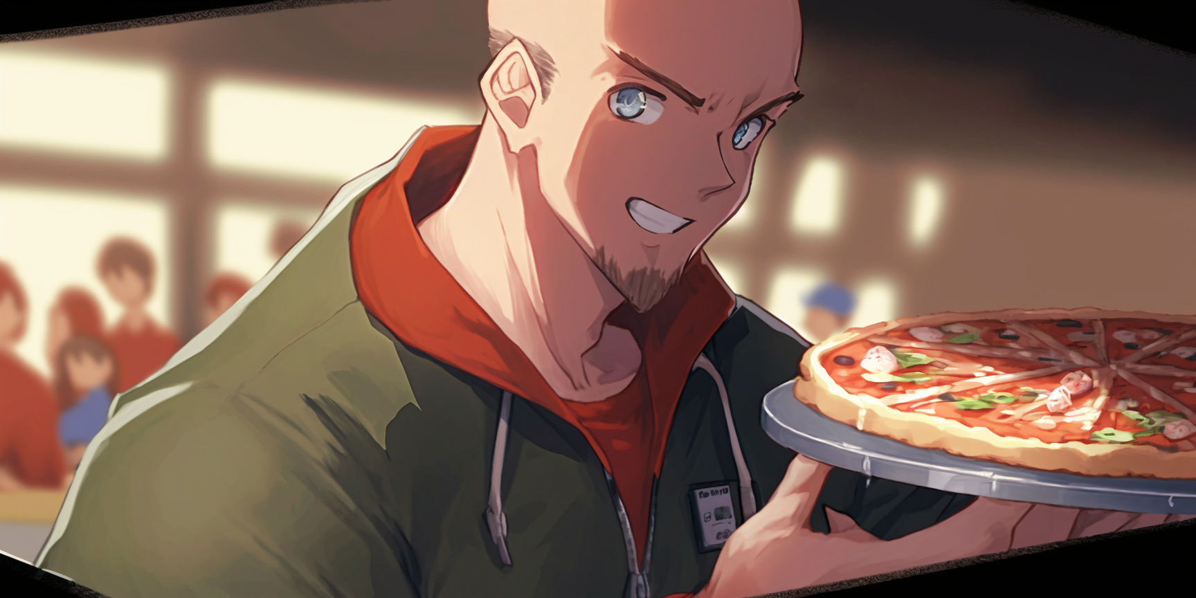
Hanton just got his pizza!
He is going to be distracted for a while

Slide 19
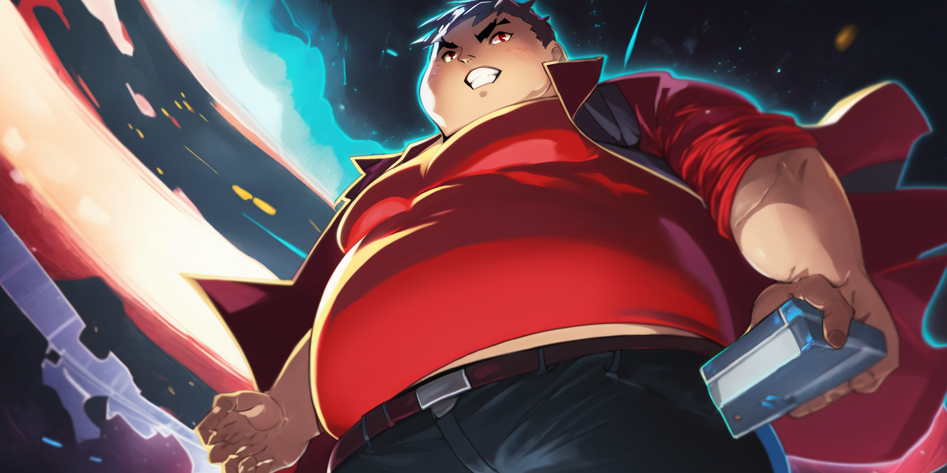
We can hurry up
back to the dorm
then sneak into his room,
and steal his notes!

Slide 20
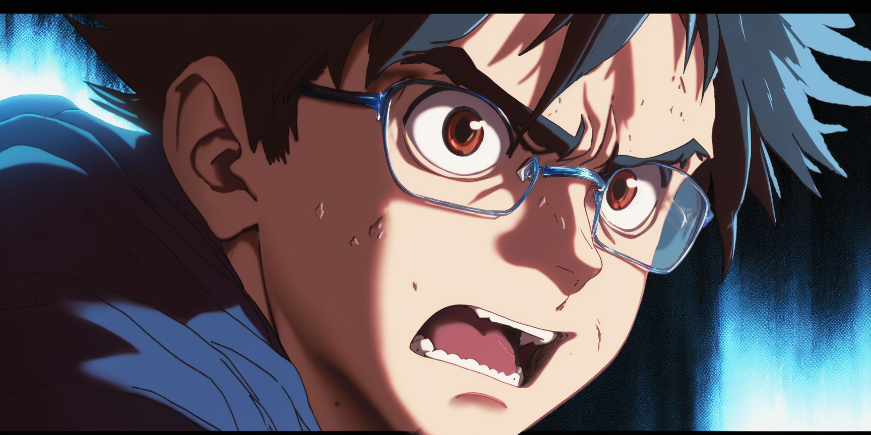
I want to help my friends,
but this feels wrong

Slide 21
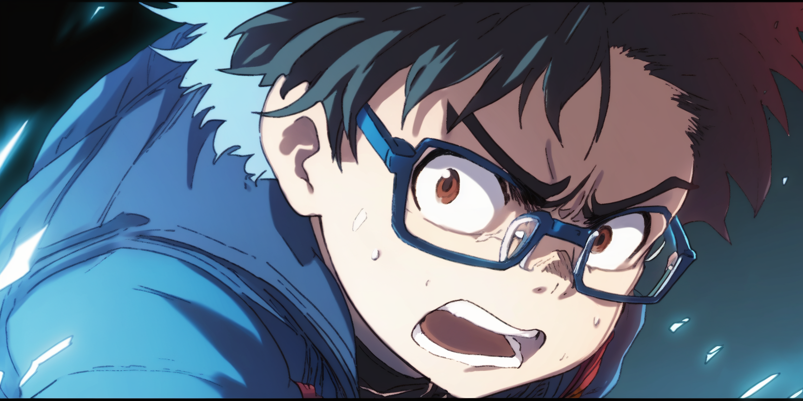
If I don't help them, they may try to get the notes anyway …
and they could get hurt in the process.

Slide 22
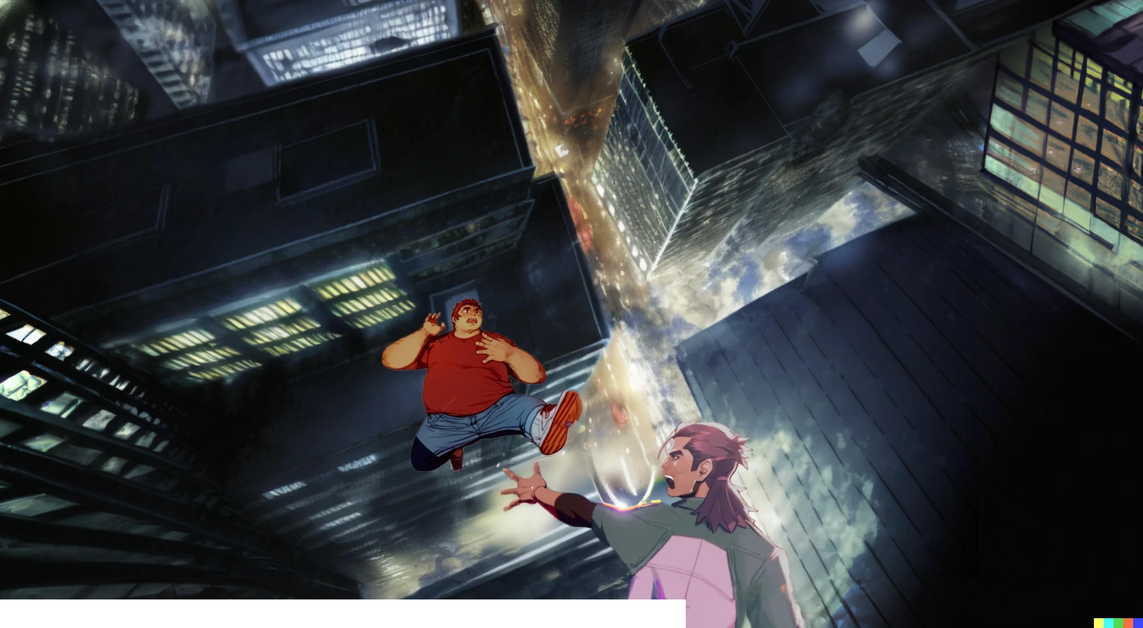
A
No! Riky,
NO!!
A
H
H

Slide 23
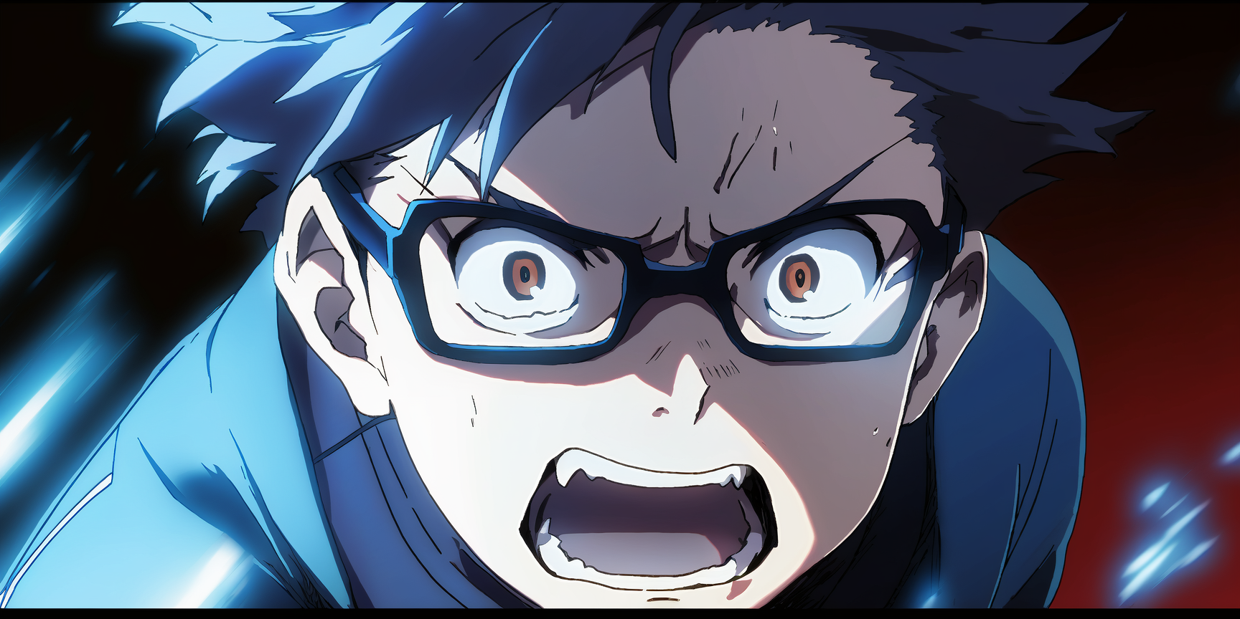

Slide 24
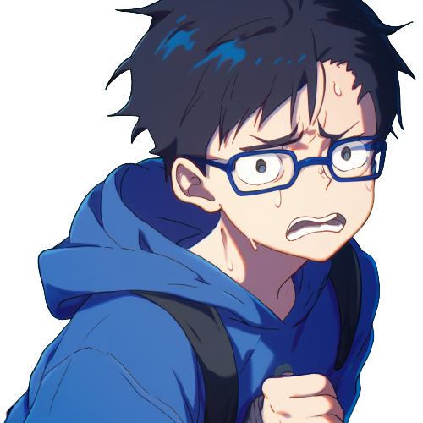
Ricky, …
he's so goofy.
I need to make sure they're safe
A
No! Riky,
NO!!
A
H
H

Slide 25
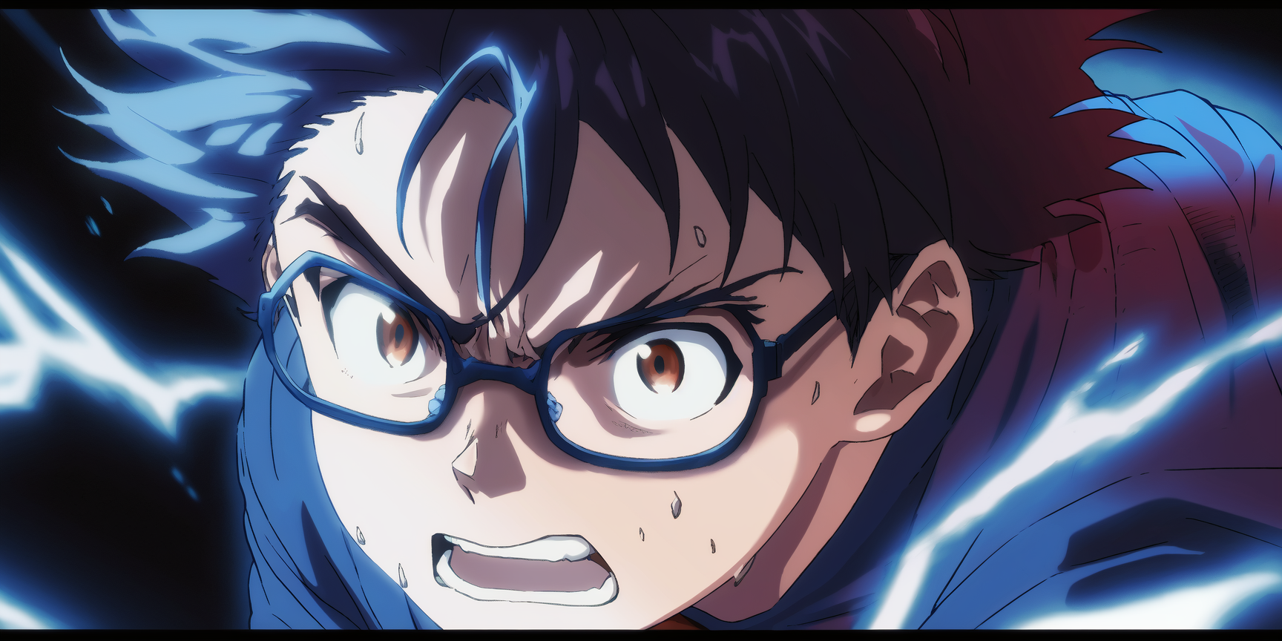
I'll go with them and make sure things don't get out of hand.

Slide 26
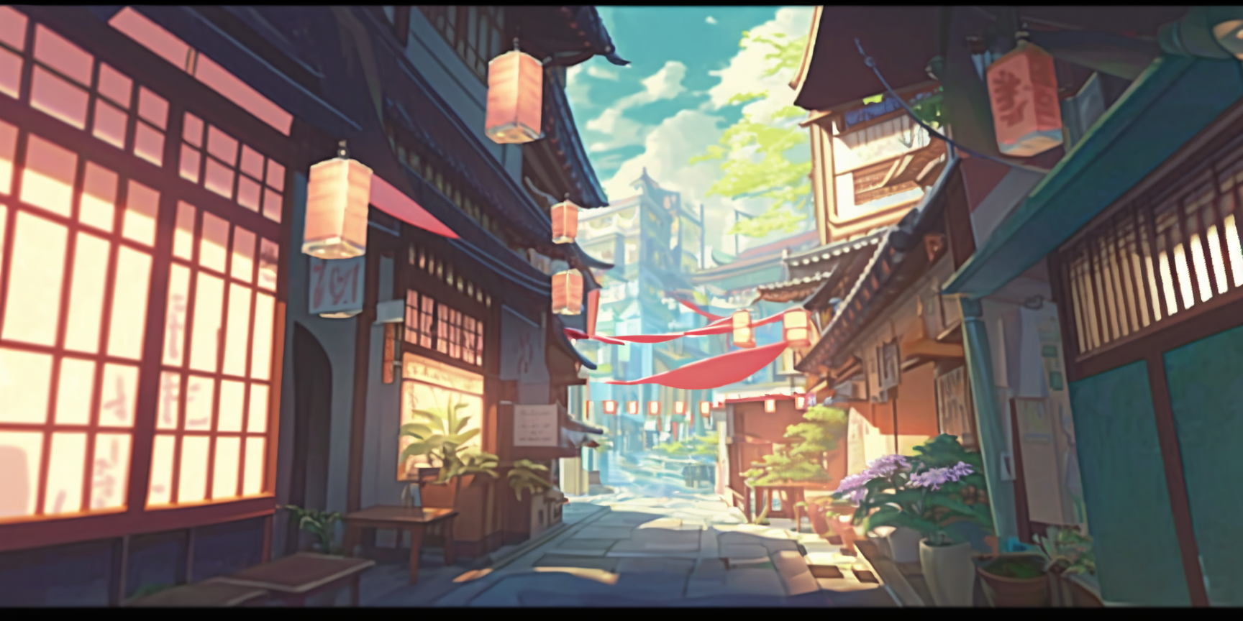
The sun is setting right now…
We shall hurry!

Slide 27
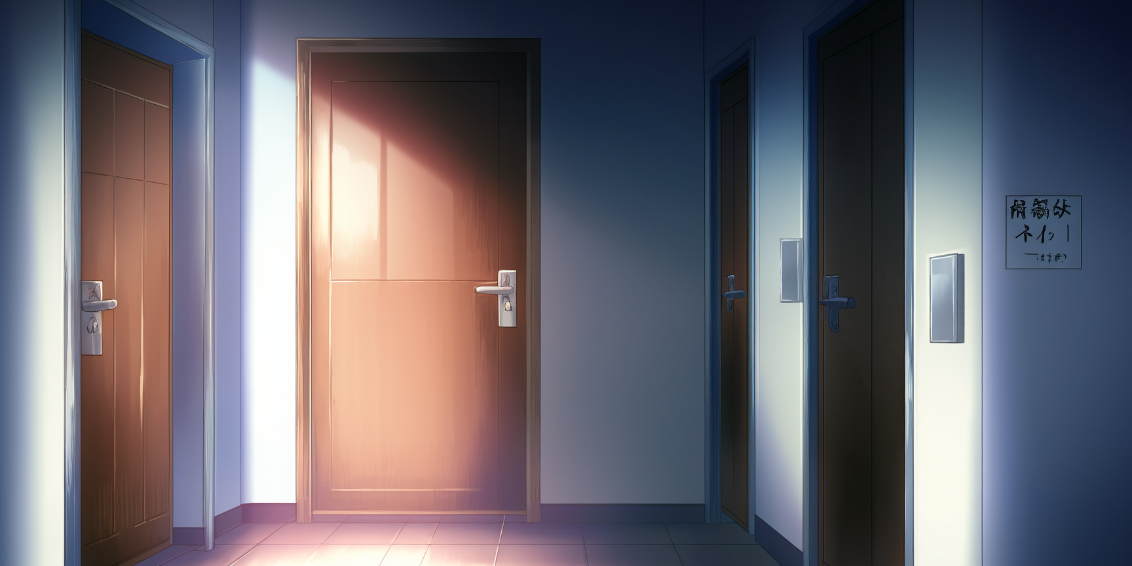
The door of Hanton, in the dormitory
I don't know about this. Breaking in to
steal someone's notes doesn't seem right.
Come on Dany, …
we just need to have a look
And we need those notes
to pass our courses
We will make photocopies
and then give them back

Slide 28
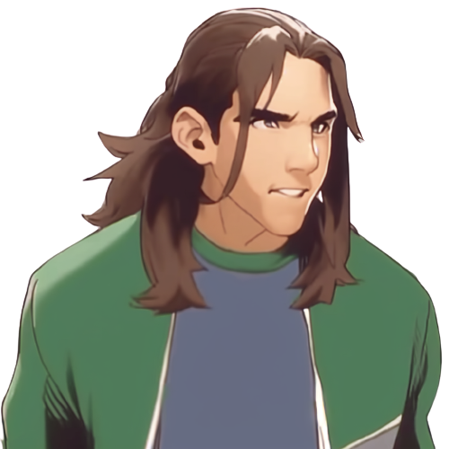
The door is locked!
If we try to break in,
other students might notice

Slide 29
I've got an idea
We can use the roof
and climb down using
a rope up to his window
I will do it!

Slide 30
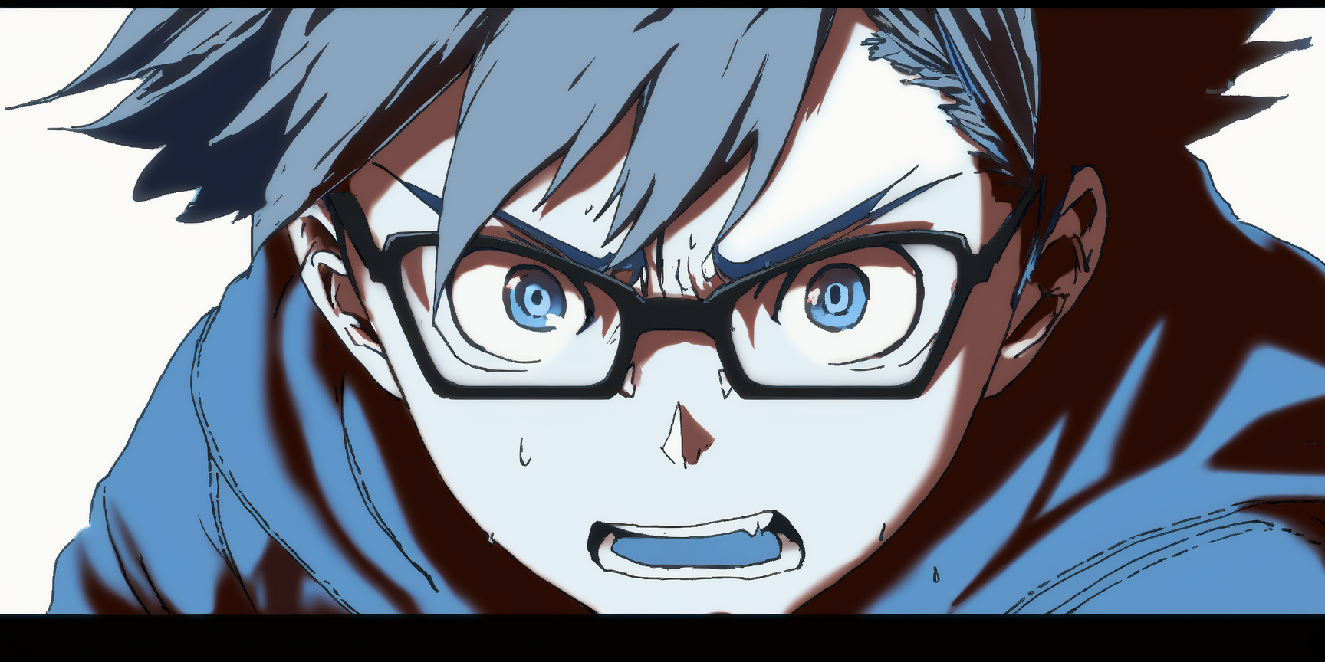
I don't want anything to happen to you guys
I … I'll go down the rope.

Slide 31
Are you sure, Dany?
with your thin arms
you would just fall down
I will go

Slide 32
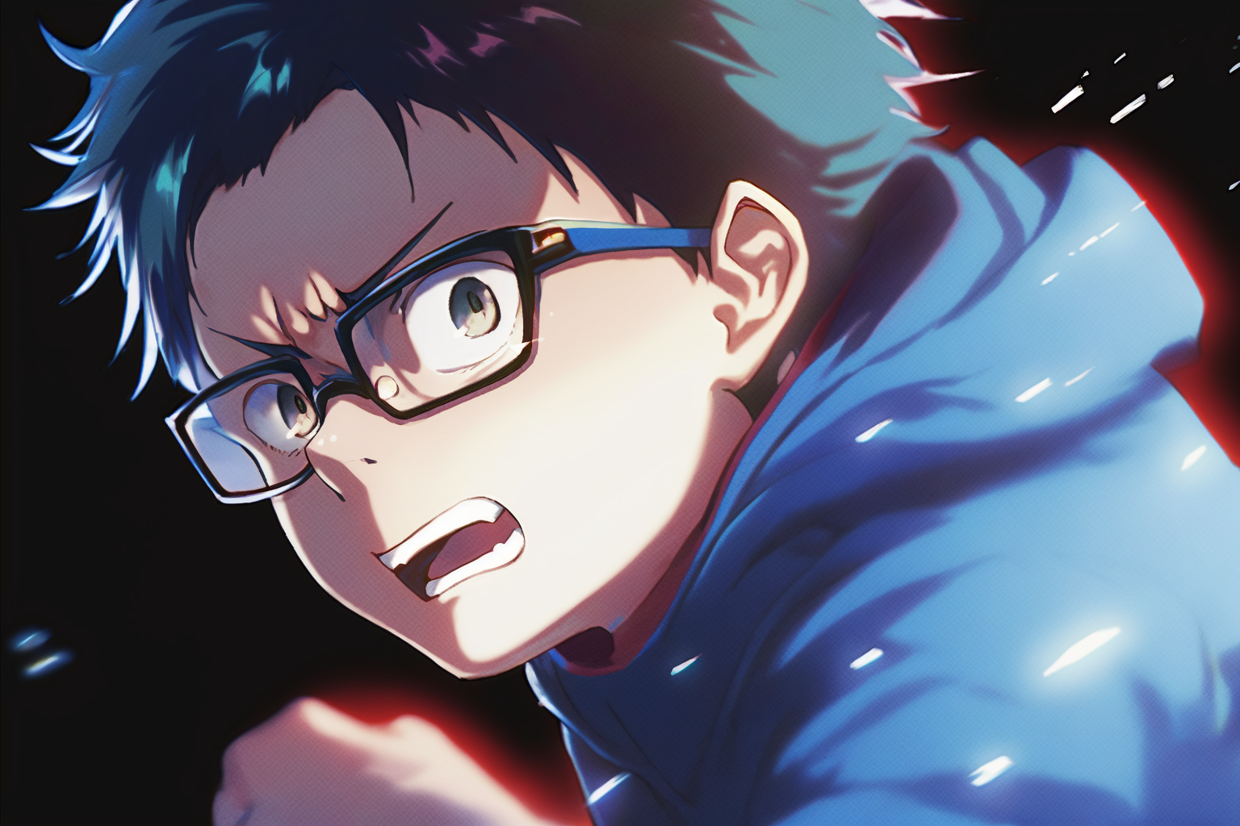
Ok, I'll keep a lookout, let's hurry!

Slide 33
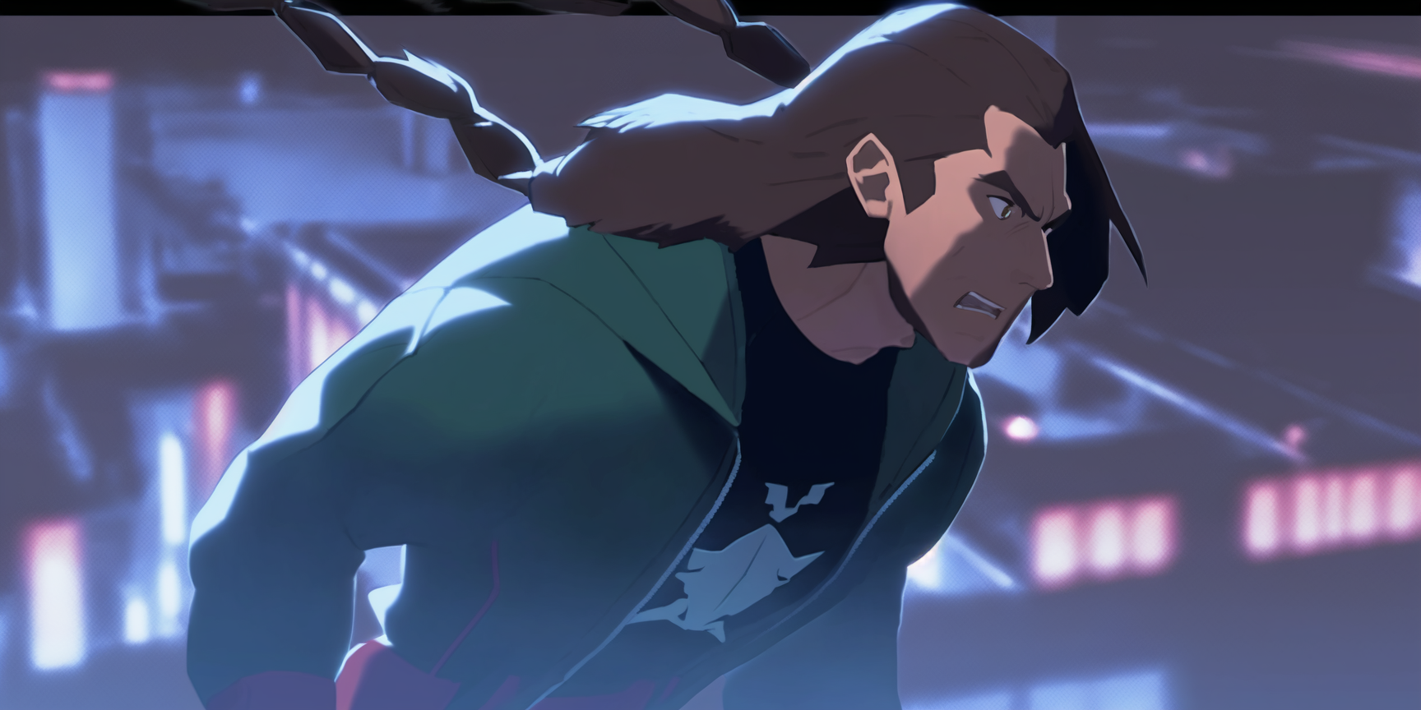
Wow, it is quite tall…

Slide 34
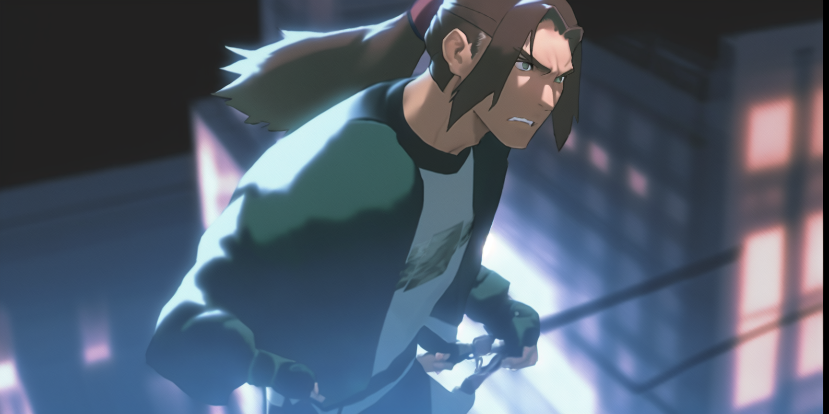
Please,
hold tight to the rope!

Slide 35
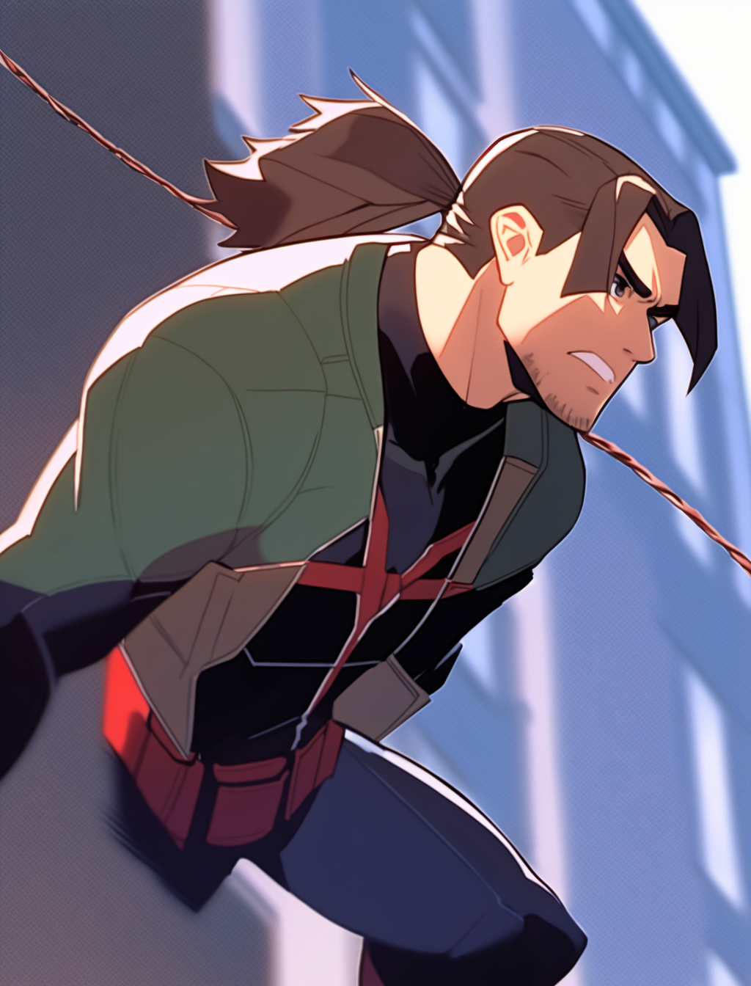
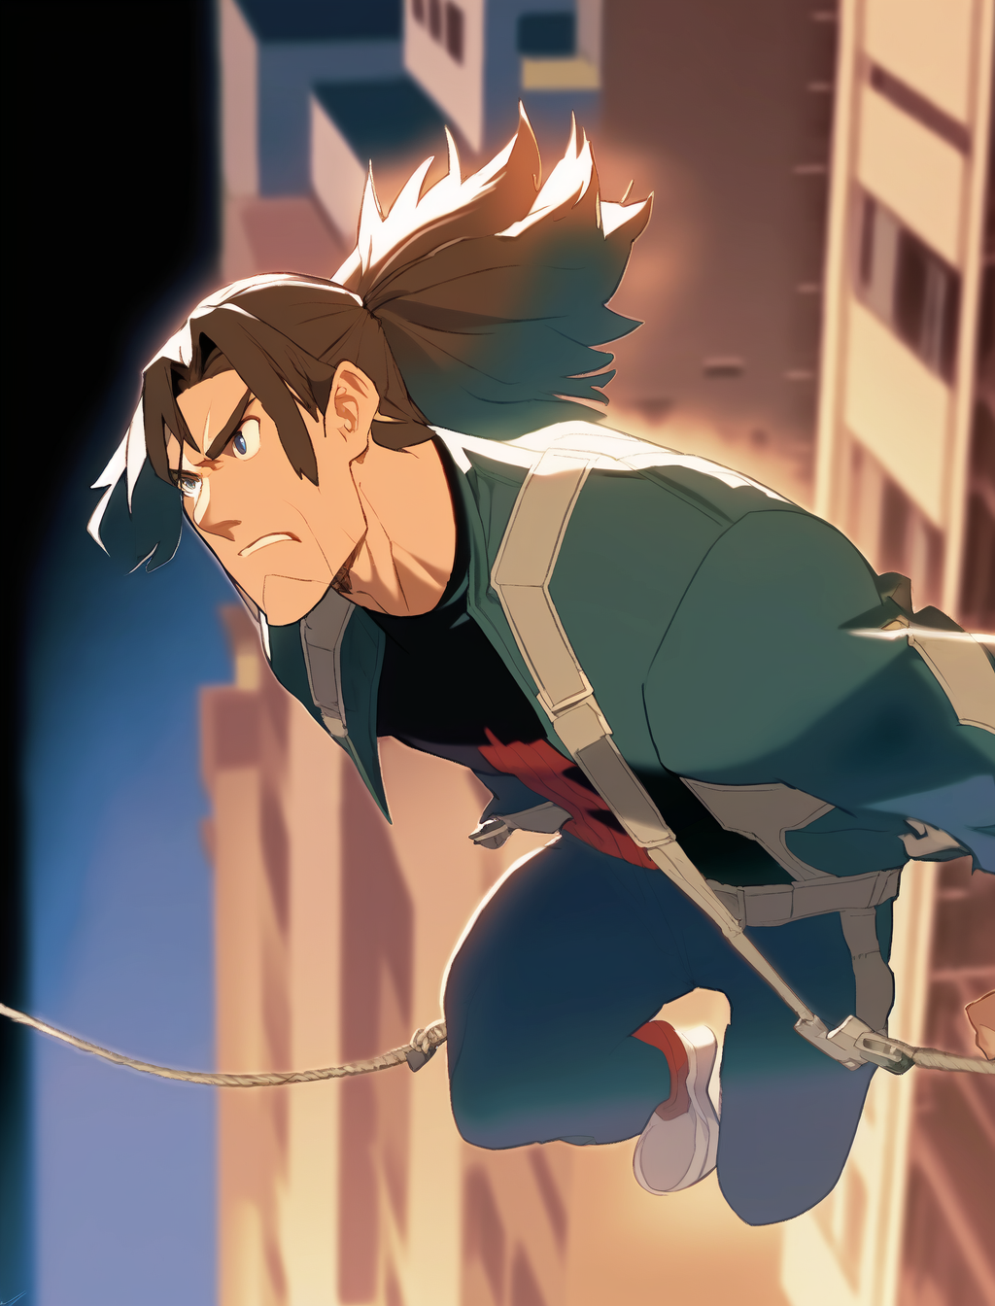

Slide 36
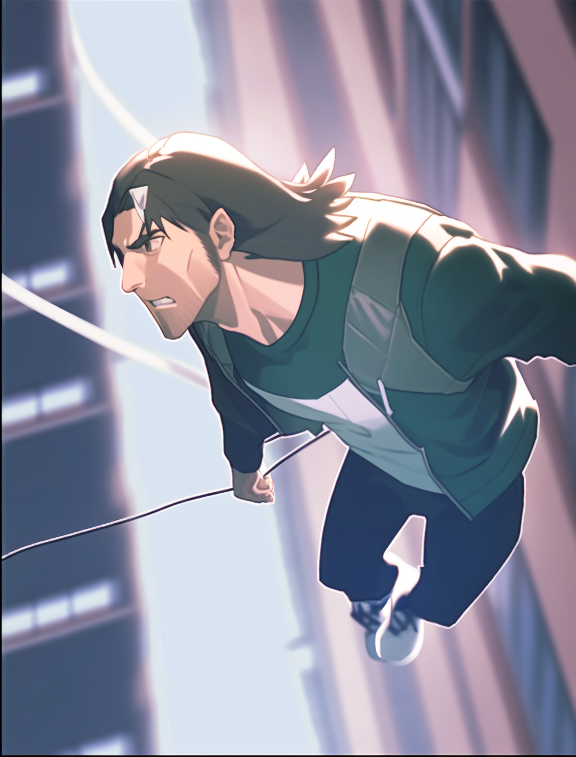
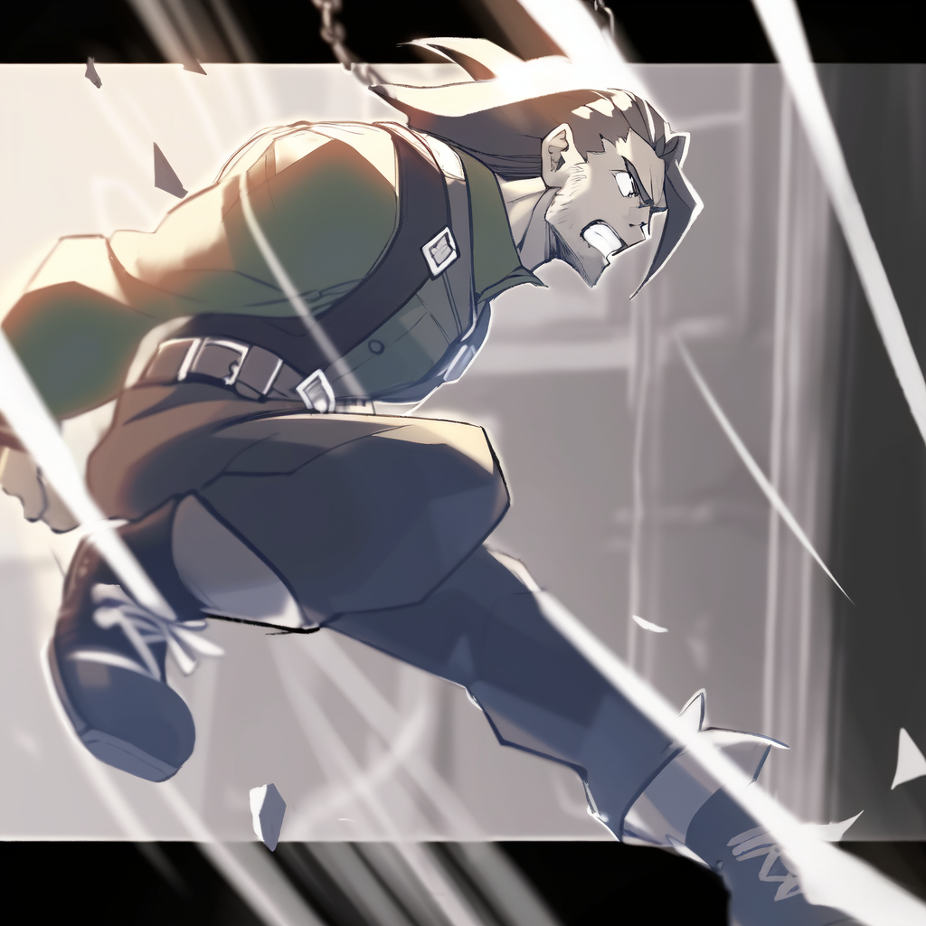
! CRASH !

Slide 37
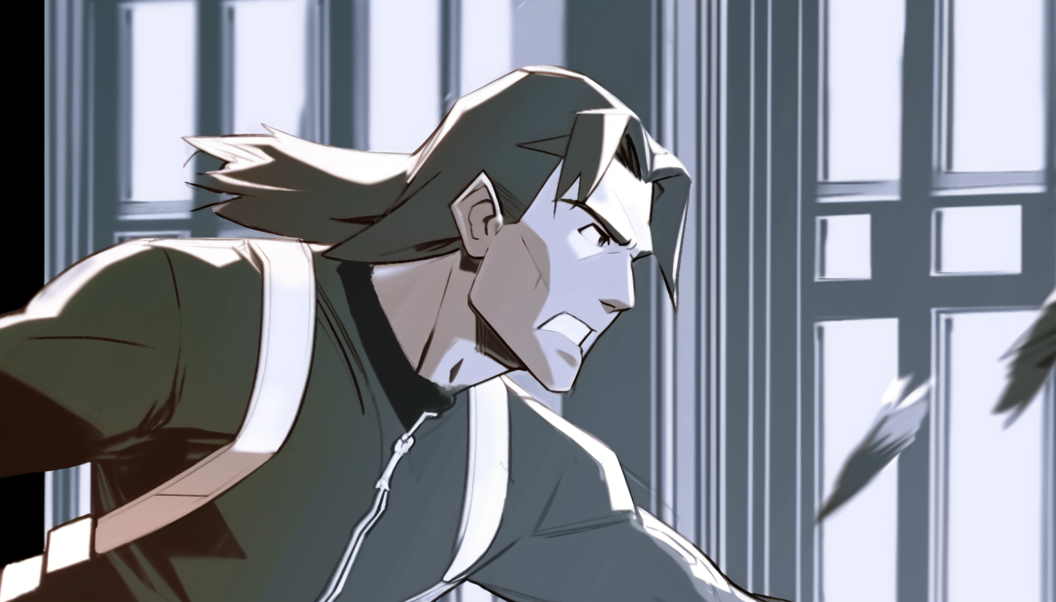
I’m in!
Now I can just
Open the door

Slide 38
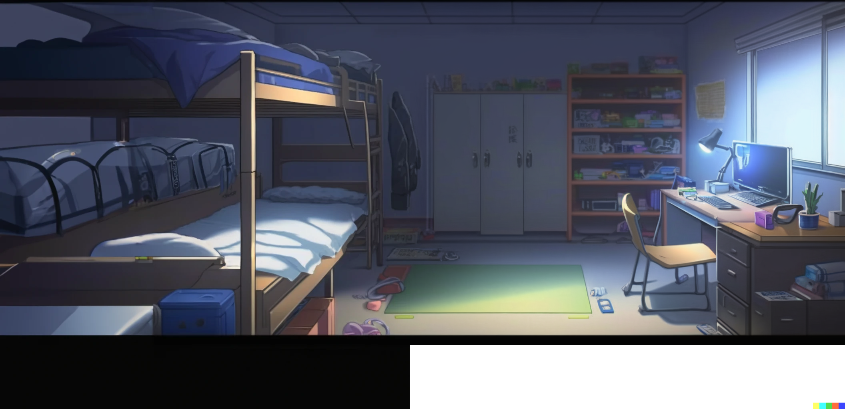
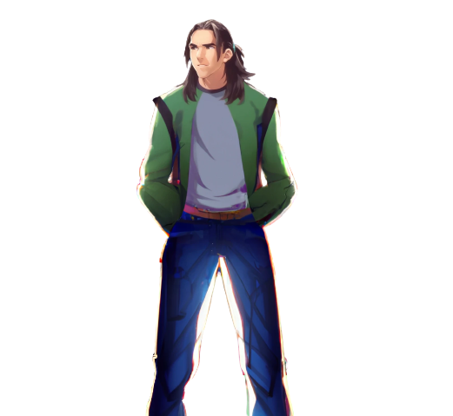
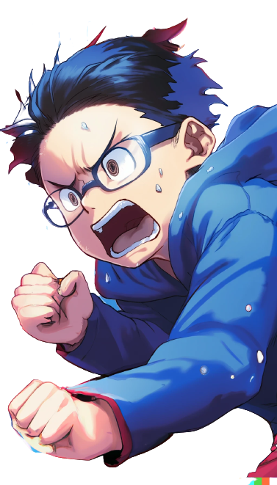
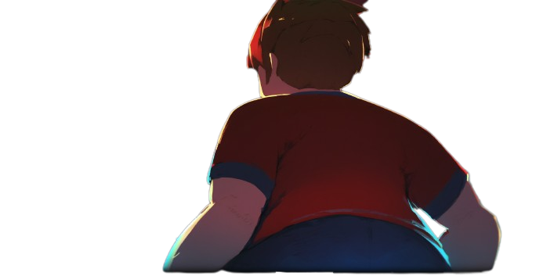
Inside of Hanton room
Here we are
Let’s hurry to find the notes!
Here they are!

Slide 39
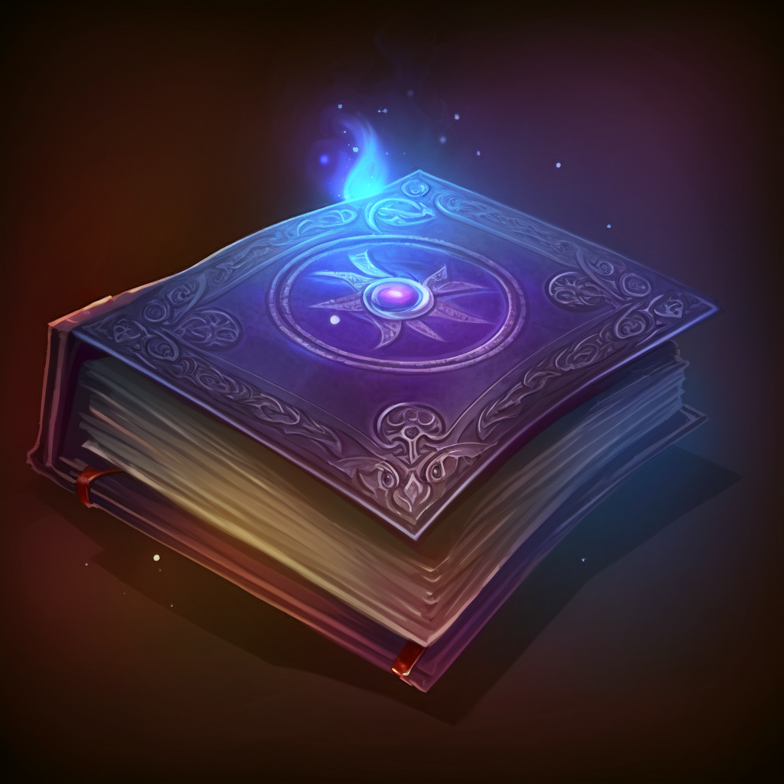
The notes!
The forbidden tome
of Hanton’s knowledge

Slide 40


Slide 41
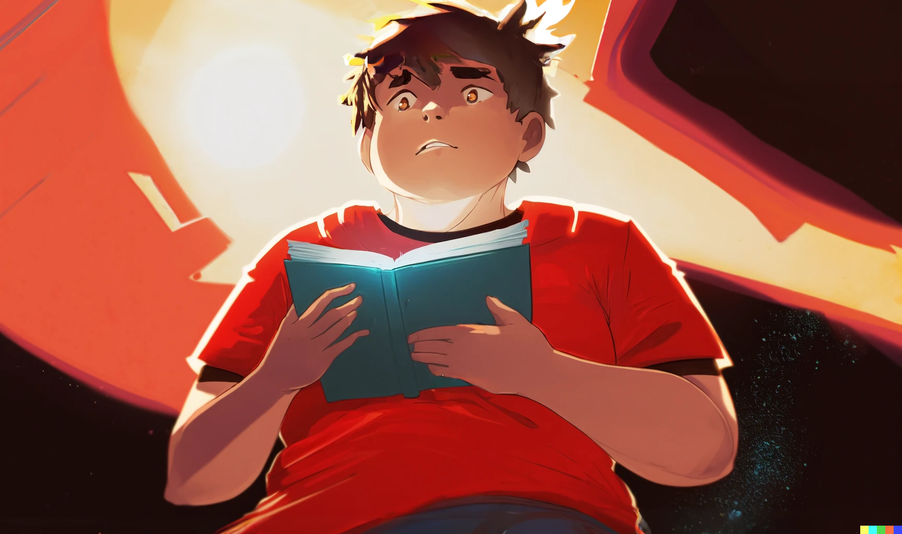
Oh, No!
I… I can not believe it!

Slide 42



