Slide 1
12334567890qwertyuiopasdfghjklzxcvbnm1234567890
12334567890qwertyuiopasdfghjklzxcvbnm1234567890

Slide 3
The alternative is
billions of deaths
… and it is with great difficulty that
I selected the student Charley
Dany, my man,
when have you ever
not aced a test?
Ricky, you ever think…
what if it's too much?
Programming, algorithms...
What if we can't keep up?
One for Harvard
and one for Oxford
You worry about
everything!
And so, with evident reluctance, the UN approved and established UPU,
Ultimate Programming University, granting it exceptional permissions.

Slide 5

I’m Elricho Pupon
Your Programming Professor
I’m Elricho Pupon
Your Programming Professor

Slide 6
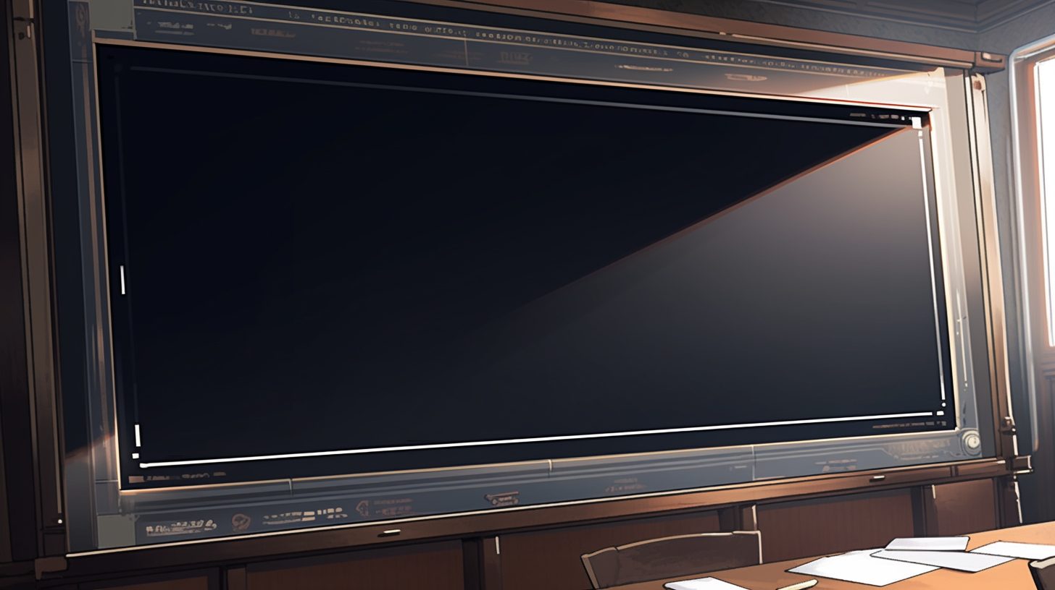



The course now continue with a single lecturer
I’m Elricho Pupon
Your Programming Professor
Computer Science
We divided the class in two,
to make it more manageable
You are the 100 students
assigned to me
The other 100 students are
assigned to Pumpkin

Slide 7
The course now continue with a single lecturer
I’m Elricho Pupon
Your Programming Professor
We divided the class in two,
to make it more manageable
You are the 100 students
assigned to me
The other 100 students are
assigned to Pumpkin

Slide 8
Places where the computer
store information.
They have names, called identifiers.
We can access them by their names,
and we can update the data stored in them
them by using the ‘equal’ sign.
For example, variables can contains numbers,
and we can use conventional operations on
those numbers, like addition, multiplication
or subtraction
Variables:

Slide 9


We can start
with some
example code
We are going to use Java, but
this would work the same in many
other languages

Slide 10

int a = 24;
int b = 50;
I’m declaring two variables,
“a” and “b”
They are both of type “int”
They are initialized with
values “24” and “50”

Slide 11

We can make “c”
using “a” and “b”
int a = 24;
int b = 50;
int c = a + b + 10;
Here “c” is “a” plus “b” plus “10”
As you can see, we can use
variable names or numbers

Slide 12

What is the value of “c”?
int a = 24;
int b = 50;
int c = a + b + 10;
assert c == ??;
It is the value of “a” plus
the value of “b” plus “10”

Slide 13
int a = 24;
int b = 50;
int c = a + b + 10;
assert c == 84; //24 + 50 + 10
That is, “84”
We write “assert” to mark expressions
that should hold true
Equals equals evaluates to “true” if the
left and the right value are the same, and “false”
otherwise

Slide 14

We can reuse a variable
instead of making a new one

Slide 15
What is this
code doing?
int a = 24;
int b = 50;
b = a + b + 10;
It is updating the value of “b”
using the result of the expression
on the right
That is, the equals is not like the
math equals, where we state that two terms
have the same value

Slide 16
int a = 24;
int b = 50;
b = a + b + 10;
//b = 24 + b + 10;
//b = 24 + 50 + 10;
//b = 74 + 10;
//b = 84;
assert b == 84;
Step by step
We can see that first “a” is read,
then “b” is read,
then the sum is computed,
finally “b” is updated

Slide 17
What if we wanted to swap the
content of two variables?

Slide 18

We can see our two variables
as our two hands,
holding one ball each.

Slide 19
We can see our two variables
as our two hands,
holding one ball each.
A hand only holds one ball;

Slide 20
We can see our two variables
as our two hands,
holding one ball each.
A hand only holds one ball;
taking the other ball, we have to
abandon the current ball, which
would fall down, out of reach.

Slide 21
In code
int a = 24;
int b = 50;
a = b;
assert a == 50;
assert b == 50; //we have lost the “24”

Slide 22
In code
int a = 24;
int b = 50;
a = b;
assert a == 50;
assert b == 50; //we have lost the “24”
it looks like this!

Slide 23
In code
int a = 24;
int b = 50;
a = b;
assert a == 50;
assert b == 50; //we have lost the “24”
it looks like this!
As soon as we update “a”, we lose
the original contents of “a”.

Slide 24
As you can see, we can’t do it!

Slide 25
As you can see, we can’t do it!
Not with only two variables!

Slide 26
As you can see, we can’t do it!
Not with only two variables!
We need a third variable to
help us!

Slide 27
We do it in 3 steps!
int a = 24;
int b = 50;
int tmp = a;
....
....
assert a == 50;
assert b == 24;

Slide 28
We do it in 3 steps!
int a = 24;
int b = 50;
int tmp = a; //step 1
....
....
assert a == 50;
assert b == 24;
First we save the original value of “a”
in a new temporary local variable

Slide 29
We do it in 3 steps!
int a = 24;
int b = 50;
int tmp = a; //step 1
a = b; //step 2
....
assert a == 50;
assert b == 24;
First we save the original value of “a”
in a new temporary local variable
Then we write the content of “b” into “a”.

Slide 30
We do it in 3 steps!
int a = 24;
int b = 50;
int tmp = a; //step 1
a = b; //step 2
b = tmp; //step 3
assert a == 50;
assert b == 24;
First we save the original value of “a”
in a new temporary local variable
Then we write the content of “b” into “a”.
Finally we write “tmp” into “b”.

Slide 31
We do it in 3 steps!
int a = 24;
int b = 50;
int tmp = a; //step 1
a = b; //step 2
b = tmp; //step 3
assert a == 50;
assert b == 24;
As you can see, it can not be done
with only two variables,
it is mathematically proven
You need a third variable!

Slide 32

Something is wrong here

Slide 33
Something is wrong here
I’m seeing stuff

Slide 34



What?

Slide 35
What?
I’m under water?

Slide 36
What?
I’m under water?
What is this?

Slide 37

Two glasses?
With water?

Slide 38
Two glasses?
With water?
But I’m already
underwater…

Slide 39
Two glasses?
With water?
But I’m already
underwater…
I must be dreaming

Slide 40
Anyway, can I swap
the content

Slide 41
Anyway, can I swap
the content
without
a third glass?

Slide 42


int a = 24;
int b = 50;
a = a + b;
If I add the two glasses in
the first one,

Slide 43
int a = 24;
int b = 50;
a = a + b;
If I add the two glasses in
the first one,
would the second
glass get empty?

Slide 44
int a = 24;
int b = 50;
a = a + b;
No! This does not
update b.

Slide 45
int a = 24;
int b = 50;
a = a + b;
No! This does not
update b.
Values are not shuffled
around, but duplicated

Slide 46

int a = 24;
int b = 50;
a = a + b;
That is, even after
adding a and b

Slide 47
int a = 24;
int b = 50;
a = a + b;
That is, even after
adding a and b
All the information
is still in the system.

Slide 48
int a = 24;
int b = 50;
a = a + b;
That is, even after
adding a and b
All the information
is still in the system.
b is still in b, and
the original a is just
the current a minus b

Slide 49
int a = 24;
int b = 50;
a = a + b;
b = a - b;
a = a - b;
So, in 3 steps,
I can swap them

Slide 51



Slide 52
! Sorry !

Slide 53

! Hey, .. !

Slide 54
! Hey, .. !
Dany, stop!
What are you doing?

Slide 55
Yes?
Do you have a question on
this basic material?

Slide 56


Slide 57
I CAN do it!

Slide 58
So you ‘CAN’ do..

Slide 59
So you ‘CAN’ do..
what is it, that you can do?

Slide 60
So you ‘CAN’ do..
what is it, that you can do?
I can swap the variables
without a third one!

Slide 61
Really?
Do not make us laugh.
It is mathematically proved.
It can not be done!

Slide 62
Really?
Do not make us laugh.
It is mathematically proved.
It can not be done!
Now, let’s move one
with the lecture..

Slide 63
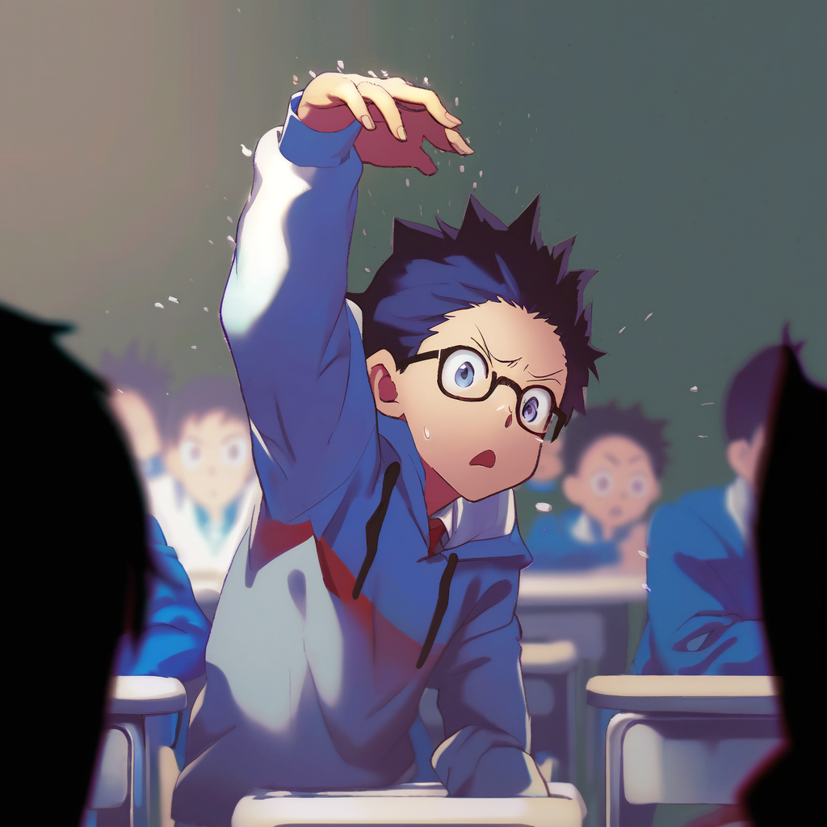
Dany, please stop!
It is going to get dangerous!

Slide 64

WRITE IT DOWN!

Slide 65
WRITE IT DOWN!
a = a + b;

Slide 66
WRITE IT DOWN!
a = a + b;
b = a - b;
a = a - b;

Slide 67
?.. are you...

Slide 68
?.. are you... for real.. ?

Slide 69
int a = 24;
int b = 50;
Ok then, .. I will write it doooown,

Slide 70
int a = 24;
int b = 50;
a = a+b;
Ok then, .. I will write it doooown,
So that I can shooow you that
it does nooot work

Slide 71
int a = 24;
int b = 50;
a = a+b;
b = a-b;
a = a-b;
Ok then, .. I will write it doooown,
So that I can shooow you that
it does nooot work
And then we will all laughs at you
and your dumb arrogance!

Slide 72
Ok class, give me some numbers
for a and b
int a = ??;
int b = ??;
a = a+b;//
b = a-b;//
a = a-b;//

Slide 73
Ok class, give me some numbers
for a and b
int a = 5;
int b = 12;
a = a+b;//
b = a-b;//
a = a-b;//
5
12

Slide 74
Ok class, give me some numbers
for a and b
int a = 5;
int b = 12;
a = a+b;//a = 5+12;//a = 17
b = a-b;//b =
a = a-b;//a =
With 5 and 12 we get… let’s see
step by step...
5
12

Slide 75
Ok class, give me some numbers
for a and b
int a = 5;
int b = 12;
a = a+b;//a = 5+12;//a = 17
b = a-b;//b = 17-12;//b = 5
a = a-b;//a =
With 5 and 12 we get… let’s see
step by step...
5
12

Slide 76

….
int a = 5;
int b = 12;
a = a+b;//a = 5+12;//a = 17
b = a-b;//b = 17-12;//b = 5
a = a-b;//a = 17-5;// a = 12
hahah

Slide 77
….
int a = 5;
int b = 12;
a = a+b;//a = 5+12;//a = 17
b = a-b;//b = 17-12;//b = 5
a = a-b;//a = 17-5;// a = 12
What, it worked?
hahah

Slide 78

Relax, it must be that those
two numbers are somehow special
int a = 5;
int b = 12;
a = a+b;//a = 5+12;//a = 17
b = a-b;//b = 17-12;//b = 5
a = a-b;//a = 17-5;// a = 12

Slide 79
Relax, it must be that those
two numbers are somehow special
int a = 5;
int b = 12;
a = a+b;//a = 5+12;//a = 17
b = a-b;//b = 17-12;//b = 5
a = a-b;//a = 17-5;// a = 12
Give me two other numbers,
this time one positive
and one negative

Slide 80

Please, stop this
and just solve
it symbolically

Slide 81
Such a good idea,
you must be very smart.

Slide 82
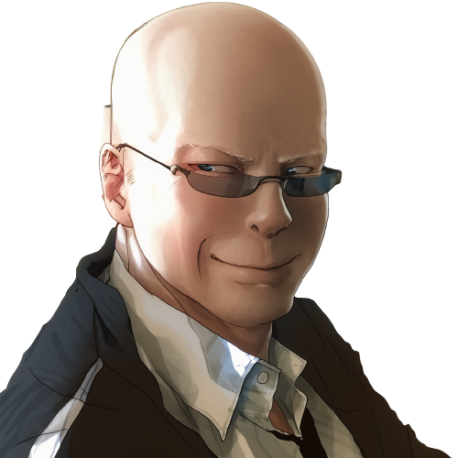
We can use use x and y for the
Original values of a and b.
int a = x;
int b = y;
a = a+b;//a = x+y;
b = a-b;//b =
a = a-b;//a =

Slide 83
We can use use x and y for the
Original values of a and b.
int a = x;
int b = y;
a = a+b;//a = x+y;
b = a-b;//b = (x+y)-y;//b = x
a = a-b;//a =
It can’t be!

Slide 84

int a = x;
int b = y;
a = a+b;//a = x+y;
b = a-b;//b = (x+y)-y;//b = x
a = a-b;//a = (x+y)-x;//a = y
Oh… but how...

Slide 85

int a = x;
int b = y;
a = a+b;//a = x+y;
b = a-b;//b = (x+y)-y;//b = x
a = a-b;//a = (x+y)-x;//a = y
It does not make sense,
there is even a repeated
“a” minus “b”…

Slide 86
int a = x;
int b = y;
a = a+b;//a = x+y;
b = a-b;//b = (x+y)-y;//b = x
a = a-b;//a = (x+y)-x;//a = y
It does not make sense,
there is even a repeated
“a” minus “b”…
Ah?
so it is
working!

Slide 87
int a = x;
int b = y;
a = a+b;//a = x+y;
b = a-b;//b = (x+y)-y;//b = x
a = a-b;//a = (x+y)-x;//a = y
It does not make sense,
there is even a repeated
“a” minus “b”…
Ah?
so it is
working!
LOL, I’m
never forgetting
this

Slide 88
int a = x;
int b = y;
a = a+b;//a = x+y;
b = a-b;//b = (x+y)-y;//b = x
a = a-b;//a = (x+y)-x;//a = y
It does not make sense,
there is even a repeated
“a” minus “b”…
How can the same expression
make two different results...

Slide 89

int a = x;
int b = y;
a = a+b;//a = x+y;
b = a-b;//b = (x+y)-y;//b = x
a = a-b;//a = (x+y)-x;//a = y
No, wait, there must be some other...

Slide 90

The bell rings in this crucial moment.
It is the end of the lecture

Slide 91

No, NO!

Slide 92


What have I done!

Slide 93


It is over!

Slide 94
It is over!
All the class was
laughing at him,
he is going to hate me!

Slide 95
It is over!
All the class was
laughing at him,
he is going to hate me!
He is going to make
my life a nightmare!

Slide 96

01: Invalid Metaphors

Slide 97

This is the end of
the first chapter.
What waits in the future
for our cowardly hero?

Slide 98

Credits
- Story: Marco
- Art: MidJourney, NijiJourney, Dall-E
- Composition: Marco
- Thanks to all my friends for
providing great feedback!

