Slide 1




Hey, boys,
I’m Sophia.
You are from our
class, right?
You are talking “generics”.
Can we join you?

Slide 2

Oh, yea! The more the merrier
I’m Tommy,
nice to meet you!

Slide 3
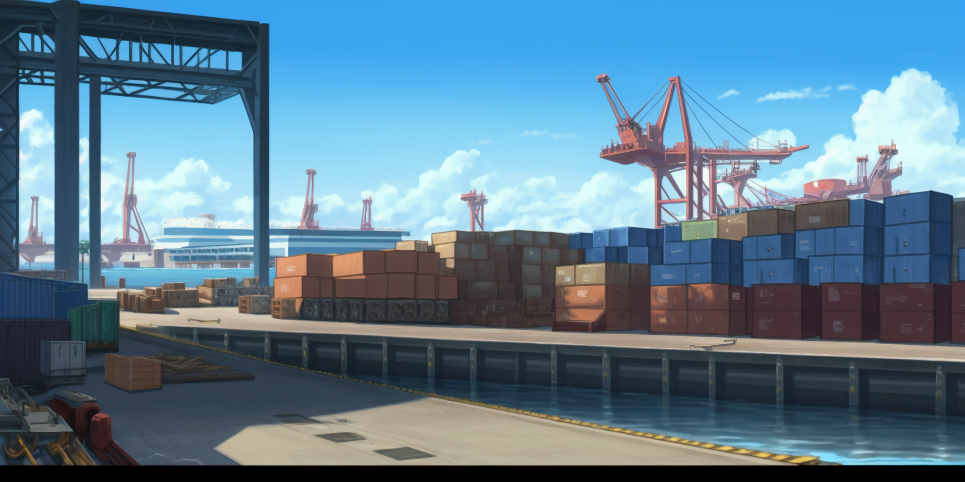

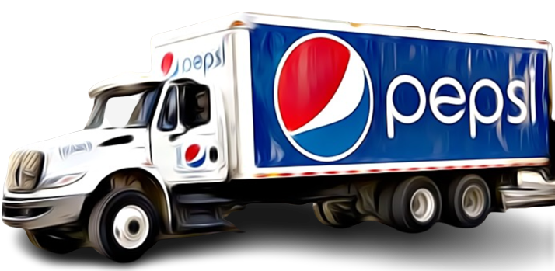
I’m Ricky
We were discussing
about that Pepsi truck
And what options there are to encode
it properly with generics

Slide 4
In the lecture Pupon
discussed inheritance
… using trucks as an
example, right?

Slide 5


There they are,
like in the lecture!
A cabover truck parked
near a bonneted truck!

Slide 6
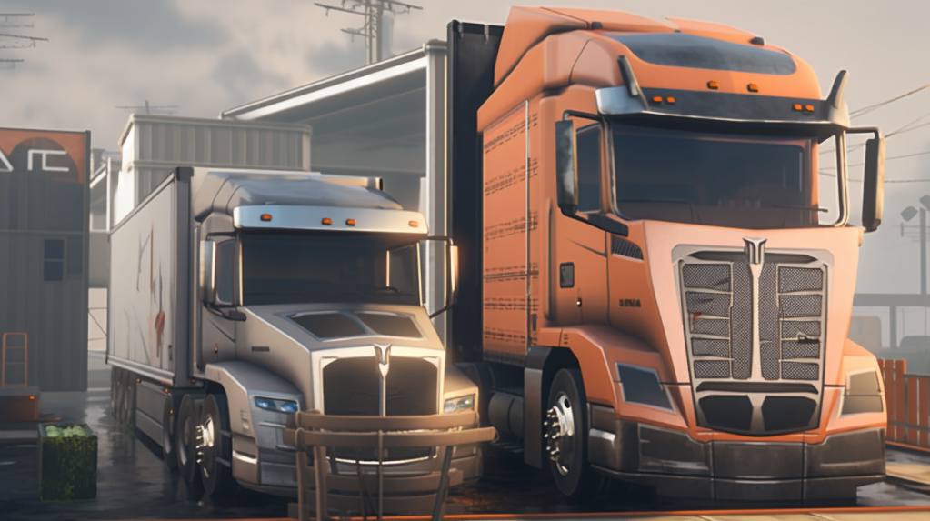

Here they are!
I’m Luna,
by the way

Slide 7


abstract class Truck<T>{
public abstract int aerodynamics();
public Cargo<List<T>> cargo(){ return cargo; }
public Point location(){ return location; }
public void location(Point p){ location=p; }
void driveToward(Point destination, int duration){
...
Point wayPoint=...;
location(wayPoint);
}
private Cargo<List<T>> cargo;
private Point location;
Truck(Point p, Cargo<List<T>> c){
location=p; cargo=c;
}
}
This is the code,
as shown in
the lecture
Can you understand this code?
Do you think it is the best way to handle this?
The main objective is to reuse the ‘driveToward’
method in Bonneted and CabOver without having to duplicate it.
But, ‘driveToward’ may have to use ‘aerodynamics’ inside;
and the aerodynamics of bonnetted and cabover trucks are different
‘Aerodynamics’ is just an example, there could be
more complex differences
class Bonneted<T> extends Truck<T>{
Bonneted(Point p, Cargo<List<T>> c){
super(p,c);
}
public int aerodynamics(){ ... }
}
class CabOver<T> extends Truck<T>{
CabOver(Point p, Cargo<List<T>> c){
super(p,c);
}
public int aerodynamics(){ ... }
}

Slide 8

Wow, that is exactly
Pupon code
You must be very fast
at taking notes!

Slide 9

Er… no,
I can’t write
that fast.
You see, Luna has
photographic memory.
She wrote it down
right now
just for our sake.

Slide 10


You are Dany right?
The guy that squashed
Pupon the first day.
Surely you must have
some tricks up
your sleeves too.
I’m Emma.
If you are planning to
get in trouble again,
do NOT involve me

Slide 11
Talking about trouble…
Miss Pumpkin also
had a similar example
But the code looks
completely different!

Slide 12

How can you access
Pumpkin’s notes?!
We are Pupon students,
so UPU rules prevents
us to follow the lectures
of Pumpkin
But.. how?
Oh, I just snatched them!

Slide 13


You did what?
This is very serious!
Again? After all the mess
when we stole Hanton notes?

Slide 14

Wait…
Wow…
So, you want to see
them or not?
This is not even
the first time?

Slide 15



Hey Tommy,
how did you snatch
them this time?
I have a man
inside the other class

Slide 16

Wow, you sound
like a mafia boss
But you are just saying that
your friend in the other class
shared their notes with you

Slide 17

Those notes are going to be precious!
The final exam is coming soon and
it will be written half and half,
by both Pupon and Pumpkin

Slide 18

Come on,
just show us the
notes already!

Slide 19

Here they are!
Get ready for
the surprise!

Slide 20

interface Truck<Self,T>{
int aerodynamics();
CargoC<List<T>> cargo();
Point location();
Self withLocation(Point p);
default Self driveToward(Point destination, int duration){
...
Point wayPoint=...;
return withLocation(wayPoint);
}
}
record Bonneted<T>
(Point location, CargoC<List<T>> cargo) implements Truck<Bonneted<T>,T>{
public Bonneted<T> withLocation(Point p){ return new Bonneted<>(p,cargo); }
public int aerodynamics(){ ... }
}
record CabOver<T>
(Point location, CargoC<List<T>> cargo) implements Truck<CabOver<T>,T>{
public CabOver<T> withLocation(Point p){ return new CabOver<>(p,cargo); }
public int aerodynamics(){ ... }
}
Pumpkin code

Slide 21

abstract class Truck<T>{
public abstract int aerodynamics();
public Cargo<List<T>> cargo(){ return cargo; }
public Point location(){ return location; }
public void location(Point p){ location=p; }
void driveToward(Point destination, int duration){
...
Point wayPoint=...;
location(wayPoint);
}
private Cargo<List<T>> cargo;
private Point location;
Truck(Point p, Cargo<List<T>> c){ location=p; cargo=c; }
}
class Bonneted<T> extends Truck<T>{
Bonneted(Point p, Cargo<List<T>> c){ super(p,c); }
public int aerodynamics(){ ... }
}
class CabOver<T> extends Truck<T>{
CabOver(Point p, Cargo<List<T>> c){ super(p,c); }
public int aerodynamics(){ ... }
}
Pupon code

Slide 22



interface Truck<Self,T>{
int aerodynamics();
CargoC<List<T>> cargo();
Point location();
Self withLocation(Point p);
default Self driveToward(Point destination, int duration){
...
Point wayPoint=...;
return withLocation(wayPoint);
}
}
record Bonneted<T>
(Point location, CargoC<List<T>> cargo) implements Truck<Bonneted<T>,T>{
public Bonneted<T> withLocation(Point p){ return new Bonneted<>(p,cargo); }
public int aerodynamics(){ ... }
}
record CabOver<T>
(Point location, CargoC<List<T>> cargo) implements Truck<CabOver<T>,T>{
public CabOver<T> withLocation(Point p){ return new CabOver<>(p,cargo); }
public int aerodynamics(){ ... }
}
abstract class Truck<T>{
public abstract int aerodynamics();
public CargoC<List<T>> cargo(){ return cargo; }
public Point location(){ return location; }
public void location(Point p){ location=p; }
void driveToward(Point destination, int duration){
...
Point wayPoint=...;
location(wayPoint);
}
private CargoC<List<T>> cargo;
private Point location;
Truck(Point p, CargoC<List<T>> c){ location=p; cargo=c; }
}
class Bonneted<T> extends Truck<T>{
Bonneted(Point p, CargoC<List<T>> c){ super(p,c); }
public int aerodynamics(){ ... }
}
class CabOver<T> extends Truck<T>{
CabOver(Point p, CargoC<List<T>> c){ super(p,c); }
public int aerodynamics(){ ... }
}
Pumpkin code
Pupon code
Can you understand the difference in these two approaches?
Do you think one is better then the other?
One of these two is not as usable as it should.
Which one? Why?
It looks like they are using
completely different languages
But… how can it be?
They are modeling exactly
the same concept!
Wow, this is
unexpected

Slide 23
interface Truck<Self,T>{
int aerodynamics();
CargoC<List<T>> cargo();
Point location();
Self withLocation(Point p);
default Self driveToward(Point destination, int duration){
...
Point wayPoint=...;
return withLocation(wayPoint);
}
}
record Bonneted<T>
(Point location, CargoC<List<T>> cargo) implements Truck<Bonneted<T>,T>{
public Bonneted<T> withLocation(Point p){ return new Bonneted<>(p,cargo); }
public int aerodynamics(){ ... }
}
record CabOver<T>
(Point location, CargoC<List<T>> cargo) implements Truck<CabOver<T>,T>{
public CabOver<T> withLocation(Point p){ return new CabOver<>(p,cargo); }
public int aerodynamics(){ ... }
}
abstract class Truck<T>{
public abstract int aerodynamics();
public CargoC<List<T>> cargo(){ return cargo; }
public Point location(){ return location; }
public void location(Point p){ location=p; }
void driveToward(Point destination, int duration){
...
Point wayPoint=...;
location(wayPoint);
}
private CargoC<List<T>> cargo;
private Point location;
Truck(Point p, CargoC<List<T>> c){ location=p; cargo=c; }
}
class Bonneted<T> extends Truck<T>{
Bonneted(Point p, CargoC<List<T>> c){ super(p,c); }
public int aerodynamics(){ ... }
}
class CabOver<T> extends Truck<T>{
CabOver(Point p, CargoC<List<T>> c){ super(p,c); }
public int aerodynamics(){ ... }
}
Pumpkin code
Pupon code
If the six of us are to pass,
we need to learn
this stuff now!
I’ve now memorized both
versions but I can’t understand
why they are so different!
We are lost for words too.

Slide 24

This is it.

Slide 25

If I use my power,
I can understand that code
and teach them

Slide 26

And we could all pass

Slide 27

But if all of us pass

Slide 28

Pupon would likely
win the challenge

Slide 29

And if he wins,
he will just …

Slide 30

Fail me!

Slide 31

However, I cannot just …

Slide 32

make other people fail
so that I can pass

Slide 34

I will do it!

Slide 35

Power of
Angelic explanations

Slide 36


Activate

Slide 37

It is do or die time!

Slide 38

It looks like he is in
some sort of trance
Hey Dany,
are you… ok?
Oh, not again!
He will be ok,
he just panics easily
Hey Dany,
snap out of it!

Slide 39

Yes, snapshots!
It is all about snapshots!
Now I can explain
that code!

Slide 40

interface Truck<Self,T>{
int aerodynamics();
CargoC<List<T>> cargo();
Point location();
Self withLocation(Point p);
default Self driveToward(Point destination, int duration){
...
Point wayPoint=...;
return withLocation(wayPoint);
}
}
record Bonneted<T>
(Point location, CargoC<List<T>> cargo) implements Truck<Bonneted<T>,T>{
public Bonneted<T> withLocation(Point p){ return new Bonneted<>(p,cargo); }
public int aerodynamics(){ ... }
}
record CabOver<T>
(Point location, CargoC<List<T>> cargo) implements Truck<CabOver<T>,T>{
public CabOver<T> withLocation(Point p){ return new CabOver<>(p,cargo); }
public int aerodynamics(){ ... }
}
abstract class Truck<T>{
public abstract int aerodynamics();
public CargoC<List<T>> cargo(){ return cargo; }
public Point location(){ return location; }
public void location(Point p){ location=p; }
void driveToward(Point destination, int duration){
...
Point wayPoint=...;
location(wayPoint);
}
private CargoC<List<T>> cargo;
private Point location;
Truck(Point p, CargoC<List<T>> c){ location=p; cargo=c; }
}
class Bonneted<T> extends Truck<T>{
Bonneted(Point p, CargoC<List<T>> c){ super(p,c); }
public int aerodynamics(){ ... }
}
class CabOver<T> extends Truck<T>{
CabOver(Point p, CargoC<List<T>> c){ super(p,c); }
public int aerodynamics(){ ... }
}
Pumpkin code
Pupon code
Pumpkin is using interfaces and records,
while Pupon is using classes and abstract classes.
In interfaces the ‘public’ and ‘abstract’ keywords are
implicit, but in classes they are required.
Also, interfaces need this funny ‘default’ keyword to
implement methods.
Keywords ‘implements’ and ‘extends’ means the
same thing but they need to be used in specific locations

Slide 41

interface Truck<Self,T>{
int aerodynamics();
CargoC<List<T>> cargo();
Point location();
Self withLocation(Point p);
default Self driveToward(Point destination, int duration){
...
Point wayPoint=...;
return withLocation(wayPoint);
}
}
record Bonneted<T>
(Point location, CargoC<List<T>> cargo) implements Truck<Bonneted<T>,T>{
public Bonneted<T> withLocation(Point p){ return new Bonneted<>(p,cargo); }
public int aerodynamics(){ ... }
}
record CabOver<T>
(Point location, CargoC<List<T>> cargo) implements Truck<CabOver<T>,T>{
public CabOver<T> withLocation(Point p){ return new CabOver<>(p,cargo); }
public int aerodynamics(){ ... }
}
abstract class Truck<T>{
public abstract int aerodynamics();
public CargoC<List<T>> cargo(){ return cargo; }
public Point location(){ return location; }
public void location(Point p){ location=p; }
void driveToward(Point destination, int duration){
...
Point wayPoint=...;
location(wayPoint);
}
private CargoC<List<T>> cargo;
private Point location;
Truck(Point p, CargoC<List<T>> c){ location=p; cargo=c; }
}
class Bonneted<T> extends Truck<T>{
Bonneted(Point p, CargoC<List<T>> c){ super(p,c); }
public int aerodynamics(){ ... }
}
class CabOver<T> extends Truck<T>{
CabOver(Point p, CargoC<List<T>> c){ super(p,c); }
public int aerodynamics(){ ... }
}
Pumpkin code
Pupon code
The more I learn Java,
the more it looks like a
very inconsistent language
Yes it is. For our own understanding, lets remove
all the ‘public’, ‘abstract’ and ‘default’ keyword, and
replace ‘implements’ and ‘extends’ with just ‘:’

Slide 42
interface Truck<Self,T>{
int aerodynamics();
CargoC<List<T>> cargo();
Point location();
Self withLocation(Point p);
Self driveToward(Point dest, int duration){
...
Point wayPoint=...;
return withLocation(wayPoint);
}
}
record Bonneted<T>
(Point location, CargoC<List<T>> cargo) : Truck<Bonneted<T>,T>{
Bonneted<T> withLocation(Point p){return new Bonneted<>(p,cargo);}
int aerodynamics(){ ... }
}
record CabOver<T>
(Point location, CargoC<List<T>> cargo) : Truck<CabOver<T>,T>{
CabOver<T> withLocation(Point p){return new CabOver<>(p,cargo);}
int aerodynamics(){ ... }
}
class Truck<T>{
int aerodynamics();
CargoC<List<T>> cargo(){ return cargo; }
Point location(){ return location; }
void location(Point p){ location=p; }
void driveToward(Point dest, int duration){
...
Point wayPoint=...;
location(wayPoint);
}
private CargoC<List<T>> cargo;
private Point location;
Truck(Point p, CargoC<List<T>> c){location=p; cargo=c;}
}
class Bonneted<T> : Truck<T>{
Bonneted(Point p, CargoC<List<T>> c){ super(p,c); }
int aerodynamics(){ ... }
}
class CabOver<T> : Truck<T>{
CabOver(Point p, CargoC<List<T>> c){ super(p,c); }
int aerodynamics(){ ... }
}
Pumpkin code
Pupon code
Now we see more similarity between their code.
The most important one is that they both want to reuse the
‘driveToward’ implementation for both kinds of trucks.

Slide 43
interface Truck<Self,T>{
int aerodynamics();
CargoC<List<T>> cargo();
Point location();
Self withLocation(Point p);
Self driveToward(Point dest, int duration){
...
Point wayPoint=...;
return withLocation(wayPoint);
}
}
record Bonneted<T>
(Point location, CargoC<List<T>> cargo) : Truck<Bonneted<T>,T>{
Bonneted<T> withLocation(Point p){return new Bonneted<>(p,cargo);}
int aerodynamics(){ ... }
}
record CabOver<T>
(Point location, CargoC<List<T>> cargo) : Truck<CabOver<T>,T>{
CabOver<T> withLocation(Point p){return new CabOver<>(p,cargo);}
int aerodynamics(){ ... }
}
class Truck<T>{
int aerodynamics();
CargoC<List<T>> cargo(){ return cargo; }
Point location(){ return location; }
void location(Point p){ location=p; }
void driveToward(Point dest, int duration){
...
Point wayPoint=...;
location(wayPoint);
}
private CargoC<List<T>> cargo;
private Point location;
Truck(Point p, CargoC<List<T>> c){location=p; cargo=c;}
}
class Bonneted<T> : Truck<T>{
Bonneted(Point p, CargoC<List<T>> c){ super(p,c); }
int aerodynamics(){ ... }
}
class CabOver<T> : Truck<T>{
CabOver(Point p, CargoC<List<T>> c){ super(p,c); }
int aerodynamics(){ ... }
}
Pumpkin code
Pupon code
They both have Truck, Bonneted and CabOver concepts, with getters for location and cargo.
Truck has an abstract ‘aerodynamics’ method that they implement in Bonneted and CabOver.
Except for the return type and the last line, the ‘driveToward’ method is identical. Overall, in both approaches the difference between Bonneted and CabOver is irrelevant, so we can just consider CabOver going forward.

Slide 44
interface Truck<Self,T>{
int aerodynamics();
CargoC<List<T>> cargo();
Point location();
Self withLocation(Point p);
Self driveToward(Point dest, int duration){
... Point wayPoint=...;
return withLocation(wayPoint);
}
}
record CabOver<T>
(Point location, CargoC<List<T>> cargo) : Truck<CabOver<T>,T>{
CabOver<T> withLocation(Point p){return new CabOver<>(p,cargo);}
int aerodynamics(){ ... }
}
class Truck<T>{
int aerodynamics();
CargoC<List<T>> cargo(){ return cargo; }
Point location(){ return location; }
void location(Point p){ location=p; }
void driveToward(Point dest, int duration){
... Point wayPoint=...;
location(wayPoint);
}
private CargoC<List<T>> cargo;
private Point location;
Truck(Point p, CargoC<List<T>> c){location=p; cargo=c;}
}
class CabOver<T> : Truck<T>{
CabOver(Point p, CargoC<List<T>> c){ super(p,c); }
int aerodynamics(){ ... }
}
Pumpkin code
Pupon code
We can now focus on the main conceptual difference:
Pumpkin records have all fields final,
while Pupon classes can update the location field.
So, while Pupon represent trucks moving by modifying the current object, Pumpkin uses objects as snapshots, and creates new Truck objects to represent the moved trucks.

Slide 45
interface Truck<Self,T>{
int aerodynamics();
CargoC<List<T>> cargo();
Point location();
Self withLocation(Point p);
Self driveToward(Point dest, int duration){
... Point wayPoint=...;
return withLocation(wayPoint);
}
}
record CabOver<T>
(Point location, CargoC<List<T>> cargo) : Truck<CabOver<T>,T>{
CabOver<T> withLocation(Point p){return new CabOver<>(p,cargo);}
int aerodynamics(){ ... }
}
class Truck<T>{
int aerodynamics();
CargoC<List<T>> cargo(){ return cargo; }
Point location(){ return location; }
void location(Point p){ location=p; }
void driveToward(Point dest, int duration){
... Point wayPoint=...;
location(wayPoint);
}
private CargoC<List<T>> cargo;
private Point location;
Truck(Point p, CargoC<List<T>> c){location=p; cargo=c;}
}
class CabOver<T> : Truck<T>{
CabOver(Point p, CargoC<List<T>> c){ super(p,c); }
int aerodynamics(){ ... }
}
Pumpkin code
Pupon code
To have usable classes we need to manually define private fields and constructors.
Plus, every derived class must define their own constructor and call
the superconstructor explicitly!
To do a good job, Pupon should also override equals, hashCode and toString.

Slide 46
True, Pupon code would
be more verbose, but …
It seams like Pumpkin code
would be super slow!
Why would anyone
want to code like that?

Slide 47

Do not jump to
conclusions so fast!
It would be very
slow in C/C++
Java is highly
optimized for small
short lived objects
Plus, limiting object mutations
makes code intrinsically friendlier
for many different kinds
of optimizations
For example, concurrency!

Slide 48
interface Truck<Self,T>{
int aerodynamics();
CargoC<List<T>> cargo();
Point location();
Self withLocation(Point p);
Self driveToward(Point dest, int duration){
... Point wayPoint=...;
return this.withLocation(wayPoint);
}
}
record CabOver<T>
(Point location, CargoC<List<T>> cargo) : Truck<CabOver<T>,T>{
CabOver<T> withLocation(Point p){return new CabOver<>(p,cargo);}
int aerodynamics(){ ... }
}
class Truck<T>{
int aerodynamics();
CargoC<List<T>> cargo(){ return cargo; }
Point location(){ return location; }
void location(Point p){ location=p; }
void driveToward(Point dest, int duration){
... Point wayPoint=...;
location(wayPoint);
}
private CargoC<List<T>> cargo;
private Point location;
Truck(Point p, CargoC<List<T>> c){location=p; cargo=c;}
}
class CabOver<T> : Truck<T>{
CabOver(Point p, CargoC<List<T>> c){ super(p,c); }
int aerodynamics(){ ... }
}
Pumpkin code
Pupon code
Since Pumpkin has to create new object, she defines a wither: ‘withLocation’
Pupon needs to mutate the current object, so he defines a setter: ‘location’
Pupon signature is easy: the current object is mutated and ‘void’ is returned.
Pumpkin, however is in trouble: as we will see in a moment,
we can not just return ‘Truck’!

Slide 49
interface Truck<Self,T>{
int aerodynamics();
CargoC<List<T>> cargo();
Point location();
Self withLocation(Point p);
Self driveToward(Point dest, int duration){
... Point wayPoint=...;
return this.withLocation(wayPoint);
}
}
record CabOver<T>
(Point location, CargoC<List<T>> cargo) : Truck<CabOver<T>,T>{
CabOver<T> withLocation(Point p){return new CabOver<>(p,cargo);}
int aerodynamics(){ ... }
}
class Truck<T>{
int aerodynamics();
CargoC<List<T>> cargo(){ return cargo; }
Point location(){ return location; }
void location(Point p){ location=p; }
void driveToward(Point dest, int duration){
... Point wayPoint=...;
location(wayPoint);
}
private CargoC<List<T>> cargo;
private Point location;
Truck(Point p, CargoC<List<T>> c){location=p; cargo=c;}
}
class CabOver<T> : Truck<T>{
CabOver(Point p, CargoC<List<T>> c){ super(p,c); }
int aerodynamics(){ ... }
}
Pumpkin code
Pupon code
In the crucial method ‘driveToward’, we take a destination point and a max trip duration. We compute a wayPoint, that could be either the destination or some point in between if the destination is too far.
This can take quite a lot of code and so it is omitted in this example.
As you can see, the end of ‘driveToward’ uses either
the wither or the setter as a way to represent the result.
So, the return type of ‘driveToward’ must be the same of the return type of the wither

Slide 50
So, why this common return type
can not just be ‘Truck’?
We are just moving Trucks, right?
We are even writing this
code inside of ‘Truck’!

Slide 51
It is not so easy, …
We want to preserve
the type of our
CabOver Truck!
Otherwise our code
would be pretty unusable!
...
CabOver<Pepsi> optimus = new CabOver<Pepsi>(...);
optimus = optimus.driveToward(…); //if the return type was just ‘Truck’
//we would get a type error here

Slide 52
interface Truck<Self,T>{
int aerodynamics();
CargoC<List<T>> cargo();
Point location();
Self withLocation(Point p);
Self driveToward(Point dest, int duration){
... Point wayPoint=...;
return this.withLocation(wayPoint);
}
}
record CabOver<T>
(Point location, CargoC<List<T>> cargo) : Truck<CabOver<T>,T>{
CabOver<T> withLocation(Point p){return new CabOver<>(p,cargo);}
int aerodynamics(){ ... }
}
class Truck<T>{
int aerodynamics();
CargoC<List<T>> cargo(){ return cargo; }
Point location(){ return location; }
void location(Point p){ location=p; }
void driveToward(Point dest, int duration){
... Point wayPoint=...;
location(wayPoint);
}
private CargoC<List<T>> cargo;
private Point location;
Truck(Point p, CargoC<List<T>> c){location=p; cargo=c;}
}
class CabOver<T> : Truck<T>{
CabOver(Point p, CargoC<List<T>> c){ super(p,c); }
int aerodynamics(){ ... }
}
Pumpkin code
Pupon code
And here is why we use an additional generic type argument: Self!
While T represents the content of the Truck, Self represents the specific kind of truck!
You see? CabOver of T implements Truck of CabOver of T and T.
We instantiate the Self generic with our own type!

Slide 53

Oh, so elegant!
Wait, you understand
what is going on here?

Slide 54

Yes, now it is clear
In Truck we have no way
to create an object that looks
like ‘this’, but with a
single updated field

Slide 55

That is why
Truck.withLocation is abstract!
Self withLocation(Point p);

Slide 56

How could you implement it?
Self withLocation(Point p);
We can not just use new
new Self(???);

Slide 57

What arguments would
the constructor take?
new Self(???);
The compiler have no clue
Self is just a type argument,
not a type!

Slide 58

That is why we
have to wait patiently
CabOver<T> withLocation(Point p){ return new CabOver<>(p,cargo); }
And implement it in CabOver!

Slide 59

Truck can then rely
on withers to ...
return withLocation(...anything!...);
encode any kind of behavior
needing new objects of its own kind
Here ‘driveToward’ is the only such method,
but we could have dozens like it in a real application!

Slide 60

Easy, right?

