Slide 1


Slide 2
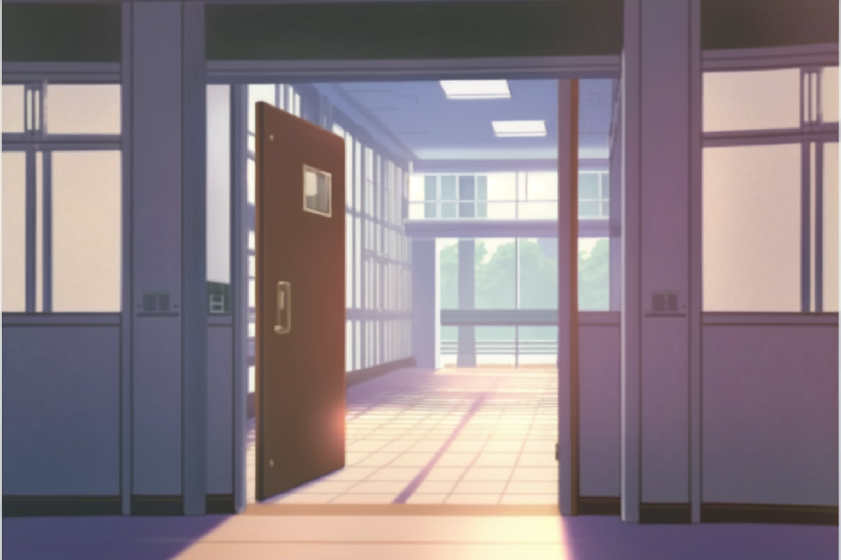

The next day, Dany is back at UPU

Slide 3
The next day, Dany is back at UPU
Since I can not ask Pupon questions …

Slide 4
The next day, Dany is back at UPU
Since I can not ask Pupon questions …
I should get in contact with the other professors

Slide 5

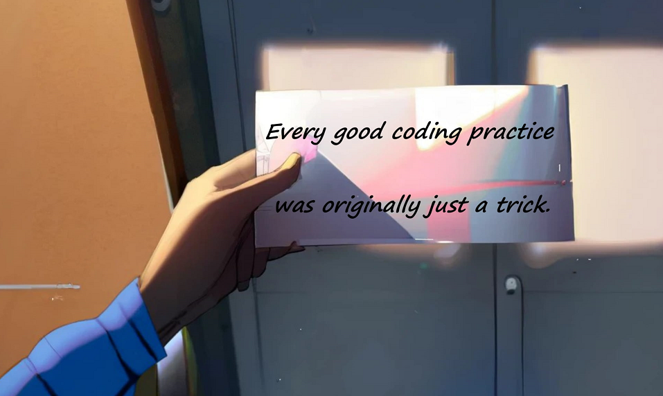
The next day, Dany is back at UPU
I’m still concerned about the secret message that someone delivered under my door…

Slide 6
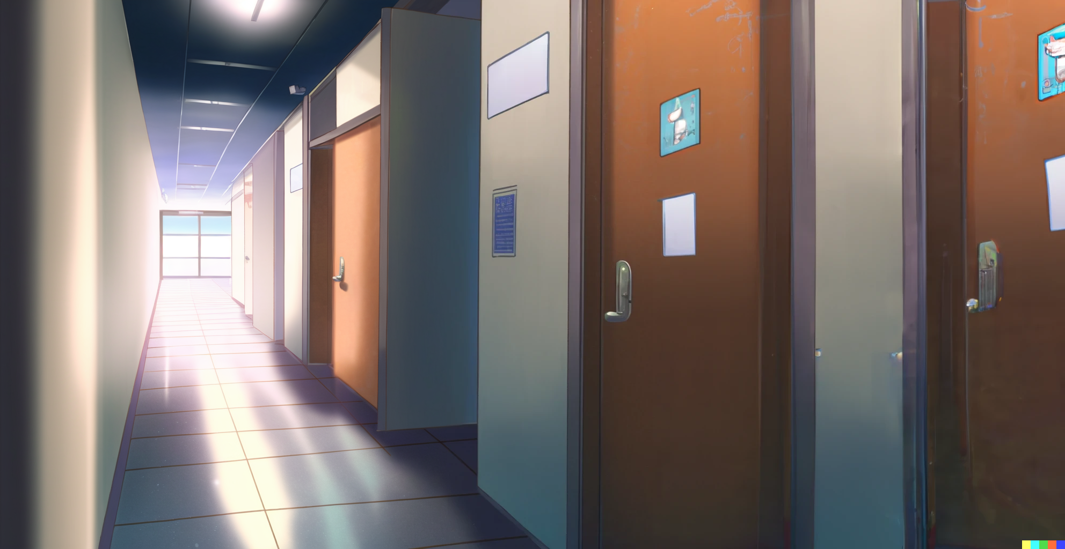

That is the door.
Tommy says that she is a chill and lovely lecturer

Slide 7

Knock Knock!

Slide 8
Knock Knock!
I hope that
she is not busy

Slide 9
Wait …
What if Tommy was
being sarcastic!

Slide 10
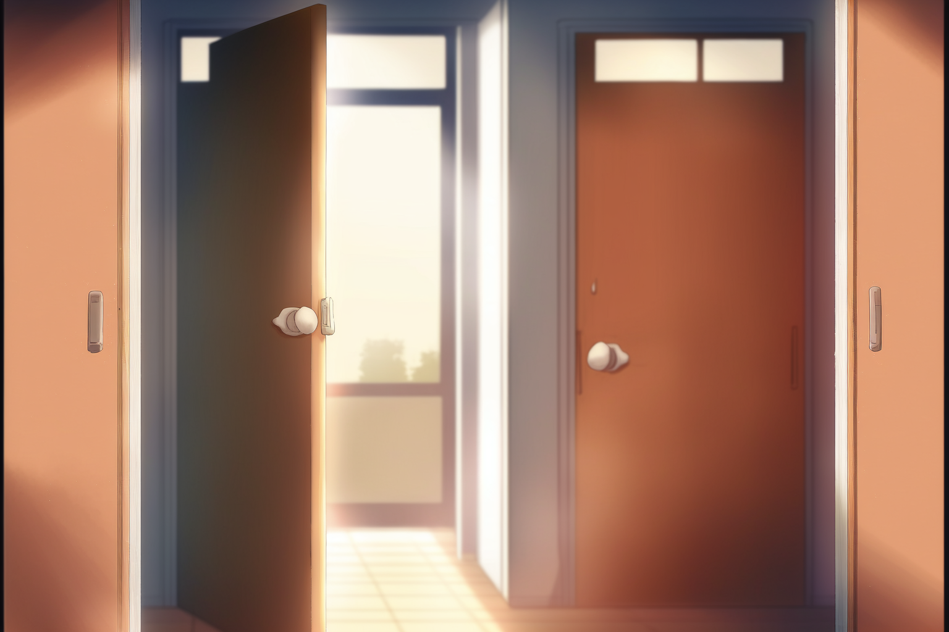

Please come in

Slide 11
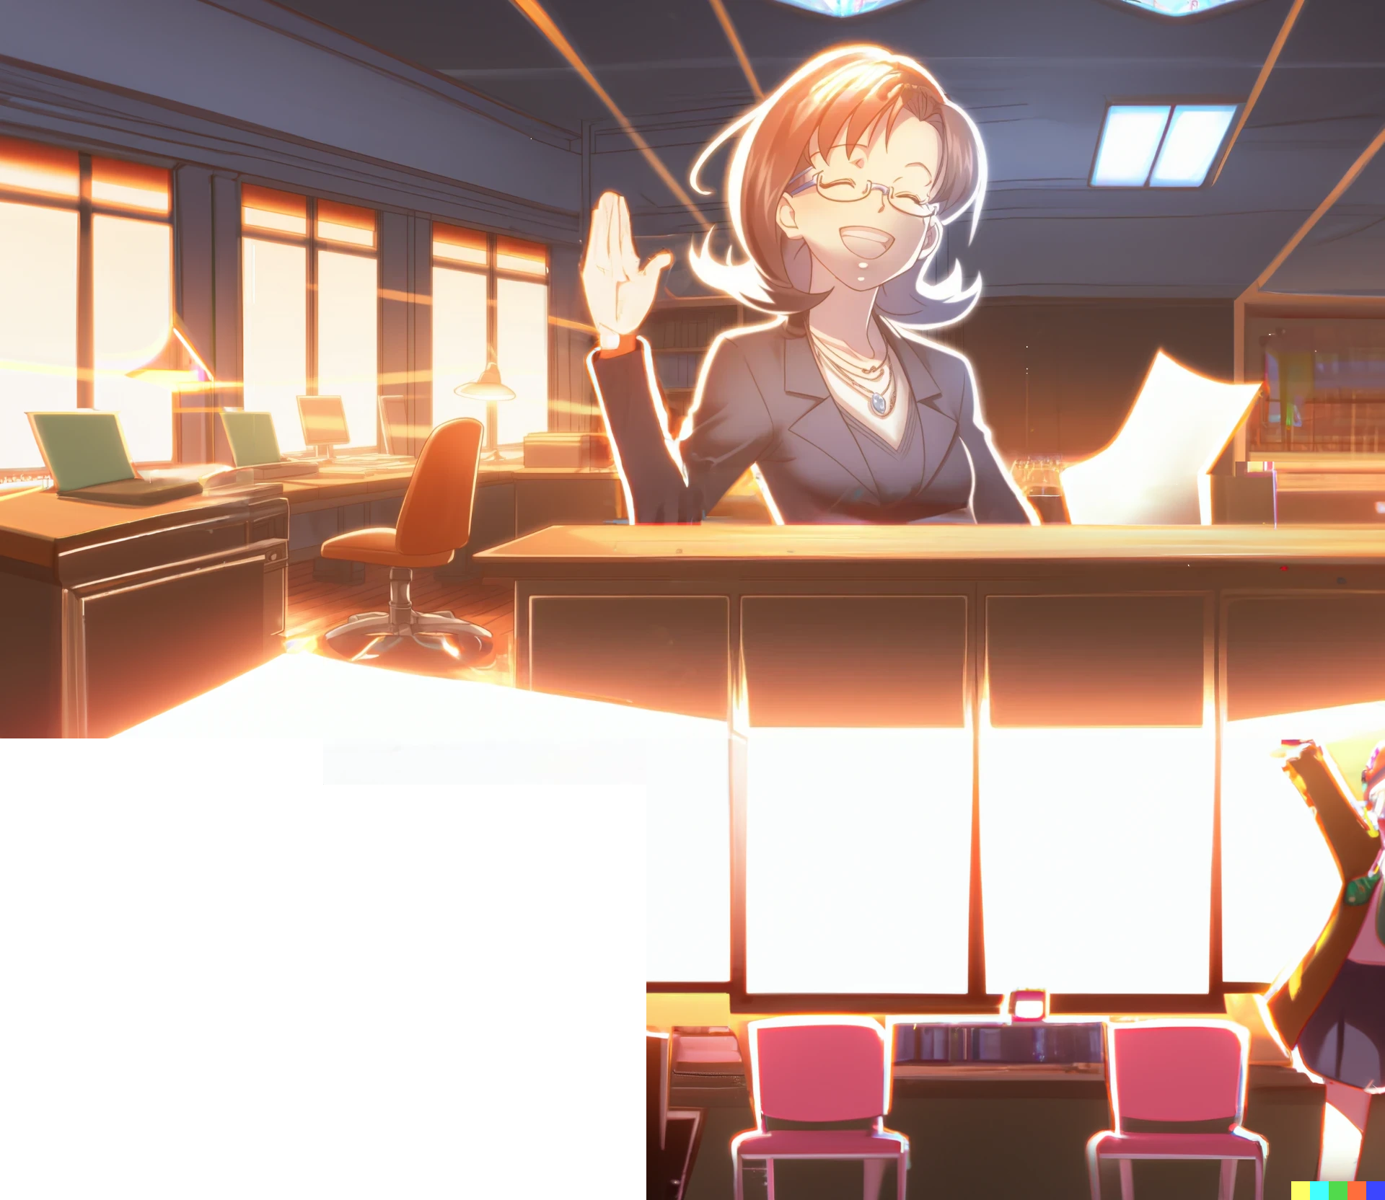
Hey,
how’s it going?

Slide 12
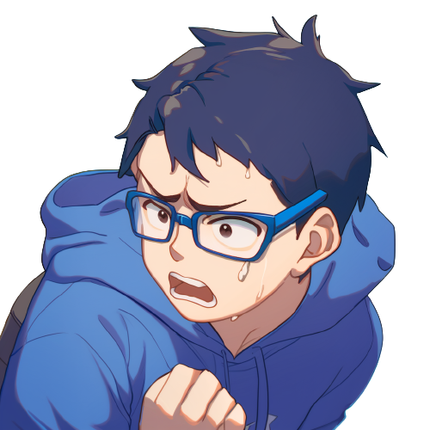
YES! She looks like
a decent person!

Slide 13
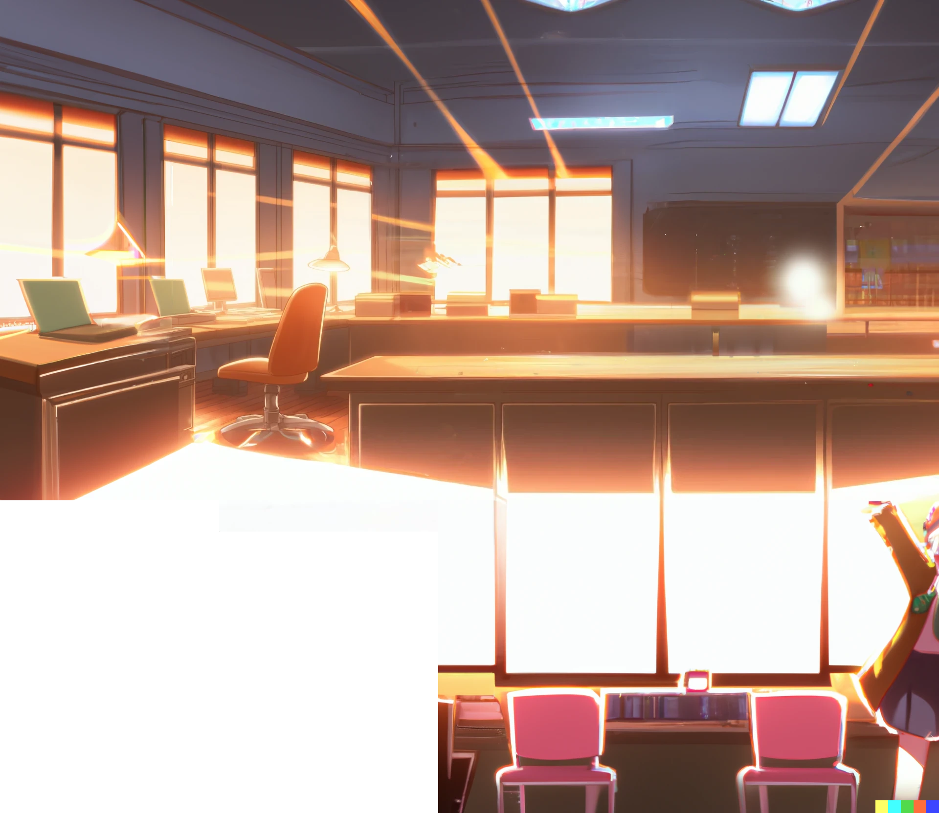
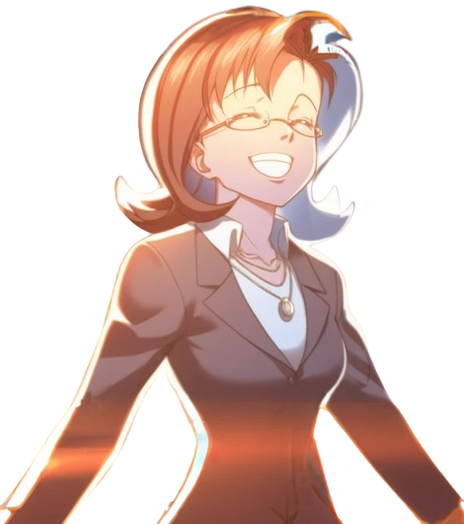

I’m Miss Pumpkin.
How can I help
you today?

Slide 14
I’m Miss Pumpkin.
How can I help
you today?
Hi Professor Pumpkin,
I have some …

Slide 15
I’m Miss Pumpkin.
How can I help
you today?
Hi Professor Pumpkin,
I have some …
questions about programming
and I was wondering
if you could help me

Slide 16
Is it
true
that...

Slide 17
Is it
true
that...
all good programming practices
were originally just tricks?

Slide 18
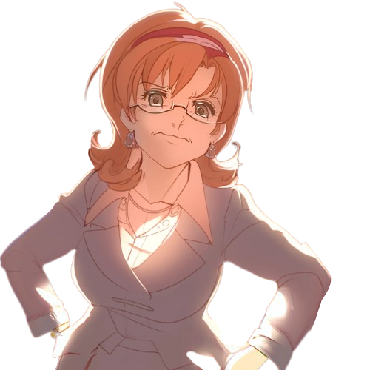
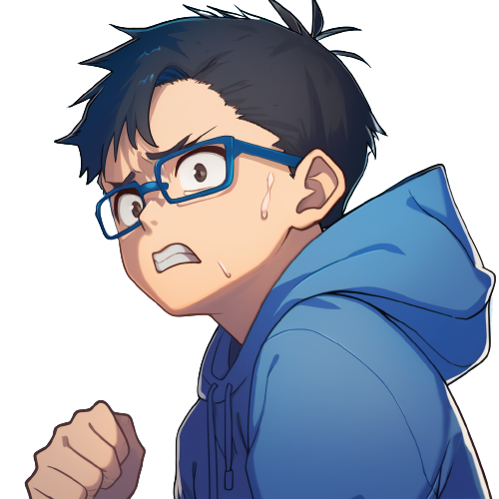
Yes,
for an appropriate
definition of trick.

Slide 19
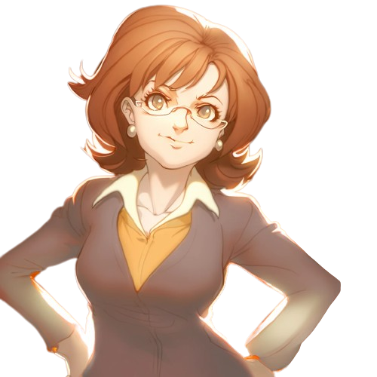
Good practices are not simply
hacks that developers use to get
their code to work.

Slide 20
Good practices are not simply
hacks that developers use to get
their code to work.
They are a set of guidelines
that have been developed
over time …

Slide 21
Good practices are not simply
hacks that developers use to get
their code to work.
They are a set of guidelines
that have been developed
over time …
through the collective experience
and knowledge of the
programming community.

Slide 22
Good practices are not simply
hacks that developers use to get
their code to work.
They are a set of guidelines
that have been developed
over time …
through the collective experience
and knowledge of the
programming community.
But where do these
guidelines come from?

Slide 23
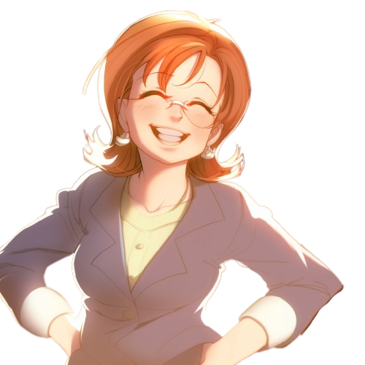
They are discovered by regular
programmers, ...

Slide 24
They are discovered by regular
programmers, ...
desperately trying
to combine
existing features …

Slide 25
They are discovered by regular
programmers, ...
desperately trying
to combine
existing features …
to somehow
produce a
better result

Slide 26
They are discovered by regular
programmers, ...
desperately trying
to combine
existing features …
to somehow
produce a
better result
So, it it all built upon human desperation

Slide 27
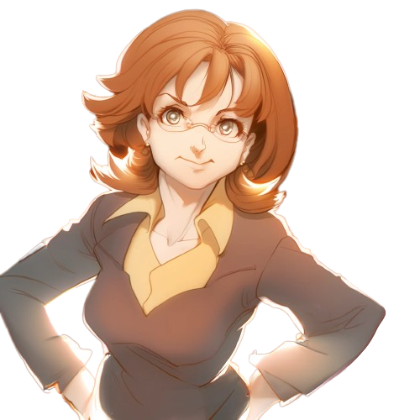
Can you give me an example?

Slide 28
Can you give me an example?
For example,
using meaningful variable names

Slide 29
Can you give me an example?
For example,
using meaningful variable names
... and indenting your code contributes
to making your code more readable.

Slide 30
Can you give me an example?
For example,
using meaningful variable names
... and indenting your code contributes
to making your code more readable.
Yes, indentation;
one of the most well established
programming practices!

Slide 31
Surely it was not born as a trick!

Slide 32
Well, how else do you think
'indentation' was discovered?
Surely it was not born as a trick!

Slide 33
Well, how else do you think
'indentation' was discovered?
Surely it was not born as a trick!
In the early days of programming,
indentation may have been
seen as more of a trick …

Slide 34
Well, how else do you think
'indentation' was discovered?
Surely it was not born as a trick!
In the early days of programming,
indentation may have been
seen as more of a trick …
to make code more readable,
relying on the otherwise
meaningless white spaces.

Slide 35
As the field of computer science
and programming evolved, …

Slide 36
As the field of computer science
and programming evolved, …
indentation became widely
accepted as a best practice
and it is now a fundamental
aspect of programming

Slide 37
As the field of computer science
and programming evolved, …
indentation became widely
accepted as a best practice
and it is now a fundamental
aspect of programming
Same for JavaDocs.
JavaDocs are a trick, …

Slide 38
As the field of computer science
and programming evolved, …
indentation became widely
accepted as a best practice
and it is now a fundamental
aspect of programming
Same for JavaDocs.
JavaDocs are a trick, …
in the sense that they leverage the
pre-existing syntax of multi-line
comments to generate documentation.

Slide 39
And what about more semantic concepts,
like `Separation of concerns`?

Slide 40
Even the very concept of
‘Separation of concerns’, …
And what about more semantic concepts,
like `Separation of concerns`?

Slide 41
Even the very concept of
‘Separation of concerns’, …
And what about more semantic concepts,
like `Separation of concerns`?
the most important principle
in software design, …

Slide 42
Even the very concept of
‘Separation of concerns’, …
And what about more semantic concepts,
like `Separation of concerns`?
the most important principle
in software design, …
may have originally
been seen just as a trick,
to make code more maintainable

Slide 43
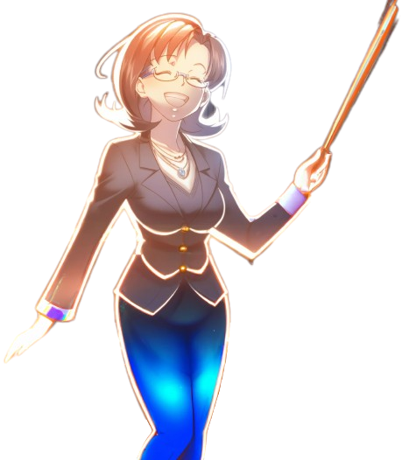
Remember:
what is considered a trick
and what is …

Slide 44
Remember:
what is considered a trick
and what is …
considered a best practice,
changes over time as the field of
computer science and programming evolves

Slide 45
Remember:
what is considered a trick
and what is …
considered a best practice,
changes over time as the field of
computer science and programming evolves
Keep an open mind
and try new things!

Slide 46
Remember:
what is considered a trick
and what is …
considered a best practice,
changes over time as the field of
computer science and programming evolves
Keep an open mind
and try new things!
Your new trick could grow in popularity and
eventually even be considered a best practice

Slide 47
Our understanding of what
an elegant solution is
changes over time.

Slide 48
Our understanding of what
an elegant solution is
changes over time.
What we consider a trick today
might be considered
an elegant solution
tomorrow

Slide 49
Our understanding of what
an elegant solution is
changes over time.
What we consider a trick today
might be considered
an elegant solution
tomorrow
But… what about the design
decisions of the original
language creators?

Slide 50
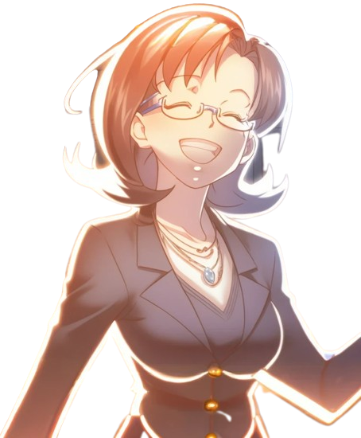
You see, programming languages
are not invented but discovered.

Slide 51
You see, programming languages
are not invented but discovered.
The initial intent of the original
language creators is pretty much irrelevant.

Slide 52
You see, programming languages
are not invented but discovered.
The initial intent of the original
language creators is pretty much irrelevant.
Programming languages are just
tools that we use to communicate
with computers, and …

Slide 53
You see, programming languages
are not invented but discovered.
The initial intent of the original
language creators is pretty much irrelevant.
Programming languages are just
tools that we use to communicate
with computers, and …
as our understanding of computers
and their capabilities evolves, so does
the way we use languages
to interact with them.

Slide 54
You see, programming languages
are not invented but discovered.
The initial intent of the original
language creators is pretty much irrelevant.
Programming languages are just
tools that we use to communicate
with computers, and …
as our understanding of computers
and their capabilities evolves, so does
the way we use languages
to interact with them.
It can’t be!

Slide 55
So this is why programming languages
are constantly evolving,

Slide 56
So this is why programming languages
are constantly evolving,
and new languages and frameworks
are constantly being developed.

Slide 57
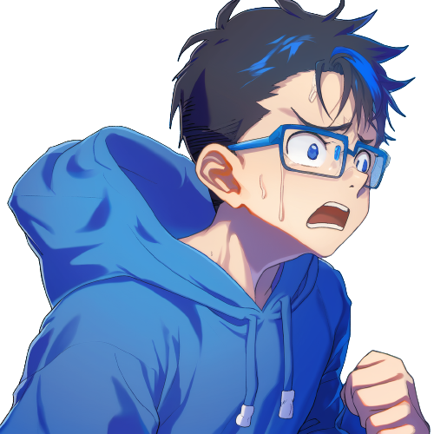
Because we still have not
figured out what it even means
to make software right!

Slide 58
Because we still have not
figured out what it even means
to make software right!
Well, there is one thing that
we have figured out:
Lambdas are good.

Slide 59

Professor Pumpkin looks at Dany, puzzled
But why are you not
asking Professor Pupon;
isn't he your lecturer?

Slide 60
Professor Pumpkin looks at Dany, puzzled
But why are you not
asking Professor Pupon;
isn't he your lecturer?
I don't have a good
relationship with
Professor Pupon

Slide 61
Oh, I see. Well,
at UPU, the lecturers compete
against each other.

Slide 62
Oh, I see. Well,
at UPU, the lecturers compete
against each other.
Every year, two first-year classes
of 100 students each are created.
One handled by Professor Pupon,
and the other is handled by me.

Slide 63
Oh, I see. Well,
at UPU, the lecturers compete
against each other.
Every year, two first-year classes
of 100 students each are created.
One handled by Professor Pupon,
and the other is handled by me.
At the end, the two lecturers
write half of the final exam each, …

Slide 64
Oh, I see. Well,
at UPU, the lecturers compete
against each other.
Every year, two first-year classes
of 100 students each are created.
One handled by Professor Pupon,
and the other is handled by me.
At the end, the two lecturers
write half of the final exam each, …
and we will mark anonymized scripts.
The lecturer whose students
are the most successful wins

Slide 65
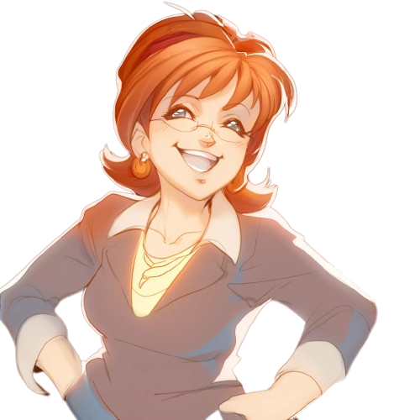
Professor Pumpkin is embarrassed
What is the prize
that you compete
so fiercely for?

Slide 66
Professor Pumpkin is embarrassed
What is the prize
that you compete
so fiercely for?
The winning lecturer has the right
to select and fail an extra student
who would otherwise have passed

Slide 67
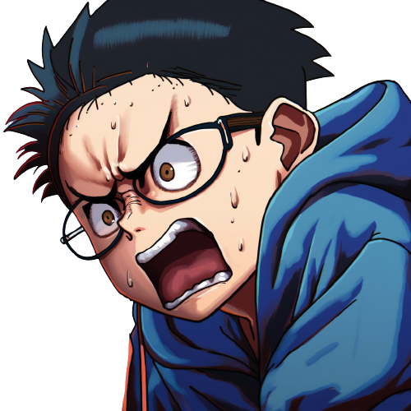
Professor Pumpkin is embarrassed
What is the prize
that you compete
so fiercely for?
The winning lecturer has the right
to select and fail an extra student
who would otherwise have passed

Slide 68
So if Professor Pupon wins,
he could fail me independently
of my score or performance?

Slide 69
So if Professor Pupon wins,
he could fail me independently
of my score or performance?
Yes,
technically speaking,
he could.

Slide 70

How can this be fair
for the students!

Slide 71
How can this be fair
for the students!
And why,
why are you competing to
get such a disgusting privilege

Slide 72
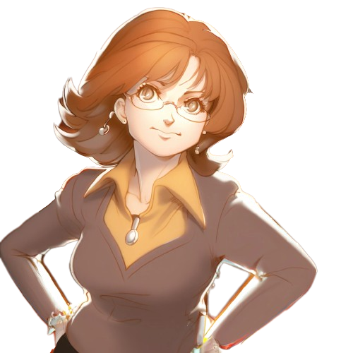
Oh, no Dany, you are
misunderstanding.

Slide 73
Oh, no Dany, you are
misunderstanding.
Failing a student in the first year
instead of condemning them to spend an unbounded
amount of time studying programming …

Slide 74
Oh, no Dany, you are
misunderstanding.
Failing a student in the first year
instead of condemning them to spend an unbounded
amount of time studying programming …
could be the best form of love
and respect toward such a student

Slide 75
Oh, no Dany, you are
misunderstanding.
Failing a student in the first year
instead of condemning them to spend an unbounded
amount of time studying programming …
could be the best form of love
and respect toward such a student
Especially when we are sure
that they would never be able
to complete their studies.

Slide 77
See you
next time!

Slide 78
See you
next time!
So, any time I help my friends, like I did in the last lab, ...

Slide 79
See you
next time!
So, any time I help my friends, like I did in the last lab, ...
I'm making it
easier for Pupon to
win and fail me.

Slide 80


Slide 81
I want to help my friends pass the courses, but by helping them …
What should I do?

Slide 83
03: Java Screams!

Slide 84

Credits
- Story: Marco
- Art: MidJourney, NijiJourney, Dall-E
- Wording: Marco, chatGPT
- Composition: Marco
- Thanks to all my friends for
providing great feedback!

