Slide 1
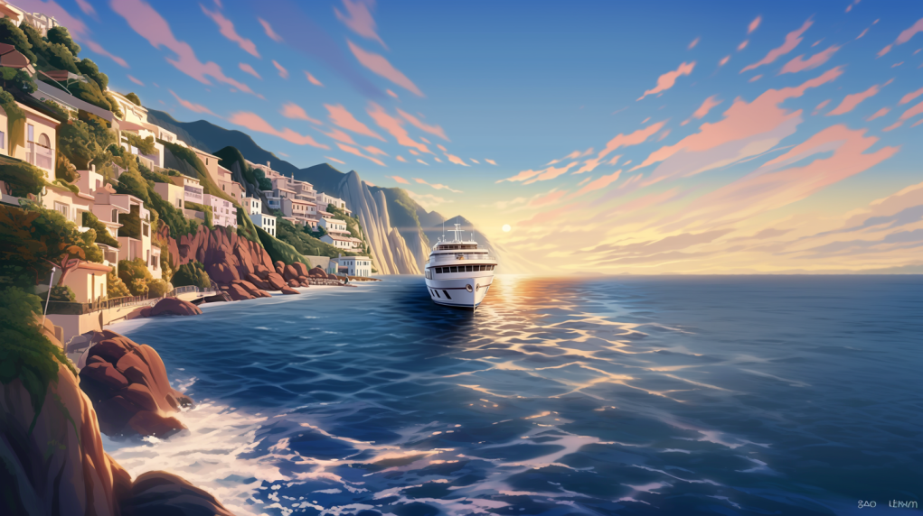
A ferry is approaching the dock
It is the ferry for the Ivory tower

Slide 2
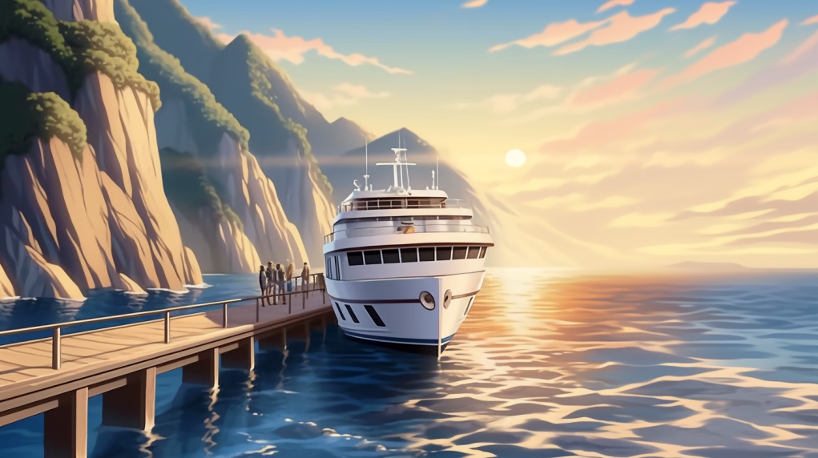
The ferry pulls up to the dock
A few odd characters emerge from the ferry

Slide 3
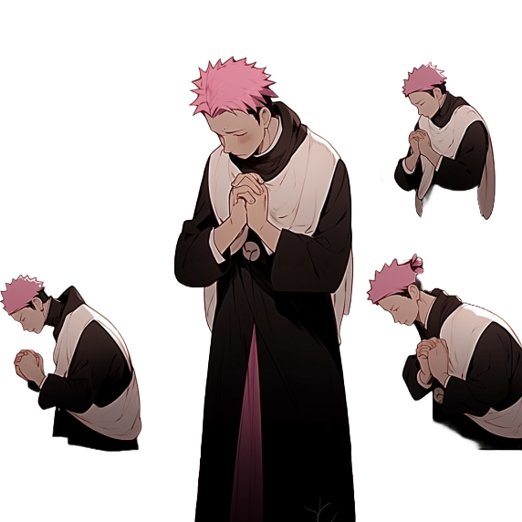
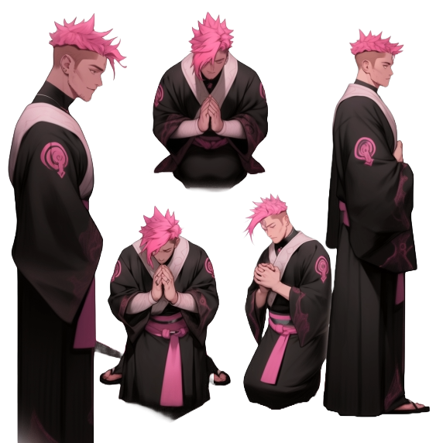
The ferry pulls up to the dock
A few odd characters emerge from the ferry

Slide 4
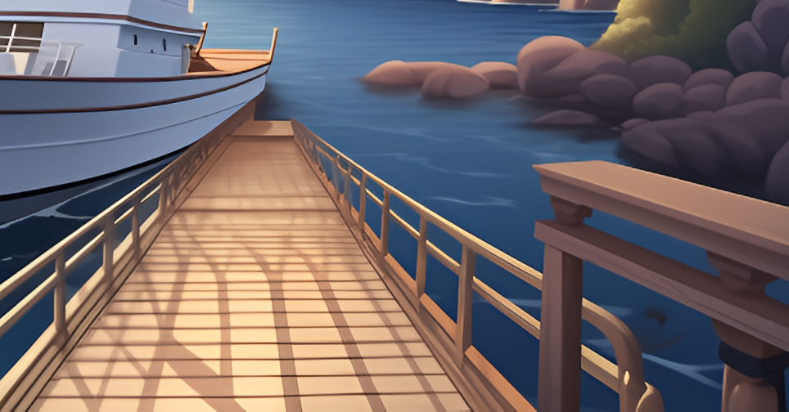
Dynamic dispatch!
Dynamic dispatch!
Dynamic dispatch!
Dynamic dispatch!

Slide 5
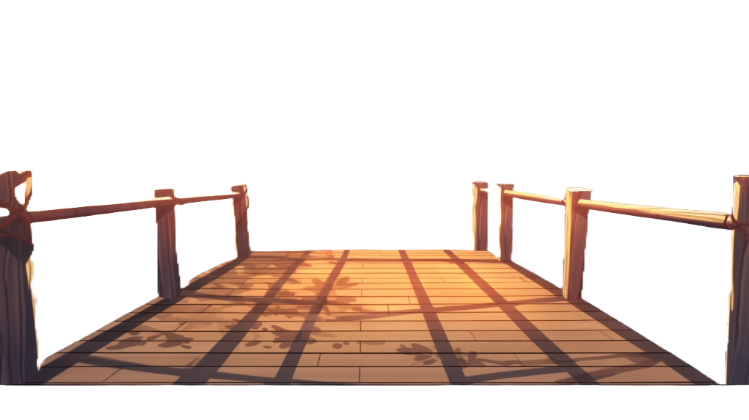
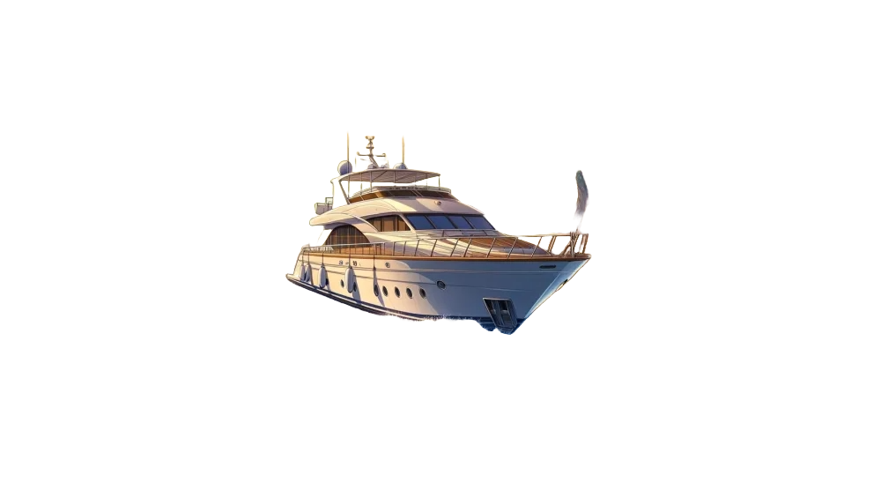
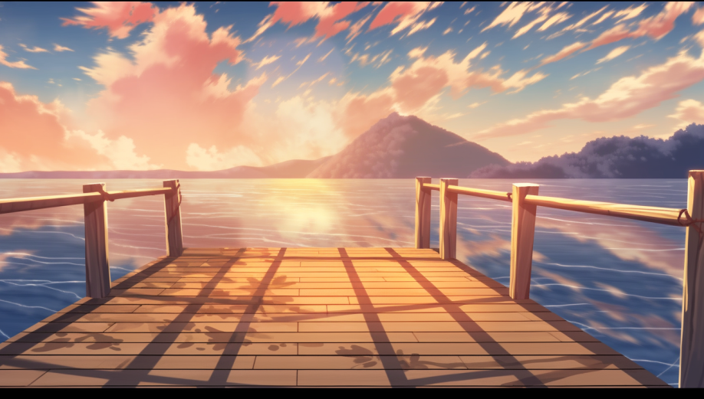
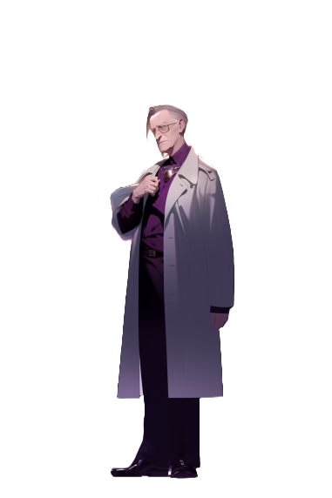
The monks make a circle around Mortis

Slide 6
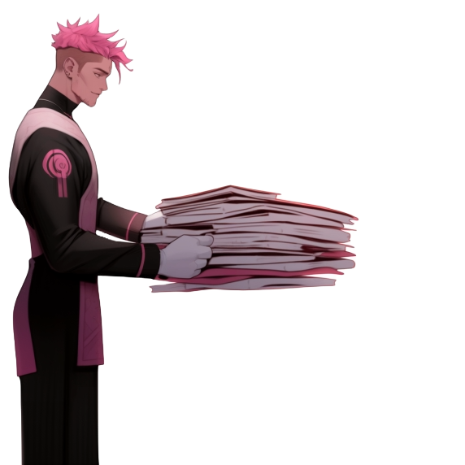
The scholarship documents are passed to Mortis
Dynamic dispatch!

Slide 7
Now, Everyone
that passed
form a line and get ready
to sign the contract

Slide 8
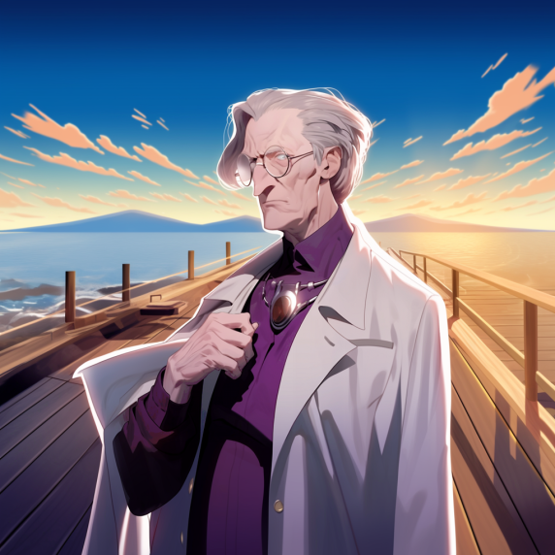
The contract for the
second year scolarship!

Slide 9

The ship arrives and docks,
the monks come out and make a cirle around Mortis
they give him a pile of documents
Now, Everyone that passed
form a line and get
ready to sign the contract for
the second year scholarship

Slide 11


