Slide 1
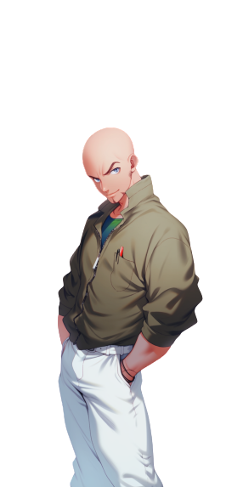
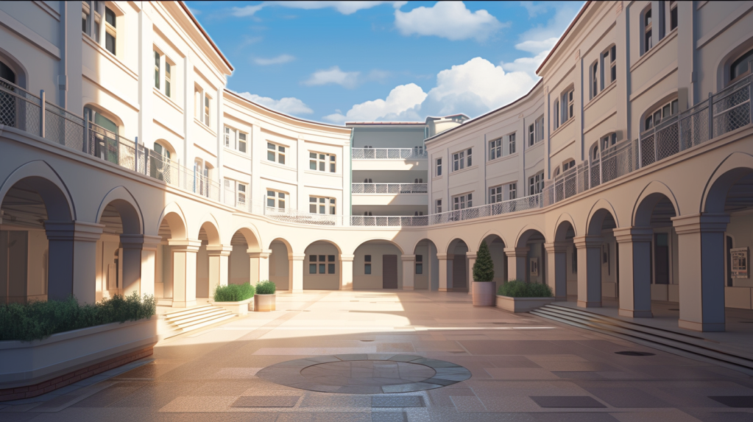
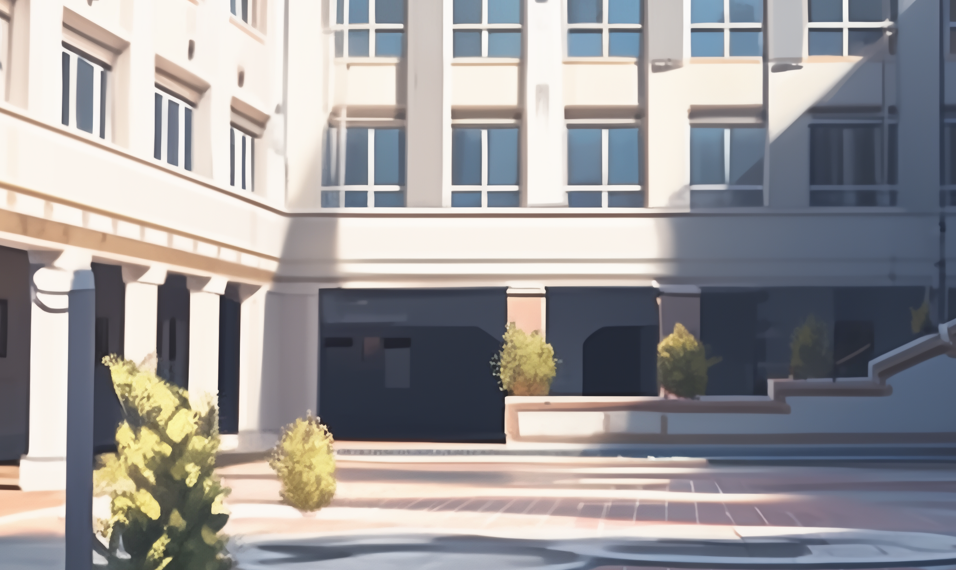

Oh, the five-year
scholarship documents!
Five years? But ... this
is just a three-year degree!
And we just finished the first year, so
shouldn't it be just another two years?

Slide 2
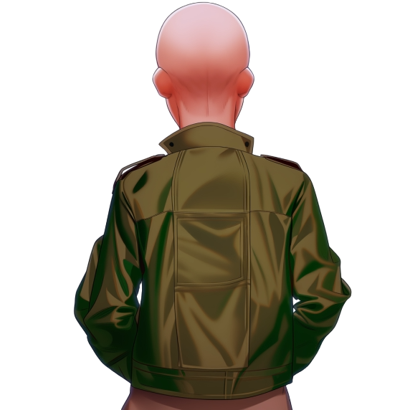
Oh, it is just in case
you lose a few years
UPU is a challenging
course of study indeed!
Still, five years seems
kind of excessive
How long does the
average student take
to graduate from UPU?

Slide 3
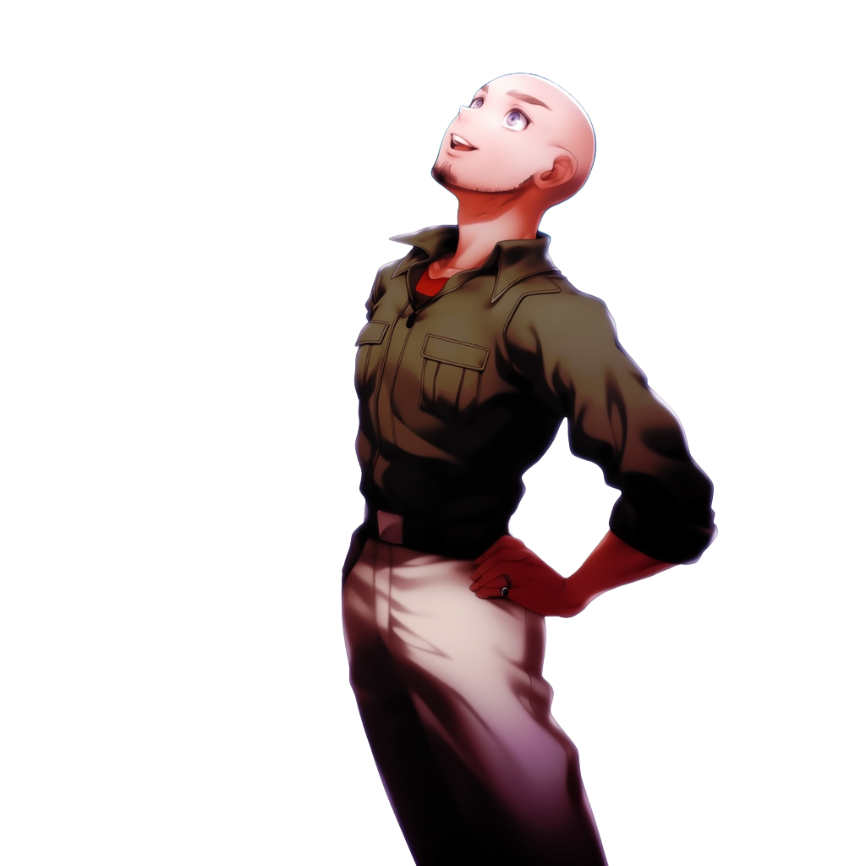
Still unclear!
But, I plan to be the
first one to graduate!

Slide 4
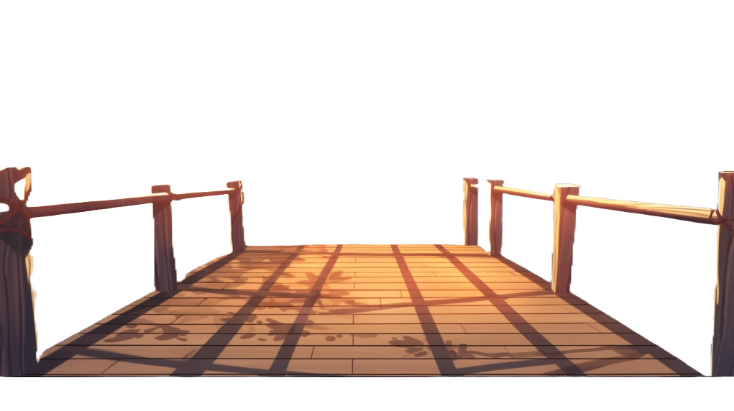

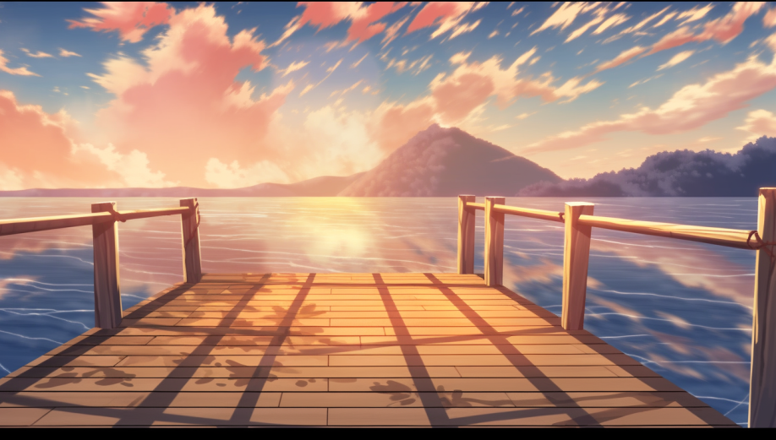
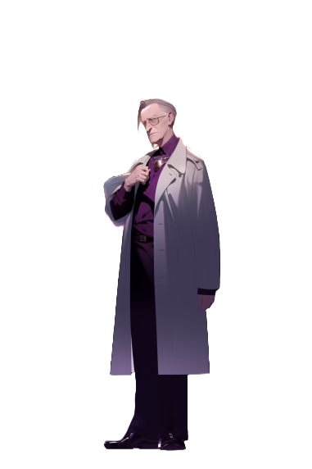

Tommy,
welcome to the rest
of your life
Tommy has just signed the contract
Who’s next?

Slide 5

It’s my turn!
Ivory Tower and
scholarship,
here I come!

Slide 6
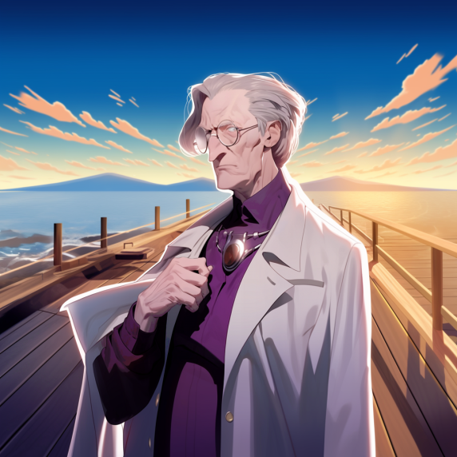
Dany,
are you willing to stay
in the Ivory Tower
and there, to dedicate
every moment necessary
for your studies
persevering until
the day you emerge as
a graduate of UPU?
This journey demands
dedication beyond the ordinary
are you ready for
this challenge?

Slide 7

Here is my
signed document!

Slide 8
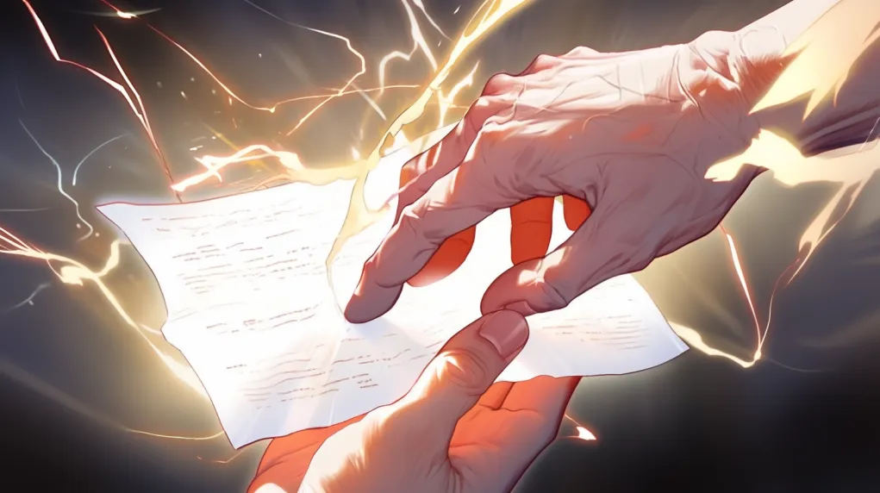


Slide 9
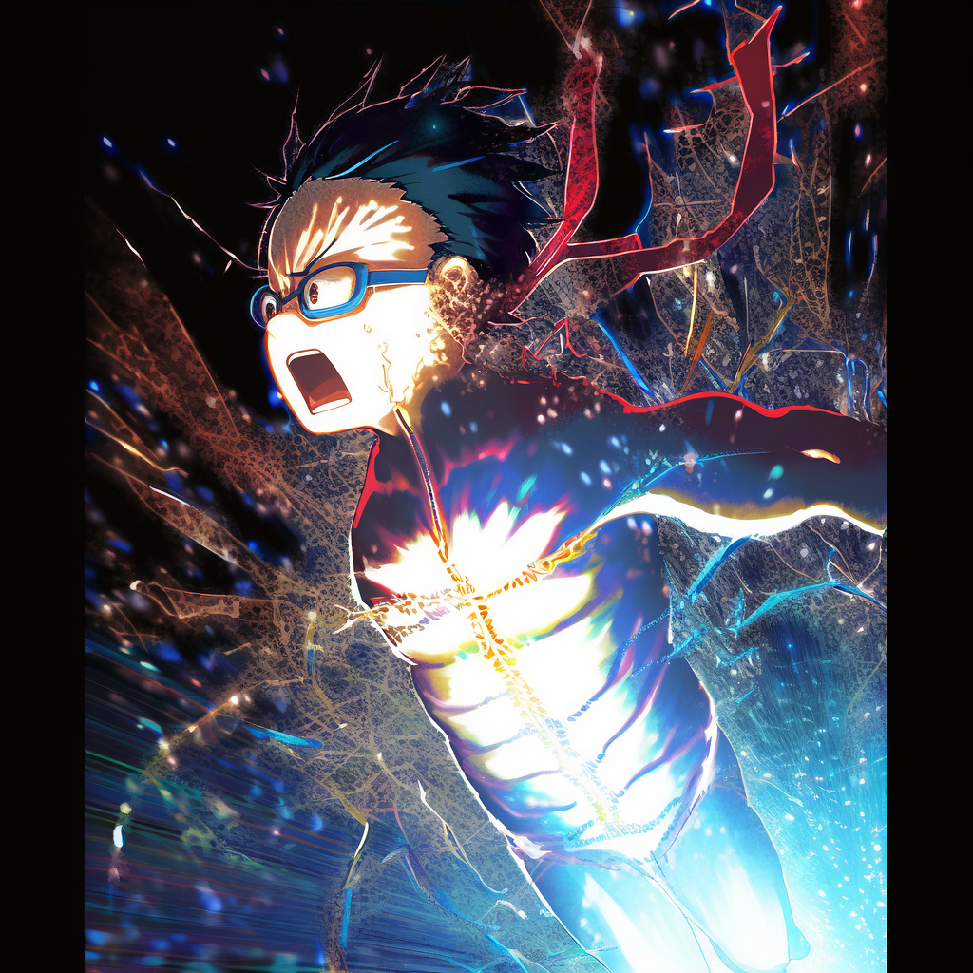

Slide 10
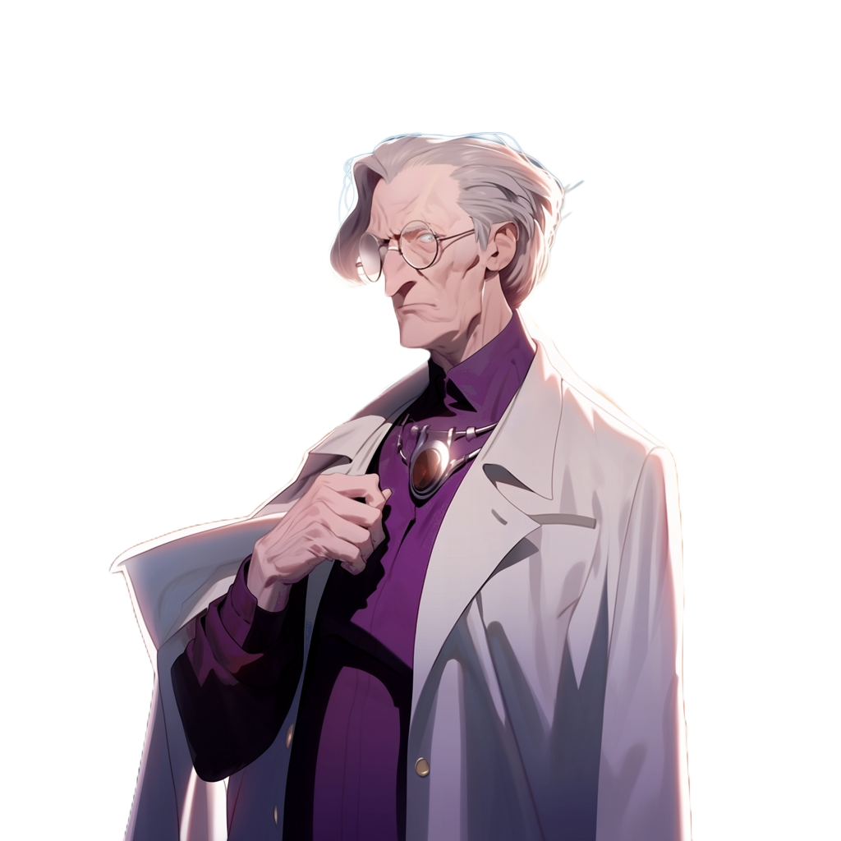
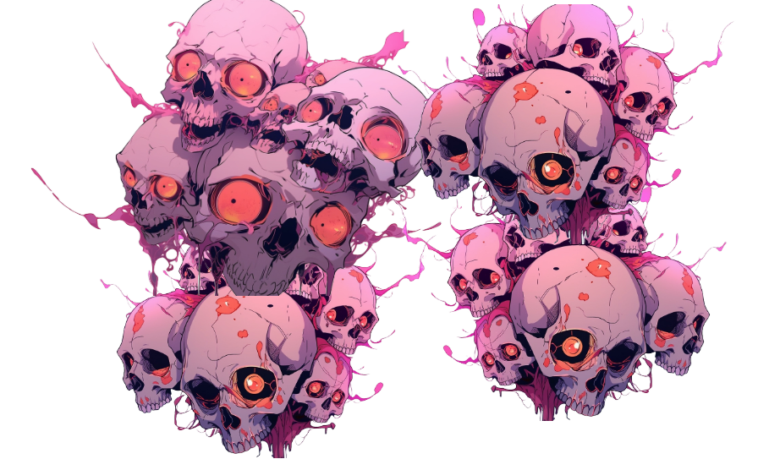

Slide 11
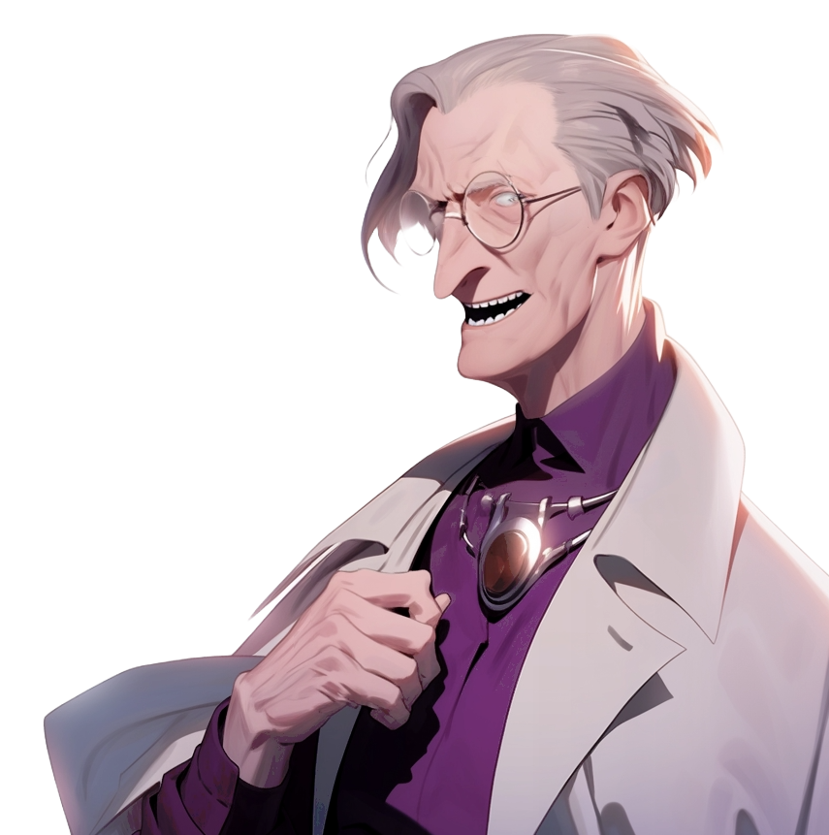
Welcome to the rest
of your life!

Slide 12
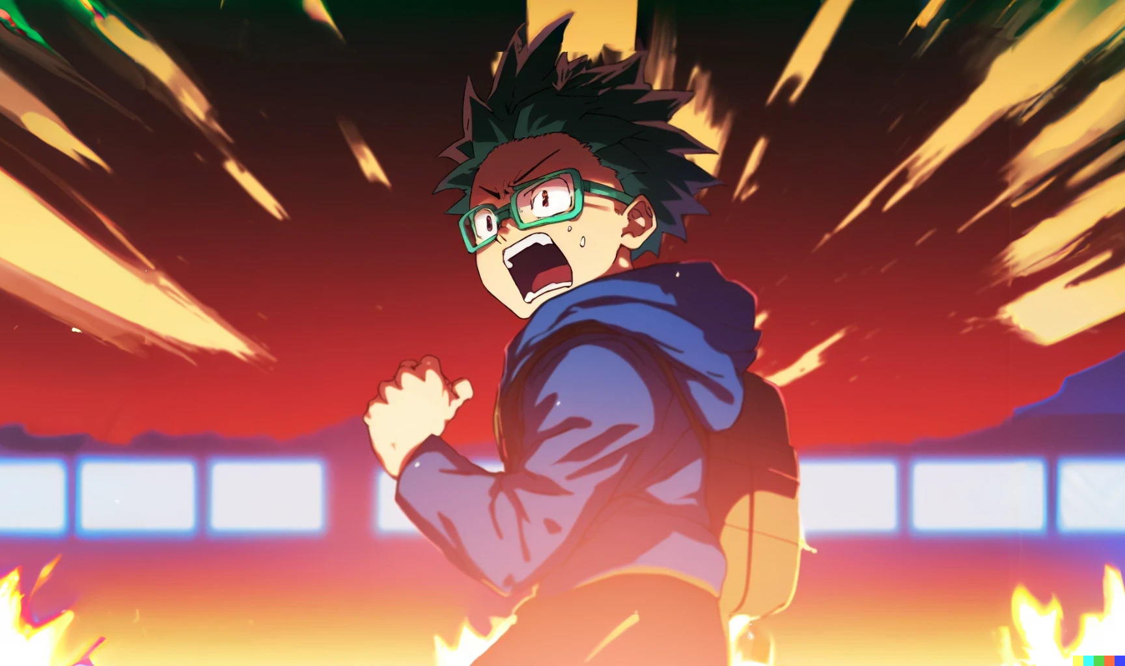
What is this?
I’m I hallucinating?
I’m I haunted?
I’m sure my angelic explanations
power is not active now…
what in the world is going on?!

Slide 13
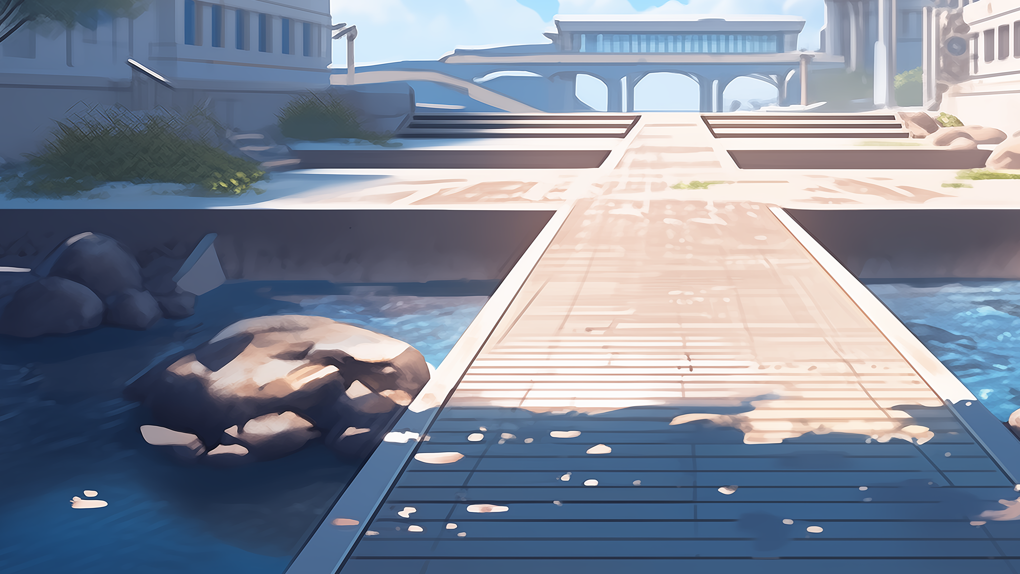

Relax Dany,
relex!

Slide 14
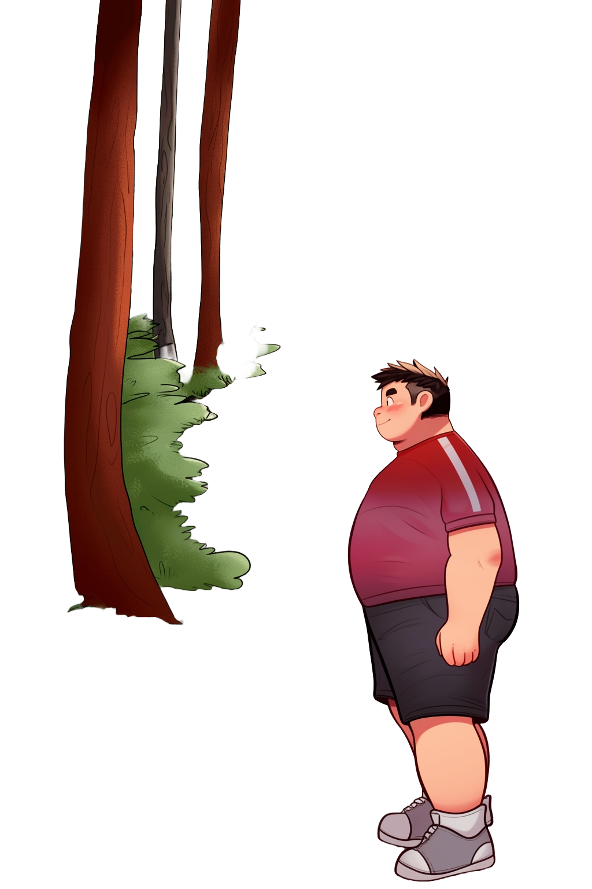

Hey Riky
Does it all
looks ok to you?

Slide 15
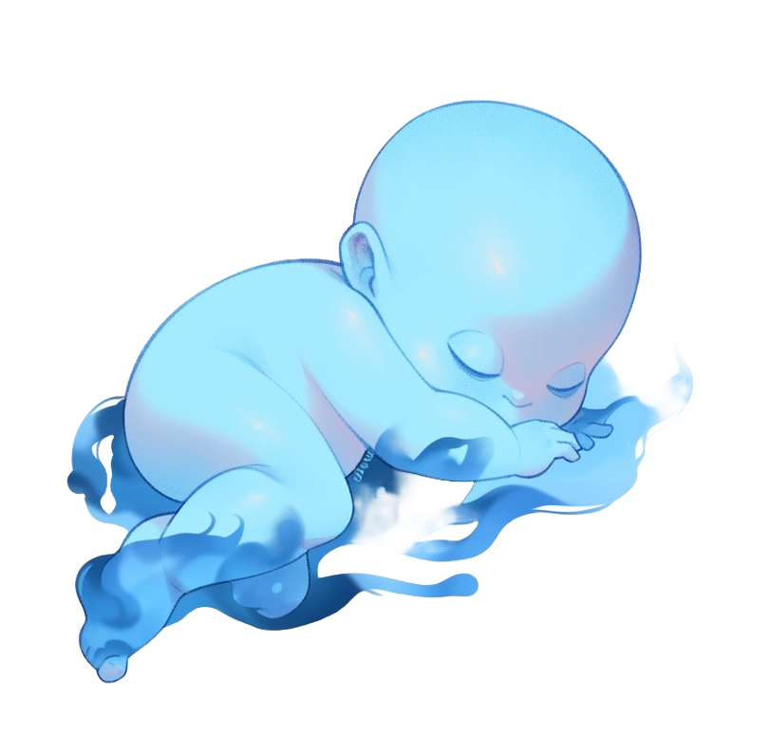
Hey Riky
Does it all
looks ok to you?

Slide 16
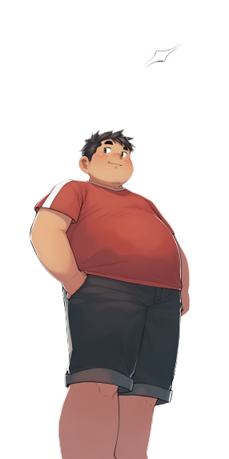
Better then just ok!
Second year is
going to be great!

Slide 17
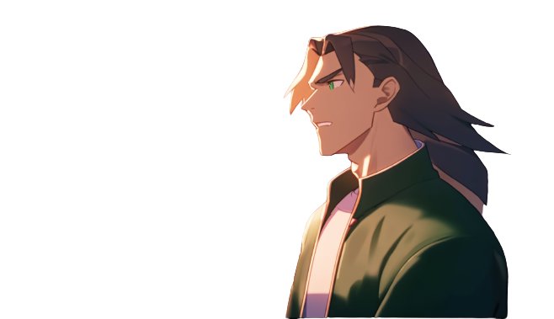
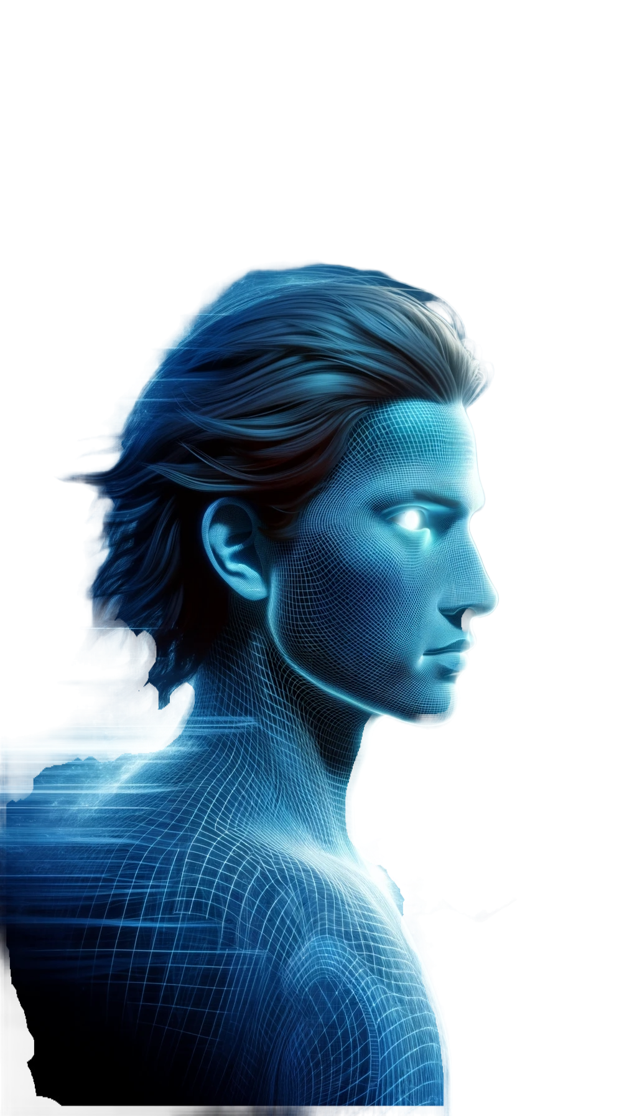
Yes, I can feel it!
We are going to have
a blast, all together!

Slide 18
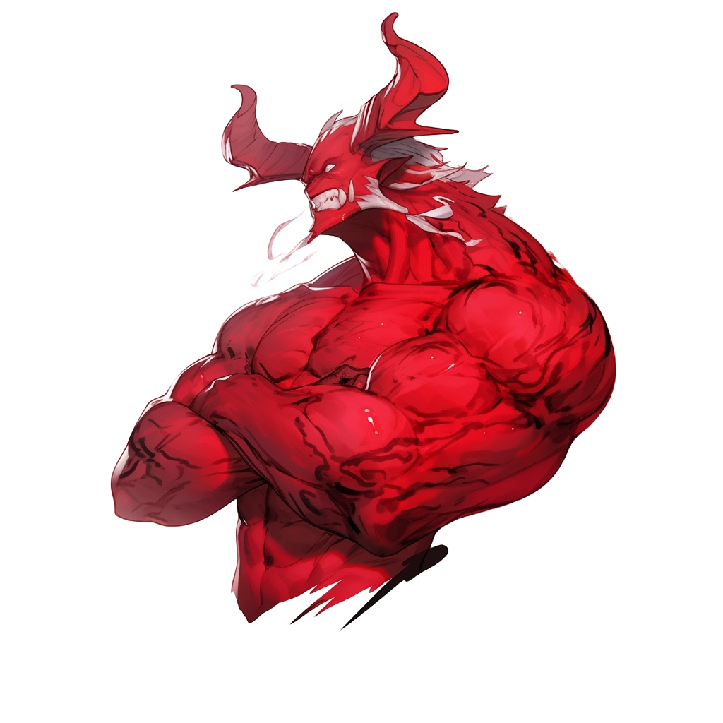
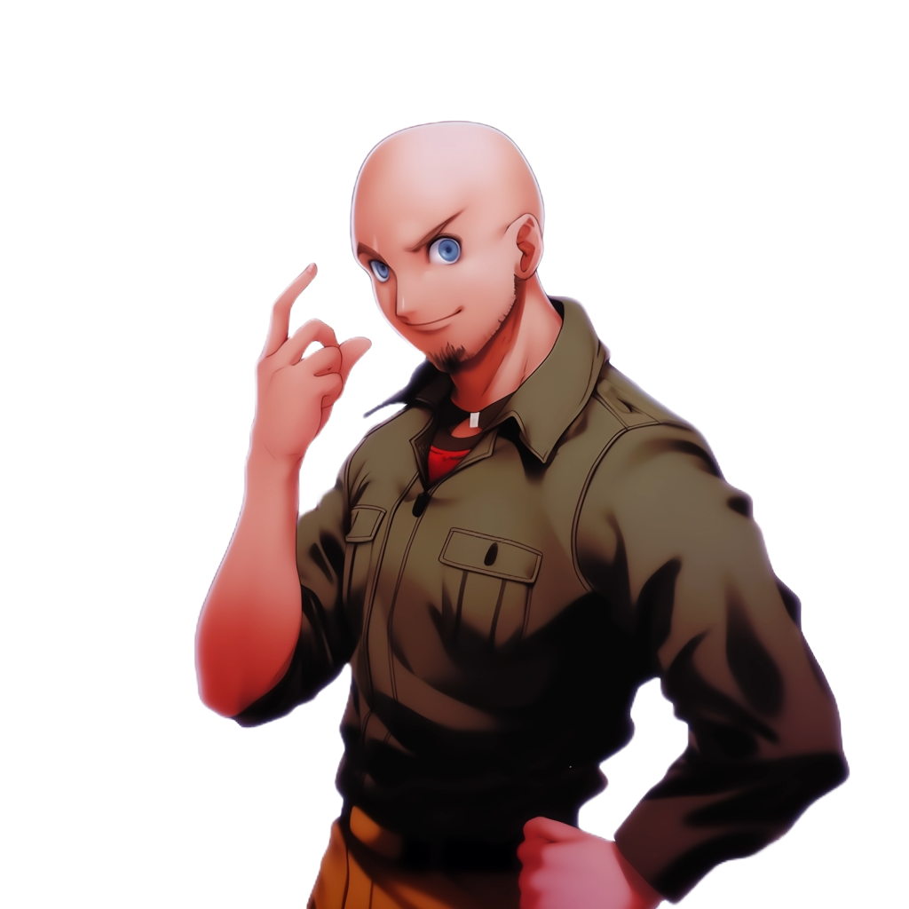
Hey Dany,
are you feeling all right?
You look so pale!

Slide 19
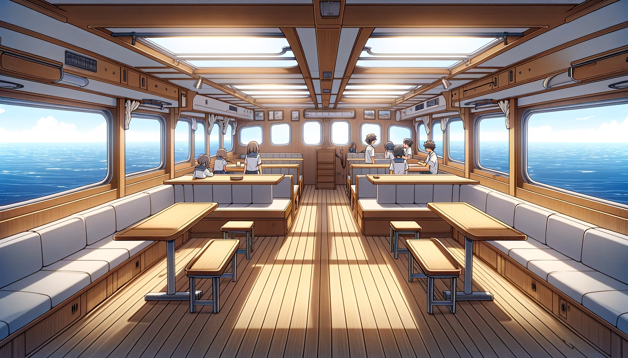
Haunted by the visions he had just witnessed, Dany hastened
towards the ship awaiting him and the other scholarship recipients
What is going on?

Slide 20
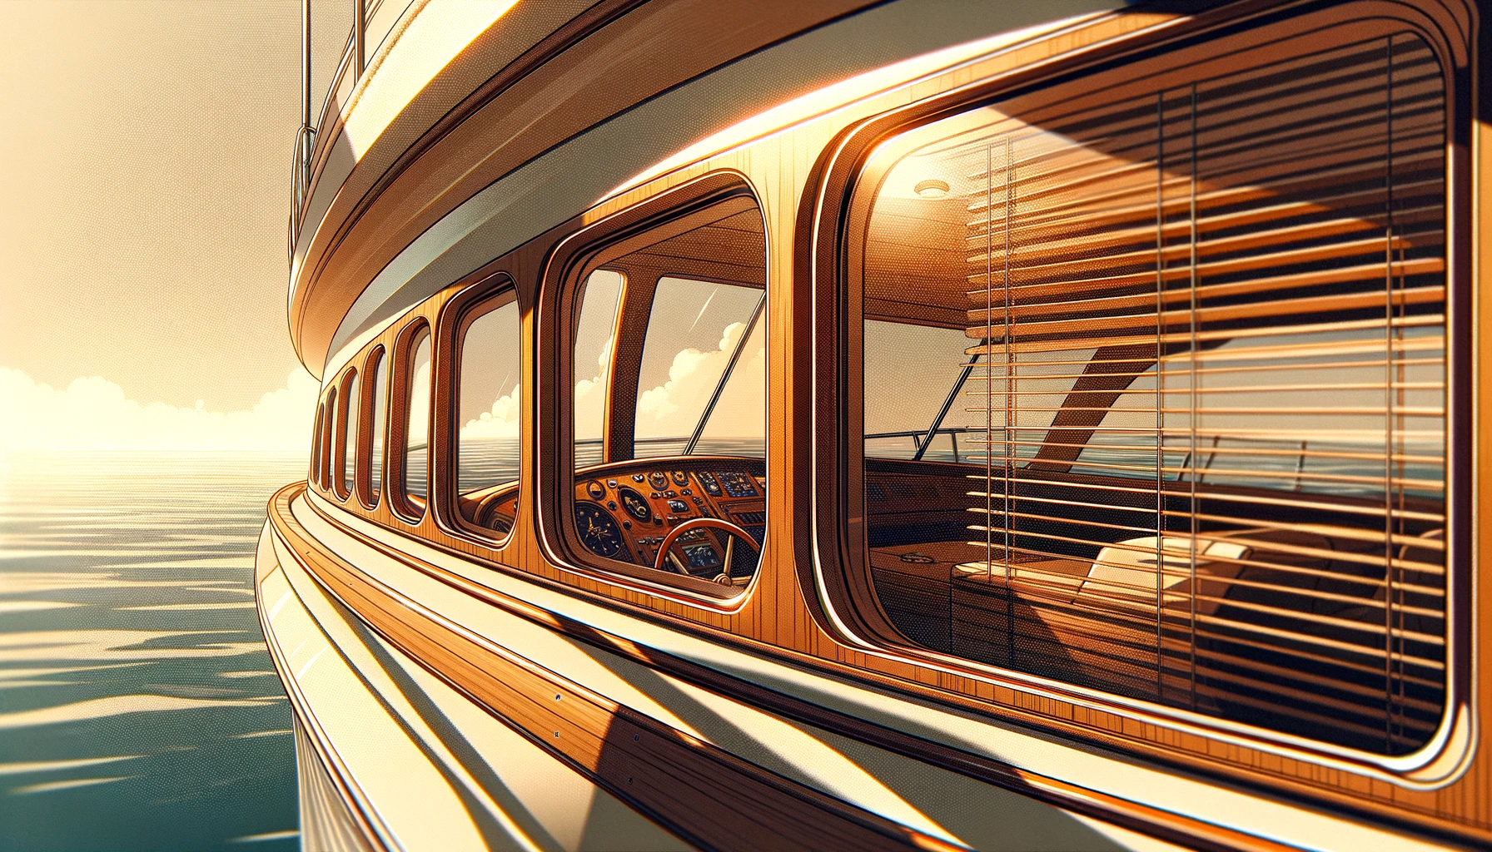
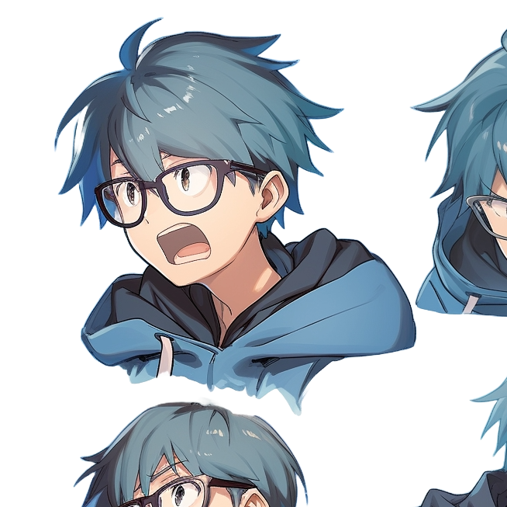
The ship sets sail, steadily navigating towards
the familiar silhouette of the Ivory Tower
A symbol of aspiration and knowledge, standing
proudly on its small island in the heart of the bay

Slide 21
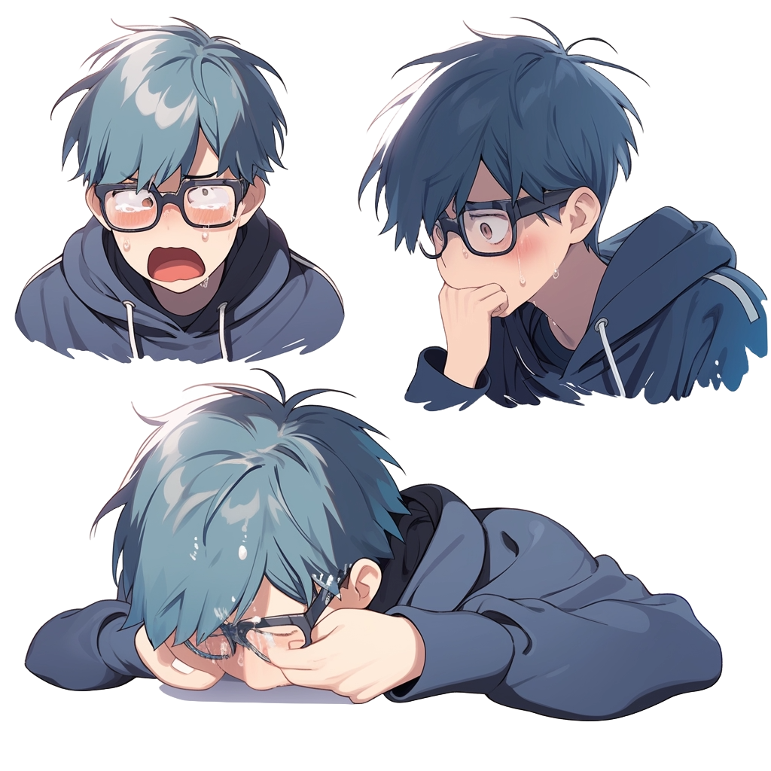
It was a long day for Dany. Too long.

Slide 23


Slide 24
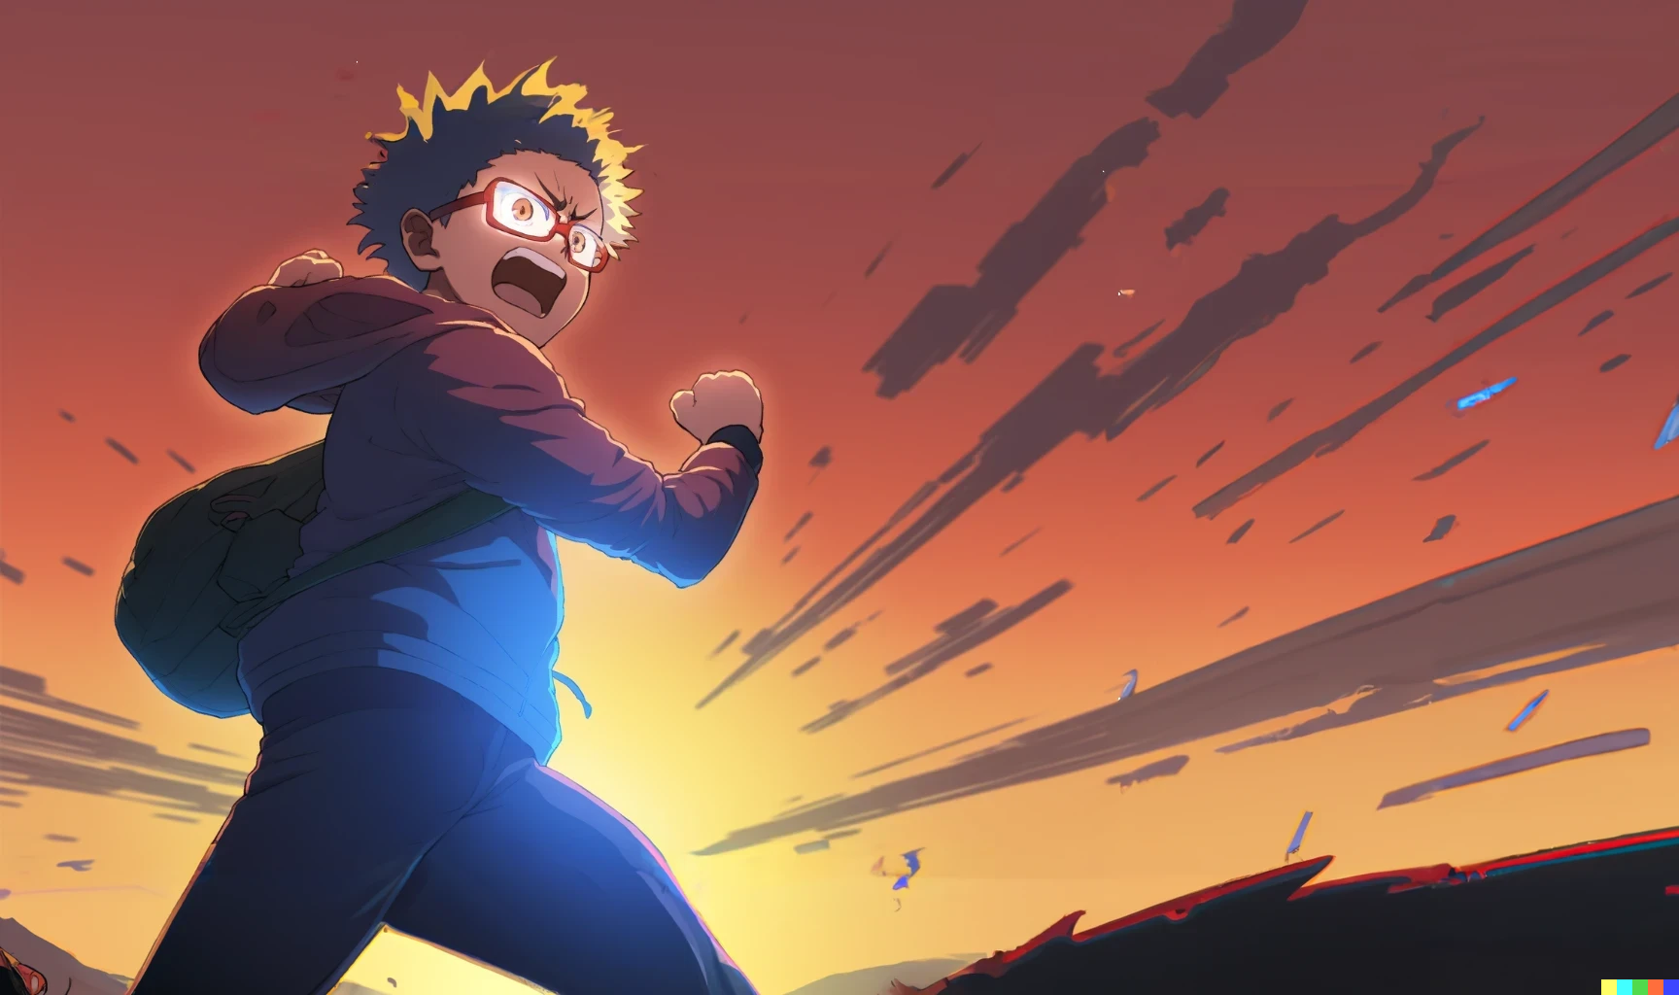
Credits
- Story: Marco
- Art: MidJourney, NijiJourney, Dall-E
- Wording: Marco, chatGPT, jfw01
- Composition: Marco
- Thanks to all my friends for
providing great feedback!

Slide 26

Should I make the story of hanton in chap 2 redone? As an olimpionic
programmer that just wan the programming olimpics?
Hanton: so, Dany, you managed to pass with a miserable 54!
Riky, you’ve got 50 exact.
Ricky: yes, that was my cap, I submitted so many times!
Sopia and Emma also passed, with 58 and 56.
So, 42 students passed, 20 from the class of Pumpkin
and 22 from the class of Pupon.
Finally, 58 students managed to submit at least one question and
took a mark between zero and 49%!

