Slide 1


Slide 2


Slide 3
Sorrento Bay; Freshman city;
Ultimate Programming University (UPU)

Slide 4

Freshmen city
Main campus
building

Slide 5



Hey Dany, are you ok?

Slide 6
Hey Dany, are you ok?
Do I look ok to you?

Slide 7
No, you look lost,
that is why I’m asking

Slide 8

No, you look lost,
that is why I’m asking
Those lectures are a nightmare,
I can not understand anything,

Slide 9
No, you look lost,
that is why I’m asking
Those lectures are a nightmare,
I can not understand anything,
We are going to fail this!

Slide 10

This university is absurd!
What’s up with that giant
ivory tower?

Slide 11
This university is absurd!
What’s up with that giant
ivory tower?
I’m not sure, but it is very cool!

Slide 12

That is where the second
year students live

Slide 13
That is where the second
year students live
But do no worry
about it.

Slide 14
Only few manage to get there,
and that is a good thing.

Slide 15
Only few manage to get there,
and that is a good thing.
This place is not good for you,
leave while you can!

Slide 16

Poor guys,
they never listen
in time

Slide 17


Slide 18


Aaah!

Slide 19
Aaah!
Whooops,
what was that...

Slide 20

What is going on?
I hate this place!

Slide 21
Umm.. maybe I was wrong...
What is going on?
I hate this place!

Slide 22
Umm.. maybe I was wrong...
What is going on?
I hate this place!
Maybe you do have what it takes
to survive here

Slide 23


The next lecture is starting.
Maybe this is going to be easier!

Slide 24
The next lecture is starting.
Maybe this is going to be easier!
Where is the lecturer?

Slide 25



Three lecturers?

Slide 26
All three are bold?

Slide 27
All three with sun glasses?

Slide 28
Welcome to the first
programming lecture

Slide 29

I’m Elricho Pupon
Your Programming Professor

Slide 30
I’m Elricho Pupon
Your Programming Professor
Please, do not mind the
security guards

Slide 31
I’m Elricho Pupon
Your Programming Professor
Please, do not mind the
security guards
We had some trouble last year,
we have to be ready this time

Slide 32
Places where the computer
store information.
Variables:

Slide 33
Places where the computer
store information.
They have names, called identifiers.
Variables:

Slide 34
Places where the computer
store information.
They have names, called identifiers.
We can access them by their names,
and we can update the data stored in them
them by using the ‘equal’ sign.
Variables:

Slide 35
Places where the computer
store information.
They have names, called identifiers.
We can access them by their names,
and we can update the data stored in them
them by using the ‘equal’ sign.
For example, variables can contains numbers,
and we can use conventional operations on
those numbers, like addition, multiplication
or subtraction
Variables:

Slide 36

We can start
with some
example code

Slide 37
We can start
with some
example code
We are going to use Java, but
this would work the same in many
other languages

Slide 38

int a = 24;
int b = 50;
I’m declaring two variables, “a” and “b”.

Slide 39
int a = 24;
int b = 50;
I’m declaring two variables, “a” and “b”.
They are both of type “int”.

Slide 40
int a = 24;
int b = 50;
I’m declaring two variables, “a” and “b”.
They are both of type “int”.
They are initialized with values
“24” and “50”.

Slide 41
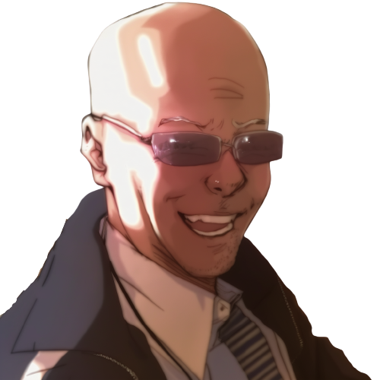
We can make “c”
using “a” and “b”
int a = 24;
int b = 50;
int c = a + b + 10;

Slide 42
We can make “c”
using “a” and “b”
int a = 24;
int b = 50;
int c = a + b + 10;
Here “c” is “a” plus “b” plus “10”.

Slide 43
We can make “c”
using “a” and “b”
int a = 24;
int b = 50;
int c = a + b + 10;
Here “c” is “a” plus “b” plus “10”.
As you can see, we can use
variable names or numbers

Slide 44

What is the value of “c”?
int a = 24;
int b = 50;
int c = a + b + 10;
assert c == ??;

Slide 45
What is the value of “c”?
int a = 24;
int b = 50;
int c = a + b + 10;
assert c == ??;
It is the value of “a” plus
the value of “b” plus “10”

Slide 46
That is, “84”.
int a = 24;
int b = 50;
int c = a + b + 10;
assert c == 84; //24 + 50 + 10

Slide 47
That is, “84”.
int a = 24;
int b = 50;
int c = a + b + 10;
assert c == 84; //24 + 50 + 10
We write “assert” to mark expressions
that should hold.

Slide 48
That is, “84”.
int a = 24;
int b = 50;
int c = a + b + 10;
assert c == 84; //24 + 50 + 10
We write “assert” to mark expressions
that should hold.
Equals equals evaluates to “true” if the
left and the right value are the same, and “false”
otherwise.

Slide 49
We can reuse a variable
instead of making a new one.

Slide 50
What is this
code doing?
int a = 24;
int b = 50;
b = a + b + 10;

Slide 51
What is this
code doing?
int a = 24;
int b = 50;
b = a + b + 10;
It is updating the value of “b”
using the result of the expression
on the right.

Slide 52
What is this
code doing?
int a = 24;
int b = 50;
b = a + b + 10;
It is updating the value of “b”
using the result of the expression
on the right.
That is, the equals is not like the
math equals, where we state that two terms
have the same value

Slide 53
Step by step...
int a = 24;
int b = 50;
b = a + b + 10;
//b =
//b =
assert b ==

Slide 54
Step by step...
int a = 24;
int b = 50;
b = a + b + 10;
//b = 24 + 50 + 10;
//b =
assert b ==
We can see that first “b” is read,

Slide 55
Step by step...
int a = 24;
int b = 50;
b = a + b + 10;
//b = 24 + 50 + 10;
//b = 84;
assert b ==
We can see that first “b” is read,
then the sum is computed,

Slide 56
Step by step...
int a = 24;
int b = 50;
b = a + b + 10;
//b = 24 + 50 + 10;
//b = 84;
assert b == 84;
We can see that first “b” is read,
then the sum is computed,
finally “b” is updated.

Slide 57
What if wanted to swap the
content of two variables?

Slide 58

We can see our two variables
as our two hands,
holding one ball each.

Slide 59
We can see our two variables
as our two hands,
holding one ball each.
A hand only hold one ball;

Slide 60
We can see our two variables
as our two hands,
holding one ball each.
A hand only hold one ball;
taking the other ball, we have to
abandon the current ball, that
would fall down, out of reach.

Slide 61
In code
int a = 24;
int b = 50;
a = b;
assert a == 50;
assert b == 50; //we have lost the “24”

Slide 62
In code
int a = 24;
int b = 50;
a = b;
assert a == 50;
assert b == 50; //we have lost the “24”
this looks like this!

Slide 63
In code
int a = 24;
int b = 50;
a = b;
assert a == 50;
assert b == 50; //we have lost the “24”
this looks like this!
As soon as we update “a”, we lose
the original content of “a”.

Slide 64
As you can see, we can not do it!

Slide 65
As you can see, we can not do it!
Not with only two variables!

Slide 66
As you can see, we can not do it!
Not with only two variables!
We need a third variable to
help us!

Slide 67
We do it in 3 steps!
int a = 24;
int b = 50;
int tmp = a;
....
....
assert a == 50;
assert b == 24;

Slide 68
We do it in 3 steps!
int a = 24;
int b = 50;
int tmp = a; //step 1
....
....
assert a == 50;
assert b == 24;
First we save the original value of “a”
in a new temporary local variable

Slide 69
We do it in 3 steps!
int a = 24;
int b = 50;
int tmp = a; //step 1
a = b; //step 2
....
assert a == 50;
assert b == 24;
First we save the original value of “a”
in a new temporary local variable
Then we write the content of “b” into “a”.

Slide 70
We do it in 3 steps!
int a = 24;
int b = 50;
int tmp = a; //step 1
a = b; //step 2
b = tmp; //step 3
assert a == 50;
assert b == 24;
First we save the original value of “a”
in a new temporary local variable
Then we write the content of “b” into “a”.
Finally we write “tmp” into “b”.

Slide 71
We do it in 3 steps!
int a = 24;
int b = 50;
int tmp = a; //step 1
a = b; //step 2
b = tmp; //step 3
assert a == 50;
assert b == 24;
As you can see, it can not be done
with only two variables,
it is mathematically proven
You need a third variable!

Slide 72

Something is wrong here

Slide 73
Something is wrong here
I’m seeing stuff

Slide 74



What?

Slide 75
What?
I’m under water?

Slide 76
What?
I’m under water?
What is this?

Slide 77
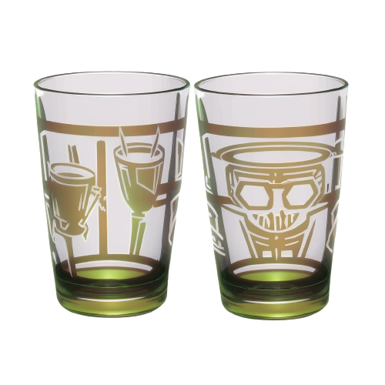
Two glasses?
With water?

Slide 78
Two glasses?
With water?
But I’m already
underwater…

Slide 79
Two glasses?
With water?
But I’m already
underwater…
I must be dreaming

Slide 80
Anyway, can I swap
the content

Slide 81
Anyway, can I swap
the content
without
a third glass?

Slide 82

int a = 24;
int b = 50;
a = a + b;
If I add the two glasses in
the first one,

Slide 83
int a = 24;
int b = 50;
a = a + b;
If I add the two glasses in
the first one,
would the second
glass get empty?

Slide 84
int a = 24;
int b = 50;
a = a + b;
No! this does not
update b.

Slide 85
int a = 24;
int b = 50;
a = a + b;
No! this does not
update b.
Values are not shuffled
around, but duplicated

Slide 86
int a = 24;
int b = 50;
a = a + b;
That is, even after
adding a and b

Slide 87
int a = 24;
int b = 50;
a = a + b;
That is, even after
adding a and b
All the information
is still in the system.

Slide 88
int a = 24;
int b = 50;
a = a + b;
That is, even after
adding a and b
All the information
is still in the system.
b is still in b, and
the original a is just
the current a minus b

Slide 89
int a = 24;
int b = 50;
a = a + b;
b = a - b;
a = a - b;
So, in 3 steps,
I can swap them

Slide 91



Slide 92
! Sorry !

Slide 93

! Hey, .. !

Slide 94
! Hey, .. !
Dany, stop!
What are you doing?

Slide 95
Yes?
Do you have a question on
this basic material?

Slide 96


Slide 97
I CAN do it!

Slide 98
So you ‘CAN’ do..

Slide 99
So you ‘CAN’ do..
what is it, that you can do?

Slide 100
So you ‘CAN’ do..
what is it, that you can do?
I can swap the variables
without a third one!

Slide 101
Really?
Do not make us laugh,
It is mathematically proved,
It can not be done!

Slide 102
Really?
Do not make us laugh,
It is mathematically proved,
It can not be done!
Now, let’s move one
with the lecture..

Slide 103
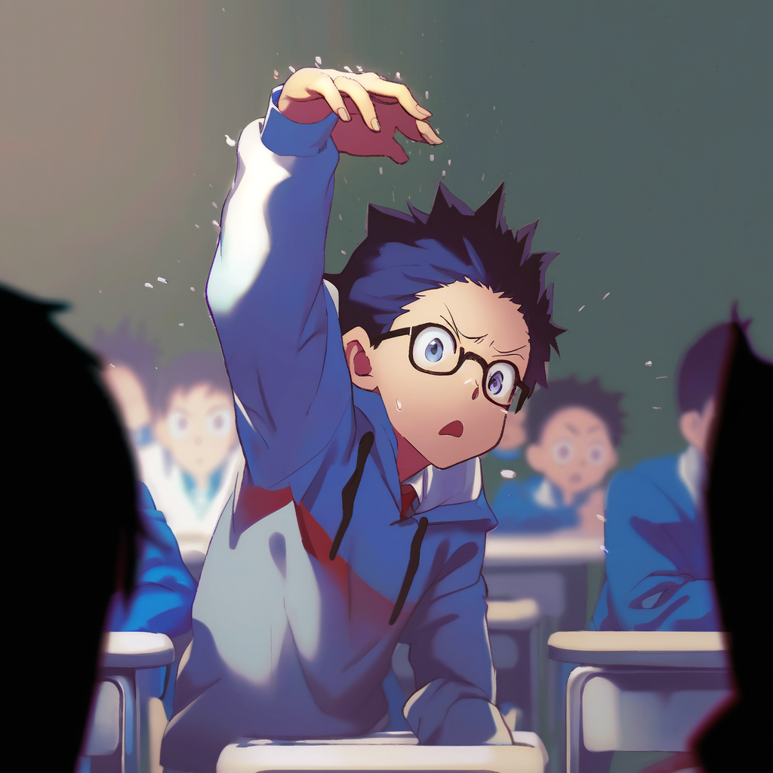
Dany, please stop!
It is going to get dangerous!

Slide 104
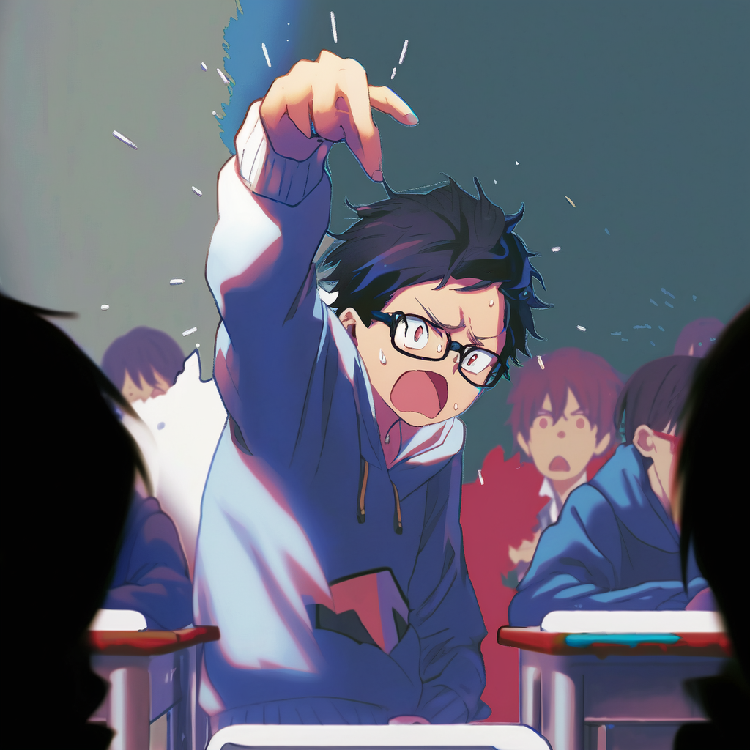
WRITE IT DOWN!

Slide 105
WRITE IT DOWN!
a = a + b;

Slide 106
WRITE IT DOWN!
a = a + b;
b = a - b;
a = a - b;

Slide 107
?.. are you...

Slide 108
?.. are you... for real.. ?

Slide 109
int a = 24;
int b = 50;
Ok then, .. I will write it doooown,

Slide 110
int a = 24;
int b = 50;
a = a+b;
Ok then, .. I will write it doooown,
So that I can shooow you that
does nooot work

Slide 111
int a = 24;
int b = 50;
a = a+b;
b = a-b;
a = a-b;
Ok then, .. I will write it doooown,
So that I can shooow you that
does nooot work
And then we will all laughs at you
and your dumb arrogance!

Slide 112
Ok class, give me some numbers
for a and b
int a = ??;
int b = ??;
a = a+b;//
b = a-b;//
a = a-b;//

Slide 113
Ok class, give me some numbers
for a and b
int a = 5;
int b = 12;
a = a+b;//
b = a-b;//
a = a-b;//
5
12

Slide 114
Ok class, give me some numbers
for a and b
int a = 5;
int b = 12;
a = a+b;//a = 5+12;//a = 17
b = a-b;//b =
a = a-b;//a =
With 5 and 12 we get… let’s see
step by step...
5
12

Slide 115
Ok class, give me some numbers
for a and b
int a = 5;
int b = 12;
a = a+b;//a = 5+12;//a = 17
b = a-b;//b = 17-12;//b = 5
a = a-b;//a =
With 5 and 12 we get… let’s see
step by step...
5
12

Slide 116
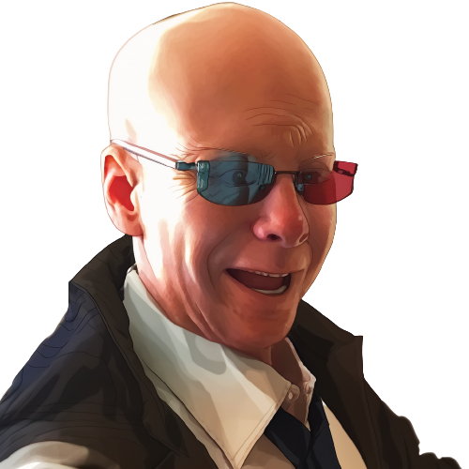
….
int a = 5;
int b = 12;
a = a+b;//a = 5+12;//a = 17
b = a-b;//b = 17-12;//b = 5
a = a-b;//a = 17-5;// a = 12
hahah

Slide 117
….
int a = 5;
int b = 12;
a = a+b;//a = 5+12;//a = 17
b = a-b;//b = 17-12;//b = 5
a = a-b;//a = 17-5;// a = 12
What, it worked?
hahah

Slide 118

Relax, it must be that those
two numbers are somehow special
int a = 5;
int b = 12;
a = a+b;//a = 5+12;//a = 17
b = a-b;//b = 17-12;//b = 5
a = a-b;//a = 17-5;// a = 12

Slide 119
Relax, it must be that those
two numbers are somehow special
int a = 5;
int b = 12;
a = a+b;//a = 5+12;//a = 17
b = a-b;//b = 17-12;//b = 5
a = a-b;//a = 17-5;// a = 12
Give me two other numbers,
this time one positive
and one negative

Slide 120

Please, stop this
and just solve
it symbolically

Slide 121
Such a good idea,
you must be very smart.

Slide 122
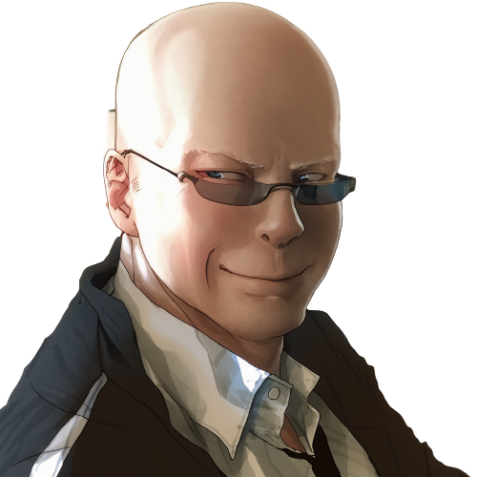
We can use use x and y for the
Original values of a and b.
int a = x;
int b = y;
a = a+b;//a = x+y;
b = a-b;//b =
a = a-b;//a =

Slide 123
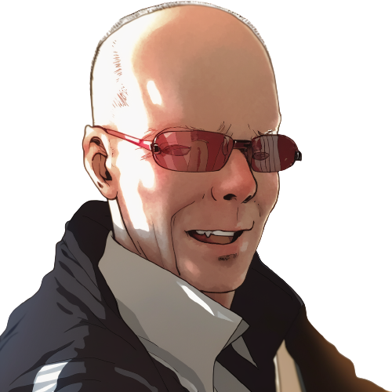
We can use use x and y for the
Original values of a and b.
int a = x;
int b = y;
a = a+b;//a = x+y;
b = a-b;//b = (x+y)-y;//b = x
a = a-b;//a =
It can’t be!

Slide 124

int a = x;
int b = y;
a = a+b;//a = x+y;
b = a-b;//b = (x+y)-y;//b = x
a = a-b;//a = (x+y)-x;//a = y
Oh… but how...

Slide 125

int a = x;
int b = y;
a = a+b;//a = x+y;
b = a-b;//b = (x+y)-y;//b = x
a = a-b;//a = (x+y)-x;//a = y
It does not make sense,
there is even a repeated
“a” minus “b”…

Slide 126
int a = x;
int b = y;
a = a+b;//a = x+y;
b = a-b;//b = (x+y)-y;//b = x
a = a-b;//a = (x+y)-x;//a = y
It does not make sense,
there is even a repeated
“a” minus “b”…
Ah?
so it is
working!

Slide 127
int a = x;
int b = y;
a = a+b;//a = x+y;
b = a-b;//b = (x+y)-y;//b = x
a = a-b;//a = (x+y)-x;//a = y
It does not make sense,
there is even a repeated
“a” minus “b”…
Ah?
so it is
working!
LOL, I’m
never forgetting
this

Slide 128

int a = x;
int b = y;
a = a+b;//a = x+y;
b = a-b;//b = (x+y)-y;//b = x
a = a-b;//a = (x+y)-x;//a = y
It does not make sense,
there is even a repeated
“a” minus “b”…
How can the same expression
make two different results...

Slide 129

int a = x;
int b = y;
a = a+b;//a = x+y;
b = a-b;//b = (x+y)-y;//b = x
a = a-b;//a = (x+y)-x;//a = y
No, wait, there must be some other...

Slide 130
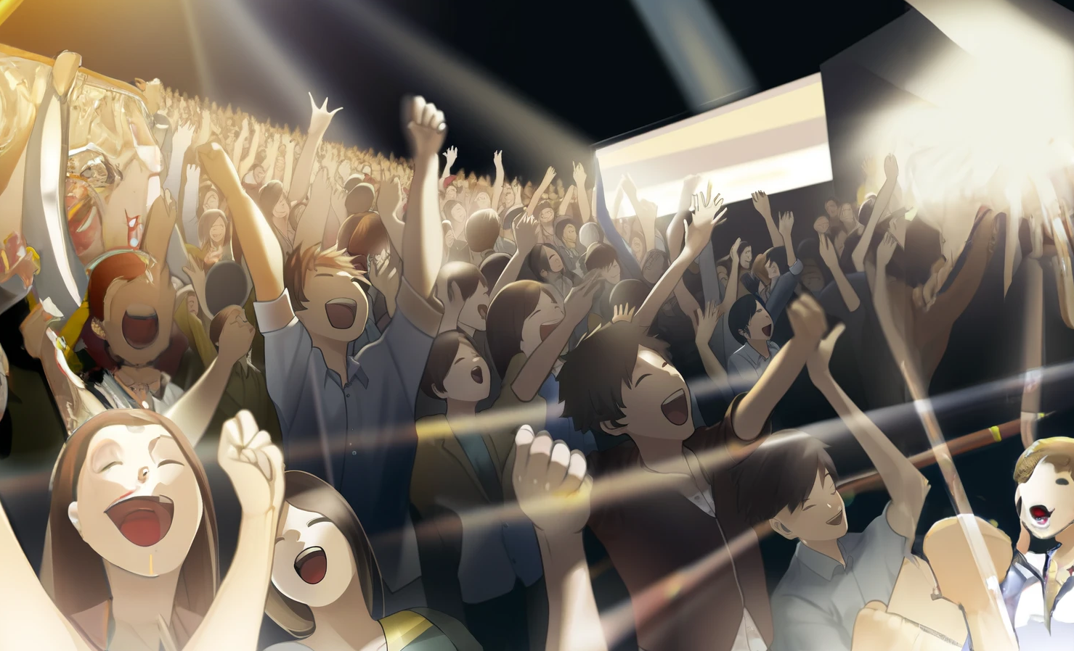
The bell rings in this crucial moment.
It is the end of the lecture

Slide 131

No, NO!

Slide 132
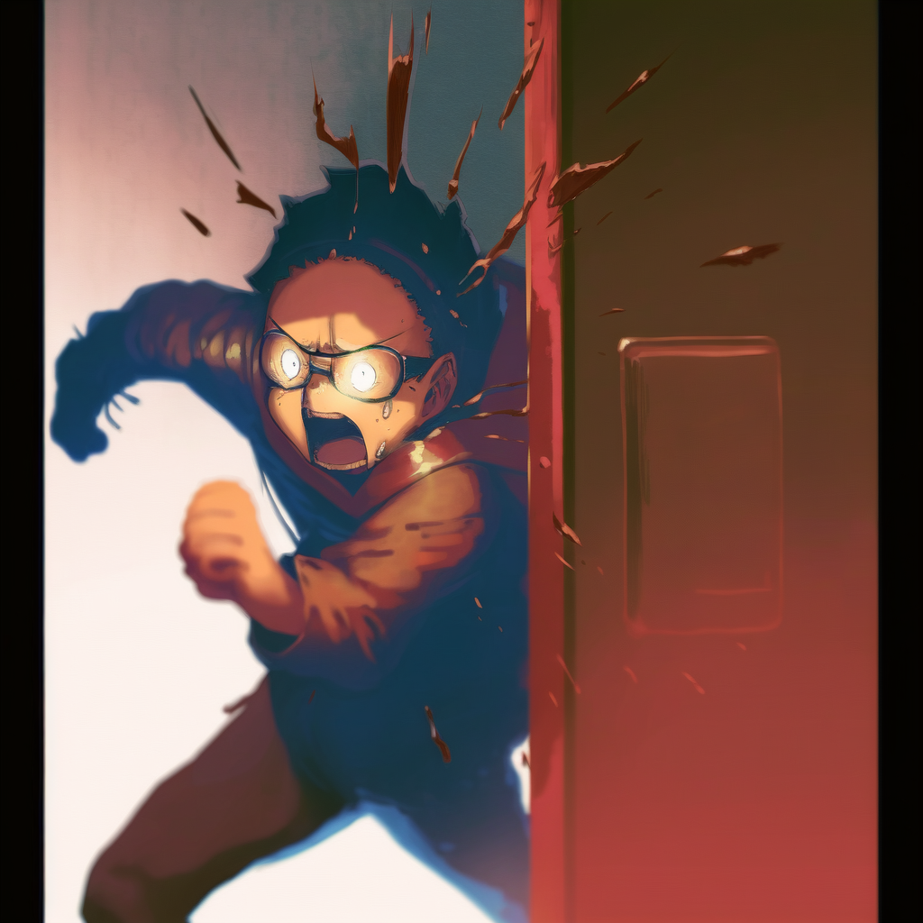
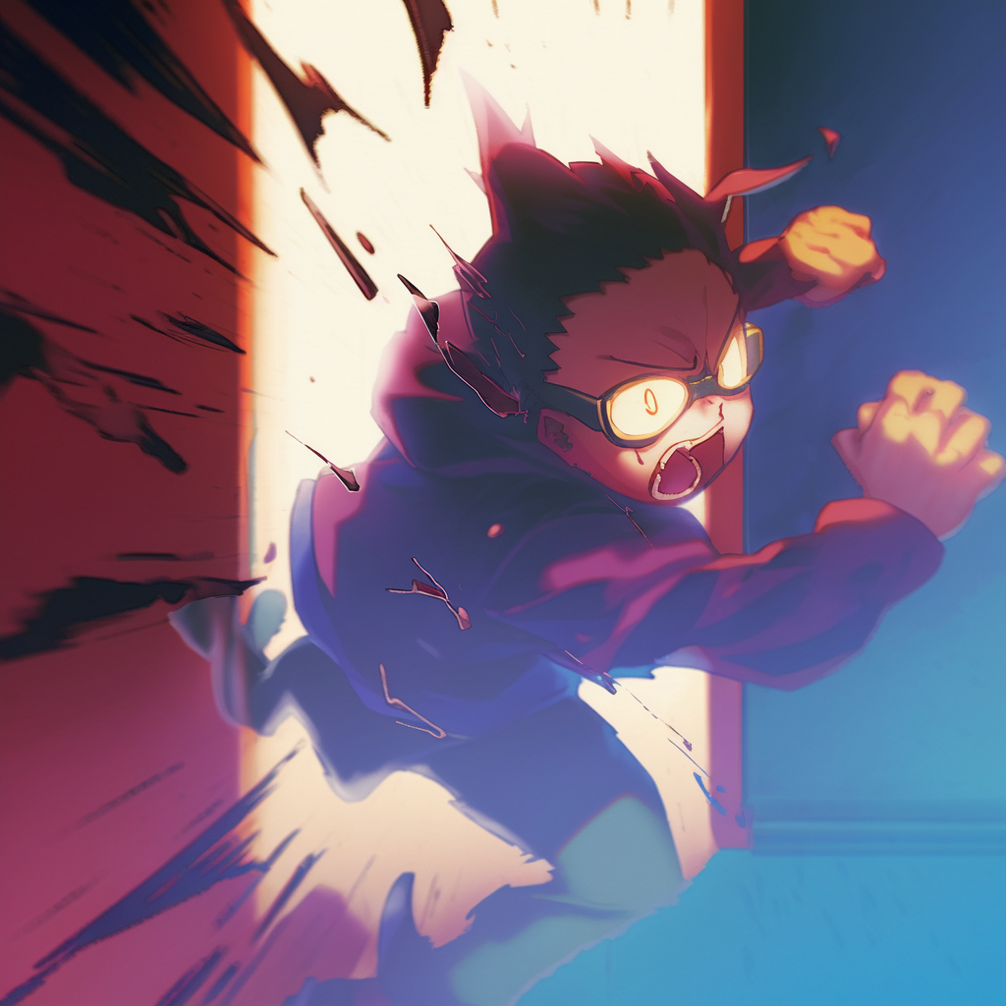
What have I done!

Slide 133


It is over!

Slide 134
It is over!
He is going to make
my life a nightmare!

Slide 135

This is the end of
the first chapter.
What waits in the future
of our cowardly hero?

