Slide 1
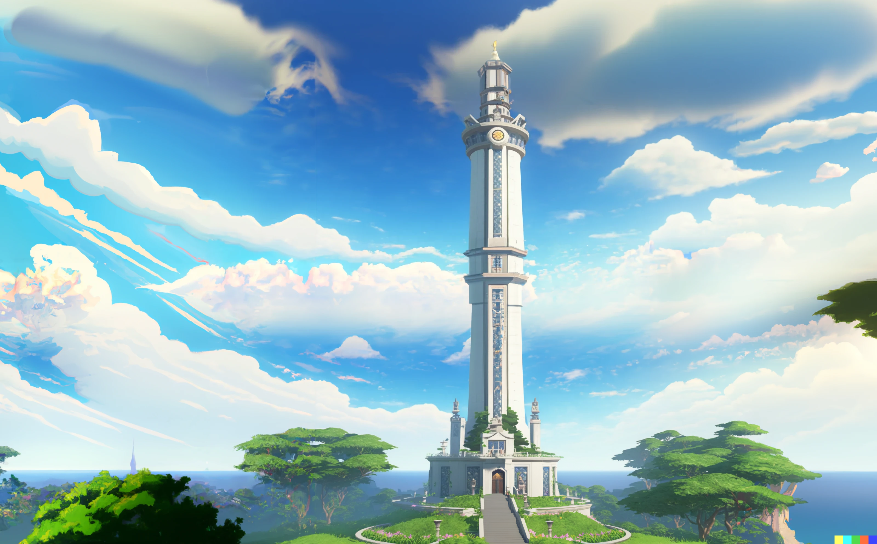
Sorrento Bay; Freshman city;
Ultimate Programming University (UPU)
Hey Dany, are you ok?

Slide 3
Sorrento Bay
The Ivory tower (UPU)

Slide 4
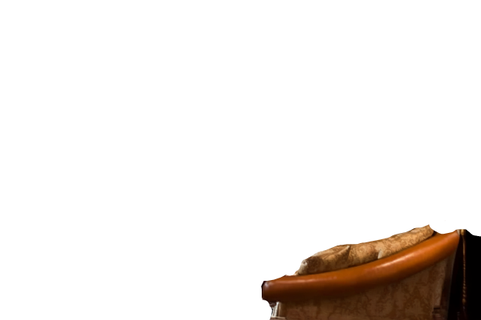
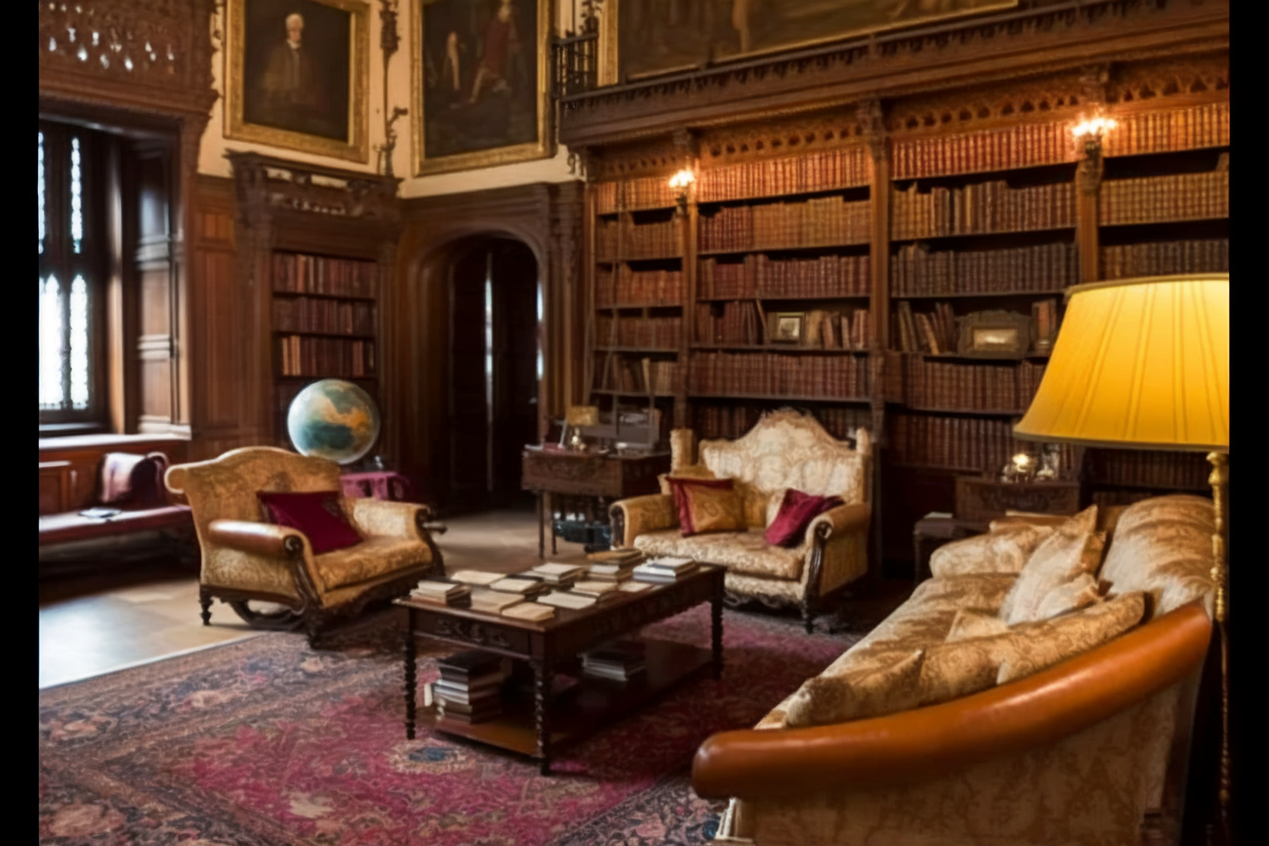

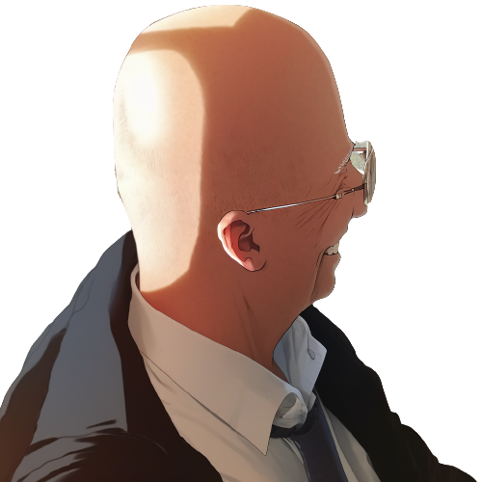
At the top of the Ivory tower,
Professor Mortis and Professor Pupon
stand facing each other, their expressions grave.

Slide 5
Pupon, I understand that you
had a bit of a mishap
during your first lecture.
You've become a laughing stock
among the first-year class.

Slide 6
Pupon hangs his head in shame,
his shoulders slumping
That's correct, Professor Mortis.
I was too confident in my own
assumptions and didn't
consider the possibility of an error.

Slide 7
This is not the kind of behavior
that we expect from UPU professors.
You must be open to the ideas
and perspectives of our students.

Slide 8
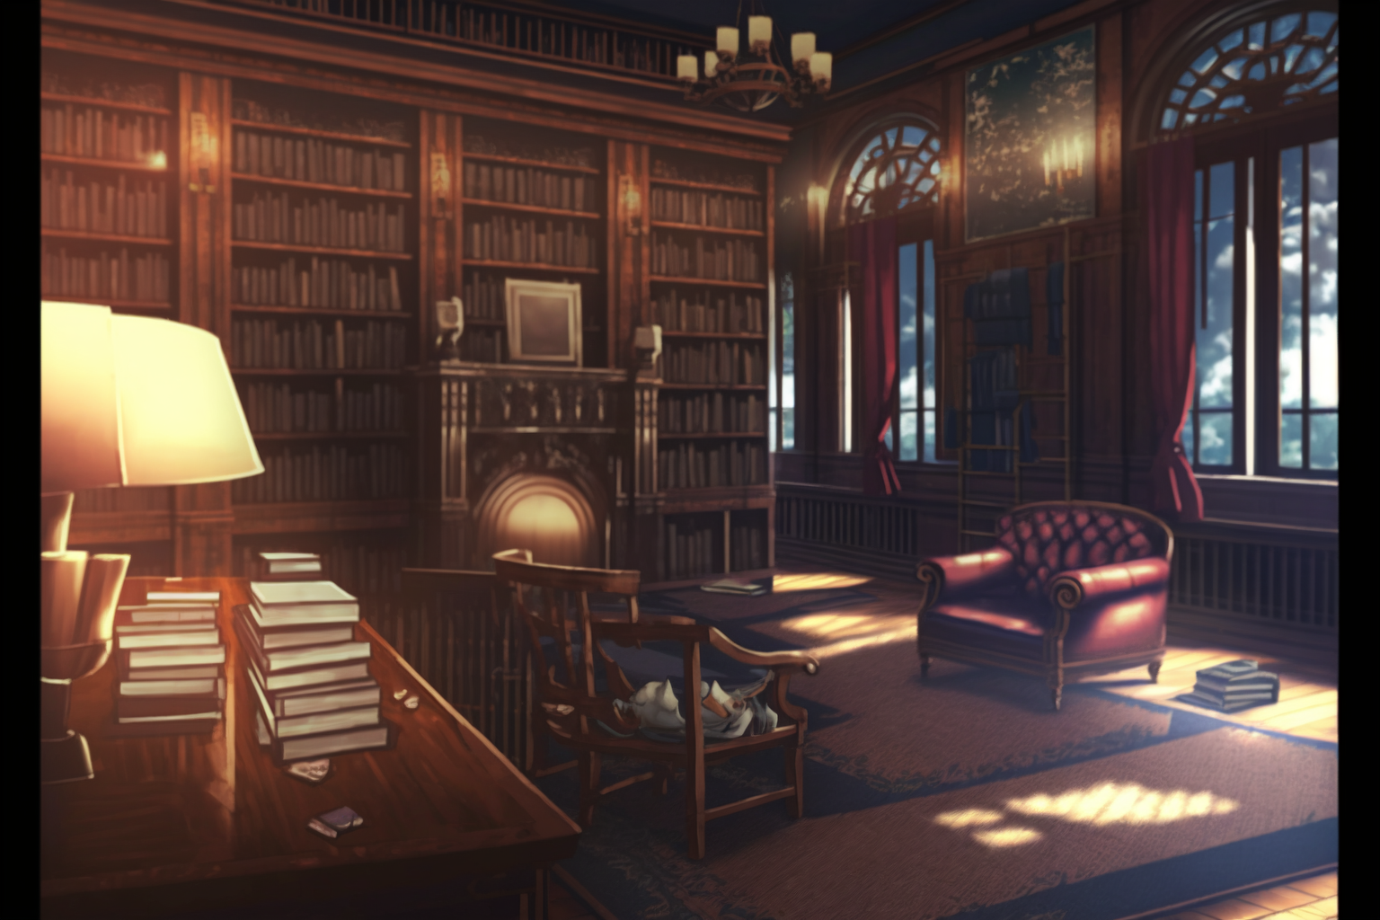

I, … I apologize for bringing shame
upon the university.
I'll make sure to be more thorough
in my explanations in the future.

Slide 9
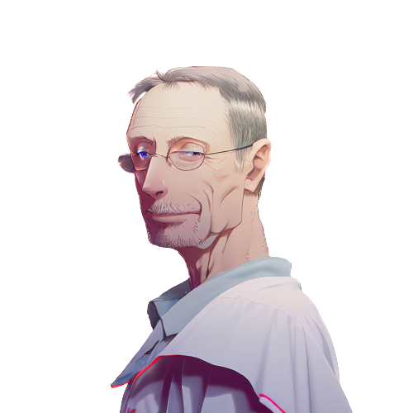
Don't worry, it just
means that this year's students
are particularly talented.
We should raise the difficulty
of our course material to
match their abilities.

Slide 10
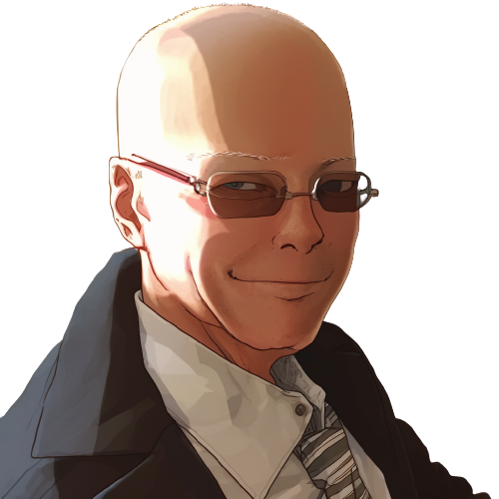
What are you proposing?

Slide 11
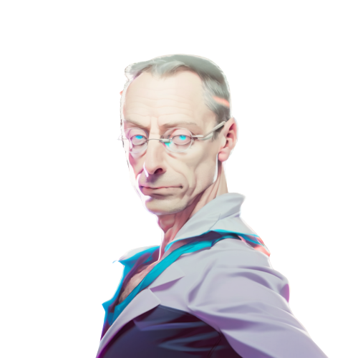
The 'equals switcheroo'.
It will test their skills and
understanding of programming.
By raising the difficulty
of our lessons, we can further
challenge and engage our students.

Slide 12

Pupon's face falls,
a look of dread crossing his features.
The 'equals switcheroo'?
Oh no, I remember that lesson.
It's the most difficult and frustrating
challenge we give to students.

Slide 13
Mortis nods, his expression serious.
Exactly. It's reserved for
only the most gifted students.
I have a feeling that this year's
class will be up to the task.

Slide 14

Pupon takes a deep breath, steeling himself.
I hope they are ready for the challenge.
I certainly wasn't when I took it.
I will have my revenge
against that student.

Slide 15
Pupon takes a deep breath, steeling himself.
I agree, Professor Mortis.
The 'equals switcheroo'
will certainly be a healthy challenge
for our students.

Slide 16

Excellent.
Now let's get back to work.
I’ve important research
to conclude today.
Yes, sir!

Slide 17
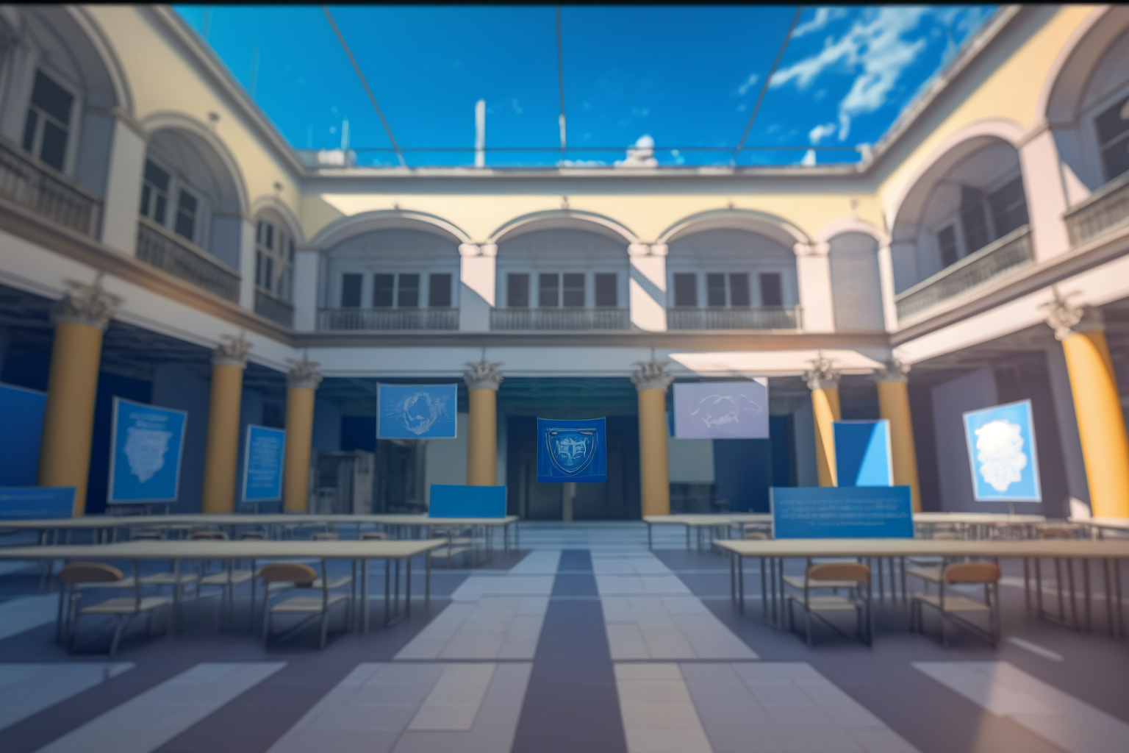
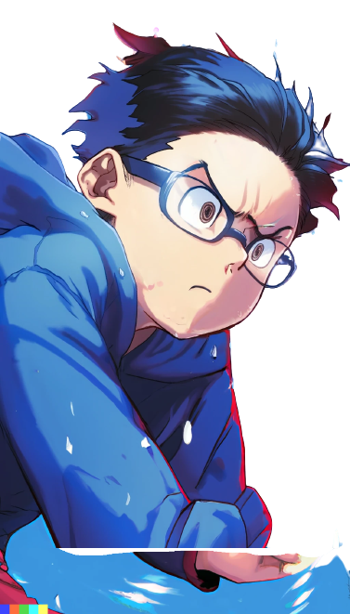
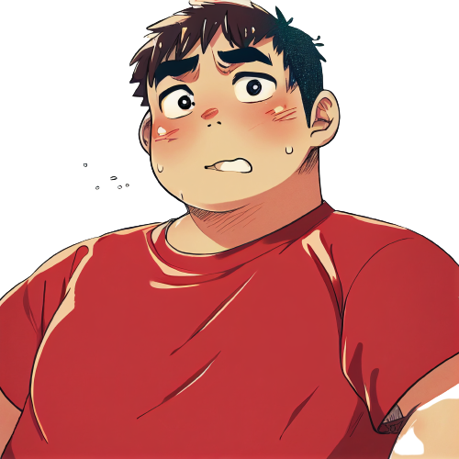
Meanwhile, at freshman campus.
Why Dany, why did you do that?
Why did you have to
correct Professor Pupon in
front of the whole class?

Slide 18

I know, right? I'm so scared.
Now Pupon is going
to be mad at me.

Slide 19

Relax, we're at UPU.
This is a prestigious university
Professor Pupon will
have to act professionally.
He won't hold it
against you, right?

Slide 20
I'm not so sure about that.
UPU is known for only
accepting the best and
brightest high school students.
But we both know how our
computer science teacher
was in high school, right?

Slide 21
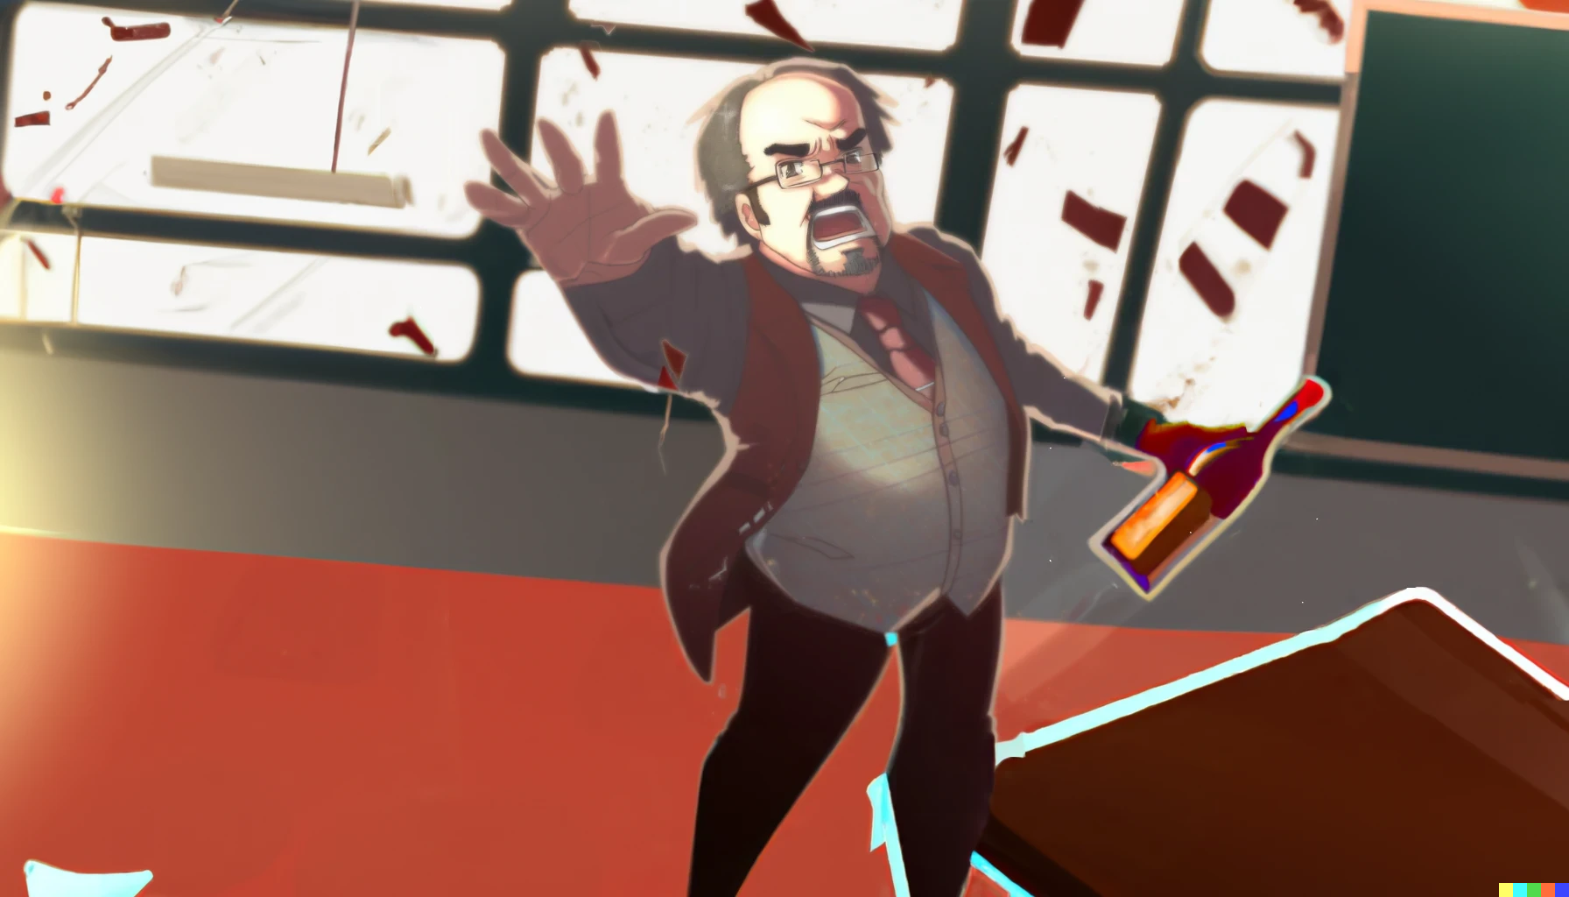

..And you get an A+!
I can't believe our high school
teacher was always drunk.
He was always stumbling
around the classroom

Slide 22
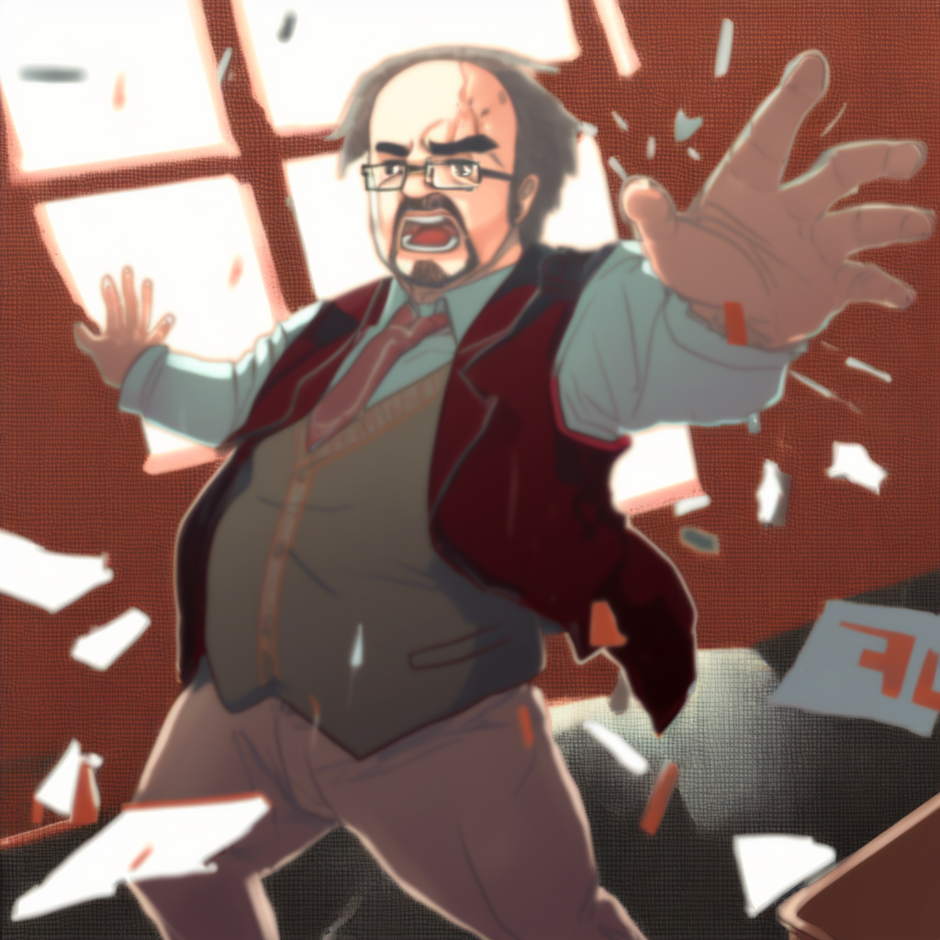
..And you get an A+ too!
And you!
Always giving everyone A+ grades

Slide 23
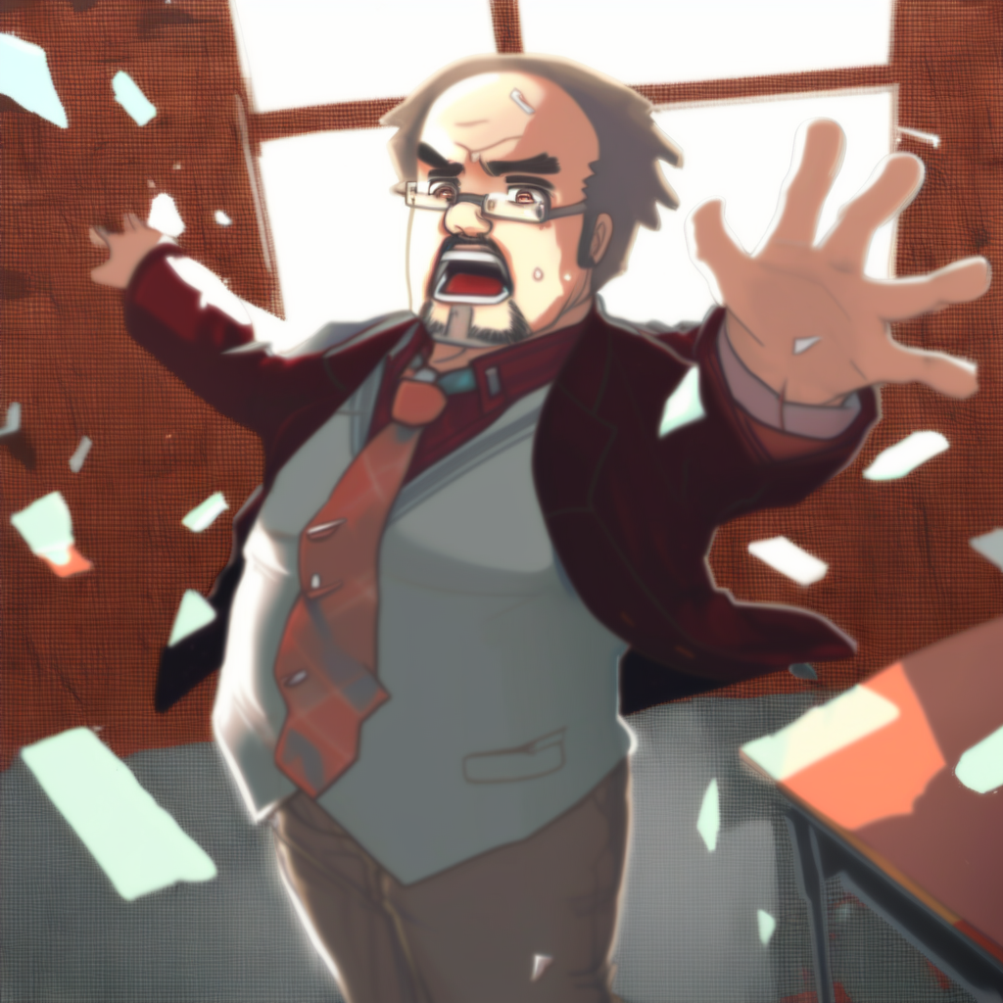
And you! And you!
Everyone gets an A+!
..And you get an A+ too!
And you!
without actually
teaching us anything.

