Slide 1
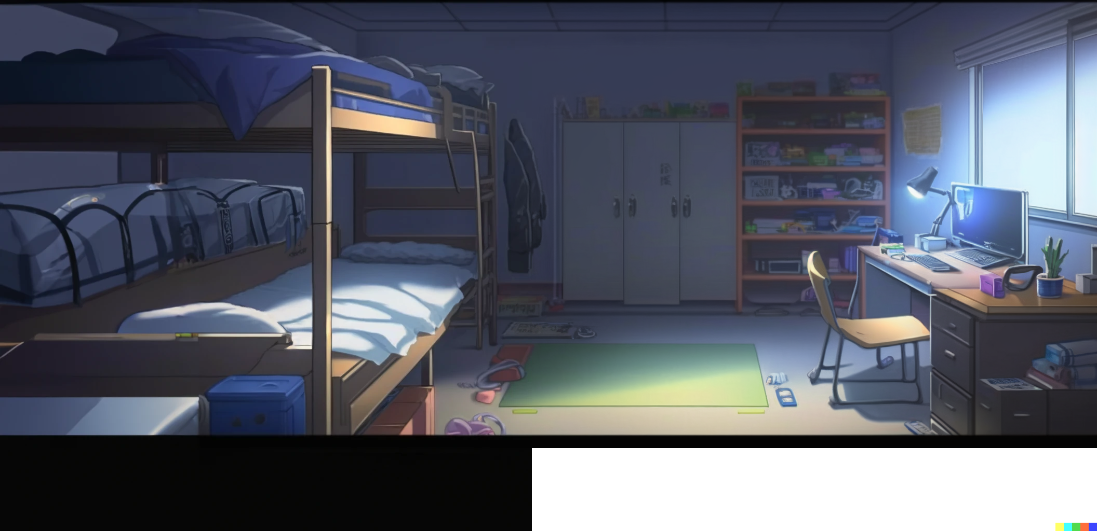



Inside of Hanton room

Slide 2
Inside of Hanton room
Here we are

Slide 3
Inside of Hanton room
Here we are
Let’s hurry up and find those notes!

Slide 4
Inside of Hanton room
Here we are
Let’s hurry up and find those notes!
Here they are!

Slide 5

The notes!
The forbidden tome
of Hanton’s knowledge

Slide 6


Slide 7


Slide 8


Slide 9
Oh, NO !
I… I cannot believe it!

Slide 10


Are they so unbelievably good?

Slide 11
Are they so unbelievably good?
No… this is just…

Slide 12
Are they so unbelievably good?
No… this is just…
a list of timestamps

Slide 13

Pupon: Lec1 - 9:40 :
“It can not be done with only two variables,
It is mathematically proven.”
Nope: Just use this trivial one-liner
b = a + (a=b)*0;
Pupon: Lec3 – 9:10
“A try block always throws at most one exception,
and all exceptions are propagated to the caller.”
Nope:
In Java we have suppressed exceptions now!
class MyResource implements AutoCloseable {
public void doSomething(){
throw new IllegalArgumentException();
}
public void close(){
throw new NullPointerException();
}
static void main(String[] a){
try(var r = new MyResource()){ r.doSomething(); }
}
}
This main throws an exception e of type
IllegalArgumentException, with
e.getSuppressed()[0] instanceof NullPointerException

Slide 14
Pupon: Lec4 - 9:23 :
“We can never be sure if assertions are enabled”
Nope: Just add this at the start of your main
try{ assert false; throw new Error("..."); }
catch(AssertionError){}
Pupon: Lec4 - 15:16 :
“Assertions need to be enabled from the command
line with option -ea”
Nope: we can enable them programmatically via
ClassLoader.getSystemClassLoader()
.setDefaultAssertionStatus(true);
This also shows the nature of class loading:
public class Main {
public static void main(String[]a){
//First the class Main is loaded
ClassLoader.getSystemClassLoader()
.setDefaultAssertionStatus(true);
assert false:"ignored, no error";
System.out.println("Hello");//Prints no problem
Other.method(); //Loading class ‘Other’
}
}
class Other{
static void method(){
assert false:"Error here";
System.out.println("World"); //Not printed
}
}

Slide 15


This is so confusing

Slide 16
This is so confusing
Wow, those are
pretty advanced remarks.
But… why the time stamps?

Slide 17
This is so confusing
Wow, those are
pretty advanced remarks.
But… why the time stamps?
Is it possible that …

Slide 18
Pupon: Lec5 - 9:55 :
“In Java, Lists are serializable”
Nope: Not only we can define our own
non serializable list, but even the common
java.util.ArrayList$SubList is not serializable
Those are obtained by calling
the .subList(..) method.
However, many kinds of lists are serializable:
- ArrayList,
- List.of(),
- List.copyOf()
- Stream.toList()
Pupon: Lec5 - 9:37 :
“Java does not have the comma operator of C/C++”
Nope: the comma operator is present in Java, but only
in the third component of the ‘for’:
for(int x=0,y=1;x<10;x+=1,y=x+y+1){/*..*/}
However, using it is often considered bad style.

Slide 19


The timestamps are
all and only the moments
when Pupon was wrong.

Slide 20
The timestamps are
all and only the moments
when Pupon was wrong.
Hanton!

Slide 21
The timestamps are
all and only the moments
when Pupon was wrong.
Hanton!
Oh, no, he’s got us!

Slide 23
Why are you
in my dorm room?

Slide 24
Why are you
in my dorm room?
Wait, we can explain …

Slide 25
Why are you
in my dorm room?
Wait, we can explain …
What, you broke my window
to get in?

Slide 26

If you just gave us your notes
none of this would have happened

Slide 27
Woah, slow down.
I just told you that they
would not have helped you.

Slide 28
Woah, slow down.
I just told you that they
would not have helped you.
Now that you have them,
are they helpful?

Slide 29
Woah, slow down.
I just told you that they
would not have helped you.
Now that you have them,
are they helpful?
Not really…

Slide 30


Slide 31
Told you so!

Slide 32

Now,
is there something
ELSE
I can do for you?

Slide 33
Hey Hanton … sorry, we should not
have broken in your room.

Slide 34
Hey Hanton … sorry, we should not
have broken in your room.
Tonight
I’m going to be cold.
They will not fix the
window until tomorrow!

Slide 35


Slide 36
Yea, we messed up big time.
But we are so desperate.

Slide 37
Yea, we messed up big time.
But we are so desperate.
We can not understand
records and classes.

Slide 38
Yea, we messed up big time.
But we are so desperate.
We can not understand
records and classes.
Are we going to just fail?

Slide 39

So, … why did you bunch
not just ask for help?
I could just have
tutored you.

Slide 40
So, … why did you bunch
not just ask for help?
I could just have
tutored you.
As I said:
“is there something
else I can do for you?”

Slide 41


Slide 42
Are you… for real?

Slide 43
Are you… for real?
Will you tutor us even after
we broke into your room?

Slide 44
Of course!
Your stupidity
does not reach me.

Slide 45
Of course!
Your stupidity
does not reach me.
See you all tomorrow
in the cafeteria.

Slide 46
Of course!
Your stupidity
does not reach me.
See you all tomorrow
in the cafeteria.
But,
you will have to pay me.
What about 245 dollars?

Slide 47
245 dollars? Are you insane?

Slide 48
If you asked earlier,
I would have done
it for free.

Slide 49
If you asked earlier,
I would have done
it for free.
But fixing
a window in the dorm, …
it costs 245 dollars!

