Slide 1
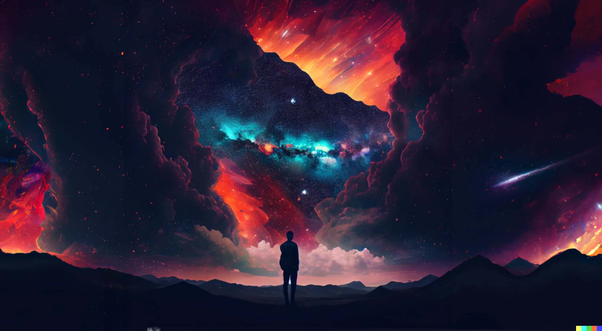
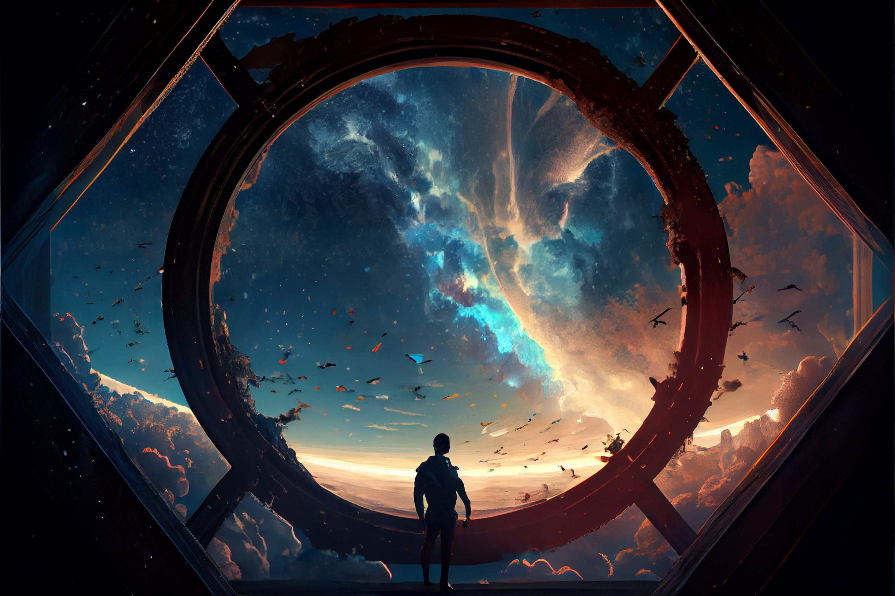

Slide 3
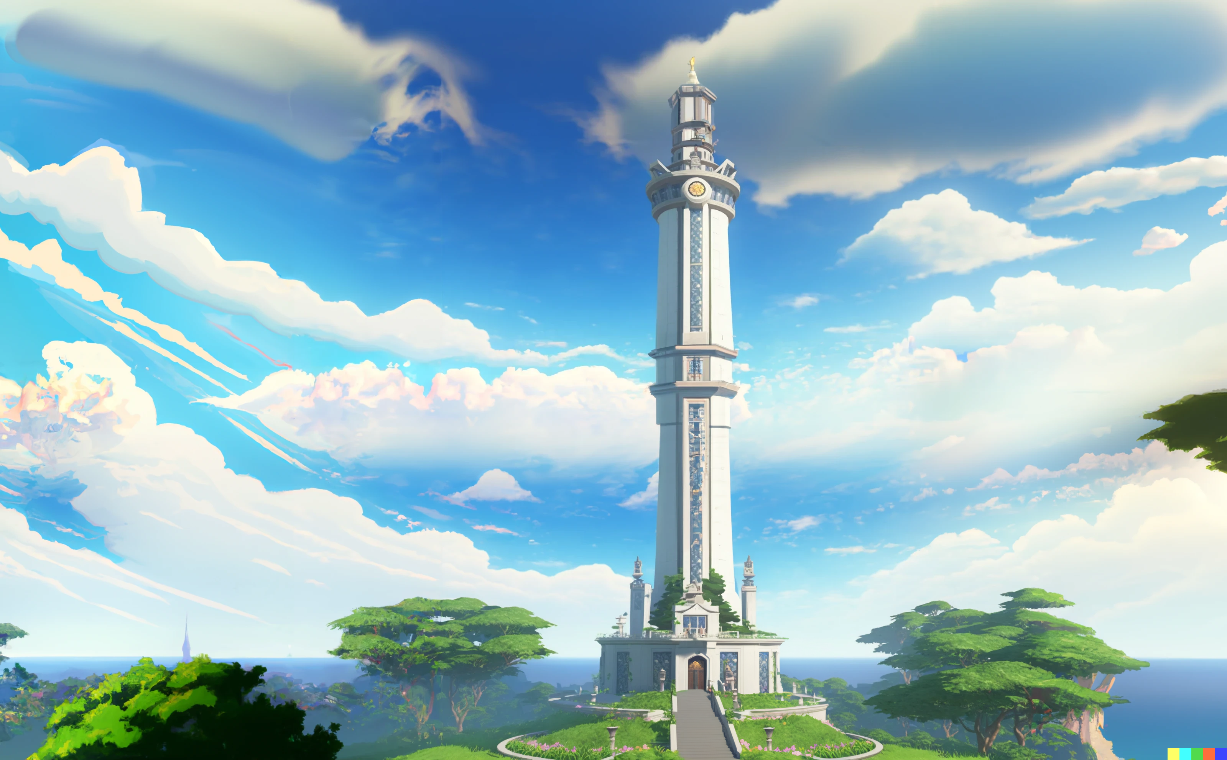

Slide 4
Sorrento Bay
The Ivory tower (UPU)

Slide 5

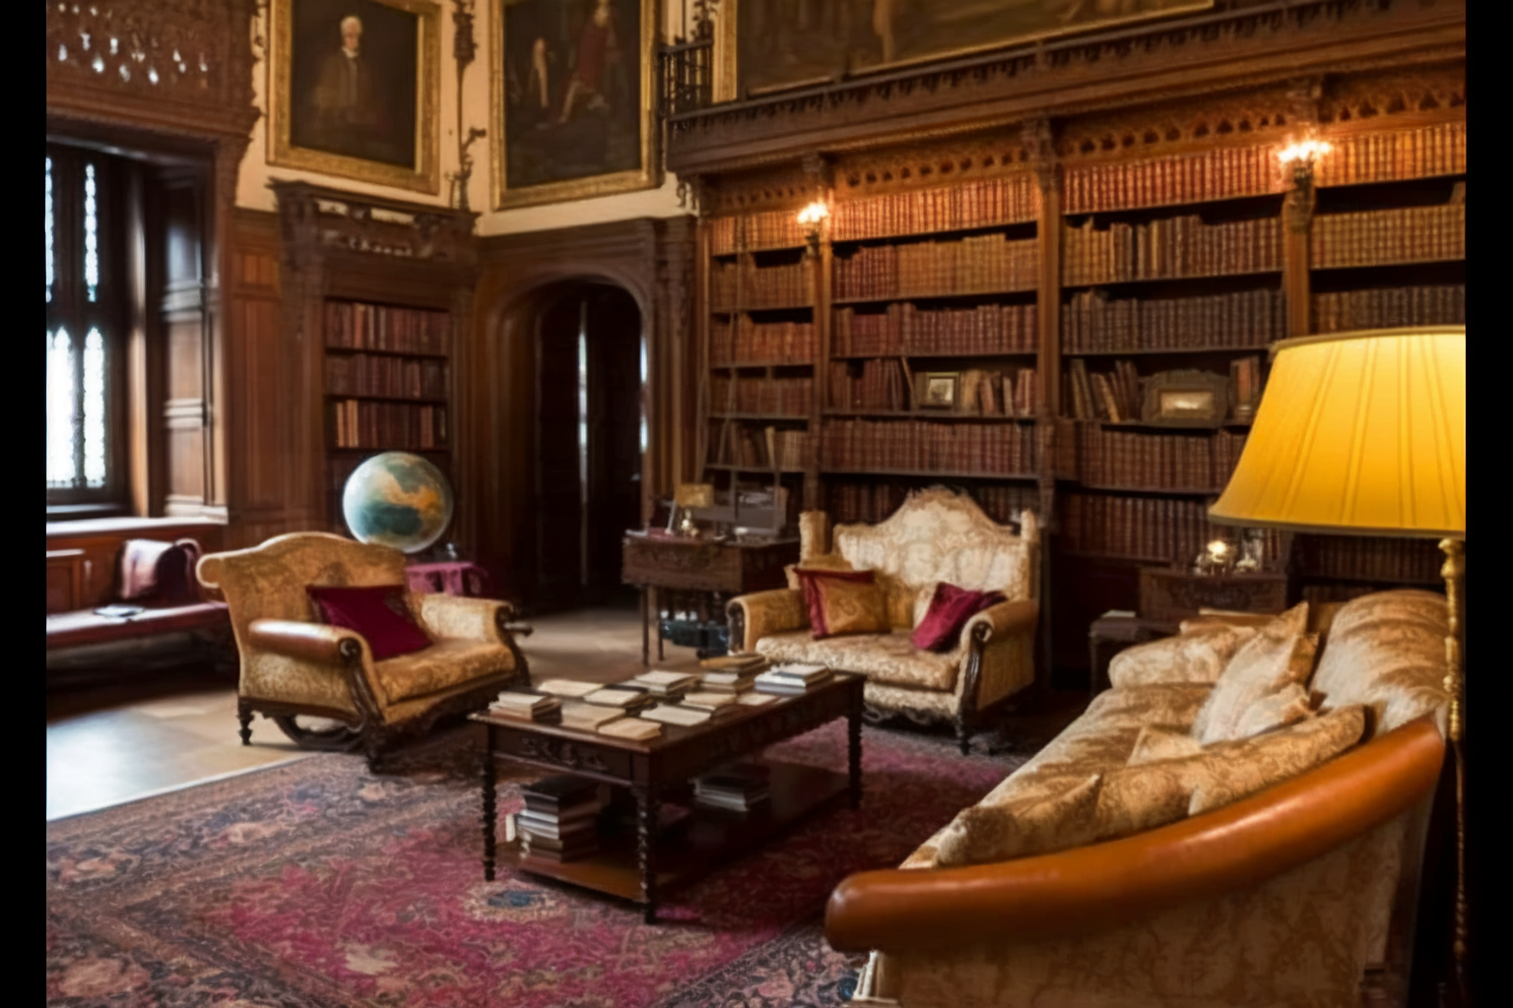

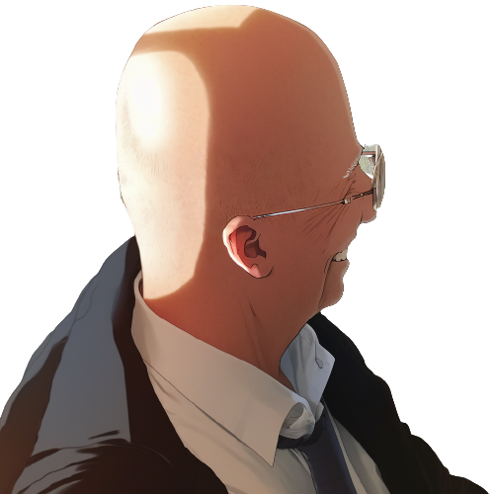
At the top of the Ivory tower,
Professor Mortis and Professor Pupon
stand facing each other, their expressions grave.

Slide 6
Pupon, I understand that you
had a bit of a mishap
during your first lecture.
You've become a laughing stock
among the first-year class.

Slide 7
Pupon hangs his head in shame,
his shoulders slumping
That's correct, Professor Mortis.
I was too confident in my own
assumptions and didn't
consider the possibility of an error.

Slide 8
This is not the kind of behavior
that we expect from UPU professors.
You must be open to the ideas
and perspectives of our students.

Slide 9
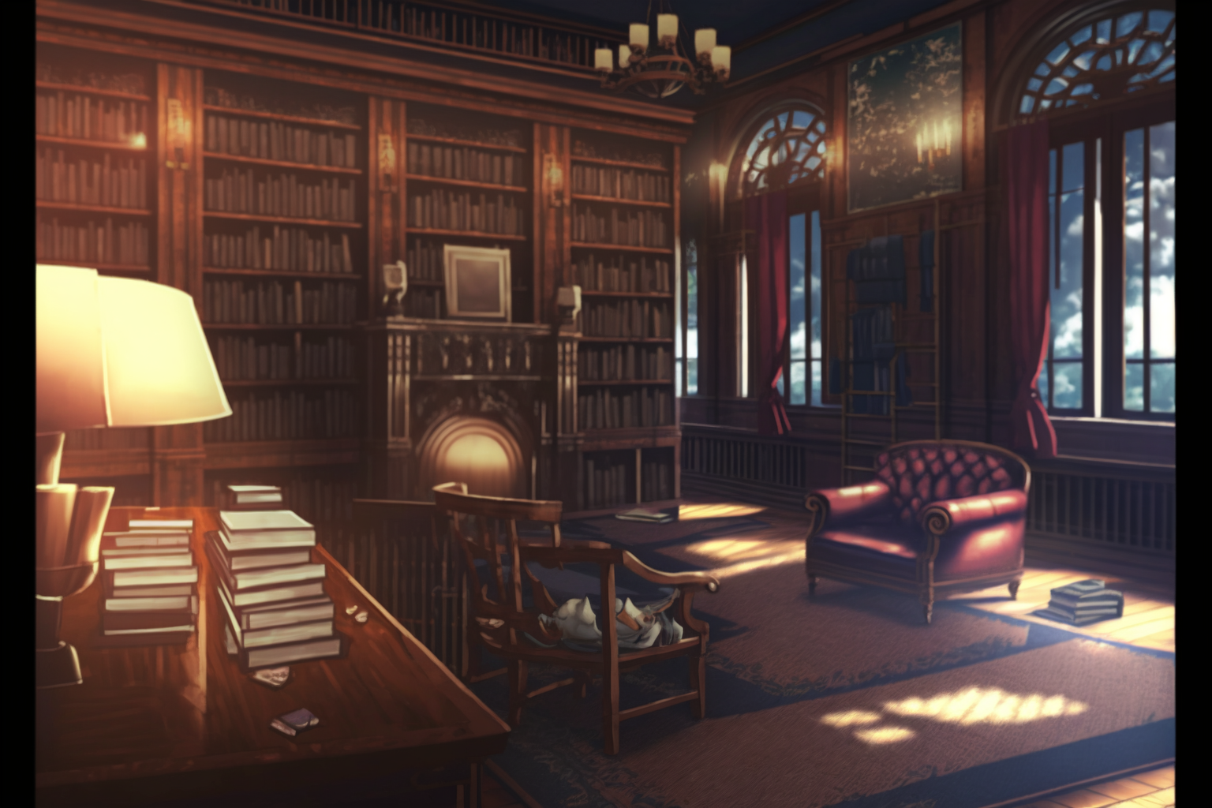

I, … I apologize for bringing shame
upon the university.
I'll make sure to be more thorough
in my explanations in the future.

Slide 10
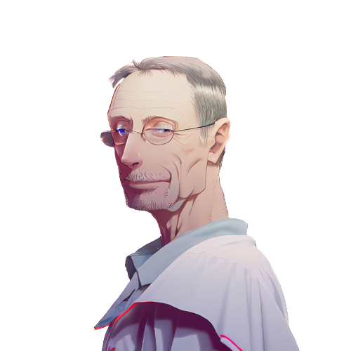
Don't worry, it just
means that this year's students
are particularly talented.
We should raise the difficulty
of our course material to
match their abilities.

Slide 11
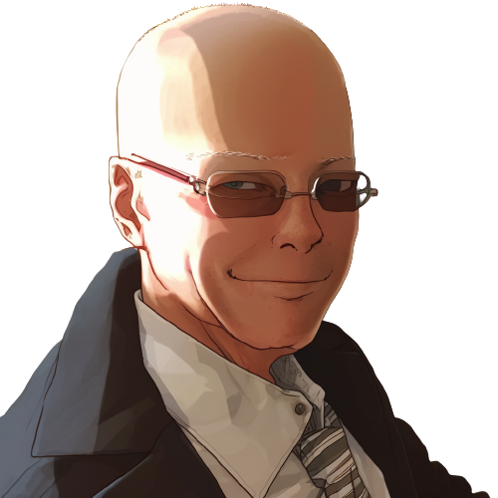
What are you proposing?

Slide 12
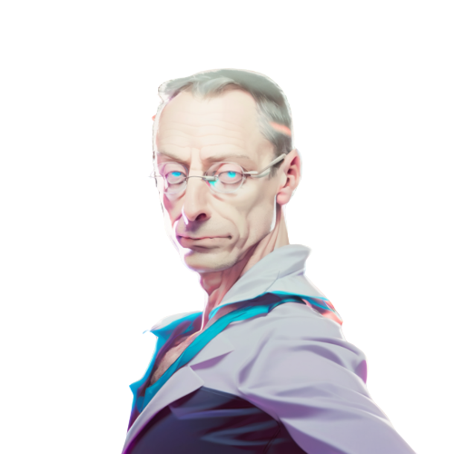
The 'equals switcheroo'.
It will test their skills and
understanding of programming.
By raising the difficulty
of our lessons, we can further
challenge and engage our students.

Slide 13

Pupon's face falls,
a look of dread crossing his features.
The 'equals switcheroo'?
Oh no, I remember that lesson.
It's the most difficult and frustrating
challenge we give to students.

Slide 14
Mortis nods, his expression serious.
Exactly. It's reserved for
only the most gifted students.
I have a feeling that this year's
class will be up to the task.

Slide 15

Pupon takes a deep breath, steeling himself.
I hope they are ready for the challenge.
I certainly wasn't when I took it.
I will have my revenge
against that student.

Slide 16
Pupon takes a deep breath, steeling himself.
I agree, Professor Mortis.
The 'equals switcheroo'
will certainly be a healthy challenge
for our students.

Slide 17

Excellent.
Now let's get back to work.
I’ve important research
to conclude today.
Yes, sir!

Slide 18
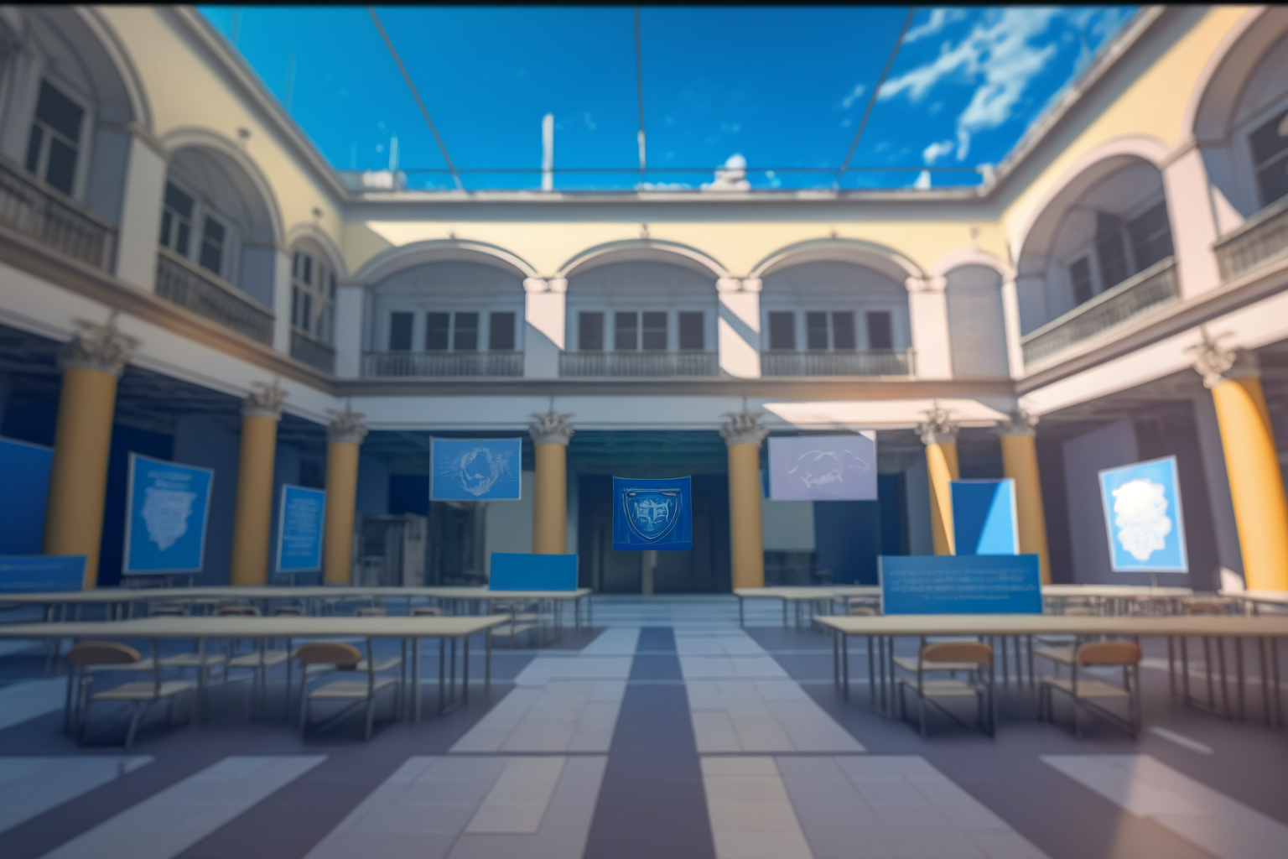
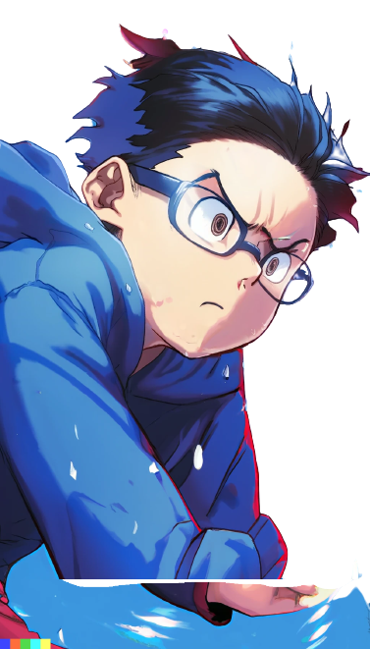
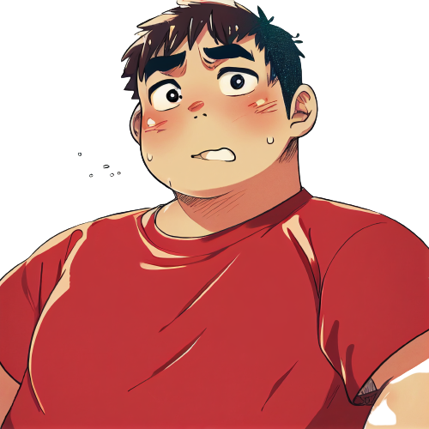
Meanwhile, at freshman campus.
Why Dany, why did you do that?
Why did you have to
correct Professor Pupon in
front of the whole class?

Slide 19

I know, right? I'm so scared.
Now Pupon is going
to be mad at me.

Slide 20

Relax, we're at UPU.
This is a prestigious university
Professor Pupon will
have to act professionally.
He won't hold it
against you, right?

Slide 21
I'm not so sure about that.
UPU is known for only
accepting the best and
brightest high school students.
But we both know how our
computer science teacher
was in high school, right?

Slide 22
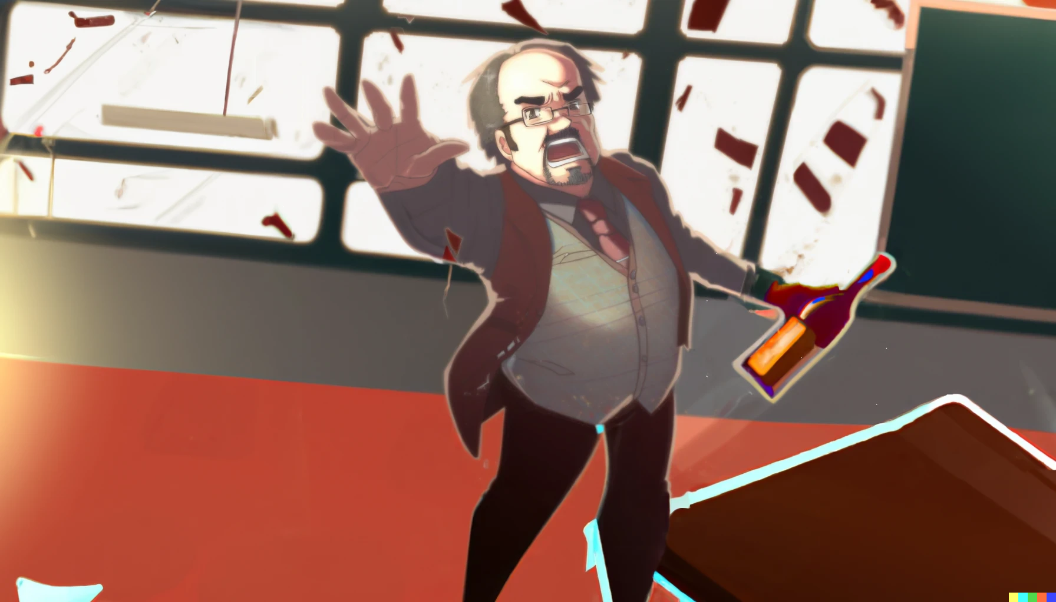
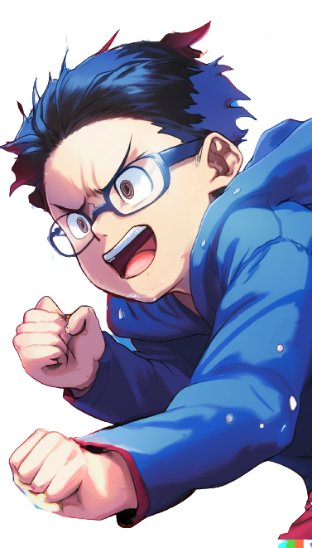
..And you get an A+!
I can't believe our high school
teacher was always drunk.
He was always stumbling
around the classroom

Slide 23
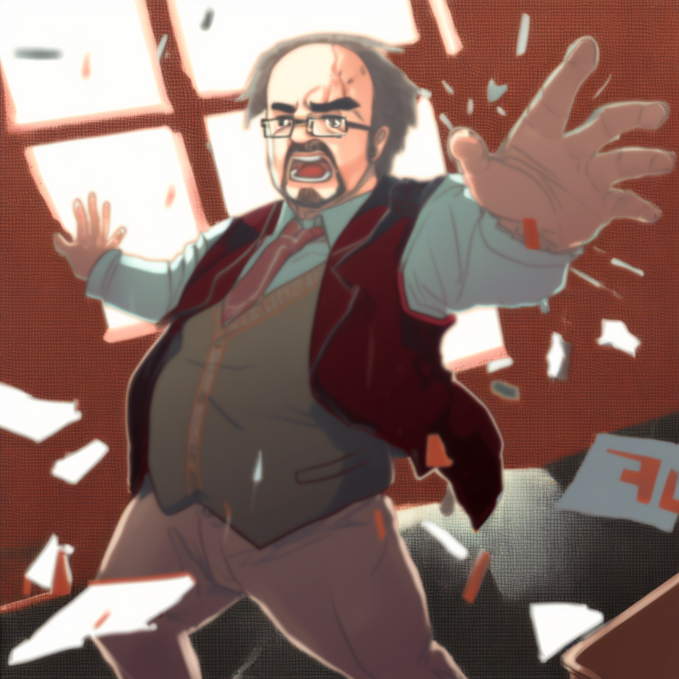
..And you get an A+ too!
And you!
Always giving everyone A+ grades

Slide 24
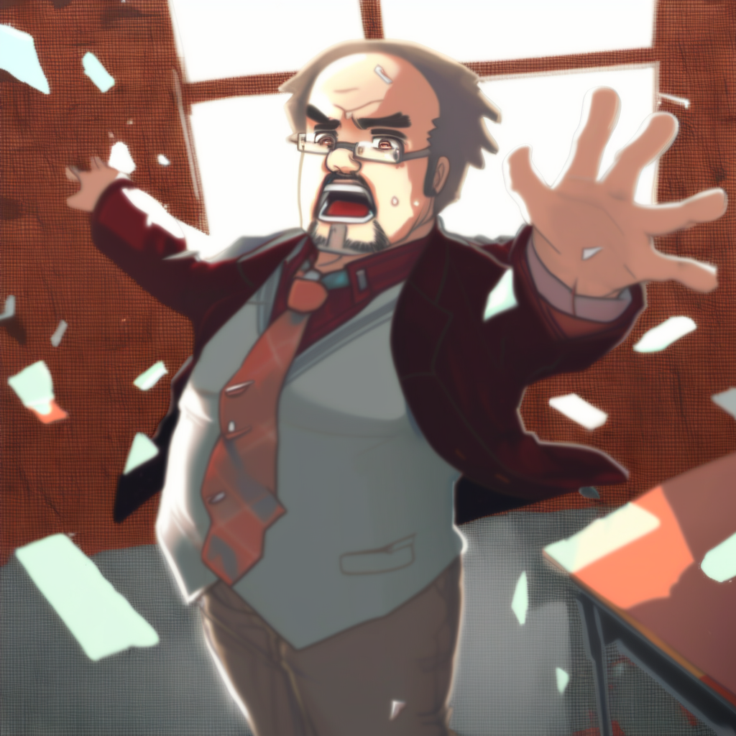
And you! And you!
Everyone gets an A+!
..And you get an A+ too!
And you!
without actually
teaching us anything.

Slide 25
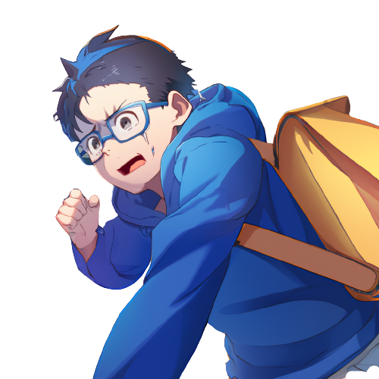

Yeah, it was crazy.
we both loved the idea of
learning to make videogames
so we enrolled at UPU
and hoped for the best
But this place feels extremely
hard and full of theoretical
programming courses.
We were probably a little naive.

Slide 26
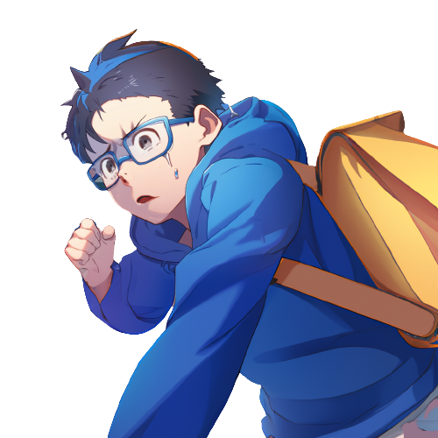
Anyway, finding that solution
in Professor Pupon's lecture...
It was impressive.
How did you figure it out?

Slide 27
I have no idea. It was like...
like I was possessed or something.
I just saw the solution in
my mind and acted on it.
I just couldn't help it.
It was like a vision or something.

Slide 28

I saw the solution in my mind
and I had to act on it,
even though I was terrified.

