Slide 1



But.. how.. yes..
int res = 0;
if( res == (res=5) ){ res = 10; }
assert res == 5;
It is correct. Go back to your seat…
Is this what he meant?
the equals switcheroo
could not break him!
I have a feeling that this year's
class will be up to the task.

Slide 2


After the lecture, Dany rushes to his room
Again!
Every lecture feels like a fight to the death!
The class looked confused,
as if I said something absurd.
How many of them would
have been able to answer?

Slide 3


After a hot shower, Dany mumbles about
Is this a sensible way to code?
The first time Pupon was showing
a reasonable intuitive solution
and I made the tricky variation.
But this time..
The lecture and the questions
was all about the tricky part!

Slide 4

Is code all about tricks?
int input = 2;//Code shown by Pupon
int res = 0;
int value = 0;
if( (value=input*10)>40 ){ res = 10; }
assert res == 0;
assert value == 20;
Why all those tricks?
Just to save a
few lines of code?
Should we instead make
code more readable by
making it longer?

Slide 5
For example, like this?
int input = 2;
int res = 0;
int value = 0;
value = input*10;
boolean shouldUpdate = value>40;
if(shouldUpdate){ res = 10; }
assert res == 0;
assert value == 20;
Would this be better?
Is it only a few lines ever time,
or some of those tricks do
save massive amounts of code?

Slide 6


Dany suddenly heard a rustling sound coming from the door

Slide 7

He turned to look and saw a small piece of paper sliding under the door.
He reached down and picked up the note, his hands shaking as he unfolded it.

Slide 8
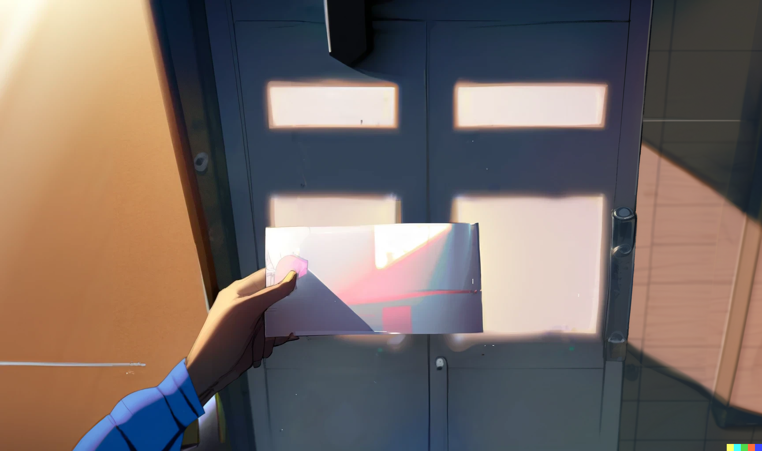
As he read the words written in neat handwriting, a sense of dread washed over him.
b = a+(a=b)-b; Works in Java, but it is undefined behavior in C/C++

Slide 9
int a = x;
int b = y;
b = a+(a=b)-b;
Is this what I think it is?
By going step by step, using
x and y as symbolic values

Slide 10
int a = x;
int b = y;
b = x+(a=b)-b;
We evaluate a into x

Slide 11
int a = x;
int b = y;
b = x+(a=y)-b;
We evaluate the first b into y

Slide 12
int a = y;
int b = y;
b = x+(y)-b;
We update a with y

Slide 13
int a = y;
int b = y;
b = x+(y)-y;
We evaluate the second b
And now is just simple math

Slide 14
int a = y;
int b = y;
b = x;
Finally we update b with x

Slide 15
int a = y;
int b = x;
//swap two variables
// b = a+(a=b)-b;
//Works in Java, but it is
//undefined behavior in C/C++
And here it is.
A one liner swapping
two variables in Java.
Also, it is undefined
behavior in C/C++?
So, different languages are different indeed;
even if they may look superficially similar

Slide 16
Dani then turns the paper, and on the other side there is another shocking message!
Every good coding practice
was originally just a trick.

Slide 17


Slide 18
02: The sky is infinite

Slide 19


Slide 20
Credits
- Story: Marco
- Art: MidJourney, NijiJourney, Dall-E
- Wording: Marco, chatGPT
- Composition: Marco
- Thanks to all my friends for
providing great feedback!

