Slide 1

Professor Elricho Pupon is concluding a lecture with his usual arrogance
Generics are not just for
Lists, Sets, and Maps
They can be used for a range
of user defined types
They provide type safety and eliminate
the need for explicit type casting

Slide 2
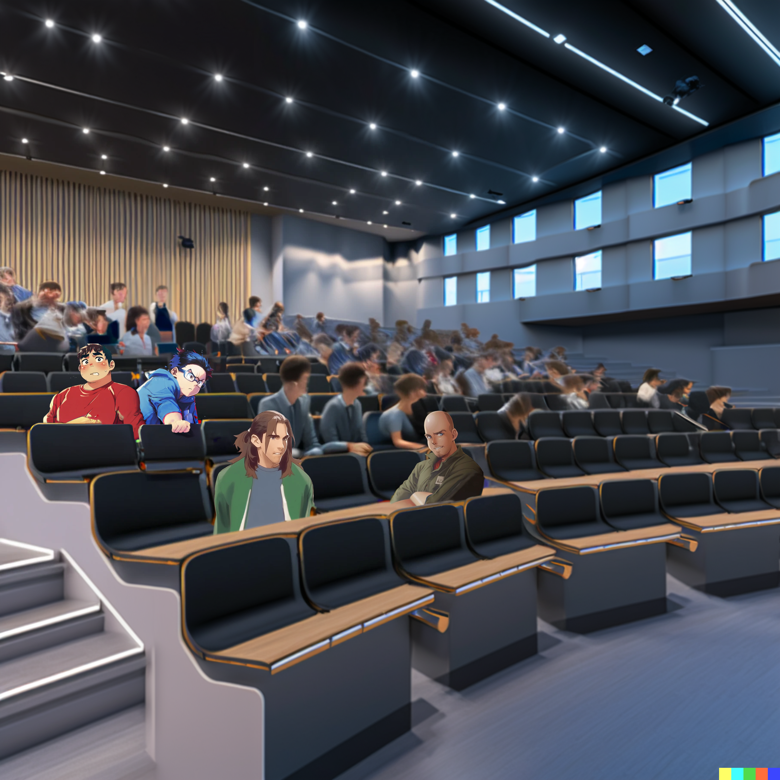
This guy is so full of himself.
He acts like he invented generics
Yeah, and he makes them sound
so complicated and confusing

Slide 3
I wonder if generics are really that important
I mean, how often do we need to use them in real life?
Another lecture
pack full of
mistakes and misconceptions

Slide 4


Generic classes
and methods …
myList.stream()
.map(()->...)//type inference here
.toList();
allow for
code reuse and
maintainability
Improvements of Type inference in Java 9
and later versions make it even more
convenient to use generics.

Slide 5
The lecture on Java generics came to an end
However, it's crucial
to use wildcards ...
and generic bounds correctly
to ensure type safety

Slide 6




The students are leaving for lunch
Ok, we shall start studying
generics pronto
Maybe we can just study
in our own dorm rooms?
Nah, it is such a good day!
Let’s go to the park together

Slide 7

Or we could go to the docks, …
where it's peaceful and less crowded

Slide 8

And they do a great fish and chips!

Slide 9
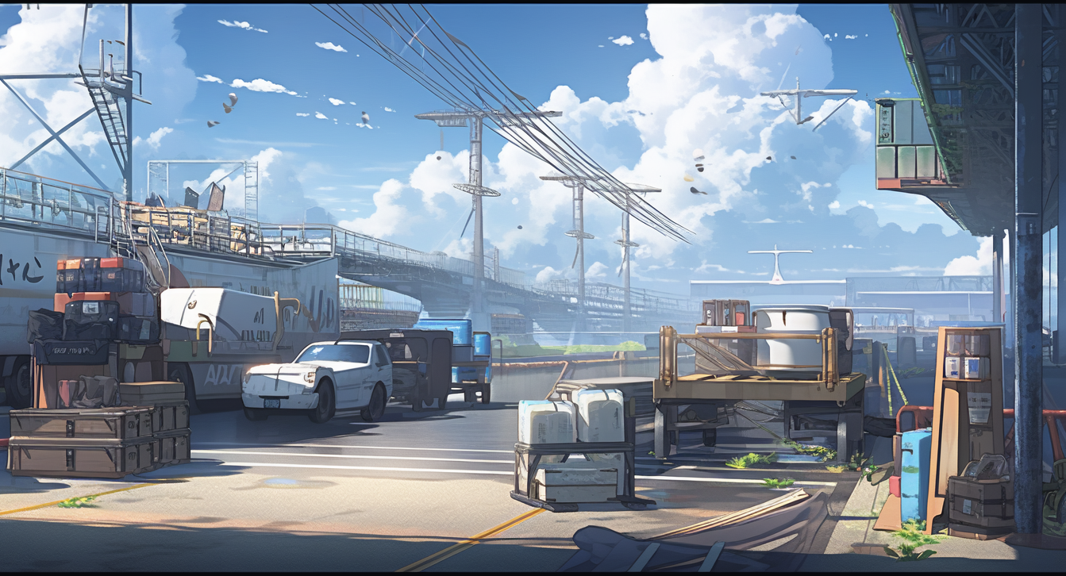



Ah, food!
Nothing beats food.
Let’s keep our eyes open, …
we may find some
good inspiration
to understand
generics better!

Slide 10


Slide 11

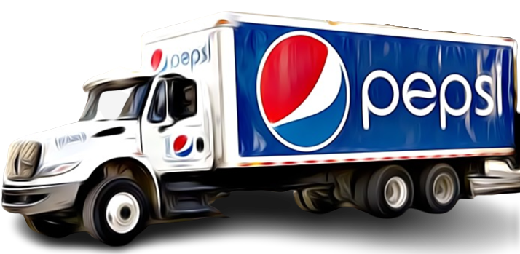
Divide in 3: no truck, truck, effect

Slide 12
Truck< >

Slide 13

Look!
A Pepsi Truck …
or a Truck of Pepsi?

Slide 14



Is it though?
It contains tons of pepsis,
not just a single pepsi can!
Truck< >

Slide 15

A Truck of pepsi could have …
record Truck<T>(List<T> cargo){}
a List of Pepsi field
Truck< >

Slide 16
A Truck of pepsi could have …
interface Cargo<T>{ T cargo(); }
record Truck<T>(
Cargo<List<T>> cargo){}
a List of Pepsi field
Truck< >
Or a Cargo of List of Pepsi field!

Slide 17
class Cargo<T>{ T cargo; … }
class Truck<T>
extends Cargo<List<T>>{}
It could even extend
a Cargo of List of T
Truck< >
I guess you
are right

Slide 18

record Truck<T>(List<T> cargo){}
-------------------------------
interface Cargo<T>{ T cargo(); }
record Truck<T>(
Cargo<List<T>> cargo){}
-------------------------------
class Cargo<T>{ T cargo; … }
class Truck<T>
extends Cargo<List<T>>{}
generics are
used to contains
various kinds of stuff
But, there can be quite of a
roundabout relation between
… the generic type
and what is contained.

