Slide 1
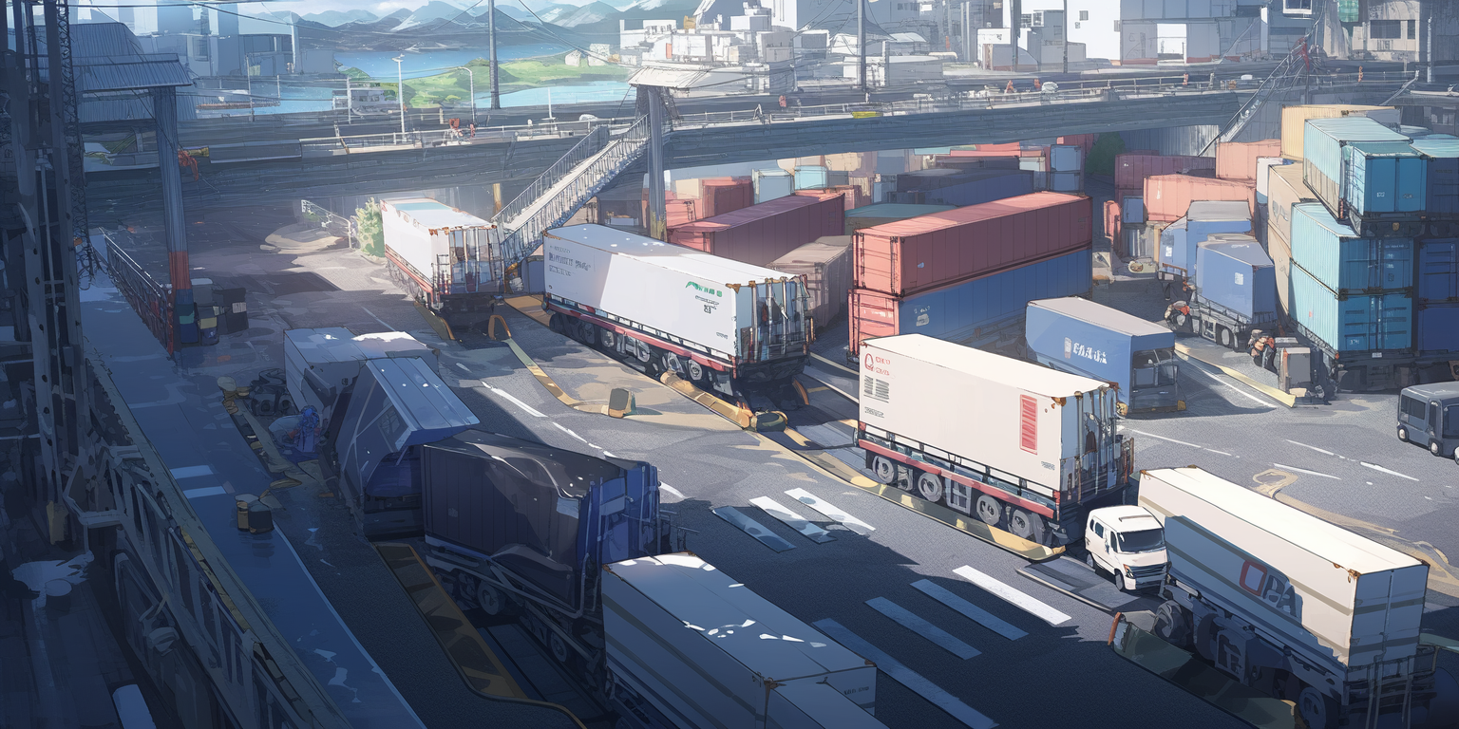
Generics at the docks

Slide 2


Slide 3
Professor Elricho Pupon is concluding a lecture with arrogance

Slide 4
Professor Elricho Pupon is concluding a lecture with arrogance
Generics are not just for
Lists, Sets, and Maps

Slide 5
Professor Elricho Pupon is concluding a lecture with arrogance
Generics are not just for
Lists, Sets, and Maps
They can be used for a range
of user defined types

Slide 6
Professor Elricho Pupon is concluding a lecture with arrogance
Generics are not just for
Lists, Sets, and Maps
They can be used for a range
of user defined types
They provide type safety and eliminate
the need for explicit type casting

Slide 7
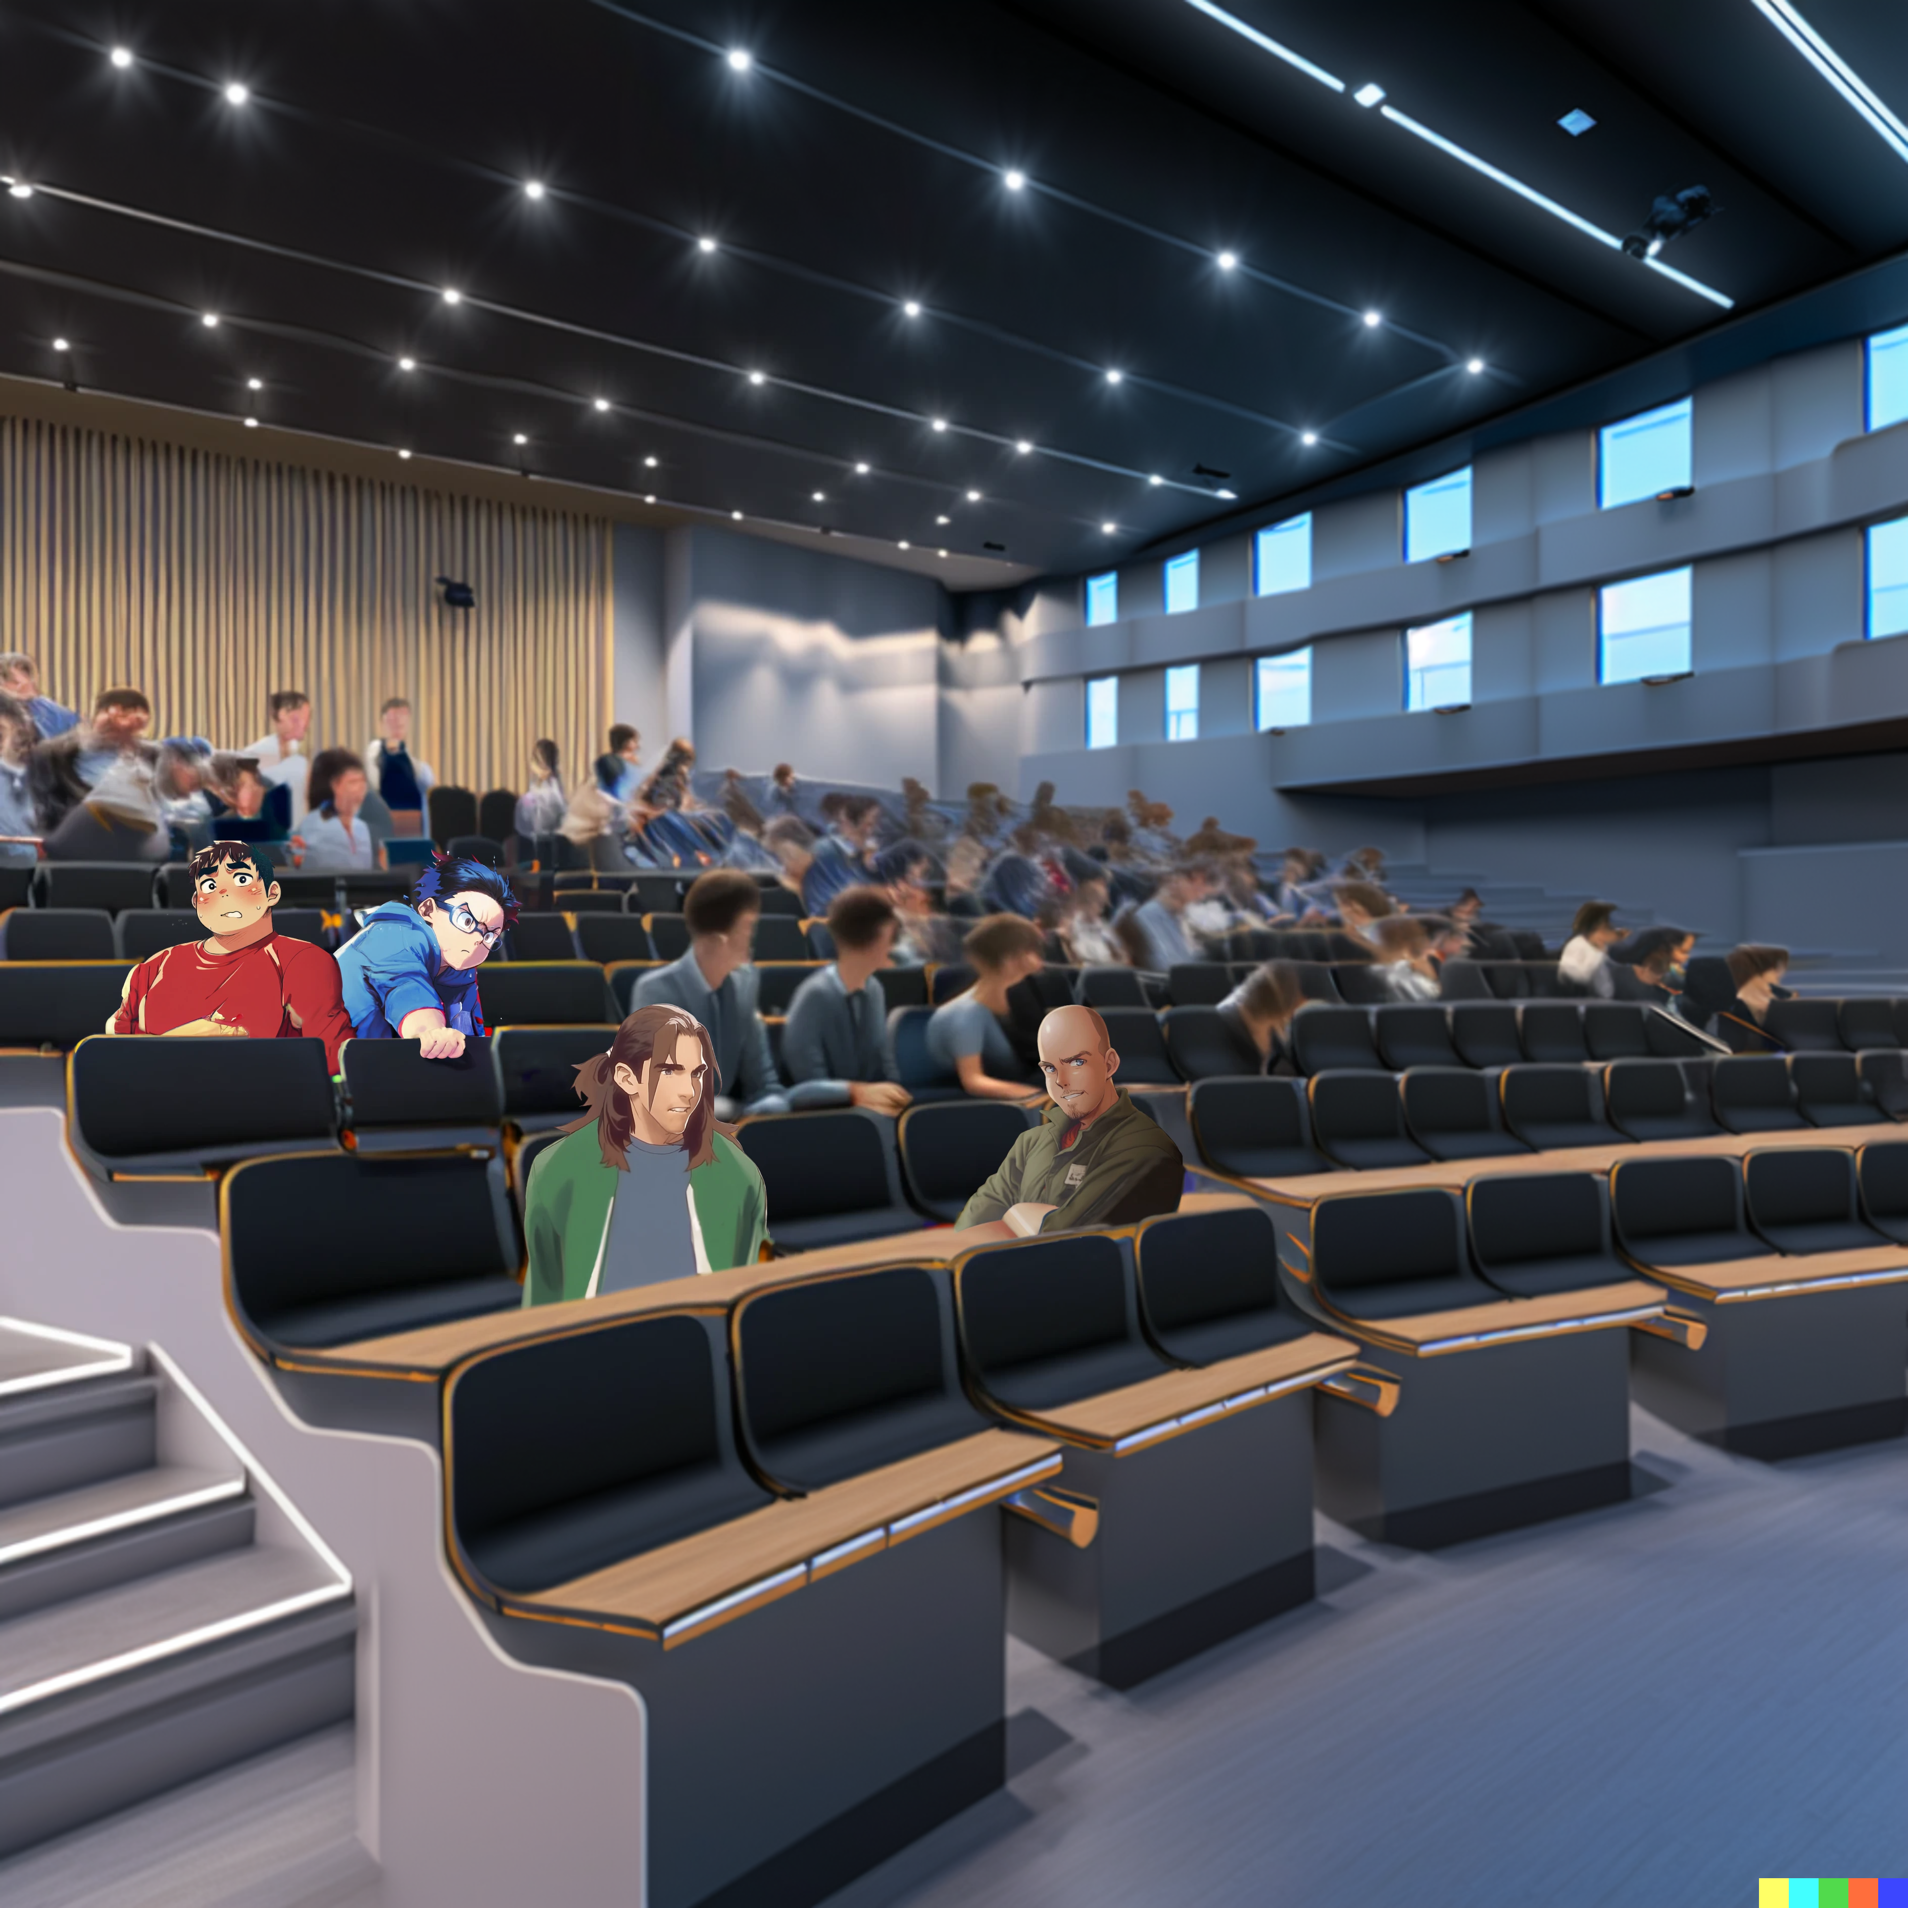

Slide 8
He acts as if he invented generics

Slide 9
He acts as if he invented generics
he makes them sound so
complicated and confusing

Slide 11
I wonder if generics are really that important

Slide 12
I wonder if generics are really that important
I mean, how often do we need to use them in real life?

Slide 13
I wonder if generics are really that important
I mean, how often do we need to use them in real life?
Another lecture
pack full of
mistakes and misconceptions

Slide 14



Slide 15
Generic classes
and methods …

Slide 16
Generic classes
and methods …
allow for
code reuse and
maintainability

Slide 17
Generic classes
and methods …
myList.stream()
.map(()->...)//type inference here
.toList();
allow for
code reuse and
maintainability

Slide 18
Generic classes
and methods …
myList.stream()
.map(()->...)//type inference here
.toList();
allow for
code reuse and
maintainability
Improvements of Type inference in Java 9
and later versions make it even more
convenient to use generics.

Slide 20
The lecture on Java generics came to an end

Slide 21
The lecture on Java generics came to an end
However, it's crucial
to use wildcards ...

Slide 22
The lecture on Java generics came to an end
However, it's crucial
to use wildcards ...
and generic bounds correctly
to ensure type safety

Slide 23
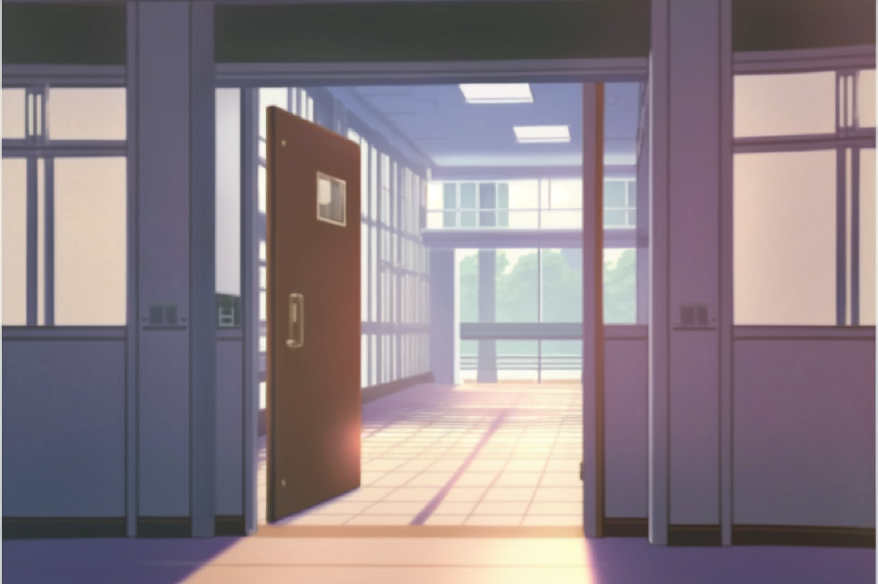
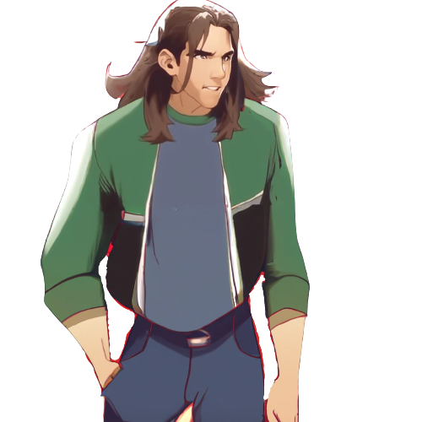



Slide 24
The students are leaving for lunch

Slide 25
The students are leaving for lunch
Ok, we shall start studying
generics pronto

Slide 26
The students are leaving for lunch
Ok, we shall start studying
generics pronto
Maybe we can just study
in our own dorm rooms?

Slide 27
The students are leaving for lunch
Ok, we shall start studying
generics pronto
Maybe we can just study
in our own dorm rooms?
Nah, it is such a good day!
Let’s go to the park together

Slide 28
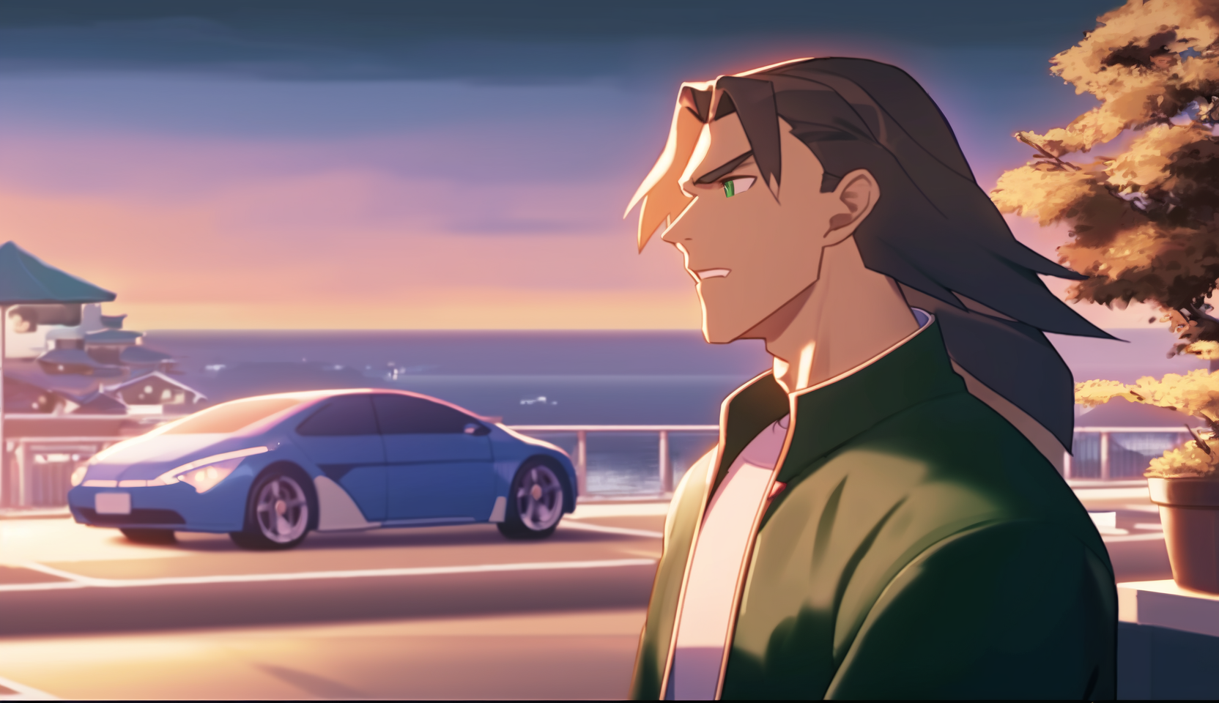

Slide 29
Or we could go to the docks, …

Slide 30
Or we could go to the docks, …
where it's peaceful and less crowded

Slide 31
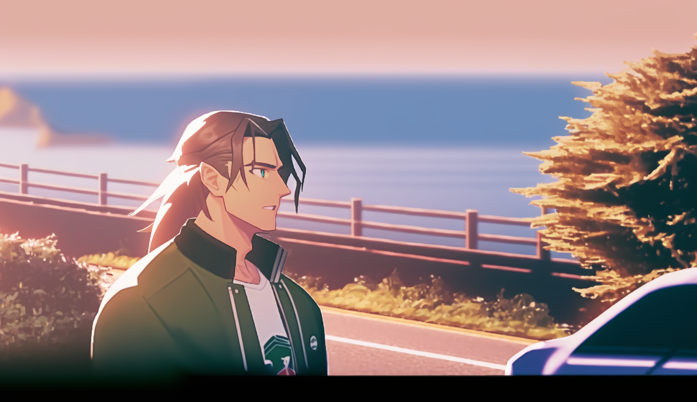

Slide 32
And they do a great fish and chips!

Slide 33
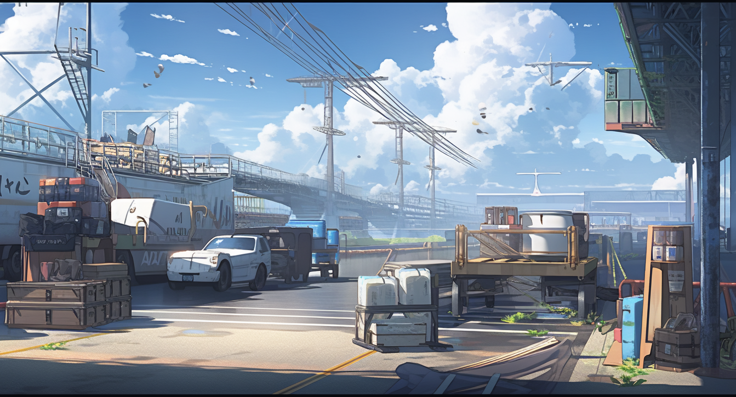




Slide 34
Ah, food!
Nothing beats food.

Slide 35
Ah, food!
Nothing beats food.
Let’s keep our eyes open, …

Slide 36
Ah, food!
Nothing beats food.
Let’s keep our eyes open, …
we may find some
good inspiration
to understand
generics better!

