Slide 1
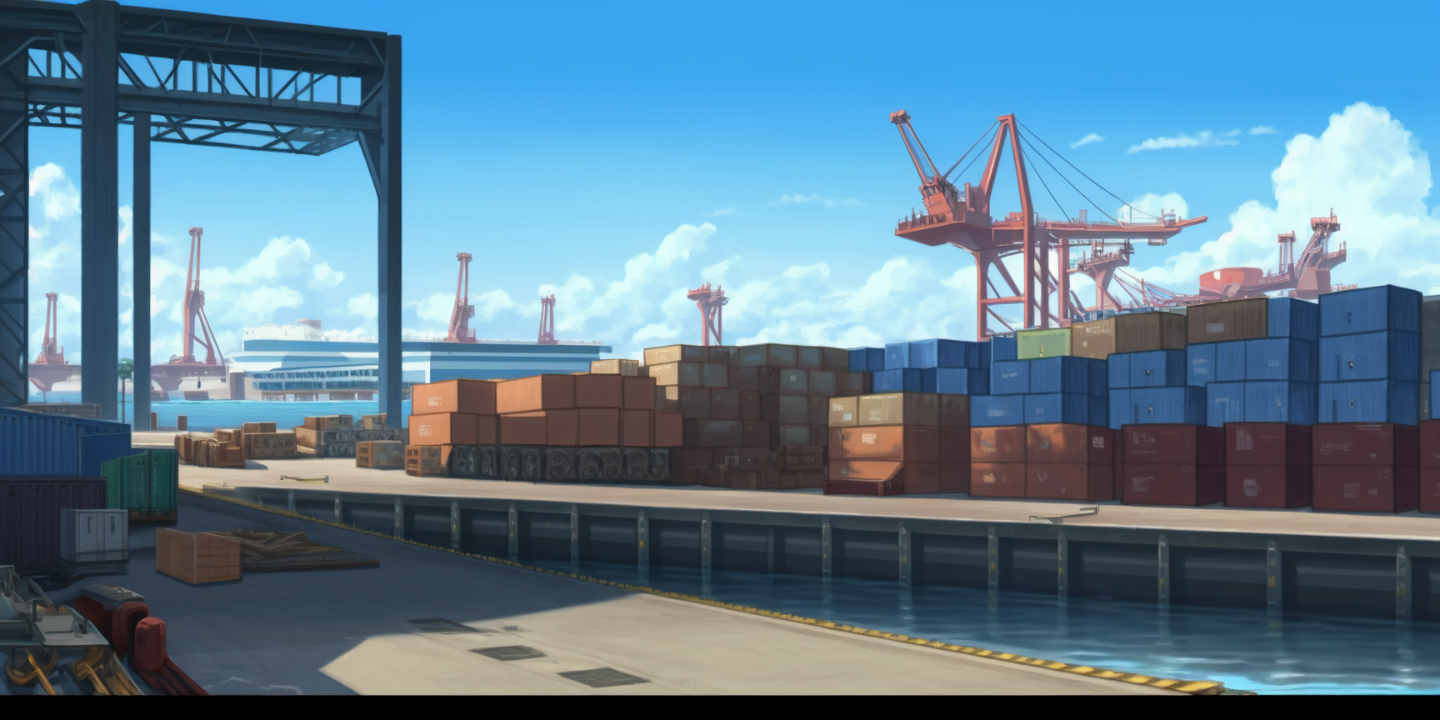

Slide 3
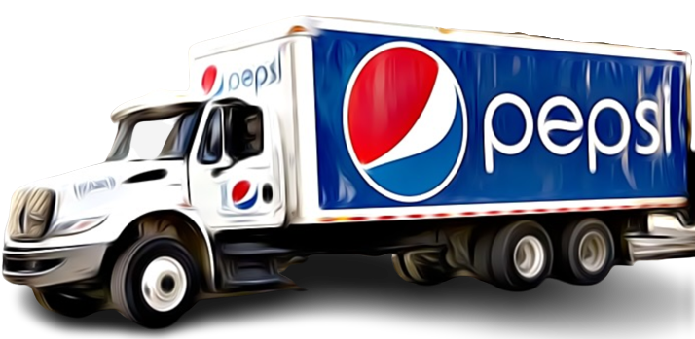

Slide 4


Slide 6
Truck< >

Slide 7
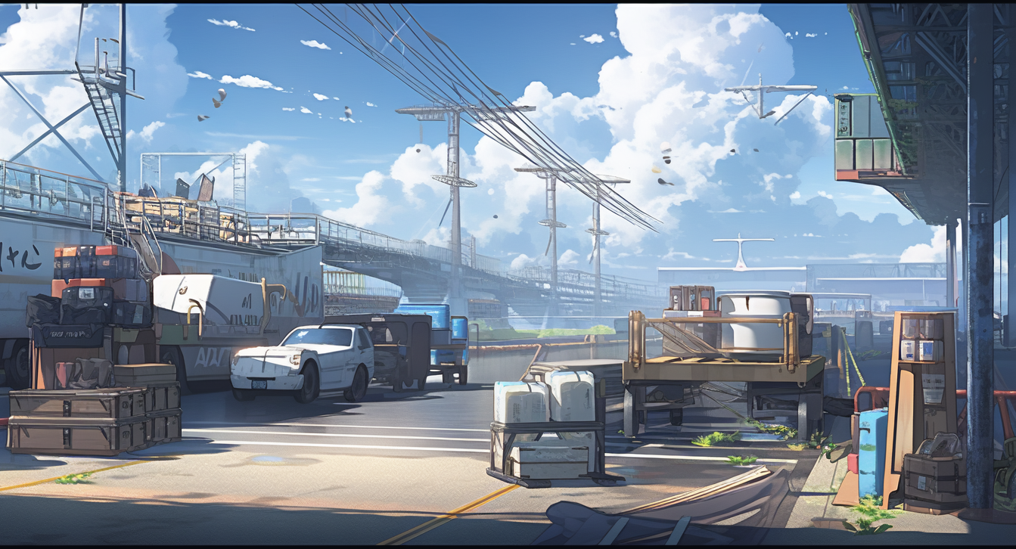




Slide 8
Look!

Slide 9
Look!
A Pepsi Truck …

Slide 10
Look!
A Pepsi Truck …
or a Truck of Pepsi?

Slide 11
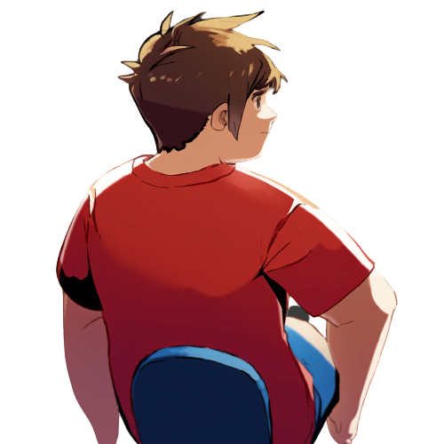


Truck< >

Slide 12
Is it though?
Truck< >

Slide 13
Is it though?
It contains tons of pepsis,
not just a single pepsi can!
Truck< >

Slide 14
Truck< >

Slide 15
A Truck of pepsi could have …
Truck< >

Slide 16
A Truck of pepsi could have …
a List of Pepsi field
Truck< >

Slide 17

A Truck of pepsi could have …
record Truck<T>(List<T> cargo){}
a List of Pepsi field
Truck< >

Slide 18
A Truck of pepsi could have …
a List of Pepsi field
Truck< >
Or a Cargo of List of Pepsi field!

Slide 19
A Truck of pepsi could have …
interface Cargo<T>{ T cargo(); }
record Truck<T>(
Cargo<List<T>> cargo){}
a List of Pepsi field
Truck< >
Or a Cargo of List of Pepsi field!

Slide 20
Truck< >

Slide 21
It could even extend
a Cargo of List of T
Truck< >

Slide 22
class Cargo<T>{ T cargo; … }
class Truck<T>
extends Cargo<List<T>>{}
It could even extend
a Cargo of List of T
Truck< >

Slide 23
class Cargo<T>{ T cargo; … }
class Truck<T>
extends Cargo<List<T>>{}
It could even extend
a Cargo of List of T
Truck< >
I guess you
are right

Slide 24

-------------------------------
-------------------------------

Slide 25
-------------------------------
-------------------------------
generics are
used to contains
various kinds of stuff

Slide 26
-------------------------------
-------------------------------
generics are
used to contains
various kinds of stuff
But, there can be quite of a
roundabout relation between

Slide 27
-------------------------------
-------------------------------
generics are
used to contains
various kinds of stuff
But, there can be quite of a
roundabout relation between
… the generic type
and what is contained.

Slide 28
record Truck<T>(List<T> cargo){}
-------------------------------
-------------------------------
generics are
used to contains
various kinds of stuff
But, there can be quite of a
roundabout relation between
… the generic type
and what is contained.

Slide 29
record Truck<T>(List<T> cargo){}
-------------------------------
interface Cargo<T>{ T cargo(); }
record Truck<T>(
Cargo<List<T>> cargo){}
-------------------------------
generics are
used to contains
various kinds of stuff
But, there can be quite of a
roundabout relation between
… the generic type
and what is contained.

Slide 30
record Truck<T>(List<T> cargo){}
-------------------------------
interface Cargo<T>{ T cargo(); }
record Truck<T>(
Cargo<List<T>> cargo){}
-------------------------------
class Cargo<T>{ T cargo; … }
class Truck<T>
extends Cargo<List<T>>{}
generics are
used to contains
various kinds of stuff
But, there can be quite of a
roundabout relation between
… the generic type
and what is contained.

