Slide 1
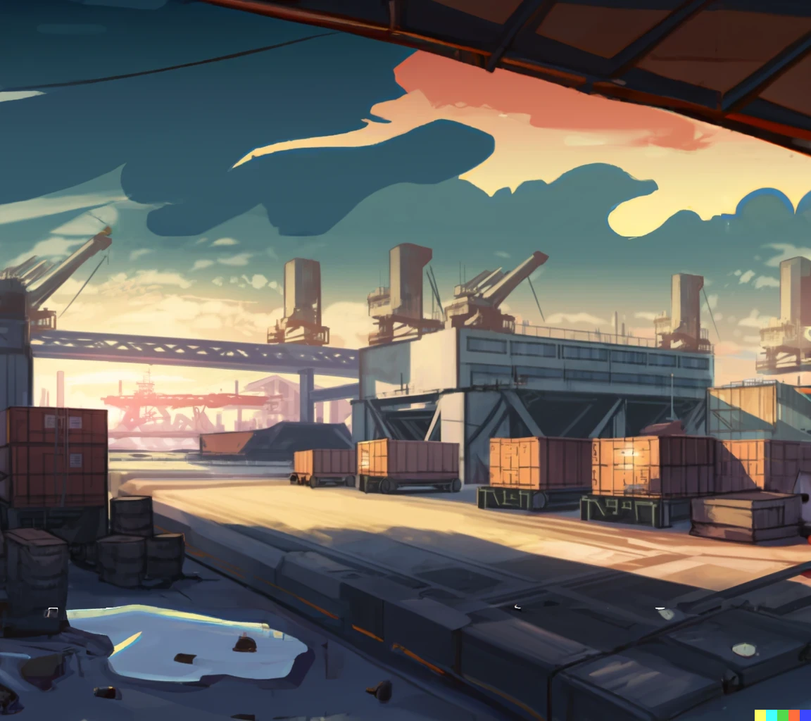




Slide 3
Hey, boys,
I’m Sophia.

Slide 4
Hey, boys,
I’m Sophia.
You are from our
class, right?

Slide 5
Hey, boys,
I’m Sophia.
You are from our
class, right?
You are talking “generics”.
Can we join you?

Slide 6


Slide 7
Oh, yea! The more the merrier

Slide 8
Oh, yea! The more the merrier
I’m Tommy,
nice to meet you!

Slide 9
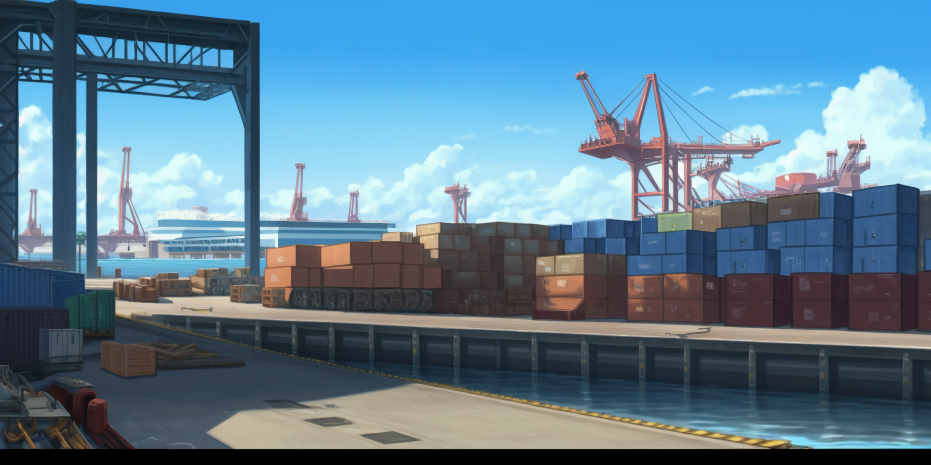

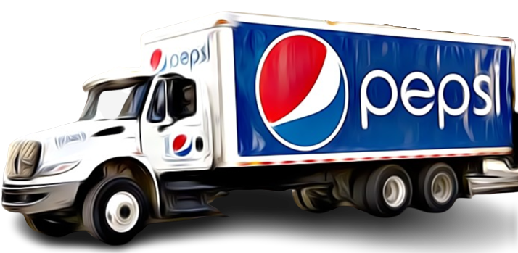

Slide 10
I’m Ricky

Slide 11
I’m Ricky
We were discussing
about that Pepsi truck

Slide 12
I’m Ricky
We were discussing
about that Pepsi truck
And what options there are to encode
it properly with generics

Slide 14
In the lecture Pupon
discussed inheritance

Slide 15
In the lecture Pupon
discussed inheritance
… using trucks as an
example, right?

Slide 16



Slide 17
There they are,
like in the lecture!

Slide 18
There they are,
like in the lecture!
A cabover truck parked
near a bonneted truck!

Slide 19
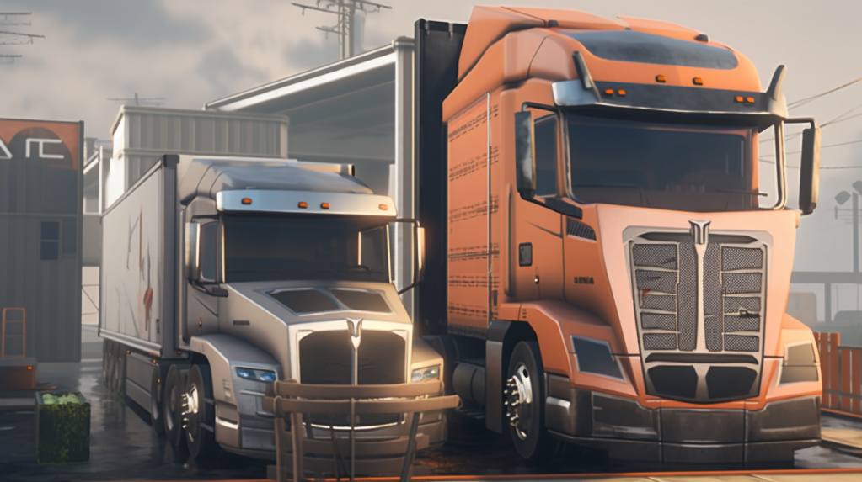

Slide 20


Slide 21
Here they are!

Slide 22
Here they are!
I’m Luna,
by the way

Slide 23


abstract class Truck<T>{
}

Slide 24
abstract class Truck<T>{
public abstract int aerodynamics();
public Cargo<List<T>> cargo(){ return cargo; }
public Point location(){ return location; }
public void location(Point p){ location=p; }
void driveToward(Point destination, int duration){
}
}

Slide 25
abstract class Truck<T>{
public abstract int aerodynamics();
public Cargo<List<T>> cargo(){ return cargo; }
public Point location(){ return location; }
public void location(Point p){ location=p; }
void driveToward(Point destination, int duration){
...
Point wayPoint=...;
location(wayPoint);
}
}

Slide 26
abstract class Truck<T>{
public abstract int aerodynamics();
public Cargo<List<T>> cargo(){ return cargo; }
public Point location(){ return location; }
public void location(Point p){ location=p; }
void driveToward(Point destination, int duration){
...
Point wayPoint=...;
location(wayPoint);
}
private Cargo<List<T>> cargo;
private Point location;
Truck(Point p, Cargo<List<T>> c){
location=p; cargo=c;
}
}

Slide 27
abstract class Truck<T>{
public abstract int aerodynamics();
public Cargo<List<T>> cargo(){ return cargo; }
public Point location(){ return location; }
public void location(Point p){ location=p; }
void driveToward(Point destination, int duration){
...
Point wayPoint=...;
location(wayPoint);
}
private Cargo<List<T>> cargo;
private Point location;
Truck(Point p, Cargo<List<T>> c){
location=p; cargo=c;
}
}
class Bonneted<T> extends Truck<T>{
}
class CabOver<T> extends Truck<T>{
}

Slide 28
abstract class Truck<T>{
public abstract int aerodynamics();
public Cargo<List<T>> cargo(){ return cargo; }
public Point location(){ return location; }
public void location(Point p){ location=p; }
void driveToward(Point destination, int duration){
...
Point wayPoint=...;
location(wayPoint);
}
private Cargo<List<T>> cargo;
private Point location;
Truck(Point p, Cargo<List<T>> c){
location=p; cargo=c;
}
}
class Bonneted<T> extends Truck<T>{
Bonneted(Point p, Cargo<List<T>> c){
super(p,c);
}
public int aerodynamics(){ ... }
}
class CabOver<T> extends Truck<T>{
CabOver(Point p, Cargo<List<T>> c){
super(p,c);
}
public int aerodynamics(){ ... }
}

Slide 29
abstract class Truck<T>{
public abstract int aerodynamics();
public Cargo<List<T>> cargo(){ return cargo; }
public Point location(){ return location; }
public void location(Point p){ location=p; }
void driveToward(Point destination, int duration){
...
Point wayPoint=...;
location(wayPoint);
}
private Cargo<List<T>> cargo;
private Point location;
Truck(Point p, Cargo<List<T>> c){
location=p; cargo=c;
}
}
This is the code,
as shown in
the lecture
class Bonneted<T> extends Truck<T>{
Bonneted(Point p, Cargo<List<T>> c){
super(p,c);
}
public int aerodynamics(){ ... }
}
class CabOver<T> extends Truck<T>{
CabOver(Point p, Cargo<List<T>> c){
super(p,c);
}
public int aerodynamics(){ ... }
}

Slide 30
abstract class Truck<T>{
public abstract int aerodynamics();
public Cargo<List<T>> cargo(){ return cargo; }
public Point location(){ return location; }
public void location(Point p){ location=p; }
void driveToward(Point destination, int duration){
...
Point wayPoint=...;
location(wayPoint);
}
private Cargo<List<T>> cargo;
private Point location;
Truck(Point p, Cargo<List<T>> c){
location=p; cargo=c;
}
}
This is the code,
as shown in
the lecture
Can you understand this code?
Do you think it is the best way to handle this?
The main objective is to reuse the ‘driveToward’
method in Bonneted and CabOver without having to duplicate it.
But, ‘driveToward’ may have to use ‘aerodynamics’ inside;
and the aerodynamics of bonnetted and cabover trucks are different
‘Aerodynamics’ is just an example, there could be
more complex differences
class Bonneted<T> extends Truck<T>{
Bonneted(Point p, Cargo<List<T>> c){
super(p,c);
}
public int aerodynamics(){ ... }
}
class CabOver<T> extends Truck<T>{
CabOver(Point p, Cargo<List<T>> c){
super(p,c);
}
public int aerodynamics(){ ... }
}

Slide 31
abstract class Truck<T>{
public abstract int aerodynamics();
public Cargo<List<T>> cargo(){ return cargo; }
public Point location(){ return location; }
public void location(Point p){ location=p; }
void driveToward(Point destination, int duration){
...
Point wayPoint=...;
location(wayPoint);
}
private Cargo<List<T>> cargo;
private Point location;
Truck(Point p, Cargo<List<T>> c){
location=p; cargo=c;
}
}
This is the code,
as shown in
the lecture
class Bonneted<T> extends Truck<T>{
Bonneted(Point p, Cargo<List<T>> c){
super(p,c);
}
public int aerodynamics(){ ... }
}
class CabOver<T> extends Truck<T>{
CabOver(Point p, Cargo<List<T>> c){
super(p,c);
}
public int aerodynamics(){ ... }
}

Slide 32


Slide 33
Wow, that is exactly
Pupon code

Slide 34
Wow, that is exactly
Pupon code
You must be very fast
at taking notes!

Slide 35


Slide 36
Er… no,
I can’t write
that fast.

Slide 37
Er… no,
I can’t write
that fast.
You see, Luna has
photographic memory.

Slide 38
Er… no,
I can’t write
that fast.
You see, Luna has
photographic memory.
She wrote it down

Slide 39
Er… no,
I can’t write
that fast.
You see, Luna has
photographic memory.
She wrote it down
right now
just for our sake.

Slide 40



Slide 41
You are Dany right?

Slide 42
You are Dany right?
The guy that squashed
Pupon the first day.

Slide 43
You are Dany right?
The guy that squashed
Pupon the first day.
Surely you must have
some tricks up
your sleeves too.

Slide 44
You are Dany right?
The guy that squashed
Pupon the first day.
Surely you must have
some tricks up
your sleeves too.
I’m Emma.

Slide 45
You are Dany right?
The guy that squashed
Pupon the first day.
Surely you must have
some tricks up
your sleeves too.
I’m Emma.
If you are planning to
get in trouble again,
do NOT involve me

Slide 47
Talking about trouble…

Slide 48
Talking about trouble…
Miss Pumpkin also
had a similar example

Slide 49
Talking about trouble…
Miss Pumpkin also
had a similar example
But the code looks
completely different!

Slide 50


Slide 51
But.. how?

Slide 52
How can you access
Pumpkin’s notes?!
But.. how?

Slide 53
How can you access
Pumpkin’s notes?!
We are Pupon students,
But.. how?

Slide 54
How can you access
Pumpkin’s notes?!
We are Pupon students,
so UPU rules prevents
us to follow the lectures
But.. how?

Slide 55
How can you access
Pumpkin’s notes?!
We are Pupon students,
so UPU rules prevents
us to follow the lectures
of Pumpkin
But.. how?

Slide 56
How can you access
Pumpkin’s notes?!
We are Pupon students,
so UPU rules prevents
us to follow the lectures
of Pumpkin
But.. how?
Oh, I just snatched them!

Slide 57


Slide 58
You did what?

Slide 59
You did what?
This is very serious!

Slide 60

You did what?
This is very serious!

Slide 61
You did what?
This is very serious!
Again? After all the mess
when we stole Hanton notes?

Slide 63
Wait…
Wow…

Slide 64
Wait…
Wow…
This is not even
the first time?

Slide 65

Wait…
Wow…
This is not even
the first time?

Slide 66
Wait…
Wow…
So, you want to see
them or not?
This is not even
the first time?

Slide 67
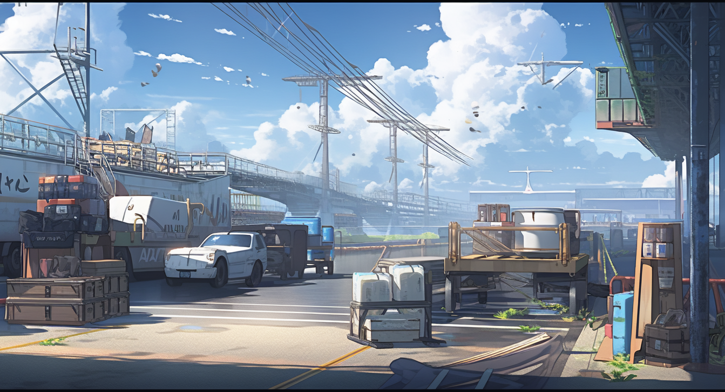



Slide 68
Hey Tommy,
how did you snatch
them this time?

Slide 69
Hey Tommy,
how did you snatch
them this time?
I have a man
inside the other class

Slide 70


Slide 71
Wow, you sound
like a mafia boss

Slide 72
Wow, you sound
like a mafia boss
But you are just saying that
your friend in the other class

Slide 73
Wow, you sound
like a mafia boss
But you are just saying that
your friend in the other class
shared their notes with you

Slide 74


Slide 75
Those notes are going to be precious!
The final exam is coming soon

Slide 76
Those notes are going to be precious!
The final exam is coming soon
It will be written half and half,
by both Pupon and Pumpkin

Slide 77


Slide 78
Come on,
just show us the
notes already!

Slide 79


Slide 80
Here they are!
Get ready for
the surprise!

Slide 81

interface Truck<Self,T>{
}
Pumpkin code

Slide 82
interface Truck<Self,T>{
int aerodynamics();
CargoC<List<T>> cargo();
Point location();
Self withLocation(Point p);
default Self driveToward(Point destination, int duration){
}
}
Pumpkin code

Slide 83
interface Truck<Self,T>{
int aerodynamics();
CargoC<List<T>> cargo();
Point location();
Self withLocation(Point p);
default Self driveToward(Point destination, int duration){
...
Point wayPoint=...;
return withLocation(wayPoint);
}
}
Pumpkin code

Slide 84
interface Truck<Self,T>{
int aerodynamics();
CargoC<List<T>> cargo();
Point location();
Self withLocation(Point p);
default Self driveToward(Point destination, int duration){
...
Point wayPoint=...;
return withLocation(wayPoint);
}
}
record Bonneted<T>
(Point location, CargoC<List<T>> cargo) implements Truck<Bonneted<T>,T>{
}
record CabOver<T>
(Point location, CargoC<List<T>> cargo) implements Truck<CabOver<T>,T>{
}
Pumpkin code

Slide 85
interface Truck<Self,T>{
int aerodynamics();
CargoC<List<T>> cargo();
Point location();
Self withLocation(Point p);
default Self driveToward(Point destination, int duration){
...
Point wayPoint=...;
return withLocation(wayPoint);
}
}
record Bonneted<T>
(Point location, CargoC<List<T>> cargo) implements Truck<Bonneted<T>,T>{
public Bonneted<T> withLocation(Point p){ return new Bonneted<>(p,cargo); }
}
record CabOver<T>
(Point location, CargoC<List<T>> cargo) implements Truck<CabOver<T>,T>{
public CabOver<T> withLocation(Point p){ return new CabOver<>(p,cargo); }
}
Pumpkin code

Slide 86
interface Truck<Self,T>{
int aerodynamics();
CargoC<List<T>> cargo();
Point location();
Self withLocation(Point p);
default Self driveToward(Point destination, int duration){
...
Point wayPoint=...;
return withLocation(wayPoint);
}
}
record Bonneted<T>
(Point location, CargoC<List<T>> cargo) implements Truck<Bonneted<T>,T>{
public Bonneted<T> withLocation(Point p){ return new Bonneted<>(p,cargo); }
public int aerodynamics(){ ... }
}
record CabOver<T>
(Point location, CargoC<List<T>> cargo) implements Truck<CabOver<T>,T>{
public CabOver<T> withLocation(Point p){ return new CabOver<>(p,cargo); }
public int aerodynamics(){ ... }
}
Pumpkin code

Slide 87

abstract class Truck<T>{
}
Pupon code

Slide 88
abstract class Truck<T>{
public abstract int aerodynamics();
public Cargo<List<T>> cargo(){ return cargo; }
public Point location(){ return location; }
public void location(Point p){ location=p; }
void driveToward(Point destination, int duration){
}
}
Pupon code

Slide 89
abstract class Truck<T>{
public abstract int aerodynamics();
public Cargo<List<T>> cargo(){ return cargo; }
public Point location(){ return location; }
public void location(Point p){ location=p; }
void driveToward(Point destination, int duration){
...
Point wayPoint=...;
location(wayPoint);
}
}
Pupon code

Slide 90
abstract class Truck<T>{
public abstract int aerodynamics();
public Cargo<List<T>> cargo(){ return cargo; }
public Point location(){ return location; }
public void location(Point p){ location=p; }
void driveToward(Point destination, int duration){
...
Point wayPoint=...;
location(wayPoint);
}
private Cargo<List<T>> cargo;
private Point location;
Truck(Point p, Cargo<List<T>> c){ location=p; cargo=c; }
}
Pupon code

Slide 91
abstract class Truck<T>{
public abstract int aerodynamics();
public Cargo<List<T>> cargo(){ return cargo; }
public Point location(){ return location; }
public void location(Point p){ location=p; }
void driveToward(Point destination, int duration){
...
Point wayPoint=...;
location(wayPoint);
}
private Cargo<List<T>> cargo;
private Point location;
Truck(Point p, Cargo<List<T>> c){ location=p; cargo=c; }
}
class Bonneted<T> extends Truck<T>{
}
class CabOver<T> extends Truck<T>{
}
Pupon code

Slide 92
abstract class Truck<T>{
public abstract int aerodynamics();
public Cargo<List<T>> cargo(){ return cargo; }
public Point location(){ return location; }
public void location(Point p){ location=p; }
void driveToward(Point destination, int duration){
...
Point wayPoint=...;
location(wayPoint);
}
private Cargo<List<T>> cargo;
private Point location;
Truck(Point p, Cargo<List<T>> c){ location=p; cargo=c; }
}
class Bonneted<T> extends Truck<T>{
Bonneted(Point p, Cargo<List<T>> c){ super(p,c); }
}
class CabOver<T> extends Truck<T>{
CabOver(Point p, Cargo<List<T>> c){ super(p,c); }
}
Pupon code

Slide 93
abstract class Truck<T>{
public abstract int aerodynamics();
public Cargo<List<T>> cargo(){ return cargo; }
public Point location(){ return location; }
public void location(Point p){ location=p; }
void driveToward(Point destination, int duration){
...
Point wayPoint=...;
location(wayPoint);
}
private Cargo<List<T>> cargo;
private Point location;
Truck(Point p, Cargo<List<T>> c){ location=p; cargo=c; }
}
class Bonneted<T> extends Truck<T>{
Bonneted(Point p, Cargo<List<T>> c){ super(p,c); }
public int aerodynamics(){ ... }
}
class CabOver<T> extends Truck<T>{
CabOver(Point p, Cargo<List<T>> c){ super(p,c); }
public int aerodynamics(){ ... }
}
Pupon code

Slide 94



interface Truck<Self,T>{
int aerodynamics();
CargoC<List<T>> cargo();
Point location();
Self withLocation(Point p);
default Self driveToward(Point destination, int duration){
...
Point wayPoint=...;
return withLocation(wayPoint);
}
}
record Bonneted<T>
(Point location, CargoC<List<T>> cargo) implements Truck<Bonneted<T>,T>{
public Bonneted<T> withLocation(Point p){ return new Bonneted<>(p,cargo); }
public int aerodynamics(){ ... }
}
record CabOver<T>
(Point location, CargoC<List<T>> cargo) implements Truck<CabOver<T>,T>{
public CabOver<T> withLocation(Point p){ return new CabOver<>(p,cargo); }
public int aerodynamics(){ ... }
}
abstract class Truck<T>{
public abstract int aerodynamics();
public CargoC<List<T>> cargo(){ return cargo; }
public Point location(){ return location; }
public void location(Point p){ location=p; }
void driveToward(Point destination, int duration){
...
Point wayPoint=...;
location(wayPoint);
}
private CargoC<List<T>> cargo;
private Point location;
Truck(Point p, CargoC<List<T>> c){ location=p; cargo=c; }
}
class Bonneted<T> extends Truck<T>{
Bonneted(Point p, CargoC<List<T>> c){ super(p,c); }
public int aerodynamics(){ ... }
}
class CabOver<T> extends Truck<T>{
CabOver(Point p, CargoC<List<T>> c){ super(p,c); }
public int aerodynamics(){ ... }
}
Pumpkin code
Pupon code

Slide 95
interface Truck<Self,T>{
int aerodynamics();
CargoC<List<T>> cargo();
Point location();
Self withLocation(Point p);
default Self driveToward(Point destination, int duration){
...
Point wayPoint=...;
return withLocation(wayPoint);
}
}
record Bonneted<T>
(Point location, CargoC<List<T>> cargo) implements Truck<Bonneted<T>,T>{
public Bonneted<T> withLocation(Point p){ return new Bonneted<>(p,cargo); }
public int aerodynamics(){ ... }
}
record CabOver<T>
(Point location, CargoC<List<T>> cargo) implements Truck<CabOver<T>,T>{
public CabOver<T> withLocation(Point p){ return new CabOver<>(p,cargo); }
public int aerodynamics(){ ... }
}
abstract class Truck<T>{
public abstract int aerodynamics();
public CargoC<List<T>> cargo(){ return cargo; }
public Point location(){ return location; }
public void location(Point p){ location=p; }
void driveToward(Point destination, int duration){
...
Point wayPoint=...;
location(wayPoint);
}
private CargoC<List<T>> cargo;
private Point location;
Truck(Point p, CargoC<List<T>> c){ location=p; cargo=c; }
}
class Bonneted<T> extends Truck<T>{
Bonneted(Point p, CargoC<List<T>> c){ super(p,c); }
public int aerodynamics(){ ... }
}
class CabOver<T> extends Truck<T>{
CabOver(Point p, CargoC<List<T>> c){ super(p,c); }
public int aerodynamics(){ ... }
}
Pumpkin code
Pupon code
Wow, this is
unexpected

Slide 96
interface Truck<Self,T>{
int aerodynamics();
CargoC<List<T>> cargo();
Point location();
Self withLocation(Point p);
default Self driveToward(Point destination, int duration){
...
Point wayPoint=...;
return withLocation(wayPoint);
}
}
record Bonneted<T>
(Point location, CargoC<List<T>> cargo) implements Truck<Bonneted<T>,T>{
public Bonneted<T> withLocation(Point p){ return new Bonneted<>(p,cargo); }
public int aerodynamics(){ ... }
}
record CabOver<T>
(Point location, CargoC<List<T>> cargo) implements Truck<CabOver<T>,T>{
public CabOver<T> withLocation(Point p){ return new CabOver<>(p,cargo); }
public int aerodynamics(){ ... }
}
abstract class Truck<T>{
public abstract int aerodynamics();
public CargoC<List<T>> cargo(){ return cargo; }
public Point location(){ return location; }
public void location(Point p){ location=p; }
void driveToward(Point destination, int duration){
...
Point wayPoint=...;
location(wayPoint);
}
private CargoC<List<T>> cargo;
private Point location;
Truck(Point p, CargoC<List<T>> c){ location=p; cargo=c; }
}
class Bonneted<T> extends Truck<T>{
Bonneted(Point p, CargoC<List<T>> c){ super(p,c); }
public int aerodynamics(){ ... }
}
class CabOver<T> extends Truck<T>{
CabOver(Point p, CargoC<List<T>> c){ super(p,c); }
public int aerodynamics(){ ... }
}
Pumpkin code
Pupon code
It looks like they are using
completely different languages
Wow, this is
unexpected

Slide 97
interface Truck<Self,T>{
int aerodynamics();
CargoC<List<T>> cargo();
Point location();
Self withLocation(Point p);
default Self driveToward(Point destination, int duration){
...
Point wayPoint=...;
return withLocation(wayPoint);
}
}
record Bonneted<T>
(Point location, CargoC<List<T>> cargo) implements Truck<Bonneted<T>,T>{
public Bonneted<T> withLocation(Point p){ return new Bonneted<>(p,cargo); }
public int aerodynamics(){ ... }
}
record CabOver<T>
(Point location, CargoC<List<T>> cargo) implements Truck<CabOver<T>,T>{
public CabOver<T> withLocation(Point p){ return new CabOver<>(p,cargo); }
public int aerodynamics(){ ... }
}
abstract class Truck<T>{
public abstract int aerodynamics();
public CargoC<List<T>> cargo(){ return cargo; }
public Point location(){ return location; }
public void location(Point p){ location=p; }
void driveToward(Point destination, int duration){
...
Point wayPoint=...;
location(wayPoint);
}
private CargoC<List<T>> cargo;
private Point location;
Truck(Point p, CargoC<List<T>> c){ location=p; cargo=c; }
}
class Bonneted<T> extends Truck<T>{
Bonneted(Point p, CargoC<List<T>> c){ super(p,c); }
public int aerodynamics(){ ... }
}
class CabOver<T> extends Truck<T>{
CabOver(Point p, CargoC<List<T>> c){ super(p,c); }
public int aerodynamics(){ ... }
}
Pumpkin code
Pupon code
It looks like they are using
completely different languages
But… how can it be?
They are modeling exactly
the same concept!
Wow, this is
unexpected

Slide 98
interface Truck<Self,T>{
int aerodynamics();
CargoC<List<T>> cargo();
Point location();
Self withLocation(Point p);
default Self driveToward(Point destination, int duration){
...
Point wayPoint=...;
return withLocation(wayPoint);
}
}
record Bonneted<T>
(Point location, CargoC<List<T>> cargo) implements Truck<Bonneted<T>,T>{
public Bonneted<T> withLocation(Point p){ return new Bonneted<>(p,cargo); }
public int aerodynamics(){ ... }
}
record CabOver<T>
(Point location, CargoC<List<T>> cargo) implements Truck<CabOver<T>,T>{
public CabOver<T> withLocation(Point p){ return new CabOver<>(p,cargo); }
public int aerodynamics(){ ... }
}
abstract class Truck<T>{
public abstract int aerodynamics();
public CargoC<List<T>> cargo(){ return cargo; }
public Point location(){ return location; }
public void location(Point p){ location=p; }
void driveToward(Point destination, int duration){
...
Point wayPoint=...;
location(wayPoint);
}
private CargoC<List<T>> cargo;
private Point location;
Truck(Point p, CargoC<List<T>> c){ location=p; cargo=c; }
}
class Bonneted<T> extends Truck<T>{
Bonneted(Point p, CargoC<List<T>> c){ super(p,c); }
public int aerodynamics(){ ... }
}
class CabOver<T> extends Truck<T>{
CabOver(Point p, CargoC<List<T>> c){ super(p,c); }
public int aerodynamics(){ ... }
}
Pumpkin code
Pupon code
Can you understand the difference in these two approaches?
Do you think one is better then the other?
One of these two is not as usable as it should.
Which one? Why?
It looks like they are using
completely different languages
But… how can it be?
They are modeling exactly
the same concept!
Wow, this is
unexpected

Slide 99
interface Truck<Self,T>{
int aerodynamics();
CargoC<List<T>> cargo();
Point location();
Self withLocation(Point p);
default Self driveToward(Point destination, int duration){
...
Point wayPoint=...;
return withLocation(wayPoint);
}
}
record Bonneted<T>
(Point location, CargoC<List<T>> cargo) implements Truck<Bonneted<T>,T>{
public Bonneted<T> withLocation(Point p){ return new Bonneted<>(p,cargo); }
public int aerodynamics(){ ... }
}
record CabOver<T>
(Point location, CargoC<List<T>> cargo) implements Truck<CabOver<T>,T>{
public CabOver<T> withLocation(Point p){ return new CabOver<>(p,cargo); }
public int aerodynamics(){ ... }
}
abstract class Truck<T>{
public abstract int aerodynamics();
public CargoC<List<T>> cargo(){ return cargo; }
public Point location(){ return location; }
public void location(Point p){ location=p; }
void driveToward(Point destination, int duration){
...
Point wayPoint=...;
location(wayPoint);
}
private CargoC<List<T>> cargo;
private Point location;
Truck(Point p, CargoC<List<T>> c){ location=p; cargo=c; }
}
class Bonneted<T> extends Truck<T>{
Bonneted(Point p, CargoC<List<T>> c){ super(p,c); }
public int aerodynamics(){ ... }
}
class CabOver<T> extends Truck<T>{
CabOver(Point p, CargoC<List<T>> c){ super(p,c); }
public int aerodynamics(){ ... }
}
Pumpkin code
Pupon code

Slide 100
interface Truck<Self,T>{
int aerodynamics();
CargoC<List<T>> cargo();
Point location();
Self withLocation(Point p);
default Self driveToward(Point destination, int duration){
...
Point wayPoint=...;
return withLocation(wayPoint);
}
}
record Bonneted<T>
(Point location, CargoC<List<T>> cargo) implements Truck<Bonneted<T>,T>{
public Bonneted<T> withLocation(Point p){ return new Bonneted<>(p,cargo); }
public int aerodynamics(){ ... }
}
record CabOver<T>
(Point location, CargoC<List<T>> cargo) implements Truck<CabOver<T>,T>{
public CabOver<T> withLocation(Point p){ return new CabOver<>(p,cargo); }
public int aerodynamics(){ ... }
}
abstract class Truck<T>{
public abstract int aerodynamics();
public CargoC<List<T>> cargo(){ return cargo; }
public Point location(){ return location; }
public void location(Point p){ location=p; }
void driveToward(Point destination, int duration){
...
Point wayPoint=...;
location(wayPoint);
}
private CargoC<List<T>> cargo;
private Point location;
Truck(Point p, CargoC<List<T>> c){ location=p; cargo=c; }
}
class Bonneted<T> extends Truck<T>{
Bonneted(Point p, CargoC<List<T>> c){ super(p,c); }
public int aerodynamics(){ ... }
}
class CabOver<T> extends Truck<T>{
CabOver(Point p, CargoC<List<T>> c){ super(p,c); }
public int aerodynamics(){ ... }
}
Pumpkin code
Pupon code

Slide 101
interface Truck<Self,T>{
int aerodynamics();
CargoC<List<T>> cargo();
Point location();
Self withLocation(Point p);
default Self driveToward(Point destination, int duration){
...
Point wayPoint=...;
return withLocation(wayPoint);
}
}
record Bonneted<T>
(Point location, CargoC<List<T>> cargo) implements Truck<Bonneted<T>,T>{
public Bonneted<T> withLocation(Point p){ return new Bonneted<>(p,cargo); }
public int aerodynamics(){ ... }
}
record CabOver<T>
(Point location, CargoC<List<T>> cargo) implements Truck<CabOver<T>,T>{
public CabOver<T> withLocation(Point p){ return new CabOver<>(p,cargo); }
public int aerodynamics(){ ... }
}
abstract class Truck<T>{
public abstract int aerodynamics();
public CargoC<List<T>> cargo(){ return cargo; }
public Point location(){ return location; }
public void location(Point p){ location=p; }
void driveToward(Point destination, int duration){
...
Point wayPoint=...;
location(wayPoint);
}
private CargoC<List<T>> cargo;
private Point location;
Truck(Point p, CargoC<List<T>> c){ location=p; cargo=c; }
}
class Bonneted<T> extends Truck<T>{
Bonneted(Point p, CargoC<List<T>> c){ super(p,c); }
public int aerodynamics(){ ... }
}
class CabOver<T> extends Truck<T>{
CabOver(Point p, CargoC<List<T>> c){ super(p,c); }
public int aerodynamics(){ ... }
}
Pumpkin code
Pupon code
We are lost for words too.

Slide 102
interface Truck<Self,T>{
int aerodynamics();
CargoC<List<T>> cargo();
Point location();
Self withLocation(Point p);
default Self driveToward(Point destination, int duration){
...
Point wayPoint=...;
return withLocation(wayPoint);
}
}
record Bonneted<T>
(Point location, CargoC<List<T>> cargo) implements Truck<Bonneted<T>,T>{
public Bonneted<T> withLocation(Point p){ return new Bonneted<>(p,cargo); }
public int aerodynamics(){ ... }
}
record CabOver<T>
(Point location, CargoC<List<T>> cargo) implements Truck<CabOver<T>,T>{
public CabOver<T> withLocation(Point p){ return new CabOver<>(p,cargo); }
public int aerodynamics(){ ... }
}
abstract class Truck<T>{
public abstract int aerodynamics();
public CargoC<List<T>> cargo(){ return cargo; }
public Point location(){ return location; }
public void location(Point p){ location=p; }
void driveToward(Point destination, int duration){
...
Point wayPoint=...;
location(wayPoint);
}
private CargoC<List<T>> cargo;
private Point location;
Truck(Point p, CargoC<List<T>> c){ location=p; cargo=c; }
}
class Bonneted<T> extends Truck<T>{
Bonneted(Point p, CargoC<List<T>> c){ super(p,c); }
public int aerodynamics(){ ... }
}
class CabOver<T> extends Truck<T>{
CabOver(Point p, CargoC<List<T>> c){ super(p,c); }
public int aerodynamics(){ ... }
}
Pumpkin code
Pupon code
We are lost for words too.

Slide 103
interface Truck<Self,T>{
int aerodynamics();
CargoC<List<T>> cargo();
Point location();
Self withLocation(Point p);
default Self driveToward(Point destination, int duration){
...
Point wayPoint=...;
return withLocation(wayPoint);
}
}
record Bonneted<T>
(Point location, CargoC<List<T>> cargo) implements Truck<Bonneted<T>,T>{
public Bonneted<T> withLocation(Point p){ return new Bonneted<>(p,cargo); }
public int aerodynamics(){ ... }
}
record CabOver<T>
(Point location, CargoC<List<T>> cargo) implements Truck<CabOver<T>,T>{
public CabOver<T> withLocation(Point p){ return new CabOver<>(p,cargo); }
public int aerodynamics(){ ... }
}
abstract class Truck<T>{
public abstract int aerodynamics();
public CargoC<List<T>> cargo(){ return cargo; }
public Point location(){ return location; }
public void location(Point p){ location=p; }
void driveToward(Point destination, int duration){
...
Point wayPoint=...;
location(wayPoint);
}
private CargoC<List<T>> cargo;
private Point location;
Truck(Point p, CargoC<List<T>> c){ location=p; cargo=c; }
}
class Bonneted<T> extends Truck<T>{
Bonneted(Point p, CargoC<List<T>> c){ super(p,c); }
public int aerodynamics(){ ... }
}
class CabOver<T> extends Truck<T>{
CabOver(Point p, CargoC<List<T>> c){ super(p,c); }
public int aerodynamics(){ ... }
}
Pumpkin code
Pupon code
I’ve now memorized both
versions but I can’t understand
why they are so different!
We are lost for words too.

Slide 104
interface Truck<Self,T>{
int aerodynamics();
CargoC<List<T>> cargo();
Point location();
Self withLocation(Point p);
default Self driveToward(Point destination, int duration){
...
Point wayPoint=...;
return withLocation(wayPoint);
}
}
record Bonneted<T>
(Point location, CargoC<List<T>> cargo) implements Truck<Bonneted<T>,T>{
public Bonneted<T> withLocation(Point p){ return new Bonneted<>(p,cargo); }
public int aerodynamics(){ ... }
}
record CabOver<T>
(Point location, CargoC<List<T>> cargo) implements Truck<CabOver<T>,T>{
public CabOver<T> withLocation(Point p){ return new CabOver<>(p,cargo); }
public int aerodynamics(){ ... }
}
abstract class Truck<T>{
public abstract int aerodynamics();
public CargoC<List<T>> cargo(){ return cargo; }
public Point location(){ return location; }
public void location(Point p){ location=p; }
void driveToward(Point destination, int duration){
...
Point wayPoint=...;
location(wayPoint);
}
private CargoC<List<T>> cargo;
private Point location;
Truck(Point p, CargoC<List<T>> c){ location=p; cargo=c; }
}
class Bonneted<T> extends Truck<T>{
Bonneted(Point p, CargoC<List<T>> c){ super(p,c); }
public int aerodynamics(){ ... }
}
class CabOver<T> extends Truck<T>{
CabOver(Point p, CargoC<List<T>> c){ super(p,c); }
public int aerodynamics(){ ... }
}
Pumpkin code
Pupon code
I’ve now memorized both
versions but I can’t understand
why they are so different!
We are lost for words too.

Slide 105
interface Truck<Self,T>{
int aerodynamics();
CargoC<List<T>> cargo();
Point location();
Self withLocation(Point p);
default Self driveToward(Point destination, int duration){
...
Point wayPoint=...;
return withLocation(wayPoint);
}
}
record Bonneted<T>
(Point location, CargoC<List<T>> cargo) implements Truck<Bonneted<T>,T>{
public Bonneted<T> withLocation(Point p){ return new Bonneted<>(p,cargo); }
public int aerodynamics(){ ... }
}
record CabOver<T>
(Point location, CargoC<List<T>> cargo) implements Truck<CabOver<T>,T>{
public CabOver<T> withLocation(Point p){ return new CabOver<>(p,cargo); }
public int aerodynamics(){ ... }
}
abstract class Truck<T>{
public abstract int aerodynamics();
public CargoC<List<T>> cargo(){ return cargo; }
public Point location(){ return location; }
public void location(Point p){ location=p; }
void driveToward(Point destination, int duration){
...
Point wayPoint=...;
location(wayPoint);
}
private CargoC<List<T>> cargo;
private Point location;
Truck(Point p, CargoC<List<T>> c){ location=p; cargo=c; }
}
class Bonneted<T> extends Truck<T>{
Bonneted(Point p, CargoC<List<T>> c){ super(p,c); }
public int aerodynamics(){ ... }
}
class CabOver<T> extends Truck<T>{
CabOver(Point p, CargoC<List<T>> c){ super(p,c); }
public int aerodynamics(){ ... }
}
Pumpkin code
Pupon code
If the six of us are to pass,
we need to learn
this stuff now!
I’ve now memorized both
versions but I can’t understand
why they are so different!
We are lost for words too.

Slide 106

This is it.

Slide 107

If I use my power,
I can understand that code
and teach them

Slide 108


Slide 109
And we could all pass

Slide 110


Slide 111
But if all of us pass

Slide 112


Slide 113
Pupon would likely
win the challenge

Slide 114


Slide 115
And if he wins,
he will just …

Slide 116


Slide 117
Fail me!

Slide 118
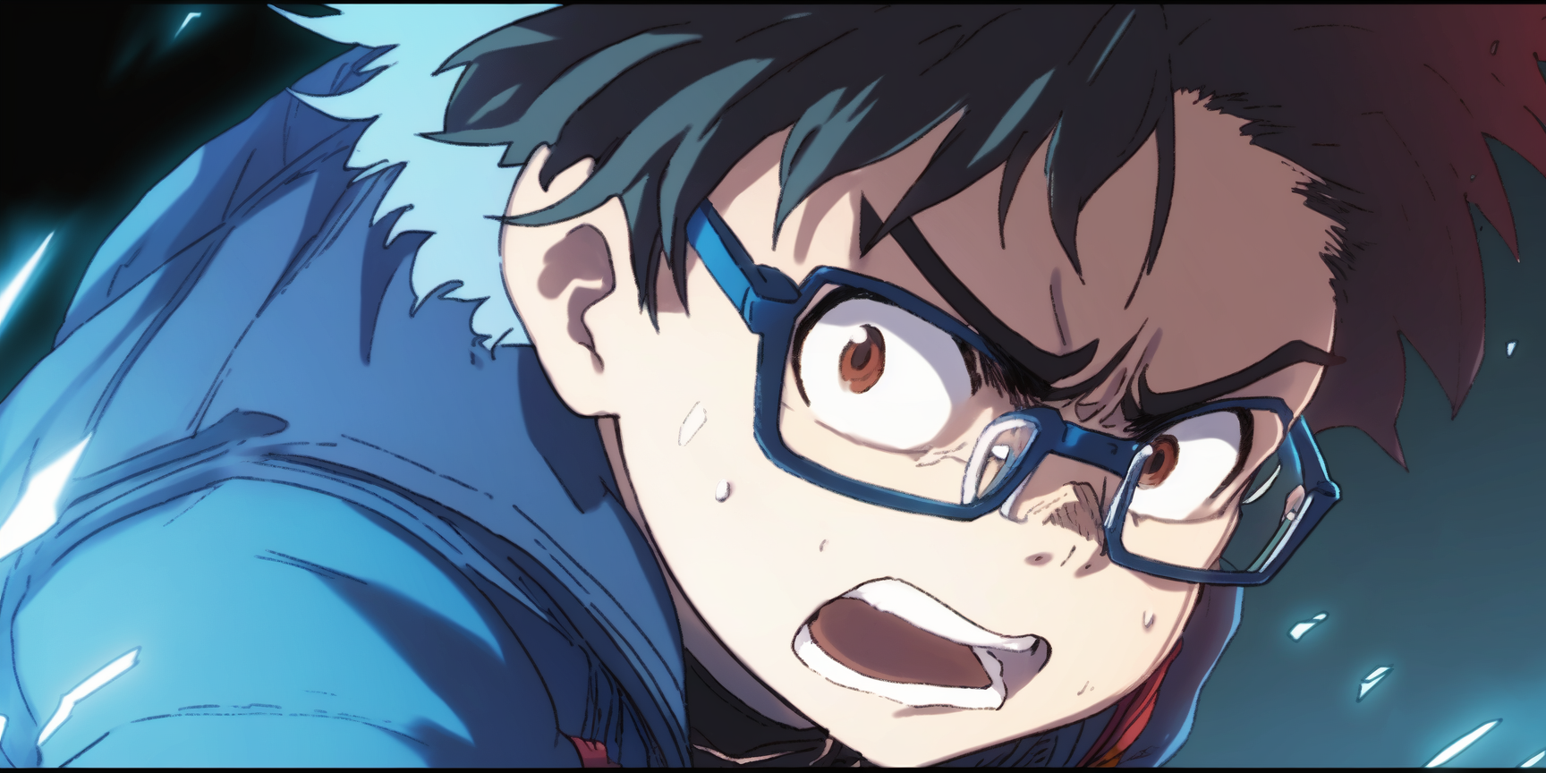

Slide 119
However, I cannot just …

Slide 120


Slide 121
make other people fail
so that I can pass

Slide 123


Slide 124
I will do it!

Slide 125


Slide 126
Power of
Angelic explanations

Slide 127


Slide 128
Activate

Slide 129

Activate

Slide 131


Slide 132
It is do or die time!

