Slide 1
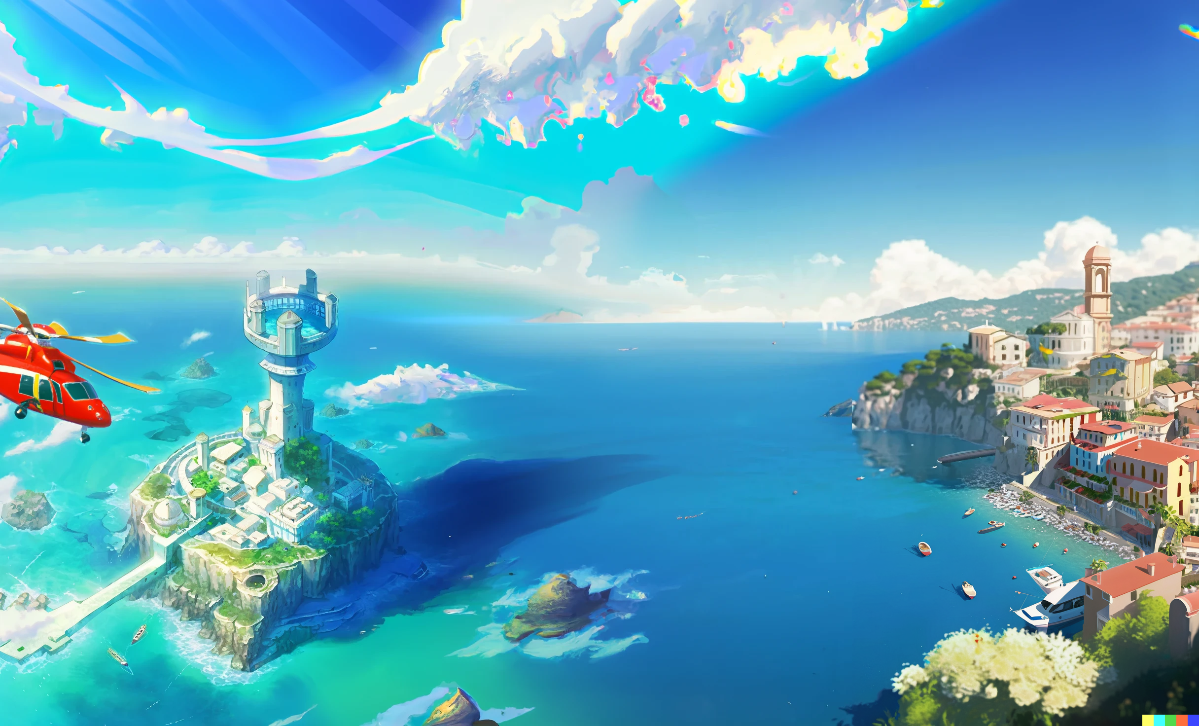

Slide 2
Sorrento Bay; Freshman city;
Ultimate Programming University (UPU)

Slide 3
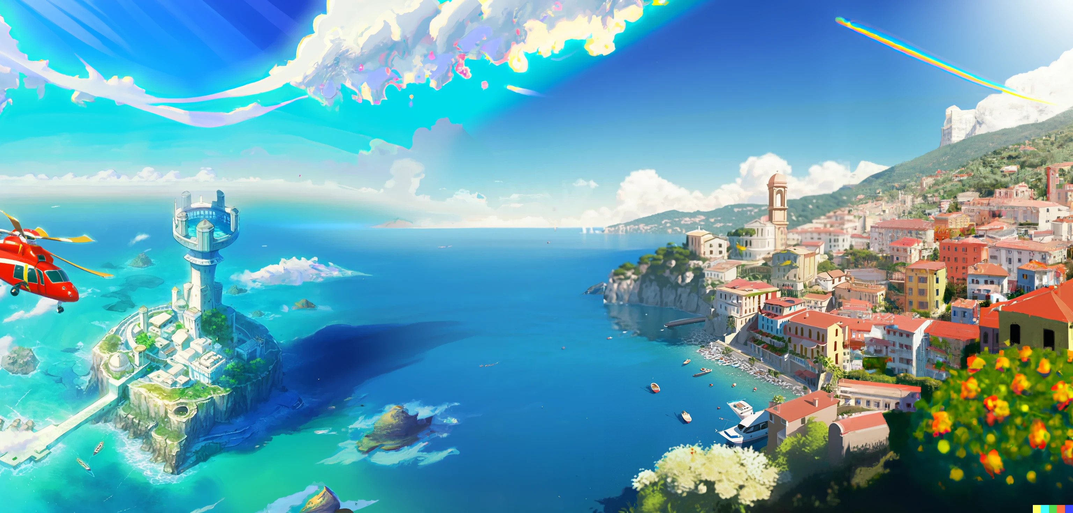
Freshmen city
Main campus
building

Slide 4



Hey Dany, are you ok?
Do I look ok to you?

Slide 5

No, you look lost,
that is why I’m asking
Those lectures are a nightmare,
I can not understand anything,
We are going to fail this!

Slide 6

This university is absurd!
What’s up with that giant
ivory tower?
I’m not sure, but it is very cool!

Slide 7

That is where the second
year students live
But do no worry
about it.

Slide 8
Only few manage to get there,
and that is a good thing.
This place is not good for you,
leave while you can!

Slide 9
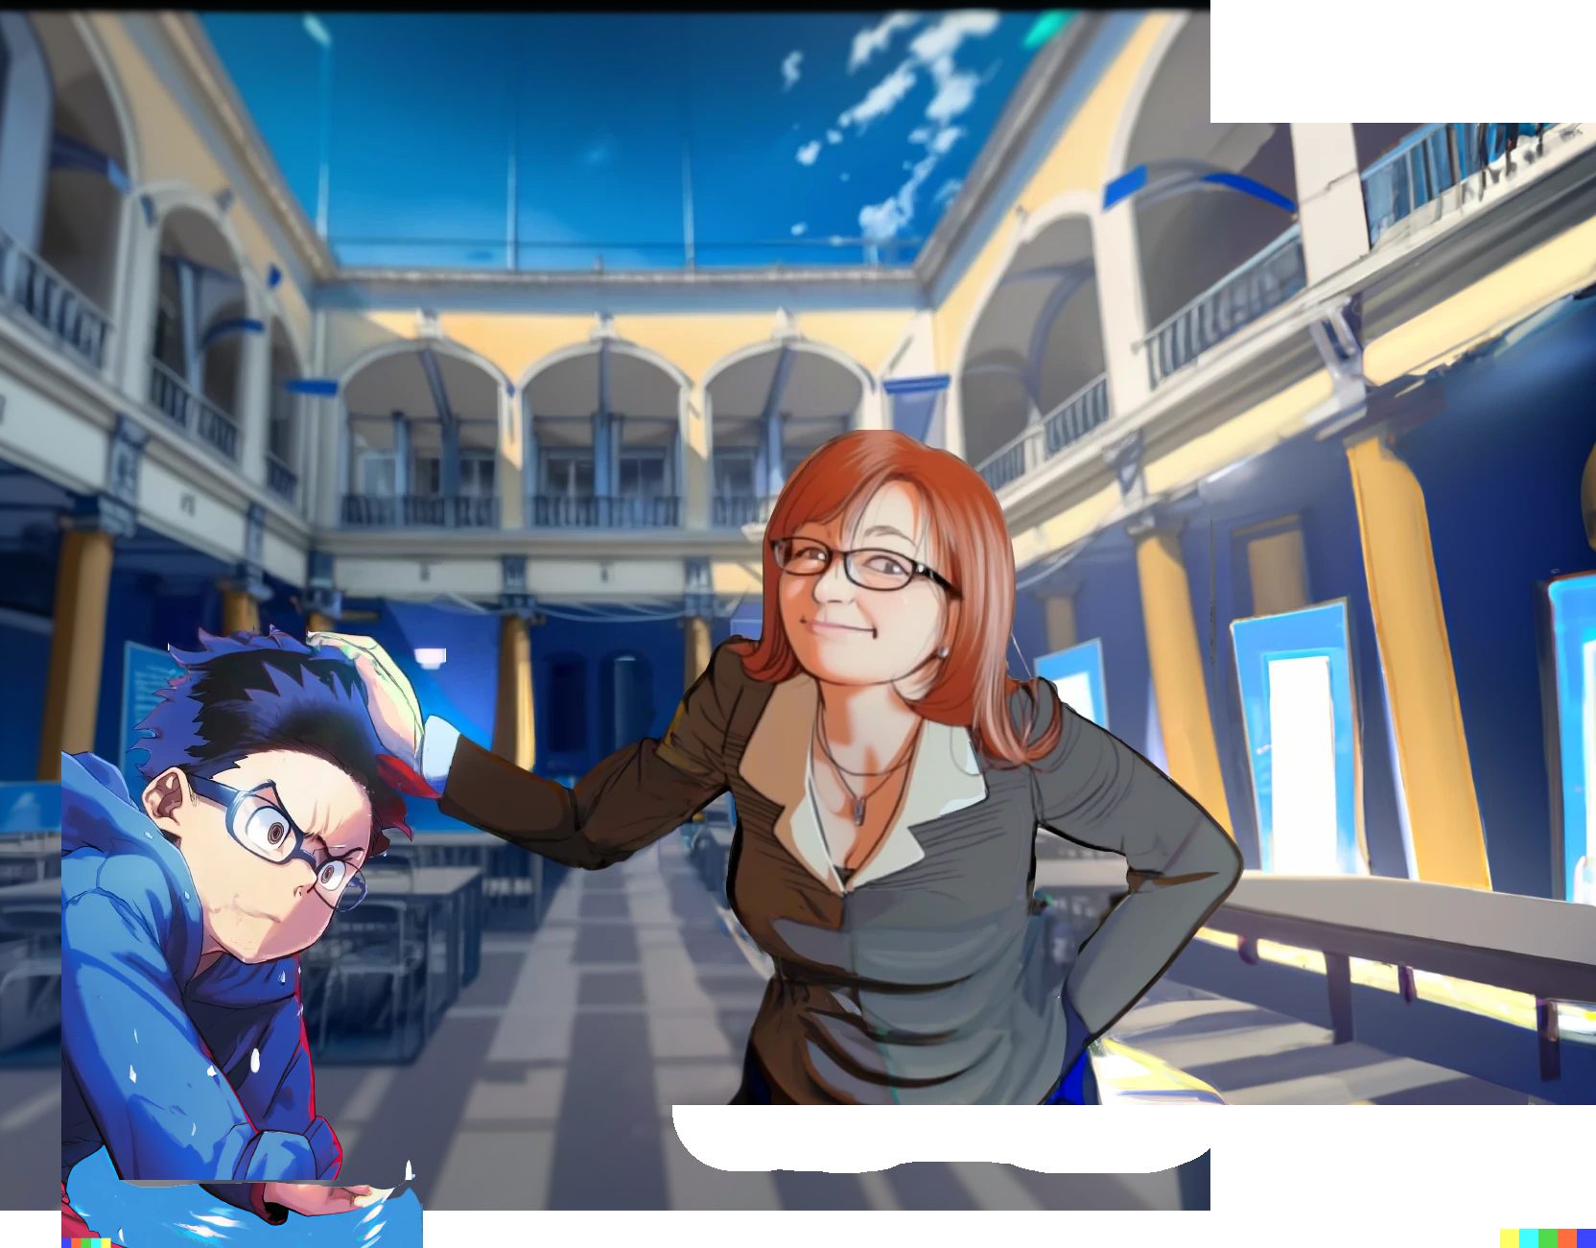
Poor guys,
they never listen
in time

Slide 10

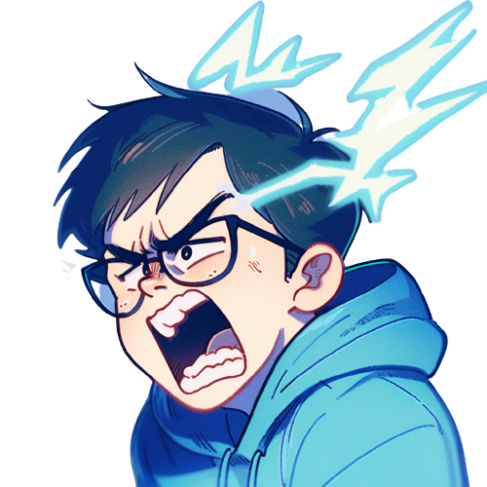
Aaah!
Whooops,
what was that...

Slide 11
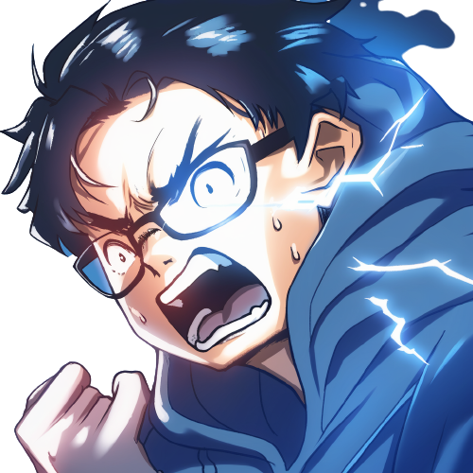
Umm.. maybe I was wrong...
What is going on?
I hate this place!
Maybe you do have what it takes
to survive here

