Slide 1


Slide 2
Sorrento Bay; Freshman city;
Ultimate Programming University (UPU)

Slide 3

Freshmen city
Main campus
building

Slide 4



Hey Dany, are you ok?
Do I look ok to you?

Slide 5

No, you look lost,
that is why I’m asking
Those lectures are a nightmare,
I can not understand anything,
We are going to fail this!

Slide 6

This university is absurd!
What’s up with that giant
ivory tower?
I’m not sure, but it is very cool!

Slide 7

That is where the second
year students live
But do no worry
about it.

Slide 8
Only few manage to get there,
and that is a good thing.
This place is not good for you,
leave while you can!

Slide 9

Poor guys,
they never listen
in time

Slide 10


Aaah!
Whooops,
what was that...

Slide 11

Umm.. maybe I was wrong...
What is going on?
I hate this place!
Maybe you do have what it takes
to survive here

Slide 12


The next lecture is starting.
Maybe this is going to be easier!
Where is the lecturer?

Slide 13



Three lecturers?

Slide 14
All three are bold?

Slide 15
All three with sun glasses?

Slide 16
Welcome to the first
programming lecture

Slide 17

I’m Elricho Pupon
Your Programming Professor
Please, do not mind the
security guards
We had some trouble last year,
we have to be ready this time

Slide 18
Places where the computer
store information.
They have names, called identifiers.
We can access them by their names,
and we can update the data stored in them
them by using the ‘equal’ sign.
For example, variables can contains numbers,
and we can use conventional operations on
those numbers, like addition, multiplication or
subtraction
Variables:

Slide 19

We can start
with some
example code
We are going to use Java, but
this would work the same in many
other languages

Slide 20

int a = 24;
int b = 50;
I’m declaring two variables, a and b.
They are both of type ‘int’.
They are initialized with values
24 and 50.

Slide 21
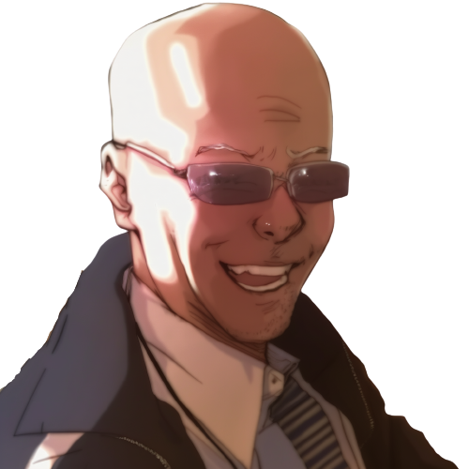
We can make c
using a and b
int a = 24;
int b = 50;
int c = a + b + 10;
Here c is a plus b plus 10.
As you can see, we can use
variable names or numbers

Slide 22

What is the value of c?
int a = 24;
int b = 50;
int c = a + b + 10;
assert c == ??;
It is the value of a plus
the value of b plus 10

Slide 23
That is, 84.
int a = 24;
int b = 50;
int c = a + b + 10;
assert c == 84; //24 + 50 + 10
We write “assert” to mark expressions
that should hold.
Equals equals evaluates to “true” if the
left and the right value are the same, and “false”
otherwise.

Slide 24
We can reuse a variable
instead of making a new one.

Slide 25
What is this
code doing?
int a = 24;
int b = 50;
b = a + b + 10;
It is updating the value of b
using the result of the expression
on the right.
That is, the equals is not like the
math equals, where we state that two terms
have the same value

Slide 26
Step by step...
int a = 24;
int b = 50;
b = a + b + 10;
//b = 24 + 50 + 10;
//b = 84;
assert b == 84;
We can see that first b is read,
then the sum is computed,
finally ‘b’ is updated.

Slide 27
What if wanted to swap the
content of two variables?

Slide 28

We can see our two variables
as our two hands,
holding one ball each.
A hand only hold one ball;
taking the other ball, we have to
abandon the current ball, that
would fall down, out of reach.

Slide 29
In code
int a = 24;
int b = 50;
a = b;
assert a == 50;
assert b == 50; //we have lost the “24”
this looks like this!
As soon as we update “a”, we lose
the original content of “a”.

Slide 30
As you can see, we can not do it!
Not with only two variables!
We need a third variable to
help us!

Slide 31
We do it in 3 steps!
int a = 24;
int b = 50;
int tmp = a; //step 1
a = b; //step 2
b = tmp; //step 3
assert a == 50;
assert b == 24;
First we save the original value of “a”
in a new temporary local variable
Then we write the content of “b” into “a”.
Finally we write “tmp” into “b”.

Slide 32
We do it in 3 steps!
int a = 24;
int b = 50;
int tmp = a; //step 1
a = b; //step 2
b = tmp; //step 3
assert a == 50;
assert b == 24;
As you can see, it can not be done
with only two variables,
it is mathematically proven
You need a third variable!

Slide 33

Something is wrong here
I’m seeing stuff

Slide 34



What?
I’m under water?
What is this?

Slide 35
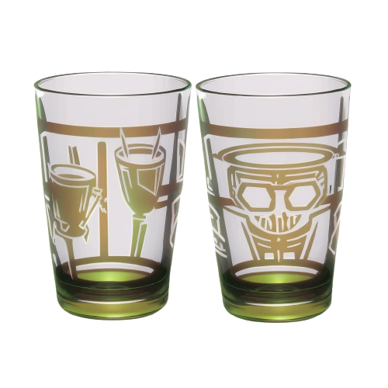
Two glasses?
With water?
But I’m already
underwater…
I must be dreaming

Slide 36
Anyway, can I swap
the content
without
a third glass?

Slide 37

int a = 24;
int b = 50;
a = a + b;
If I add the two glasses in
the first one,
would the second
glass get empty?

Slide 38
int a = 24;
int b = 50;
a = a + b;
No! this does not
update b.
Values are not shuffled
around, but duplicated

Slide 39
int a = 24;
int b = 50;
a = a + b;
That is, even after
adding a and b
All the information
is still in the system.
b is still in b, and
the original a is just
the current a minus b

Slide 40
int a = 24;
int b = 50;
a = a + b;
b = a - b;
a = a - b;
So, in 3 steps,
I can swap them

Slide 41


! Sorry !

Slide 42

! Hey, .. !
Dany, stop!
What are you doing?

Slide 43
Yes?
Do you have a question on
this basic material?

Slide 44

I CAN do it!

Slide 45
So you ‘CAN’ do..
what is it, that you can do?
I can swap the variables
without a third one!

Slide 46
Really?
Do not make us laugh,
It is mathematically proved,
It can not be done!
Now, let’s move one
with the lecture..

Slide 47
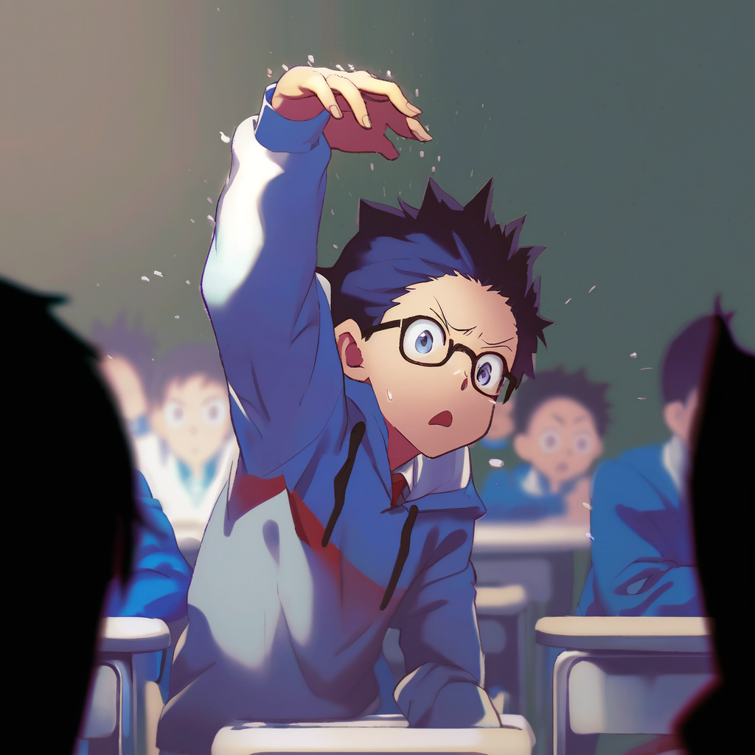
Dany, please stop!
It is going to get dangerous!

Slide 48

WRITE IT DOWN!
a = a + b;
b = a - b;
a = a - b;

Slide 49
?.. are you... for real.. ?

Slide 50
int a = 24;
int b = 50;
a = a+b;
b = a-b;
a = a-b;
Ok then, .. I will write it doooown,
So that I can show you that
does not work
And then we will all laughs at you
and your dumb arrogance!

Slide 51
Ok class, give me some numbers
for a and b
int a = 5;
int b = 12;
a = a+b;//a = 5+12;//a = 17
b = a-b;//b = 17-12;//b = 5
a = a-b;//a = 17-5;// a = 12
With 5 and 12 we get… let’s see
step by step...
5
12

Slide 52
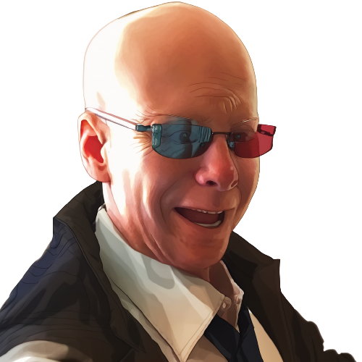
….
int a = 5;
int b = 12;
a = a+b;//a = 5+12;//a = 17
b = a-b;//b = 17-12;//b = 5
a = a-b;//a = 17-5;// a = 12
What, it worked?
hahah

Slide 53

Relax, it must be that those
two numbers are somehow special
int a = 5;
int b = 12;
a = a+b;//a = 5+12;//a = 17
b = a-b;//b = 17-12;//b = 5
a = a-b;//a = 17-5;// a = 12
Give me two other numbers,
this time one positive
and one negative

Slide 54

Please, stop this
and just solve
it symbolically

Slide 55
Such a good idea,
you must be very smart.

Slide 56
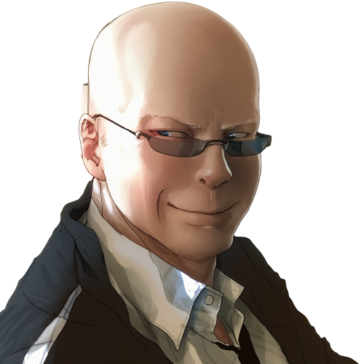
We can use use x and y for the
Original values of a and b.
int a = x;
int b = y;
a = a+b;//a = x+y;
b = a-b;//b =
a = a-b;//a =

Slide 57
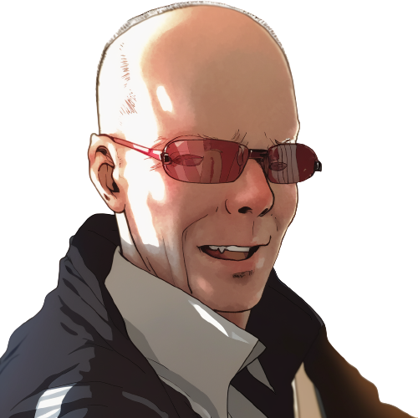
We can use use x and y for the
Original values of a and b.
int a = x;
int b = y;
a = a+b;//a = x+y;
b = a-b;//b = (x+y)-y;//b = x
a = a-b;//a =
It can’t be!

Slide 58

We can use use x and y for the
Original values of a and b.
int a = x;
int b = y;
a = a+b;//a = x+y;
b = a-b;//b = (x+y)-y;//b = x
a = a-b;//a = (x+y)-x;// a = y
Oh… but how...

Slide 59

We can use use x and y for the
Original values of a and b.
int a = x;
int b = y;
a = a+b;//a = x+y;
b = a-b;//b = (x+y)-y;//b = x
a = a-b;//a = (x+y)-x;// a = y
It does not make sense,
there is even a repeated
a minus b…
Ah?
so it is
working!
LOL, I’m
never forgetting
this

Slide 60

We can use use x and y for the
Original values of a and b.
int a = x;
int b = y;
a = a+b;//a = x+y;
b = a-b;//b = (x+y)-y;//b = x
a = a-b;//a = (x+y)-x;// a = y
It does not make sense,
there is even a repeated
a minus b…
How can the same expression
make two different results...

Slide 61

We can use use x and y for the
Original values of a and b.
int a = x;
int b = y;
a = a+b;//a = x+y;
b = a-b;//b = (x+y)-y;//b = x
a = a-b;//a = (x+y)-x;// a = y
No, wait, there must be some other...

Slide 62
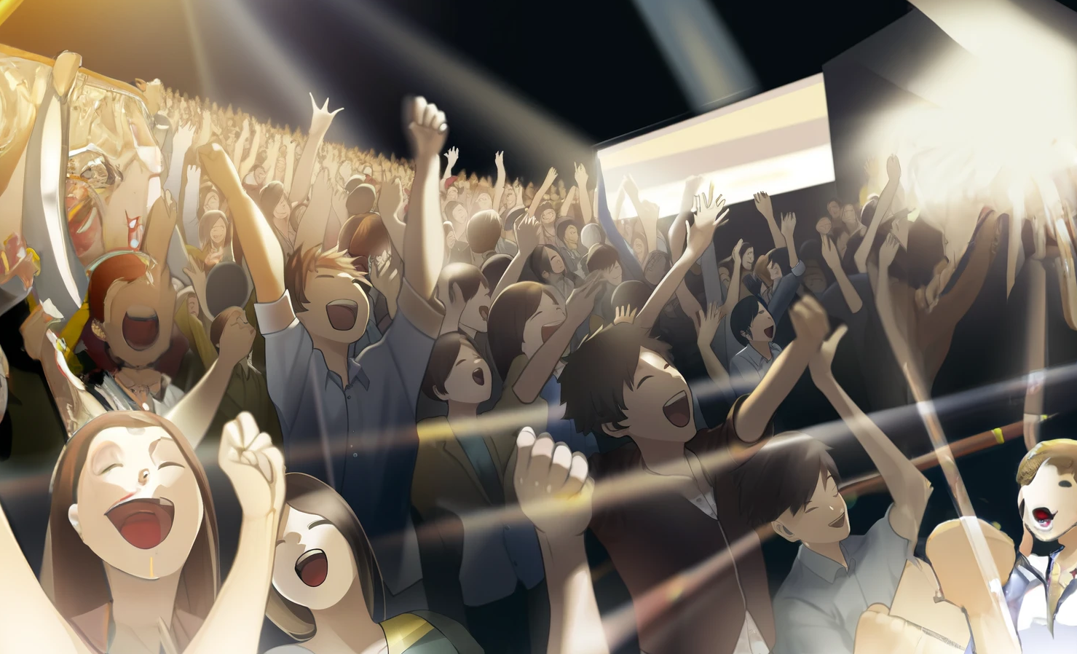
The bell rings in this crucial moment.
It is the end of the lecture

Slide 63

No, NO!

Slide 64
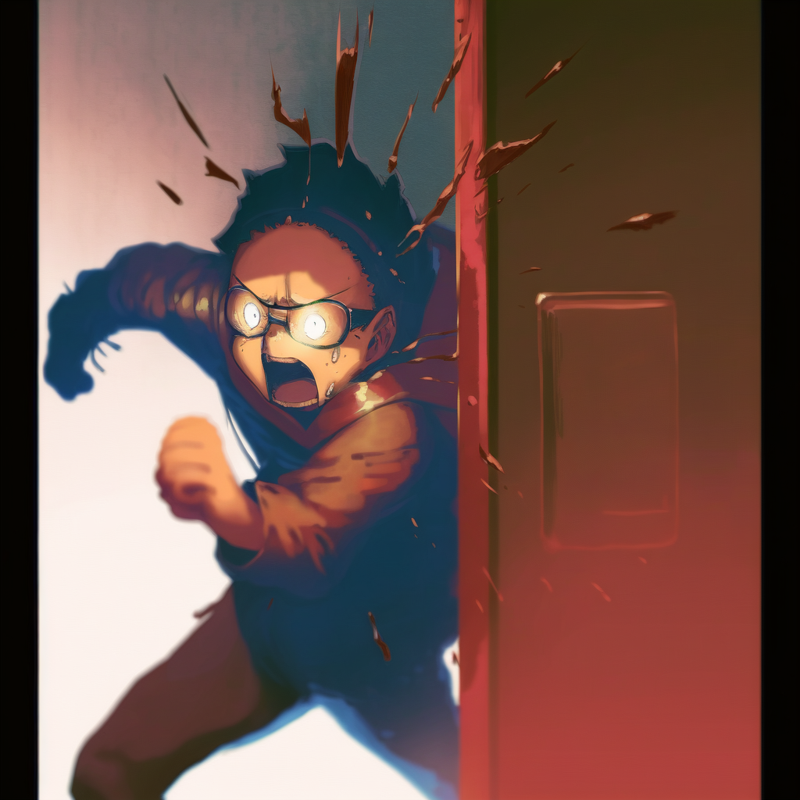

What have I done!

Slide 65


It is over!
He is going to make
my life a nightmare!

Slide 66

This is the end of
the first chapter.
What waits in the future
of our cowardly hero?

