Slide 2


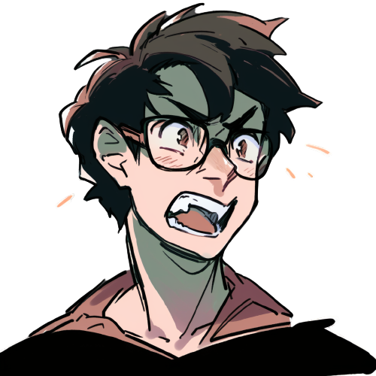
Do you prefer this stile?
Or this one?

