Slide 1


Slide 2


Slide 3


Slide 4
Sorrento Bay; Freshman city;
Ultimate Programming University (UPU)

Slide 5

Freshmen city
Main campus
building

Slide 6



At the end of the first week of term,
Ricky and Dany are chatting
Hey Dany, are you ok?

Slide 7
Hey Dany, are you ok?
Do I look ok to you?

Slide 8
No, you look lost,
that is why I’m asking

Slide 9

No, you look lost,
that is why I’m asking
Those lectures are a nightmare,
I can not understand anything,

Slide 10
Little does he knows, but up to now,
all the lectures was just about
basic computer architecture.
No, you look lost,
that is why I’m asking
Those lectures are a nightmare,
I can not understand anything,
We are going to fail this!

Slide 11

This university is absurd!
What’s up with that giant
ivory tower?

Slide 12
This university is absurd!
What’s up with that giant
ivory tower?
I’m not sure, but it is very cool!

Slide 13

That is where the second
year students live

Slide 14
That is where the second
year students live
But do no worry
about it.

Slide 15
Only few manage to get there,
and that is a good thing.

Slide 16
Only few manage to get there,
and that is a good thing.
This place is not good for you,
leave while you can!

Slide 17

Poor guys,
they never listen
in time

Slide 18


Slide 19


Aaah!

Slide 20
Aaah!
Whooops,
what was that...

Slide 21

What is going on?
I hate this place!

Slide 22
Umm.. maybe I was wrong...
What is going on?
I hate this place!

Slide 23
Umm.. maybe I was wrong...
What is going on?
I hate this place!
Maybe you do have what it takes
to survive here

Slide 24


The next lecture is starting.
Maybe this is going to be easier!

Slide 25
The next lecture is starting.
Maybe this is going to be easier!
Where is the lecturer?

Slide 26



Three lecturers?

Slide 27
All three are bald?

Slide 28
All three with sun glasses?

Slide 29
Welcome to the first
programming lecture

Slide 30

I’m Elricho Pupon
Your Programming Professor

Slide 31
I’m Elricho Pupon
Your Programming Professor
Please, do not mind the
security guards

Slide 32
I’m Elricho Pupon
Your Programming Professor
We had some petulant
troublemakers last year,
Please, do not mind the
security guards

Slide 33
I’m Elricho Pupon
Your Programming Professor
We had some petulant
troublemakers last year,
Please, do not mind the
security guards
We have to be ready, this time

Slide 34
Places where the computer
store information.
Variables:

Slide 35
Places where the computer
store information.
They have names, called identifiers.
Variables:

Slide 36
Places where the computer
store information.
They have names, called identifiers.
We can access them by their names,
and we can update the data stored in them
them by using the ‘equal’ sign.
Variables:

Slide 37
Places where the computer
store information.
They have names, called identifiers.
We can access them by their names,
and we can update the data stored in them
them by using the ‘equal’ sign.
For example, variables can contains numbers,
and we can use conventional operations on
those numbers, like addition, multiplication
or subtraction
Variables:

Slide 38

We can start
with some
example code

Slide 39
We can start
with some
example code
We are going to use Java, but
this would work the same in many
other languages

Slide 40

int a = 24;
int b = 50;
I’m declaring two variables, “a” and “b”.

Slide 41
int a = 24;
int b = 50;
I’m declaring two variables, “a” and “b”.
They are both of type “int”.

Slide 42
int a = 24;
int b = 50;
I’m declaring two variables, “a” and “b”.
They are both of type “int”.
They are initialized with values
“24” and “50”.

Slide 43
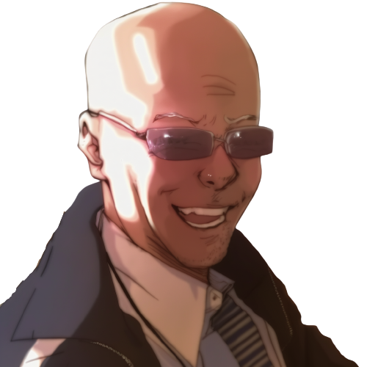
We can make “c”
using “a” and “b”
int a = 24;
int b = 50;
int c = a + b + 10;

Slide 44
We can make “c”
using “a” and “b”
int a = 24;
int b = 50;
int c = a + b + 10;
Here “c” is “a” plus “b” plus “10”.

Slide 45
We can make “c”
using “a” and “b”
int a = 24;
int b = 50;
int c = a + b + 10;
Here “c” is “a” plus “b” plus “10”.
As you can see, we can use
variable names or numbers

Slide 46
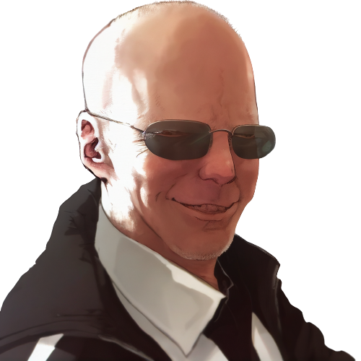
What is the value of “c”?
int a = 24;
int b = 50;
int c = a + b + 10;
assert c == ??;

Slide 47
What is the value of “c”?
int a = 24;
int b = 50;
int c = a + b + 10;
assert c == ??;
It is the value of “a” plus
the value of “b” plus “10”

Slide 48
That is, “84”.
int a = 24;
int b = 50;
int c = a + b + 10;
assert c == 84; //24 + 50 + 10

Slide 49
That is, “84”.
int a = 24;
int b = 50;
int c = a + b + 10;
assert c == 84; //24 + 50 + 10
We write “assert” to mark expressions
that should hold.

Slide 50
That is, “84”.
int a = 24;
int b = 50;
int c = a + b + 10;
assert c == 84; //24 + 50 + 10
We write “assert” to mark expressions
that should hold true.
Equals equals evaluates to “true” if the
left and the right value are the same, and “false”
otherwise.

Slide 51
We can reuse a variable
instead of making a new one.

Slide 52
What is this
code doing?
int a = 24;
int b = 50;
b = a + b + 10;

Slide 53
What is this
code doing?
int a = 24;
int b = 50;
b = a + b + 10;
It is updating the value of “b”
using the result of the expression
on the right.

Slide 54
What is this
code doing?
int a = 24;
int b = 50;
b = a + b + 10;
It is updating the value of “b”
using the result of the expression
on the right.
That is, the equals is not like the
math equals, where we state that two terms
have the same value

Slide 55
Step by step...
int a = 24;
int b = 50;
b = a + b + 10;
//b =
//b =
assert b ==

Slide 56
Step by step...
int a = 24;
int b = 50;
b = a + b + 10;
//b = 24 + b + 10;
//b =
//b =
//b =
assert b ==
We can see that first “a” is read,

Slide 57
Step by step...
int a = 24;
int b = 50;
b = a + b + 10;
//b = 24 + b + 10;
//b = 24 + 50 + 10;
//b =
//b =
assert b ==
We can see that first “a” is read,
then “b” is read,

Slide 58
Step by step...
int a = 24;
int b = 50;
b = a + b + 10;
//b = 24 + b + 10;
//b = 24 + 50 + 10;
//b = 74 + 10;
//b =
assert b ==
We can see that first “a” is read,
then “b” is read,
then the sum is computed,

Slide 59
Step by step...
int a = 24;
int b = 50;
b = a + b + 10;
//b = 24 + b + 10;
//b = 24 + 50 + 10;
//b = 74 + 10;
//b = 84;
assert b == 84;
We can see that first “a” is read,
then “b” is read,
then the sum is computed,
finally “b” is updated.

Slide 60
What if we wanted to swap the
content of two variables?

Slide 61

We can see our two variables
as our two hands,
holding one ball each.

Slide 62
We can see our two variables
as our two hands,
holding one ball each.
A hand only holds one ball;

Slide 63
We can see our two variables
as our two hands,
holding one ball each.
A hand only holds one ball;
taking the other ball, we have to
abandon the current ball, which
would fall down, out of reach.

Slide 64
In code
int a = 24;
int b = 50;
a = b;
assert a == 50;
assert b == 50; //we have lost the “24”

Slide 65
In code
int a = 24;
int b = 50;
a = b;
assert a == 50;
assert b == 50; //we have lost the “24”
it looks like this!

Slide 66
In code
int a = 24;
int b = 50;
a = b;
assert a == 50;
assert b == 50; //we have lost the “24”
it looks like this!
As soon as we update “a”, we lose
the original contents of “a”.

Slide 67
As you can see, we can’t do it!

Slide 68
As you can see, we can’t do it!
Not with only two variables!

Slide 69
As you can see, we can’t do it!
Not with only two variables!
We need a third variable to
help us!

Slide 70
We do it in 3 steps!
int a = 24;
int b = 50;
int tmp = a;
....
....
assert a == 50;
assert b == 24;

Slide 71
We do it in 3 steps!
int a = 24;
int b = 50;
int tmp = a; //step 1
....
....
assert a == 50;
assert b == 24;
First we save the original value of “a”
in a new temporary local variable

Slide 72
We do it in 3 steps!
int a = 24;
int b = 50;
int tmp = a; //step 1
a = b; //step 2
....
assert a == 50;
assert b == 24;
First we save the original value of “a”
in a new temporary local variable
Then we write the content of “b” into “a”.

Slide 73
We do it in 3 steps!
int a = 24;
int b = 50;
int tmp = a; //step 1
a = b; //step 2
b = tmp; //step 3
assert a == 50;
assert b == 24;
First we save the original value of “a”
in a new temporary local variable
Then we write the content of “b” into “a”.
Finally we write “tmp” into “b”.

Slide 74
We do it in 3 steps!
int a = 24;
int b = 50;
int tmp = a; //step 1
a = b; //step 2
b = tmp; //step 3
assert a == 50;
assert b == 24;
As you can see, it can not be done
with only two variables,
it is mathematically proven
You need a third variable!

Slide 75

Something is wrong here

Slide 76
Something is wrong here
I’m seeing stuff

Slide 77



What?

Slide 78
What?
I’m under water?

Slide 79
What?
I’m under water?
What is this?

Slide 80

Two glasses?
With water?

Slide 81
Two glasses?
With water?
But I’m already
underwater…

Slide 82
Two glasses?
With water?
But I’m already
underwater…
I must be dreaming

Slide 83
Anyway, can I swap
the content

Slide 84
Anyway, can I swap
the content
without
a third glass?

Slide 85

int a = 24;
int b = 50;
a = a + b;
If I add the two glasses in
the first one,

Slide 86
int a = 24;
int b = 50;
a = a + b;
If I add the two glasses in
the first one,
would the second
glass get empty?

Slide 87
int a = 24;
int b = 50;
a = a + b;
No! This does not
update b.

Slide 88
int a = 24;
int b = 50;
a = a + b;
No! This does not
update b.
Values are not shuffled
around, but duplicated

Slide 89
int a = 24;
int b = 50;
a = a + b;
That is, even after
adding a and b

Slide 90
int a = 24;
int b = 50;
a = a + b;
That is, even after
adding a and b
All the information
is still in the system.

Slide 91
int a = 24;
int b = 50;
a = a + b;
That is, even after
adding a and b
All the information
is still in the system.
b is still in b, and
the original a is just
the current a minus b

Slide 92
int a = 24;
int b = 50;
a = a + b;
b = a - b;
a = a - b;
So, in 3 steps,
I can swap them

Slide 94



Slide 95
! Sorry !

Slide 96

! Hey, .. !

Slide 97
! Hey, .. !
Dany, stop!
What are you doing?

Slide 98
Yes?
Do you have a question on
this basic material?

Slide 99


Slide 100
I CAN do it!

Slide 101
So you ‘CAN’ do..

Slide 102
So you ‘CAN’ do..
what is it, that you can do?

Slide 103
So you ‘CAN’ do..
what is it, that you can do?
I can swap the variables
without a third one!

Slide 104
Really?
Do not make us laugh.
It is mathematically proved.
It can not be done!

Slide 105
Really?
Do not make us laugh.
It is mathematically proved.
It can not be done!
Now, let’s move one
with the lecture..

Slide 106
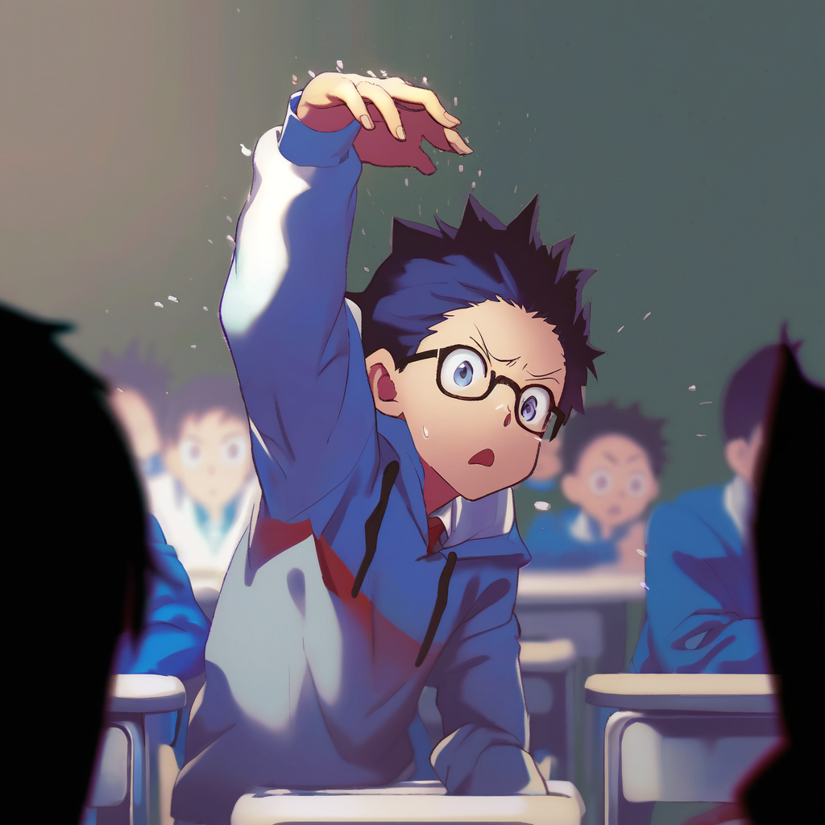
Dany, please stop!
It is going to get dangerous!

Slide 107

WRITE IT DOWN!

Slide 108
WRITE IT DOWN!
a = a + b;

Slide 109
WRITE IT DOWN!
a = a + b;
b = a - b;
a = a - b;

Slide 110
?.. are you...

Slide 111
?.. are you... for real.. ?

Slide 112
int a = 24;
int b = 50;
Ok then, .. I will write it doooown,

Slide 113
int a = 24;
int b = 50;
a = a+b;
Ok then, .. I will write it doooown,
So that I can shooow you that
it does nooot work

Slide 114
int a = 24;
int b = 50;
a = a+b;
b = a-b;
a = a-b;
Ok then, .. I will write it doooown,
So that I can shooow you that
it does nooot work
And then we will all laughs at you
and your dumb arrogance!

Slide 115
Ok class, give me some numbers
for a and b
int a = ??;
int b = ??;
a = a+b;//
b = a-b;//
a = a-b;//

Slide 116
Ok class, give me some numbers
for a and b
int a = 5;
int b = 12;
a = a+b;//
b = a-b;//
a = a-b;//
5
12

Slide 117
Ok class, give me some numbers
for a and b
int a = 5;
int b = 12;
a = a+b;//a = 5+12;//a = 17
b = a-b;//b =
a = a-b;//a =
With 5 and 12 we get… let’s see
step by step...
5
12

Slide 118
Ok class, give me some numbers
for a and b
int a = 5;
int b = 12;
a = a+b;//a = 5+12;//a = 17
b = a-b;//b = 17-12;//b = 5
a = a-b;//a =
With 5 and 12 we get… let’s see
step by step...
5
12

Slide 119

….
int a = 5;
int b = 12;
a = a+b;//a = 5+12;//a = 17
b = a-b;//b = 17-12;//b = 5
a = a-b;//a = 17-5;// a = 12
hahah

Slide 120
….
int a = 5;
int b = 12;
a = a+b;//a = 5+12;//a = 17
b = a-b;//b = 17-12;//b = 5
a = a-b;//a = 17-5;// a = 12
What, it worked?
hahah

Slide 121

Relax, it must be that those
two numbers are somehow special
int a = 5;
int b = 12;
a = a+b;//a = 5+12;//a = 17
b = a-b;//b = 17-12;//b = 5
a = a-b;//a = 17-5;// a = 12

Slide 122
Relax, it must be that those
two numbers are somehow special
int a = 5;
int b = 12;
a = a+b;//a = 5+12;//a = 17
b = a-b;//b = 17-12;//b = 5
a = a-b;//a = 17-5;// a = 12
Give me two other numbers,
this time one positive
and one negative

Slide 123

Please, stop this
and just solve
it symbolically

Slide 124
Such a good idea,
you must be very smart.

Slide 125
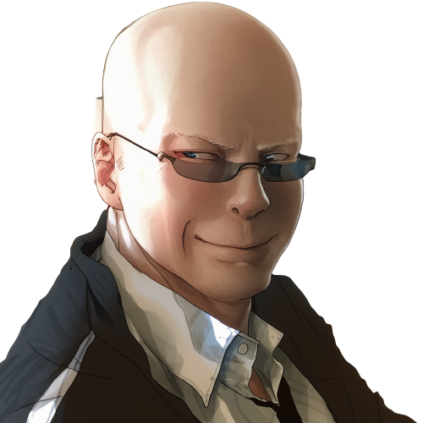
We can use use x and y for the
Original values of a and b.
int a = x;
int b = y;
a = a+b;//a = x+y;
b = a-b;//b =
a = a-b;//a =

Slide 126
We can use use x and y for the
Original values of a and b.
int a = x;
int b = y;
a = a+b;//a = x+y;
b = a-b;//b = (x+y)-y;//b = x
a = a-b;//a =
It can’t be!

Slide 127

int a = x;
int b = y;
a = a+b;//a = x+y;
b = a-b;//b = (x+y)-y;//b = x
a = a-b;//a = (x+y)-x;//a = y
Oh… but how...

Slide 128

int a = x;
int b = y;
a = a+b;//a = x+y;
b = a-b;//b = (x+y)-y;//b = x
a = a-b;//a = (x+y)-x;//a = y
It does not make sense,
there is even a repeated
“a” minus “b”…

Slide 129
int a = x;
int b = y;
a = a+b;//a = x+y;
b = a-b;//b = (x+y)-y;//b = x
a = a-b;//a = (x+y)-x;//a = y
It does not make sense,
there is even a repeated
“a” minus “b”…
Ah?
so it is
working!

Slide 130
int a = x;
int b = y;
a = a+b;//a = x+y;
b = a-b;//b = (x+y)-y;//b = x
a = a-b;//a = (x+y)-x;//a = y
It does not make sense,
there is even a repeated
“a” minus “b”…
Ah?
so it is
working!
LOL, I’m
never forgetting
this

Slide 131
int a = x;
int b = y;
a = a+b;//a = x+y;
b = a-b;//b = (x+y)-y;//b = x
a = a-b;//a = (x+y)-x;//a = y
It does not make sense,
there is even a repeated
“a” minus “b”…
How can the same expression
make two different results...

Slide 132

int a = x;
int b = y;
a = a+b;//a = x+y;
b = a-b;//b = (x+y)-y;//b = x
a = a-b;//a = (x+y)-x;//a = y
No, wait, there must be some other...

Slide 133
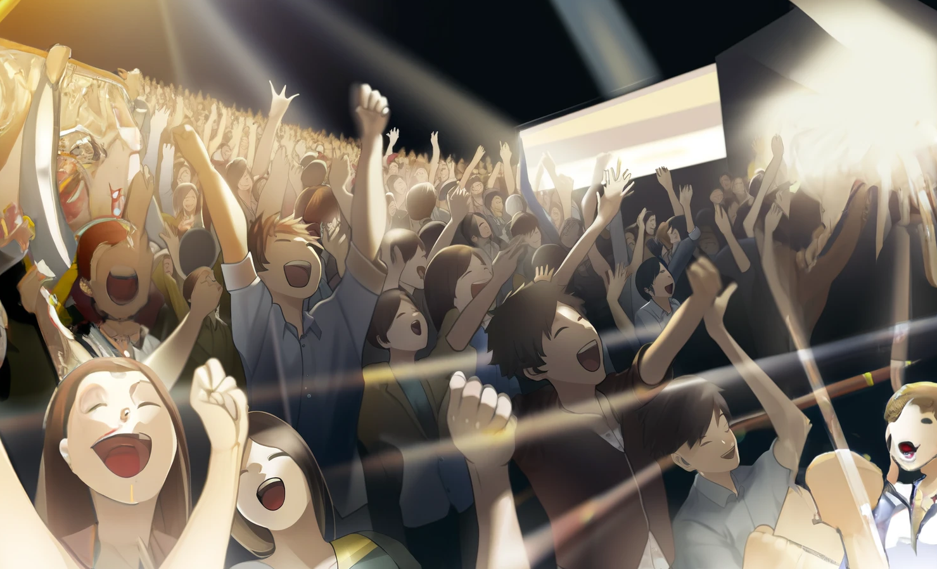
The bell rings in this crucial moment.
It is the end of the lecture

Slide 134

No, NO!

Slide 135
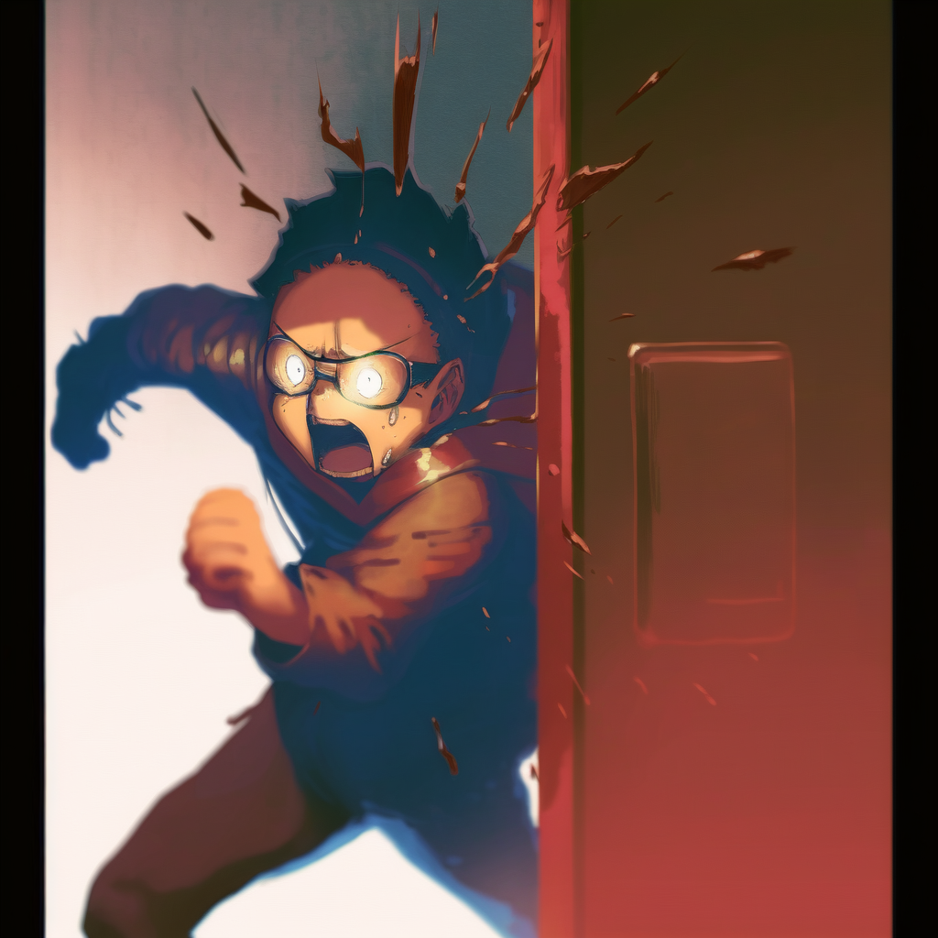
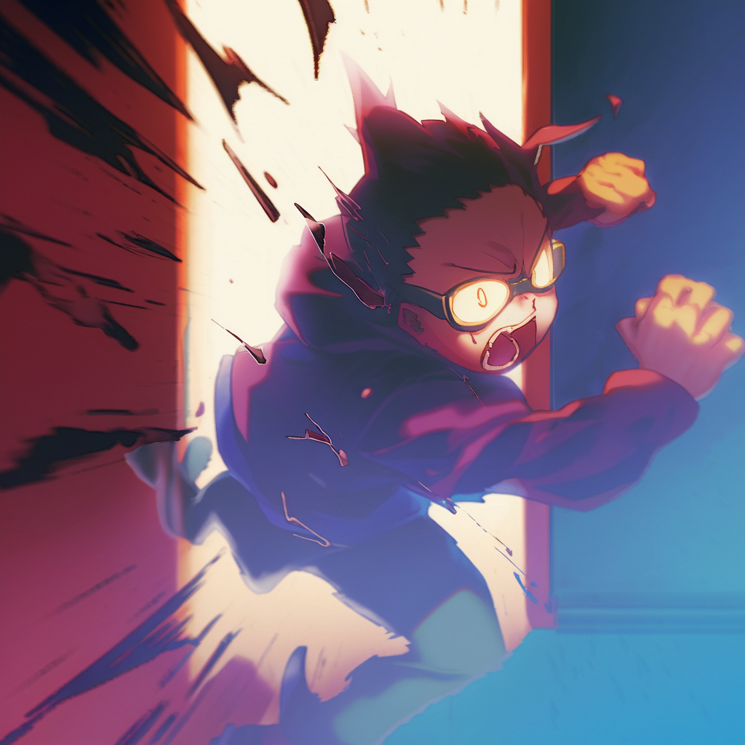
What have I done!

Slide 136


It is over!

Slide 137
It is over!
All the class was
laughing at him,
he is going to hate me!

Slide 138
It is over!
All the class was
laughing at him,
he is going to hate me!
He is going to make
my life a nightmare!

Slide 139
01: Invalid Metaphors

Slide 140

This is the end of
the first chapter.
What waits in the future
for our cowardly hero?

Slide 141
Credits
- Story: Marco
- Art: MidJourney, NijiJourney, Dall-E
- Composition: Marco
- Thanks to all my friends for
providing great feedback!

