Slide 1

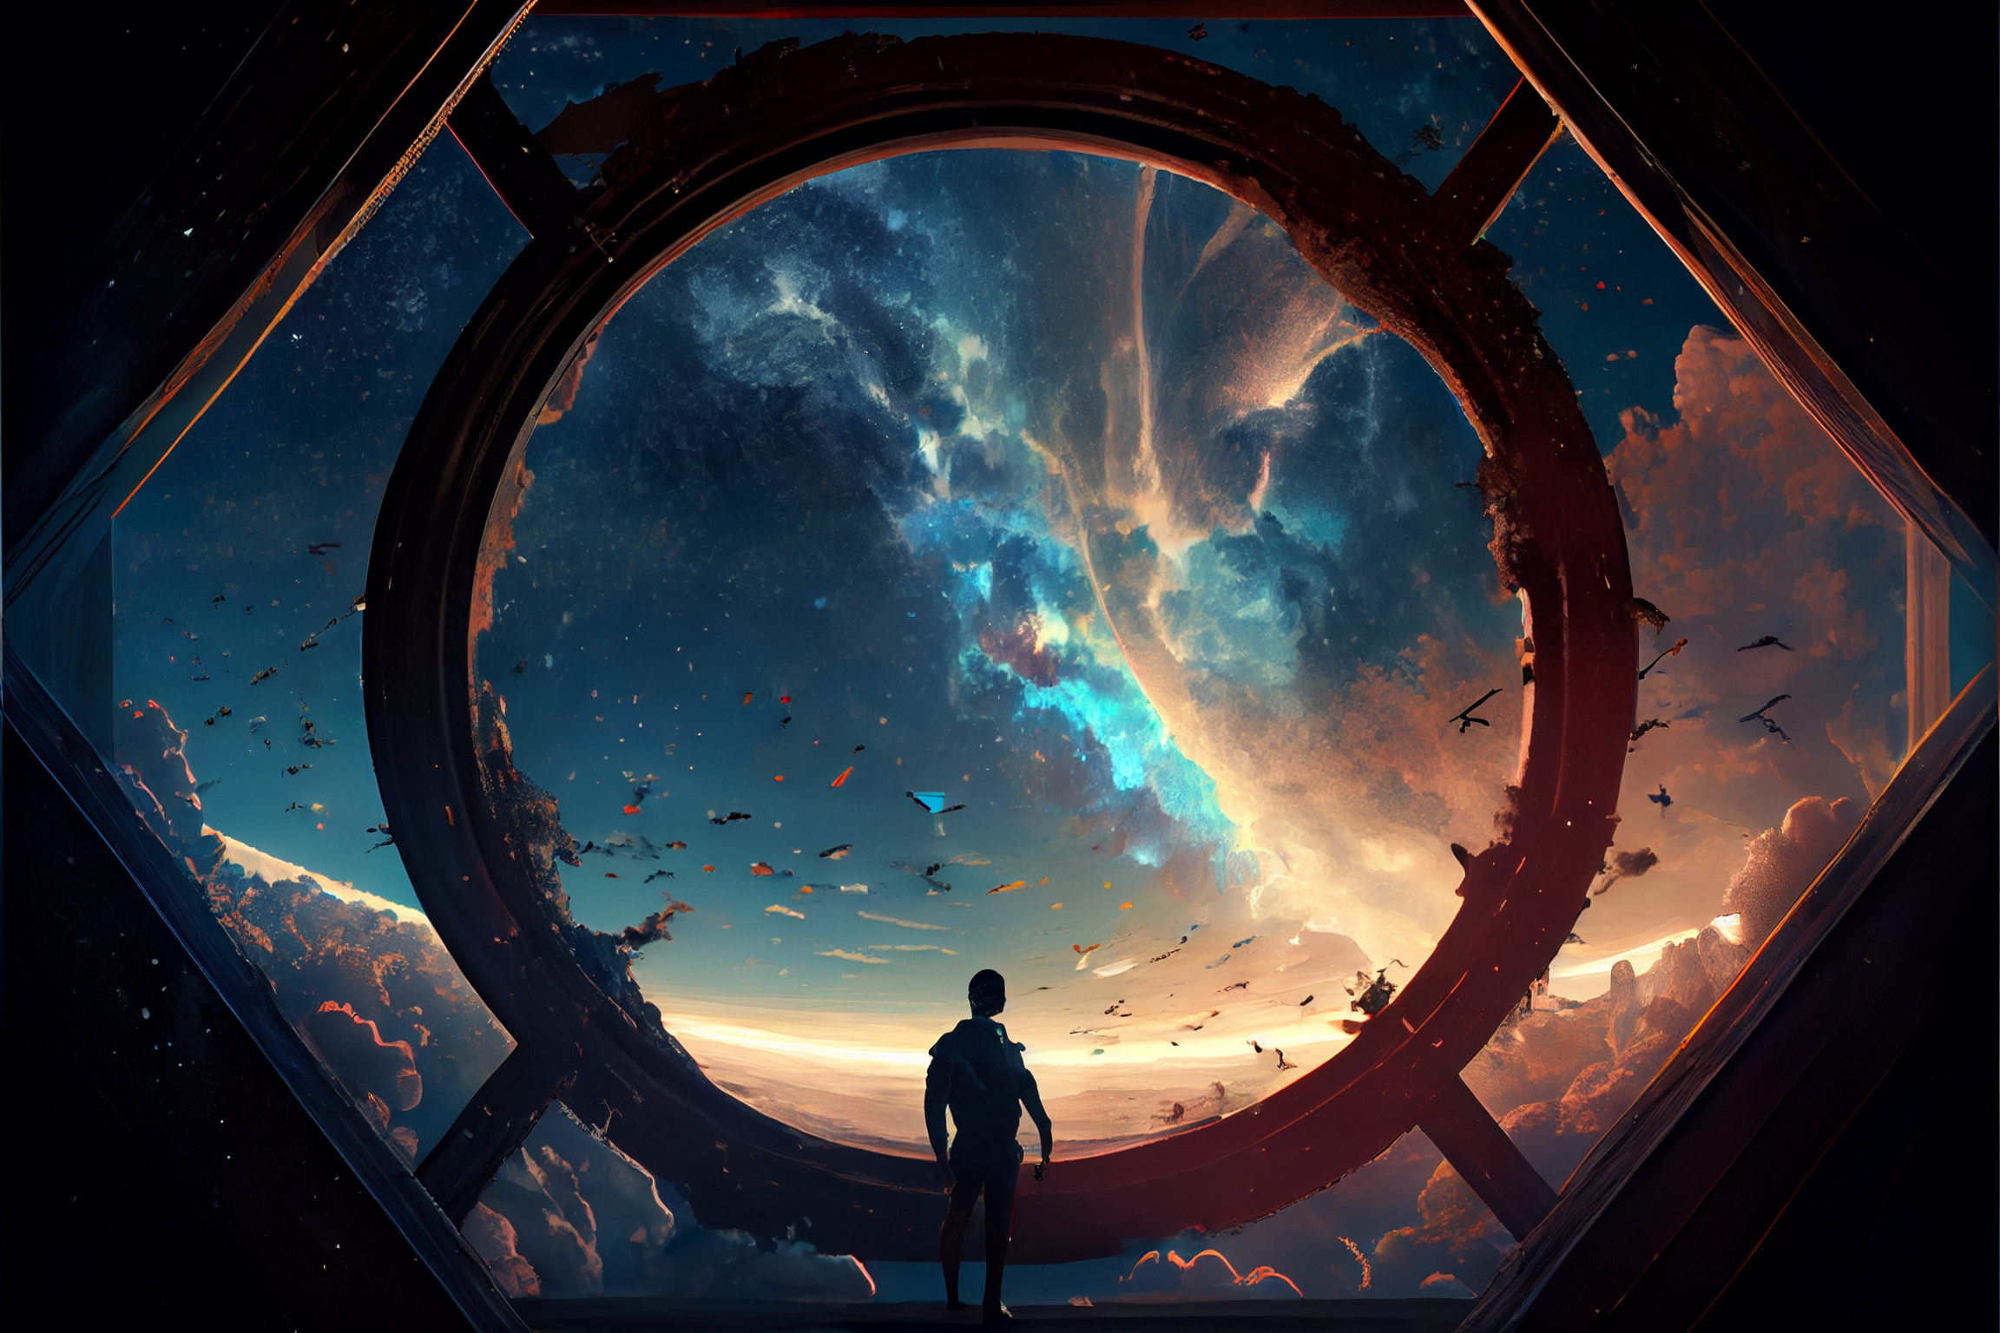

Slide 2
This is episode 2 of UPU.
Link to episode 1
in the description
Episode 3 will be available on 13 Feb 2023

Slide 4


Slide 5
Sorrento Bay
The Ivory tower (UPU)

Slide 6
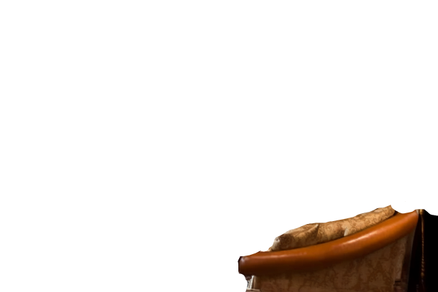


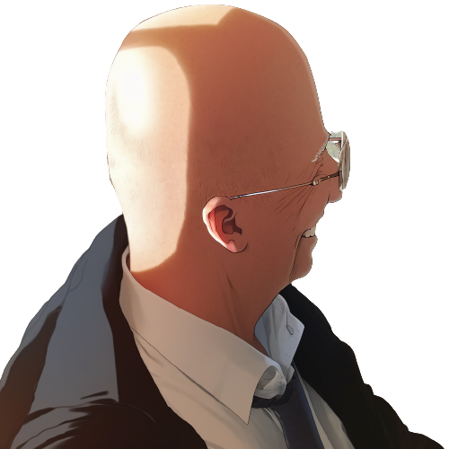
At the top of the Ivory tower,
headmaster Professor Eugene Mortis faces
Professor Elricho Pupon, his expression grave

Slide 7
Pupon, I understand that you
had a bit of a mishap
during your first lecture.

Slide 8
Pupon, I understand that you
had a bit of a mishap
during your first lecture.
You've become a laughing stock
among the first-year class.

Slide 9
Pupon hangs his head in shame,
his shoulders slumping

Slide 10
Pupon hangs his head in shame,
his shoulders slumping
That's correct, Professor Mortis.
I was too confident in my own
assumptions and didn't
consider the possibility of an error.

Slide 11
This is not the kind of behavior
that we expect from UPU professors.

Slide 12
This is not the kind of behavior
that we expect from UPU professors.
You must be open to the ideas
and perspectives of our students.

Slide 13
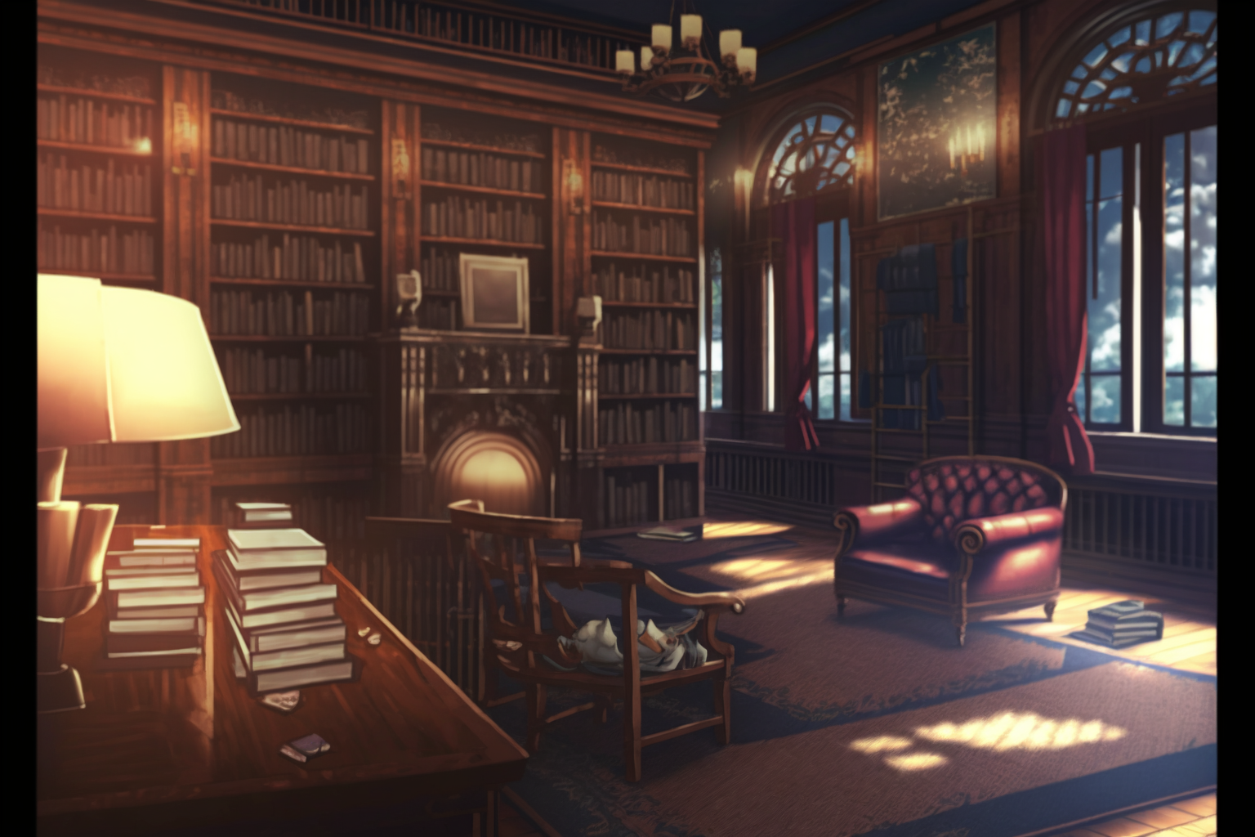

I, … I apologize for bringing shame
upon the university.

Slide 14
I, … I apologize for bringing shame
upon the university.
I'll make sure to be more thorough
in my explanations in the future.

Slide 15
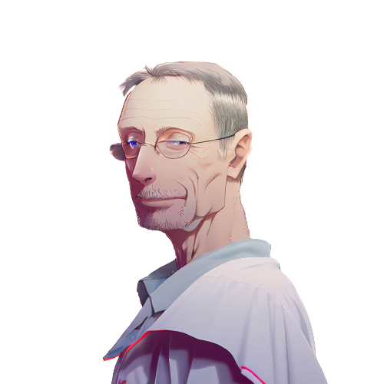
Don't worry, it just
means that this year's students
are particularly talented.

Slide 16
Don't worry, it just
means that this year's students
are particularly talented.
We should raise the difficulty
of our course material to
match their abilities.

Slide 17
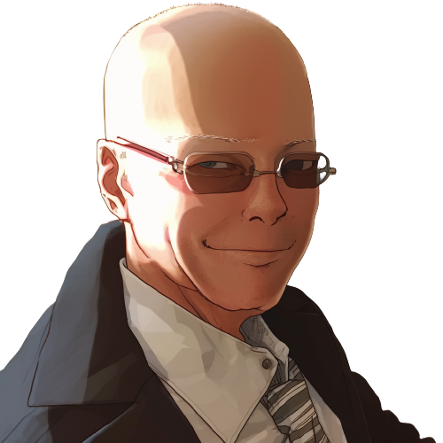
What are you proposing?

Slide 18
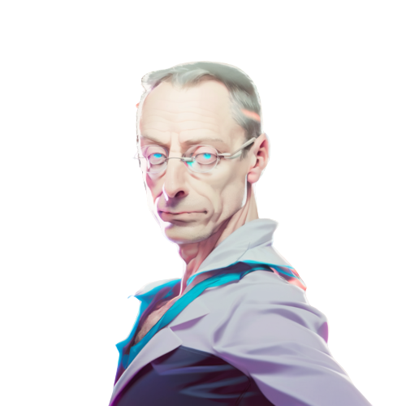
The 'equals switcheroo'.

Slide 19
The 'equals switcheroo'.
It will test their skills and
understanding of programming.

Slide 20
The 'equals switcheroo'.
It will test their skills and
understanding of programming.
By raising the difficulty
of our lessons, we can further
challenge and engage our students.

Slide 21

Pupon's face falls,
a look of dread crossing his features.
The 'equals switcheroo'?

Slide 22
Pupon's face falls,
a look of dread crossing his features.
The 'equals switcheroo'?
Oh no, I remember that lesson.

Slide 23
Pupon's face falls,
a look of dread crossing his features.
The 'equals switcheroo'?
Oh no, I remember that lesson.
It's the most difficult and frustrating
challenge we give to students.

Slide 24
Mortis nods, his expression serious.

Slide 25
Mortis nods, his expression serious.
Exactly. It's reserved for
the most gifted students only.

Slide 26
Mortis nods, his expression serious.
Exactly. It's reserved for
the most gifted students only.
I have a feeling that this year's
class will be up to the task.

Slide 27

Pupon takes a deep breath, steeling himself.

Slide 28
Pupon takes a deep breath, steeling himself.
I hope they are ready for the challenge.
I certainly wasn't when I took it.

Slide 29
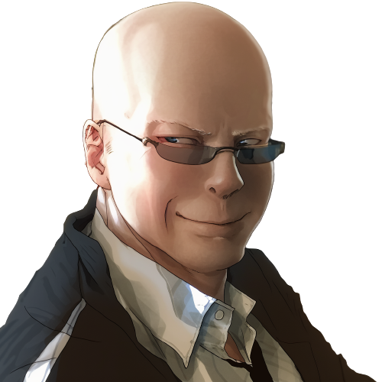
I will have my revenge
against that student.

Slide 30
I agree, Professor Mortis.
The 'equals switcheroo'
will certainly be a healthy challenge
for our students.

Slide 31

Excellent.
Now let's get back to work.
I’ve important research
to conclude today.

Slide 32
Excellent.
Now let's get back to work.
I’ve important research
to conclude today.
Yes, sir!

Slide 33
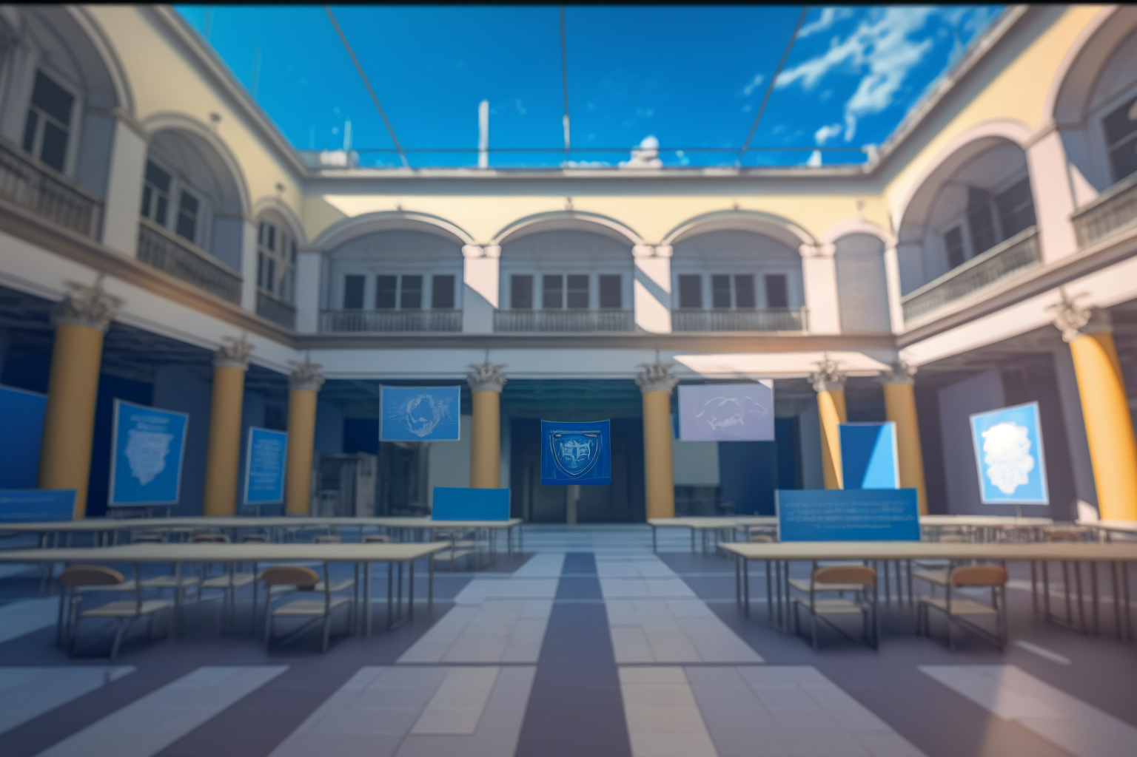
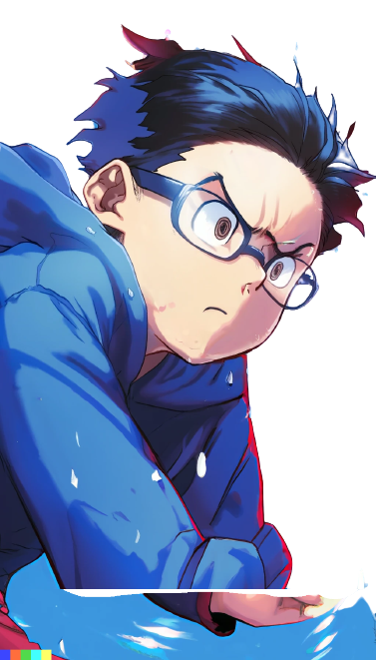
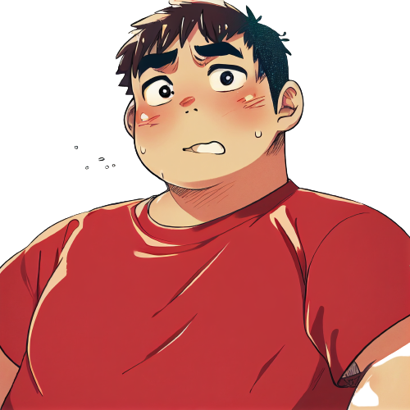
Meanwhile, at freshman campus.

Slide 34
Meanwhile, at freshman campus.
Why Dany, why did you do that?

Slide 35
Meanwhile, at freshman campus.
Why Dany, why did you do that?
Why did you have to
correct Professor Pupon in
front of the whole class?

Slide 36
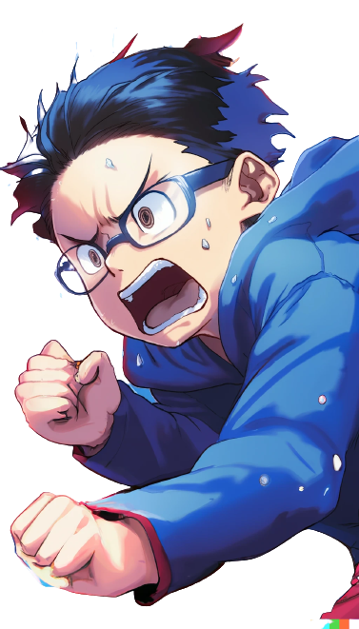
I know, right? I'm so scared

Slide 37
I know, right? I'm so scared
Now Pupon is going
to be mad at me.

Slide 38

Relax, we're at UPU.

Slide 39
Relax, we're at UPU.
This is a prestigious university

Slide 40
Relax, we're at UPU.
This is a prestigious university
Professor Pupon will
have to act professionally

Slide 41
Relax, we're at UPU.
This is a prestigious university
Professor Pupon will
have to act professionally
He won't hold it
against you, right?

Slide 42
I'm not so sure about that

Slide 43
I'm not so sure about that
UPU is known for only
accepting the best and
brightest high school students

Slide 44
I'm not so sure about that
UPU is known for only
accepting the best and
brightest high school students
But we both know how our
computer science teacher
was in high school, right?

Slide 45
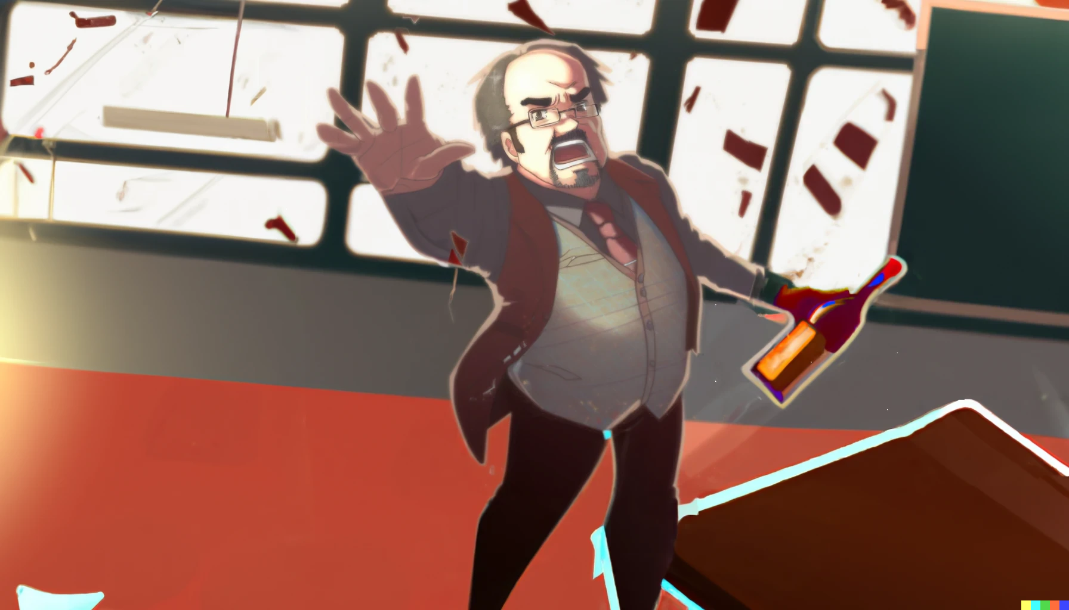
..And you get an A+!

Slide 46
..And you get an A+!
I can't believe our high school
teacher was always drunk

Slide 47

..And you get an A+!
I can't believe our high school
teacher was always drunk
He was always stumbling
around the classroom ...

Slide 48
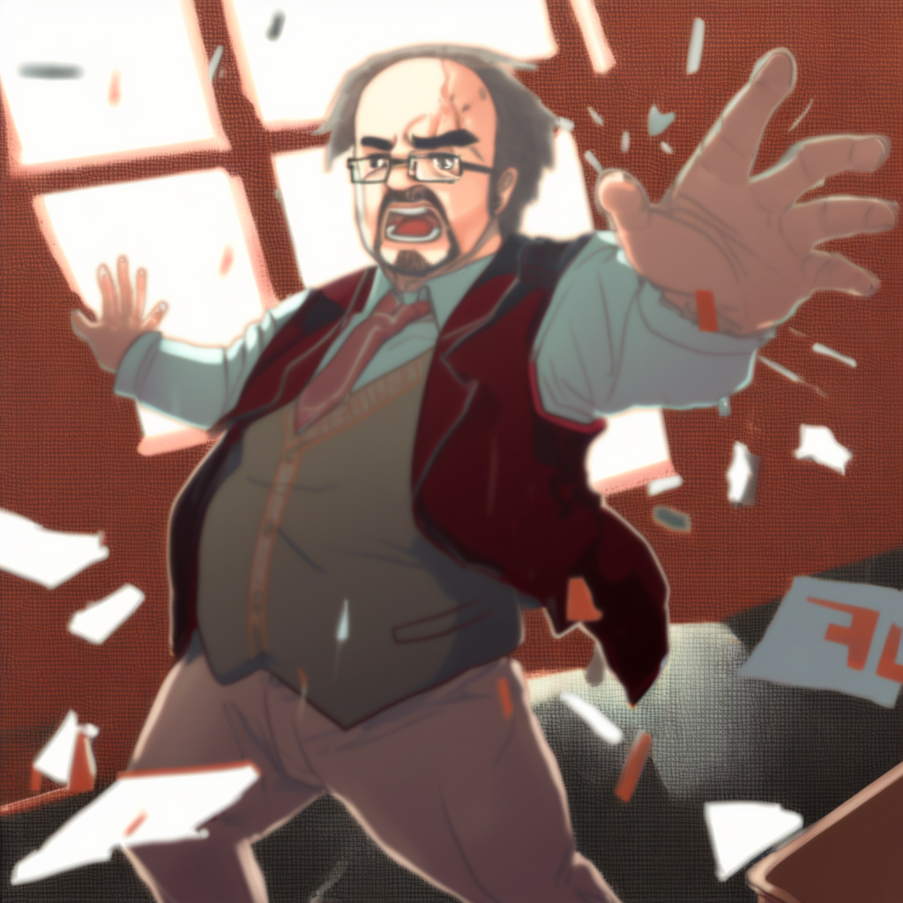
..And you get an A+ too!
And you!

Slide 49
..And you get an A+ too!
And you!
Always giving everyone A+ grades

Slide 50
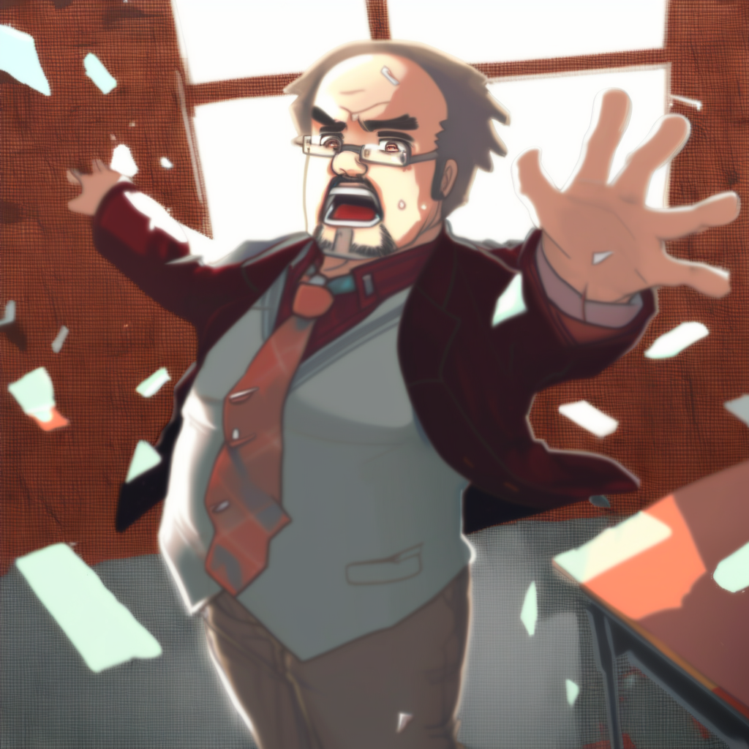
And you! And you!
..And you get an A+ too!
And you!

Slide 51
And you! And you!
Everyone gets an A+!
..And you get an A+ too!
And you!

Slide 52
And you! And you!
Everyone gets an A+!
..And you get an A+ too!
And you!
without actually
teaching us anything.

Slide 53


Yeah, it was crazy ...

Slide 54
Yeah, it was crazy ...
we both loved the idea of
learning to make videogames

Slide 55
Yeah, it was crazy ...
we both loved the idea of
learning to make videogames
So we enrolled at UPU
and hoped for the best

Slide 56
Yeah, it was crazy ...
we both loved the idea of
learning to make videogames
So we enrolled at UPU
and hoped for the best
But this place feels extremely
hard and full of theoretical
programming courses

Slide 57
Yeah, it was crazy ...
we both loved the idea of
learning to make videogames
So we enrolled at UPU
and hoped for the best
But this place feels extremely
hard and full of theoretical
programming courses
We were probably a little naive.

Slide 58

Anyway, finding that solution
in Professor Pupon's lecture...

Slide 59
Anyway, finding that solution
in Professor Pupon's lecture...
it was impressive.

Slide 60
Anyway, finding that solution
in Professor Pupon's lecture...
it was impressive.
How did you figure it out?

Slide 61
I have no idea. It was like...

Slide 62
I have no idea. It was like...
like I was possessed or something

Slide 63
I have no idea. It was like...
like I was possessed or something
I just saw the solution in
my mind and acted on it

Slide 64
I have no idea. It was like...
like I was possessed or something
I just saw the solution in
my mind and acted on it
I just couldn't help it.
It was like a vision or something

Slide 65
I saw the solution in my mind

Slide 66
I saw the solution in my mind
… and I had to act on it,
even though I was terrified.

Slide 67

The stage is set for a new lecture to commence
Conditionals:

Slide 68
The stage is set for a new lecture to commence
Conditionals:
We can use ifs to choose between options

Slide 69

We can use the if statement
to take decisions
int input = 5;
int res = 0;
if( ){ }
assert res ==

Slide 70
We can use the if statement
to take decisions
int input = 5;
int res = 0;
if( input>3 ){ }
assert res ==
In the first example,
input is 5,
the if condition holds

Slide 71
We can use the if statement
to take decisions
int input = 5;
int res = 0;
if( input>3 ){ res = 10; }
assert res == 10;
In the first example,
input is 5,
the if condition holds
Thus we execute the body
and we get 10

Slide 72
We can use the if statement
to take decisions
int input = 5;
int res = 0;
if( input>3 ){ res = 10; }
assert res == 10;
-------------------
int input = 2;
int res = 0;
if( input>3 ){ res = 10; }
assert res == 0;
In the first example,
input is 5,
the if condition holds
Thus we execute the body
and we get 10
In the second example,
input is 2,
the if condition does not hold.
Thus we skip the body
and we get 0

Slide 73
Last time we discussed
local variable update
int input = 2;
int res = 0;
int value = 0;
if( (value=input*10)>40 ){ res = 10; }
assert res == 0;
assert value == 20;

Slide 74
Last time we discussed
local variable update
int input = 2;
int res = 0;
int value = 0;
if( (value=input*10)>40 ){ res = 10; }
assert res == 0;
assert value == 20;
We can also use
it inside expressions
It is common inside
conditions

Slide 75
Last time we discussed
local variable update
int input = 2;
int res = 0;
int value = 0;
if( (value=input*10)>40 ){ res = 10; }
assert res == 0;
assert value == 20;
20
We can also use
it inside expressions
It is common inside
conditions
value equal input times ten
is an expression producing
the assigned value.
That is, 20.

Slide 76
int input = 2;
int res = 0;
int value = 0;
if( (value=input*10)>40 ){ res = 10; }
assert res == 0;
assert value == 20;
Step by step

Slide 77
Input is 2
int input = 2;
int res = 0;
int value = 0;
if( (value= 2 *10)>40 ){ res = 10; }
assert res == 0;
assert value == 20;

Slide 78
Input is 2
int input = 2;
int res = 0;
int value = 0;
if( (value= 20 )>40 ){ res = 10; }
assert res == 0;
assert value == 20;
2 times 10 is 20

Slide 79
Input is 2
int input = 2;
int res = 0;
int value = 20;
if( (value= 20 )>40 ){ res = 10; }
assert res == 0;
assert value == 20;
2 times 10 is 20
We update value to 20

Slide 80
Input is 2
int input = 2;
int res = 0;
int value = 20;
if( ( 20 )>40 ){ res = 10; }
assert res == 0;
assert value == 20;
2 times 10 is 20
We update value to 20
value = 20 is now just ‘20’

Slide 81
Input is 2
int input = 2;
int res = 0;
int value = 20;
if( false ){ res = 10; }
assert res == 0;
assert value == 20;
2 times 10 is 20
We update value to 20
value = 20 is now just ‘20’
20 is not bigger then 40
so we get false.

Slide 82
Input is 2
int input = 2;
int res = 0;
int value = 20;
if( false ){ res = 10; }
assert res == 0;
assert value == 20;
2 times 10 is 20
We update value to 20
value = 20 is now just ‘20’
20 is not bigger then 40
so we get false.
with false, we skip the if body

Slide 83
As you can see . . .

Slide 84
As you can see . . .
variable assignments in conditionals
allows us to save information about partial
computations in the condition itself

Slide 85


So, you, . . . come here!

Slide 86
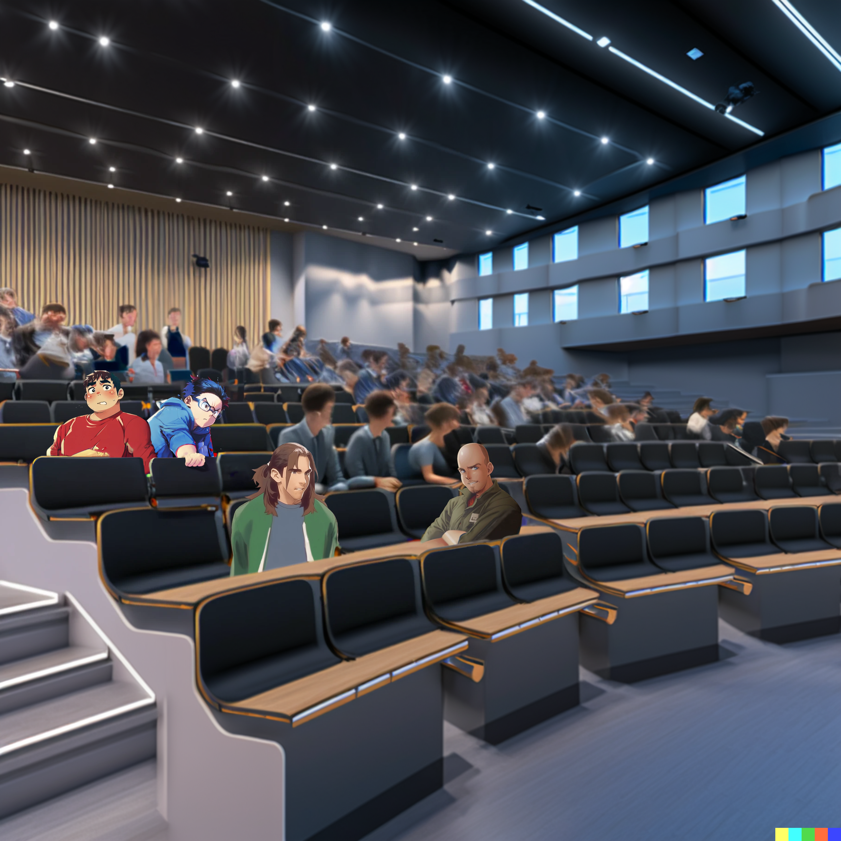
So, you, . . . come here!

Slide 87
So, you, . . . come here!
Do you mean… Me?!?

Slide 88

Here you are.

Slide 89
Here you are.
What is the result here?
int input = 5;
int res = 0;
if( input>res ){ res = 10; }
assert res == ??;

Slide 90
Here you are.
What is the result here?
int input = 5;
int res = 0;
if( input>res ){ res = 10; }
assert res == ??;
Well…

Slide 91
Here you are.
What is the result here?
int input = 5;
int res = 0;
if( input>res ){ res = 10; }
assert res == ??;
Well…
Input is more than res

Slide 92
Here you are.
What is the result here?
int input = 5;
int res = 0;
if( input>res ){ res = 10; }
assert res == ??;
Well…
Input is more than res
So we update res to 10!

Slide 93
Here you are.
What is the result here?
int input = 5;
int res = 0;
if( input>res ){ res = 10; }
assert res == ??;
Well…
Input is more than res
So we update res to 10!
Wait…
but then res becomes bigger than input so…

Slide 94
Here you are.
What is the result here?
int input = 5;
int res = 0;
if( input>res ){ res = 10; }
assert res == ??;
Well…
Input is more than res
So we update res to 10!
Wait…
but then res becomes bigger than input so…
does it get
un-updated?

Slide 95
int input = 5;
int res = 0;
if( input>res ){ res = 10; }
assert res == ??;

Slide 96
Very good
int input = 5;
int res = 0;
if( input>res ){ res = 10; }
assert res == ??;

Slide 97
Very good
Yes, the result is 10.
int input = 5;
int res = 0;
if( input>res ){ res = 10; }
assert res == 10;

Slide 98
Very good
Yes, the result is 10.
int input = 5;
int res = 0;
if( input>res ){ res = 10; }
assert res == 10;
Ok then…

Slide 99
Very good
Yes, the result is 10.
int input = 5;
int res = 0;
if( input>res ){ res = 10; }
assert res == 10;
Ok then…
Oh, I’m so confused

Slide 100
int input = 5;
int res = 0;
if( input>res ){ res = 10; }
assert res == 10;

Slide 101
Next, you above!

Slide 102
Me?!?
Next, you above!

Slide 103
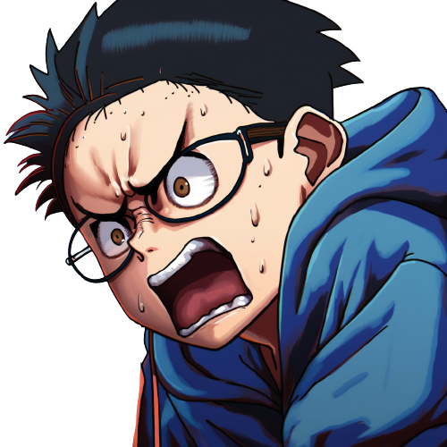

Slide 104
This is it,
he is going to take revenge!

Slide 105
Here you are.

Slide 106
Here you are.
So, what is this doing?
int res = 0;
if( (res=5) == res ){ res = 10; }
assert res == ??;

Slide 107
Here you are.
So, what is this doing?
int res = 0;
if( (res=5) == res ){ res = 10; }
assert res == ??;
res, res, ... res ... ?

Slide 108
int res = 0;
if( (res=5) == res ){ res = 10; }
assert res == ??;
res is 5 and is equal to itself? Yes?
So we update it and res = = 10

Slide 109
int res = 0;
if( (res=5) == res ){ res = 10; }
assert res == 10;
res is 5 and is equal to itself? Yes?
So we update it and res = = 10
Cool

Slide 110
What happens in this case instead?
int res = 0;
//if( (res=5) == res ){ res = 10; }
if( res == (res=5) ){ res = 10; }
assert res == ??;

Slide 111
What happens in this case instead?
int res = 0;
//if( (res=5) == res ){ res = 10; }
if( res == (res=5) ){ res = 10; }
assert res == ??;
You switched the
expressions around the equals equals

Slide 112

So?
what is the result?
int res = 0;
//if( (res=5) == res ){ res = 10; }
if( res == (res=5) ){ res = 10; }
assert res == ??;

Slide 113
So?
what is the result?
int res = 0;
//if( (res=5) == res ){ res = 10; }
if( res == (res=5) ){ res = 10; }
assert res == ??;
It looks like it’s the same.
I mean, = = is clearly a commutative operation.

Slide 114
So?
what is the result?
int res = 0;
//if( (res=5) == res ){ res = 10; }
if( res == (res=5) ){ res = 10; }
assert res == ??;
Stop the video and try to answer!
Can you beat the
‘equals switcheroo’ ?
Subscribe and ring the bell for more!
Describe your attempt
into the comments!

Slide 115
So?
what is the result?
int res = 0;
//if( (res=5) == res ){ res = 10; }
if( res == (res=5) ){ res = 10; }
assert res == ??;
It looks like is the same,
I mean, = = is clearly a commutative operation.

Slide 116
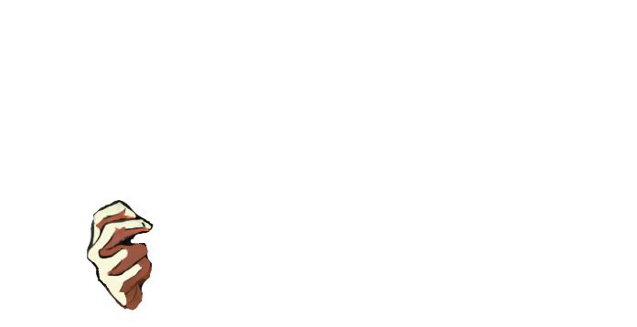
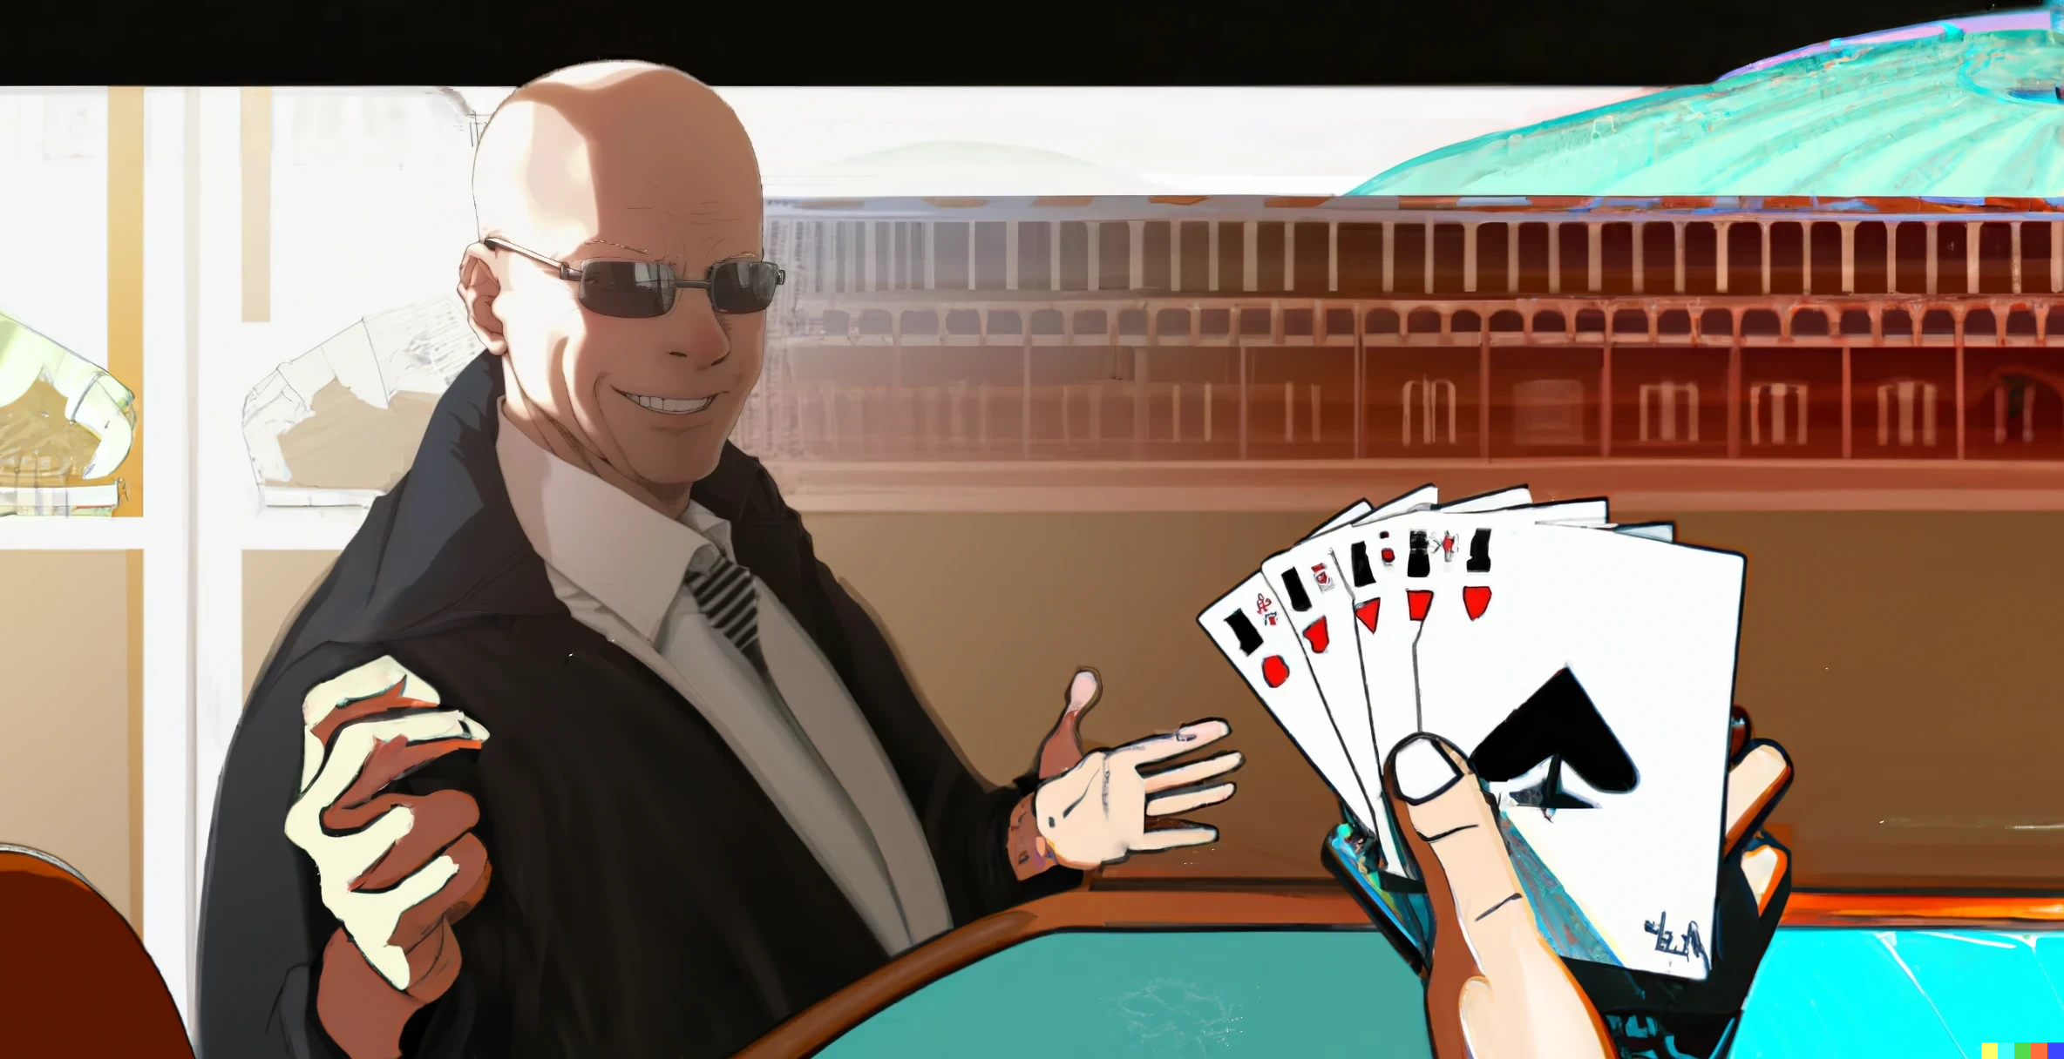
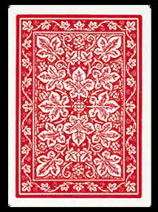
Wait a minute, would he even ask the question if it was the same?

Slide 117
There must be a difference then!

Slide 118
Or ... is he thinking that
I will think this,
and so it’s the same??

Slide 119
It’s as if we were
playing poker!

Slide 120
What is going on?
We ARE playing poker!
Another hallucination?

Slide 121
Pupon has 3 cards in his hand.
They are the 3 res
int res = 0;
if(res==(res=5)){res=10;}
By the way, my cards are not very good ...

Slide 122
The first one must be zero,
because at the start res is zero
int res = 0;
if(res==(res=5)){res=10;}
0

Slide 123
The first one must be zero,
because at the start res is zero
int res = 5;
if(res==(res=5)){res=10;}
0 5
The second is five:
the variable update returns the update value.
So res is now 5.

Slide 124
The first card is evaluated already,
so it is not changing
int res = 5;
if(res==(res=5)){res=10;}
0 5
zero is not equal to 5, so we skip
the body of the if!

Slide 125
The first card is evaluated already,
so it is not changing
int res = 5;
if(res==(res=5)){res=10;}
0 5
zero is not equal to 5, so we skip
the body of the if!
So the last card is not played!

Slide 126
So in the end the result is 5!
int res = 0;
if( (res=5) == res ){ res = 10; }
assert res == 5;

Slide 127
So in the end the result is 5!
int res = 0;
if( (res=5) == res ){ res = 10; }
assert res == 5;
Not zero. The update
happened in the condition!

Slide 128


Slide 129
So? Wake up!
Did you fall asleep on your feet?
int res = 0;
//if( (res=5) == res ){ res = 10; }
if( res == (res=5) ){ res = 10; }
assert res == ??;

Slide 130
So? Wake up!
Did you fall asleep on your feet?
int res = 0;
//if( (res=5) == res ){ res = 10; }
if( res == (res=5) ){ res = 10; }
assert res == ??;
The answer is 5.

Slide 131
int res = 0;
//if( (res=5) == res ){ res = 10; }
if( res == (res=5) ){ res = 10; }
assert res == ??;
The answer is 5.
What did you just say?

Slide 132

int res = 0;
//if( (res=5) == res ){ res = 10; }
if( res == (res=5) ){ res = 10; }
assert res == ??;
The answer is 5!

Slide 133
int res = 0;
//if( (res=5) == res ){ res = 10; }
if( res == (res=5) ){ res = 10; }
assert res == ??;
The answer is 5!
Apparently equality is
not commutative in Java.

Slide 134

But . . . how . . . yes . . .
int res = 0;
if( res == (res=5) ){ res = 10; }
assert res == 5;

Slide 135
But . . . how . . . yes . . .
int res = 0;
if( res == (res=5) ){ res = 10; }
assert res == 5;
That is correct. Go back to your seat . . .

Slide 136
But . . . how . . . yes . . .
int res = 0;
if( res == (res=5) ){ res = 10; }
assert res == 5;
That is correct. Go back to your seat . . .
Is this what he meant?
The equals switcheroo
could not break him!

Slide 137
But . . . how . . . yes . . .
int res = 0;
if( res == (res=5) ){ res = 10; }
assert res == 5;
That is correct. Go back to your seat . . .
Is this what he meant?
The equals switcheroo
could not break him!
I have a feeling that this year's
class will be up to the task.

Slide 138
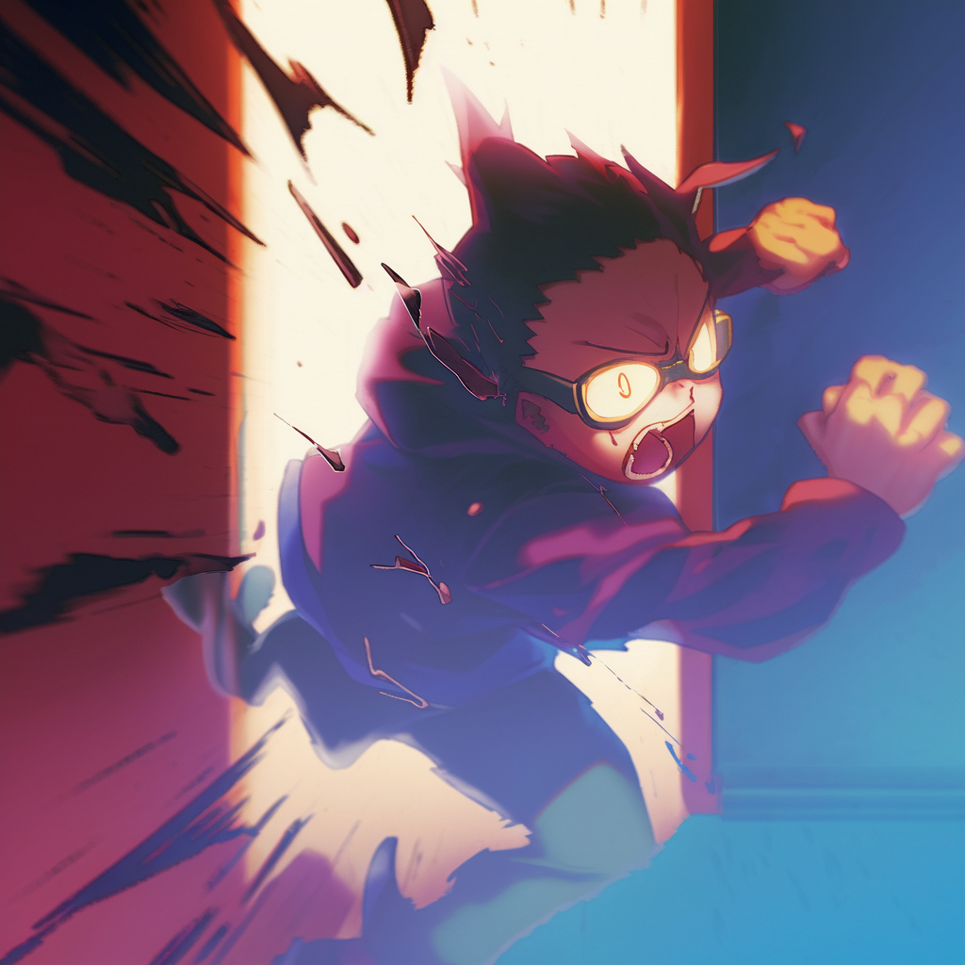

After the lecture, Dany rushes to his room

Slide 139
After the lecture, Dany rushes to his room
Again!

Slide 140
After the lecture, Dany rushes to his room
Again!
Every lecture feels like a fight to the death!

Slide 141
After the lecture, Dany rushes to his room
Again!
Every lecture feels like a fight to the death!
The class looked confused,
as if I said something absurd.

Slide 142
After the lecture, Dany rushes to his room
Again!
Every lecture feels like a fight to the death!
The class looked confused,
as if I said something absurd.
How many of them would
have been able to answer?

Slide 143
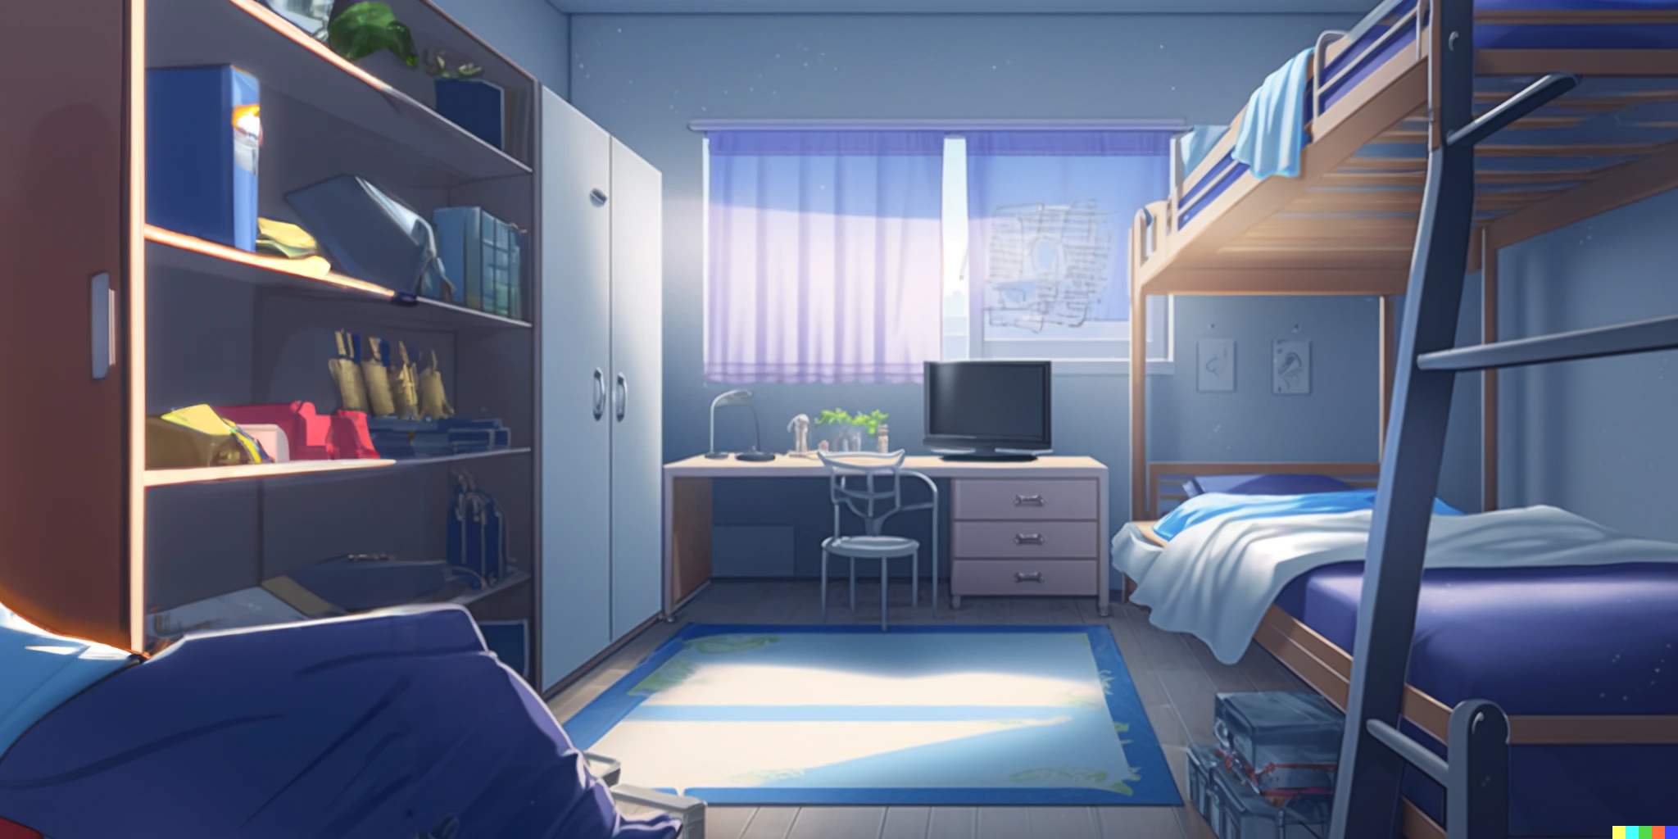
After a hot shower, Dany mumbles about ...

Slide 144
After a hot shower, Dany mumbles about ...
Is this a sensible way to code?

Slide 145
After a hot shower, Dany mumbles about ...
Is this a sensible way to code?
The first time, Pupon was showing
a reasonable intuitive solution,

Slide 146
After a hot shower, Dany mumbles about ...
Is this a sensible way to code?
The first time, Pupon was showing
a reasonable intuitive solution,
and I made the tricky variation.

Slide 147
But this time ...

Slide 148
But this time ...
the lecture and the questions
was all about the tricky part!

Slide 149

Is code all about tricks?

Slide 150
Is code all about tricks?
int input = 2;//Code shown by Pupon
int res = 0;
int value = 0;
if( (value=input*10)>40 ){ res = 10; }
assert res == 0;
assert value == 20;

Slide 151
Is code all about tricks?
int input = 2;//Code shown by Pupon
int res = 0;
int value = 0;
if( (value=input*10)>40 ){ res = 10; }
assert res == 0;
assert value == 20;
Why all those tricks?
Just to save a
few lines of code?

Slide 152
Is code all about tricks?
int input = 2;//Code shown by Pupon
int res = 0;
int value = 0;
if( (value=input*10)>40 ){ res = 10; }
assert res == 0;
assert value == 20;
Why all those tricks?
Just to save a
few lines of code?
Should we instead make
code more readable by
making it longer?

Slide 153
For example, like this?
int input = 2;
int res = 0;
int value = 0;
value = input*10;
boolean shouldUpdate = value>40;
if(shouldUpdate){ res = 10; }
assert res == 0;
assert value == 20;

Slide 154
int input = 2;
int res = 0;
int value = 0;
value = input*10;
boolean shouldUpdate = value>40;
if(shouldUpdate){ res = 10; }
assert res == 0;
assert value == 20;
Would this be better?

Slide 155
int input = 2;
int res = 0;
int value = 0;
value = input*10;
boolean shouldUpdate = value>40;
if(shouldUpdate){ res = 10; }
assert res == 0;
assert value == 20;
Would this be better?
Is it only a few lines every time,
or do some of those tricks
save massive amounts of code?

Slide 156

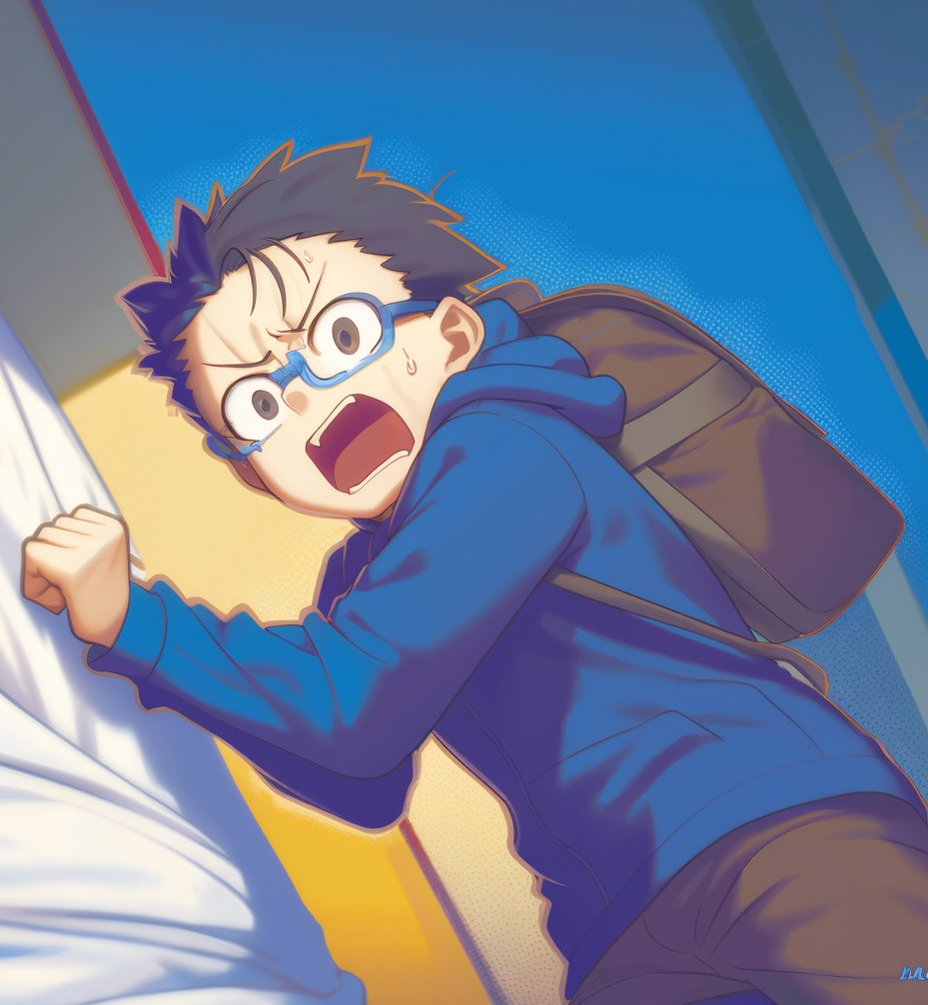
Suddenly, Dany hears a rustling sound coming from the door
Frush

Slide 157

He turns to look and sees a small piece of paper sliding under the door.
He reaches down and picks up the note, his hands shaking as he unfolds it.

Slide 158
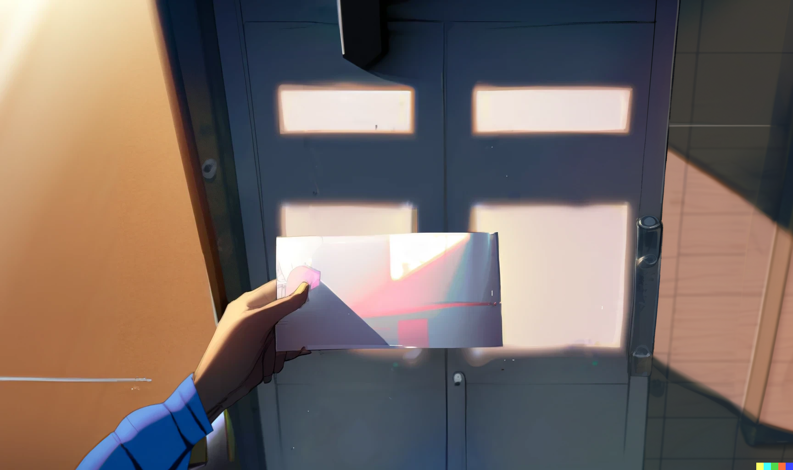
As he reads the neatly written words, a sense of dread washes over him.
b = a+(a=b)-b; Works in Java, but has undefined behavior in C/C++

Slide 159
int a = x;
int b = y;
b = a+(a=b)-b;
Is this what I think it is?

Slide 160
int a = x;
int b = y;
b = a+(a=b)-b;
Is this what I think it is?
Going step by step, using
x and y as symbolic values

Slide 161
int a = x;
int b = y;
b = x+(a=b)-b;
We evaluate a into x

Slide 162
int a = x;
int b = y;
b = x+(a=y)-b;
We evaluate the first b into y

Slide 163
int a = y;
int b = y;
b = x+(y)-b;
We update a with y

Slide 164
int a = y;
int b = y;
b = x+(y)-y;
We evaluate the second b
And now it’s just simple math

Slide 165
int a = y;
int b = y;
b = x;
Finally we update b with x

Slide 166
int a = y;
int b = x;
//swap two variables
// b = a+(a=b)-b;
//Works in Java, but has
//undefined behavior in C/C++
And here it is

Slide 167
int a = y;
int b = x;
//swap two variables
// b = a+(a=b)-b;
//Works in Java, but has
//undefined behavior in C/C++
And here it is
A one liner swapping
two variables in Java

Slide 168
int a = y;
int b = x;
//swap two variables
// b = a+(a=b)-b;
//Works in Java, but has
//undefined behavior in C/C++
And here it is
A one liner swapping
two variables in Java
Also, it has undefined
behavior in C/C++?

Slide 169
int a = y;
int b = x;
//swap two variables
// b = a+(a=b)-b;
//Works in Java, but has
//undefined behavior in C/C++
And here it is
A one liner swapping
two variables in Java
Also, it has undefined
behavior in C/C++?
So, different languages are different indeed;
even if they may look superficially similar

Slide 170
Then Dany turns the paper, and on the other side there is another shocking message!
Every good coding practice
was originally just a trick.

Slide 172
02: The sky is infinite

Slide 174
Credits
- Story: Marco
- Art: MidJourney, NijiJourney, Dall-E
- Wording: Marco, chatGPT
- Composition: Marco
- Thanks to all my friends for
providing great feedback!
Next episode on Feb 13 2023

