Slide 1
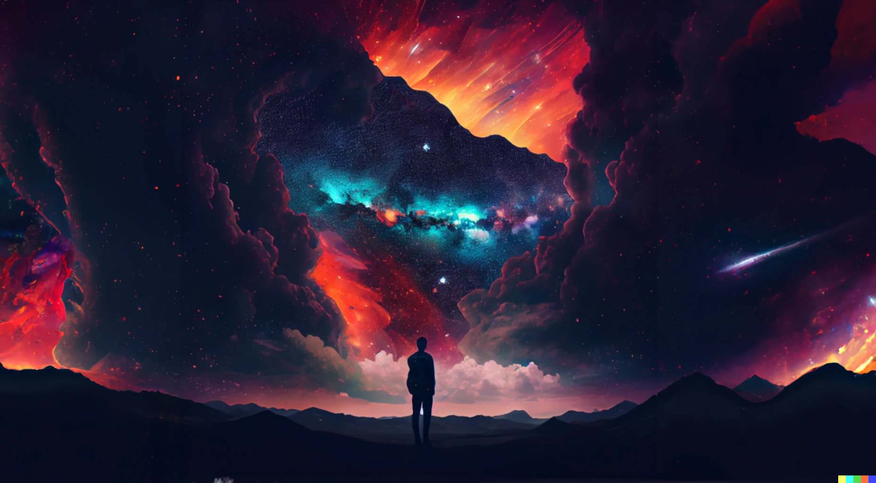
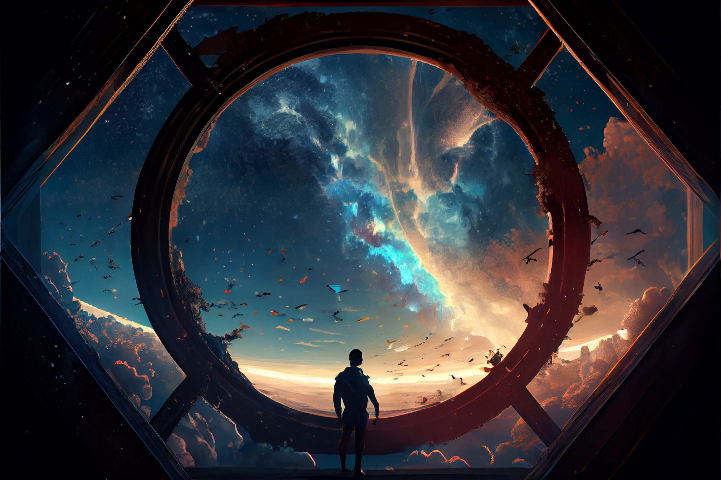

Slide 2
This is episode 2 of UPU.
Link to episode 1
in the description
Episode 3 will be available on 13 Feb 2023

Slide 4
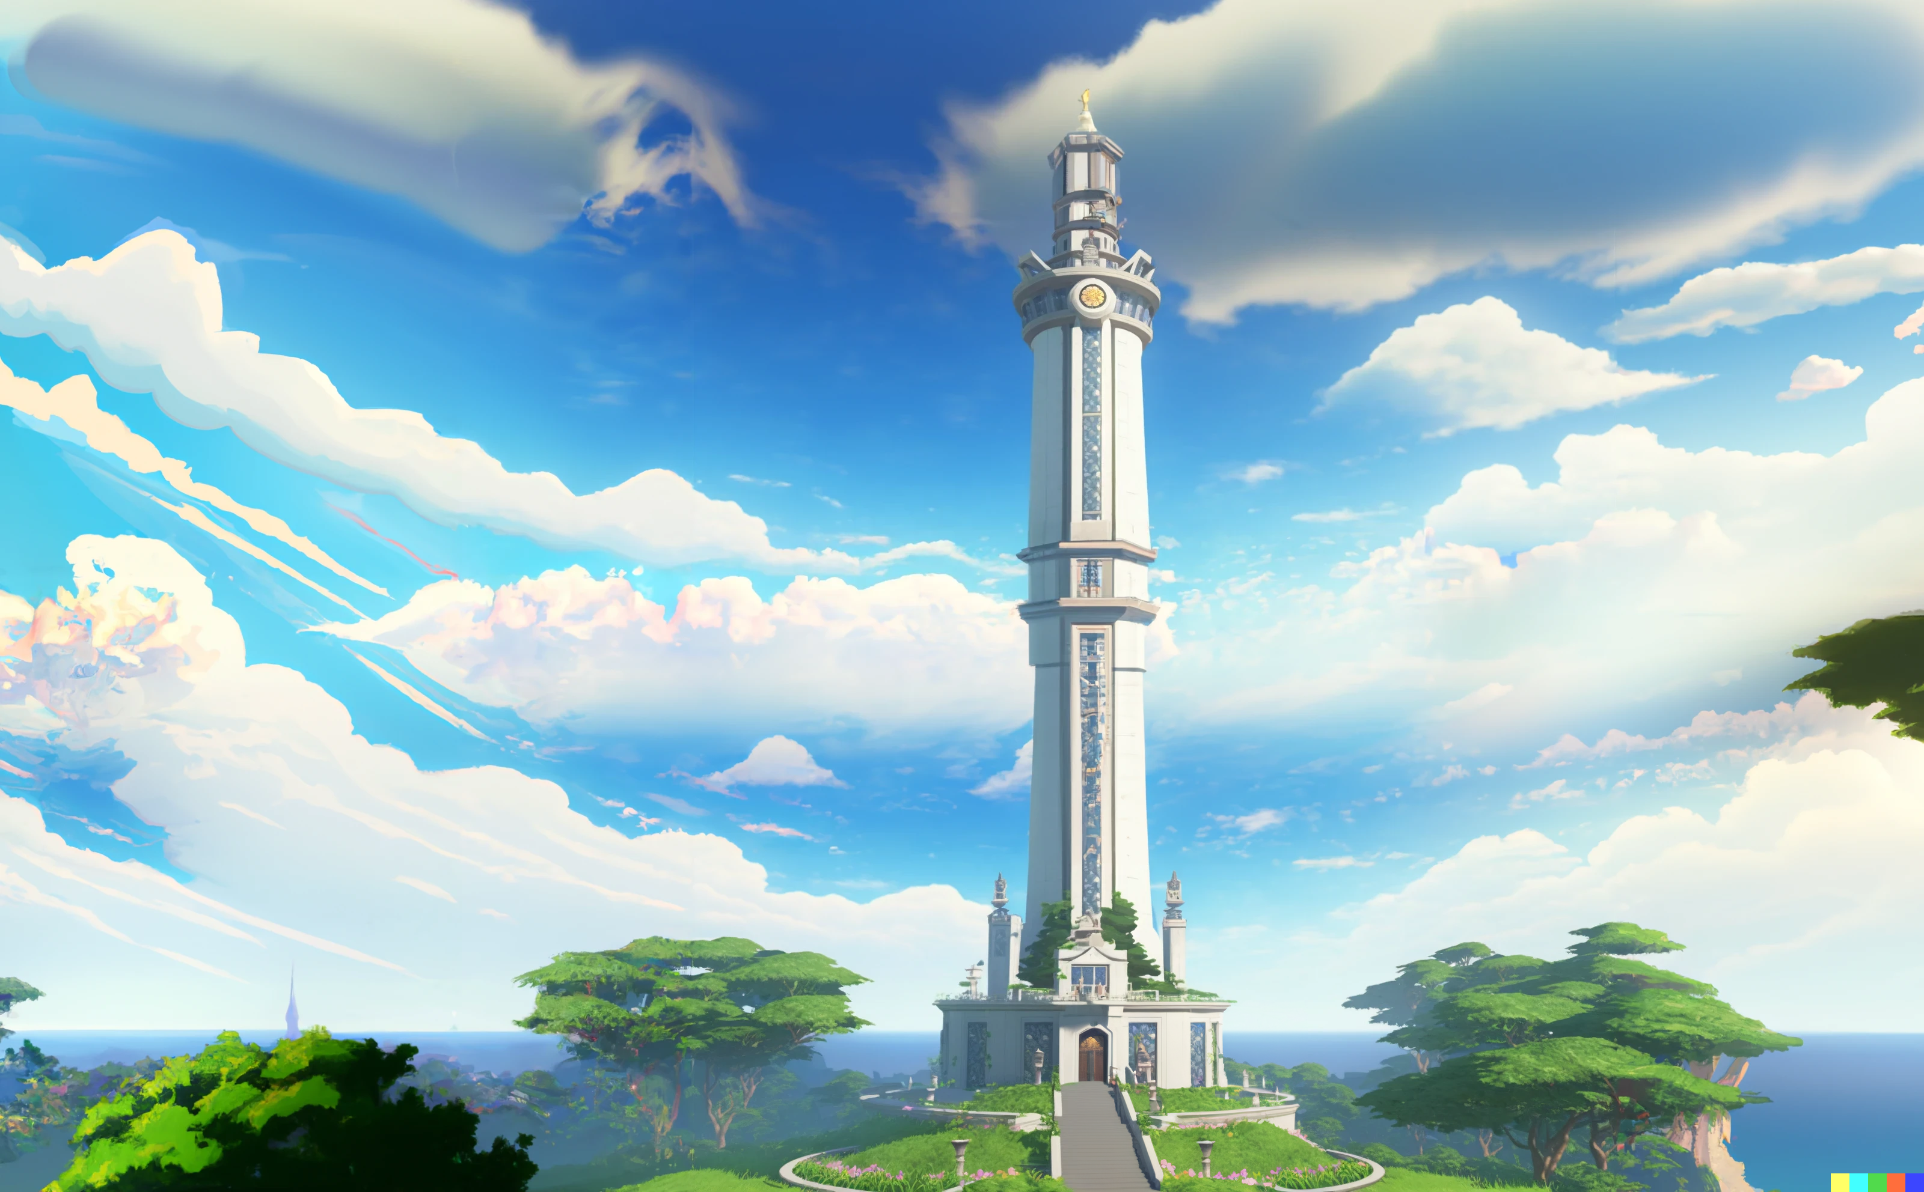

Slide 5
Sorrento Bay
The Ivory tower (UPU)

Slide 6

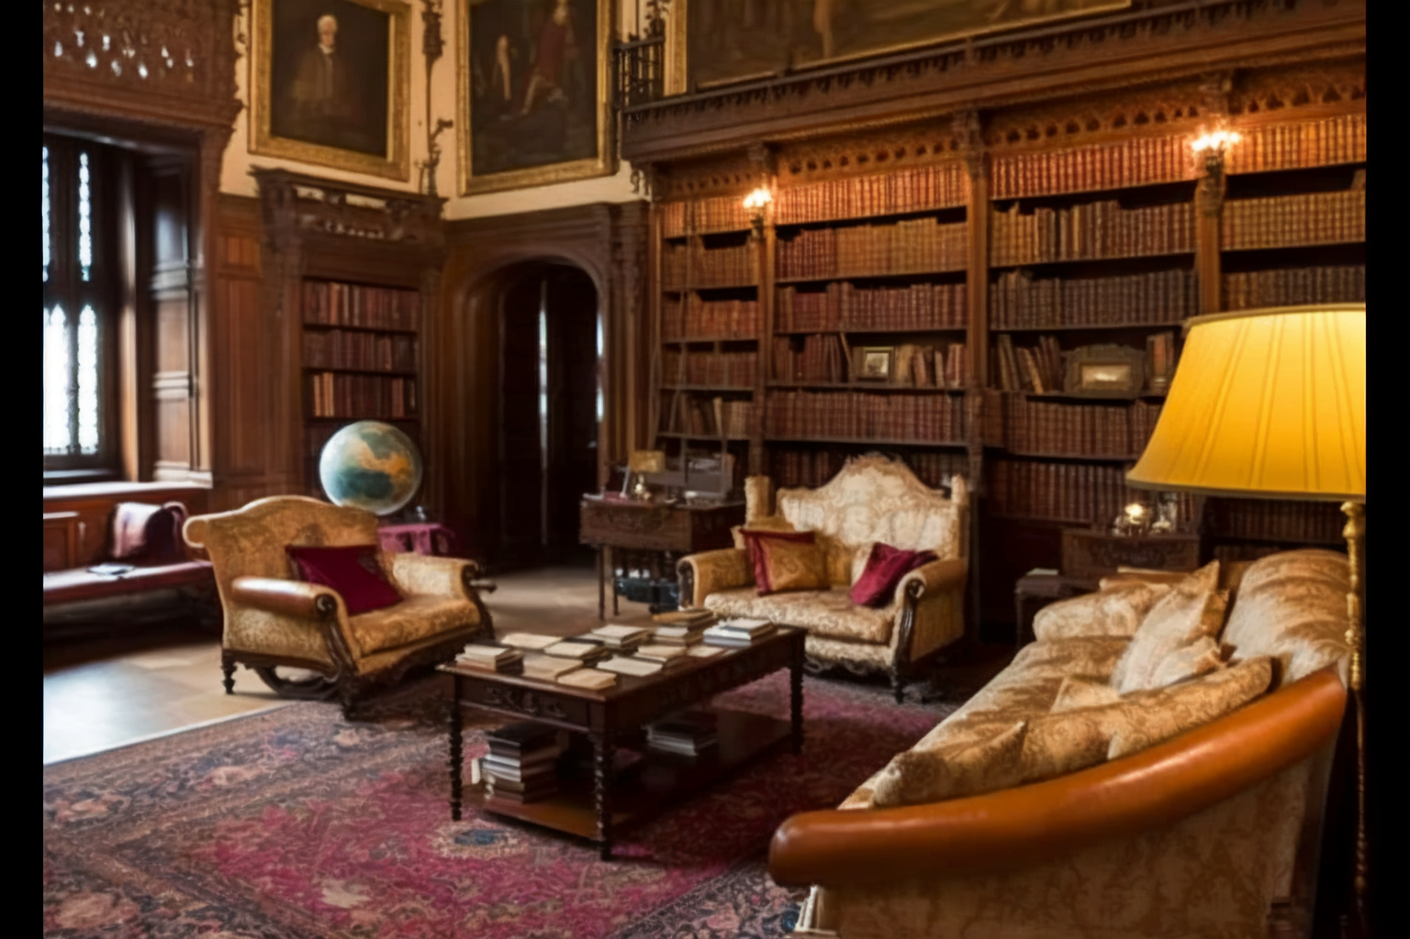

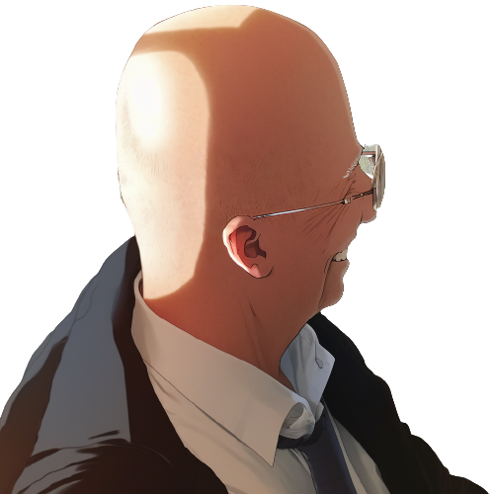
At the top of the Ivory tower,
headmaster Professor Eugene Mortis faces
Professor Elricho Pupon, his expression grave

Slide 7
Pupon, I understand that you
had a bit of a mishap
during your first lecture.

Slide 8
Pupon, I understand that you
had a bit of a mishap
during your first lecture.
You've become a laughing stock
among the first-year class.

Slide 9
Pupon hangs his head in shame,
his shoulders slumping

Slide 10
Pupon hangs his head in shame,
his shoulders slumping
That's correct, Professor Mortis.
I was too confident in my own
assumptions and didn't
consider the possibility of an error.

Slide 11
This is not the kind of behavior
that we expect from UPU professors.

Slide 12
This is not the kind of behavior
that we expect from UPU professors.
You must be open to the ideas
and perspectives of our students.

Slide 13
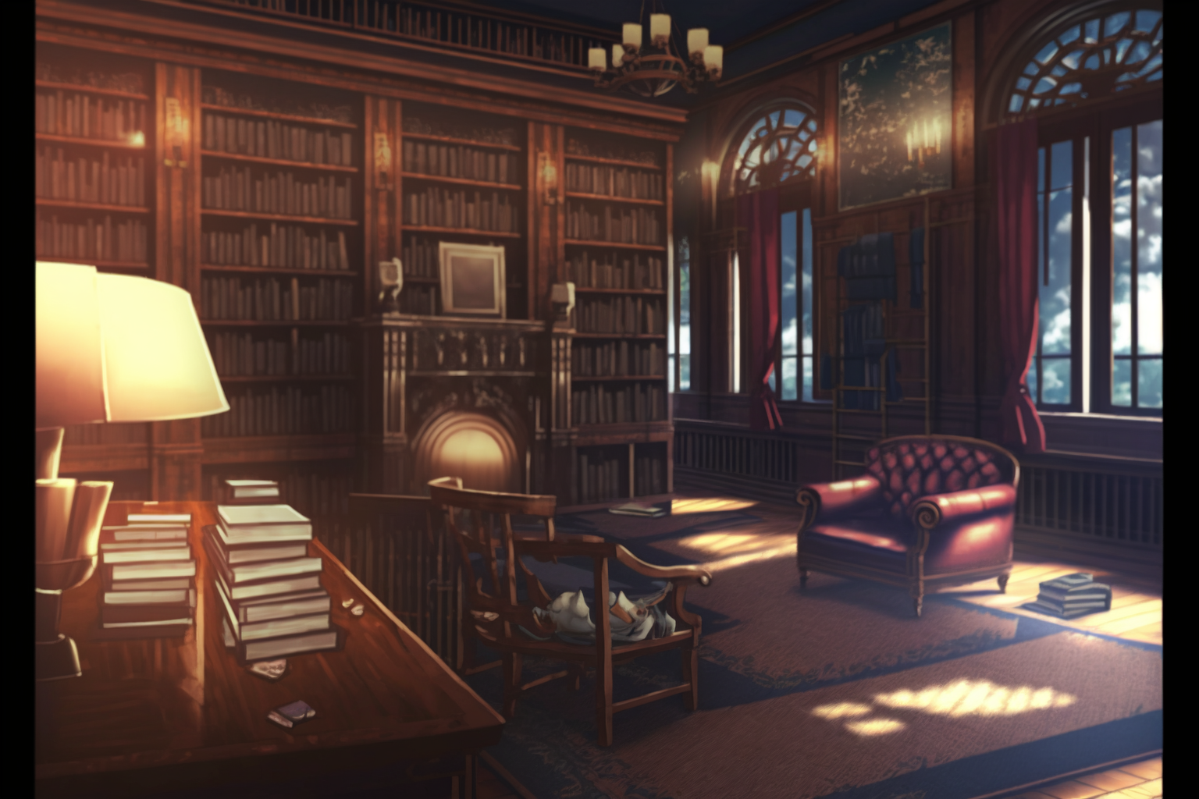

I, … I apologize for bringing shame
upon the university.

Slide 14
I, … I apologize for bringing shame
upon the university.
I'll make sure to be more thorough
in my explanations in the future.

Slide 15
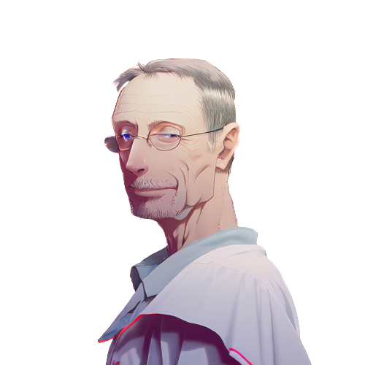
Don't worry, it just
means that this year's students
are particularly talented.

Slide 16
Don't worry, it just
means that this year's students
are particularly talented.
We should raise the difficulty
of our course material to
match their abilities.

Slide 17
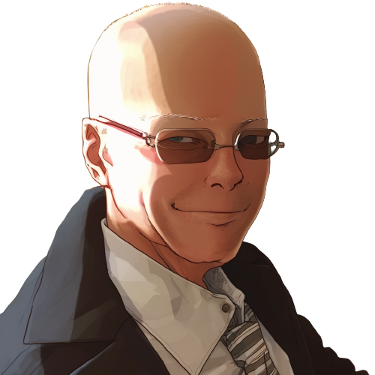
What are you proposing?

Slide 18
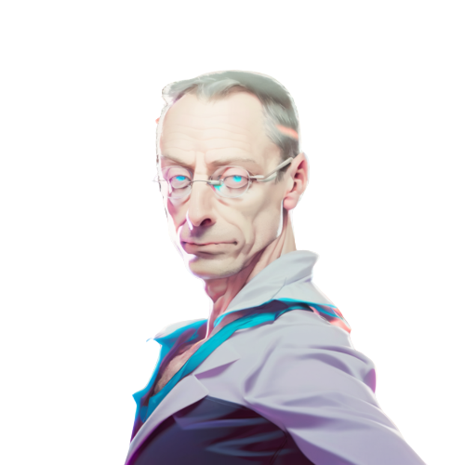
The 'equals switcheroo'.

Slide 19
The 'equals switcheroo'.
It will test their skills and
understanding of programming.

Slide 20
The 'equals switcheroo'.
It will test their skills and
understanding of programming.
By raising the difficulty
of our lessons, we can further
challenge and engage our students.

Slide 21

Pupon's face falls,
a look of dread crossing his features.
The 'equals switcheroo'?

Slide 22
Pupon's face falls,
a look of dread crossing his features.
The 'equals switcheroo'?
Oh no, I remember that lesson.

Slide 23
Pupon's face falls,
a look of dread crossing his features.
The 'equals switcheroo'?
Oh no, I remember that lesson.
It's the most difficult and frustrating
challenge we give to students.

Slide 24
Mortis nods, his expression serious.

Slide 25
Mortis nods, his expression serious.
Exactly. It's reserved for
the most gifted students only.

Slide 26
Mortis nods, his expression serious.
Exactly. It's reserved for
the most gifted students only.
I have a feeling that this year's
class will be up to the task.

Slide 27

Pupon takes a deep breath, steeling himself.

Slide 28
Pupon takes a deep breath, steeling himself.
I hope they are ready for the challenge.
I certainly wasn't when I took it.

Slide 29
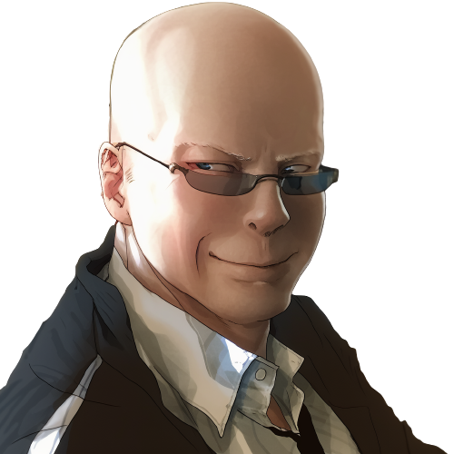
I will have my revenge
against that student.

Slide 30
I agree, Professor Mortis.
The 'equals switcheroo'
will certainly be a healthy challenge
for our students.

Slide 31

Excellent.
Now let's get back to work.
I’ve important research
to conclude today.

Slide 32
Excellent.
Now let's get back to work.
I’ve important research
to conclude today.
Yes, sir!

Slide 33
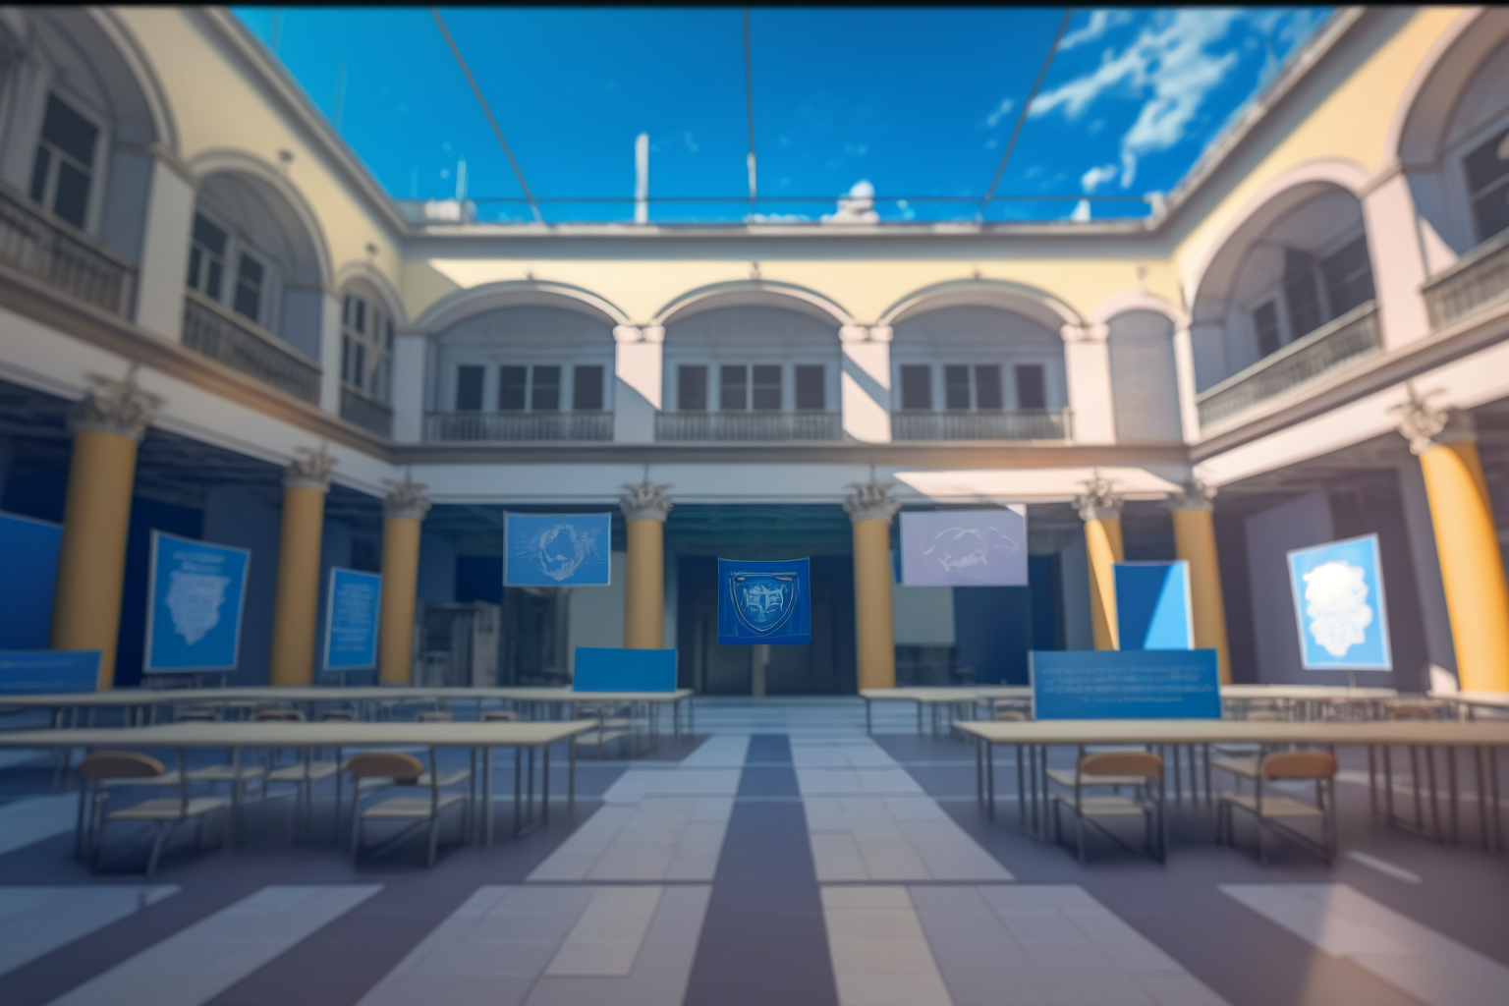
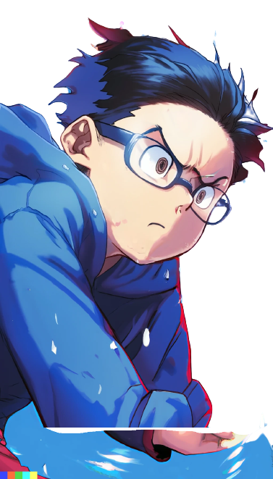
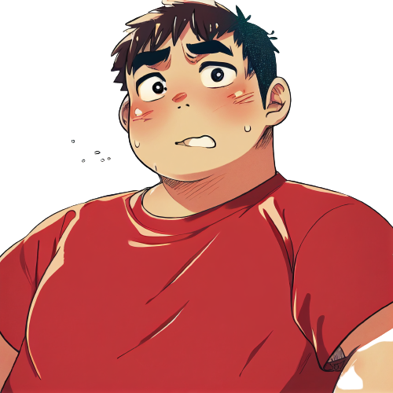
Meanwhile, at freshman campus.

Slide 34
Meanwhile, at freshman campus.
Why Dany, why did you do that?

Slide 35
Meanwhile, at freshman campus.
Why Dany, why did you do that?
Why did you have to
correct Professor Pupon in
front of the whole class?

Slide 36

I know, right? I'm so scared

Slide 37
I know, right? I'm so scared
Now Pupon is going
to be mad at me.

Slide 38

Relax, we're at UPU.

Slide 39
Relax, we're at UPU.
This is a prestigious university

Slide 40
Relax, we're at UPU.
This is a prestigious university
Professor Pupon will
have to act professionally

Slide 41
Relax, we're at UPU.
This is a prestigious university
Professor Pupon will
have to act professionally
He won't hold it
against you, right?

Slide 42
I'm not so sure about that

Slide 43
I'm not so sure about that
UPU is known for only
accepting the best and
brightest high school students

Slide 44
I'm not so sure about that
UPU is known for only
accepting the best and
brightest high school students
But we both know how our
computer science teacher
was in high school, right?

Slide 45
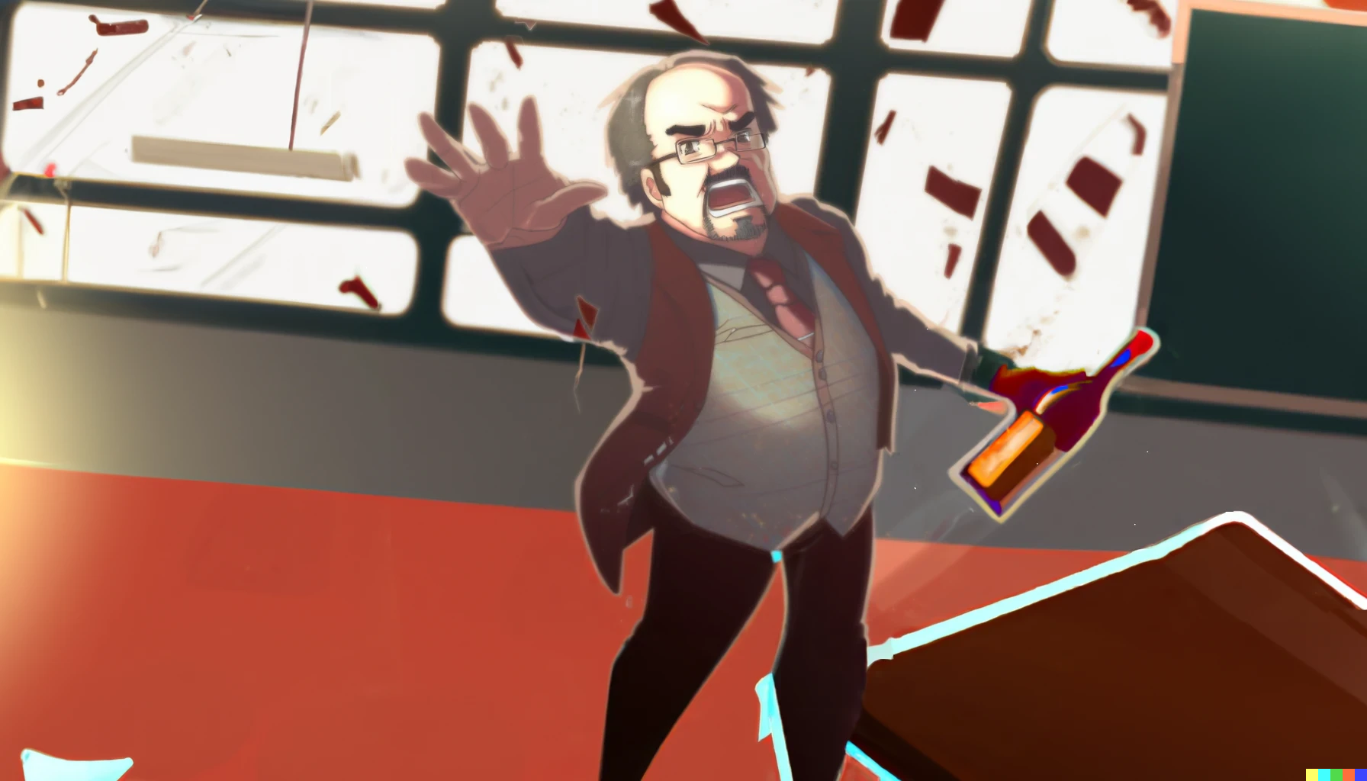
..And you get an A+!

Slide 46
..And you get an A+!
I can't believe our high school
teacher was always drunk

Slide 47

..And you get an A+!
I can't believe our high school
teacher was always drunk
He was always stumbling
around the classroom ...

Slide 48
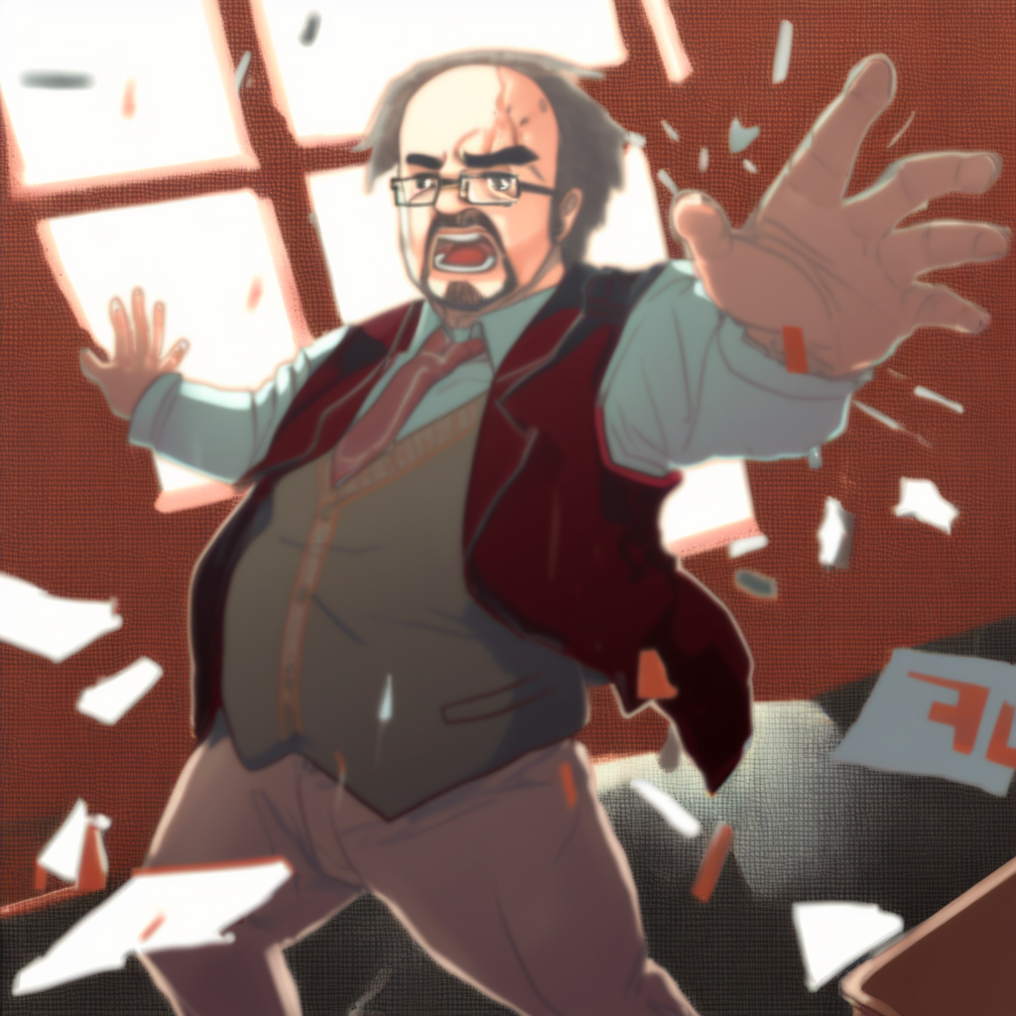
..And you get an A+ too!
And you!

Slide 49
..And you get an A+ too!
And you!
Always giving everyone A+ grades

Slide 50
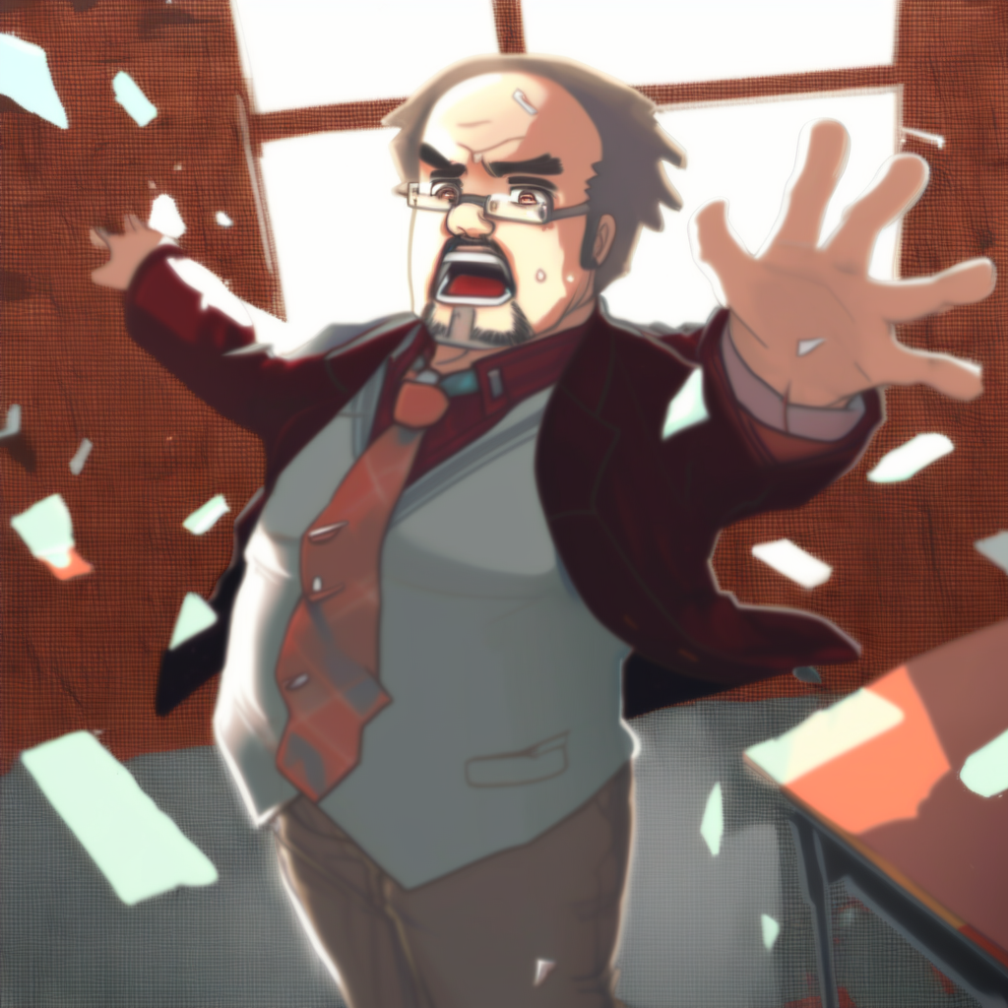
And you! And you!
..And you get an A+ too!
And you!

Slide 51
And you! And you!
Everyone gets an A+!
..And you get an A+ too!
And you!

Slide 52
And you! And you!
Everyone gets an A+!
..And you get an A+ too!
And you!
without actually
teaching us anything.

Slide 53
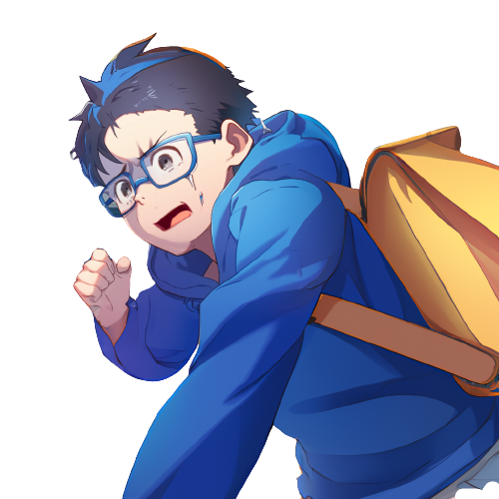

Yeah, it was crazy ...

Slide 54
Yeah, it was crazy ...
we both loved the idea of
learning to make videogames

Slide 55
Yeah, it was crazy ...
we both loved the idea of
learning to make videogames
So we enrolled at UPU
and hoped for the best

Slide 56
Yeah, it was crazy ...
we both loved the idea of
learning to make videogames
So we enrolled at UPU
and hoped for the best
But this place feels extremely
hard and full of theoretical
programming courses

Slide 57
Yeah, it was crazy ...
we both loved the idea of
learning to make videogames
So we enrolled at UPU
and hoped for the best
But this place feels extremely
hard and full of theoretical
programming courses
We were probably a little naive.

Slide 58
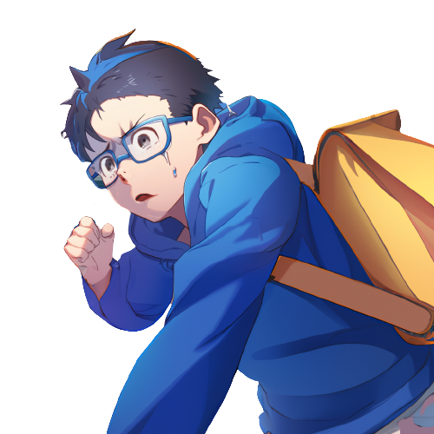
Anyway, finding that solution
in Professor Pupon's lecture...

Slide 59
Anyway, finding that solution
in Professor Pupon's lecture...
it was impressive.

Slide 60
Anyway, finding that solution
in Professor Pupon's lecture...
it was impressive.
How did you figure it out?

Slide 61
I have no idea. It was like...

Slide 62
I have no idea. It was like...
like I was possessed or something

Slide 63
I have no idea. It was like...
like I was possessed or something
I just saw the solution in
my mind and acted on it

Slide 64
I have no idea. It was like...
like I was possessed or something
I just saw the solution in
my mind and acted on it
I just couldn't help it.
It was like a vision or something

Slide 65
I saw the solution in my mind

Slide 66
I saw the solution in my mind
… and I had to act on it,
even though I was terrified.

