Slide 1



But . . . how . . . yes . . .
int res = 0;
if( res == (res=5) ){ res = 10; }
assert res == 5;
That is correct. Go back to your seat . . .
Is this what he meant?
The equals switcheroo
could not break him!
I have a feeling that this year's
class will be up to the task.

Slide 2


After the lecture, Dany rushes to his room
Again!
Every lecture feels like a fight to the death!
The class looked confused,
as if I said something absurd.
How many of them would
have been able to answer?

Slide 3


After a hot shower, Dany mumbles about ...
Is this a sensible way to code?
The first time, Pupon was showing
a reasonable intuitive solution,
and I made the tricky variation.

Slide 4
But this time ...
the lecture and the questions
was all about the tricky part!

Slide 5

Is code all about tricks?

Slide 6
Is code all about tricks?
int input = 2;//Code shown by Pupon
int res = 0;
int value = 0;
if( (value=input*10)>40 ){ res = 10; }
assert res == 0;
assert value == 20;
Why all those tricks?
Just to save a
few lines of code?
Should we instead make
code more readable by
making it longer?

Slide 7
For example, like this?
int input = 2;
int res = 0;
int value = 0;
value = input*10;
boolean shouldUpdate = value>40;
if(shouldUpdate){ res = 10; }
assert res == 0;
assert value == 20;
Would this be better?
Is it only a few lines every time,
or do some of those tricks
save massive amounts of code?

Slide 8


Suddenly, Dany hears a rustling sound coming from the door
Frush

Slide 9

He turns to look and sees a small piece of paper sliding under the door.
He reaches down and picks up the note, his hands shaking as he unfolds it.

Slide 10
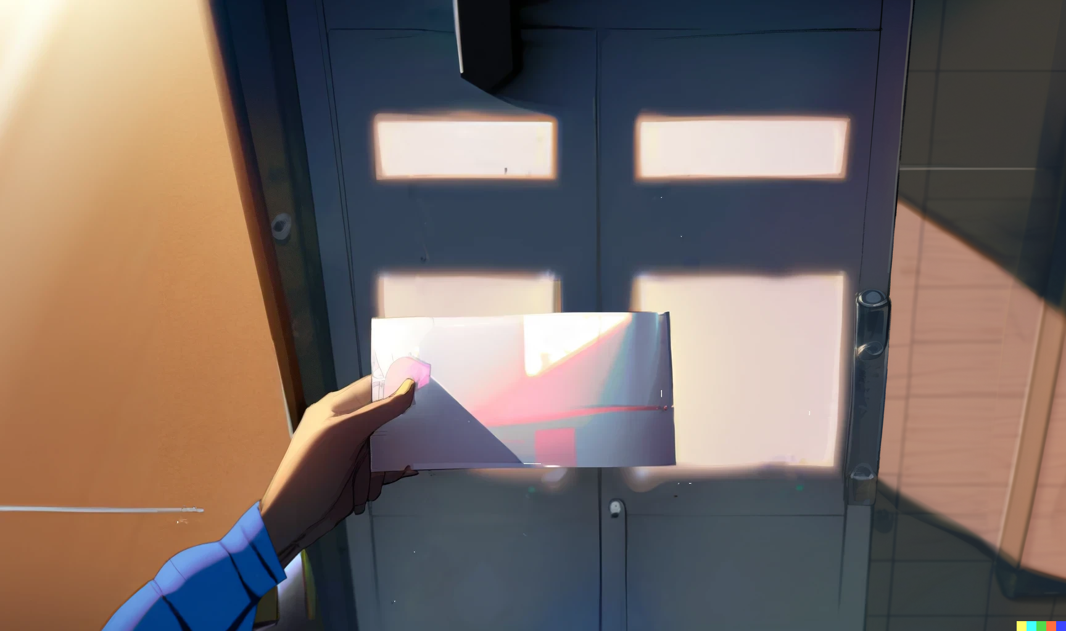
As he reads the neatly written words, a sense of dread washes over him.
b = a+(a=b)-b; Works in Java, but has undefined behavior in C/C++

Slide 11
int a = x;
int b = y;
b = a+(a=b)-b;
Is this what I think it is?
Going step by step, using
x and y as symbolic values

Slide 12
int a = x;
int b = y;
b = x+(a=b)-b;
We evaluate a into x

Slide 13
int a = x;
int b = y;
b = x+(a=y)-b;
We evaluate the first b into y

Slide 14
int a = y;
int b = y;
b = x+(y)-b;
We update a with y

Slide 15
int a = y;
int b = y;
b = x+(y)-y;
We evaluate the second b
And now it’s just simple math

Slide 16
int a = y;
int b = y;
b = x;
Finally we update b with x

Slide 17
int a = y;
int b = x;
//swap two variables
// b = a+(a=b)-b;
//Works in Java, but has
//undefined behavior in C/C++
And here it is
A one liner swapping
two variables in Java
Also, it has undefined
behavior in C/C++?
So, different languages are different indeed;
even if they may look superficially similar

Slide 18
Then Dany turns the paper, and on the other side there is another shocking message!
Every good coding practice
was originally just a trick.

Slide 19


Slide 20
02: The sky is infinite

Slide 21


Slide 22
Credits
- Story: Marco
- Art: MidJourney, NijiJourney, Dall-E
- Wording: Marco, chatGPT
- Composition: Marco
- Thanks to all my friends for
providing great feedback!

