Slide 1


But . . . how . . . yes . . .
int res = 0;
if( res == (res=5) ){ res = 10; }
assert res == 5;

Slide 2

But . . . how . . . yes . . .
int res = 0;
if( res == (res=5) ){ res = 10; }
assert res == 5;
That is correct. Go back to your seat . . .

Slide 3
But . . . how . . . yes . . .
int res = 0;
if( res == (res=5) ){ res = 10; }
assert res == 5;
That is correct. Go back to your seat . . .
Is this what he meant?
The equals switcheroo
could not break him!

Slide 4

But . . . how . . . yes . . .
int res = 0;
if( res == (res=5) ){ res = 10; }
assert res == 5;
That is correct. Go back to your seat . . .
Is this what he meant?
The equals switcheroo
could not break him!
I have a feeling that this year's
class will be up to the task.

Slide 5


After the lecture, Dany rushes to his room

Slide 6
After the lecture, Dany rushes to his room
Again!

Slide 7
After the lecture, Dany rushes to his room
Again!
Every lecture feels like a fight to the death!

Slide 8
After the lecture, Dany rushes to his room
Again!
Every lecture feels like a fight to the death!
The class looked confused,
as if I said something absurd.

Slide 9
After the lecture, Dany rushes to his room
Again!
Every lecture feels like a fight to the death!
The class looked confused,
as if I said something absurd.
How many of them would
have been able to answer?

Slide 10
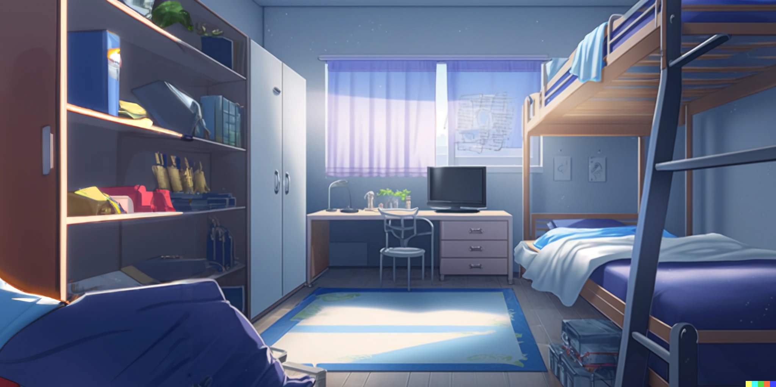

After a hot shower, Dany mumbles about ...

Slide 11
After a hot shower, Dany mumbles about ...
Is this a sensible way to code?

Slide 12
After a hot shower, Dany mumbles about ...
Is this a sensible way to code?
The first time, Pupon was showing
a reasonable intuitive solution,

Slide 13
After a hot shower, Dany mumbles about ...
Is this a sensible way to code?
The first time, Pupon was showing
a reasonable intuitive solution,
and I made the tricky variation.

Slide 14
But this time ...

Slide 15
But this time ...
the lecture and the questions
was all about the tricky part!

Slide 16

Is code all about tricks?

Slide 17
Is code all about tricks?
int input = 2;//Code shown by Pupon
int res = 0;
int value = 0;
if( (value=input*10)>40 ){ res = 10; }
assert res == 0;
assert value == 20;

Slide 18
Is code all about tricks?
int input = 2;//Code shown by Pupon
int res = 0;
int value = 0;
if( (value=input*10)>40 ){ res = 10; }
assert res == 0;
assert value == 20;
Why all those tricks?
Just to save a
few lines of code?

Slide 19
Is code all about tricks?
int input = 2;//Code shown by Pupon
int res = 0;
int value = 0;
if( (value=input*10)>40 ){ res = 10; }
assert res == 0;
assert value == 20;
Why all those tricks?
Just to save a
few lines of code?
Should we instead make
code more readable by
making it longer?

Slide 20
For example, like this?
int input = 2;
int res = 0;
int value = 0;
value = input*10;
boolean shouldUpdate = value>40;
if(shouldUpdate){ res = 10; }
assert res == 0;
assert value == 20;

Slide 21
int input = 2;
int res = 0;
int value = 0;
value = input*10;
boolean shouldUpdate = value>40;
if(shouldUpdate){ res = 10; }
assert res == 0;
assert value == 20;
Would this be better?

Slide 22
int input = 2;
int res = 0;
int value = 0;
value = input*10;
boolean shouldUpdate = value>40;
if(shouldUpdate){ res = 10; }
assert res == 0;
assert value == 20;
Would this be better?
Is it only a few lines every time,
or do some of those tricks
save massive amounts of code?

Slide 23


Suddenly, Dany hears a rustling sound coming from the door
Frush

Slide 24

He turns to look and sees a small piece of paper sliding under the door.
He reaches down and picks up the note, his hands shaking as he unfolds it.

Slide 25
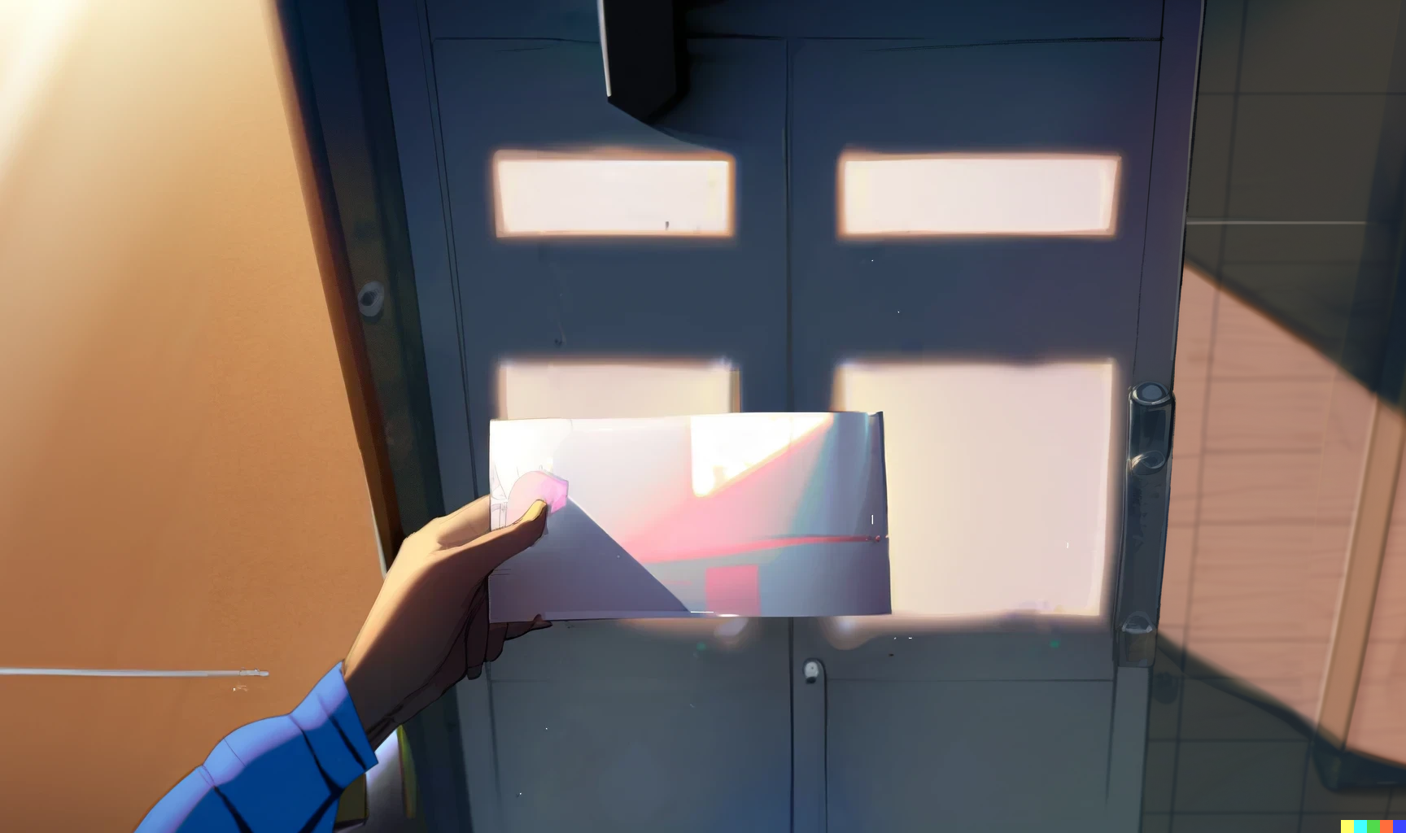
As he reads the neatly written words, a sense of dread washes over him.
b = a+(a=b)-b; Works in Java, but has undefined behavior in C/C++

Slide 26
int a = x;
int b = y;
b = a+(a=b)-b;
Is this what I think it is?

Slide 27
int a = x;
int b = y;
b = a+(a=b)-b;
Is this what I think it is?
Going step by step, using
x and y as symbolic values

Slide 28
int a = x;
int b = y;
b = x+(a=b)-b;
We evaluate a into x

Slide 29
int a = x;
int b = y;
b = x+(a=y)-b;
We evaluate the first b into y

Slide 30
int a = y;
int b = y;
b = x+(y)-b;
We update a with y

Slide 31
int a = y;
int b = y;
b = x+(y)-y;
We evaluate the second b
And now it’s just simple math

Slide 32
int a = y;
int b = y;
b = x;
Finally we update b with x

Slide 33
int a = y;
int b = x;
//swap two variables
// b = a+(a=b)-b;
//Works in Java, but has
//undefined behavior in C/C++
And here it is

Slide 34
int a = y;
int b = x;
//swap two variables
// b = a+(a=b)-b;
//Works in Java, but has
//undefined behavior in C/C++
And here it is
A one liner swapping
two variables in Java

Slide 35
int a = y;
int b = x;
//swap two variables
// b = a+(a=b)-b;
//Works in Java, but has
//undefined behavior in C/C++
And here it is
A one liner swapping
two variables in Java
Also, it has undefined
behavior in C/C++?

Slide 36
int a = y;
int b = x;
//swap two variables
// b = a+(a=b)-b;
//Works in Java, but has
//undefined behavior in C/C++
And here it is
A one liner swapping
two variables in Java
Also, it has undefined
behavior in C/C++?
So, different languages are different indeed;
even if they may look superficially similar

Slide 37
Then Dany turns the paper, and on the other side there is another shocking message!
Every good coding practice
was originally just a trick.

Slide 38


Slide 39
02: The sky is infinite

Slide 40


Slide 41
Credits
- Story: Marco
- Art: MidJourney, NijiJourney, Dall-E
- Wording: Marco, chatGPT
- Composition: Marco
- Thanks to all my friends for
providing great feedback!
Next episode on Feb 13 2023

