Slide 1


Cheapjing Cheap 精

Slide 2

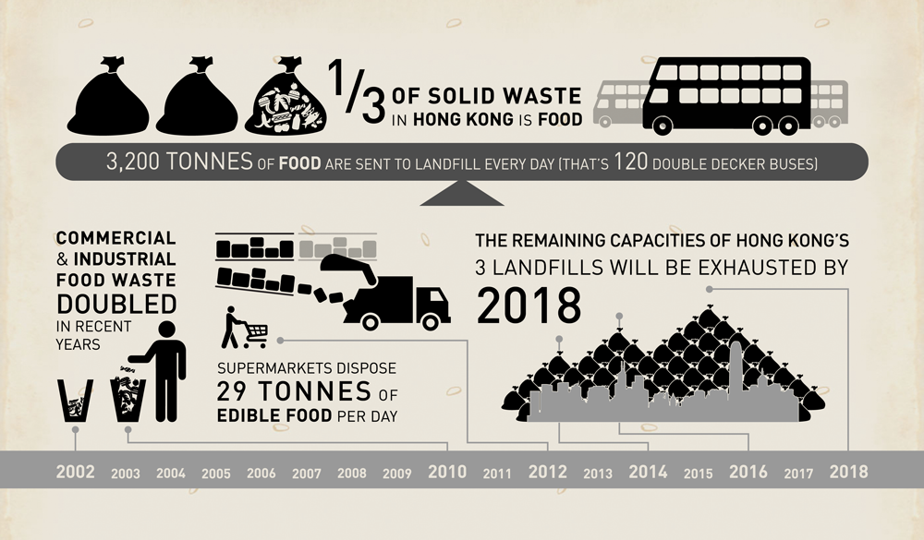

Slide 3
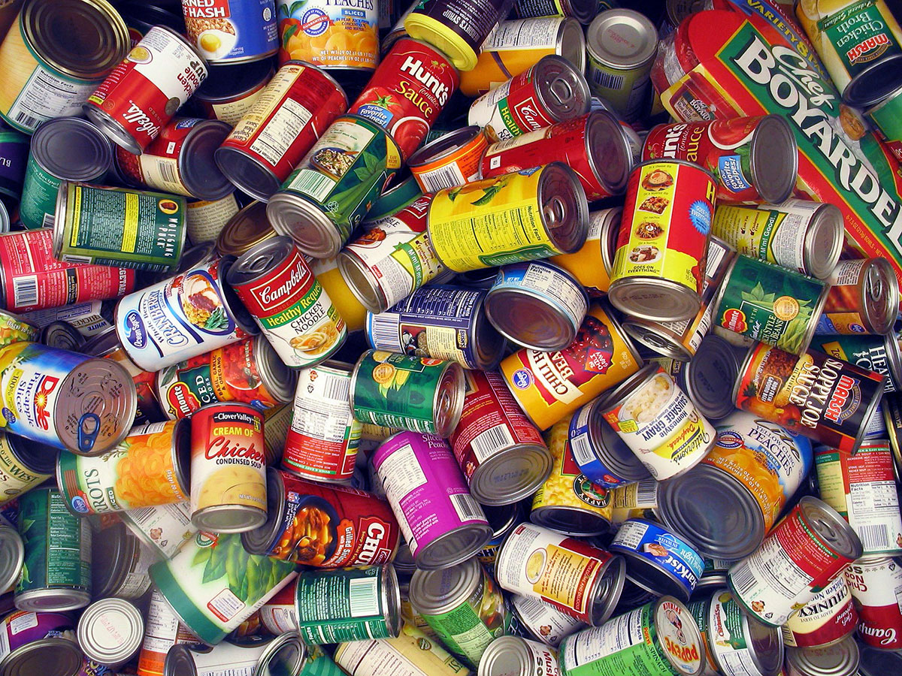



Slide 4
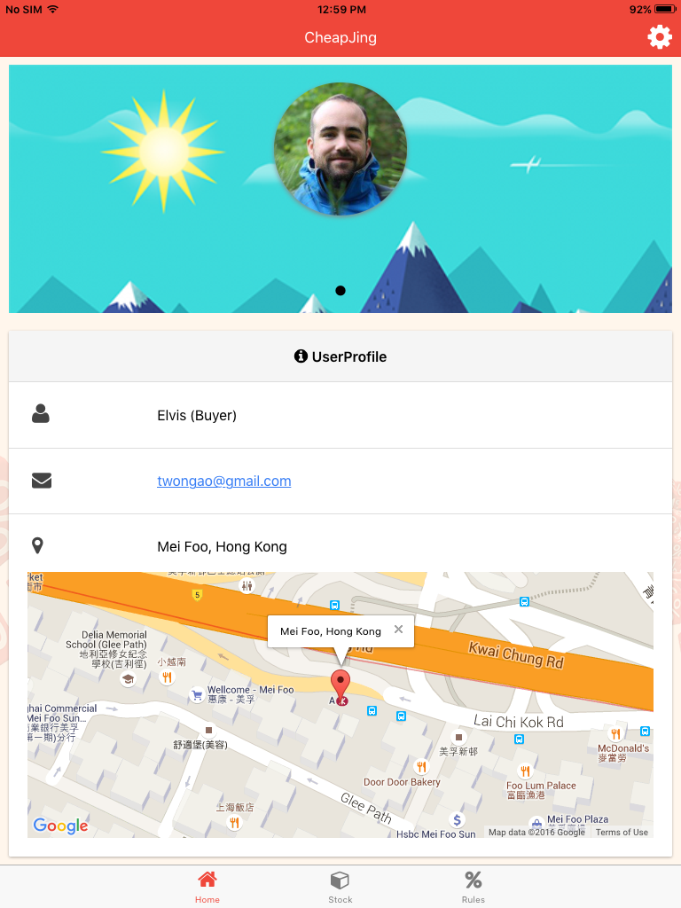
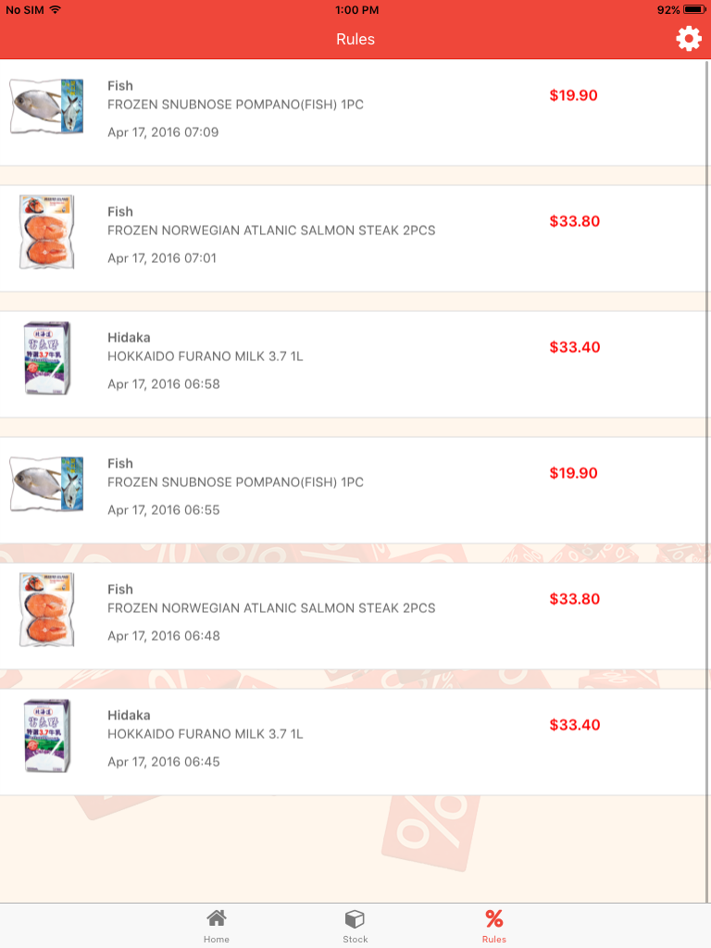

Slide 5







Cheapalization Algorithm

Slide 6
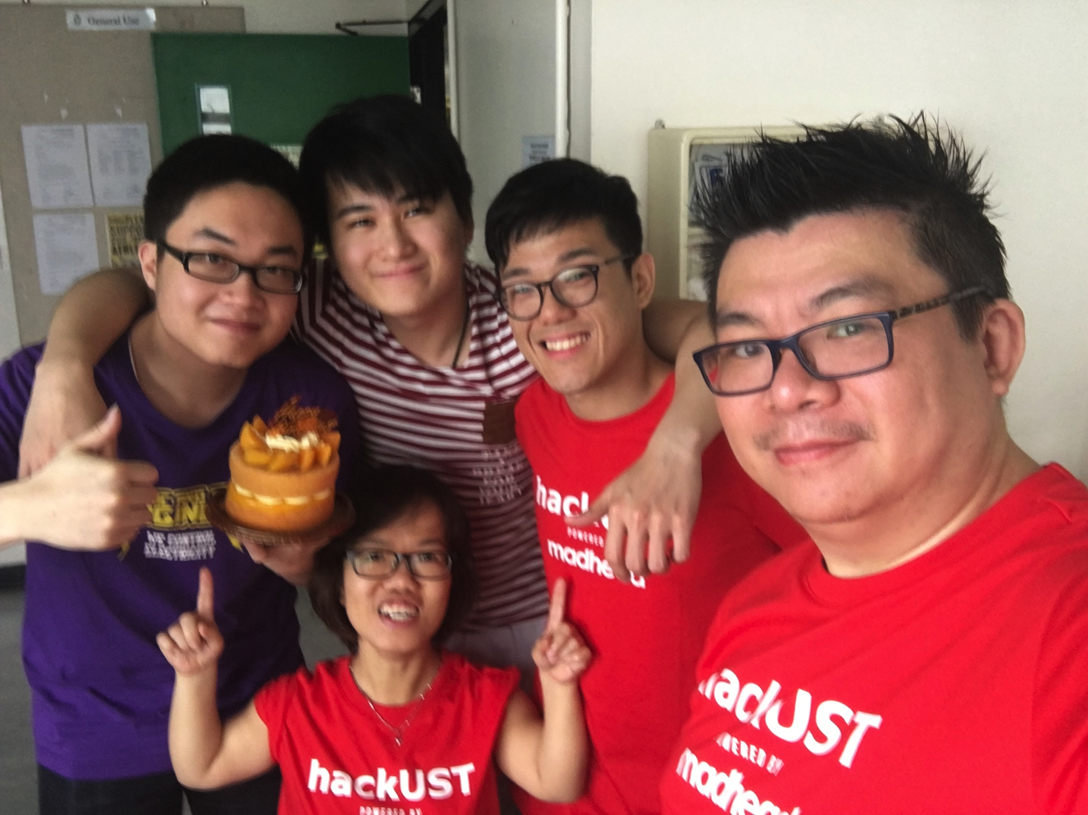
BD-boy
ZZZZ
TEAM CHEAPJING

