Slide 1


Predict Diabetes
Team Member
Ahmed Mohamed Atef
Mohamed Ibrahim Abdelghaffar
Mohamed Magdy AbdelMoneim

Slide 2
Introduction
According to the report of ( Centers of Disease Control and Prevention ) about one in seven adults in the United States have Diabetes But by next few years this rate can move higher.
In this project, we will show you how you can use machine learning to Predict Diabetes.
We will predict if person will get diabetes depend on some data we take about person

Slide 3

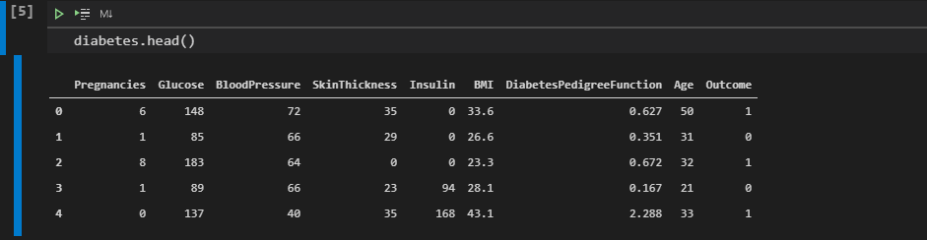
Datasets
We have data about 768 persons consisting of:
Pregnancies: Number of times pregnant
Glucose: Plasma glucose concentration over 2 hours in an oral glucose tolerance test
BloodPressure: Diastolic blood pressure (mm Hg)
SkinThickness: Triceps skin fold thickness (mm)
Insulin: 2-Hour serum insulin (mu U/ml)
BMI: Body mass index (weight in kg/(height in m)2)
DiabetesPedigreeFunction: Diabetes pedigree function (a function which scores likelihood of diabetes based on family history)
Age: Age (years)
Outcome: Class variable (0 if non-diabetic, 1 if diabetic)

Slide 4
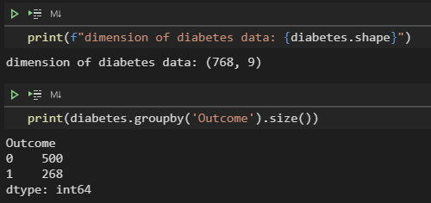
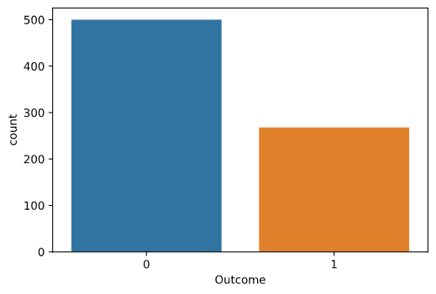
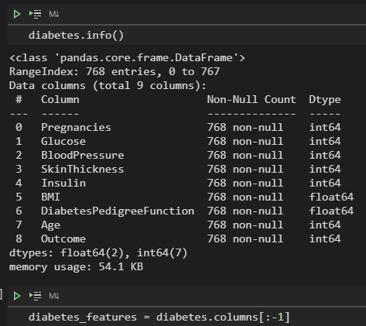
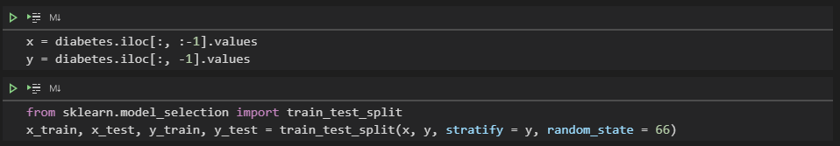
Datasets

Slide 5
Models
We use several models to predict and we make some of enhancement on it as we can.
Models:
K-Nearest Neighbors
Decision Tree Classifier
Decision Tree
Decision Tree With max depth
Deep Learning (Multi-layer Perceptron classifier)
Multi-layer Perceptron
Multi-layer Perceptron with max iteration
Multi-layer Perceptron with Scale
Multi-layer Perceptron with Scale and max iteration
We must make classifier to can analysis and predict data

Slide 6
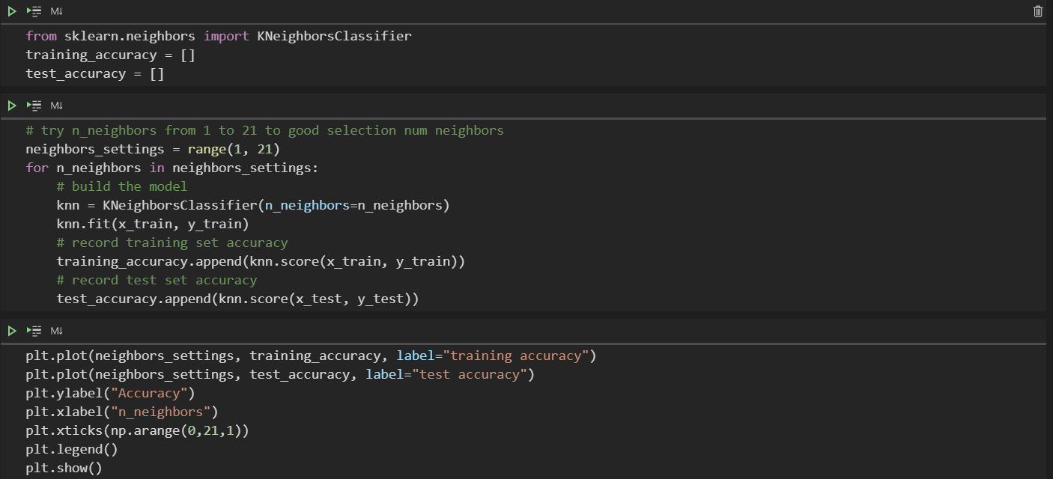
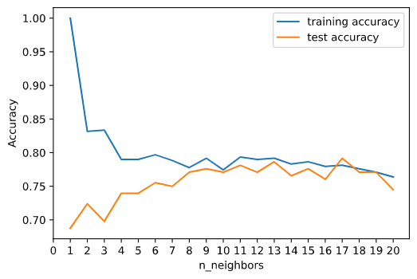
K-Nearest Neighbors (KNN)
First we test numbers of neighbors on model and fit data and plot accuracy for train and test data.
We make this to get optimal number of neighbors. (Like the elbow method in K-Means clustering)

Slide 7
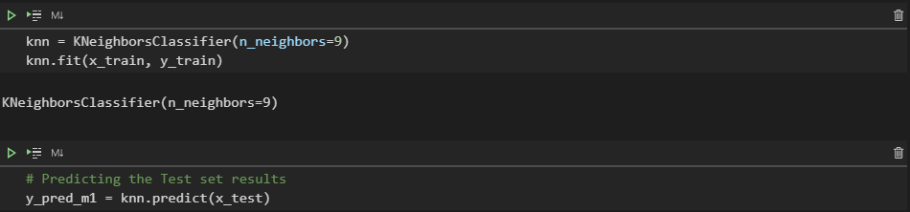
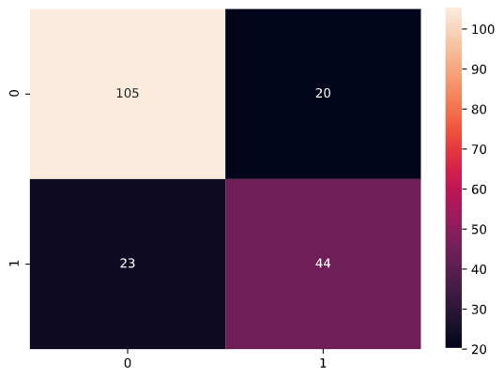
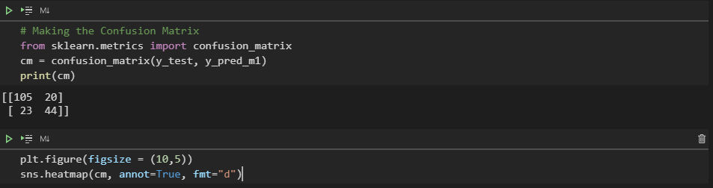
K-Nearest Neighbors (KNN)
Now we choose number of neighbors 9 because of accuracy very close after this number and we consume time and resource.
we fit model and predict and make confusion matrix to see correct data

Slide 8
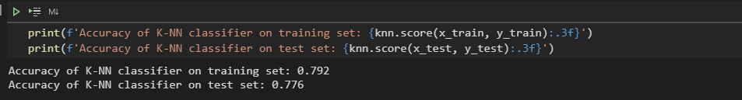
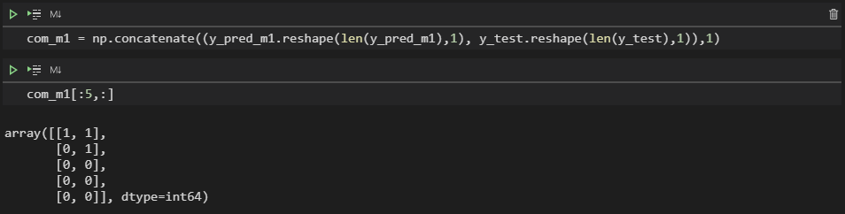
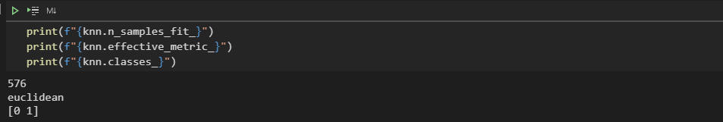
K-Nearest Neighbors (KNN)
We calculate accuracy for training set and test set and some of statistics about model

Slide 9
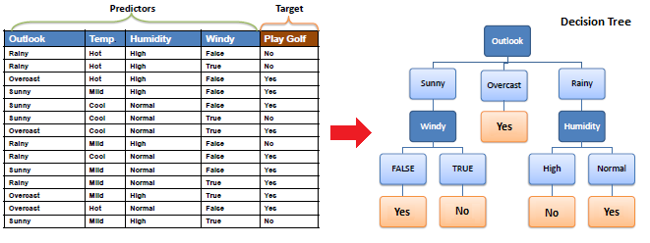
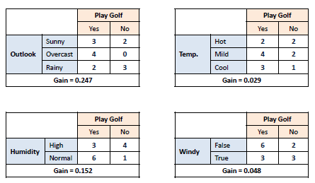
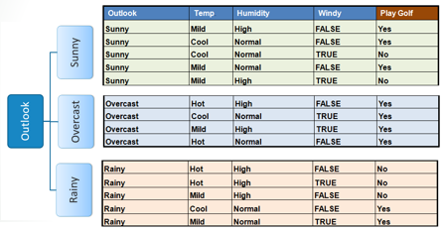
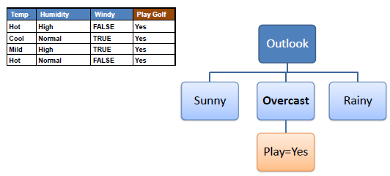
Decision Tree Classifier Intuition
The algorithm performs a calculation called (Information Gain) in which it decides the value to be separated based on the highest result.

Slide 10
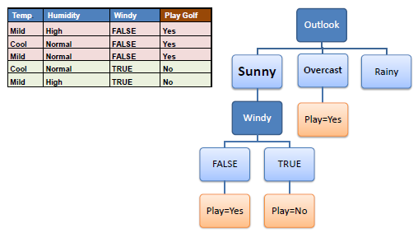
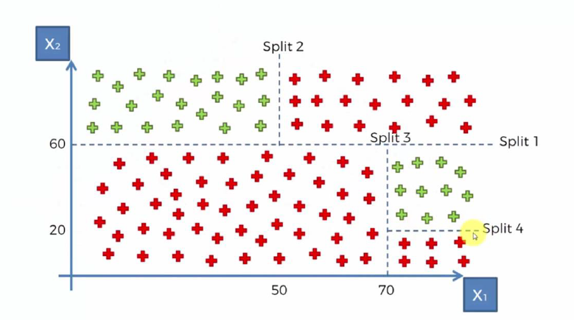
Decision Tree Classifier Intuition

Slide 11
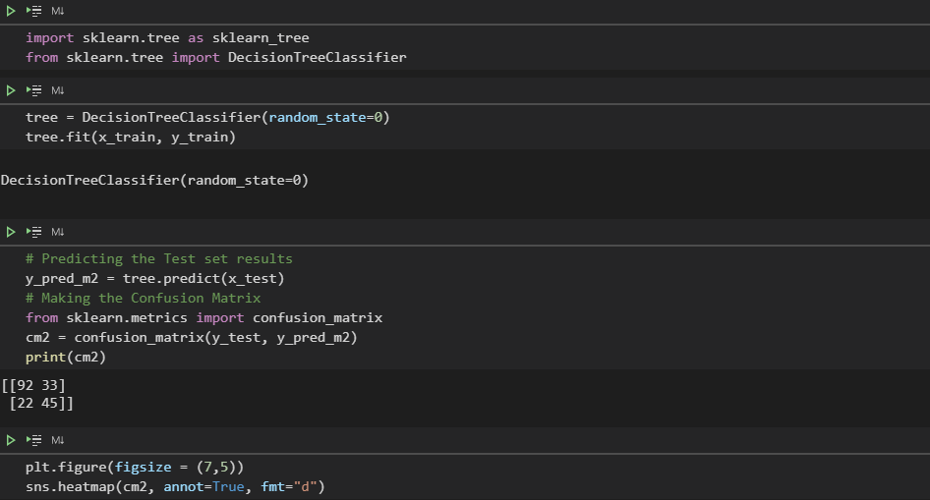
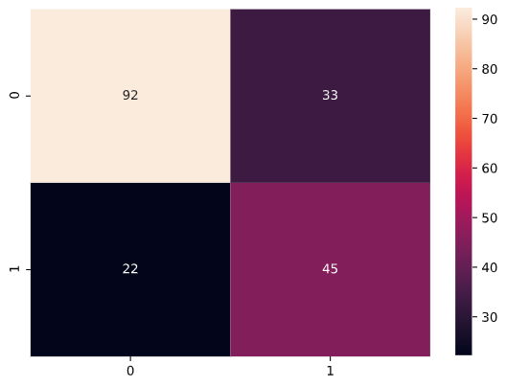
Decision Tree Classifier

Slide 12
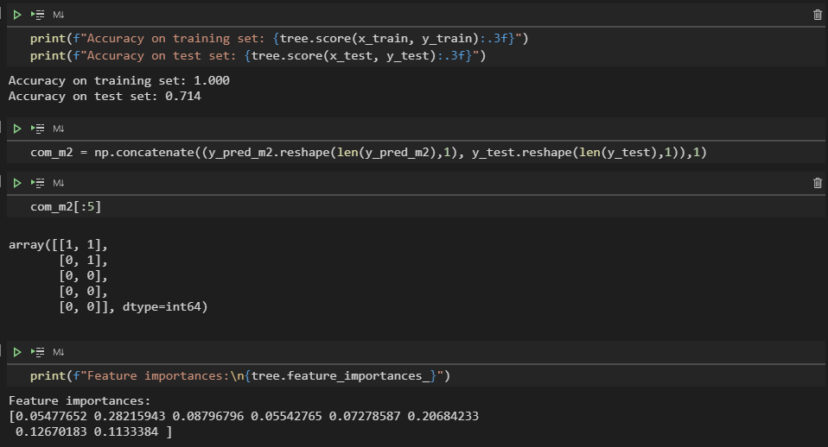
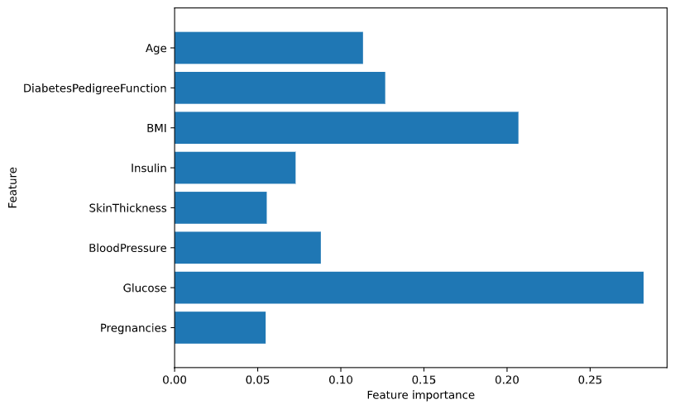
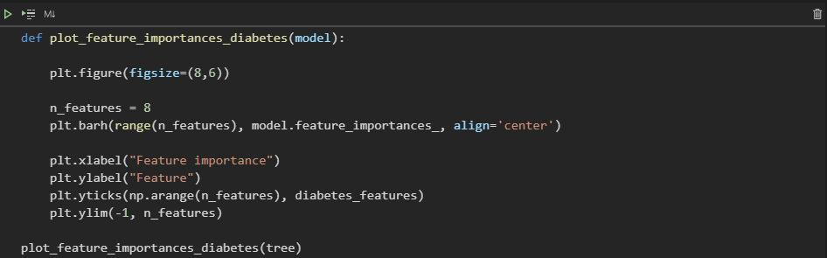
Decision Tree Classifier

Slide 13
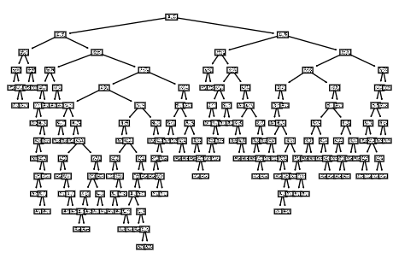
Decision Tree Classifier

Slide 14
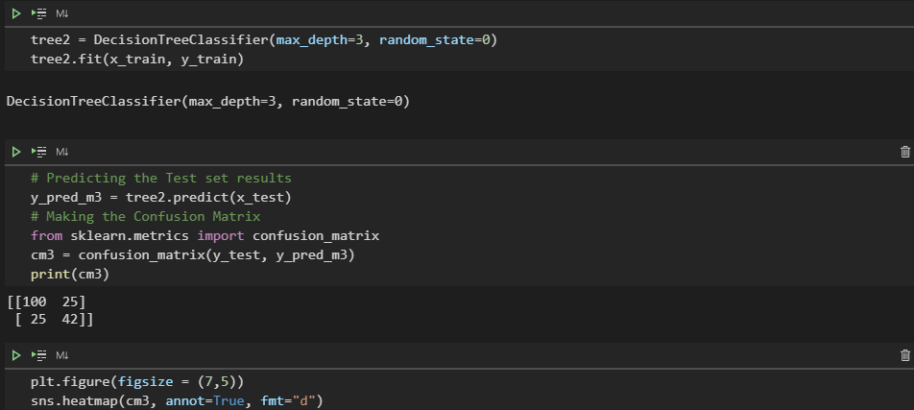
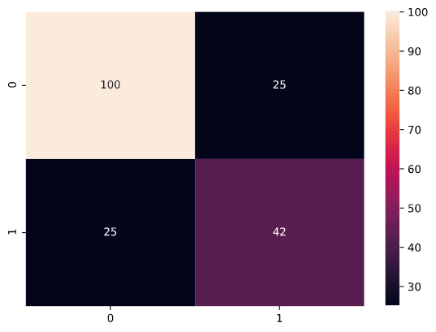
Decision Tree Classifier With max depth

Slide 15
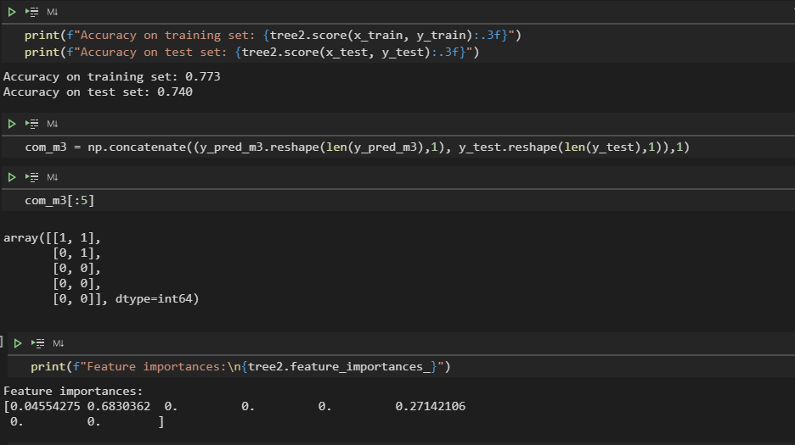
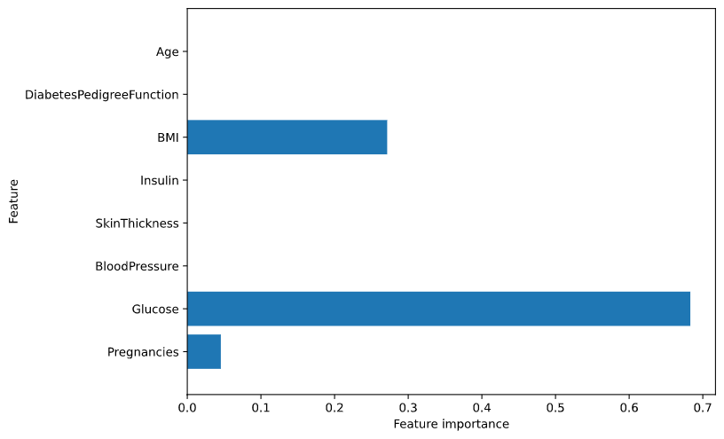
Decision Tree Classifier With max depth

Slide 16
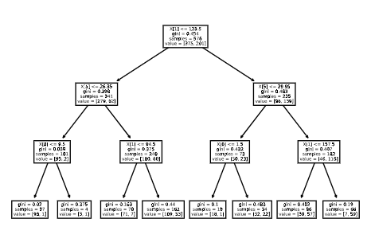
Decision Tree Classifier With max depth

Slide 17
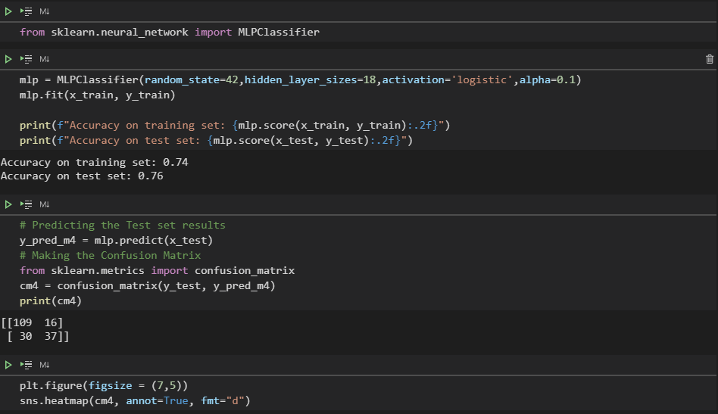
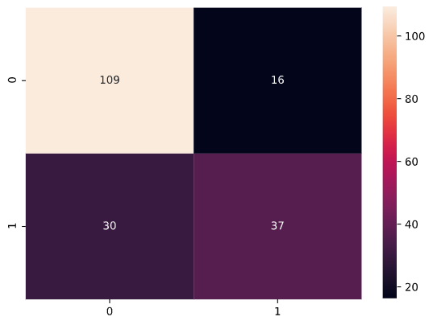
Multi-layer Perceptron classifier (MLP)

Slide 18
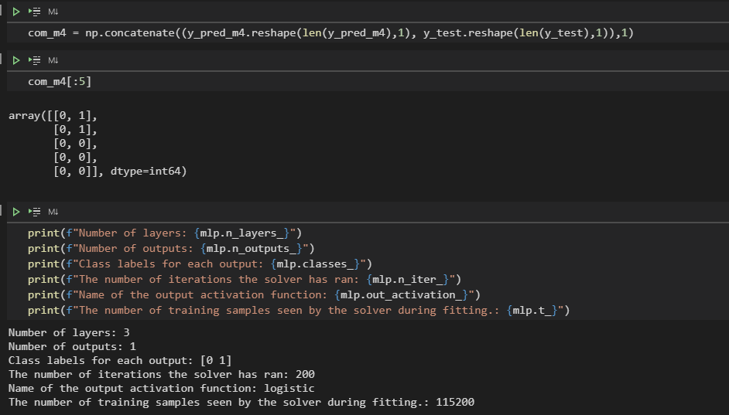
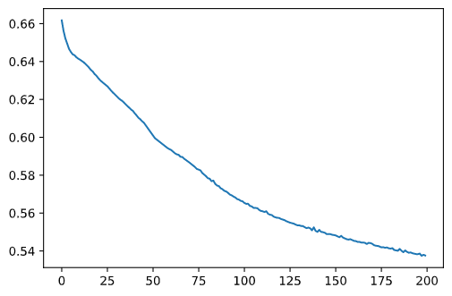
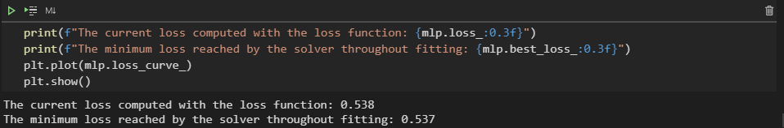
Multi-layer Perceptron classifier (MLP)

Slide 19
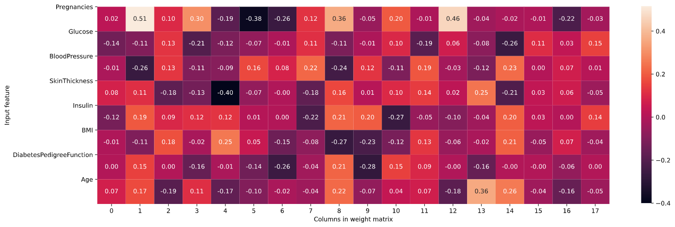
Multi-layer Perceptron classifier (MLP)

Slide 20
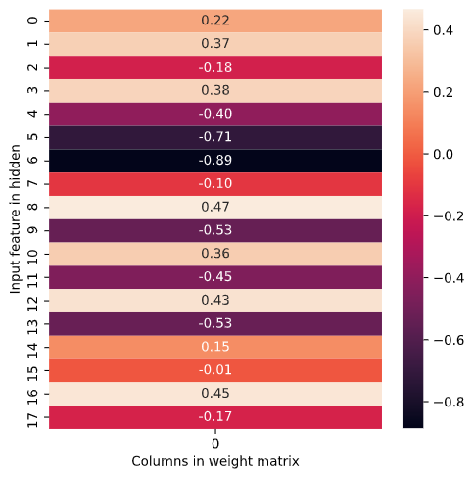
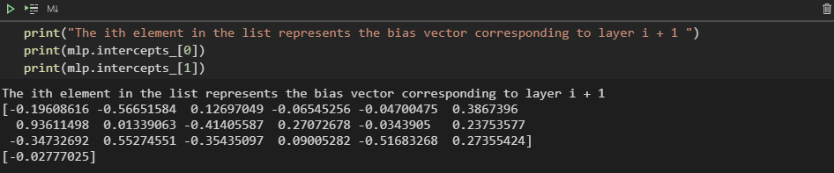
Multi-layer Perceptron classifier (MLP)

Slide 21
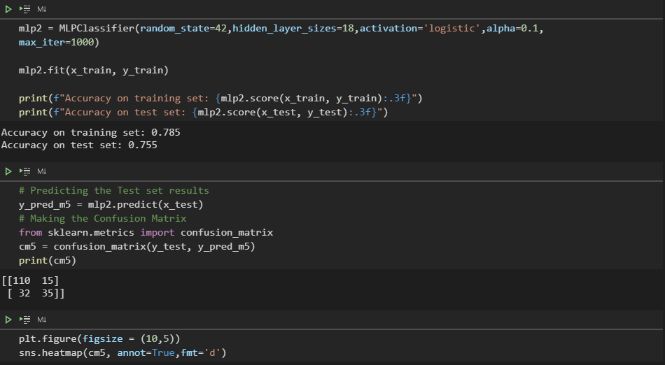
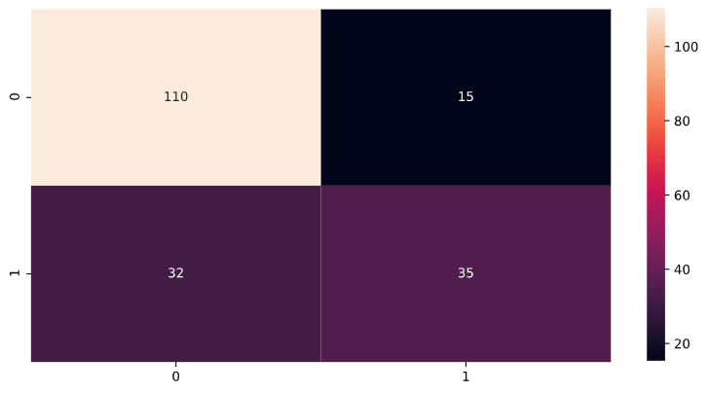
( Multi-layer Perceptron classifier ) with max iteration

Slide 22
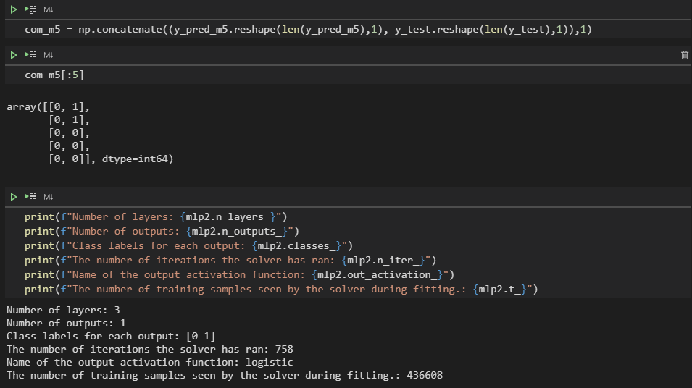
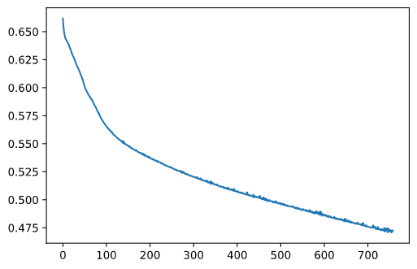
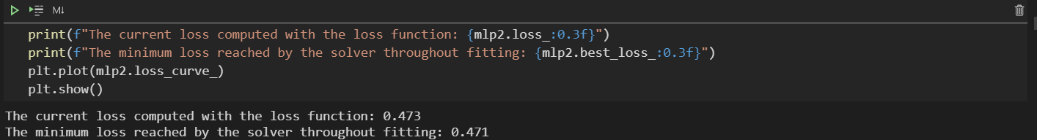
( Multi-layer Perceptron classifier ) with max iteration

Slide 23
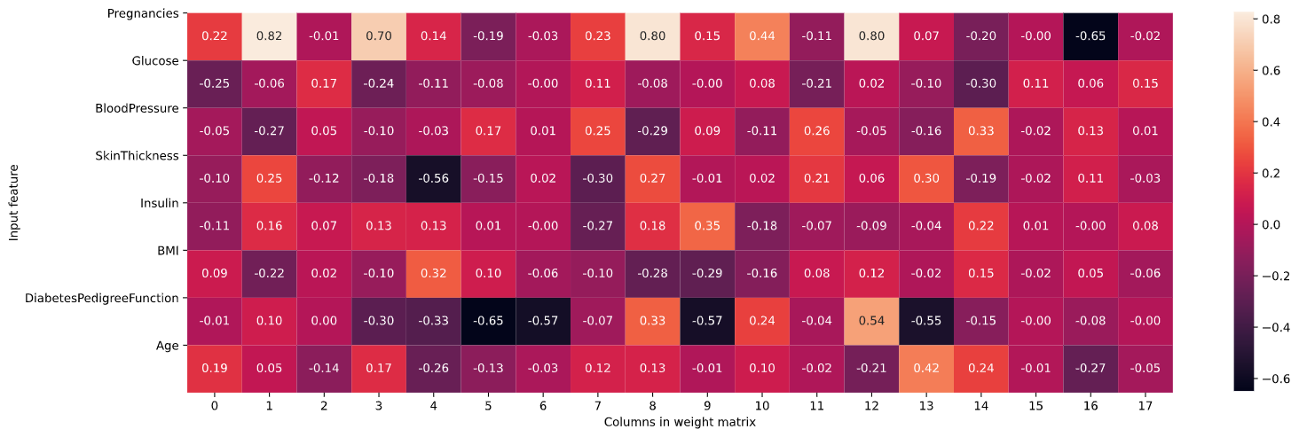
( Multi-layer Perceptron classifier ) with max iteration

Slide 24
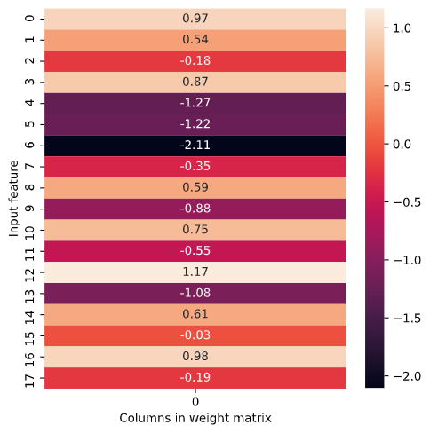
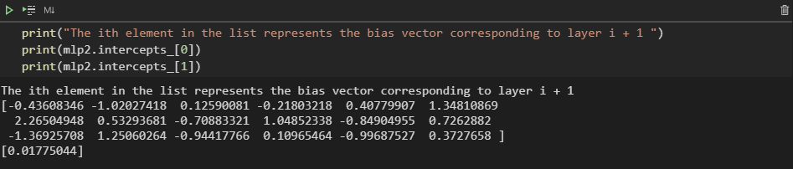
( Multi-layer Perceptron classifier ) with max iteration

Slide 25
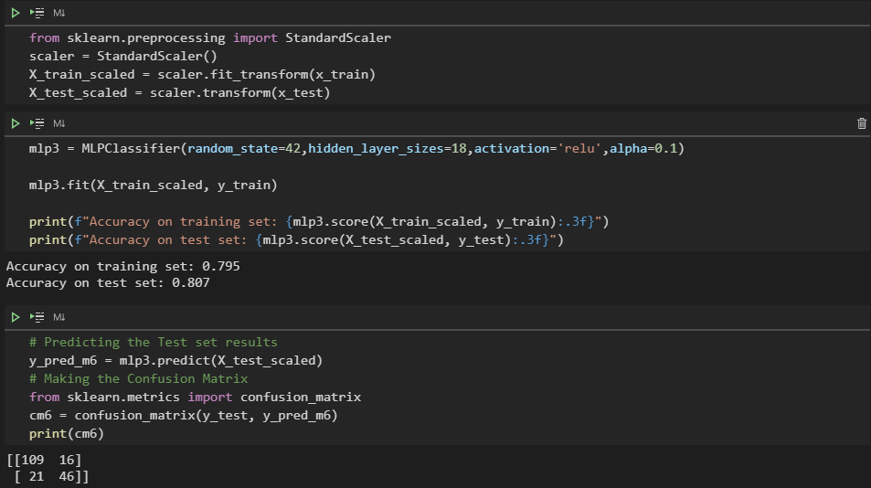
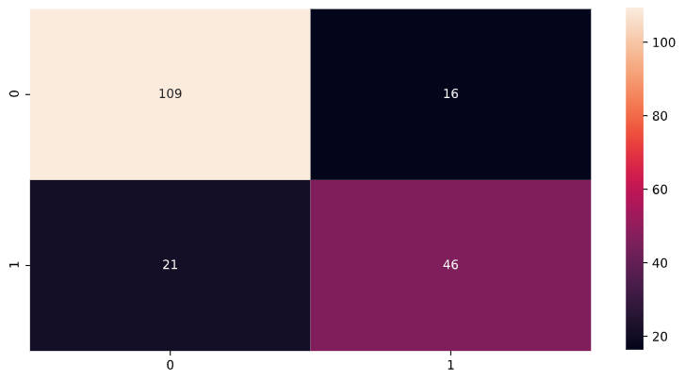
( Multi-layer Perceptron classifier ) with Scale

Slide 26
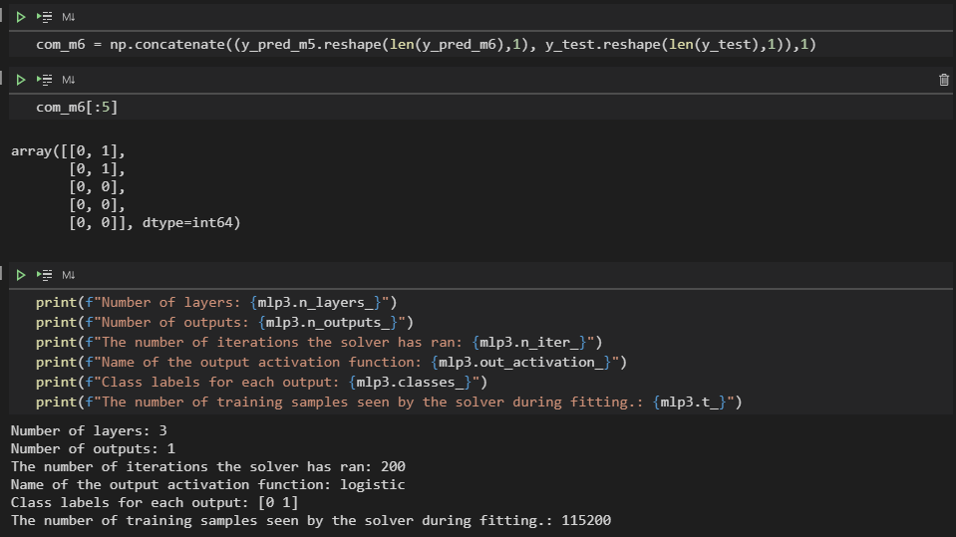
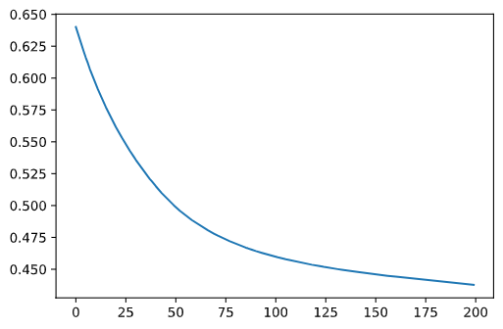

( Multi-layer Perceptron classifier ) with Scale

Slide 27

( Multi-layer Perceptron classifier ) with Scale

Slide 28


( Multi-layer Perceptron classifier ) with Scale

Slide 29


( Multi-layer Perceptron classifier ) with Scaler and max iteration

Slide 30



( Multi-layer Perceptron classifier ) with Scaler and max iteration

Slide 31

( Multi-layer Perceptron classifier ) with Scaler and max iteration

Slide 32


( Multi-layer Perceptron classifier ) with Scaler and max iteration

Slide 33

Results
All predictions in ('predictions_df.csv') file

Slide 34

Results
All accuracy in ('accuracy_df.csv')

