Slide 1


OpsMind — AI Operational Intelligence
Google Cloud AI Builder Cup 2026 · JAPAC
Team: OpsMind AI · Team lead: Sisawaktu 11
Problem: operations data is split; a power spike does not obviously track production.
Prototype: deterministic metrics + Gemini explanations. AI suggests; a person decides.

Slide 2

Executive summary
Operations data is split across production, electricity, hours and weather.
OpsMind calculates intensity, a trailing baseline, deviation and a potential cost estimate.
Gemini explains only the supplied evidence and lists what is still missing.
The model never calculates the numbers. Every demo row is labelled SIMULATED DATA.
AI suggests; a person decides.

Slide 3
Brief about the idea
• OpsMind is an AI Operational Intelligence prototype for SME manufacturers.
• It computes energy intensity (kWh/unit), a trailing baseline, deviation and a potential excess-cost estimate.
• Gemini explains the evidence, separates facts from hypotheses and recommends human checks.
• All demo data is labelled SIMULATED DATA. No saving is claimed.

Slide 4
Opportunities
• Differentiation: evidence-first investigation, not a generic chatbot or a single threshold alert.
• Every observation cites evidence E1–E13; each hypothesis lists the evidence that is still missing.
• The cost panel shows the formula and assumptions — not a claimed bill or verified saving.
• Weather is context, not proof; before/after changes are reported without asserting causation.
• USP: a human-in-the-loop path from detection → investigation → action → verification.

Slide 5
Features
• Daily dashboard: production, electricity, energy intensity and potential additional cost.
• Transparent detection: trailing baseline, 15% heuristic threshold and severity bands.
• AI investigation: Gemini or a labelled deterministic mock; Zod-validated output.
• Evidence: 13 items (E1–E13), facts vs hypotheses, missing inputs and limitations.
• Action workflow: Open / In progress / Completed with timestamps and completion notes.
• Before/after comparison with an explicit “observed change only” caveat.

Slide 6
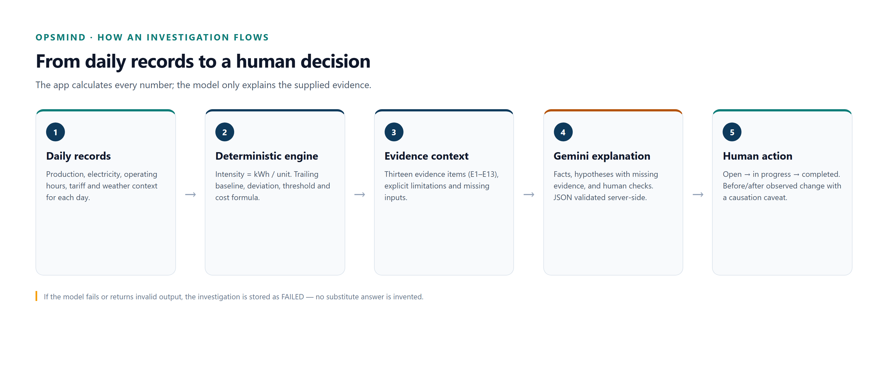
Investigation flow
The deterministic engine calculates; Gemini explains; a person decides. Model failure is stored as FAILED.

Slide 7
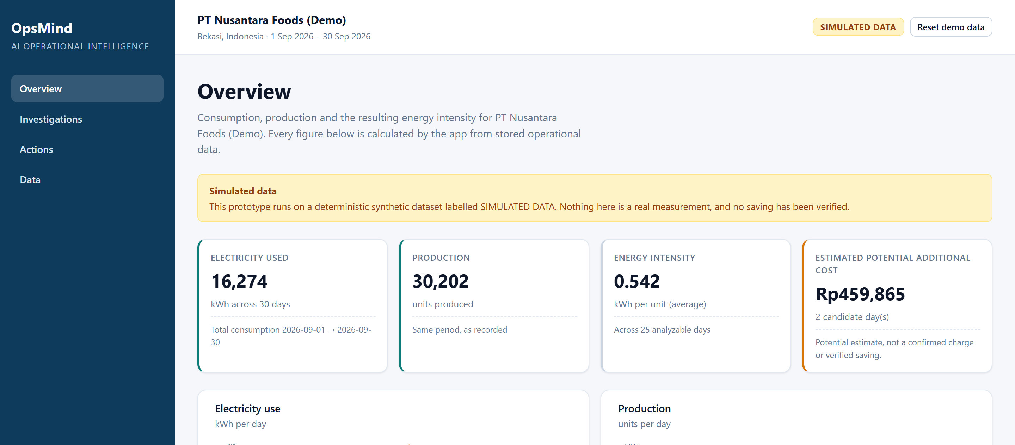
Product walkthrough — Overview
30 simulated days · 17 Sep 2026: +36.0% vs the trailing baseline · potential estimate Rp288,884.

Slide 8
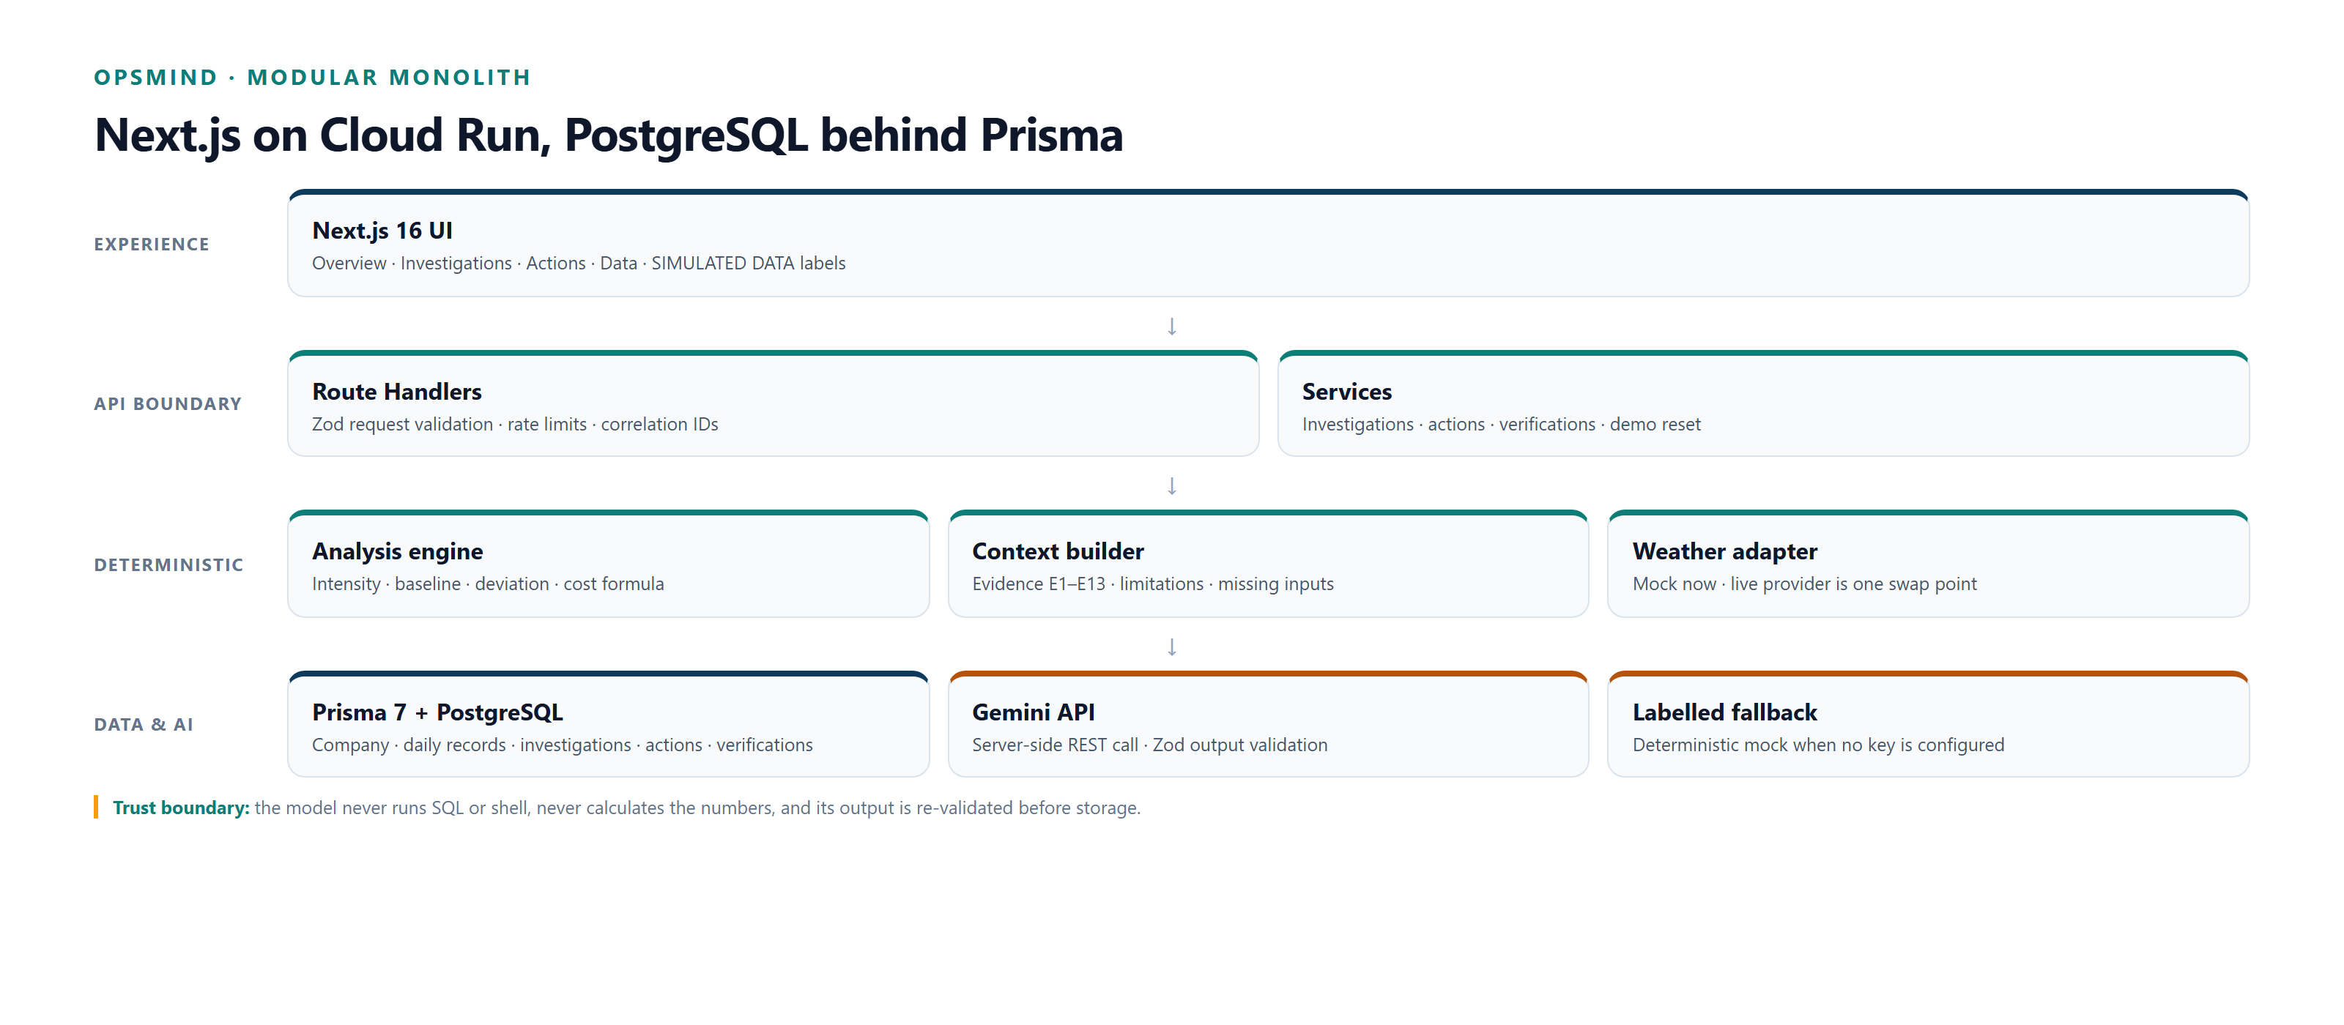
Architecture
Next.js → route handlers → validation → services → PostgreSQL; Gemini output is validated before storage.

Slide 9
Technology stack
• Next.js 16 App Router · React 19 · TypeScript 7 strict · custom CSS design tokens.
• PostgreSQL + Prisma 7 driver adapter · native decimal and date columns.
• Gemini API via server-side REST · Zod 4 output validation · labelled deterministic mock fallback.
• Vitest 5 (79 tests) · Playwright E2E · Docker · GitHub Actions.
• Local embedded PostgreSQL · deployment target: Google Cloud Run.

Slide 10
Estimated implementation cost (optional)
• Development: local embedded PostgreSQL + labelled mock investigator; no cloud spend required.
• Deployment: Cloud Run scale-to-zero + managed PostgreSQL + Gemini token usage; cost depends on traffic and region.
• The app reports a potential estimate: excess kWh × tariff, with the tariff and assumptions shown.
• It does not claim verified savings; a controlled before/after measurement is required.

Slide 11
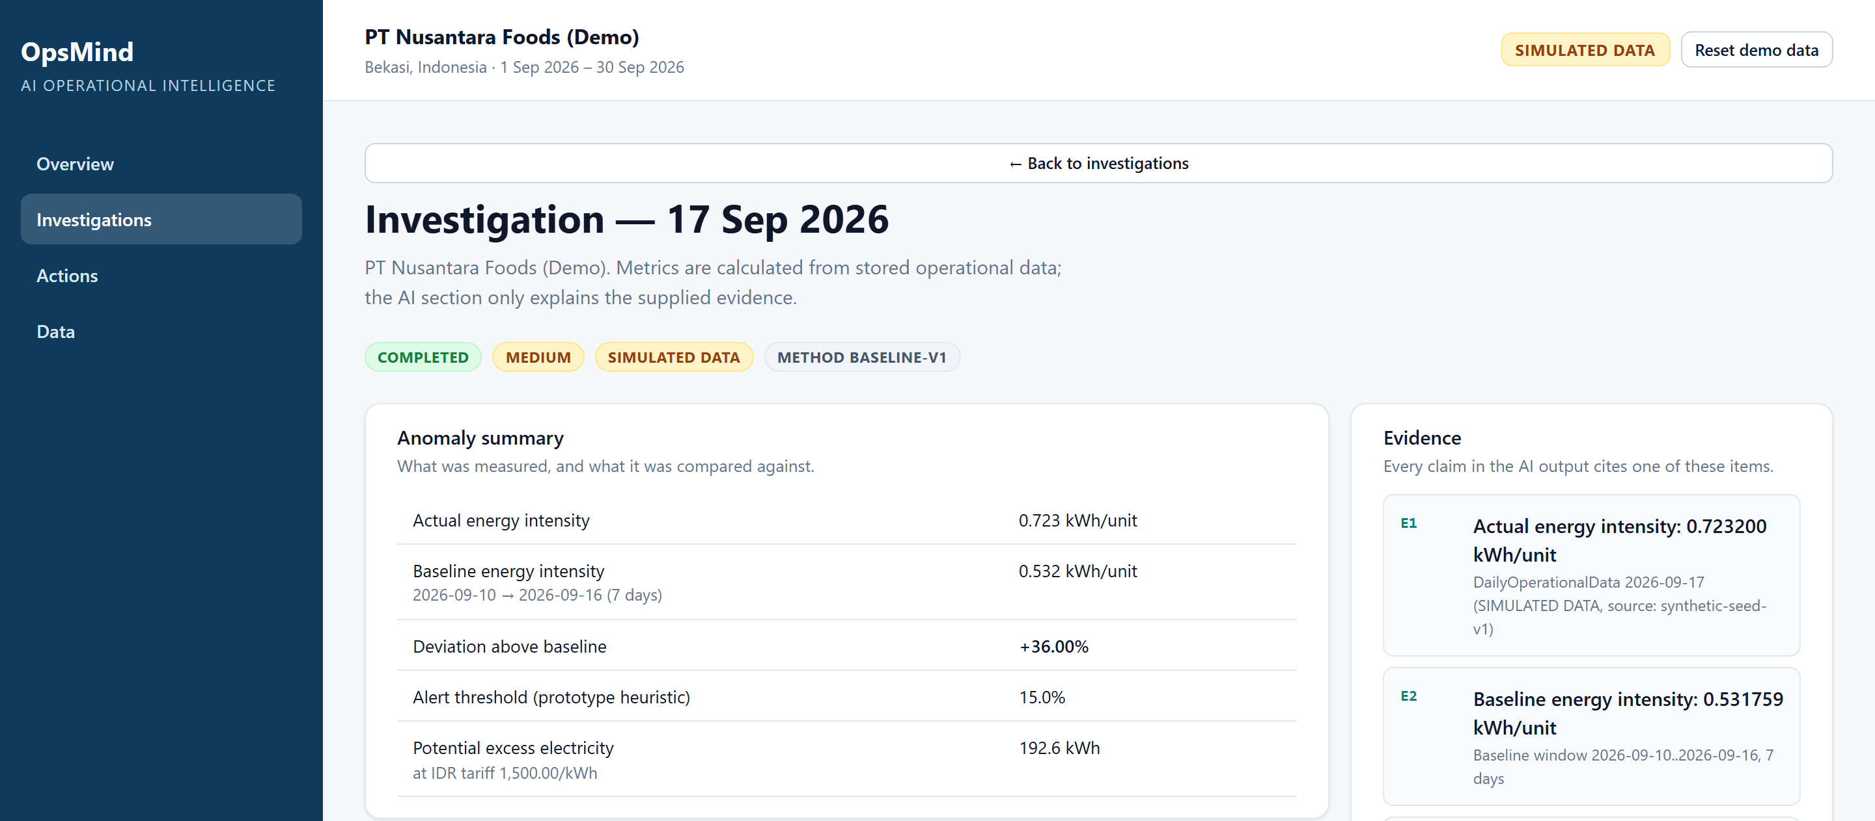
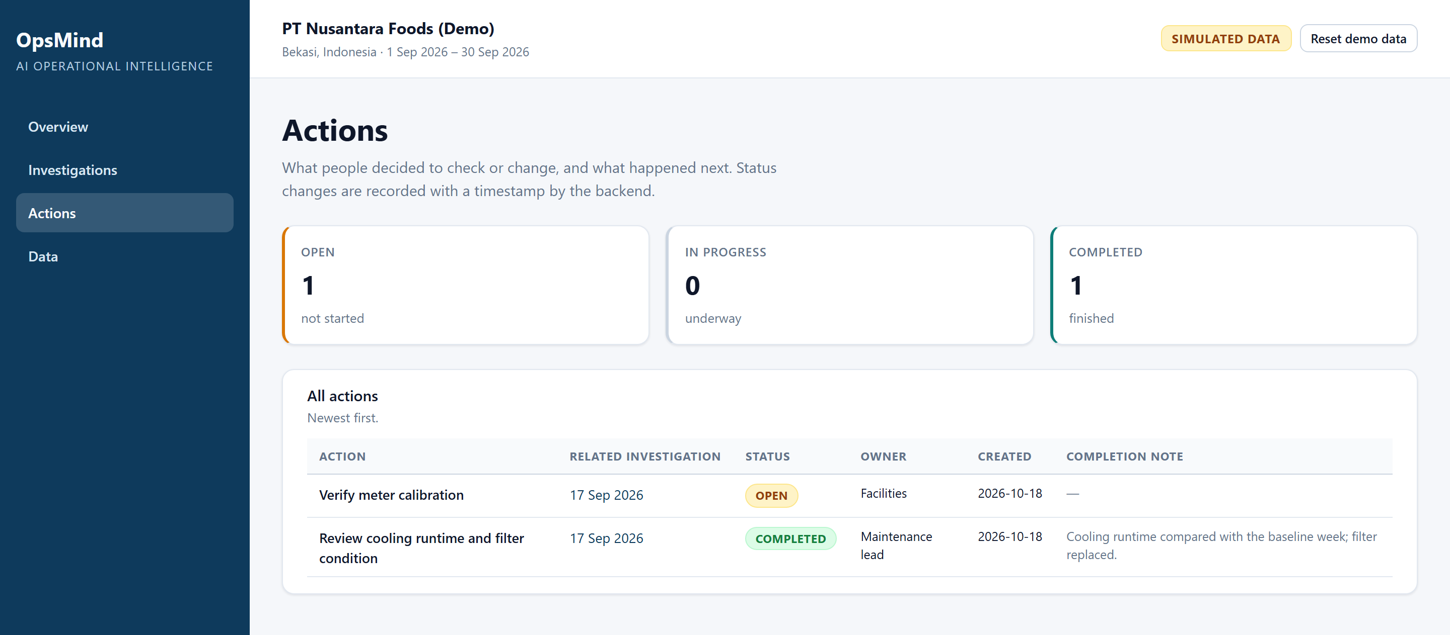
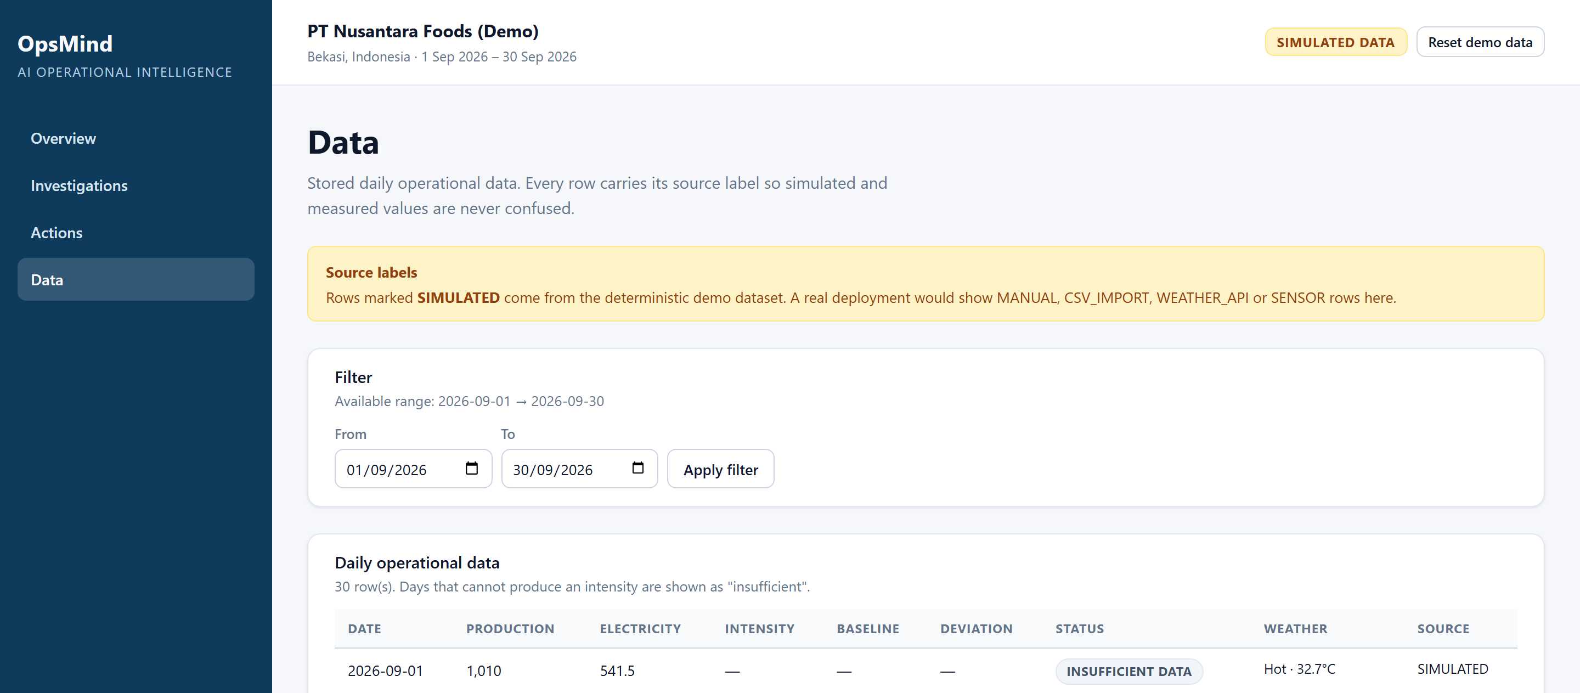
Prototype snapshots — simulated data
Overview — KPIs, trend and investigation queue
Investigation — evidence E1–E13 and AI explanation
Actions — open/completed and before/after comparison
Data — source labels and date filter

Slide 12
Performance and verification
• 79 automated tests: calculation engine, validation, AI failure modes and API integration.
• 3 Playwright E2E tests: overview, sidebar navigation and the investigate journey.
• Typecheck and production build pass; the 30-day demo dataset is deterministic.
• Health check: /api/health reports database and AI-provider status.
• Not claimed: production throughput, a latency benchmark, or real savings.

Slide 13
Roadmap
• Real weather provider with coverage, terms, attribution and rate-limit review.
• CSV upload with preview/validation; multi-site support.
• Authentication/RBAC and gateway-level rate limits.
• Controlled before/after studies with measured savings.
• Model evaluation on real operations data; prompt/model versioning.

Slide 14
Submission links
• GitHub public repository: see the Hack2skill submission form.
• Demo video (<3 min): see the submission form.
• Live prototype: see the submission form.
• Health check: /api/health (database + AI-provider status).
• The submission form is the source of truth for the final URLs.

Slide 15
OpsMind — AI Operational Intelligence
Ask: what is the evidence?
Demo candidate: 17 Sep 2026, +36.0% above the trailing baseline — a potential estimate, not a verified saving.
AI suggests; a person decides.
Thank you.

Slide 16


