Slide 1
VR Pets Status Update 4
Brought to you by the Code Monkeys
Josh Bartling, Elliot Hunt, Kyle Mitchell, and Kurt Risley
(RIP Kip DeCastro)

Slide 2
Last time
Apartment VR environment, fully furnished (utilities not included)
Pathfinding and behavior prototyping
Fox model built, rigged, and animated
Menu interface organized and constructed

Slide 3
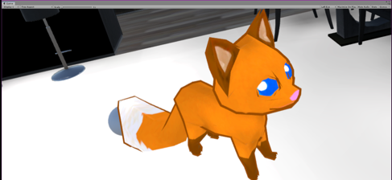
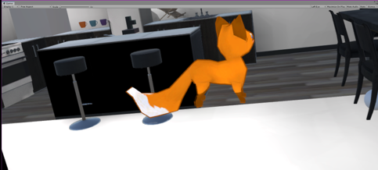
Since then
Improved animations
Swapped in Fox model
Implemented Fetch action
"Fixed" controller inputs
Corrected some menu items
SO MUCH troubleshooting

Slide 4
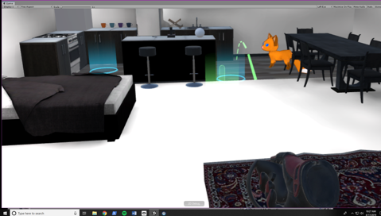
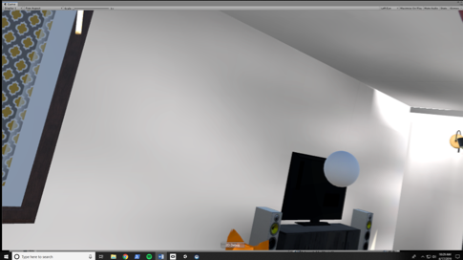
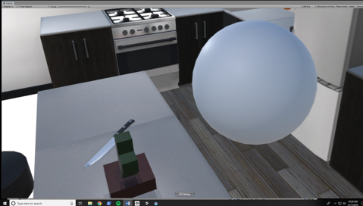
Current version
Throw a ball, pet will find and return it

Slide 5
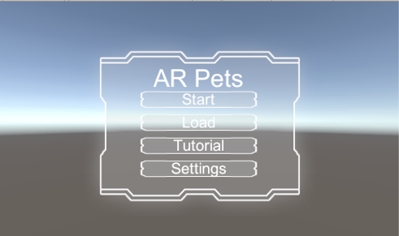
Current work
Debugging and fixes
Improve animation timing and triggers
Adding basic Pet Stats system
Round out tutorial and interface
Final presentation, narrative form
With a working MVP, we can continue with features and other plans.

Slide 6
Next steps
Future work
Get to a product we can present to our many stockholders and other investors
Repo tidying, documentation
Testing and polishing
Finish courses, graduate (?)
Get to a product we can actually put in our portfolios and show to potential employers
Polish and test more
Look into publishing
Watch for AR developments

Slide 7
Thank you!
Any questions?

