Slide 1
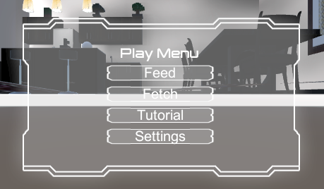
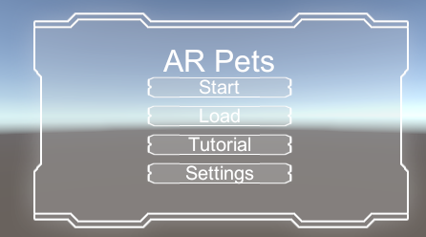
User Interface
Interactions
Loading Scenes
Tutorials
Issues
Unity
Github and Games
Branching

