Slide 1
Bioinformatics Workshop
Elyas Mohammadi
October 2026

Slide 2
Agenda
Part 1 – Understanding Modern Transcriptomics Technologies
  Bulk RNA-seq
  Single-cell RNA-seq
  Spatial Transcriptomics
Part 2 – Using Public Transcriptomics Data
  Systematically searching repositories
  Extracting data from a paper
Part 3 – How to Read and Understand Bioinformatics Code

Slide 3






Note
The content of this workshop is extracted from the following sources and some of the illustrations are generated by AI:

Slide 4
Part 1 – Understanding Modern Transcriptomics Technologies

Slide 5
Learning objectives
By the end of this section participants should be able to answer:
  What do these technologies measure?
  What information do they provide?
  What information do they miss?
  Which biological questions can they answer?
  Which biological questions cannot they answer?
  When should I choose one over another?

Slide 6
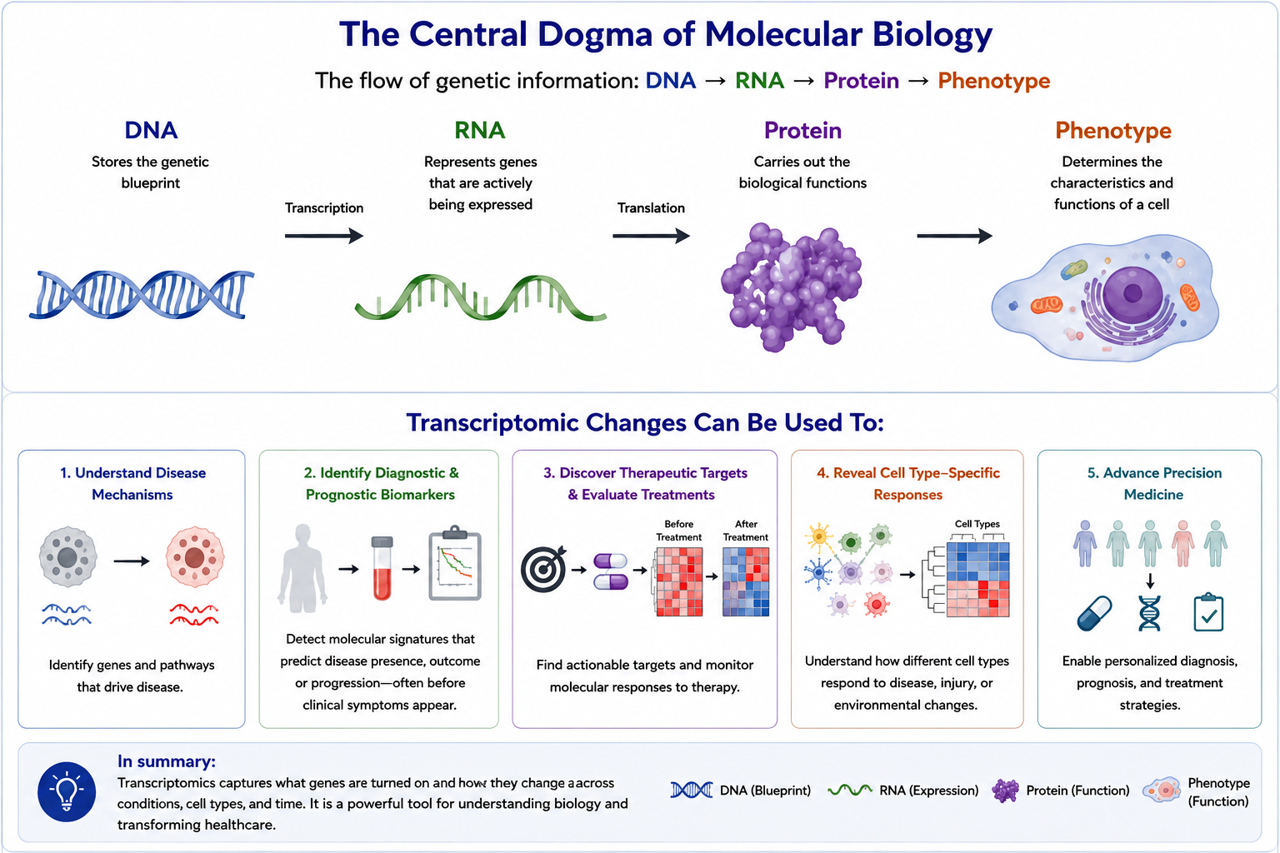
Notes:
The Central Dogma and Why Transcriptomics Matters
The flow of genetic information follows the central dogma of molecular biology: DNA → RNA → Protein. DNA stores the genetic blueprint of the cell, RNA represents the genes that are actively being expressed, and proteins carry out the biological functions that ultimately determine a cell’s phenotype.
Although nearly all cells in the body contain the same DNA, they have very different structures and functions. For example, neurons, astrocytes, oligodendrocytes, and microglia all share the same genome, yet they perform remarkably different roles. The key difference is gene expression: each cell type activates a distinct set of genes, producing a unique transcriptome that defines its identity and function.
Unlike DNA, which is relatively stable, the transcriptome is highly dynamic. RNA levels change rapidly in response to development, environmental stimuli, disease, and therapeutic interventions. These changes are translated into proteins, which execute cellular functions and ultimately shape the phenotype of the cell.
This is why transcriptomics is so important. Transcriptomic changes can therefore be used to:
Understand the molecular mechanisms underlying disease.
Identify diagnostic and prognostic biomarkers, often before clinical symptoms appear.
Discover therapeutic targets and evaluate treatment responses.
Reveal how different cell types respond to disease or injury.
Modern transcriptomic technologies provide complementary views of gene expression. Depending on the biological question, they can answer different levels of information:
Which genes are changing?
Which genes are changing in which cell types?
Which genes are changing, in which cells, and where are those cells located within the tissue?
Choosing the appropriate transcriptomic technology therefore depends on the biological question being asked. Throughout this workshop, we will explore how each technology provides unique insights into the transcriptome and how they complement one another to better understand health and disease.

Slide 7
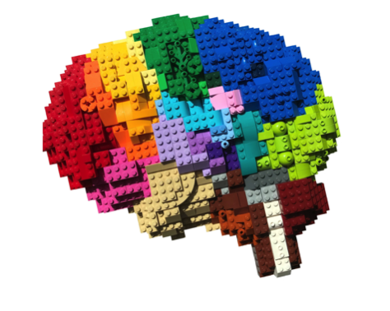
Bulk RNA-seq
Single-cell RNA-seq
Spatial Transcriptomics
Organ

Slide 8
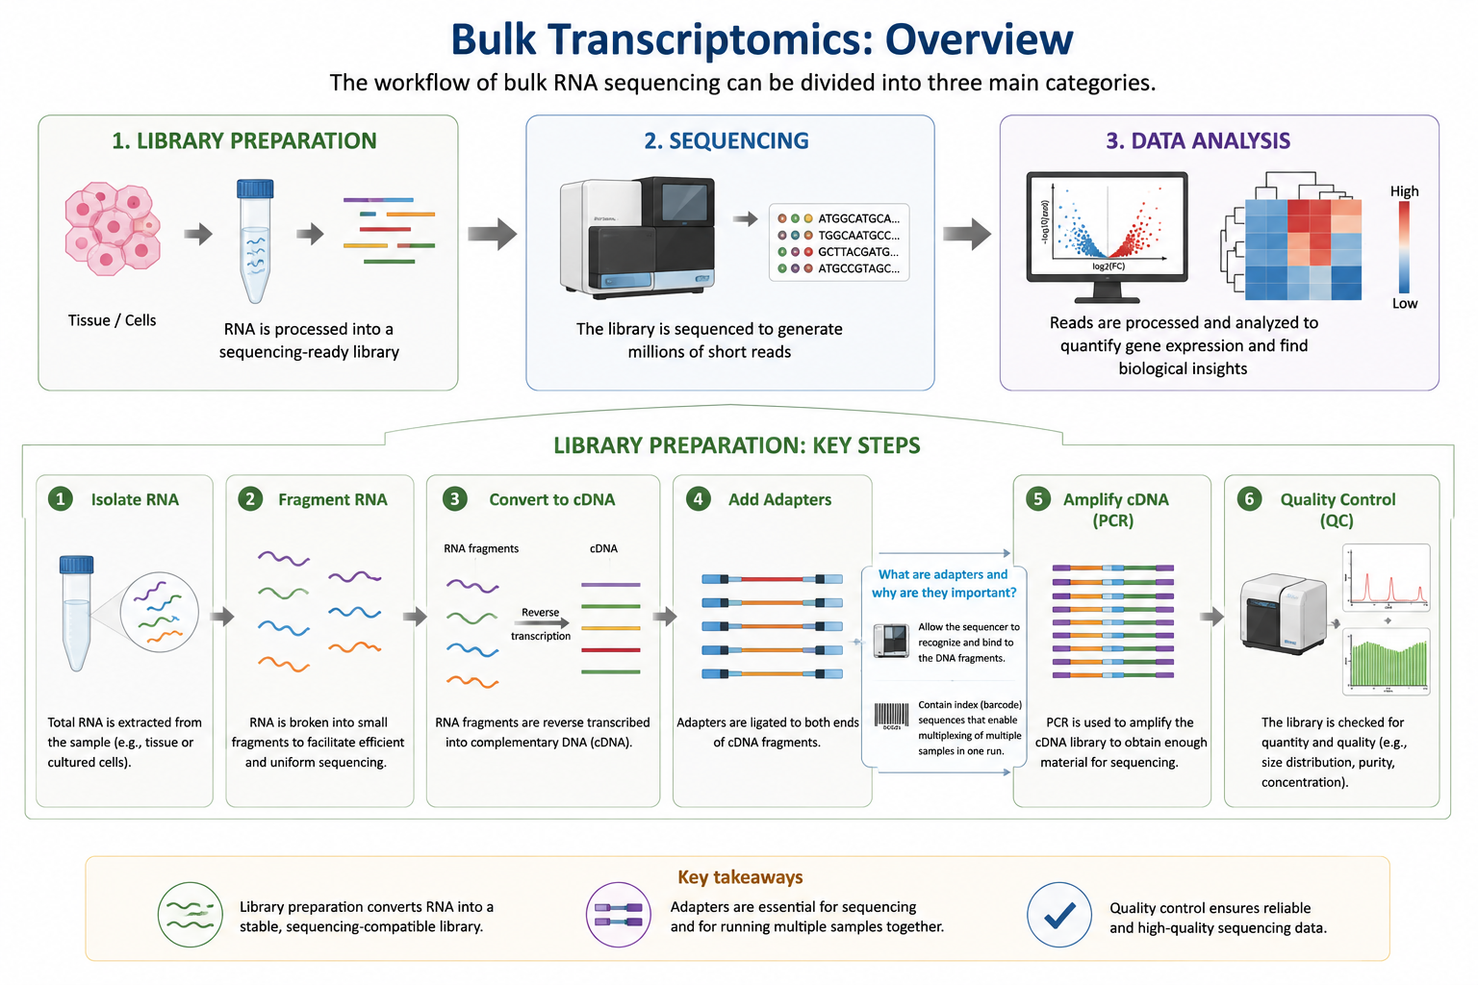

Slide 9
Can answer:
Which genes are differentially expressed?
Which pathways are altered?
Biomarker discovery.
Drug-response studies.
e.g.,:
Are TREM2 and GFAP upregulated in AD?
Is the immune response activated in AD?
Which blood RNAs predict Alzheimer’s?
Does treatment restore gene expression?
CanNot answer:
Which cell type changed?
Rare cell populations.
Cell-cell communication.
Spatial organization.
e.g.,:
Which cells express TREM2?
Are disease-associated microglia present?
Are microglia communicating with astrocytes?
Are microglia surrounding amyloid plaques?
Advantages
• Inexpensive, statistically powerful, many public datasets.
Limitations
• Cell averaging, no spatial context.

Slide 10
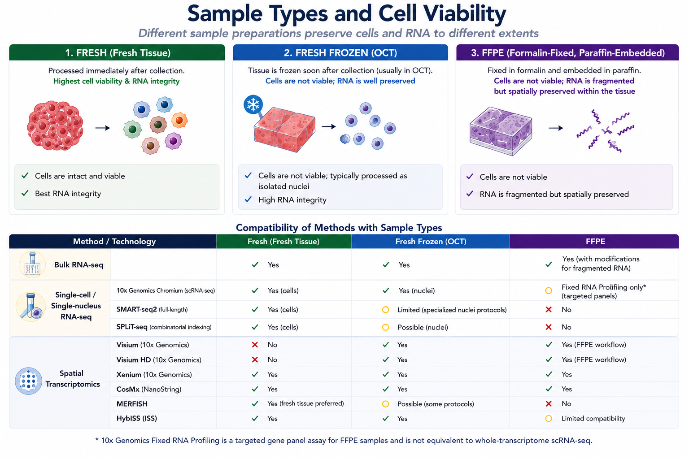

Slide 11

Requires modification for fragmented RNA

Slide 12
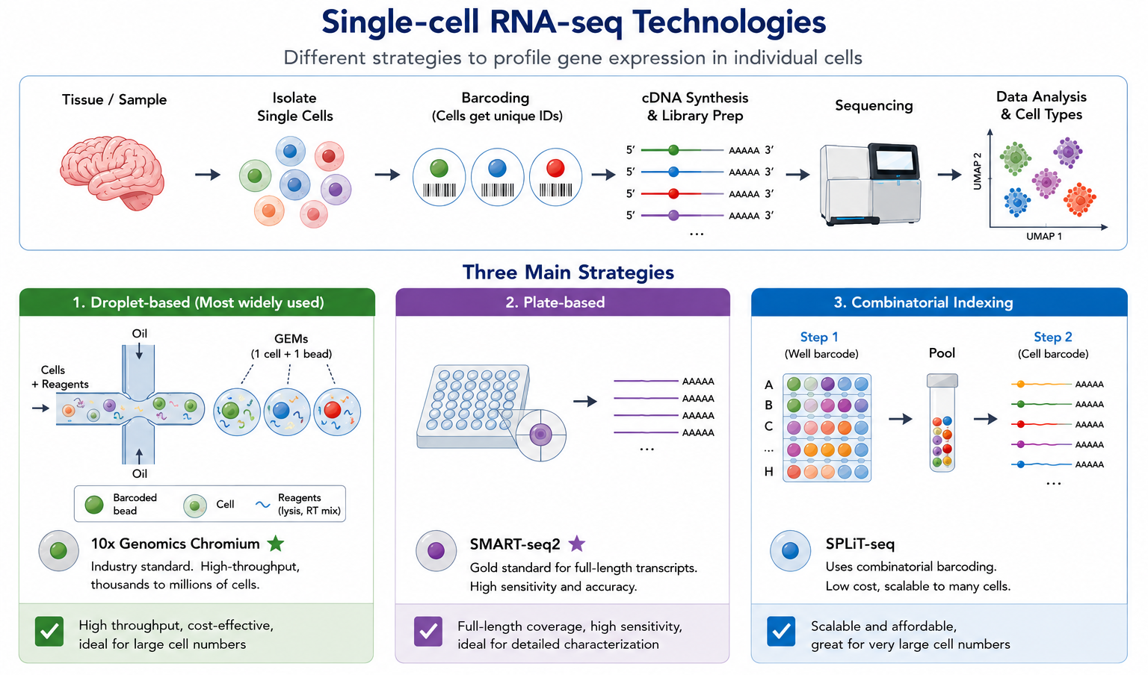
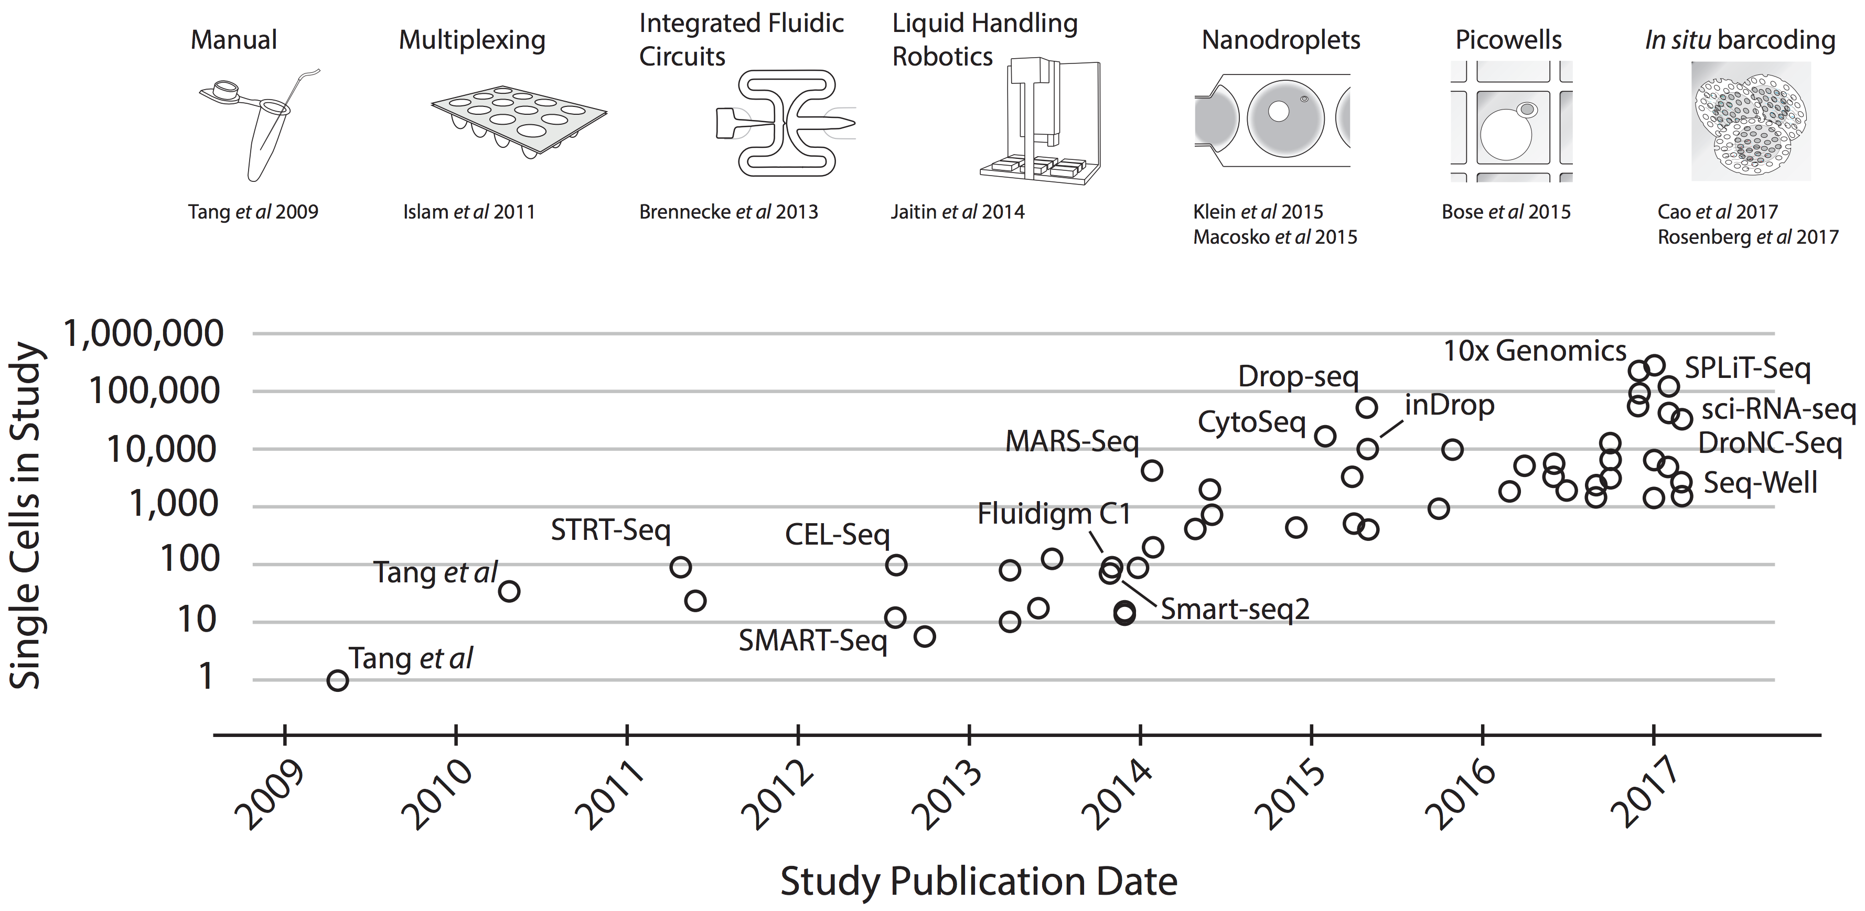

Slide 13
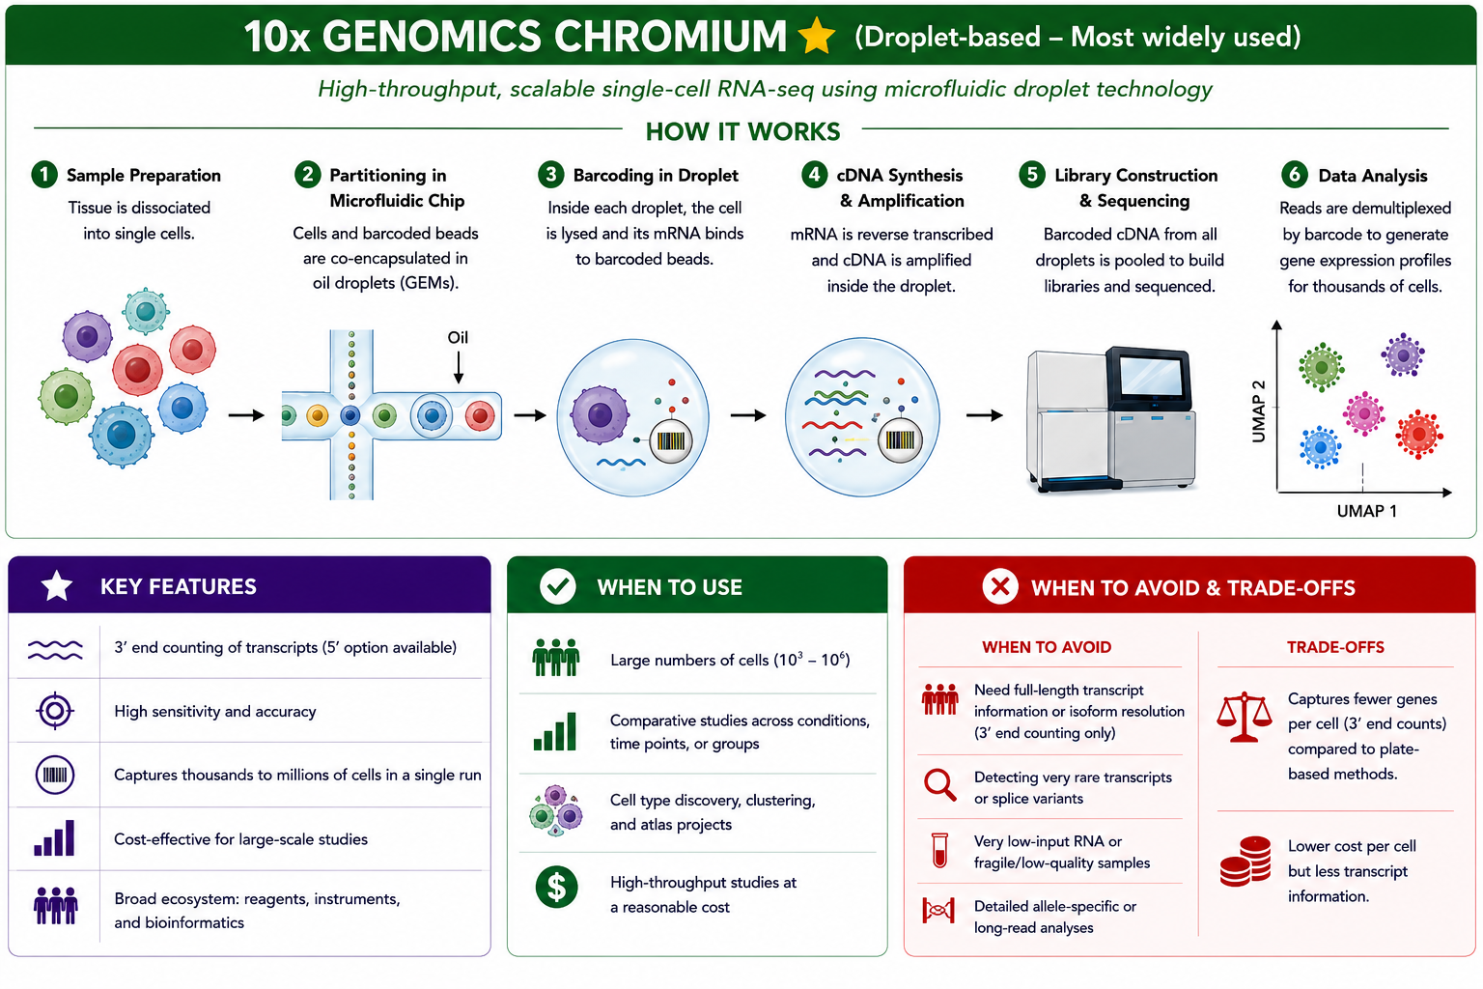

Slide 14
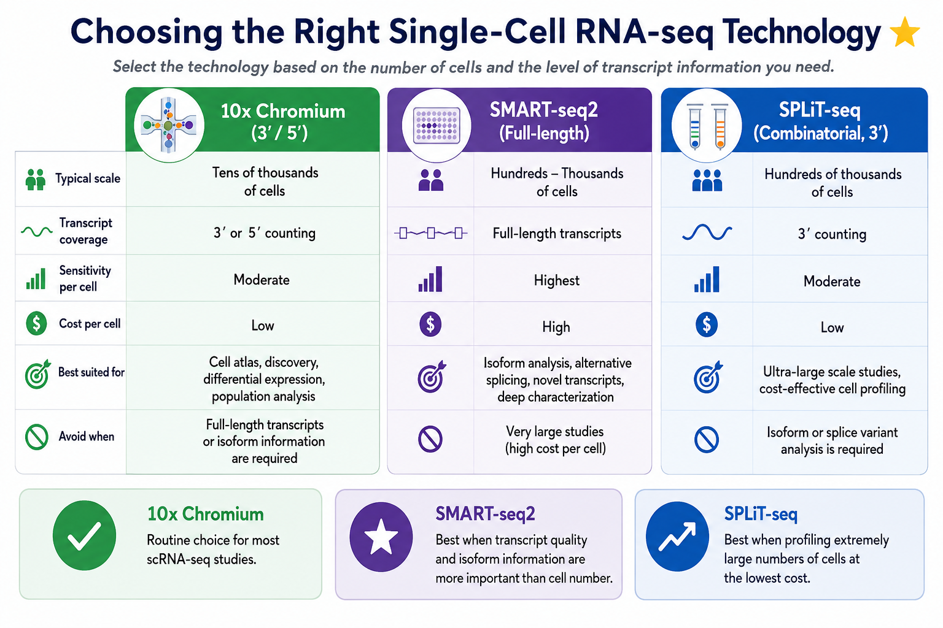

Slide 15

Requires modification for fragmented RNA
(Nuclei)
(Targeted panel)
Possible
Possible

Slide 16
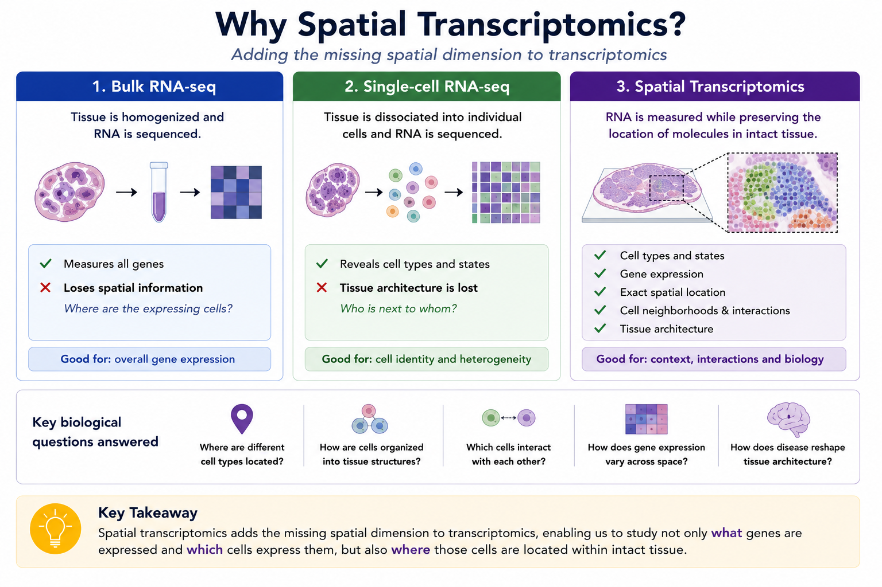
Notes:
Single-cell RNA-seq generally requires fresh, viable cells (or nuclei from frozen tissue), whereas many spatial transcriptomics technologies are compatible with preserved tissue, including FFPE.

Slide 17
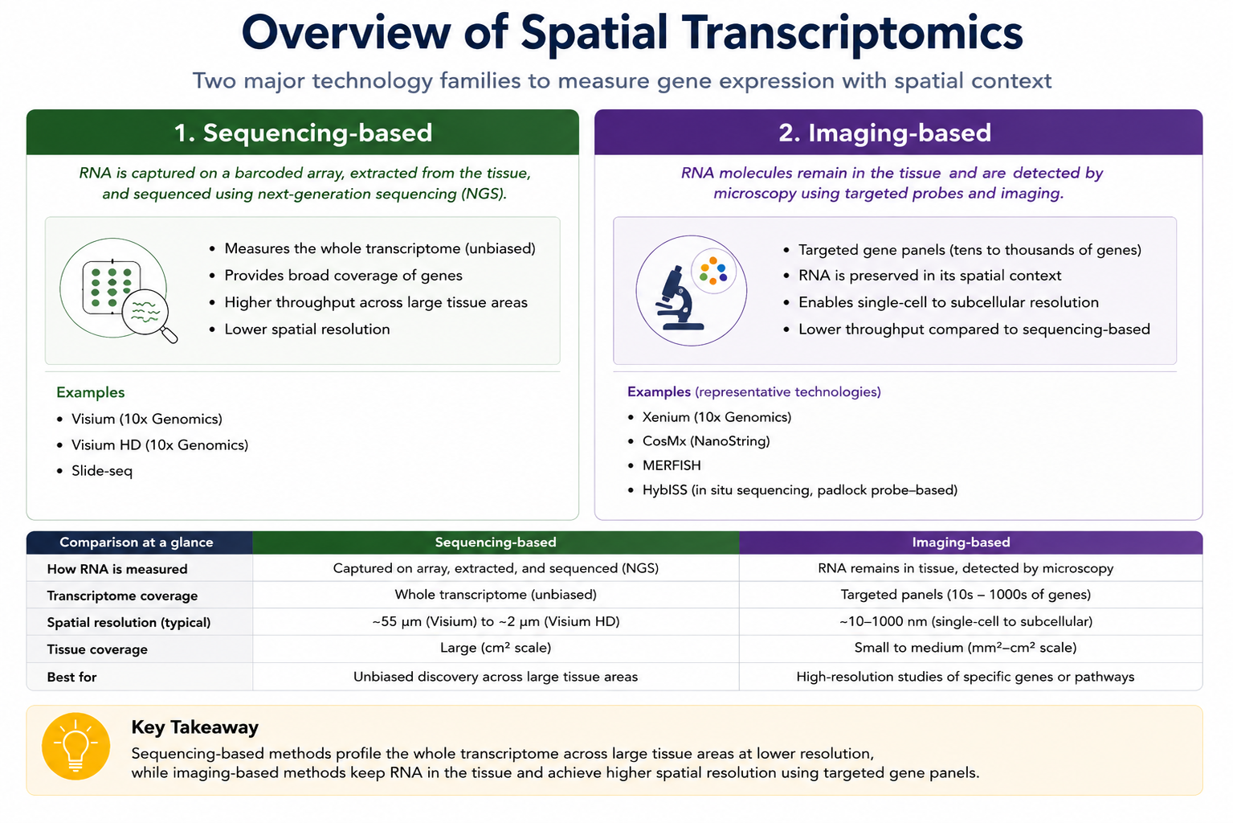

Slide 18
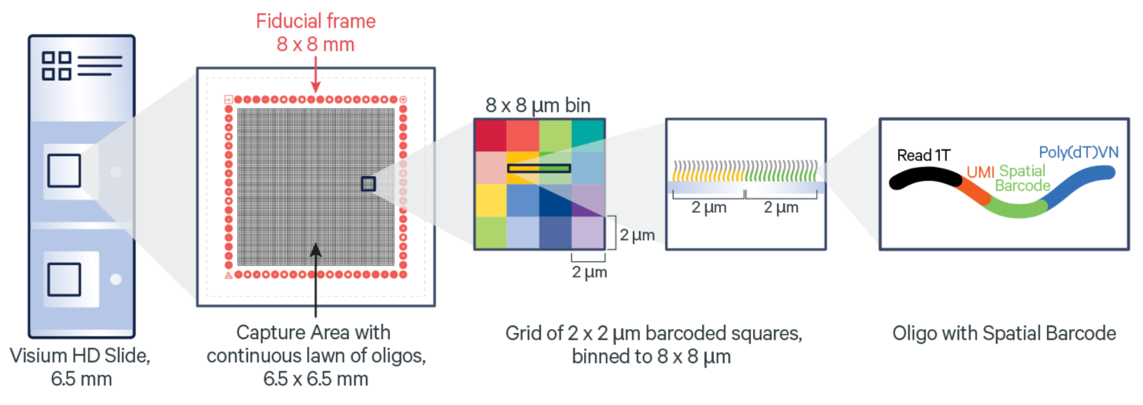
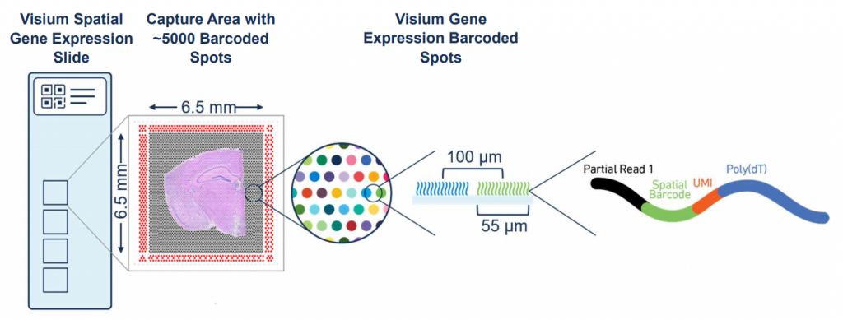

Slide 19
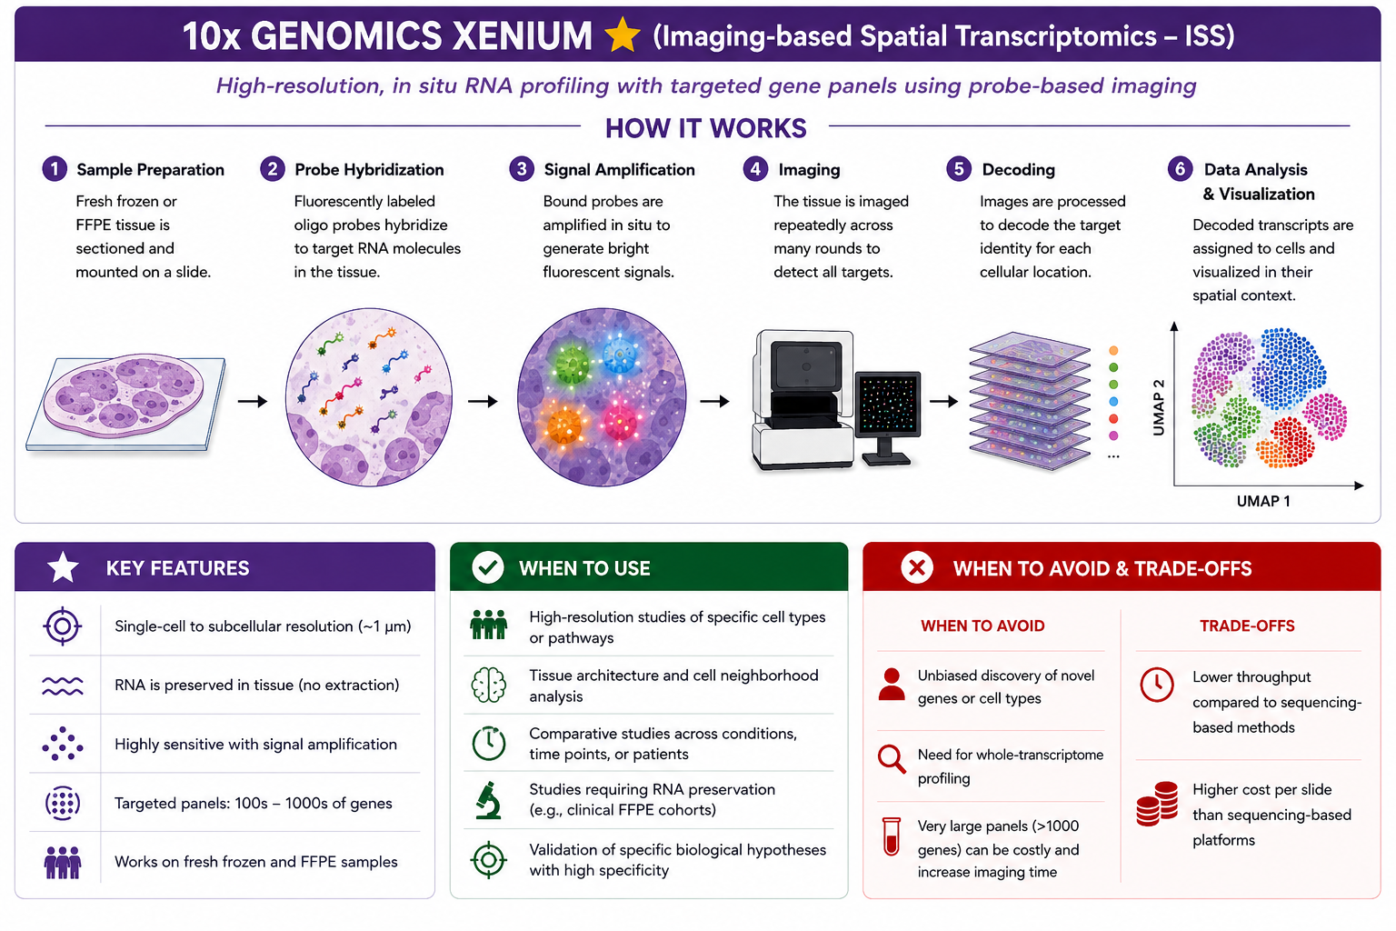
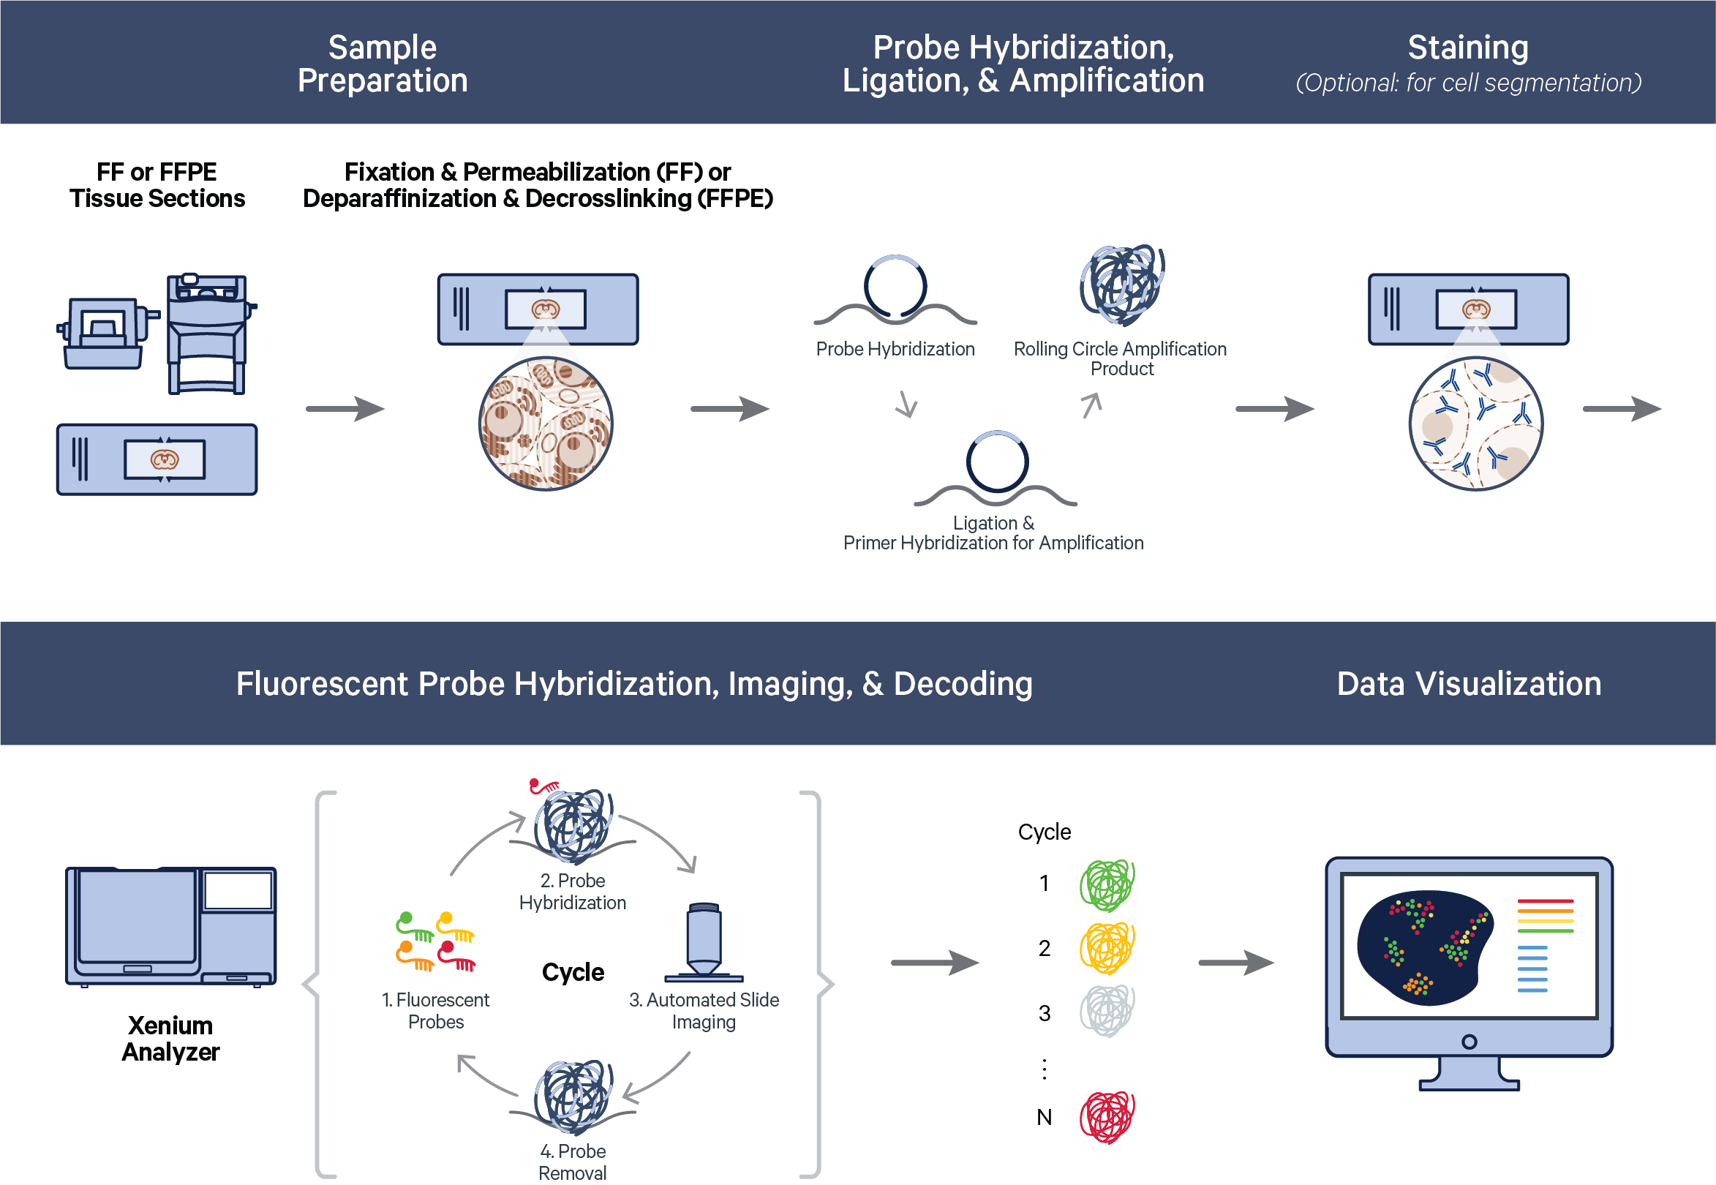

Slide 20
Requires modification for fragmented RNA
(Nuclei)
(Targeted panel)
Possible
Possible
Possible
Limited

Slide 21
Questions?

Slide 23
Notes:
Library preparation converts RNA into a stable, sequencing-ready cDNA library. Total RNA is first isolated from the sample, fragmented into short pieces (because sequencing machine can sequence fragments up to 200-300 bp and a gene can be larger than this size), reverse-transcribed into complementary DNA (cDNA), and ligated with adapter sequences. These adapters allow the sequencing instrument to recognize each fragment and contain sample-specific barcodes, enabling multiple samples to be pooled and sequenced in a single run (multiplexing).
The cDNA library is then amplified by PCR to generate sufficient material for sequencing, followed by quality control (QC) to assess library concentration, fragment size, purity, and adapter contamination. Only high-quality libraries are submitted for sequencing, ensuring accurate and reliable gene expression measurements.

Slide 24
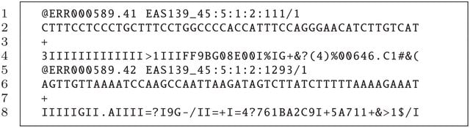
Fastq file !!!!!!
Fragment identifier
Fragment
Quality of Fragment

Slide 25
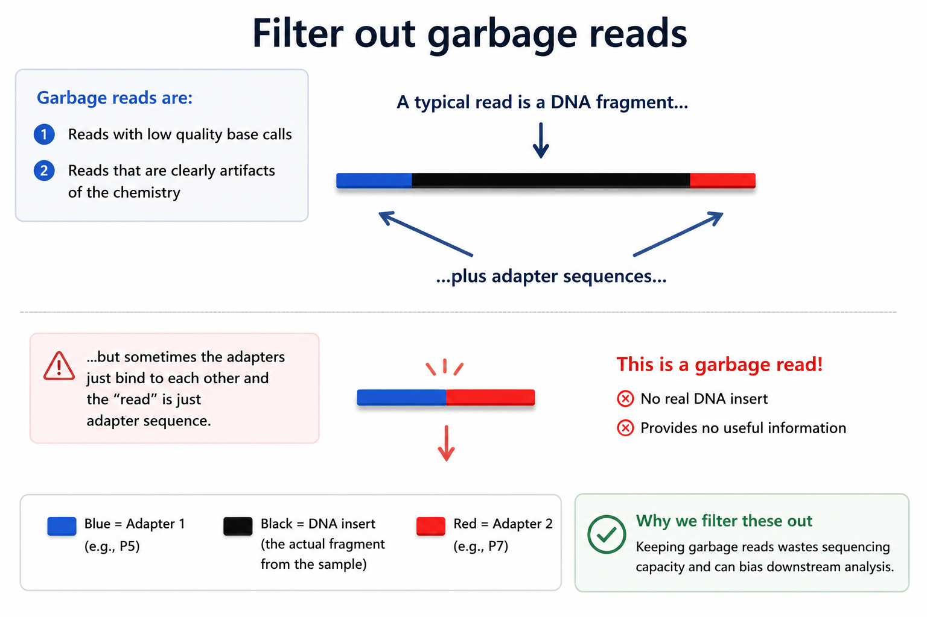

Slide 26
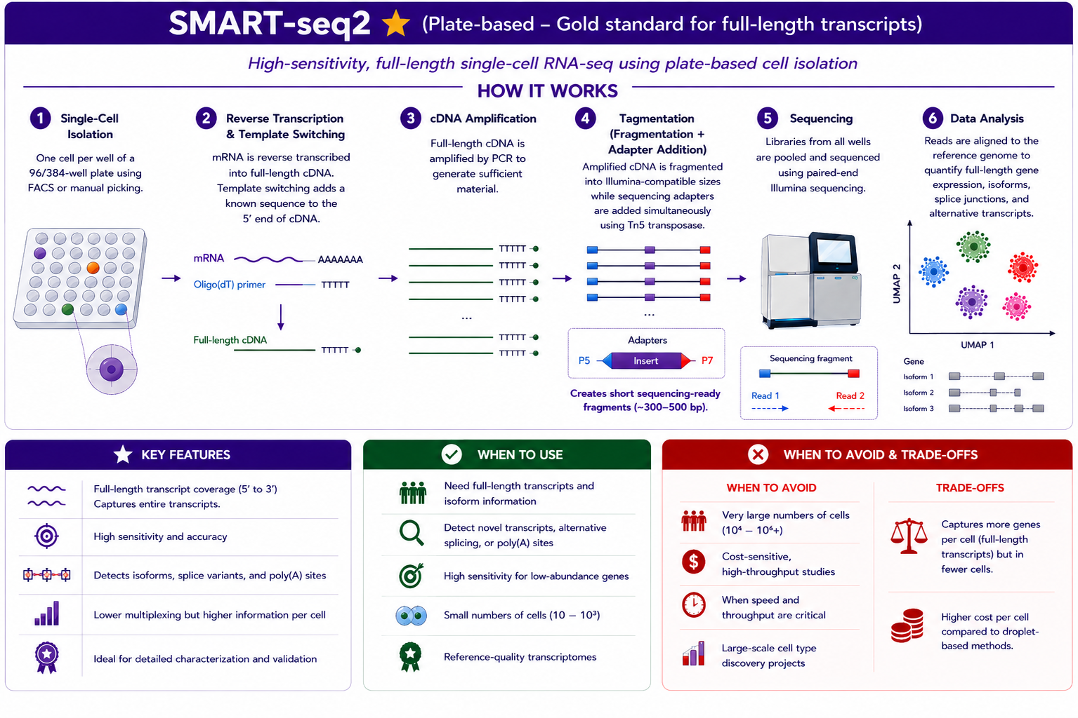

Slide 27
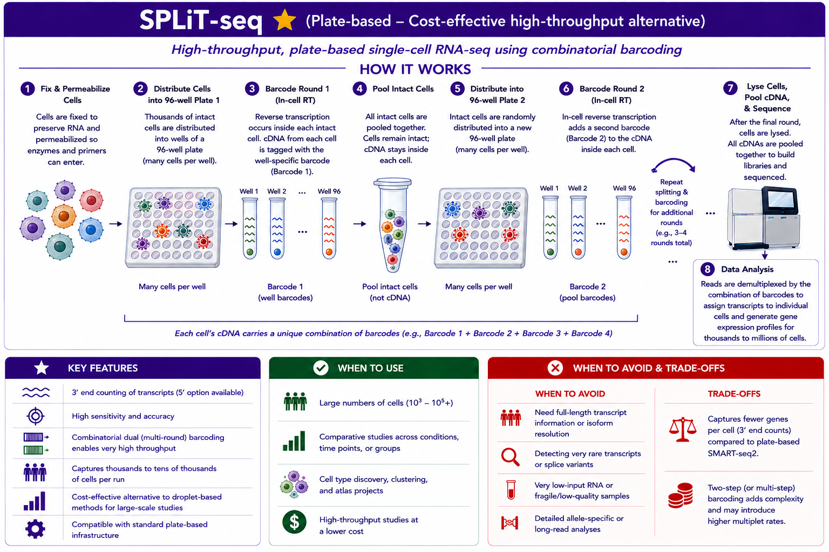

Slide 28
