Slide 1
Bioinformatics Workshop
Elyas Mohammadi
October 2026

Slide 2






Note
The content of this workshop is extracted from the following sources and some of the illustrations are generated by AI:

Slide 3
Part 2 – Using Public Transcriptomics Data

Slide 4
Learning objectives
By the end of this section, you should be able to answer:
  Where can I find public transcriptomics datasets?
  Identify appropriate resources for your research needs.
  What are the most common file formats used in transcriptomics?
  How can I efficiently reuse published datasets for my own analyses?

Slide 5
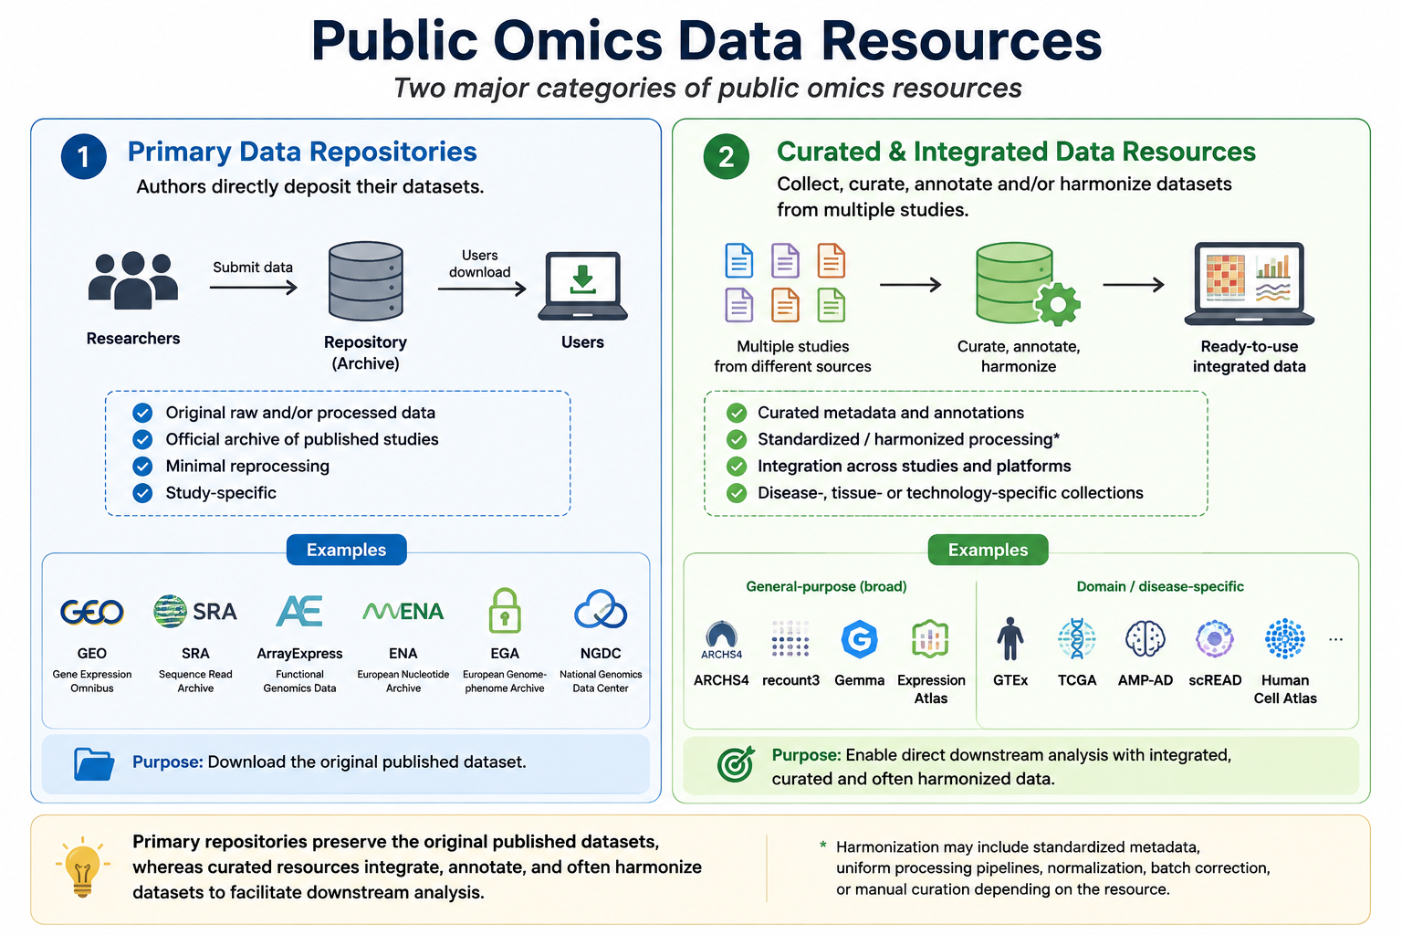

Slide 6
Primary data repositories
Repository | Organization | Data Types | Access
GEO (Gene Expression Omnibus) | NCBI (USA) | Bulk RNA-seq, scRNA-seq, Spatial, ATAC-seq, ChIP-seq, Methylation, Proteomics | 🟢 Open
SRA (Sequence Read Archive) | NCBI (USA) | Raw sequencing data (FASTQ/BAM) from all sequencing technologies | 🟢 Open
ArrayExpress | EMBL-EBI (Europe) | Transcriptomics, Epigenomics, Multi-omics | 🟢 Open
ENA (European Nucleotide Archive) | EMBL-EBI (Europe) | Raw sequencing data from all sequencing technologies | 🟢 Open
EGA (European Genome-phenome Archive) | EMBL-EBI (Europe) | Human genomic & transcriptomic datasets | 🔒 Controlled
NGDC (National Genomics Data Center) | China National Center for Bioinformation | Genomics, Transcriptomics, Single-cell, Spatial, Multi-omics | 🟢 Open / 🔒 Human

Slide 7
GEO and EGA as an example

Slide 8

Research Question
Search the Literature
(PubMed / Google Scholar)
Identify Relevant Paper(s)
Data Availability Statement
Extract Accession Number
(GEO, ENA, EGA, ...)
Searching primary repositories for data

Slide 9
What types of data format? When should I use which?
FASTQ
(raw)
BAM/SAM
(aligned raw)
Gene counts
Processed data

Slide 10
When do you need raw data?
If it is bulk transcriptomics.
You want to use a different reference genome for alignment:
  you want to detect novel transcripts or isoforms
You want to perform variant calling or fusion detection
You want to reprocess data with a different pipeline
.
.

Slide 11
Processed
Count matrices
CSV, TSV, TXT, MTX, HDF5
Metadata & annotations
CSV, TSV, XLSX
Images and cell coordinates
TIFF, PNG, JPEG, CSV, Parquet, Zarr
Ready to use R objects
RDS, H5AD, LOOM

Slide 12
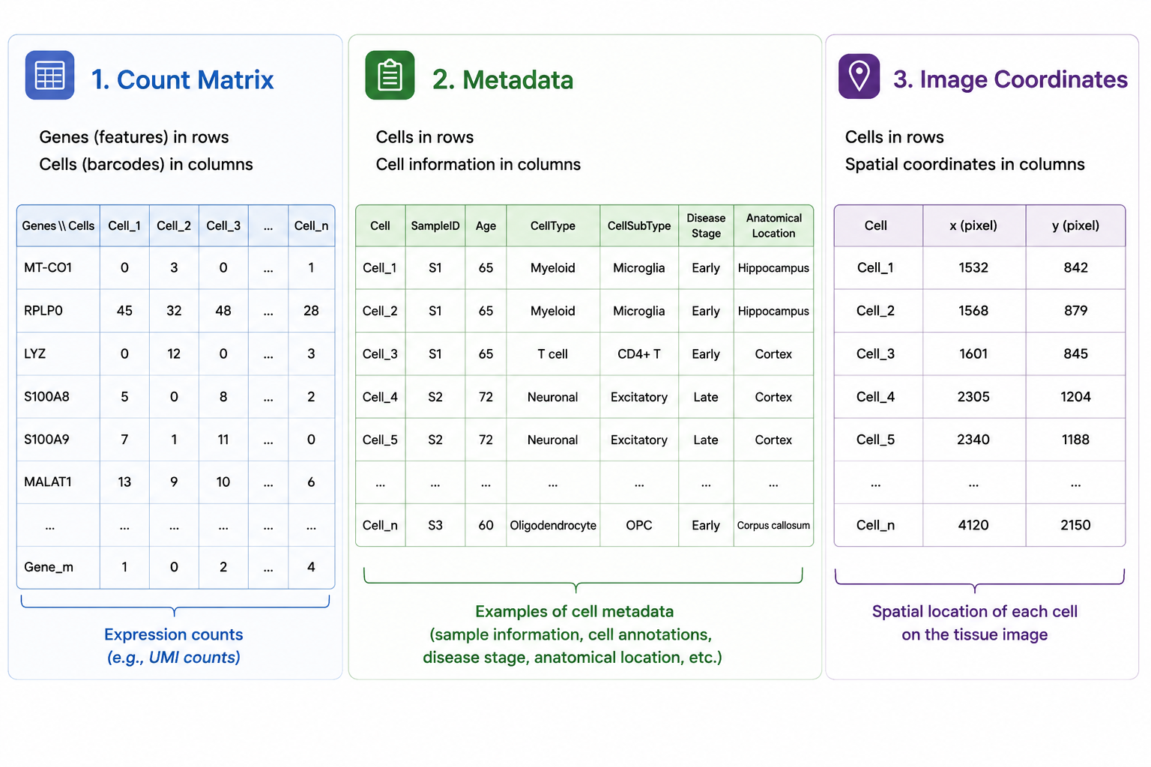

Slide 13
Questions?

Slide 15
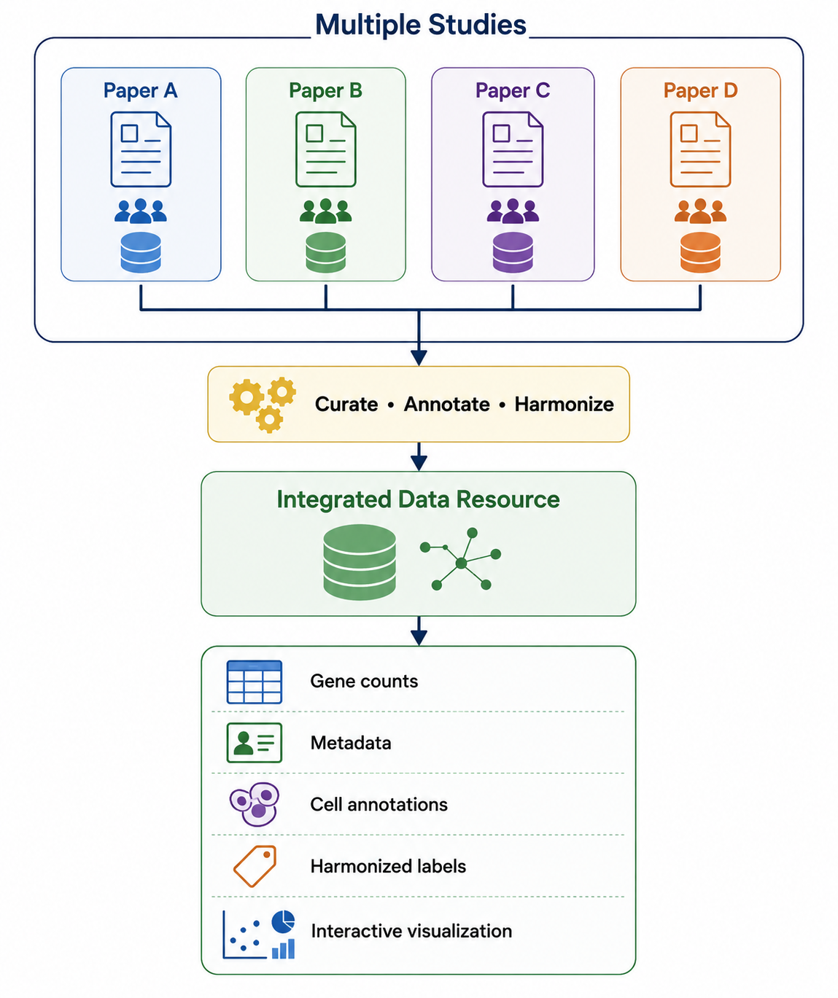

Slide 16
Resource | Main Data | How the Data are Provided
ARCHS4 | Bulk RNA-seq, scRNA-seq | Uniformly processed gene count matrices, metadata, gene search, co-expression
recount3 | Bulk RNA-seq | Uniformly processed gene, exon and junction counts (R/Bioconductor)
Expression Atlas | Bulk RNA-seq, Microarray, selected scRNA-seq | Curated baseline and differential gene expression
Gemma | Bulk RNA-seq, Microarray | Curated expression matrices with standardized metadata
Human Cell Atlas (HCA) | scRNA-seq, Spatial | Harmonized cell annotations and downloadable processed datasets
CELLxGENE Discover | scRNA-seq, Spatial | Interactive visualization and downloadable AnnData (H5AD) files

Slide 17
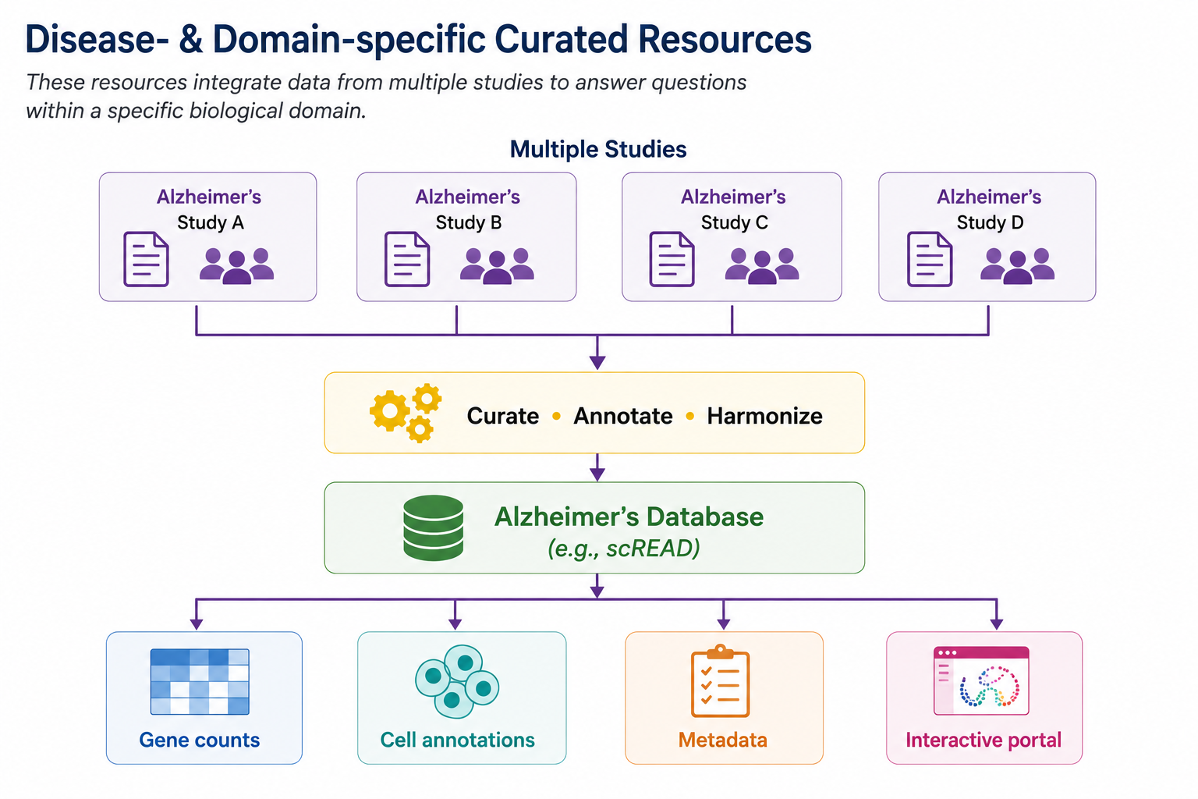

Slide 18
Resource | Field of Interest | Data Types
TCGA (The Cancer Genome Atlas) | Cancer | Bulk RNA-seq, DNA-seq, Methylation, Proteomics, Clinical
GTEx (Genotype-Tissue Expression) | Healthy human tissues | Bulk RNA-seq, Genotype, eQTL
AMP-AD Knowledge Portal | Alzheimer’s disease | Bulk RNA-seq, scRNA-seq, Proteomics, Multi-omics
ssREAD | Alzheimer’s disease | scRNA-seq, Spatial transcriptomics
PsychENCODE | Brain & psychiatric disorders | Bulk RNA-seq, scRNA-seq, Epigenomics, Genomics
ImmPort | Immunology | Bulk RNA-seq, scRNA-seq, Flow cytometry, Clinical
TARGET | Pediatric cancer | Bulk RNA-seq, DNA-seq, Clinical

Slide 19
Questions?

