Slide 1
Bioinformatics Workshop
Elyas Mohammadi
October 2026

Slide 2


Part 3 – How to Read and Understand Bioinformatics Code

Slide 3
How the data looks like in data repositories
barcodes.tsv
Cell 1 | Cell 2 | Cell 3 | Cell 4 | .
features.tsv
matrix.mtx
Gene
CD3D
CD79A
LST1
GAPDH
.
8 | 6 | 0 | 0 | .
0 | 0 | 12 | 9 | .
0 | 1 | 0 | 0 | .
15 | 11 | 18 | 14 | .
. | . | . | . | .

Slide 4
Read10X() function
Gene | Cell 1 | Cell 2 | Cell 3 | Cell 4 | .
CD3D | 8 | 6 | 0 | 0 | .
CD79A | 0 | 0 | 12 | 9 | .
LST1 | 0 | 1 | 0 | 0 | .
GAPDH | 15 | 11 | 18 | 14 | .
. | . | . | . | . | .
Rows = genes
Columns = cells
Values = expression counts (usually UMI counts)

Slide 5
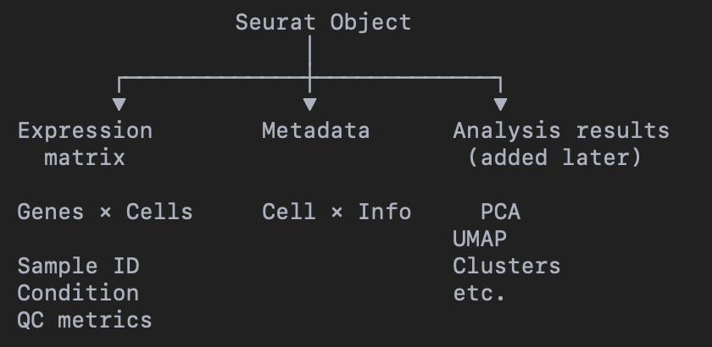
CreateSeuratObject() function
Gene | Cell 1 | Cell 2 | Cell 3 | Cell 4 | .
CD3D | 8 | 6 | 0 | 0 | .
CD79A | 0 | 0 | 12 | 9 | .
LST1 | 0 | 1 | 0 | 0 | .
GAPDH | 15 | 11 | 18 | 14 | .
. | . | . | . | . | .

Slide 6
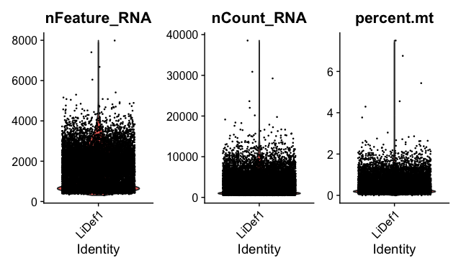
PercentageFeatureSet() function
Which Cells Should We Trust?
e.g.,
  Doublets (high features)
  Low quality cells (low features)
  Lysed cells (mt genes)

Slide 7
Normalization
Raw counts are affected by technical factors that do not necessarily represent biological expression.
1. Sequencing depth / library size
2. Gene length

Slide 8
NormalizeData() function
1. Sequencing depth / library size
 | Cell A | Cell B
Gene x | 50 | 200
Gene y | 100 | 400
Gene z | 25 | 100
. | . | .
Total count | 5000 | 20000
Cell A: 50 / 5,000 = 1%
Cell B: 200 / 20,000 = 1%

Slide 9
2. Gene length
Gene A Gene B
|------ 1 kb ------| |---------------- 4 kb ----------------|
↓ ↓ ↓ ↓ ↓
fewer reads more reads

Slide 10
2. Gene length
 | Cell A | Cell A | . | Gene length
Gene x | 50 | 200 | . | 20
Gene y | 100 | 400 | . | 100
Gene z | 25 | 100 | . | 150
. | . | . | . | .
Total count | 5000 | 20000
Gene length correction is crucial for bulk transcriptomics and might help SmartSeq2 data analysis

Slide 11
Question:
We have ~20,000 genes. Do we really need all of them to distinguish cell populations?
NO!!!!!!!

Slide 12
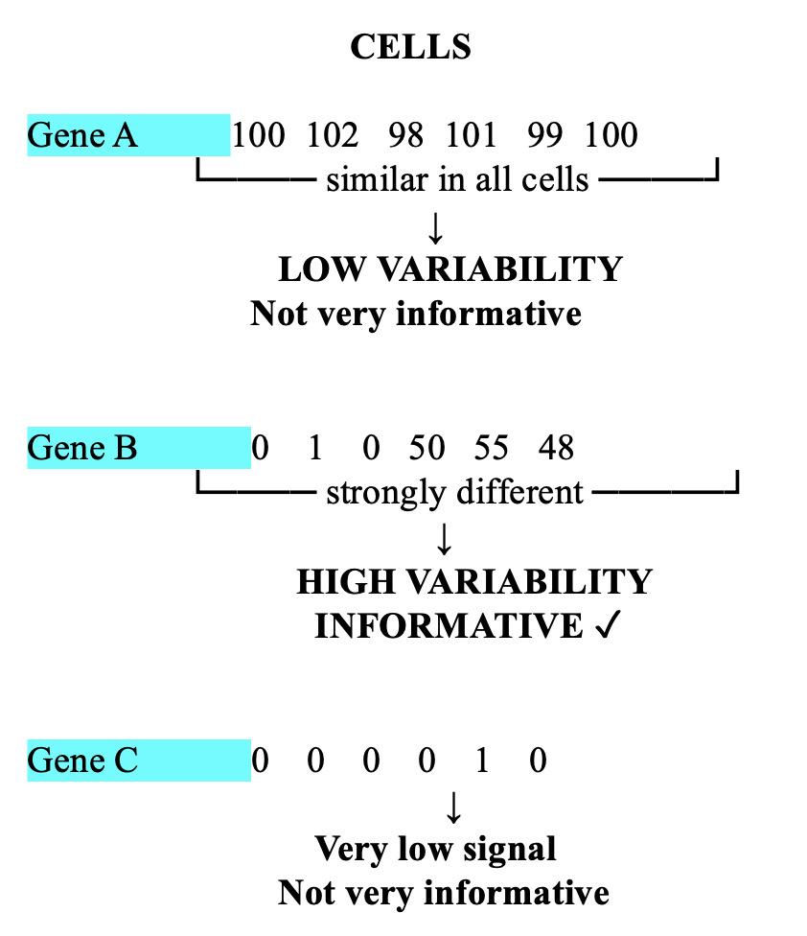
FindVariableFeatures() function
Feature selection identifies genes whose expression varies substantially across cells and therefore may help distinguish different cellular states or cell types
Note:
We are not deleting the other genes from the dataset.

Slide 13
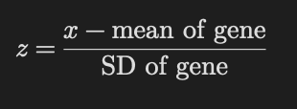
ScaleData() function
Normalization make the cells comparable
Scaling makes the genes comparable

Slide 14
Without scaling, genes with large numerical variation can have a stronger influence on PCA.
Cell | Gene A | Gene B
Cell 1 | 100 | 2
Cell 2 | 200 | 4
Cell 3 | 300 | 6
Mean | 200 | 4
Centering the data
Cell | Gene A | Gene B
Cell 1 | −100 | −2
Cell 2 | 0 | 0
Cell 3 | 100 | 2
Cell | Gene A | Gene B
Cell 1 | −1 | −1
Cell 2 | 0 | 0
Cell 3 | 1 | 1
Scaling the data

Slide 15
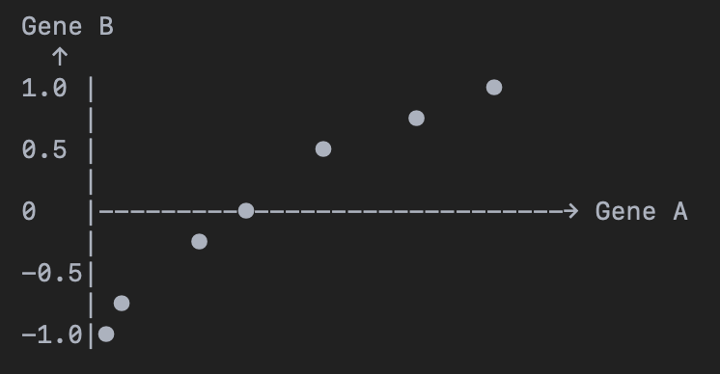
Dimensionality reduction
Cell | Gene A | Gene B
Cell 1 | -1.2 | -1.0
Cell 2 | -0.8 | -0.7
Cell 3 | -0.3 | -0.2
Cell 4 | 0.4 | 0.3
Cell 5 | 0.8 | 0.7
Cell 6 | 1.1 | 1.0
Selected features are normally between 2k to 3k

Slide 16
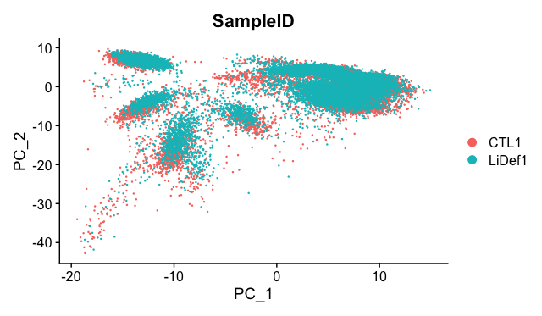
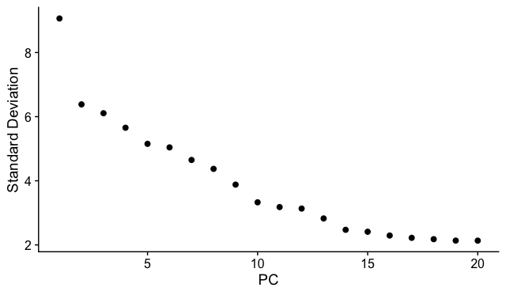
RunPCA() function
PCA plot alone cannot show all the variation

Slide 17
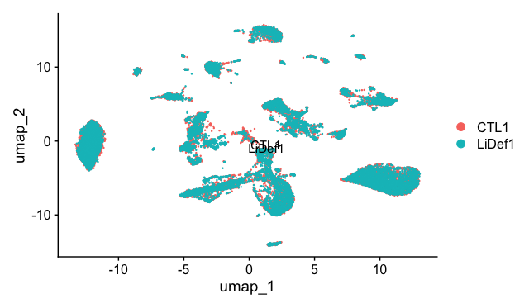
RunUMAP() function

Slide 18
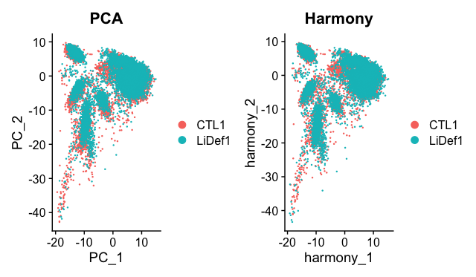
RunHarmony() function
Batch effect correction

Slide 19
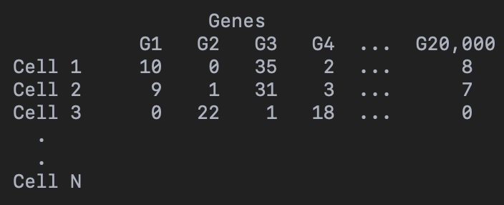
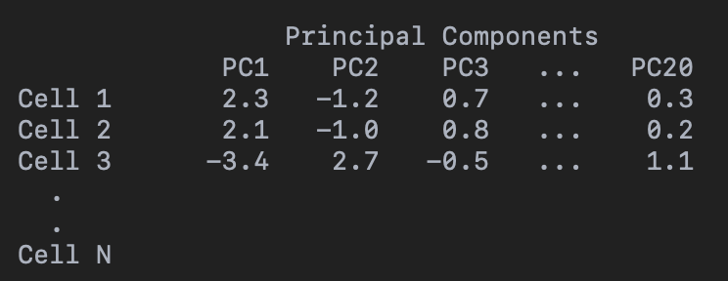
How we can group the cells (clustering)

Slide 20
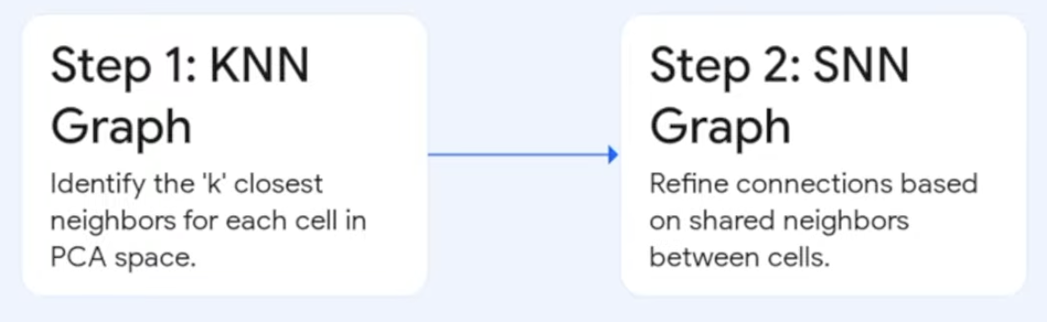
FindNeighbors() function

Slide 21
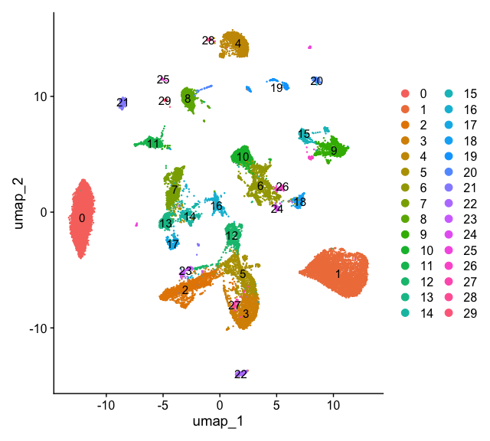
FindClusters() function
Using the information in similarity step we can group the cells together with different resolutions

Slide 22
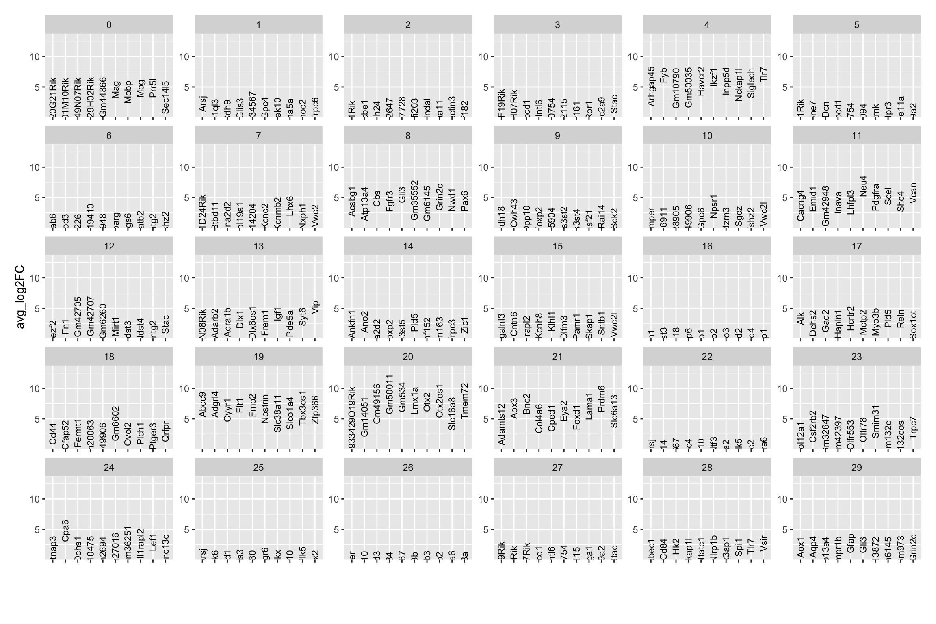
Top cluster signatures

Slide 23
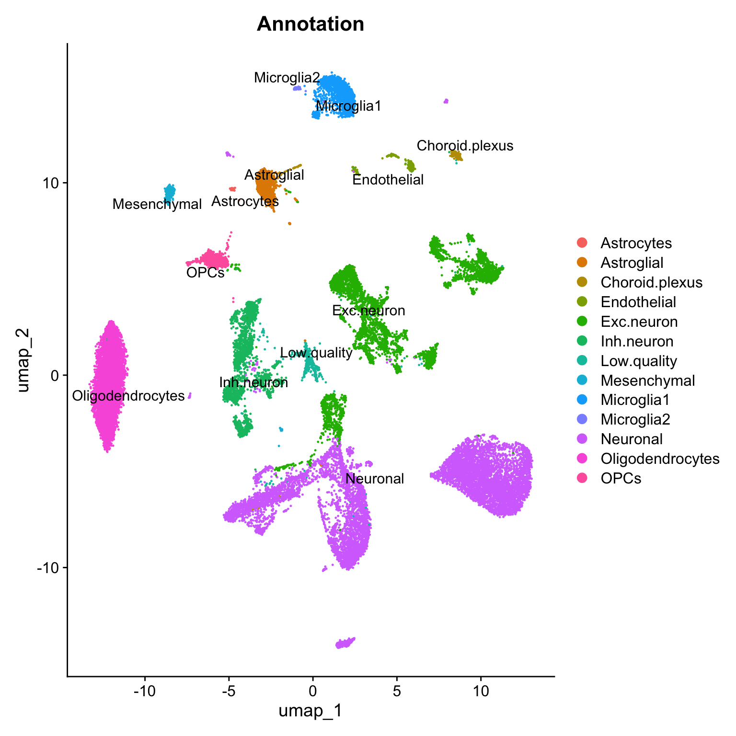
Annotation and
Downstream analysis
.
.
.

Slide 25
CELLS
Gene A 100 102 98 101 99 100
└──── similar in all cells ────┘
↓
LOW VARIABILITY
Not very informative
Gene B 0 1 0 50 55 48
└──── strongly different ─────┘
↓
HIGH VARIABILITY
INFORMATIVE ✓
Gene C 0 0 0 0 1 0
↓
Very low signal
Not very informative

