Slide 1
P
PriceLens
Price Comparison Platform
Amazon · AliExpress · eBay
Web Services Demo

Slide 2
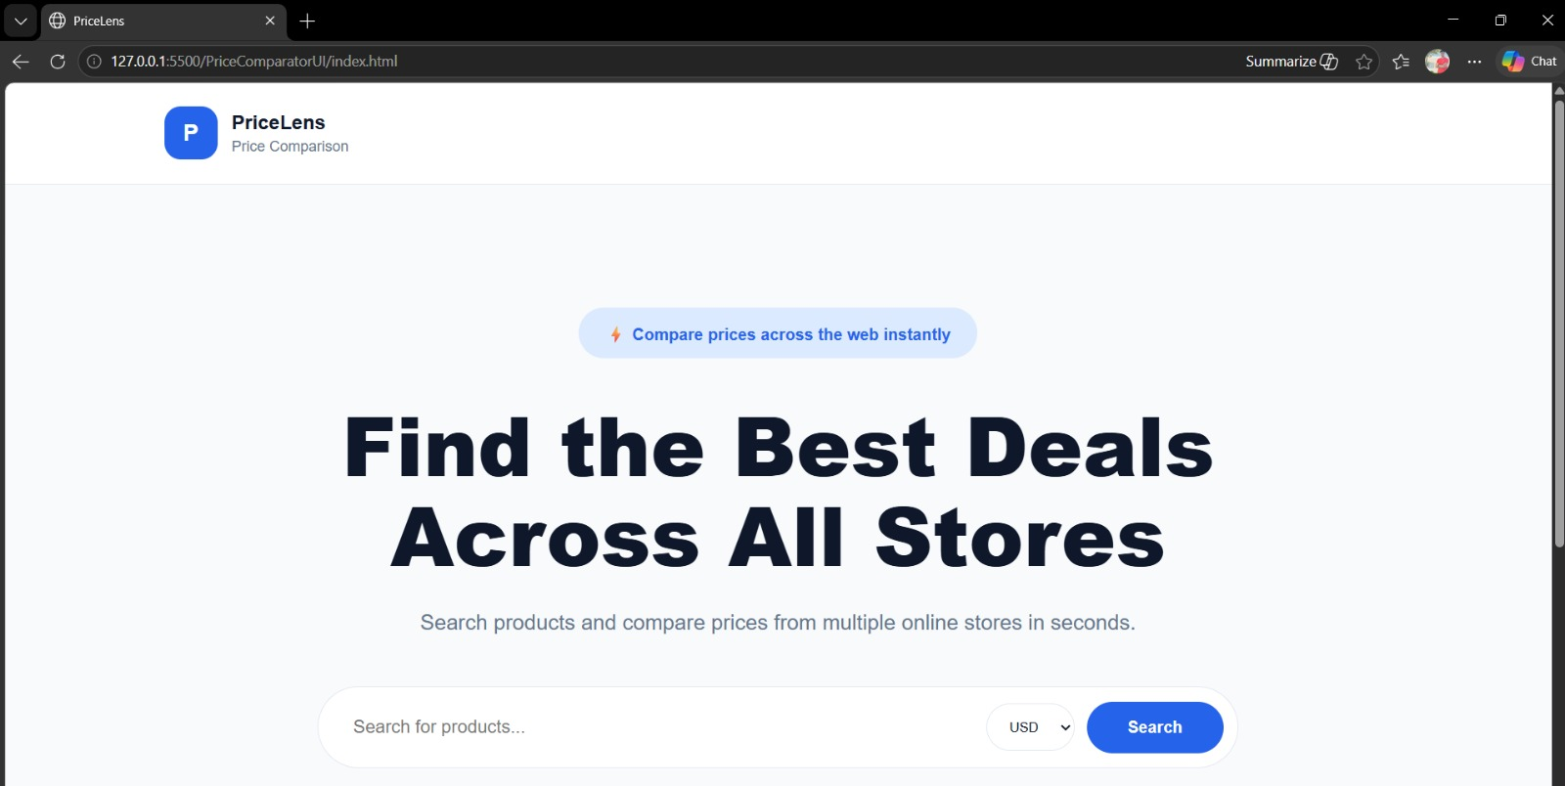
01 / Homepage
PriceLens
Homepage
Clean interface for entering a product name and selecting currency

Slide 3
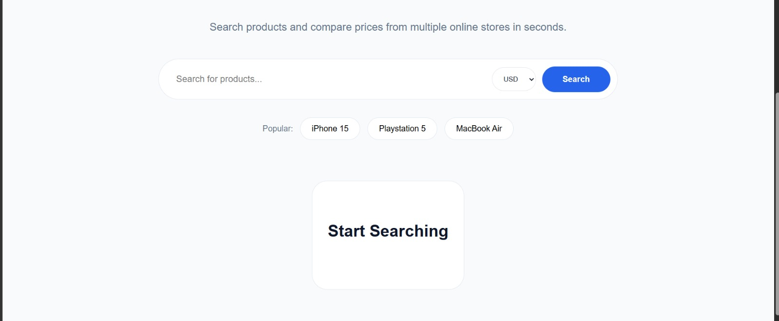
02 / Start Searching
PriceLens
Before Search
Start Searching message appears when the site first loads

Slide 4
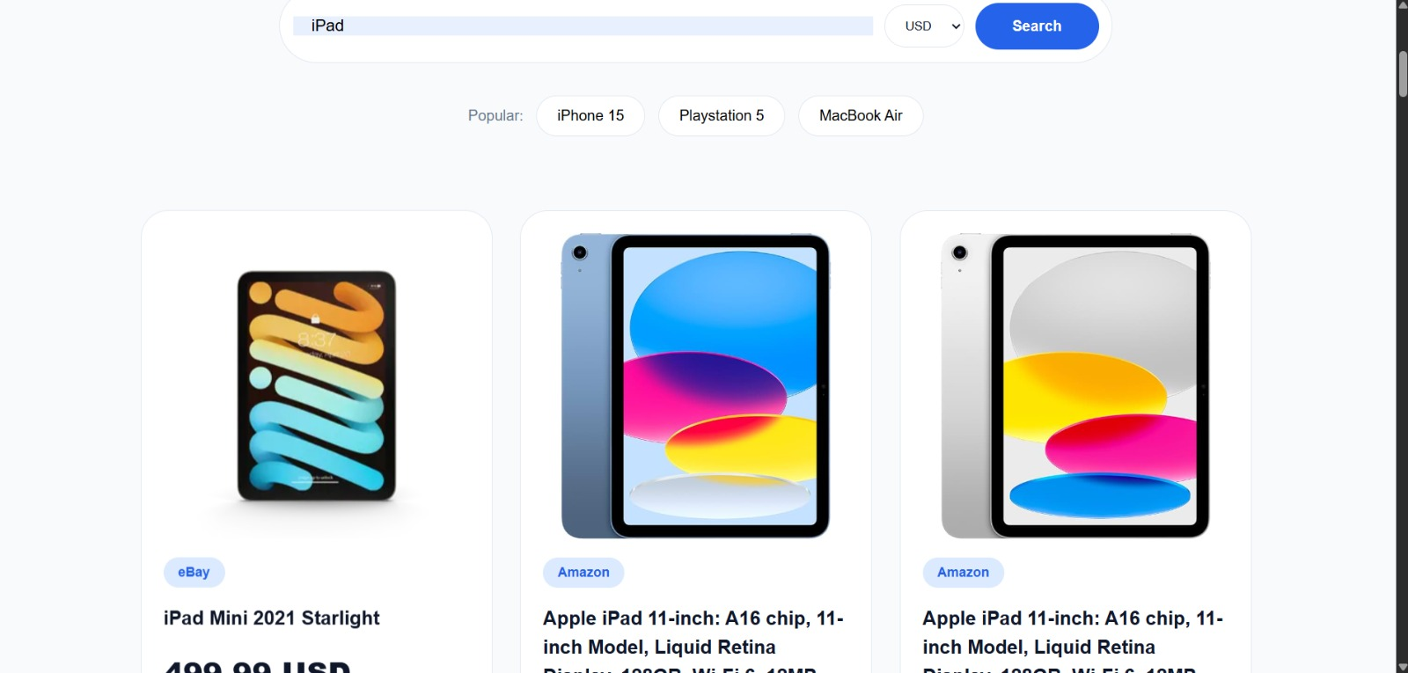
03 / Search Results
PriceLens
Search Results
Products appear from Amazon, AliExpress, and eBay simultaneously

Slide 5
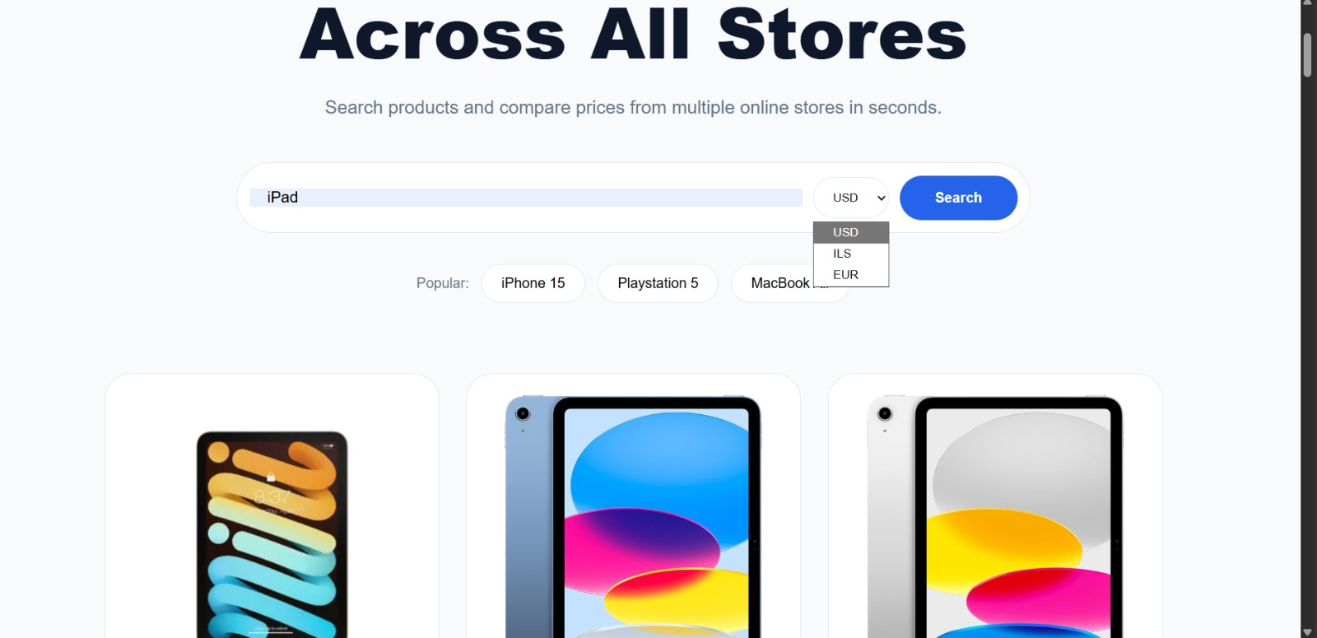
04 / Currency Select
PriceLens
Currency Selection
User selects currency from USD / ILS / EUR

Slide 6
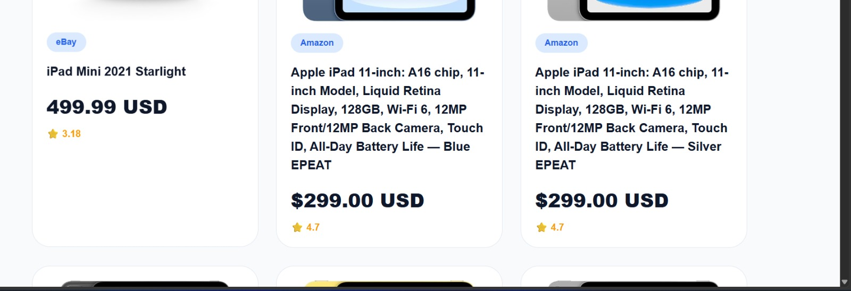
05 / USD Prices
PriceLens
Prices in USD
Prices are displayed in US dollars by default

Slide 7
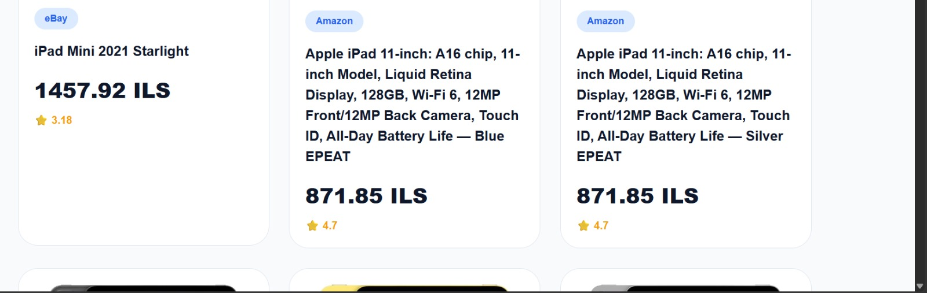
06 / ILS Prices
PriceLens
Prices in ILS
After changing currency — prices convert automatically without re-searching

Slide 8
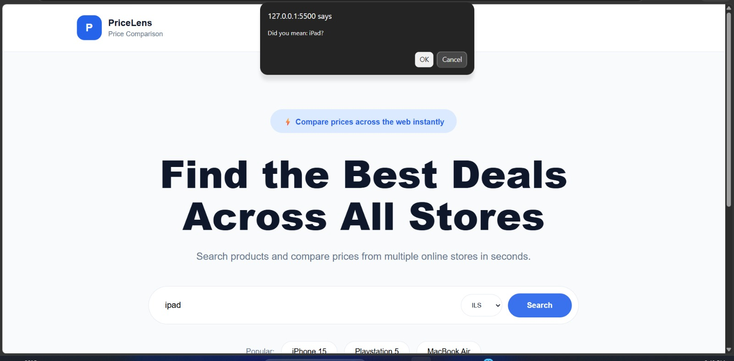
07 / Spell Check
PriceLens
Spell Check
When a wrong product name is typed — a confirmation dialog shows the correct name

Slide 9
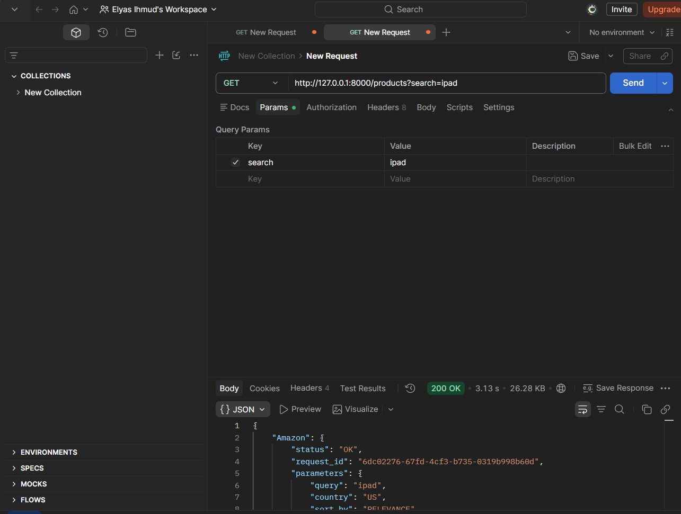
08 / Postman — GET Request
PriceLens
GET Request Setup
GET http://127.0.0.1:8000/products?search=ipad — main endpoint

Slide 10
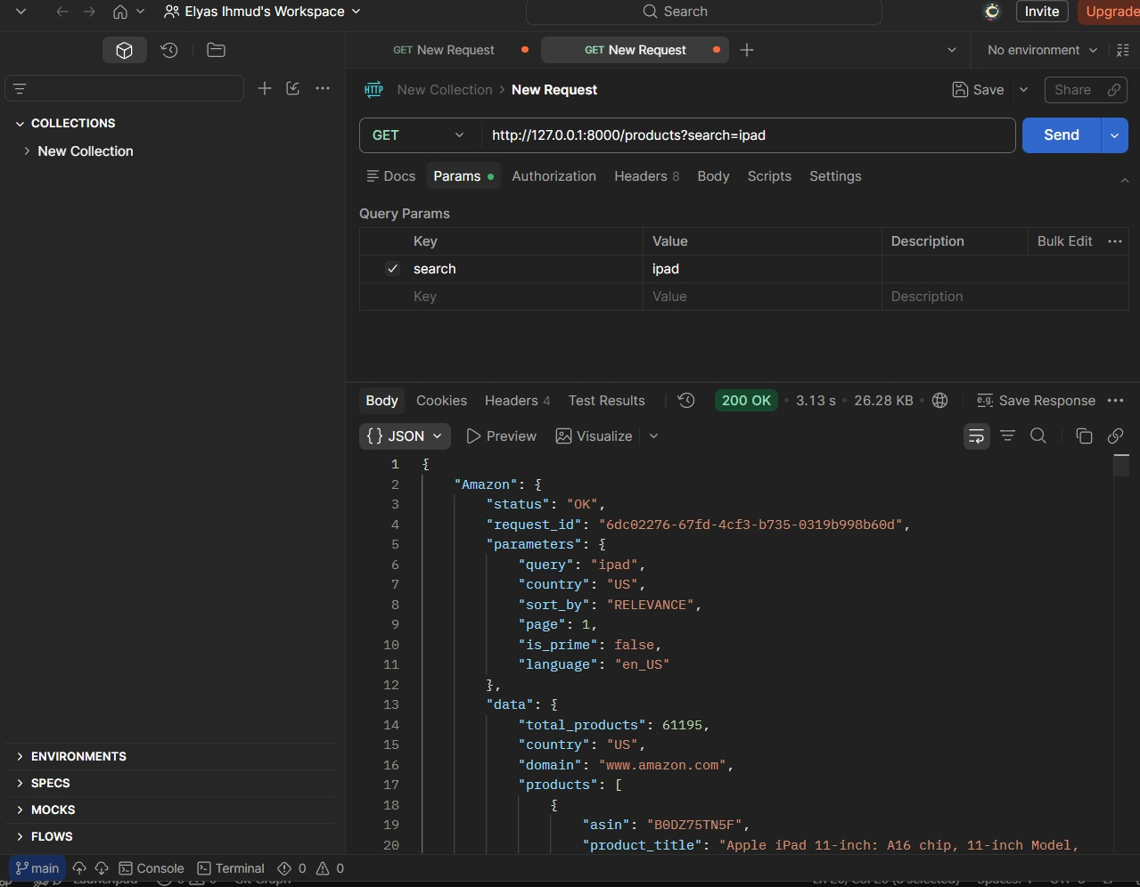
09 / Postman — Amazon Response
PriceLens
Amazon Response
JSON response from Amazon — status: OK with product data

Slide 11
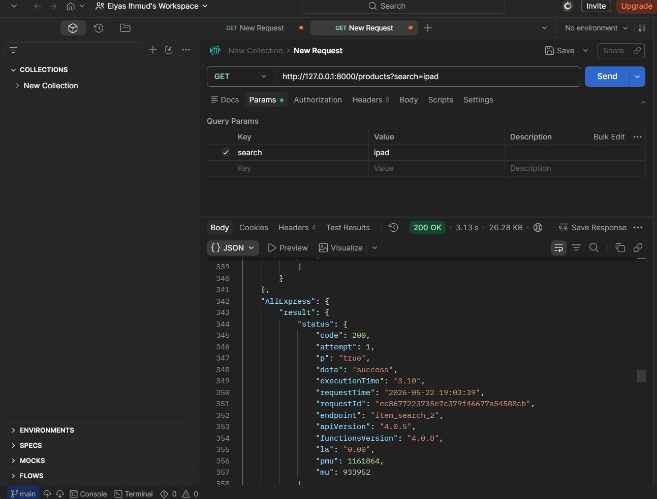
10 / Postman — AliExpress Response
PriceLens
AliExpress Response
JSON response from AliExpress — 200 OK

Slide 12
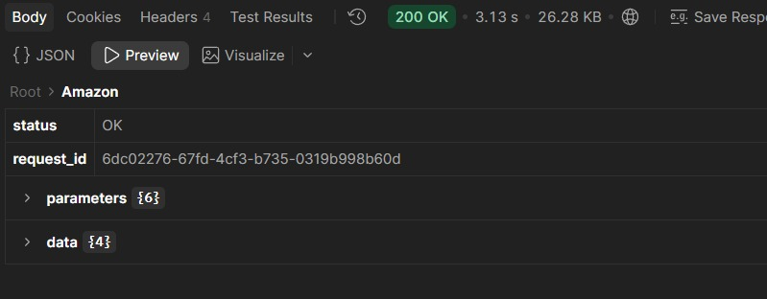
11 / Postman — Preview Mode
PriceLens
Preview Mode
Structured response view — status: OK, request_id, and data fields

Slide 13
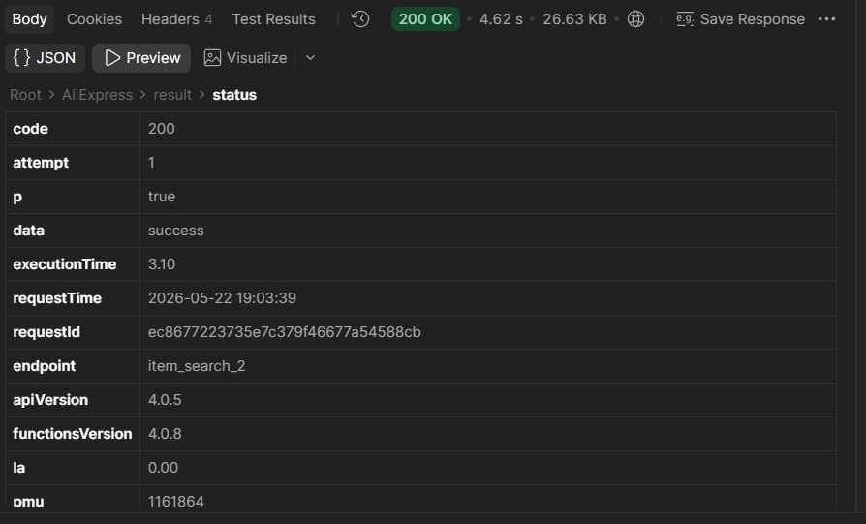
12 / Postman — AliExpress Status
PriceLens
AliExpress Status Details
Response details — code: 200, executionTime, and apiVersion

Slide 14
A / Service Providers
PriceLens
Service Providers
External APIs powering PriceLens
1 — Amazon (via RapidAPI)
2 — AliExpress (via RapidAPI)
PURPOSE: Product listings & pricing data BASE URL: real-time-amazon-data.p.rapidapi.com AUTH: x-rapidapi-key header
PURPOSE: Product listings from AliExpress BASE URL: aliexpress-datahub.p.rapidapi.com AUTH: x-rapidapi-key header
3 — eBay Sandbox
4 — Frankfurter API
5 — LanguageTool API
PURPOSE: eBay product listings BASE URL: api.sandbox.ebay.com AUTH: OAuth 2.0 token
PURPOSE: Currency conversion BASE URL: api.frankfurter.dev AUTH: None — Free public API
PURPOSE: Spell check & correction BASE URL: api.languagetool.org AUTH: None — Free public API

Slide 15
B / API Request Structure
PriceLens
API Request Structure
Example: Product Search Endpoint
http://127.0.0.1:8000/products?search=ipad
PROTOCOL
BASE URL
API SERVER ADDRESS
PATH
RESOURCE ENDPOINT
QUERY PARAMS
FILTERS & OPTIONS
Amazon Search
AUTH: Header: x-rapidapi-key: {API_KEY}
GET real-time-amazon-data.p.rapidapi.com/search
↩ JSON — products array with title, price, rating, image
?query=ipad&page=1&country=US
eBay Browse API
AUTH: Header: Authorization: Bearer {TOKEN}
GET api.sandbox.ebay.com/buy/browse/v1/item_summary/search
↩ JSON — itemSummaries array with title, price, image
?q=ipad&limit=20
Frankfurter Currency
AUTH: None required
GET api.frankfurter.dev/v1/latest
↩ JSON — rates object with converted values
?base=USD&symbols=ILS

Slide 16
P
Thank You
Questions & Demo
FastAPI
Vanilla JS
Python
github.com/ElyasNajeh/price-comparator

