Slide 1
Oral Presentation
Ghouaiel Elyes 2TSSNIR – 5 min
24/03/2023
Date
Notes:
2023/3/24

Slide 2
Table of Contents
I-Introduction
II-The 3 Documents
III-Conclusion
Notes:
2023/3/24

Slide 3

Introduction
Notes:
2023/3/24

Slide 4


Introduction
Notes:
2023/3/24

Slide 5
The 3 Documents
Framework : A Framework is a toolbox for a web developer.
Frontend : the appearance of the site
Notes:
2023/3/24

Slide 6
The 3 Documents
CSS : <link href="https://cdn.jsdelivr.net/npm/bootstrap@5.2.3/dist/css/bootstrap.min.css" rel="stylesheet">
JS : <script src="https://cdn.jsdelivr.net/npm/bootstrap@5.2.3/dist/js/bootstrap.bundle.min.js"></script>
Notes:
2023/3/24

Slide 7
The 3 Documents
Project WEB
Notes:
2023/3/24

Slide 8
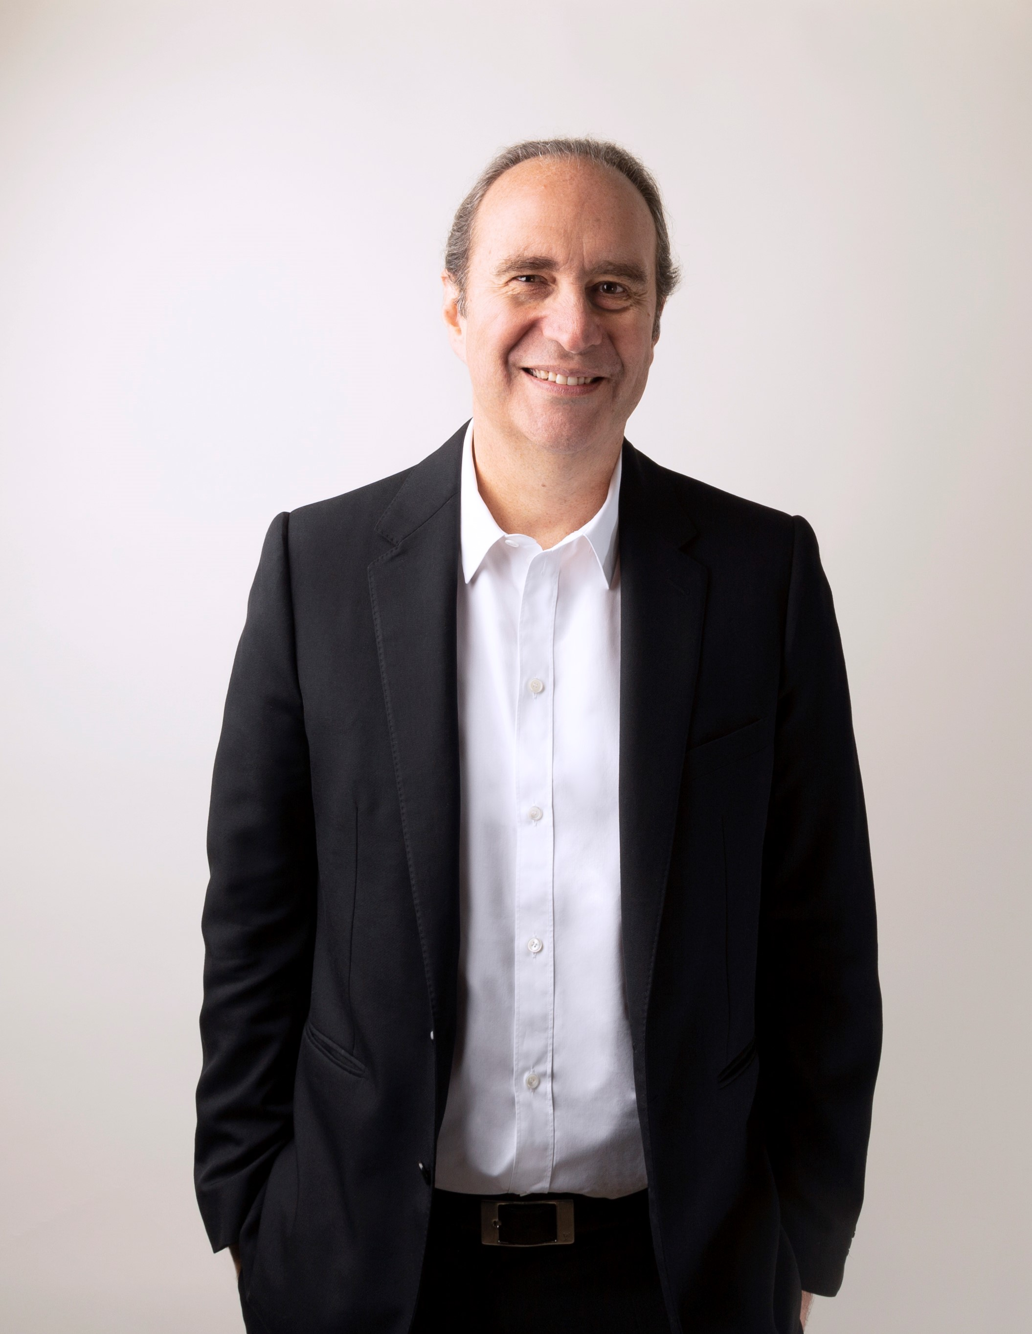

The 3 Documents
Notes:
2023/3/24

Slide 9
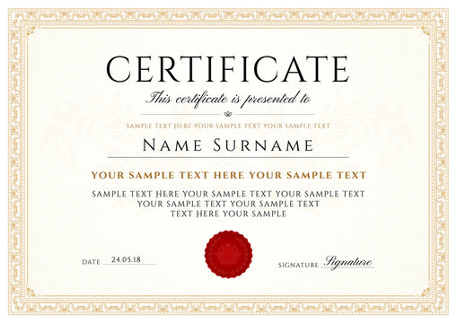
The 3 Documents
Notes:
2023/3/24

Slide 10


III-Conclusion
Notes:
2023/3/24

Slide 11
Thank You
Ghouaiel Elyes
School:
Lycée des Eucalyptus
Notes:
2023/3/24

