Slide 1




Taskini
Pitch Deck
Presented by : Hack Savvy Team:
Ahmed Dhia Labidi
Elyes Khechine
Omar Letaief
GitHub

Slide 2
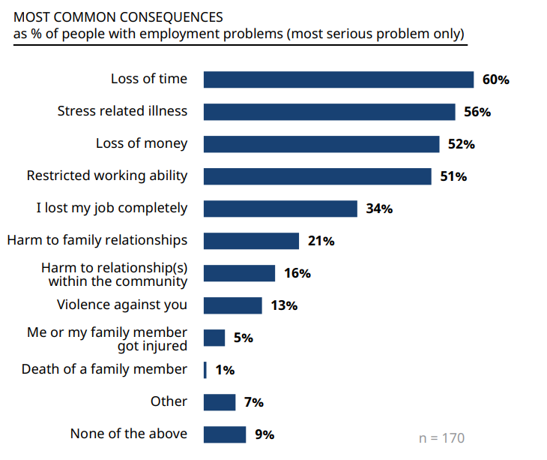
Problems
Employees struggle with task management.
Eventually: missed deadlines, decreased productivity, and increased stress.
Ultimately: loss of money.
Existing task management apps lack intelligence & individualization.

Slide 3

Solution
1
2
3
Personalized task management: Taskini learns the employee's work style and adapts accordingly.
Priority setting: Set task priorities based on urgency, importance, and personal preferences.
This can also be done manually.
Time counters: Determine the estimated time needed for each task and track progress.

Slide 4
4
5
6
Intelligent suggestions: Receive proactive recommendations to improve efficiency and overcome challenges.
Difficulty assessment: Taskini evaluates task difficulty and suggests suitable approaches.
Subtask generation: Simplify complex tasks by generating subtasks with detailed instructions.

Slide 5
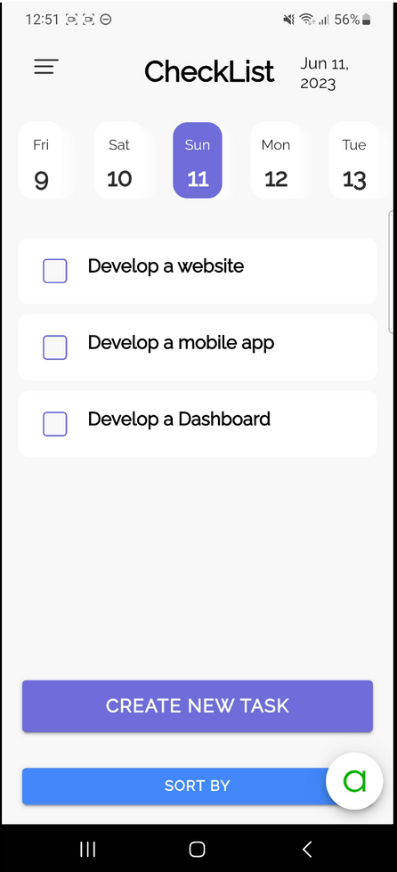
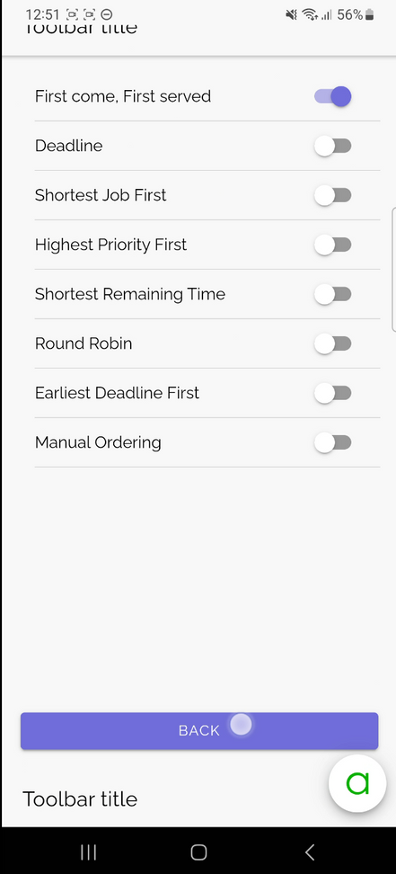
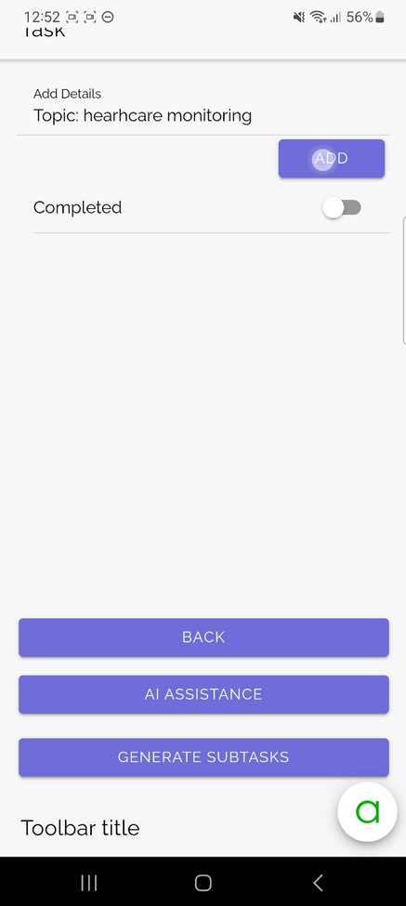
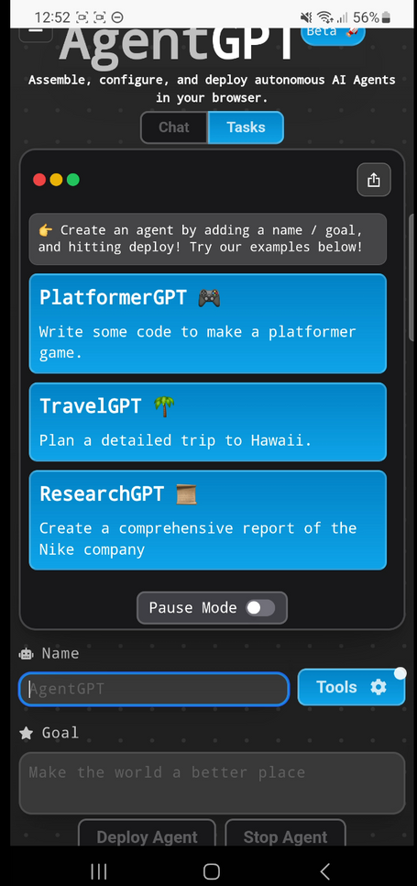
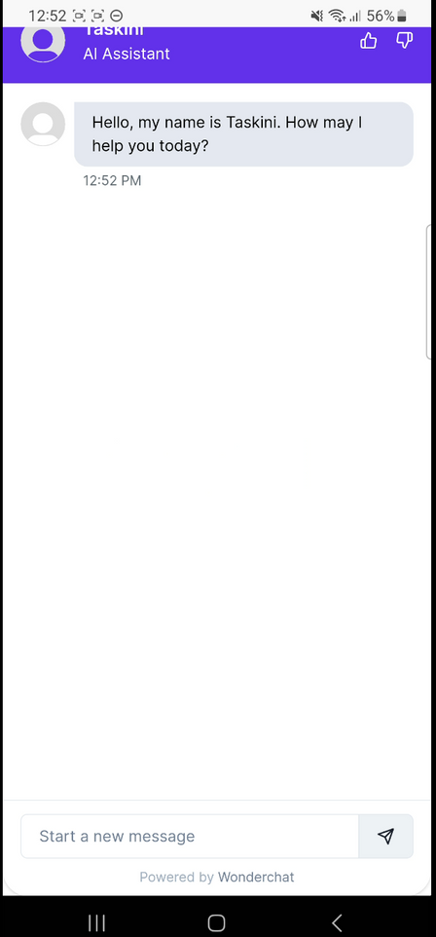

Slide 6
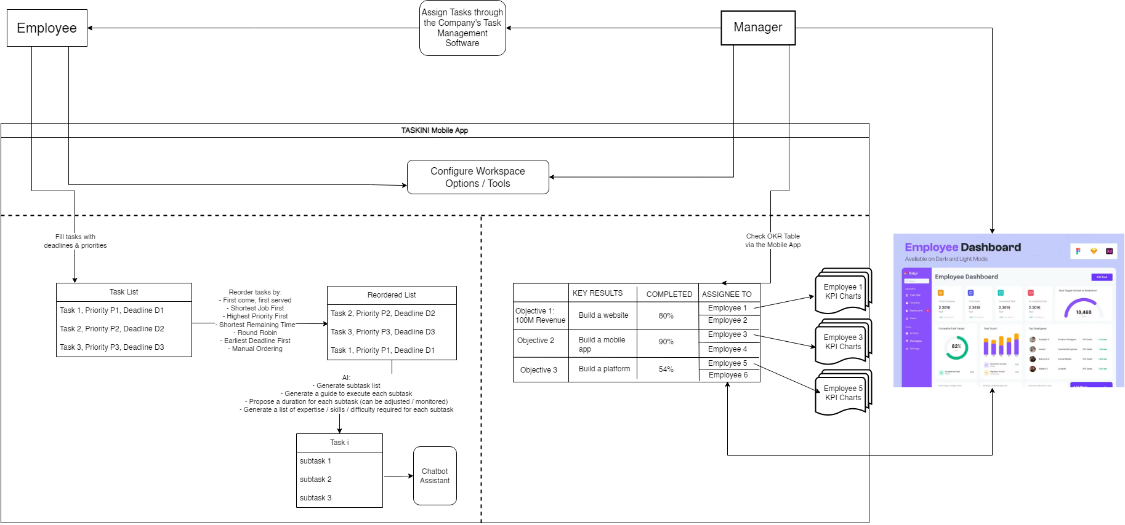

Slide 7

Market Opportunity
The task management software market is growing rapidly, with an increasing demand for intelligent solutions.
Taskini differentiates itself by focusing on personalization, AI-driven assistance, and intuitive user experience.
Target Market
B2C: all employees with access to mobile apps, including managers.
B2B: businesses who want to develop platforms empowering employees to navigate workplace challenges. These can be both in the Public and private sectors.
Freelancers: Independent contractors and remote workers who juggle multiple projects and tasks.

Slide 8
Business Plan
1-month Free Trial for new verified users:
They will have access to all of the features for each specific version.
Verified through Mobile Phone Number and Email Address.
After the Free Trial:
1st Version:
No ChatGPT 4
All features Included
Price: 25 TND per month per user (B2C).
Can go down to 15 TND for Businesses (B2B) with 1000+ Employees in Tunisia and abroad for later steps.
2nd Version:
With ChatGPT 4
All features Included
Price: 70 TND per month per user (B2C).
Can go down to 60TND for Businesses (B2B) with 1000+ Employees in Tunisia and abroad for later steps.

Slide 9
Competitors
Notion
Jira
ProProfs Project
Chanty
ProofHub
Todoist
Asana
SmartTask

Slide 10
Total Attainable Market
The global market is estimated to reach US$12.7 Billion by 2030 based on finance.yahoo.com.
Revenue Projection
Serviceable Attainable Market
Based on Start.io and Statista.com, there are around 3M employees with smartphones.
900M TND for 25TND per App/User per year.
Projected revenue growth based on market size, pricing structure, and expected user adoption.
Serviceable Obtainable Market
If only 10% of the market buys the App: 90M TND for 25TND per App/User per year.

Slide 11
Digital marketing
Social media campaigns, content marketing, and influencer partnerships.
We can promote our solution through YouTube Channels Social Media Stories, and Pages.
Marketing Strategy
App store optimization
Optimize Taskini's visibility on popular app stores through effective keyword targeting.
We can work on both Android and IOS.
User referrals
Encourage users to refer Taskini to colleagues and friends for organic growth.
For this, we can offer rewards and discounts.

Slide 12


Next Steps
Integrate an intelligent conflict and discrimination issues
Upgrade
the AI Model
Make an AI-based task manager that is more adequate for personal chores
Integrate health care reminder system that can be linked to a smartwatch to use sensors for later data analysis

Slide 13

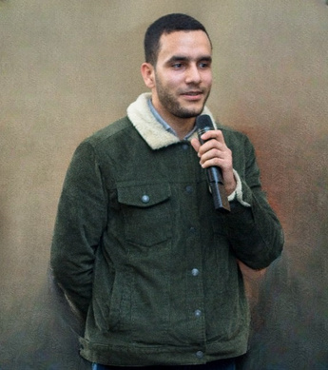
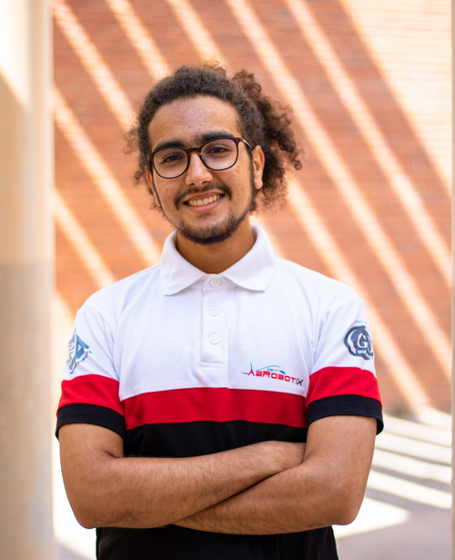
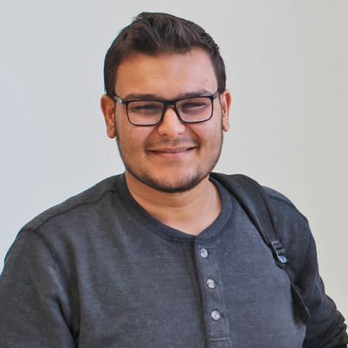
Our Team
Elyes Khechine
Ahmed Dhia Labidi
Omar Letaief
AI Engineer
Mobile App Developer
Project Manager

Slide 14
Thank You For Your Attention

