Slide 2
http://www.orionbms.com/comparison/

Slide 3
https://www.renesas.com/tw/en/application/industrial/e-bike-system-solution

Slide 4
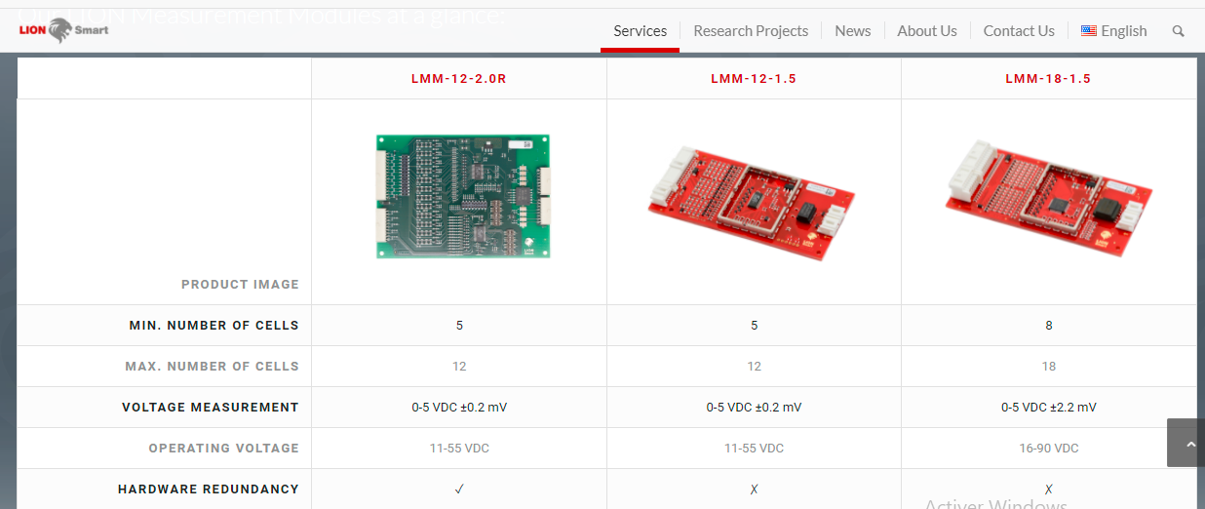
https://lionsmart.com/en/battery-management-system/

Slide 5
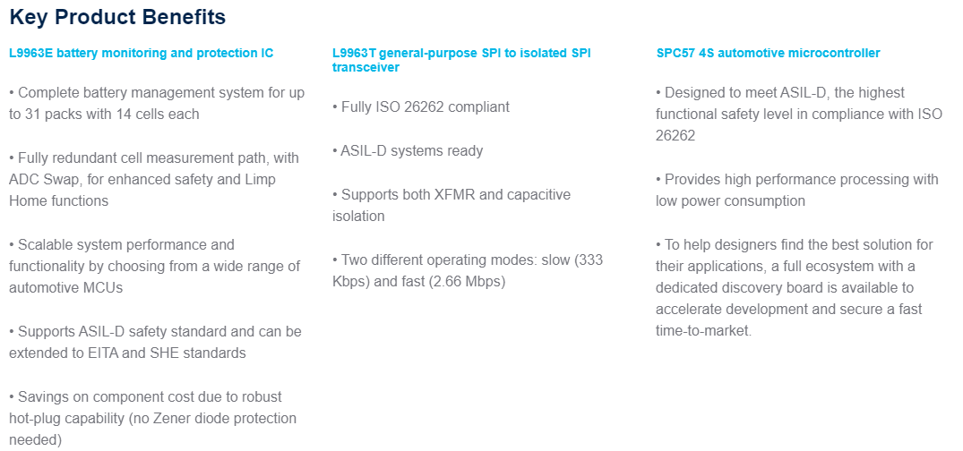
https://www.st.com/en/solutions-reference-designs/sl-prapm07001v2.html

Slide 6
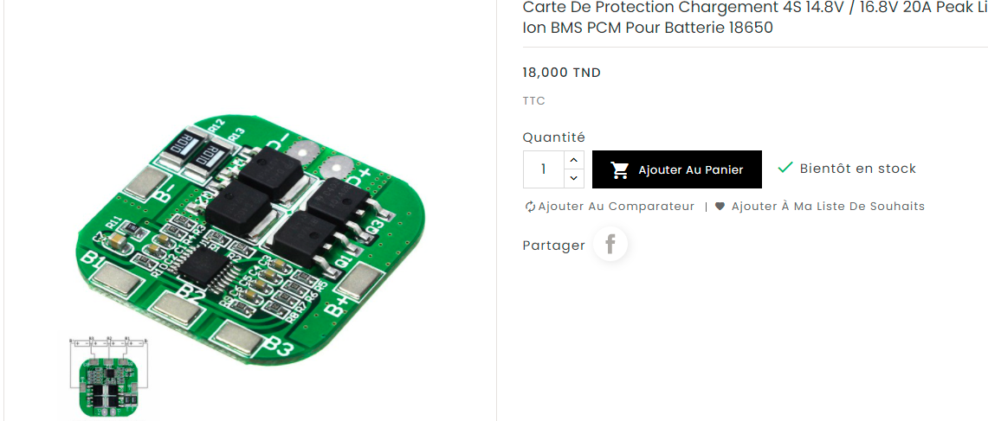
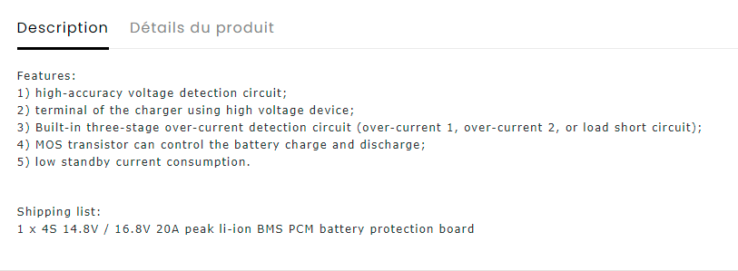
https://2betrading.com/cartes-de-developpement/1705-4s-148v-168v-20a-peak-li-ion-bms-pcm-battery-protection-board-bms-pcm-for-18650-lipo-battery.html

Slide 7
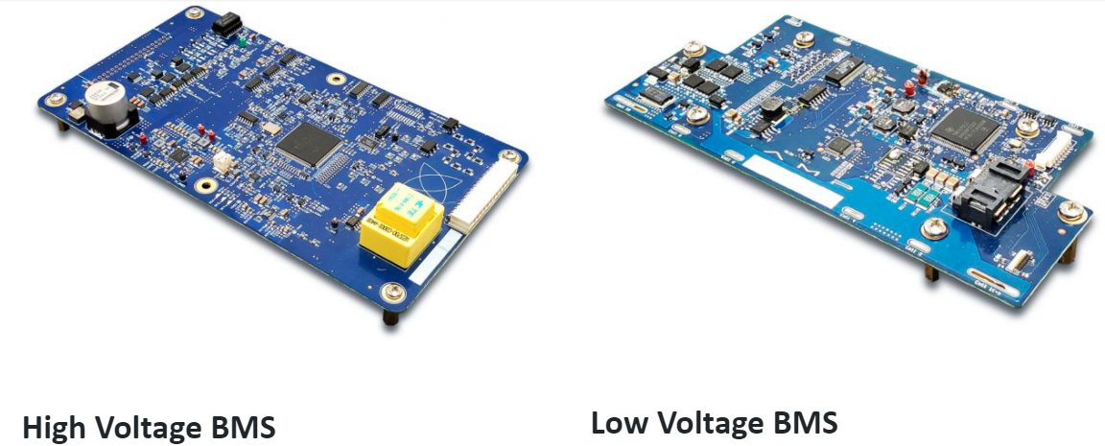
https://www.automotivepower.com/battery-management-systems/?gclid=CjwKCAiAwKyNBhBfEiwA_mrUMqfd1sCXuS-fUNo0938qf4mR_9alYsjlwZSnVdNDC8igGKDC8oMSQRoCS54QAvD_BwE

Slide 8
https://www.monolithicpower.com/design-tools/application-reference-designs/battery-management-reference-designs.html

Slide 9
https://seli.tn/page1?recherche=bms

Slide 10
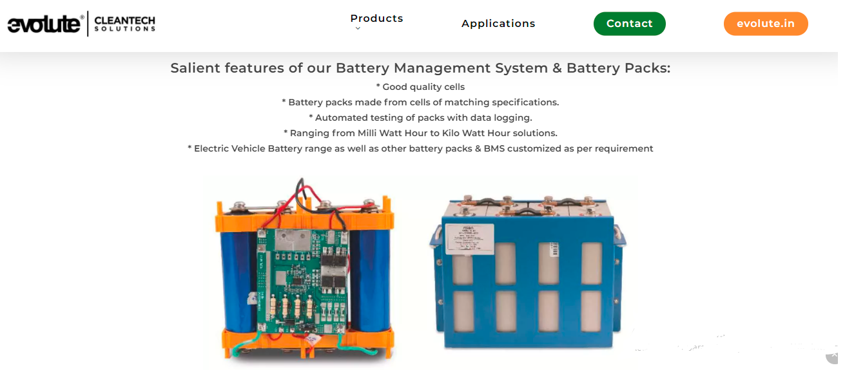
https://www.evolute.in/cleantech/battery-management-systems-bms/

Slide 11
https://www.alibaba.com/premium/smart_bms.html?src=sem_ggl&from=sem_ggl&cmpgn=2068311812&adgrp=76770518856&fditm=&tgt=kwd-296371318022&locintrst=&locphyscl=9075942&mtchtyp=b&ntwrk=g&device=c&dvcmdl=&creative=533007512042&plcmnt=&plcmntcat=&p1=&p2=&aceid=&position=&localKeyword=smart%20bms&gclid=CjwKCAiAwKyNBhBfEiwA_mrUMselPX0Q5MrGlLhg19GOFm3IiSEKqyxteTnyfBeoW1iNIRuR0NmZmhoCeKkQAvD_BwE

Slide 12
https://www.ubuy.tn/en/search/?ref_p=ser_tp&q=bms

Slide 13


