Slide 2
Battery packs based on the most advanced lithium-ion (Li-ion) and lithium-polymer (LiPo) electrochemical technologies are nowadays the only viable options to address the challenging demands in terms of the electric energy storage and deliverable power per unit mass of electric vehicles (EVs) and hybrid electric vehicles (HEVs) .
Unfortunately, unlike lead-acid batteries and other more conventional electrochemical accumulators, Li-ion and LiPo cells can be permanently damaged and can also originate life-threatening hazards such as fires and explosions in the event of overdischarging, overcharging and/or overtemperature operation. An electronic battery management system (BMS), which quickly detects the onset of dangerous conditions and takes the appropriate countermeasures to avoid hazards, is therefore necessary to safely operate Li-ion and LiPo cells in vehicles.

Slide 3
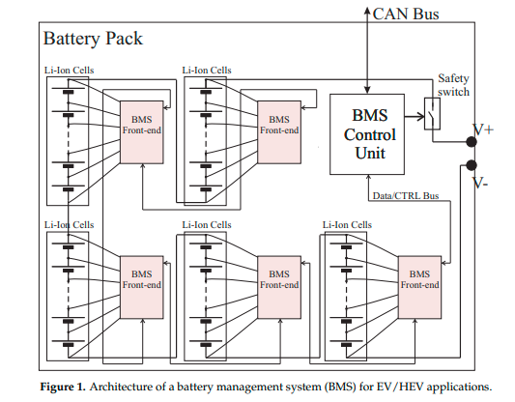
A BMS, which is schematically depicted in Figure 1, typically includes several front-end modules that acquire critical cell information, such as terminal voltages and temperatures, and a digital control unit that runs specific control and management algorithms

Slide 4
The BMS Front-End for the Tests In order to investigate the susceptibility to EMI of a BMS for electric vehicles and perform the related conducted (DPI) and radiated (in anechoic chamber) tests, a PCB was specifically designed, and it is described in this Section.

Slide 5
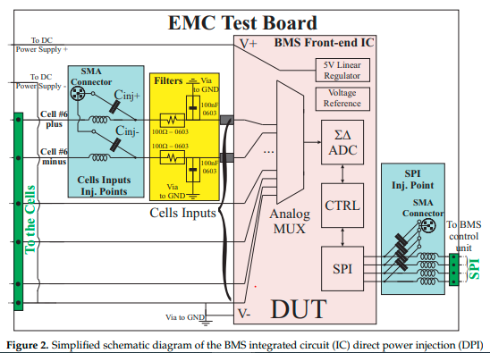
1. BMS Front-End IC Structure and Operation
The simplified block diagram of the BMS front-end IC, which is considered in what follows as the device under test (DUT), is reported in the pink box of Figure 2. Such an IC is designed to monitor the terminal voltages of up to twelve series-connected electrochemical cells using a 12-bit analog-to-digital converter (ADC). To that end, the IC includes 12 cell input pins, internally connected to the ADC’s differential input by a 12-channel, isolated, high-voltage analog multiplexer to measure the (differential) voltages across each of twelve series-connected cells, whose common-mode voltage can be up to 50 V with respect to the IC reference

Slide 6
-MP2731
-I2C
-LI-ion 18650

Slide 7
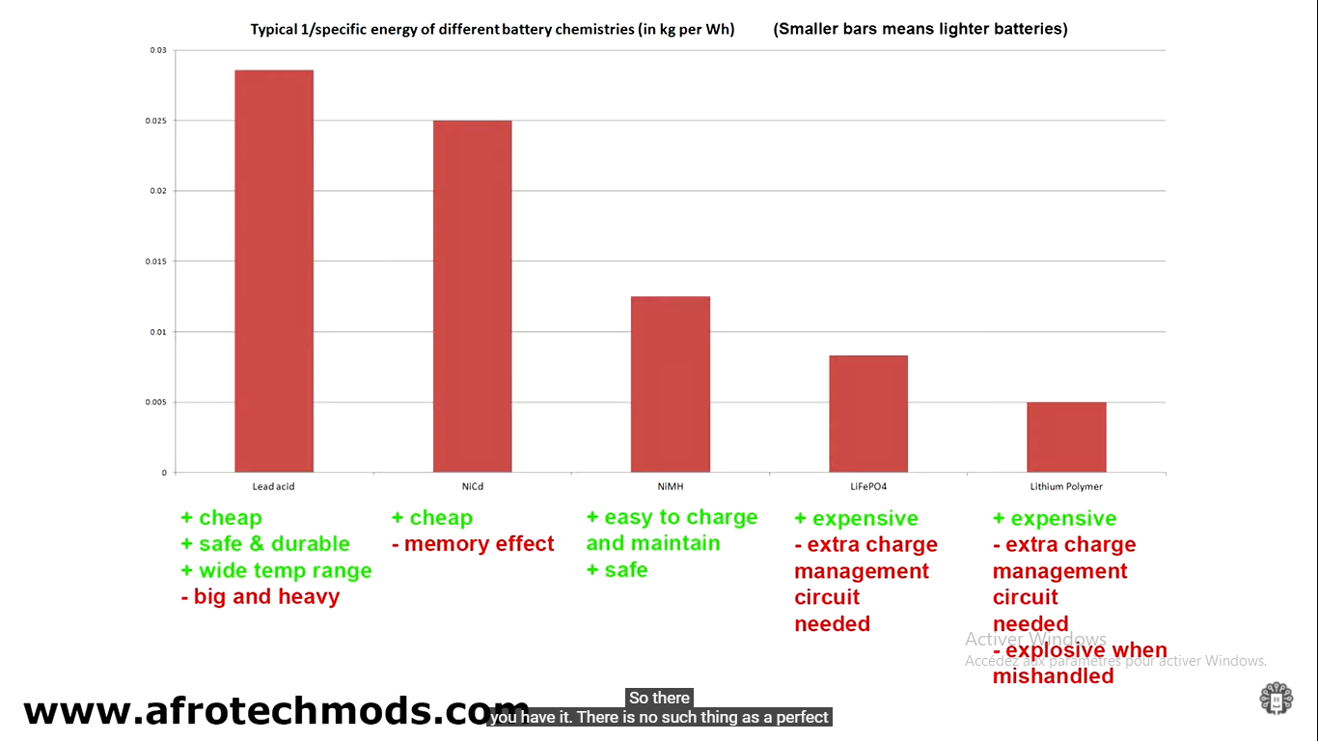

Slide 8
electromagnetic interference EMI

