Slide 1
Battery chemistry has a wider spectrum of combinations, and each type has its features and characteristics. The best thing is to choose a battery that fully meets your BESS specifications. For example, the system’s operating conditions mean a lot because battery chemistries have varying thermal tolerance. Thus, lithium-ion batteries are not resistant to extreme temperatures—they can operate properly in the range between 10ºC and 40ºC.
For example, it is best to recharge lithium-ion batteries even after a minor discharge—say 30% of capacity—and avoid complete energy drain or over discharge that would destroy the battery. Nickel-metal hydride (Ni-MH) batteries can be safely recharged irrespective of the capacity level, but regular recharging is a must for them if stored or left unused for a long time. Lead-acid batteries must be stored at full charge, otherwise, they would become sulfated and lose their capacity.

Slide 2
A BESS is an electrochemical energy storage solution with a rechargeable battery lying at the core. The system can either store or feed power as needed by charging and discharging its battery at the right time.
The first thing you need to consider when developing a BMS is the battery technology your BESS is going to use. Battery energy storage solutions can have the following battery cells configurations:
Lithium nickel manganese cobalt oxide
Lead-acid
Nickel-cadmium
Sodium-sulfur
Zinc-bromine

Slide 3
What is SOC and SOH in battery?
The State of Charge (SOC) has an important role in determining the remaining capacity of the battery pack. ... Battery State of Health (SOH) is an important indicator of the battery's life. SOH reflects the ability of a battery to deliver and receive energy and power.
Neither SOH nor SOC has equivalents among physical quantities. You’ll have to consider a whole range of factors and parameters to assess these states most accurately. Thus, calculating the SOH can rely on:
Age
Cycle life (number of charge/discharge cycles)
Capacity
Internal resistance
Energy throughput
Temperature
Self-discharge rate
Voltage

Slide 4
When evaluating the SOC, you can refer to the following parameters:
Battery chemistry
Voltage
Current
Capacity
Impedance
Charging/discharging rate
Temperature

Slide 5
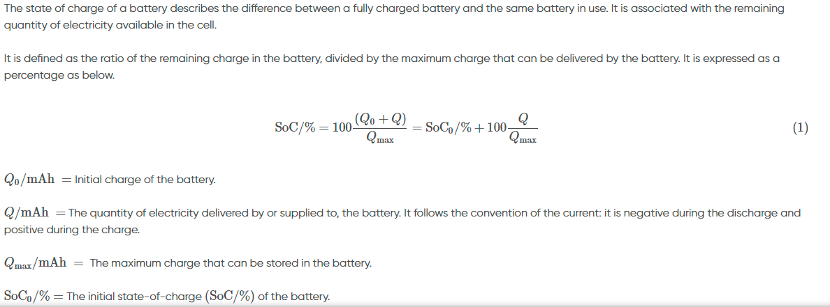

Slide 6

State of health :
State of health (SoH) is a figure of merit of the condition of a battery (or a cell, or a battery pack), compared to its ideal conditions. ... Typically, a battery's SoH will be 100% at the time of manufacture and will decrease over time and use.
When should I replace my battery state of health?
New batteries operate (should operate) at a capacity of 100%; replacement typically occurs when the packs fade to about 80%. Environmental conditions must also be considered as cold temperature lowers the capacity, especially with Li-ion
How do you find the state of battery health?
SoH of a battery describes the difference between a battery being studied and a fresh battery and considers cell aging. It is defined as the ratio of the maximum battery charge to its rated capacity. It is expressed as a percentage as seen below

Slide 7
Figure 2: Evolution of the SoH of a battery during aging

Slide 8

Coulomb Counting Method
The coulomb counting method, also known as ampere hour counting and current integration, is the most common technique for calculating the SOC. This method employs battery current readings mathematically integrated over the usage period to calculate SOC values given by
where SOC(t0) is the initial SOC, Crated is the rated capacity, Ib is the battery current, and Iloss is the current consumed by the loss reactions.

Slide 9
The general approach for measuring SOC is to measure very accurately both the coulombs and current flowing in and out of the cell stack under all operating conditions, and the individual cell voltages of each cell in the stack. This data is then employed with previously loaded cell pack data for the exact cells being monitored to develop an accurate SOC estimate.The additional data required for such a calculation includes the cell temperature, whether the cell is charging or discharging when the measurements were made, the cell age, and other relevant cell data obtained from the cell manufacturer. Sometimes it is possible to get characterization data from the manufacturer of how their Li-ion cells perform under various operating conditions. Once an SOC has been determined, it is up to the system to keep the SOC updated during subsequent operation, essentially counting the coulombs that flow in and out of the cells. The accuracy of this approach can be derailed by not knowing the initial SOC to an accurate enough state and by other factors, such as self discharge of the cells and leakage effects.

Slide 10
The evaluation platform is composed of a hardware system including an MCU and required interfaces and peripherals, embedded software for the SOC and SOH algorithm implementation, and a PC-based application software as a user interface for system configuration, and data display and analysis. The evaluation platform periodically measures the voltage value of each cell and the battery pack’s current and voltage, by means of appropriate ADCs and sensors, and will run the SOC estimation algorithm in real time. This algorithm will use measured voltage and current values and some other data collected by temperature sensors, and/or given by PC-based software application (such as constructor specifications from a database). The SOC estimation algorithm output will be sent to the PC graphical user interface for dynamic display and database updating

Slide 11
SOC and SOH Estimation Methods Overview
Regarding SOC and SOH estimation methods, three approaches are mainly being used: a coulomb counting method, voltage method, and Kalman filter method. These methods can be applied for all battery systems, especially HEV, EV, and PV, and each method is discussed in the next few sections

Slide 12
Figure 1: Evolution of the S0C0 of a battery during charge and discharge

Slide 13
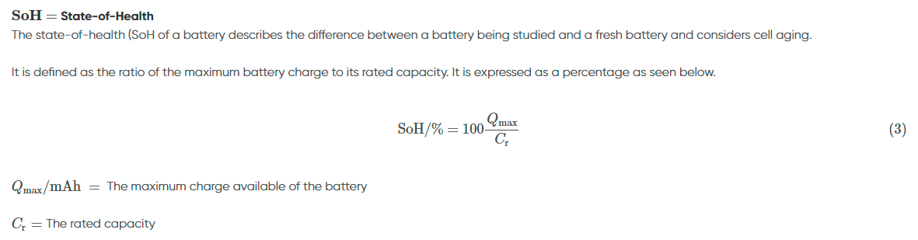

Slide 14
The discharge profile of a secondary battery is affected by its state of health. The lower the SoH, the faster the battery is discharged as it is illustrated in the Figure 3 below.
Figure 3: U vs. t during battery charge and discharge cycles for different SoH
https://www.biologic.net/topics/battery-states-state-of-charge-soc-state-of-health-soh/

Slide 15
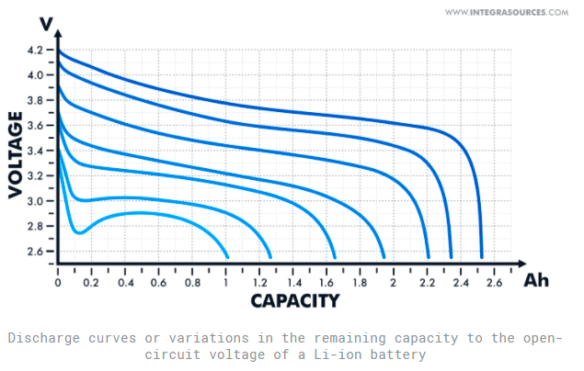
Open Circuit Voltage (OCV) Method
This method rests on the variation in the battery’s remaining capacity or SOC to the open-circuit voltage—voltage with the disconnected current load. The relationship between these parameters is reflected in a look-up table as the discharge curve. Manufacturers can provide such a table in battery datasheets or you can create it yourself by experimental measurements.

Slide 16
Although it varies with the battery chemistry, the dependence between voltage and SOC can be quite clear and the margin of error in the OCV method can be low enough. Nevertheless, this method is rarely applied in the real world. To use it, you need to cut off the current feed completely and give your battery a rest for some time—2 or 3 hours at the very minimum and 8+ hours in the ideal case. And only after all chemical reactions subside, you can gauge the battery’s voltage. That means the OCV technique cannot measure the SOC of a battery while in operation unless the power consumption is very low and we’re talking about microamps.
When your BESS or another battery-powered system is at work, it needs a constant electric power supply, and the current load can alter during operation. After a while, you’ll have to charge the battery, and that makes the OCV method an impossible task. The open circuit voltage technique is well suited to determine the initial SOC battery characteristic. For example, you can use it to calculate the state-of-charge after extended storage of a battery or if your system was powered off for a time. After measuring the OCV, you can find out the initial SOC from the voltage-capacity chart.
Calculating the state-of-charge with the OCV method is not a good fit for lithium-based batteries that have a rather flat discharge curve. The voltage value of Li-ion cells may not fluctuate through much of the capacity range, especially at some temperatures. That’s why we always combine the OCV technique with other measurement practices for the SOC estimation in lithium battery management systems.

Slide 17
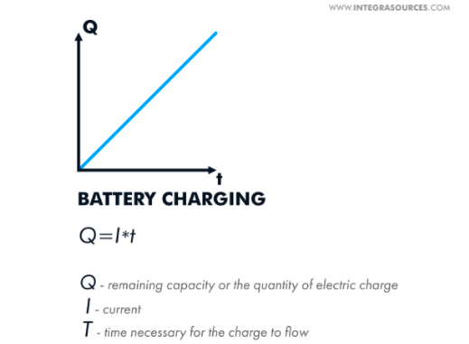
Coulomb counting (Current integration)
As the name suggests, this method is aimed at calculating coulombs or the quantity of electric charge, which is derived from current multiplied by the time necessary for the charge to flow. To measure the remaining capacity or SOC of a battery, you can add coulombs to the initial capacity in case of charging or take them away when you discharge the battery.

Slide 18
Current integration is a widespread method, but its accuracy depends on some factors. First off, you should know the correct measure of the initial SOC that serves as a reference point. You can get this by fully charging or discharging a battery. So if you want to use this technique, you need to allow for regular resetting of the battery SOC to 100% in your BMS design.
Another important condition for the accurate state-of-charge estimation with coulomb counting is the correct current measurement. You can achieve this by increasing the amplitude and time resolution of an analog-to-digital converter (ADC) in your current sensor. However, this can add to the sensor’s cost, so in most cases, BMS designers use inexpensive ADCs with 14- and 16-bit resolution and average measured data afterwards. Then, engineers process data by applying more advanced estimators, such as Kalman filtering or neural networks.

Slide 19
Kalman filtering
This method banks on the measurements and analysis of the battery’s input and output data, such as current, voltage, temperature, internal resistance, and other parameters. Based on this data, you can use the Kalman filtering algorithm to build an electrical model of a battery, simulate its behavior along with operating conditions, and estimate the state-of-charge.
This method consists of two major steps. For starters, you enter the input data into the model and represent the physical processes running in a battery as mathematical equations. Thus, you predict the behavior of the battery and its output data by drawing on theoretical calculations.

Slide 20
In the second step, you measure the actual battery parameters, such as voltage and current, and compare them with the predicted values. After that, the algorithm filters or corrects the model to reduce any possible deviations. Kalman filter can take the measurements every second throughout the entire discharge or charge cycle of a battery and predict the SOC at each iteration, every time minimizing the margin of error.
Kalman filter is one of the most high-end and precise estimators used by modern battery management systems. To apply this practice, you don’t need to know the whole history of battery charging and discharging. You can only draw on the previous iteration to calculate the current battery state. The reliability of this method directly depends on the accuracy of the electrical model, including mathematical equations and the parameters you choose for these equations.

Slide 21
The classic Kalman filter algorithm works for systems described by linear ordinary differential equations (ODEs). For non-linear systems, you can use an extended Kalman filter (EKF) that approximates non-linearity using the first-order partial derivatives. This is an upgraded version of the algorithm that needs hardware with a higher level of performance.
The unscented Kalman filter (UKF) and central difference Kalman filter (CDKF) are the types of a sigma-point Kalman filter (SPKF), which is another modification having higher accuracy compared to EKF. For SPKF, you solve equations for a set of points offset by sigma from the initial point.

Slide 22
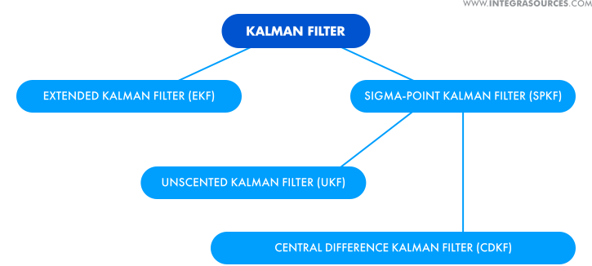
Kalman filter is one of the most precise SOC estimators used by modern battery management systems. Building an accurate battery model is key to the reliability of this method.

Slide 23
Alternative SOC estimators
There are a host of other techniques that can estimate the SOC of battery cells. Some of them have already been put into practice, the others are still in the research stage or exist as concepts. When investigating the SOC determination solutions, you can come across the following methods:
Terminal voltage method. This method consists in measuring the terminal voltage of a battery that decreases during discharge. The SOC is calculated based on the proportional relationships between the electromotive force (EMF) of a battery, its terminal voltage, and the state-of-charge. There can be a serious error in the calculations due to a sharp drop of the terminal voltage at the end of discharge.
Impedance method. This builds upon the measurements of a battery’s internal impedance that changes throughout charge and discharge cycles. The main challenges here are measuring impedance during the battery’s operation and obtaining correct data with allowances made for the temperature.
Neural networks. A neural network can estimate the SOC by learning from large amounts of a battery’s input data, such as voltage, current, and temperature, and reproducing the non-linear relationships between these parameters.
Fuzzy logic. To build a fuzzy logic model, you can use any battery data available to you even if it’s abstract and approximate. After analyzing the data, the model can determine battery characteristics, including the state-of-charge. The key requirement of both fuzzy logic and neural networks is the high performance of a microcontroller.
Ultrasonic detection. This method lies in estimating the SOC using ultrasonic guided wave technology. Owing to its sensitivity, wave signals can help understand the battery structure and thus evaluate its capacity and overall condition. Implementing this practice requires significant investments of time and effort.

Slide 24
The application of a single SOC estimation approach is rarely found in present-day battery management systems. To improve your calculations, you can put different techniques together using so-called hybrid methods. For example, combined with fuzzy logic or Kalman filtering, coulomb counting can better measure accuracy than the current integration method alone.
Present-day battery management systems rarely apply a single SOC estimation method. Putting different techniques together can improve your calculations and increase measuring accuracy.

Slide 25
Calculating Your Battery’s State-of-Health
Even though you cannot measure the SOH battery parameter directly, you can calculate it through the measurements of related physical quantities.
Internal resistance measurement
Internal resistance can be a distinct marker of the SOH that is inversely related to this parameter—the higher the battery internal resistance, the lower the state-of-health. Internal resistance can be calculated through the measurements of open circuit voltage and voltage with the connected current load. The difference between these two values will show the voltage drop. Then, you can calculate the internal resistance using Ohm’s law.

Slide 26


Slide 27
However, calculating the battery internal resistance this way takes time as you can only measure the OCV when the battery is at rest. Alternatively, you can calculate the internal resistance through Joule’s law by measuring the energy generated by the battery during operation. Or you can get the resistance value from the battery’s impedance using Electrochemical Impedance Spectroscopy (EIS).
Internal impedance measurement
As a battery degrades, its internal impedance increases, just like resistance. So you can also use the impedance measurement to estimate the state-of-health. As said above, the battery impedance can be measured by the EIS method that applies alternating current (AC) at different frequencies and identifies the impedance as a function of the frequency
However , EIS is a complex solution that cannot meet the requirements of every BMS and may not match the operating conditions of a battery.

Slide 28
Counting charge/discharge cycles
There is a relationship between the state-of-health of Li-ion batteries and their cycle life. So calculating the remaining number of charge/discharge cycles can become the simplest and most available SOH estimator for them. In this case, the cycle life claimed by the battery manufacturer can serve as a reference point, and to count the number of cycles, you need to charge the battery to the full.
Despite the simplicity of this practice, it can hardly provide a high level of accuracy as some significant factors, such as voltage and current, could influence the battery’s state. This method does not make allowance for these factors along with the operating conditions of a battery
You can calculate the battery SOH by counting the remaining number of charge/discharge cycles or through the measurements of related physical quantities, such as internal resistance and impedance.

Slide 29
SOC estimators working for SOH
The well-known techniques used for measuring the battery state-of-charge can just as well work for the SOH estimation. These include:
Coulomb counting. The decrease in the state-of-health and the loss of rated capacity occur simultaneously in a battery. Thus, you can find out the SOH once you know the rate at which the capacity fades over time. The coulomb counting method is here at your service.
Kalman filtering. The Kalman filter can lean on a variety of battery parameters, including internal resistance, which is essential for SOH estimation. The algorithm can track the behavior of a battery in real-time and predict its wear and aging.
Neural networks. Neural networks can process both linear and non-linear data. By analyzing battery internal parameters, neural networks can estimate the SOH under various conditions.
Fuzzy logic. Fuzzy logic models can use internal resistance, impedance, and other parameters as input data to evaluate the battery SOH. To apply the fuzzy logic method, you don’t necessarily need complete and comprehensive data about your battery.

Slide 30
Also, you should bear in mind that some SOH or SOC estimation methods are not suitable for certain applications. For example, to extend the battery life in electric vehicles (EVs), it is strongly recommended not to fully charge or discharge the battery. That is why the cycle calculation and coulomb counting techniques do not fit EV battery SOH evaluation.
https://www.integrasources.com/blog/battery-management-system-bms-state-charge-and-state-health/

