Slide 1
Object Detection with
YOLOR
By Elyes Khechine

Slide 2
Explicit and Implicit Knowledge for Humans
Explicit Knowledge
Implicit Knowledge
Knowledge we learn and understand from on vision, hearing,
Learned from past experience

Slide 3
Explicit and Implicit Knowledge for Neural Networks
Explicit Knowledge
Implicit Knowledge
Providing clear metadata or image databases that are either thoroughly annotated or well organized. Explicit knowledge can be thought of like flashcards for the machine learning model, with clear definitions and pictures/inputs corresponding to those images.
Obtained by features in the deep layers.
The knowledge that does not correspond to observations is known as implicit knowledge as well.

Slide 4
Humans are able to effectively process entirely new data by making use of abundant experience from prior learning that is gained through normal learning and stored in the brain.
Human beings can answer different questions given a single input. Given one piece of data, humans can analyze the data from different angles.
YOLOR aims to give this ability to machine learning models – so that they are able to serve many tasks given one input.
YOLOR uses a unified model to combine explicit knowledge, defined as learning based on given data and input, with implicit knowledge learned subconsciously.

Slide 5
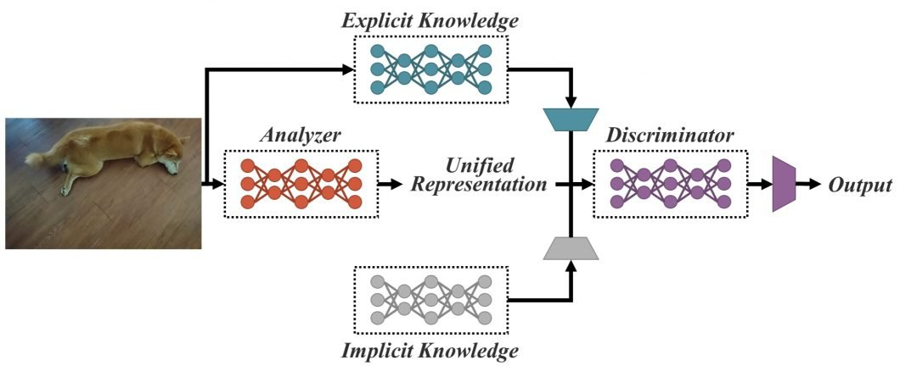
The Unified Model
The unified network proposed in YOLOR generates a unified representation to serve a variety of tasks all at once.

Slide 6
YOLOR’s Architecture Processes
Kernel Space Alignment
Prediction Refinement
CNNs with Multi-task Learning
A frequent problem in multi-task neural networks
Implicit representations are added output layers for prediction refinement.
- Learn how to get outputs
- What all the different outputs could be (rather than just one output)

Slide 7
Methods of implementing implicit information with YOLOR
Methods of modeling implicit information with YOLOR
Manifold Space Reduction
Vector / Matrix / Tensor
Kernel Alignment
Neural Network
More Functions
Matrix Factorization
YOLOR Research Paper: https://arxiv.org/pdf/2105.04206.pdf
YOLOR Source Code: https://github.com/WongKinYiu/yolor

Slide 8
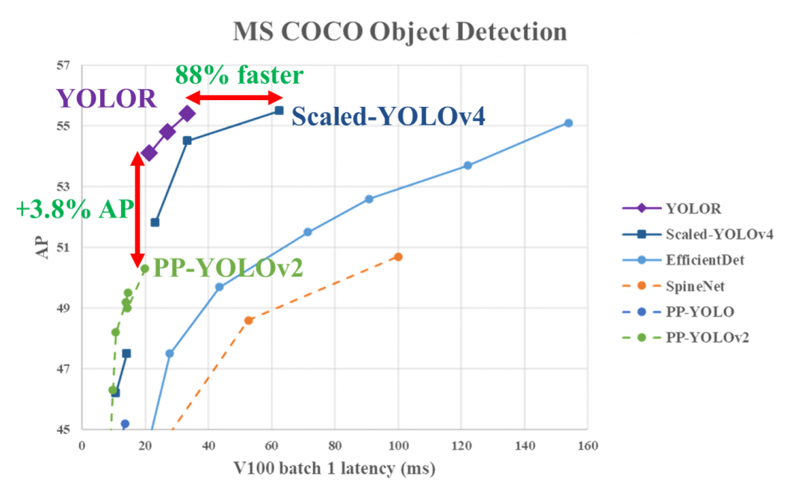
YOLOR Performance
YOLOR achieved comparable object detection accuracy as the Scaled YOLOv4, while the inference speed was increased by 88%. This makes YOLOR one of the fastest object detection algorithms in modern computer vision.
On the MS COCO dataset, the mean average precision of YOLOR is 3.8% higher compared to the PP-YOLOv2, at the same inference speed

Slide 9
THANKS

