Slide 1


LET'S HAVE A LOOK INTO
YOLOR
AI TEAM 3
TUNSA
APRIL 10, 2022

Slide 2
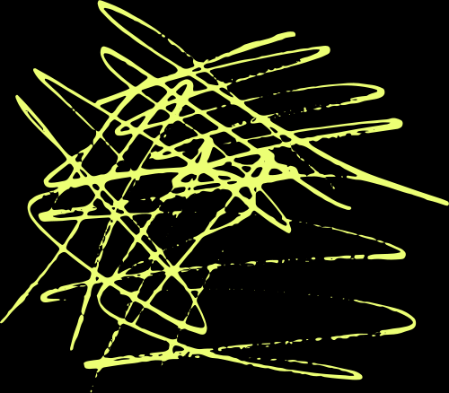
YOLOR STANDS FOR : YOU ONLY LEARN ONE REPRESENTATION
" UNIFIED NETWORKS FOR MULTIPLE TASKS"
AI TEAM 3
TUNSA
APRIL 10, 2022

Slide 3
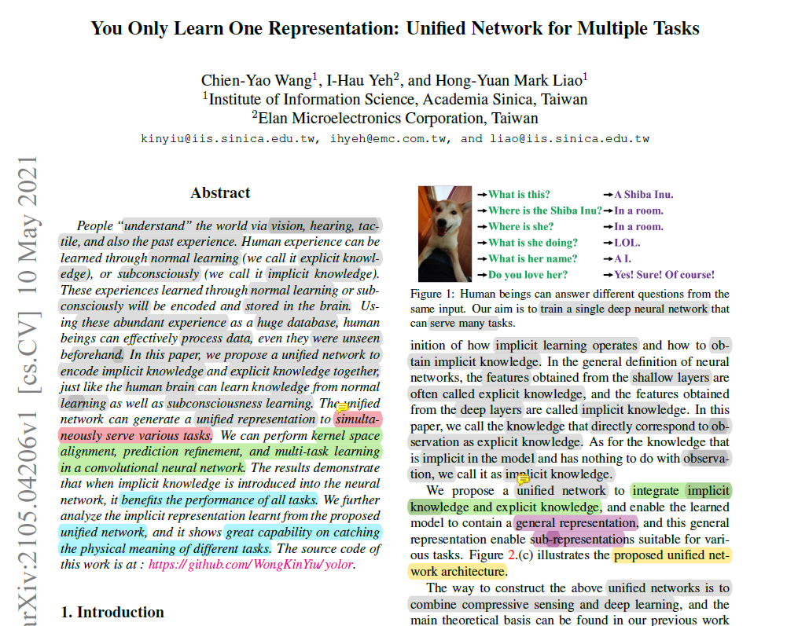
AUTHOR PAPER
AI TEAM 3
TUNSA
APRIL 10, 2022

Slide 4
So say that you and I had to look at a person for example, as humans, we can recognize that it’s a person quite easily. Well so can a Convolutional Neural Network (CNN).
However, both you and I can also recognize where the hands and legs are, what the person is wearing, where they are located, is it in a room or outside, are they standing or jumping or playing Fortnight.
A CNN can only do one thing and do that one task robustly, but fail miserably at other tasks. Why is this? Well it comes down to 2 things:
Explicit, &
Implicit Knowledge.
AI TEAM 3
TUNSA
APRIL 10, 2022

Slide 5

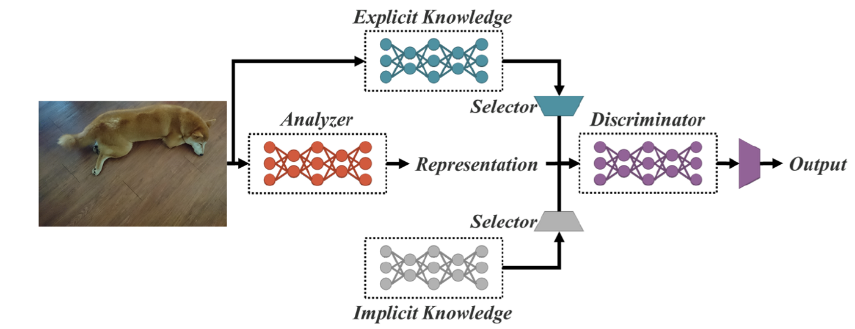
THE UNIFIED MODEL
AI TEAM 3
TUNSA
APRIL 10, 2022

Slide 6
IMPLEMENTATION
EXPLICIT DEEP LEARNING
IMPLICIT DEEP LEARNING
The authors essentially used Scaled YOLOv5 CSP
Manifold Space Reduction,
Kernel Alignment, and
More Functions.
AI TEAM
TUNSA
APRIL, 10 2022

Slide 7
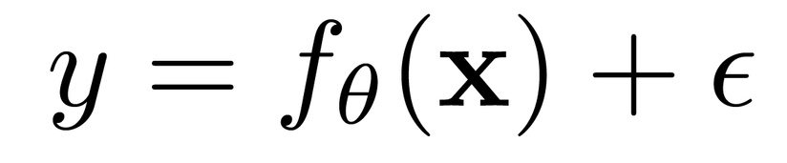

MATHEMATICAL MODELS
CONVENTIONAL NETWORK MODEL
UNIFIED NETWORKS
If we had to model a Conventional N etwork it would look something like this :
We can now expand our equation to incorporate the implicit model with g theta and the explicit error from observation x together with the implicit error from z which they term the hidden code : the representation of compressed data that makes up the implicit knowledge.
x : the observation, for example, you see a dog.
Theta : the set of parameters of a neural network,
f_θ : the operation of the neural network,
ϵ : the error term.
=> The goal is to minimize the error to make f(x) with respect to θ as close to the target y as possible.
WE CAN FURTHER SIMPLIFY THE EQUATION TO THIS :.
AI TEAM 3
TUNSA
With the ⋆ representing some possible operators like addition or concatenation that combines f and g or, rather the explicit with the implicit models.
APRIL, 10 2022

Slide 8
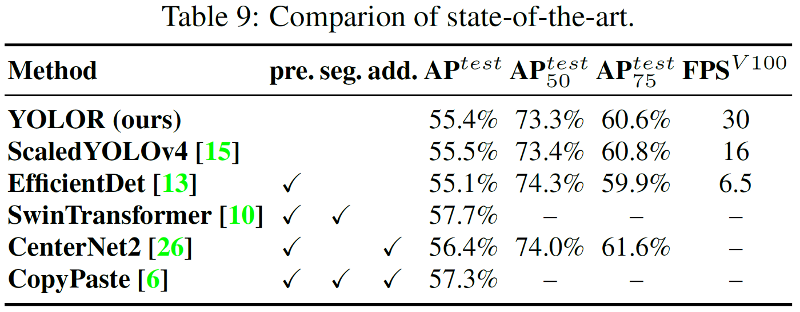

COMPARISON OF THE STATE OF THE ART ALGORITHMS
(Object Detection, image classifications, and Feature Embedding* trained on the MS-COCO Dataset )
AI TEAM 3
TUNSA
=> You can see that in terms of accuracy YoloR is comparable but where it shines, is in its frame rate : how fast an object detection model processes and generates the desired output.
*: feature embedding appears to be a synonym for feature extraction, feature learning etc. I.e. a form of embedding/dimension reduction (the goal may not be a lower dimensional representation but one of equal dimensionality, but more meaningfully expressed)
APRIL, 10 2022

Slide 9

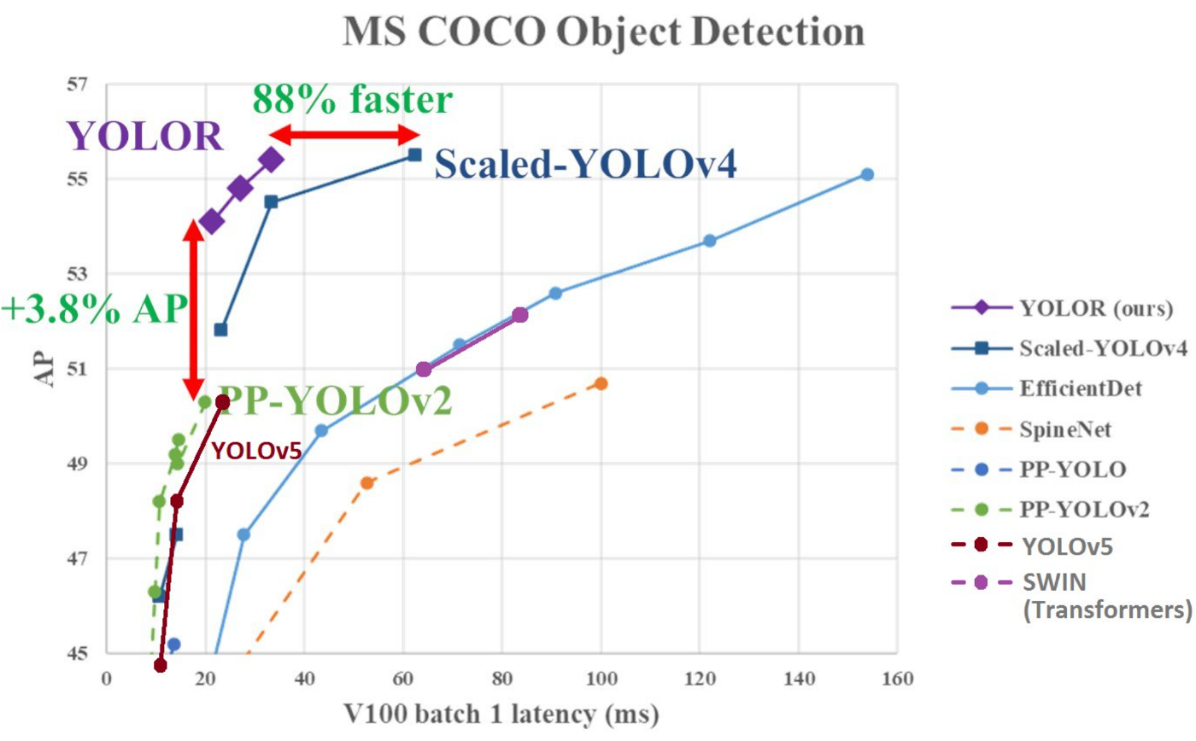
IF YOU LOOK AT THE TEST RUN BY THE LEGEND ALEXEY BOCHKOVSKIY, THEY SHOW AN 88% IN IMPROVEMENT IN SPEED WHEN COMPARED TO SCALED YOLOV4 AND A 3.8% IMPROVEMENT IN AVERAGE PRECISION COMPARED TO PP-YOLOV2.
AI TEAM 3
TUNSA
APRIL, 10 2022

Slide 10
CONCLUSION
In summary you can probably understand why the title of this paper is called You Only Learn One Representation (YOLOR) and then the second half of the title which is Unified Network for Multiple Tasks (object detection as an example).
You have also learnt how the integration of implicit knowledge along with explicit knowledge can prove very effective for multi-task learning(a machine learning approach in which we try to learn multiple tasks simultaneously, optimizing multiple loss functions at once) under a single model architecture.
AI TEAM 3
TUNSA
APRIL 10, 2022

Slide 11

THANK YOU
AI TEAM 3
TUNSA
APRIL,10 2022

