Slide 1
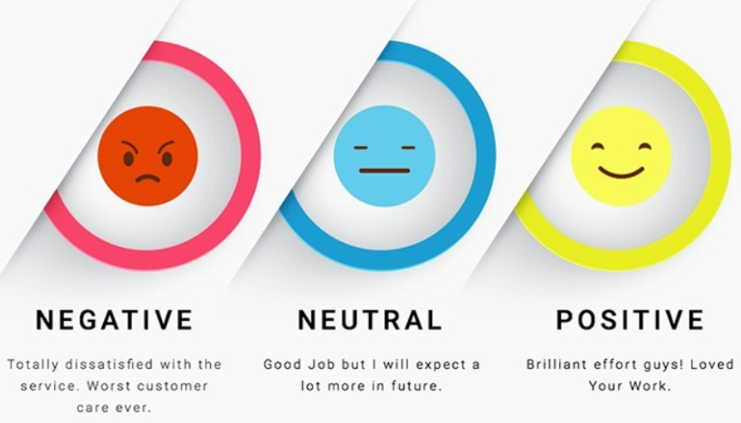
NLP : sentiment analysis
Source:https://h2oai.github.io/tutorials/natural-language-processing-sentiment-analysis/#0

Slide 2
1/DEFINITION
Sentiment analysis, also known as opinion mining, is a subfield of Natural Language Processing (NLP) that tries to identify and extract opinions from a given text.
Source:https://h2oai.github.io/tutorials/natural-language-processing-sentiment-analysis/#0

Slide 3
2/different techniques
1/using VADER model
3/ roberta pretrained model
4/

Slide 4
1/VADER
Valence Aware Dictionary and sEntiment Reasoner

Slide 6
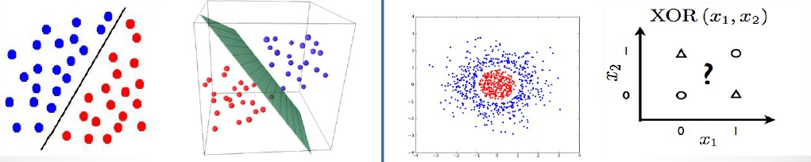
Minsky and Papert (1969)
AI Winter
A perceptron is able to find a decision boundary (hyperplane) between linearly separable classes.
But not all problems are linearly
separable.

Slide 7
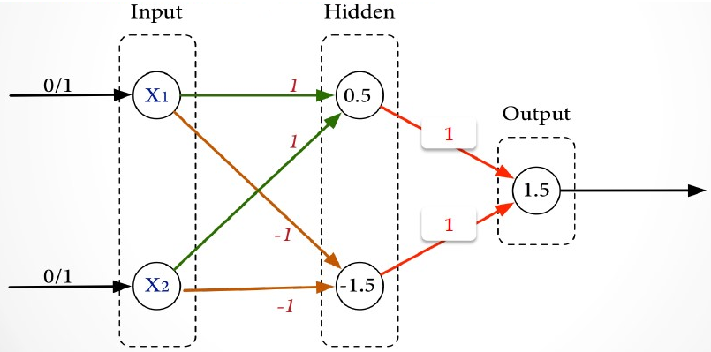
XOR Function
Solution : Networks of perceptrons (MLP)

Slide 8
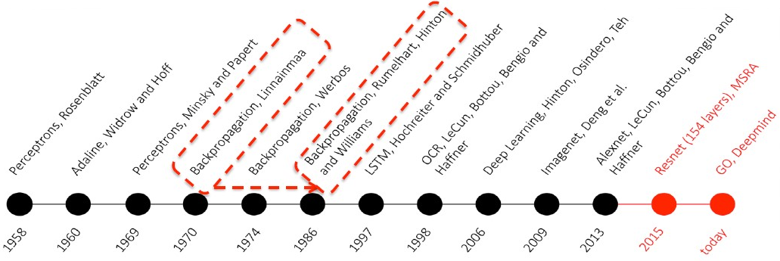
From AI Winter → Today

Slide 9
1986
David Rumelhart, Geoffrey Hinton and Ronald Williams published a paper “Learning representations by back-propagating errors”, which introduced:
• Hidden Layers
• Backpropagation and some other tricks

