Slide 1
Reinforcement
Learning

Slide 2
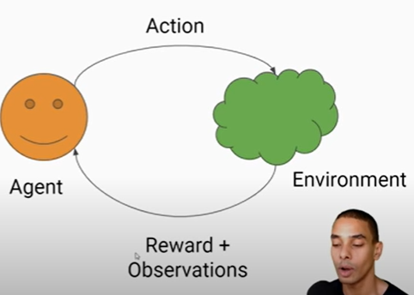
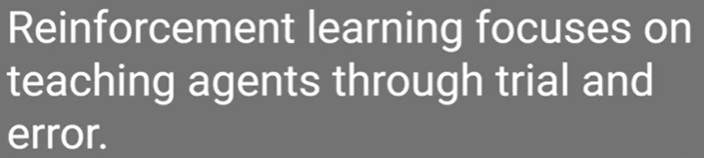

Slide 3
The agent is the component that makes the decision of what action to take
environment contains information about all possible actions that an agent can take
State is the current board position,
Action the mechanism by which the agent transitions between states of the environment.
Reward Function is an incentive mechanism that tells the agent what is correct and what is wrong using reward and punishment.
policy is, therefore, a strategy that an agent uses in pursuit of goals.
Observation So after it performs that specific action the agent observes the state of the environment (Observation) and a goodness score (or Reward) based on its last action. These feedback information are then utilized by the RL algorithm to upgrade/ improve the existing strategy (or policy), for better performance in the future.

Slide 4
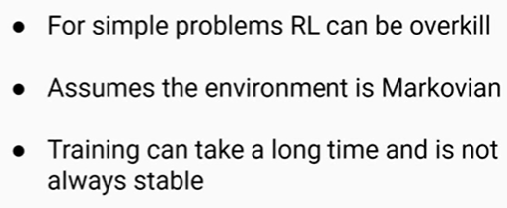
limitations
No random perturbation

Slide 5
applications
autonomous driving
securities trading
neural network architecture search // choose your best deep learning architecture for your problem
simulated training of robots

Slide 6
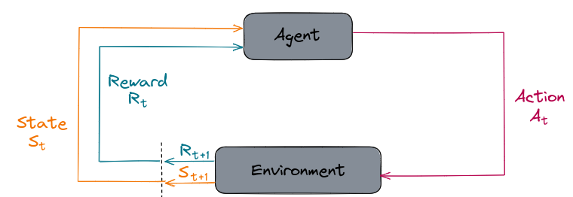
Markovian Decision Processes

Slide 7
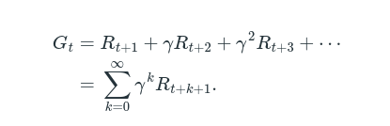
Expected Return
the agent's goal is to maximize the expected return of rewards.
Gamma : Discount Factor 0< and <1

Slide 8
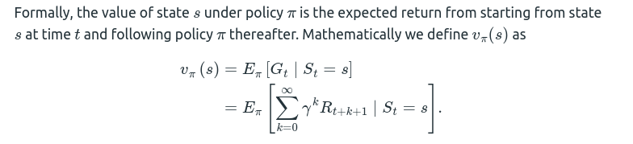
State-Value Function

Slide 9
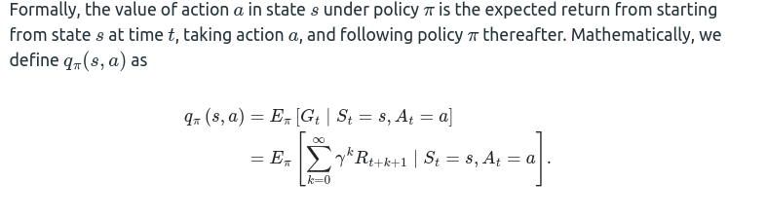
Action-Value Function

Slide 10
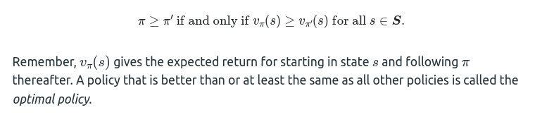
Optimality
Reinforcement learning algorithms seek to find a policy that will yield more return to the agent than all other policies.
Optimal Policy

Slide 11
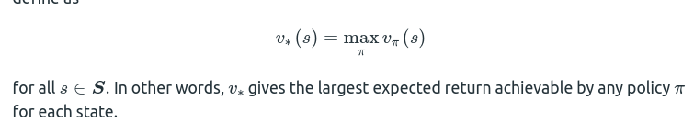
Optimal State-Value Function

Slide 12
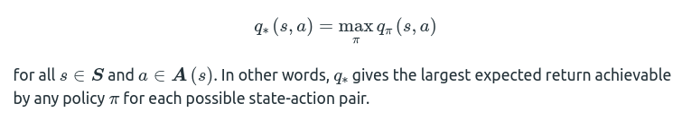
Optimal Action-Value Function

Slide 13
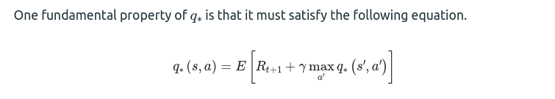
Bellman Optimality Equation

Slide 14
Q-Learning
Q-learning is a technique that can solve for the optimal policy in an MDP.
the goal of Q-learning is to find the optimal policy by learning the optimal Q-values for each state-action pair.

Slide 15
Other Algorithms
Q-Learning
Deep Q-Learning
Deep Deterministic Policy Gradient
Soft Actor-Critic
State–action–reward–state–action (SARSA)

Slide 16
General Policy iteration (GPI)
The algorithm works by first initializing a policy, and then iteratively improving it. In each iteration, two main steps are performed:
Policy Evaluation: The value function for the current policy is estimated. This is typically done by iteratively updating the value function until it converges to the true value function.
Policy Improvement: A new policy is derived from the value function by choosing actions that have higher values. This new policy is then used in the next iteration of the algorithm.
These two steps are repeated until the policy converges to an optimal policy.

Slide 17
Importance Sampling
Importance sampling is a technique used in Reinforcement Learning (RL) to estimate the value of an expected reward or return under a given policy when only samples from a different policy are available. This technique is used when the agent has to learn from experience and the environment is not fully observable. Importance sampling allows the agent to estimate the expected value of the reward, which is necessary for making decisions that maximize the expected reward.

Slide 18
Monte carlo VS one-step TD
Monte Carlo methods rely on the complete episode of interaction
Monte Carlo methods require the agent to wait until the end of an episode to update the value function
Monte Carlo methods are guaranteed to converge to the optimal policy in finite time
Monte Carlo methods can have high variance due to the dependence on the random rewards observed during the episode
TD methods update the value function incrementally based on the observed reward at each time step
TD methods update the value function at each time step
whereas TD methods do not have such guarantees
TD methods have low variance due to the update based on a single observed reward at each time step
Neither MC methods nor one-step TD methods are always the best.

Slide 19
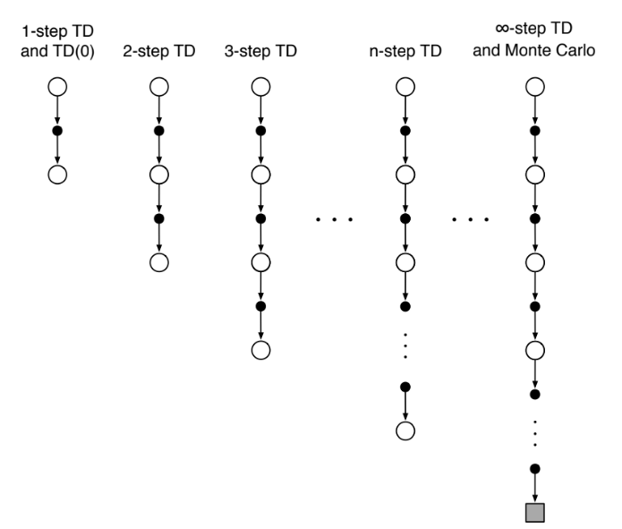
n-step TD
generalize both methods so that one can shift from one to the other smoothly as needed
n-step methods span a spectrum with MC methods at one end and one-step TD methods at the other. The best methods are often intermediate between the two extremes.
n-step methods enable bootstrapping to occur over multiple steps, freeing us from the tyranny of the single time step.
enable bootstrapping over multiple time intervals simultaneously.
One kind of intermediate method,
then, would perform an update based on an intermediate number of rewards: more than
one, but less than all of them until termination.

Slide 20
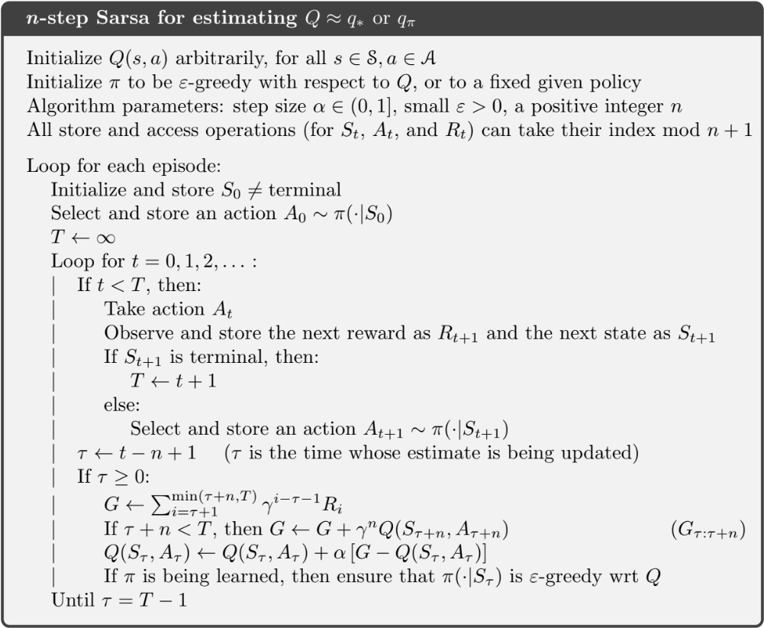
n-step on-policy
learning

Slide 21
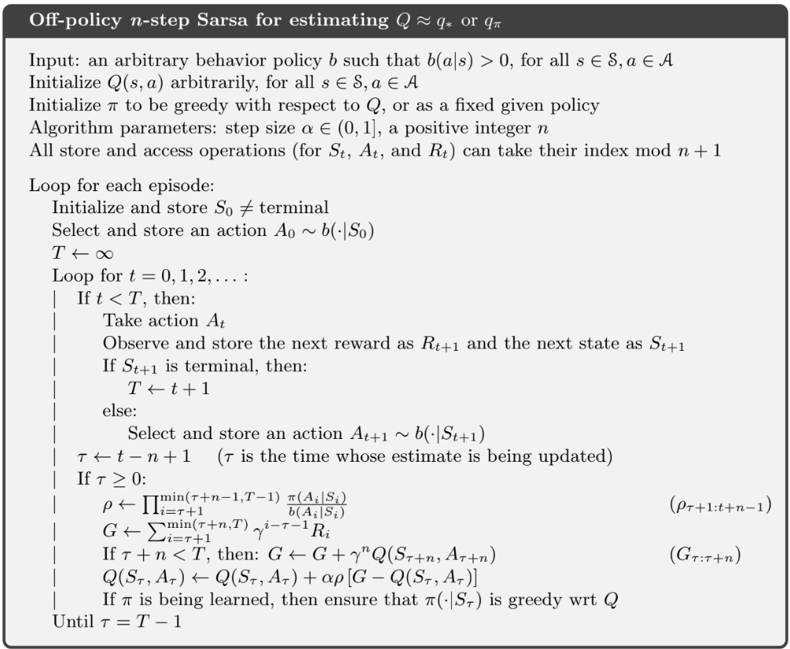
n-step off-policy
learning

Slide 22
Per-decision Methods with Control Variates
The basic idea behind this technique is to use a control variate to reduce the variance of the estimated value function, and hence improve the learning efficiency.
The control variate is a known function that is correlated with the value function, but has lower variance. In per-decision methods with control variates, the control variate is used to adjust the estimate of the value function at each decision point.

Slide 23
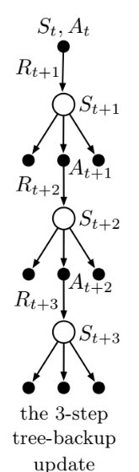
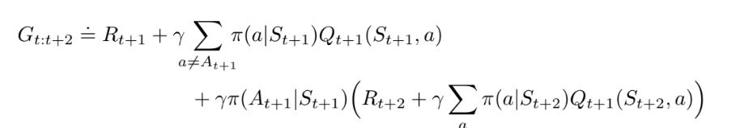
The n-step Tree Backup Algorithm

Slide 24
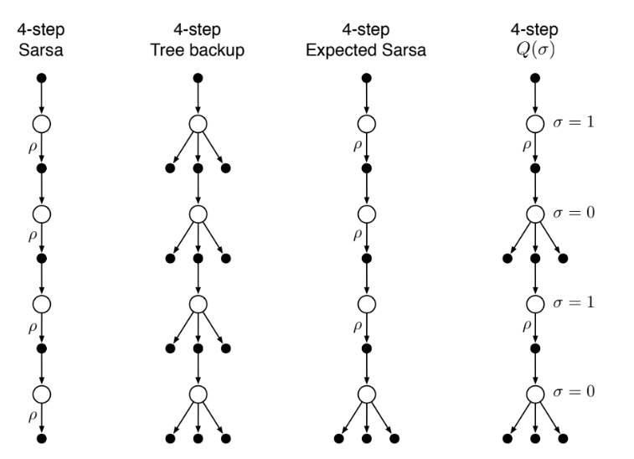
*A Unifying Algorithm:
One idea for unification is suggested by the fourth backup diagram in Figure 7.5. This
is the idea that one might decide on a step-by-step basis whether one wanted to take the
action as a sample, as in Sarsa, or consider the expectation over all actions instead, as in
the tree-backup update.

Slide 25
Approximate methods
In many of the tasks to which we would like to apply reinforcement learning the state space is combinatorial and enormous; the number of possible camera images, for example, is much larger than the number of atoms in the universe. In such cases we cannot expect to find an optimal policy or the optimal value function even in the limit of infinite time and data; our goal instead is to find a good approximate solution using limited computational resources.

Slide 26

The Prediction Objective (VE)
explicit objective for prediction: mean squared value error
specify most important states ( by assumption we have less weights than states )
Often μ(s) is
chosen to be the fraction of time spent in s.

Slide 27
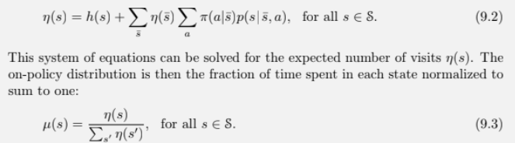
state distribution

Slide 28

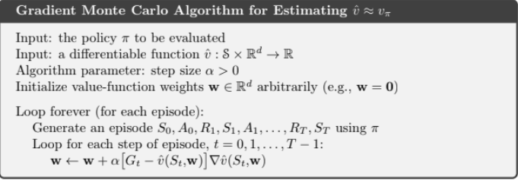
Stochastic-gradient and Semi-gradient Methods

Slide 29
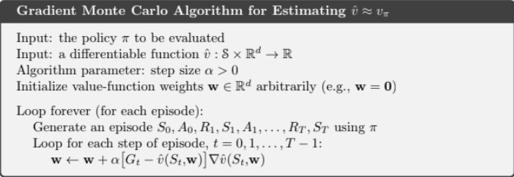
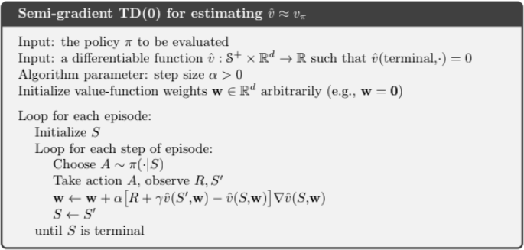

Slide 30

Linear Methods

Slide 31
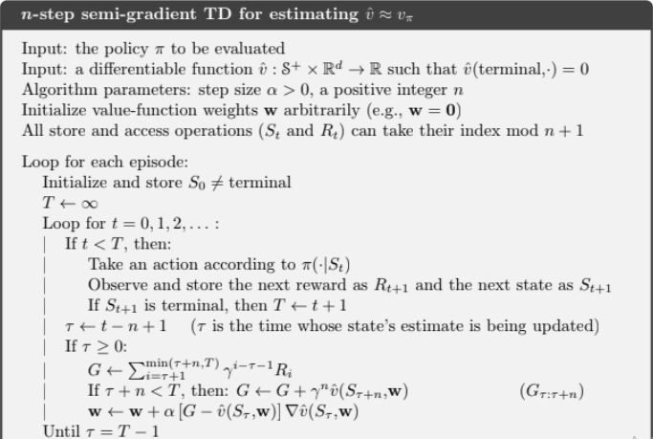
an approximation of the gradient

