Slide 1


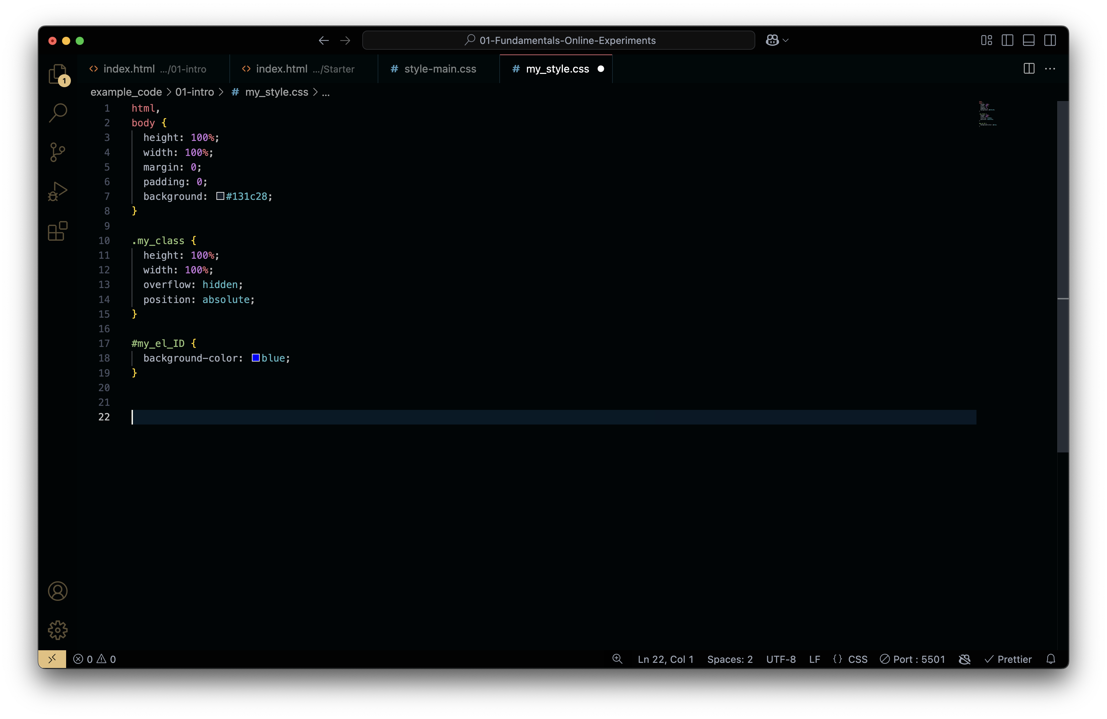
HyperText Markup Language – The structure of a webpage (headings, paragraphs, buttons, etc.).
HTML page has a nested structure, with tags inside tags.
Main part of HTML page : Head / Body.
  Head contains parameters for the browser. Importantly : it contains the link to the CSS file.
  Body contains the elements to be displayed and the link to the Javascript files.
Cascading Style Sheets – The design and appearance (colors, fonts, layouts).
Specify the look of HTML elements, using : tags, class and id.
Use your notes, MDN website or ChatGPT to find the right property names and values.

Slide 2

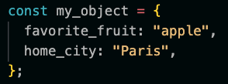
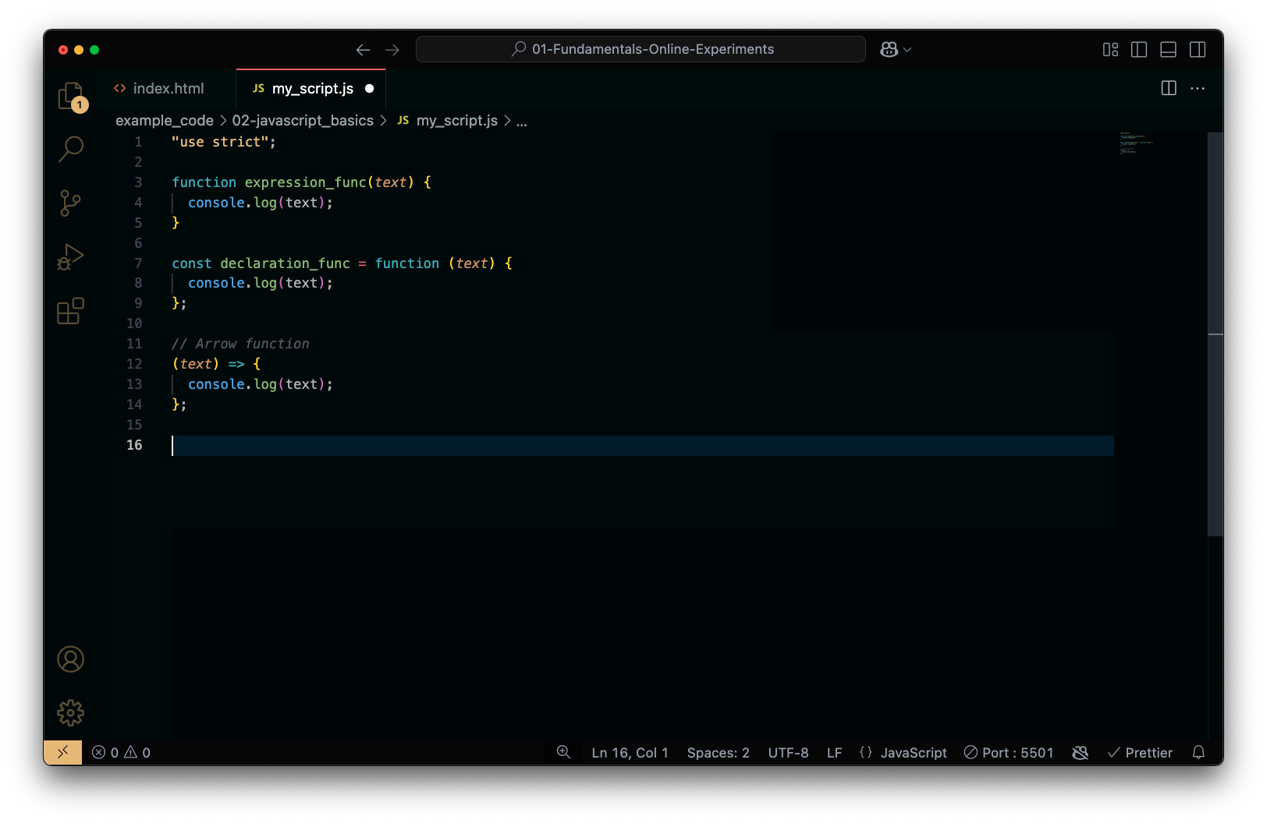
Need to be linked to the HTML page via <script src=“my_script.js”/> in the body.
We can write messages in the console (developer tool) using console.log(‘Hello there’);
Variables need to be declared. Use const for fixed values. Use let for moving values. Var works too but avoid it for now.
Three ways of defining functions.
Use arrays to group values togethers.
Use Objects to structure datasets.
Arrays and Objects have their specific methods.

Slide 3
Practice your memory !
Instructions:
Open the folder javascript_basics in VS Code.
Click on index.html and use the live server icon to display the page in chrome.
Create a new folder called revision_practice, create : index.html, style.css, script.js
Autofill index.html with ! + return .
  Write a header that says “This is a revision”
  Write a paragraph that says “What do you remember?”
Link style.css and script.js to index.html
  Check link with style.css : change the background colour to light grey,
  Display in the console : “Hello from the revision code”
In Chrome, open the developer tool and check the link with script.js
Create an array with 3 string elements + a variable counter + display in the console the size of the array
Create a function that logs to the console the selected index element from the array and that increments the counter
Use this function 3 times to span the array
Add a new element to the array and call the function from the console to display it.
Create an object participant_data, add and specify a value for the properties: Age, Date, left-right_handed
Log participant_data to the console. Log independently : values and keys.

