Slide 1
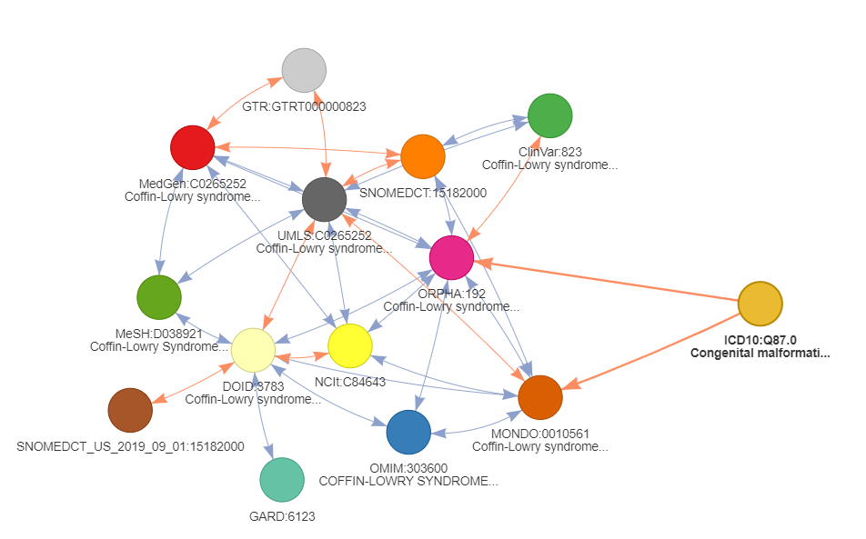
...
283 disease concepts
...
...

