Slide 1
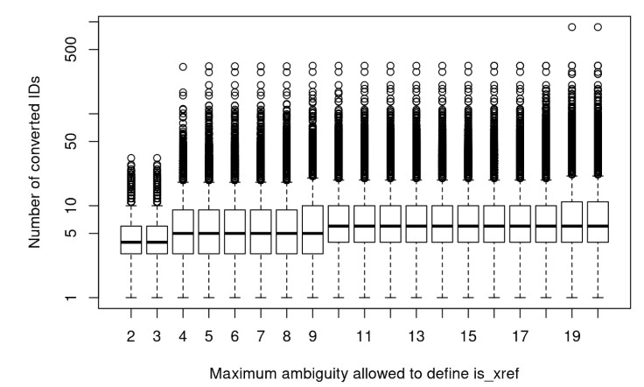
Number of converted identifiers
Maximum ambiguity allowed to define is_xref edges

