Slide 1
ORGANIZATION NAME : CDK Global
PROBLEM STATEMENT : Portal for Farmers to sell their produce at a better rate.
System that provides farmers an interface to sell their product, and connect with the buyers all over India.
Simple interface that works on smart devices, SMS to upload product details and respond via phone and SMS .
Interface for anyone to buy the produce/vegetable – initially visit the place and buy or have courier service integrated to deliver the vegetables so Farmers can get a better price for their produce, no additional cost is spent in marketing and delivery of goods, however they can choose to charge more by delivering the items themselves.
PROBLEM CODE : RA27
TEAM LEADER NAME : Abhishek Gupta
COLLEGE CODE : #2274
TEAM NAME : AgroCraft

Slide 2
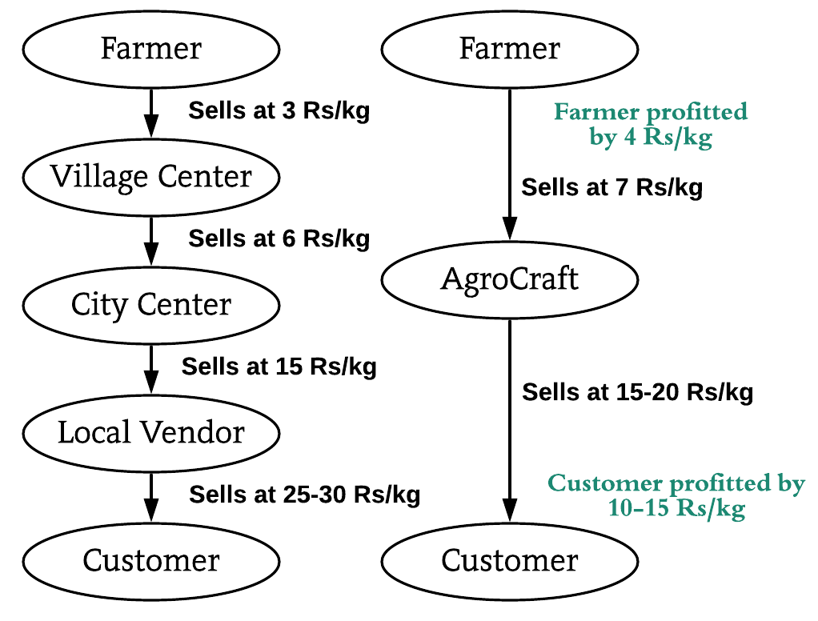
SOLUTION PROTOTYPE
Multilingual SMS and Call System for illiterate farmers to insert/edit/upload products & Multilingual portal also available.
Minimum selling price will be made visible to farmers for rough estimate to enter price of product.
Buyer can order from all over India, so if scarcity of a product arises, the buyer will be suggested of locations near to him, where the product is available.
For packaging delivery, local transportation services, courier services and Indian postal(rural areas covered) will be integrated.
Review system & Reporting system(verification team will respond, guilty farmer will be penalised and buyer, compensated).
Bestseller and Recommendation features.
Subscription feature. (Order once, product will be delivered for the specified duration). Government warehouses available for storage to reduce the repeated delivery charges.
Bookmark system (buyer prefers a farmer, he will be notified every time the farmer uploads).
Filter system(filter by price and location).
Conventional v/s AgroCraft
TECHNOLOGY STACK
Modern Technology :- Big Data , Data Analytics , Visualization, Machine learning .
Mobile Development :-Android Studio, Android SDK and Jellybean version and above.
Web Technology : - HTML, CSS, JavaScript, AJAX, Bootstrap , Django and nodeJS .
Backend Development : -MySQL Database and Firebase.
Programming languages : - Python.

Slide 3
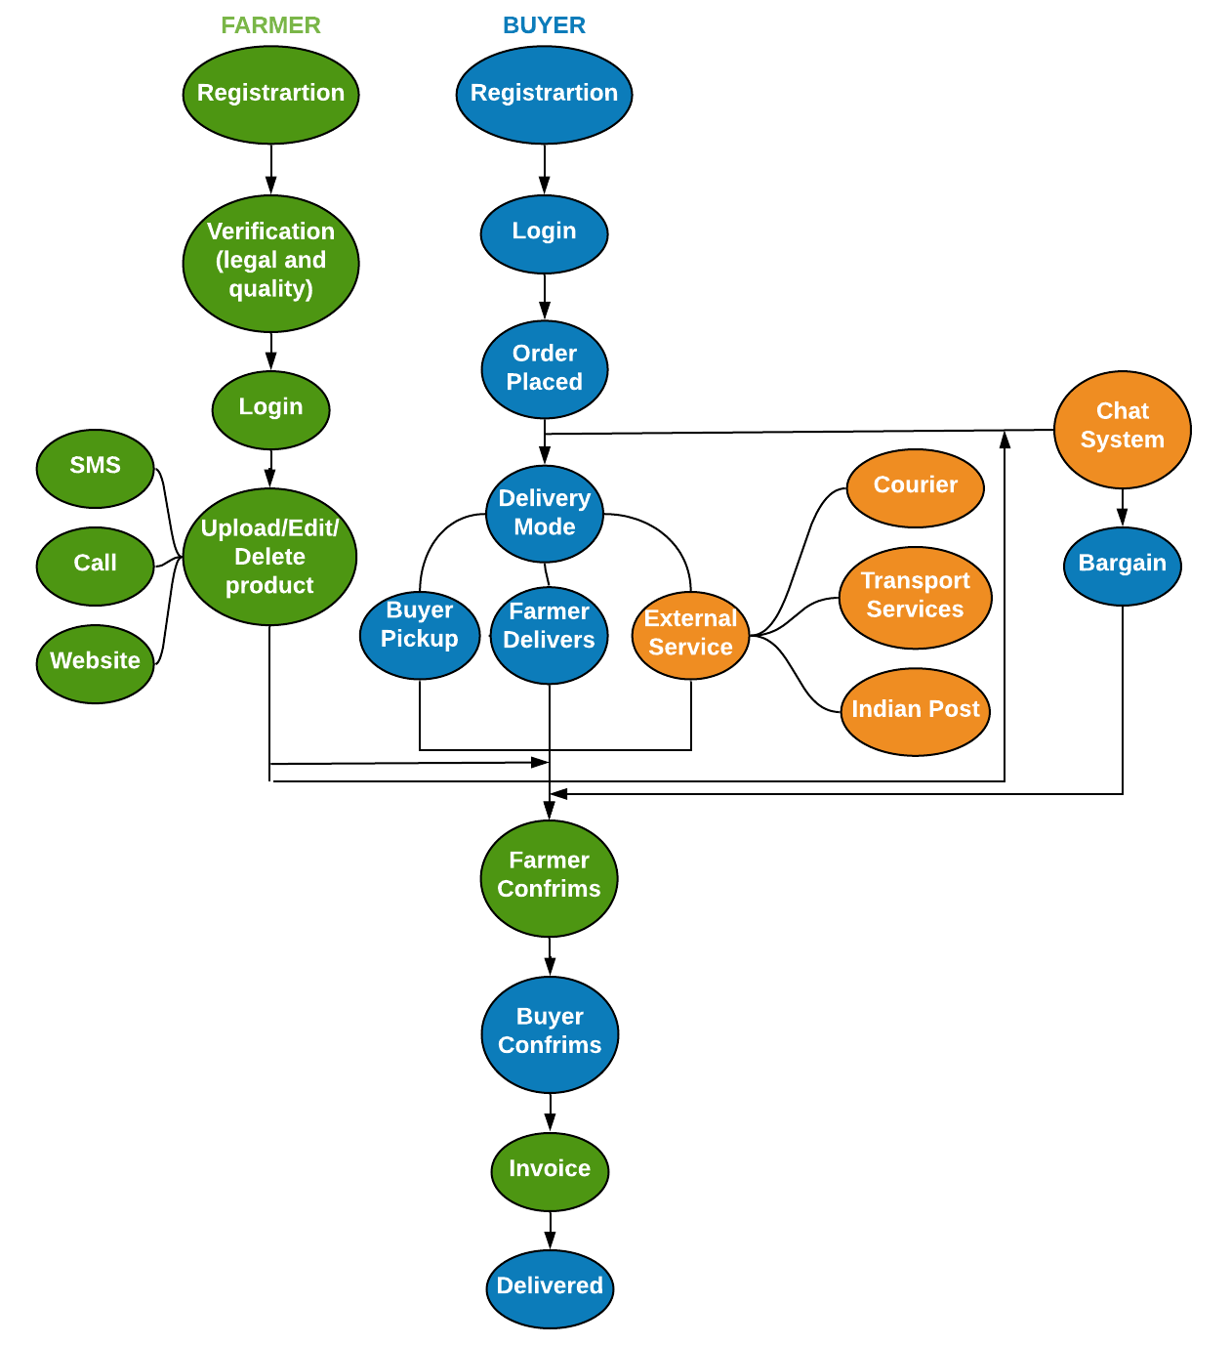
USE CASE
DEPENDENCIES
The farmer must possess a basic phone and legal documents.
This application can be installed in all devices having Android version Jellybean and higher.
An online portal generated shall require IE v9 or higher, Google Chrome, Mozilla Firefox, or any other web browser.
SHOWSTOPPERS
In India 47 percent of the farmer are illerates , to resolve this issue farmers can upload product through multilingual SMS and call centers.
The application ensures the farmer profits since he sells at better rates, the buyer profits since he can buy at cheaper rates, and the multiple transport systems because of the increase of clients at their end.
Buyers can get their hands directly on fresh products from all over India, and he is no longer restricted to his city.
Multiple farmers (many of which reside in remote areas) get in direct touch with buyers in capital cities and the prices are negotiable between them with no involvement of the admin whatsoever.

