Slide 1
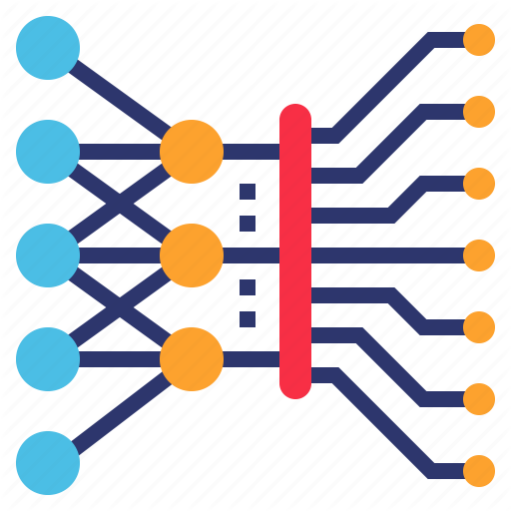
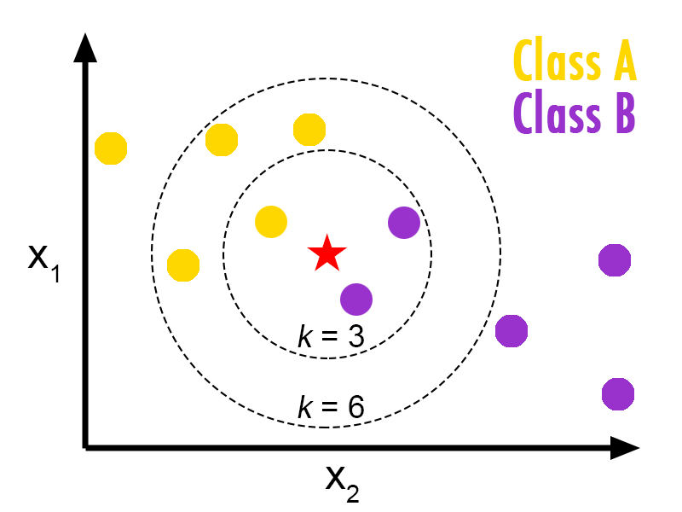


Teachable Machine Building Blocks
Input Images
Predictions
KNN Classifier
MobileNet DNN

